Slide 1
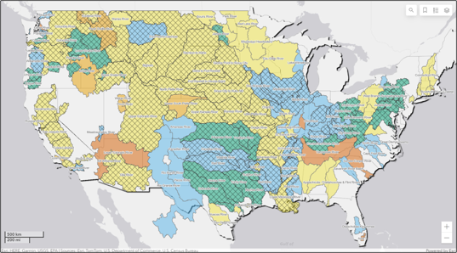

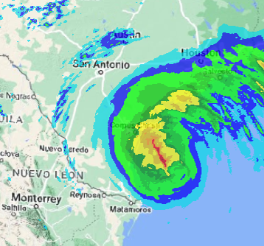
HEC-MetVue overview
Part B – Key Features Orientation
Fauwaz Hanbali
Hydrologic Engineering Center
CWMS Prospect Course

Slide 2
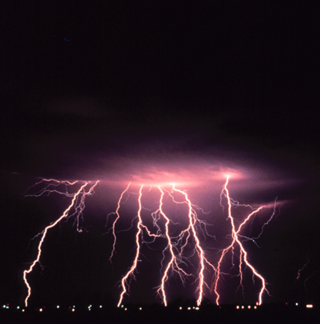
Overview
HEC-MetVue Program Interface
HEC-MetVue Key Features Orientation
HEC-MetVue Interactive and Automated Data Processing and Analysis
HEC-MetVue in CWMS
HEC-MetVue

Slide 3
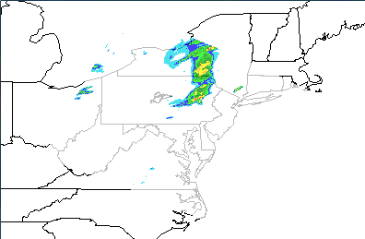
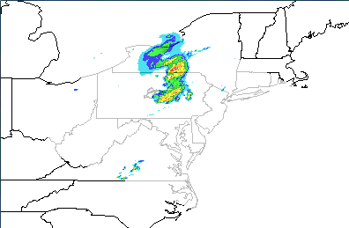
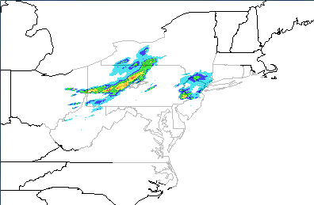
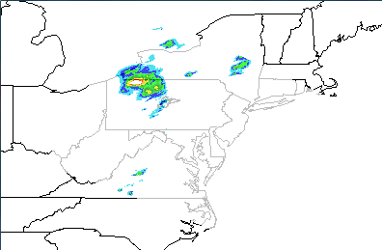
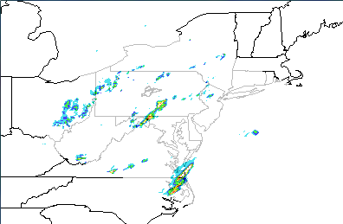
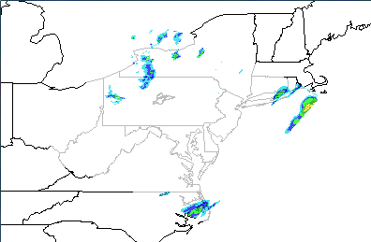
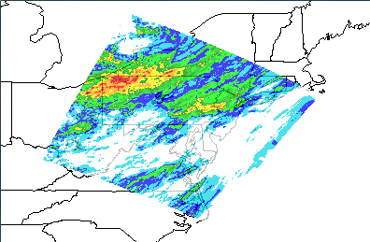
HEC-MetVue Temporal Aggregation
Hourly Radar TINs for N-Hours of Duration
Aggregate TIN for the N-Hours Duration

Slide 4
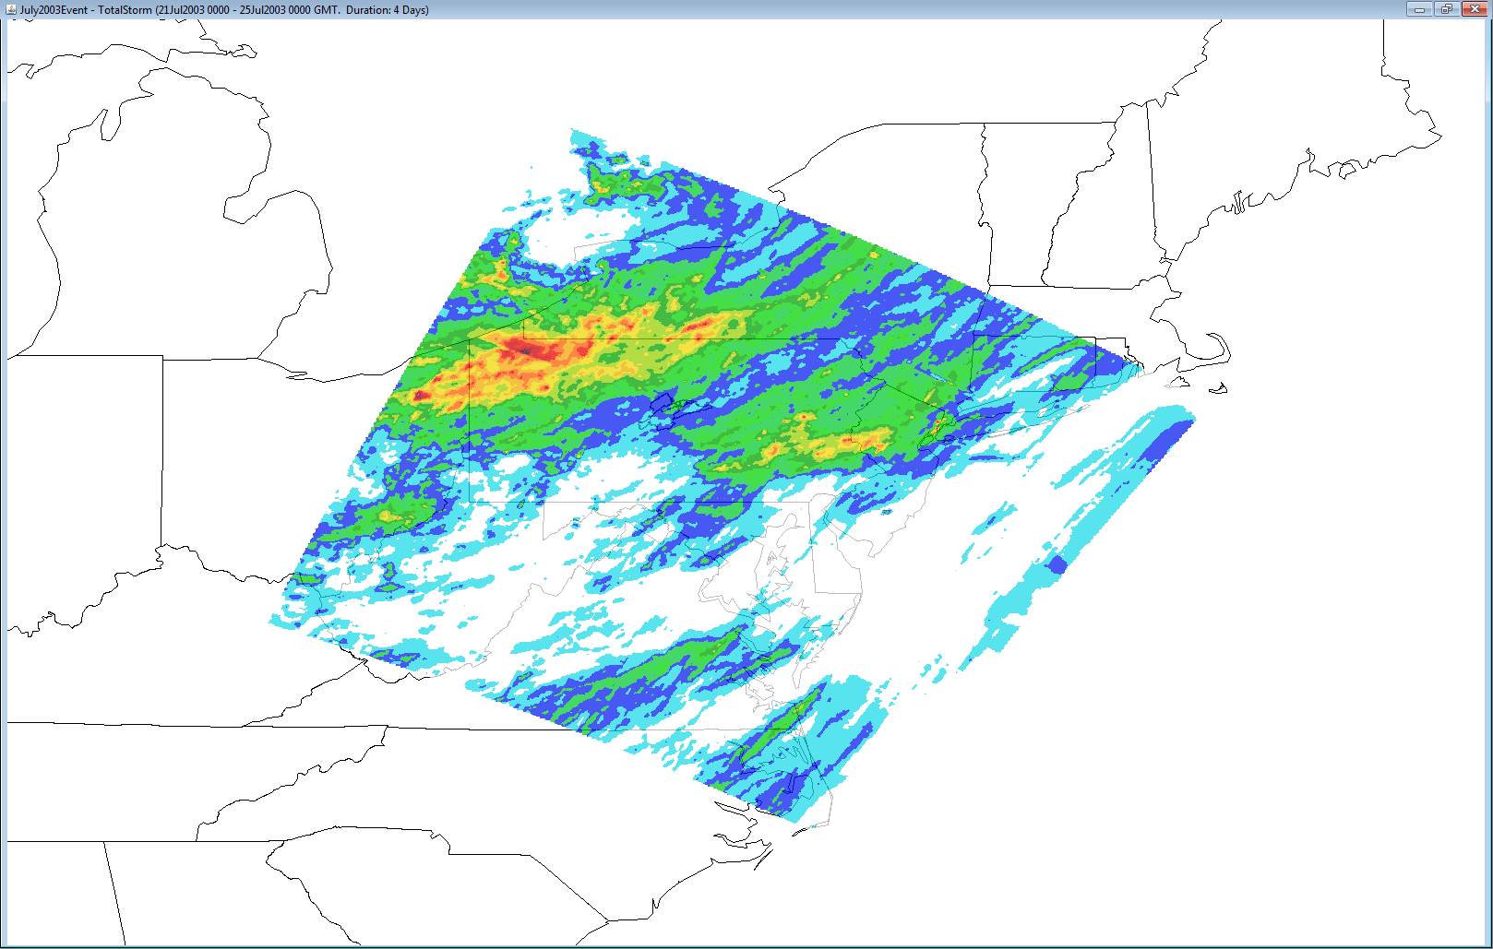
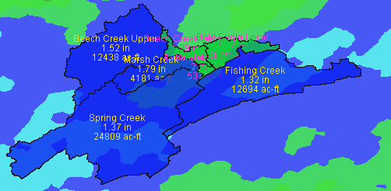
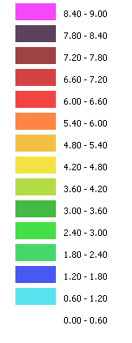
HEC-MetVue Basin Average Computation

Slide 5

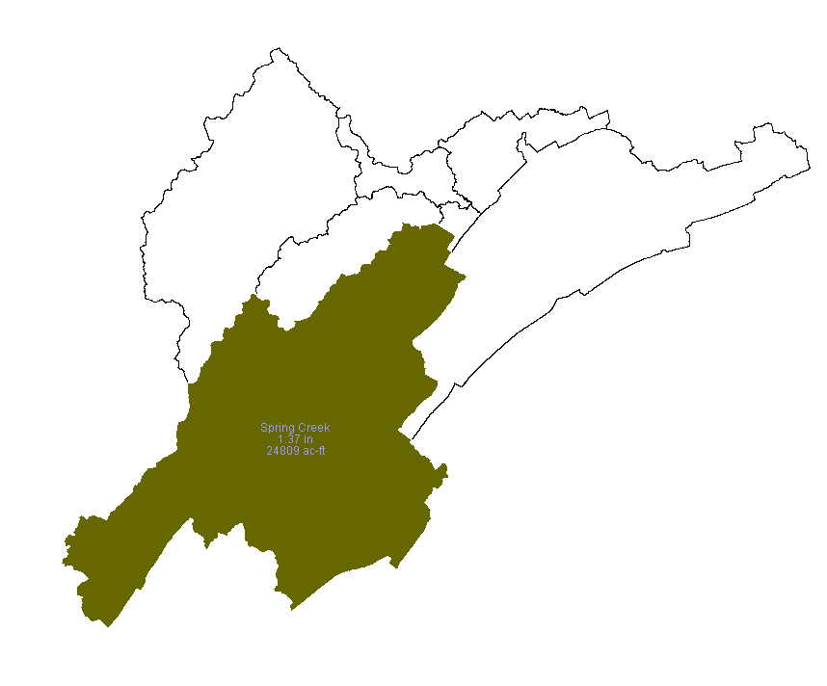
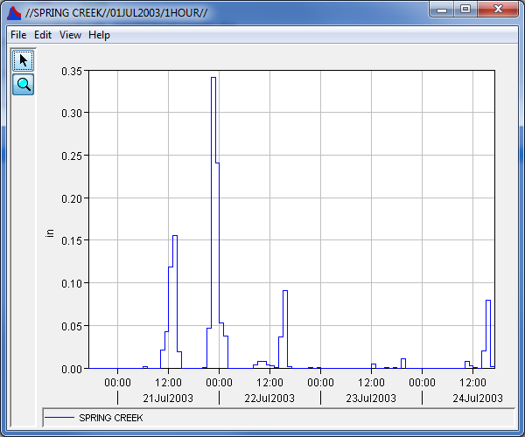
Save Time Series
96 aggregated (Hourly) TINs
21July2003 – 25July2003
Spring Creek
1.37 in
24809 ac-ft

Slide 6

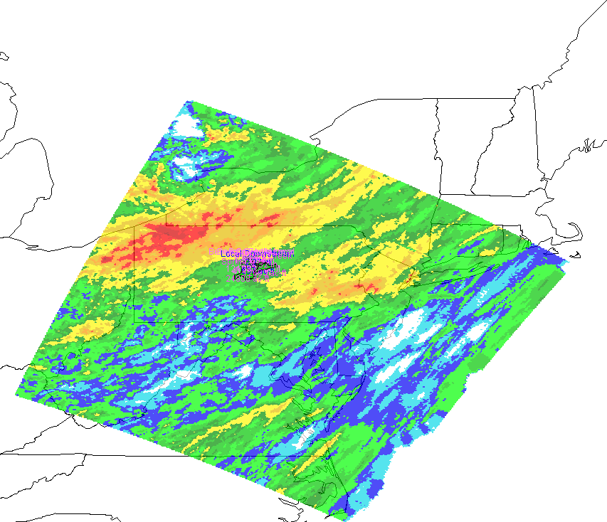
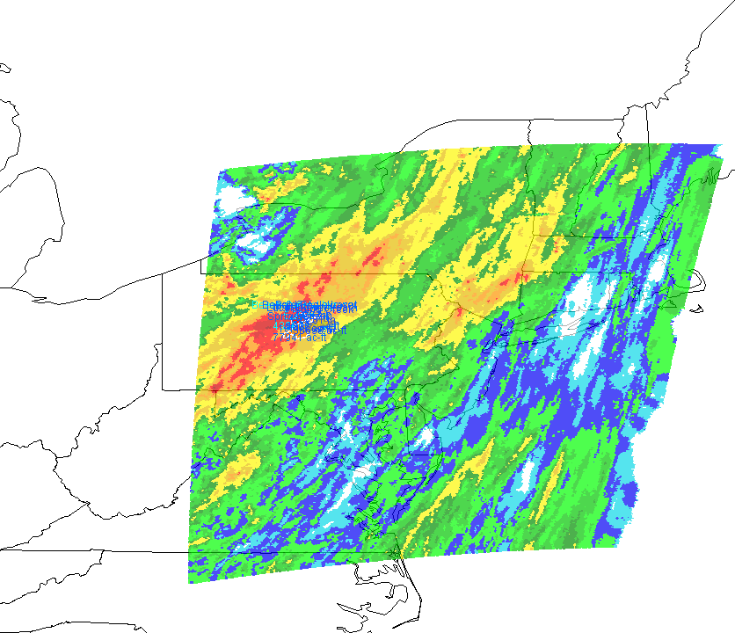
Save Modified Image as a Projection on a Grid
Translating and/or rotating an image will require reprojection of the image for saving the output.
Original Image
Translated and Rotated Image

Slide 7
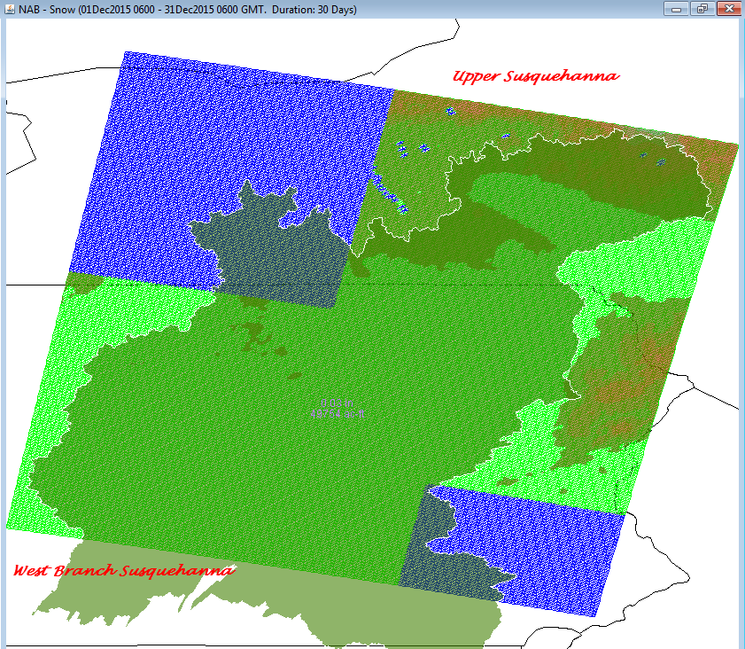
HEC-MetVue Spatial Aggregation

Slide 8


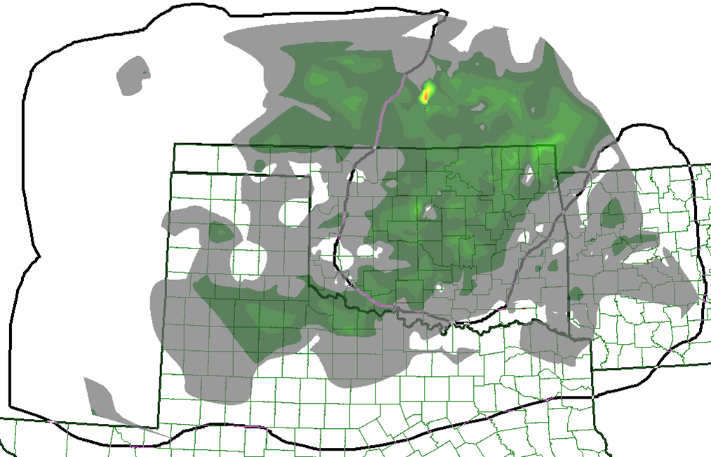
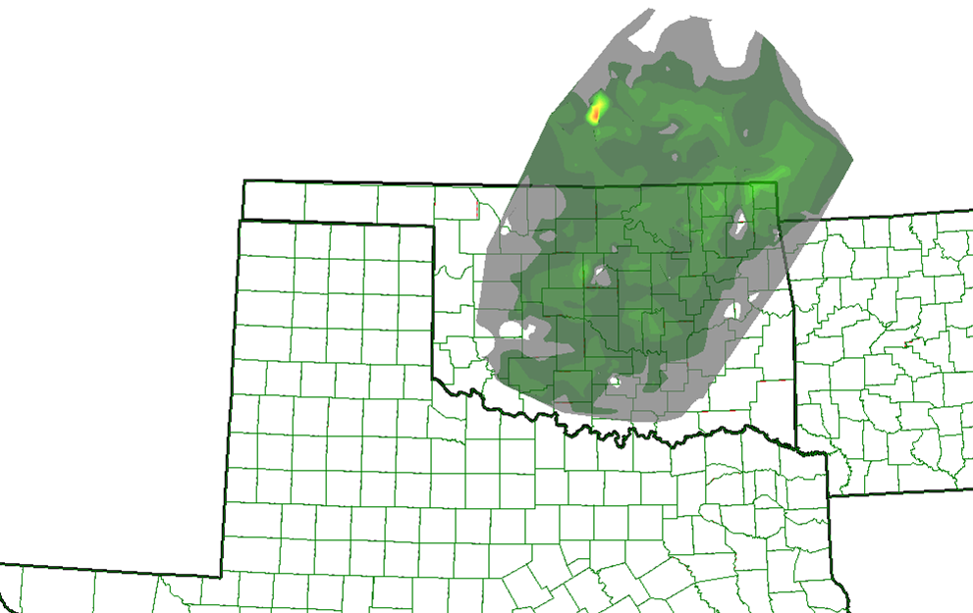
HEC-METVUE
Analysis & Manipulation
Refine Storms
  Trim & Correct
Translate Storms
  Spatially
  Temporally
Rotate Storms
  Temporally
Scale Storms
  Factor & Resize
Animate Storms
Original Image
Trimmed Image

Slide 9
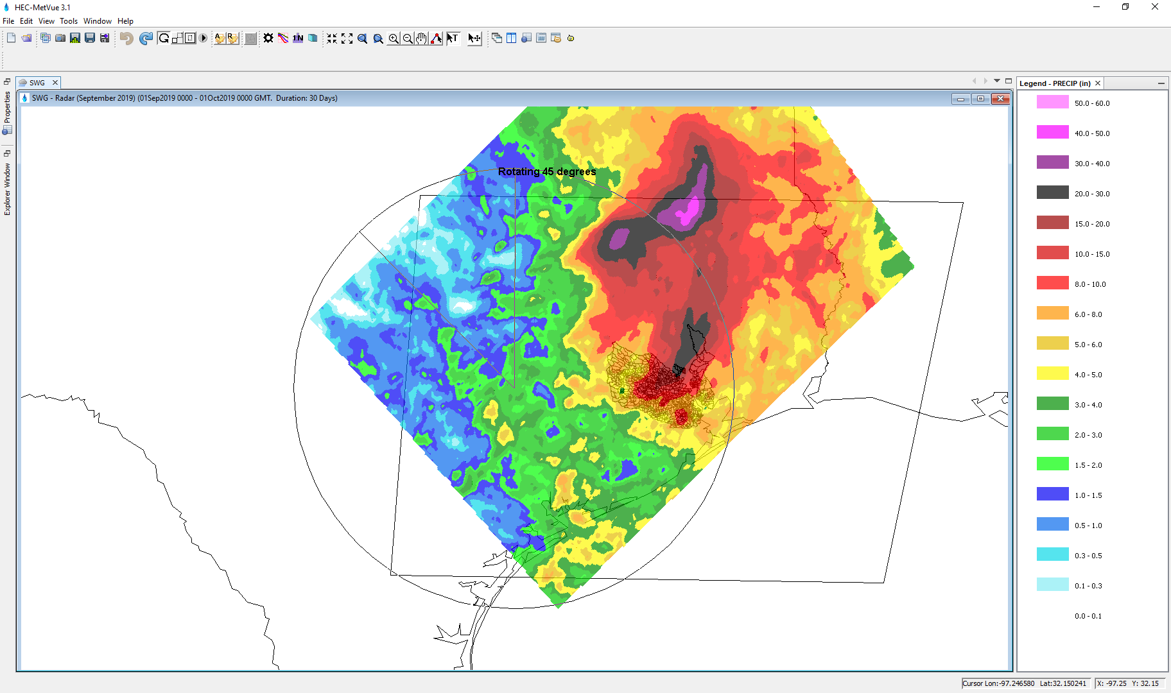
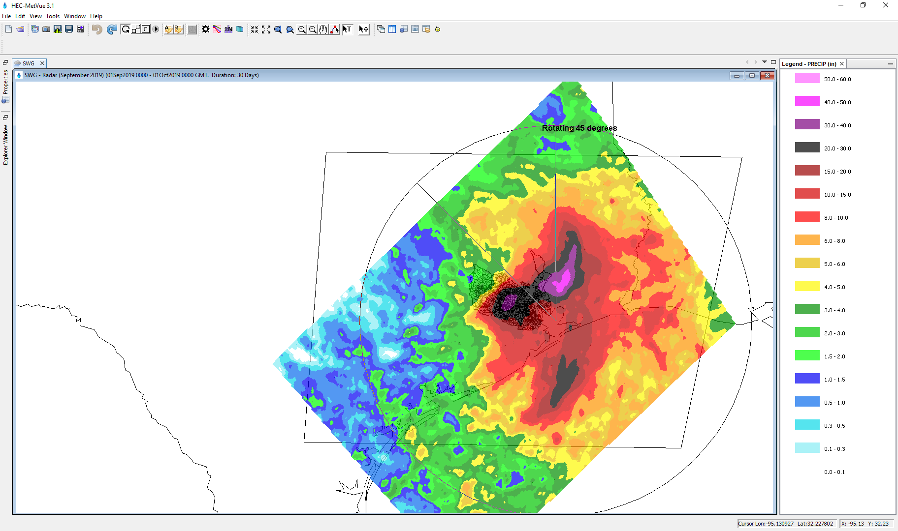
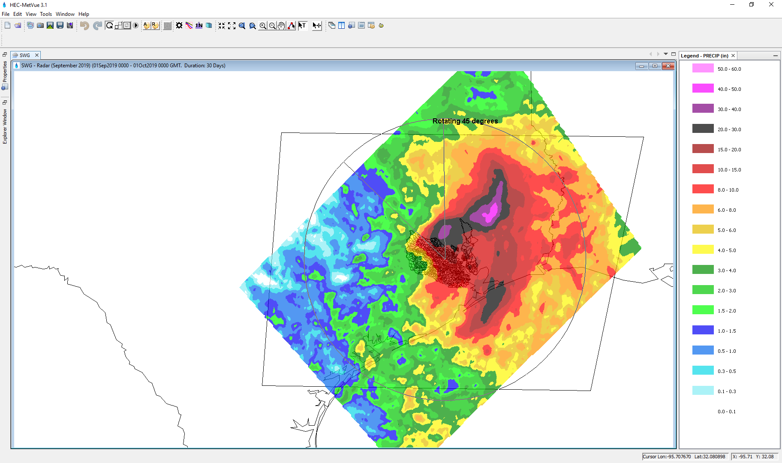
Image Rotation
  Map Center
Rotating 45 degrees
  TIN Weighted Center
Rotating 45 degrees
  TIN Geometric Center
Rotating 45 degrees

Slide 10
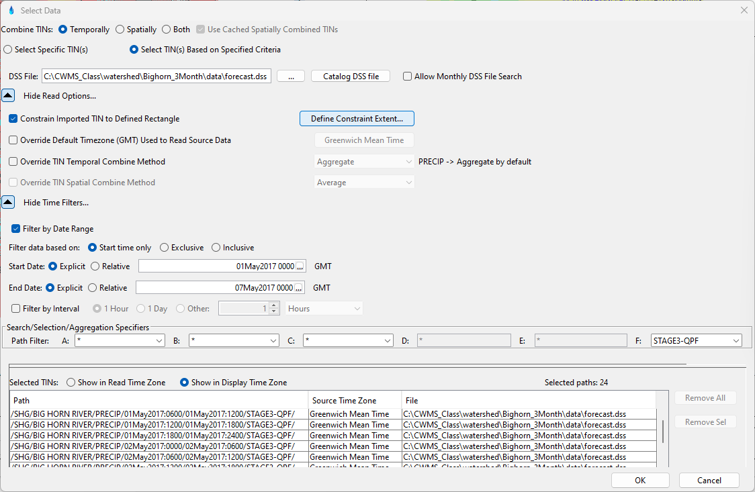
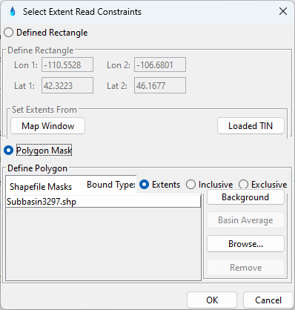
DSS Grid Selection

Slide 11
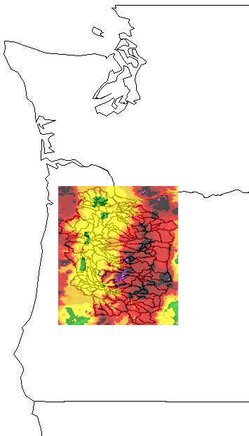
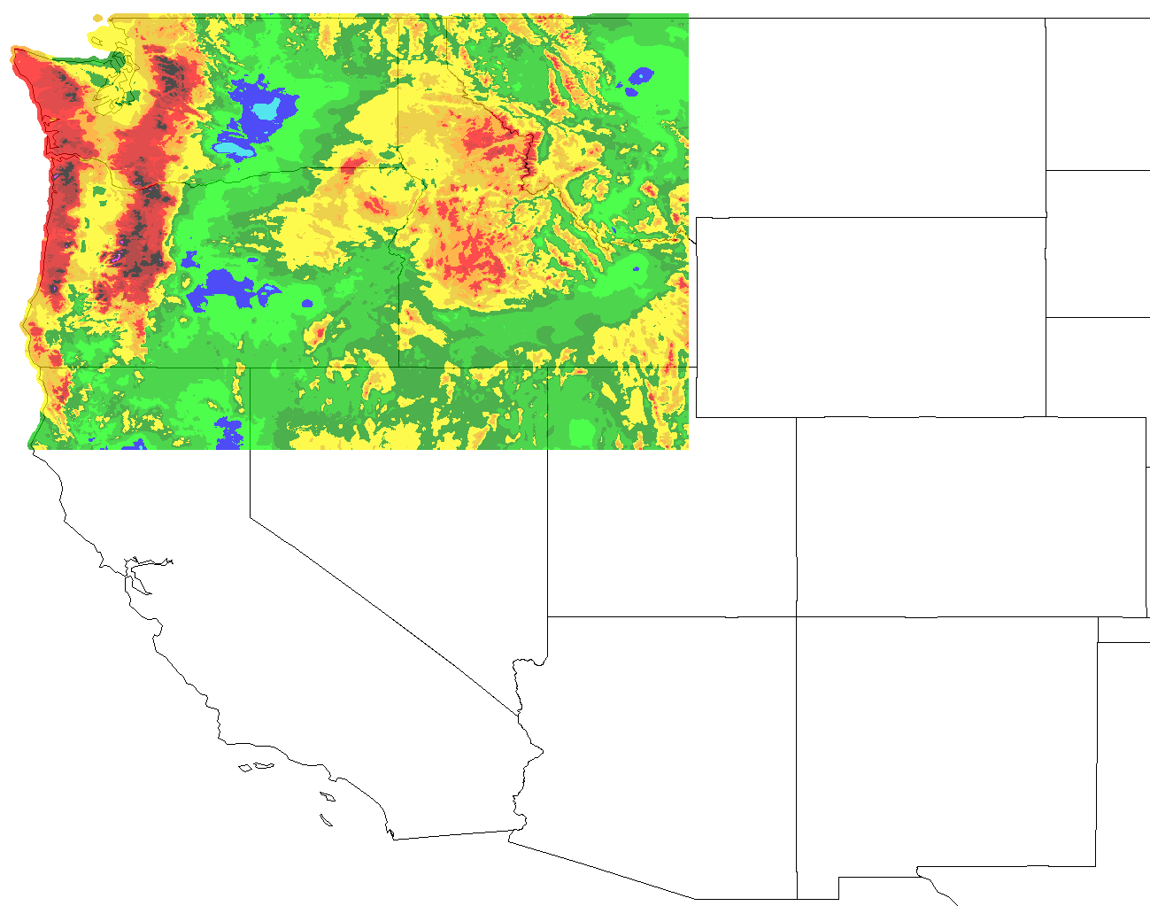
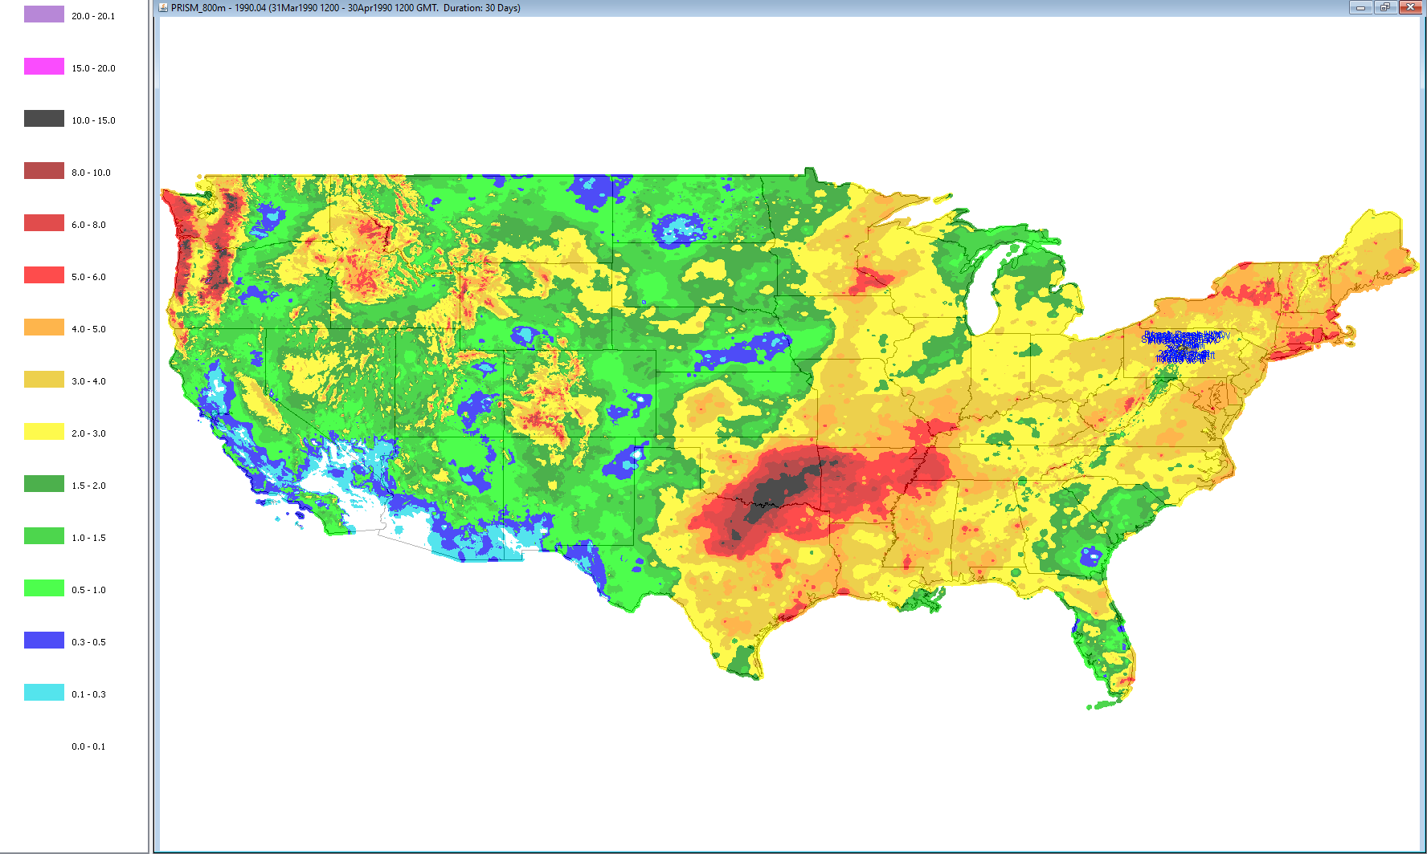
Sample PRISM Data
Polygon
Mask
Defined Rectangle
Mask

Slide 12
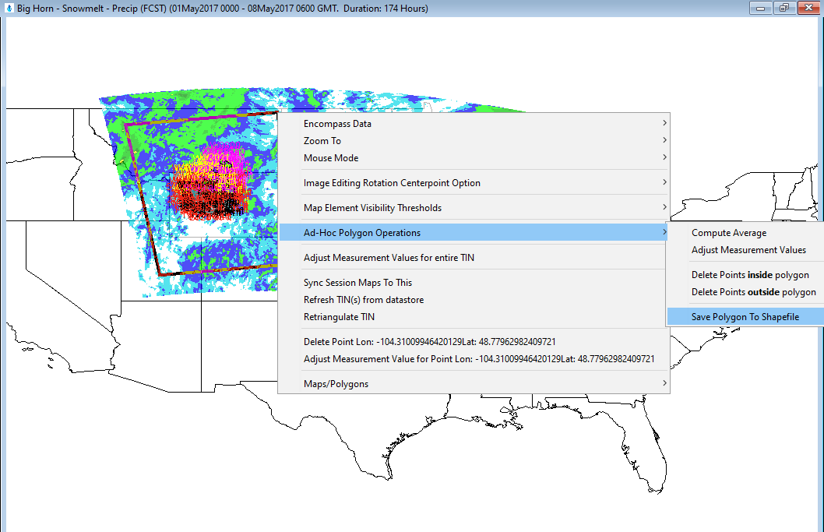
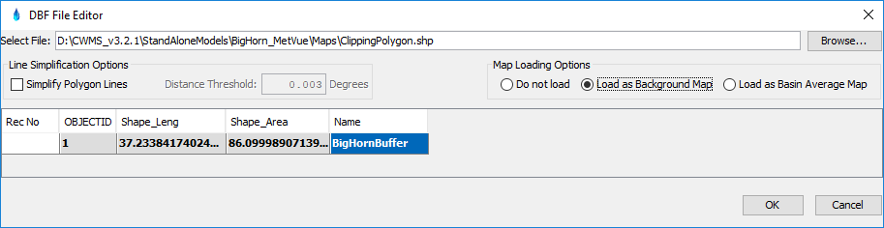
Ad-hoc Polygon Clipping

Slide 13
Time Zone Handling
Input Zone
  DSS and other data types typically have Time Zone Information in their metadata.
  If input data lacks meta data, PC Time Zone assumed by default, but user can override the time zone setting.
Display Time Zone is a user setting to convert the input dataset’s time zone.
MetVue allows for writing output datasets in any desired time zone.
Input
Display
Output

Slide 14
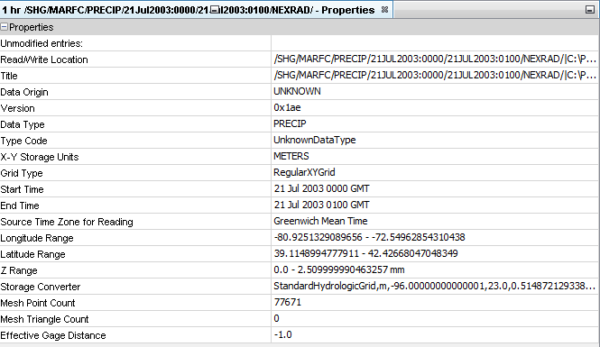
Dataset Meta Data

Slide 15
Supported Meteorological Variables
Precipitation
Temperature
Snow Water Equivalent
Snow Melt
Snow Depth
Liquid Water
Cold Content
Cold Content ATI
Metlrate ATI
Air Pressure
Humidity
Dew Point
Sky Cover
Wind Speed
Wind Direction
Solar Radiation
Sunshine
Energy
Albedo
Evapotranspiration
Moisture Deficit
Percolation Rate
Impervious Area
Crop Coefficient
Storage Capacity
Water Content
Water Potential

Slide 16
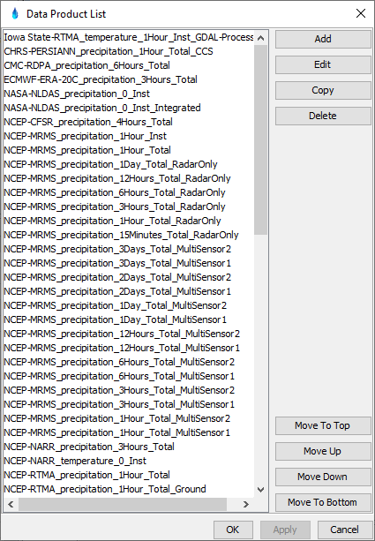
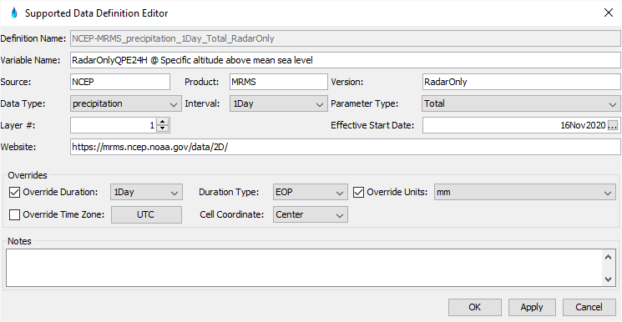
Supported Data Products

Slide 17
Questions
Help additional Training
https://usace.dps.mil/sites/KMP-WM/SitePages/Corps-Water-Management-System-(CWMS).aspx
https://www.hec.usace.army.mil/confluence/cwmsdocs
https://discourse.hecdev.net/c/cwms/5
TDL-CELRH-EC-GW-W-USACE CWMS Modeling | General | Microsoft Teams

