Slide 1
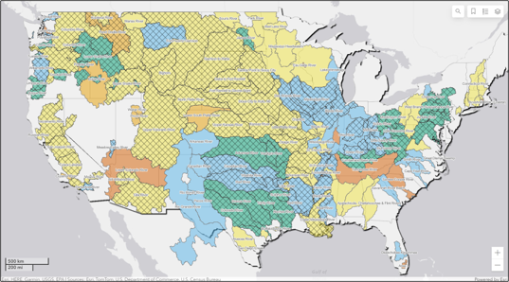

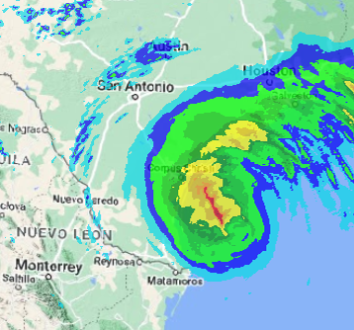
HEC-MetVue overview
Part C – Interactive & Automated Analysis
Fauwaz Hanbali
Hydrologic Engineering Center
CWMS Prospect Course

Slide 2
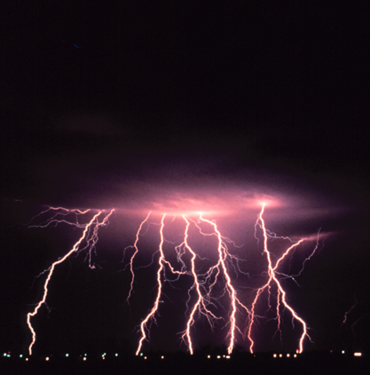
Overview
HEC-MetVue Program Interface
HEC-MetVue Key Features Orientation
HEC-MetVue Interactive and Automated Data Processing and Analysis
HEC-MetVue in CWMS
HEC-MetVue

Slide 3
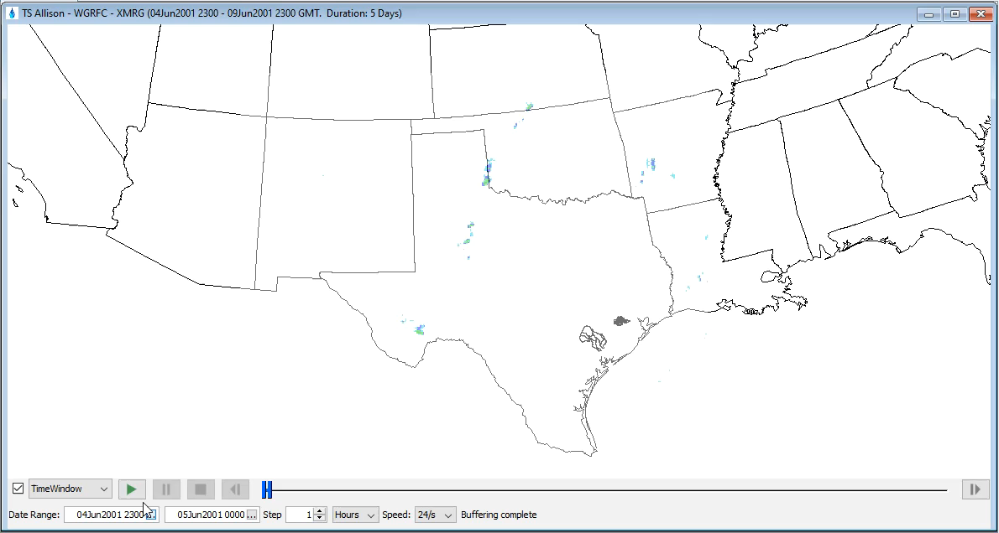
Combined Dynamic Time Window/Animation

Slide 4
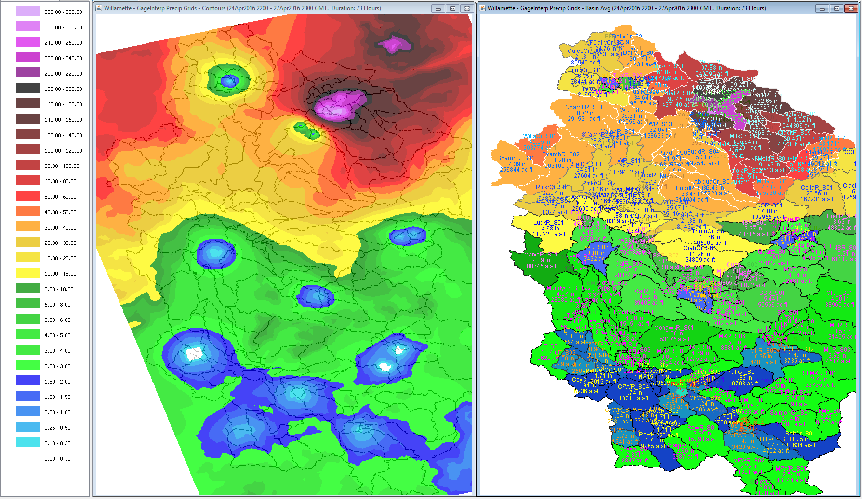
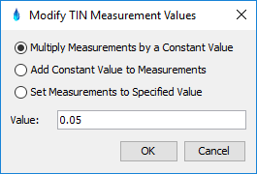
Quality Control of Interpolated Precipitation Grids

Slide 5

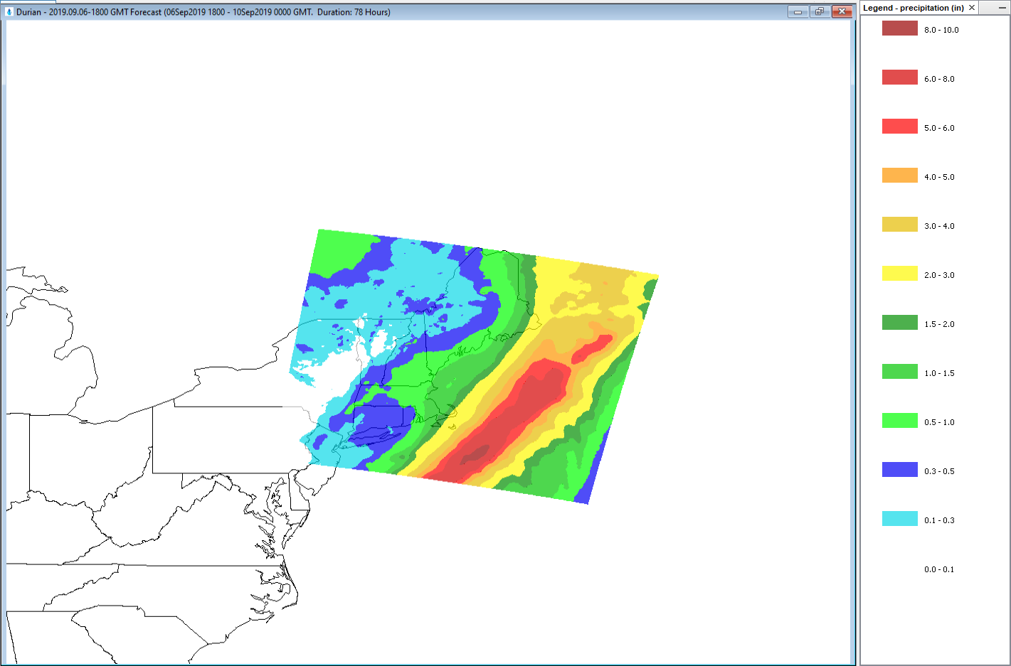
Image Translation
3-Day QPF issued on 2019.09.06-1800 GMT

Slide 6
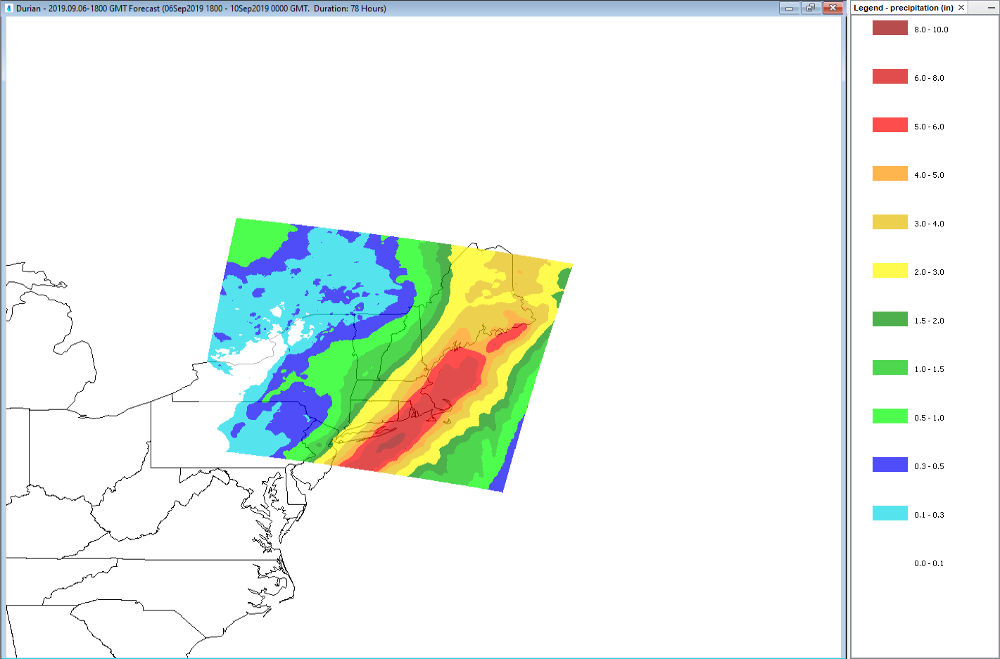
Image Translation
What if?
3-Day QPF issued on 2019.09.06-1800 GMT
(Translated over area of interest to prepare for potential consequences)

Slide 7
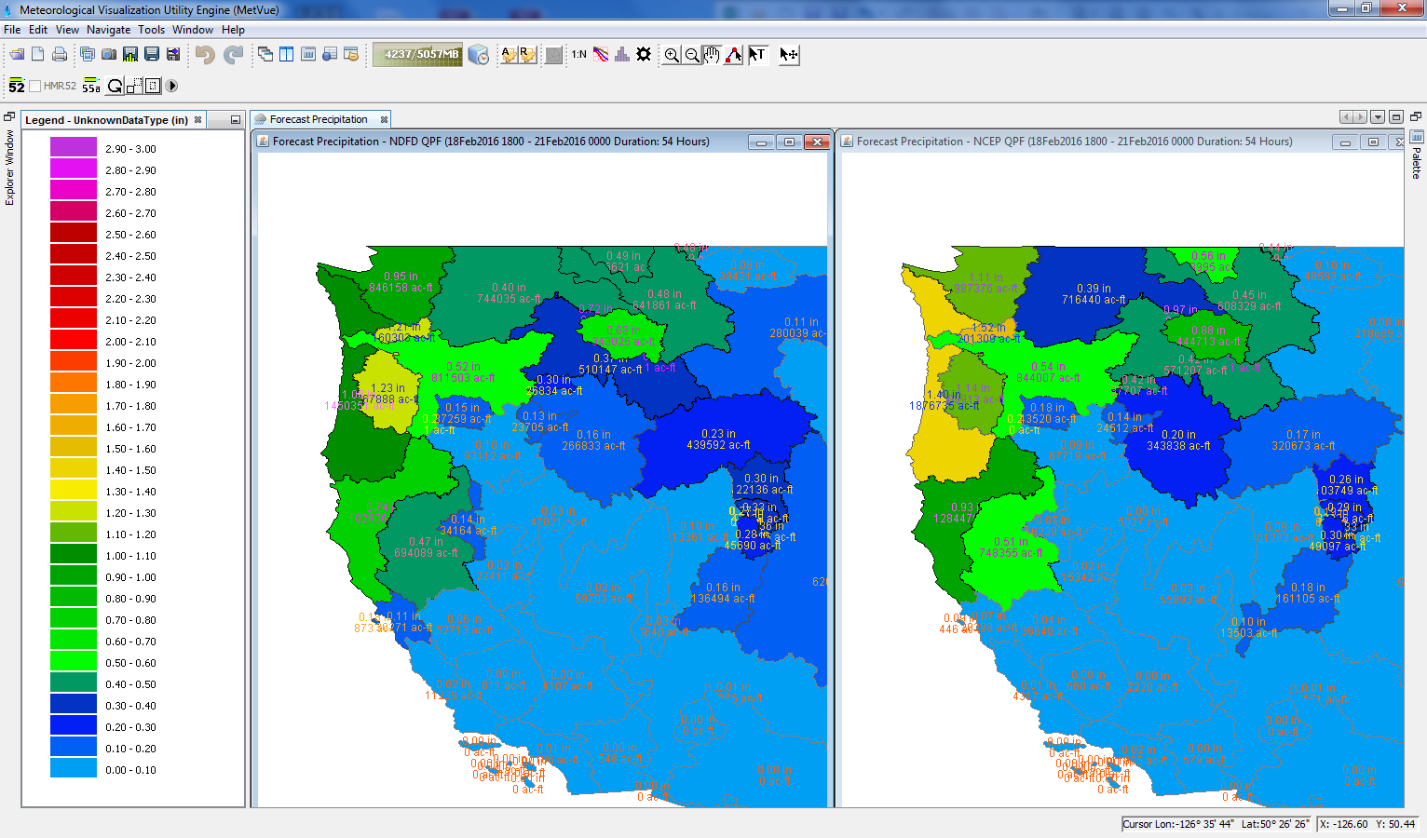
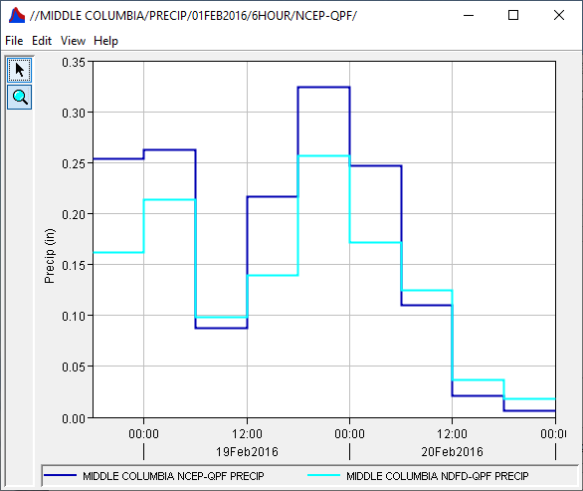
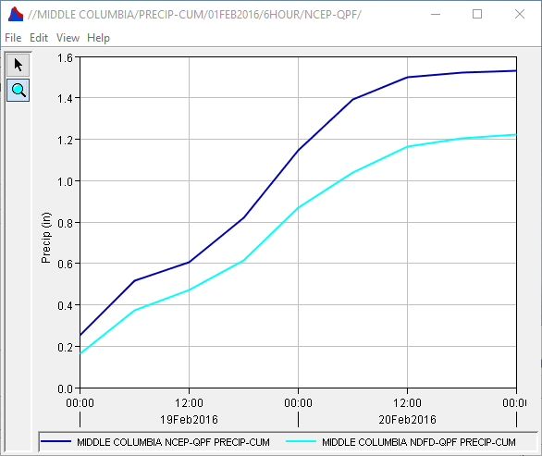
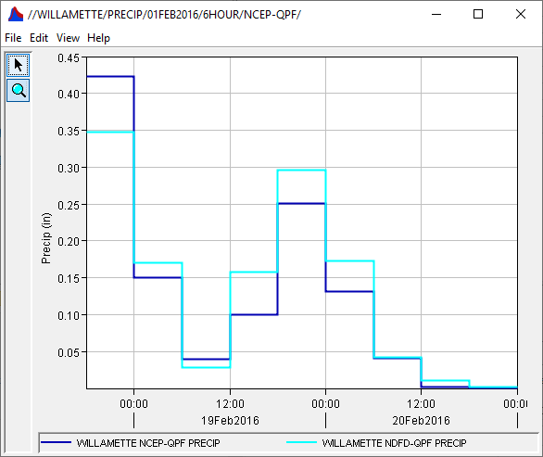
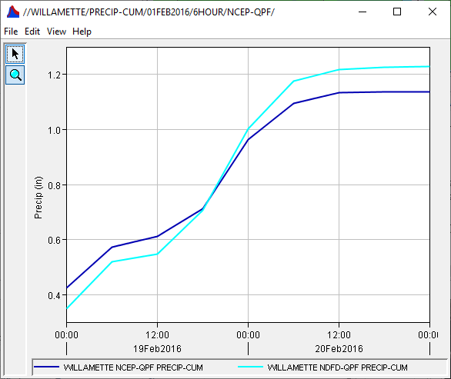
Basin Average Comparison Quantitative Forecast Precipitation (QPF)
NDFD QPF
NCEP QPF
http://www.nws.noaa.gov/ndfd/anonymous_ftp.htm
ftp://ftp.hpc.ncep.noaa.gov/5km_qpf/

Slide 8
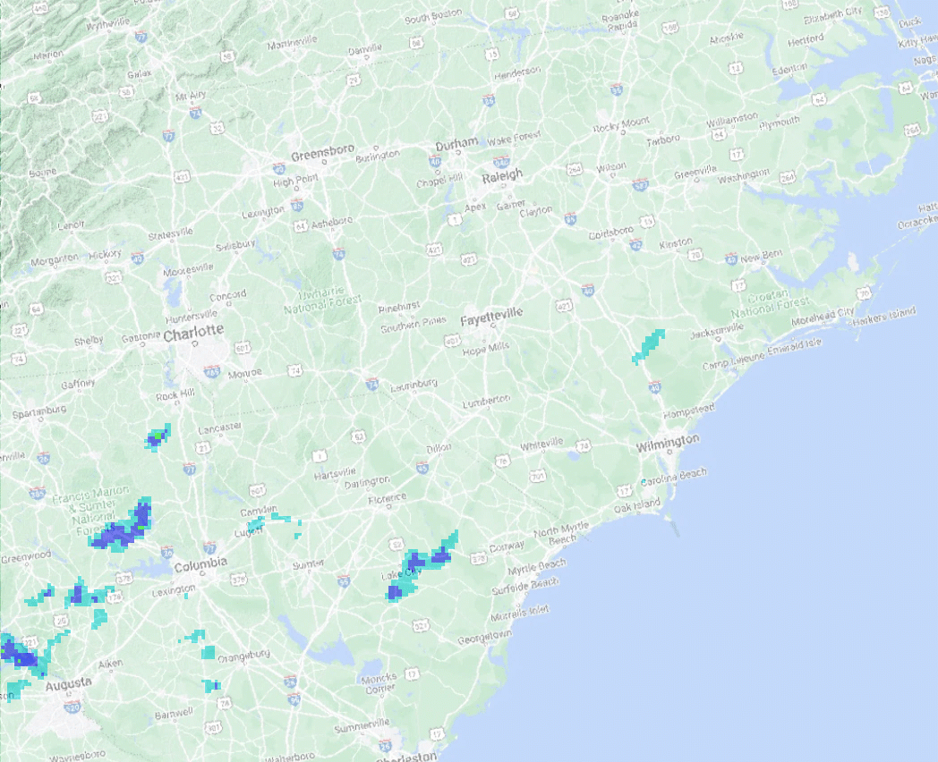

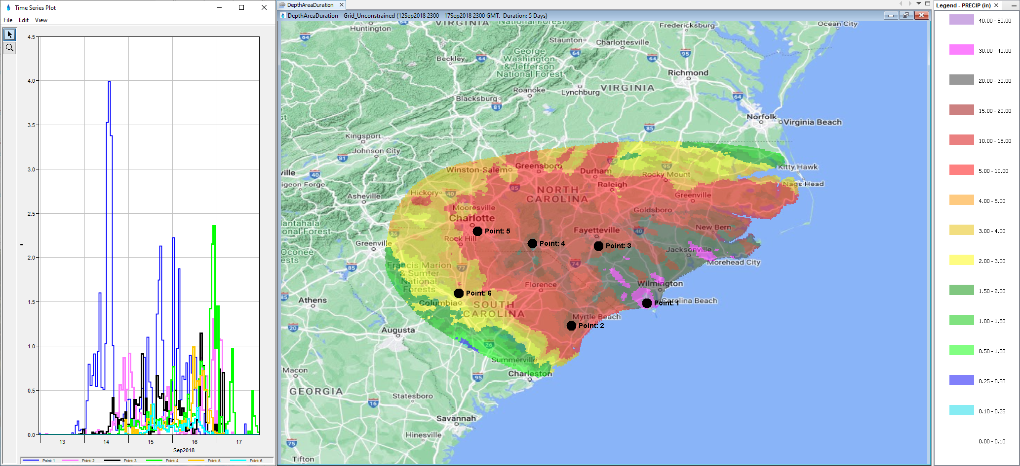
Ad Hoc Time Series Plotting
Hurricane Florence (September 2018)

Slide 9
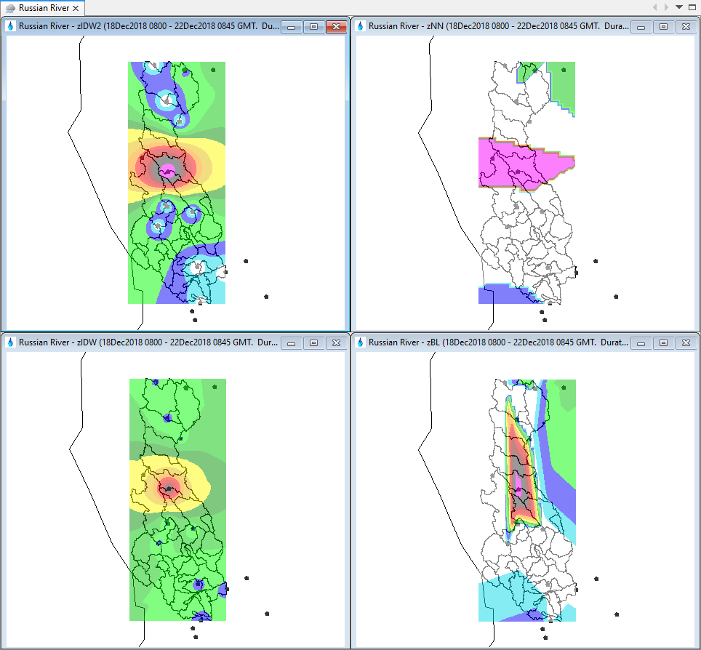
MetInterp
Inverse Distance Squared (IDW2)
Inverse Distance (IDW)
Nearest Neighbor (NN)
Bilinear (BL)
IDW2
NN
IDW
BL

Slide 10
HEC-MetVue Command Line Operations
Command Line Utilities for automating HEC-MetVue operations
Batch File | Description
GridReader.cmd | Read/Write supported Gridded Data Formats (e.g. ESRI ASCII Grid & HEC-DSS)
NCGribExtractor.cmd | Extract individual variables from multi-variable NetCDF or GRIB files
AddTin.cmd | Aggregate multiple TINs or Grids
BasinComps.cmd | Compute basin averages
ProjectTinToGrid.cmd | Generate projected Grids from TINs or modified Grids
MetInterp.cmd | Use time series measurements at point locations to generate interpolated grids.
TriangulateTin.cmd | Use aggregate measurements at point locations to generate an interpolated TIN
CalRad.cmd | Adjust Radar grids based on interpolated Gage TINs

Slide 11
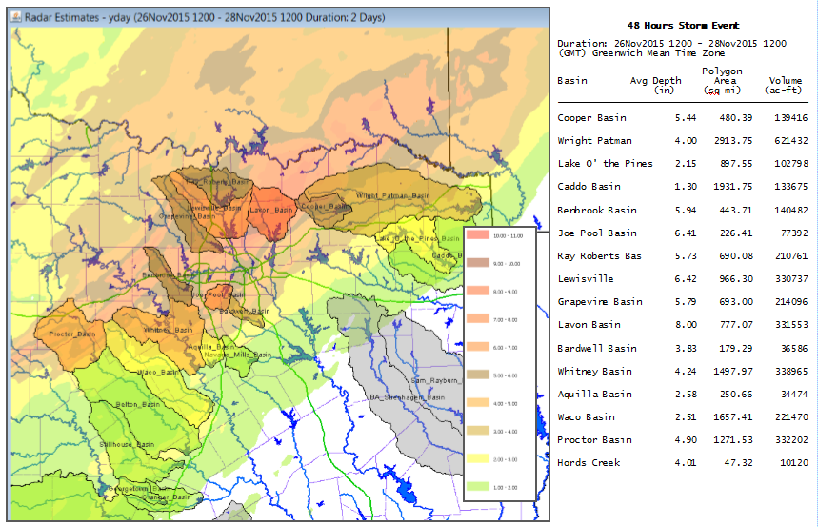
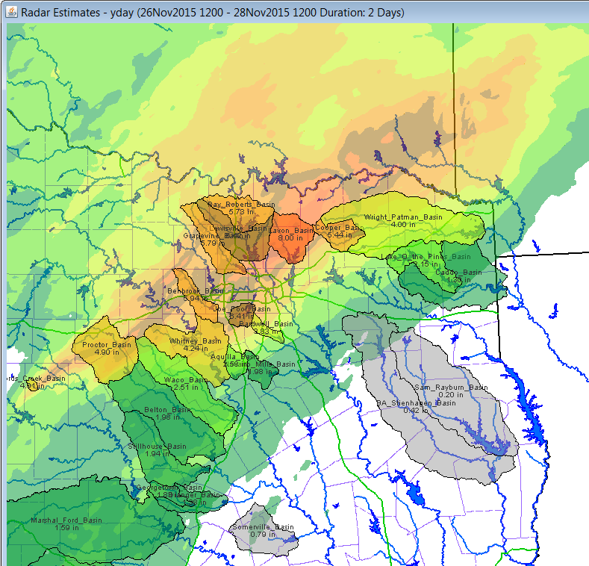
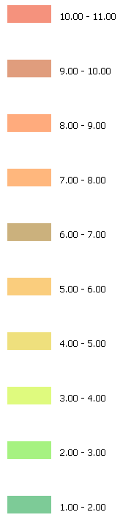
District Daily Precipitation Reports Automated Processing of Real-Time Precipitation Basin Averages

Slide 12
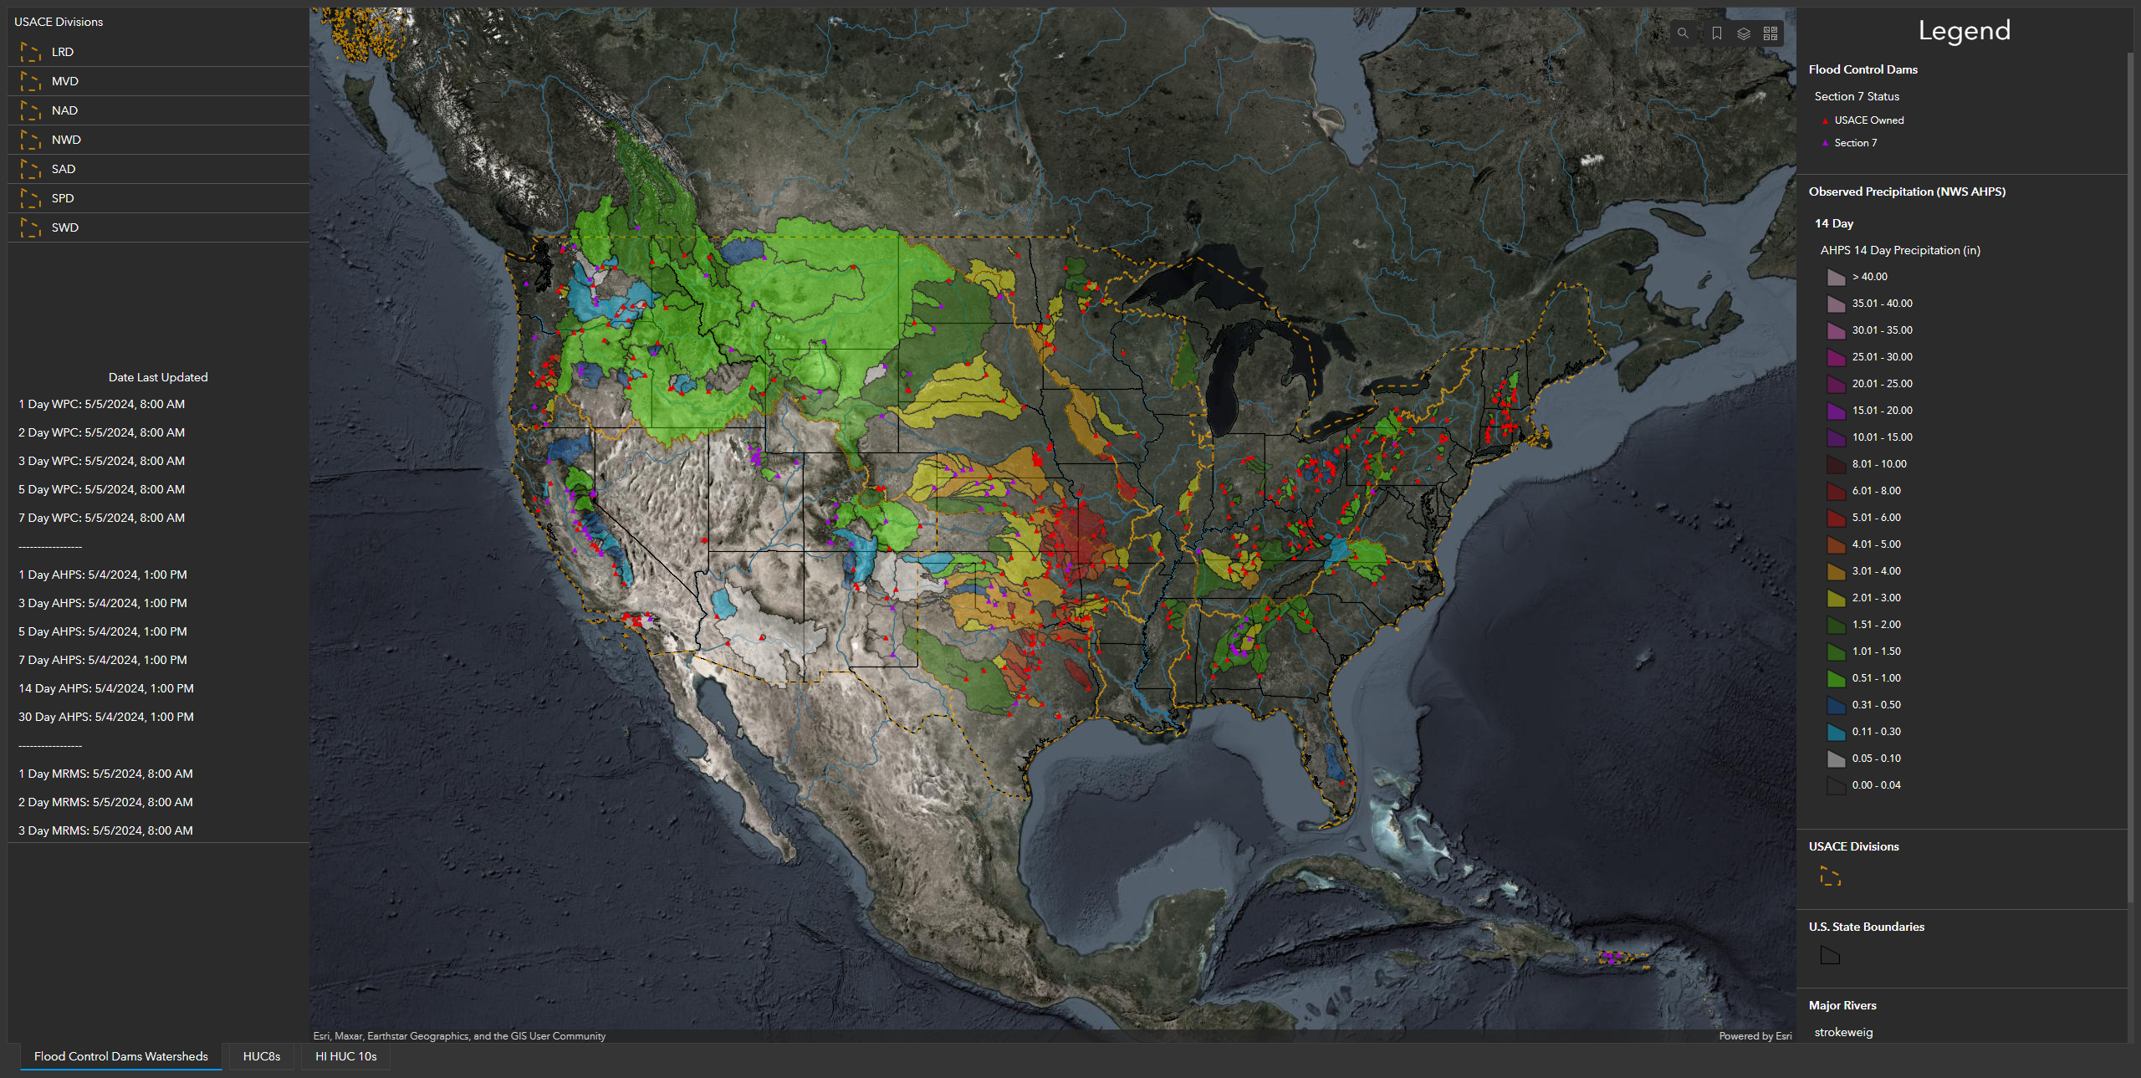
uCOP MetVue Dashboard
Automated Processing of Real-Time NWS Products
USACE Projects HW Basin Averages

Slide 13
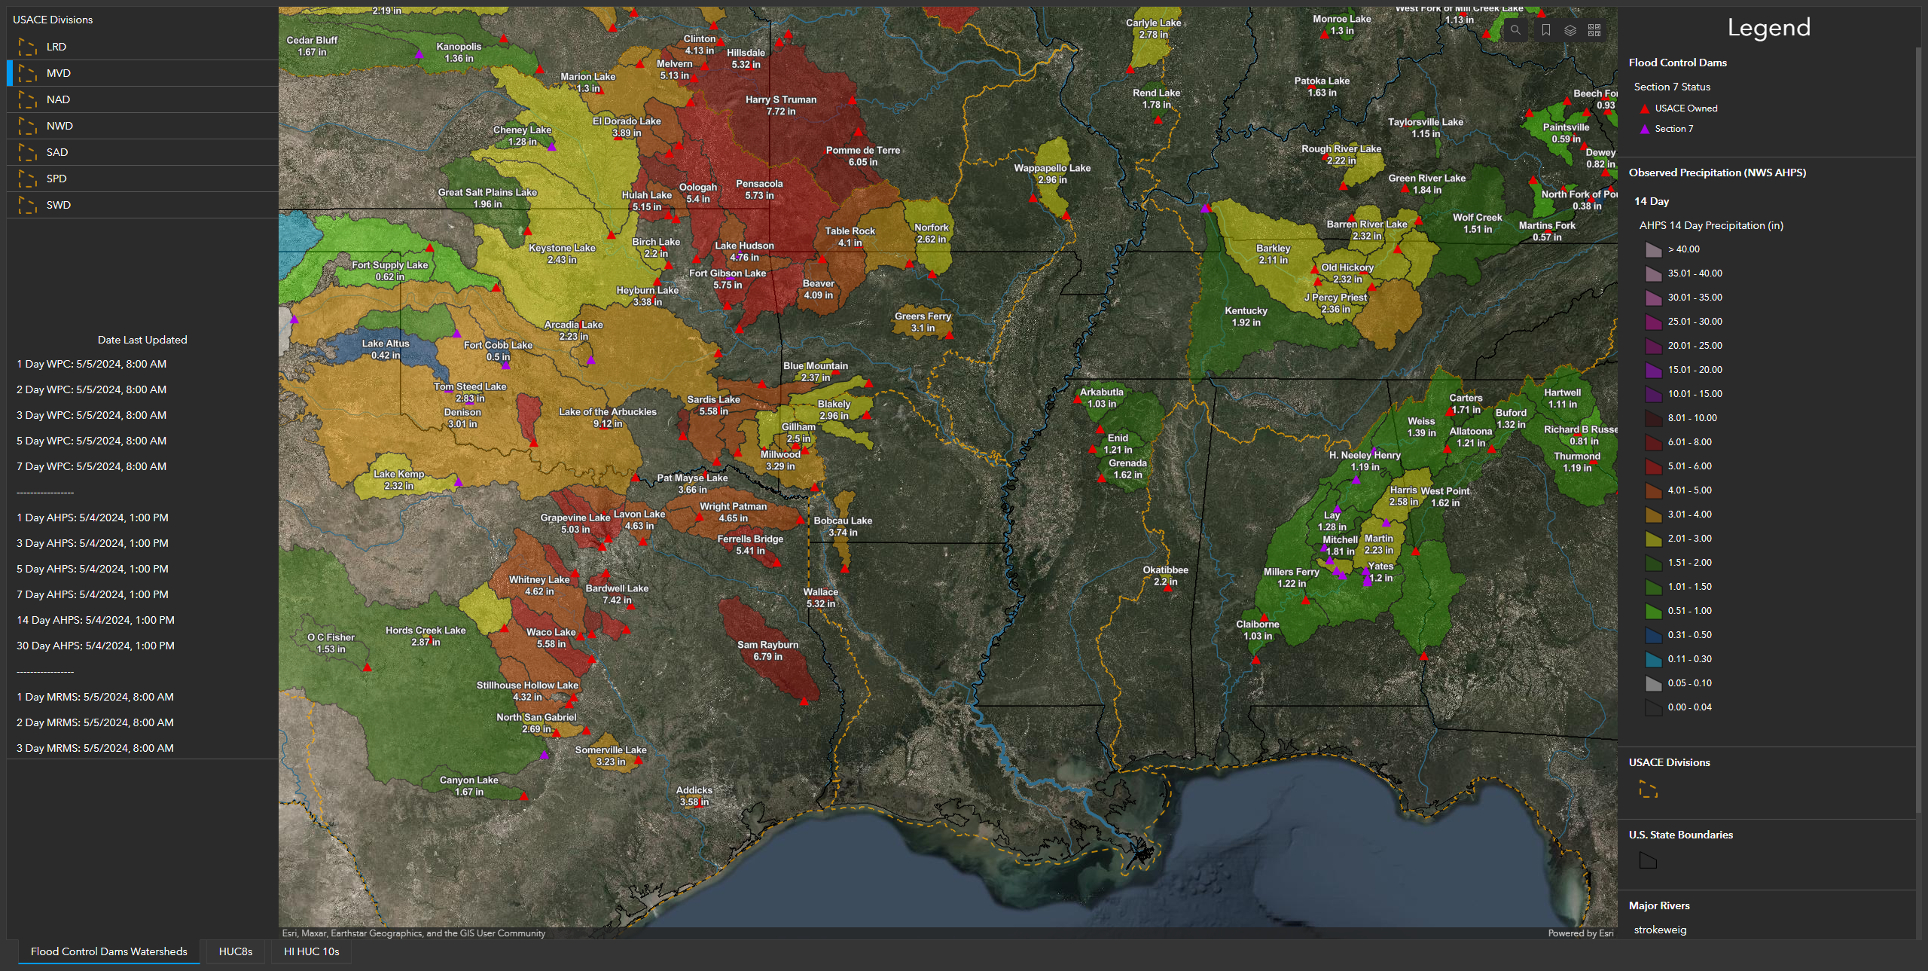
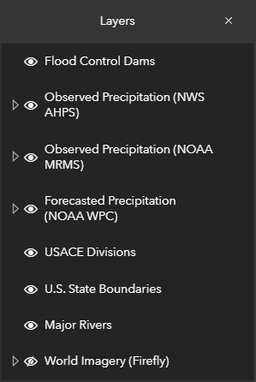

Slide 14
Questions Help additional Training
https://usace.dps.mil/sites/KMP-WM/SitePages/Corps-Water-Management-System-(CWMS).aspx
https://www.hec.usace.army.mil/confluence/cwmsdocs
https://discourse.hecdev.net/c/cwms/5
TDL-CELRH-EC-GW-W-USACE CWMS Modeling | General | Microsoft Teams

