Slide 1
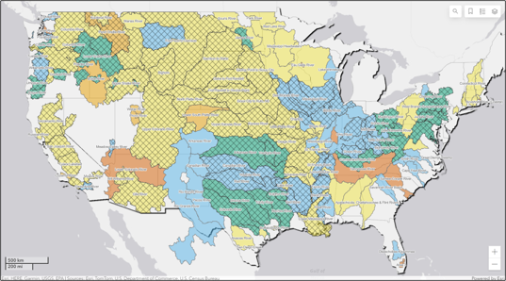

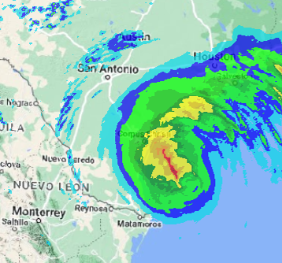
HEC-MetVue overview
Part D – HEC-MetVue in CWMS
Fauwaz Hanbali
Hydrologic Engineering Center
CWMS Prospect Course

Slide 2
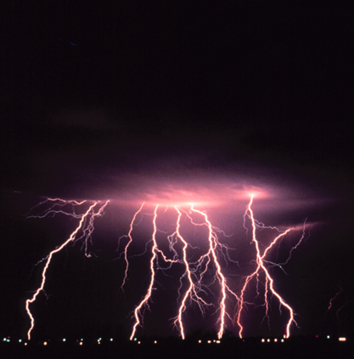
Overview
HEC-MetVue Program Interface
HEC-MetVue Key Features Orientation
HEC-MetVue Interactive and Automated Data Processing and Analysis
HEC-MetVue in CWMS
HEC-MetVue

Slide 3
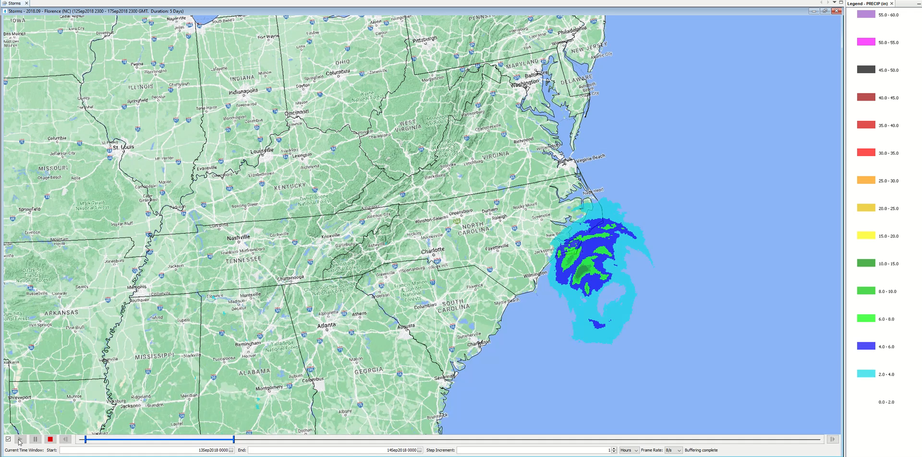
HEC-MetVue in CWMS
Automated Processing
Visualization & Interactive Analysis
Modeling & Forecast Scenarios
Data Acquisition & Processing
Data Transformation
Missing Data Filling
Historic Data Time Shifting of analog years
Report Generation
Storm Totals
Product Comparisons
Quality Control
What-if Scenarios
Animation & Dynamic Time Window Scanning
HRRR
&/or QPF
MetInterp or NEXRAD
Forecast
Precipitation
&Temperature
Observed
Precipitation
& Temperature
MetVue
Observed & Forecast
Gridded and/or Non-Gridded Precipitation and Temperature
HMS
Flow
ResSim
Flow
Flow
Observed & Forecast
Gridded and/or
Non-Gridded
Precipitation, Wind Velocity/Direction and Temperature
FIA
Stage
RAS

Slide 4
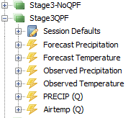
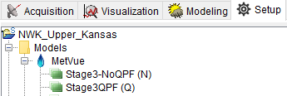
RTS-MetVue Model Alternative
HEC-MetVue Session = RTS-MetVue Model Alternative
HEC-MetVue Sessions
RTS-MetVue Alternatives

Slide 5
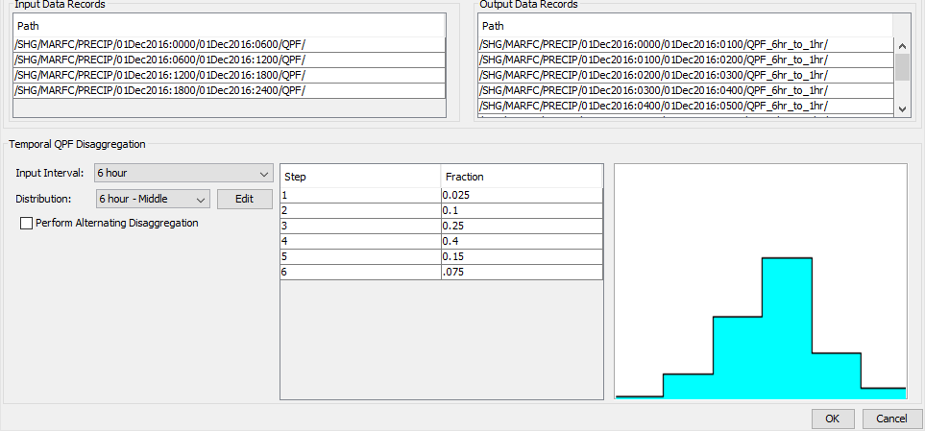
QPF Temporal Disaggregation
6 HOUR Input Dataset
1 HOUR Output Dataset

Slide 6
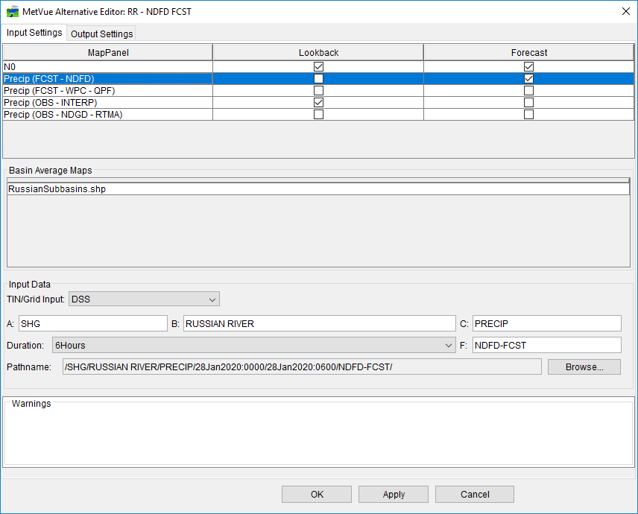
MetVue Model Alternative INput settings

Slide 7
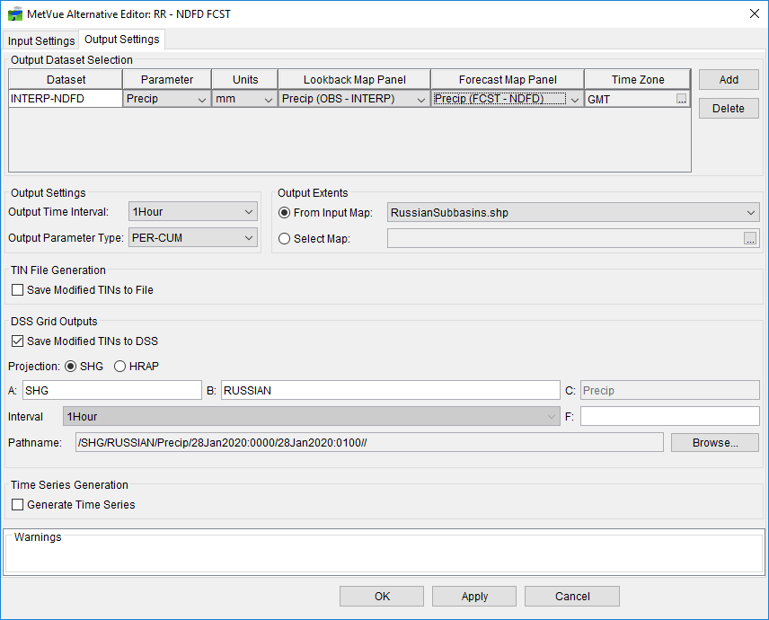
MetVue Model Alternative Output settings

Slide 8
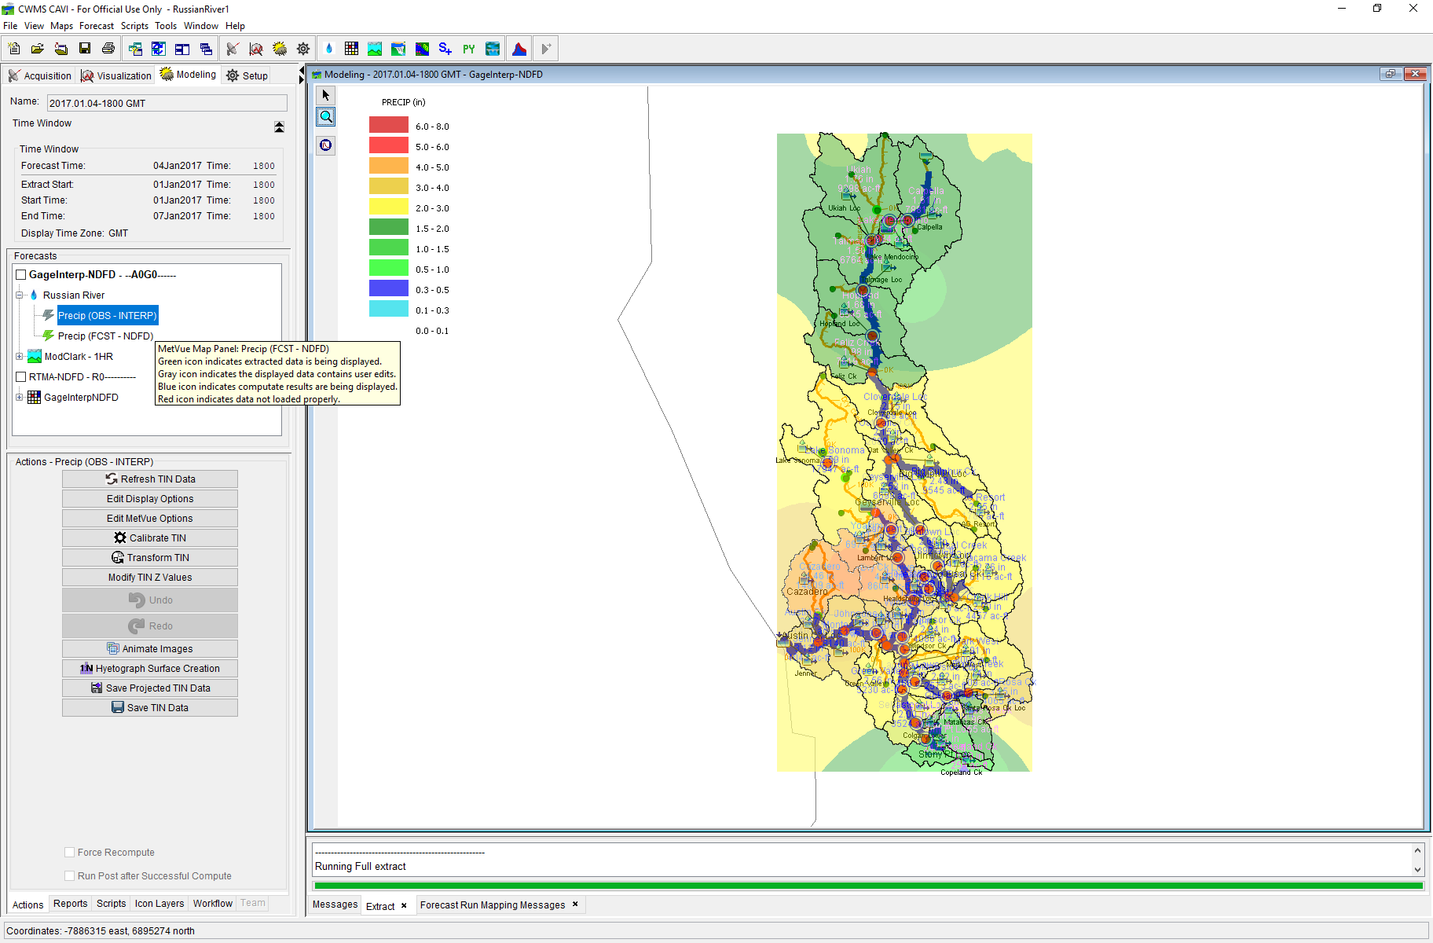
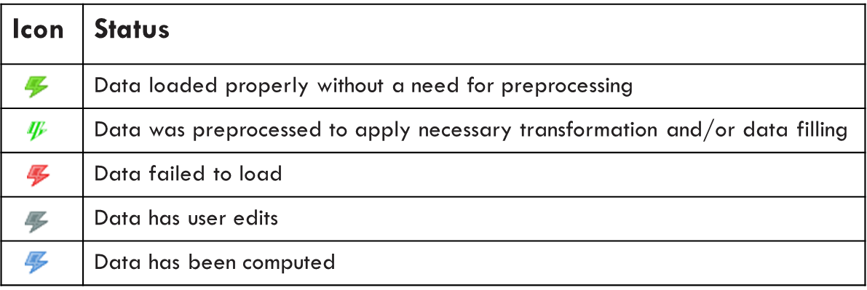
CWMS RTS-MetVue Simulation

Slide 9
Simulation Alternatives
Observed
Forecast
Interpolated Grids
RTMA
MRMS
RFC QPE
Zero Forecast
HRRR
3Day NDFD QPF
7Day WPC QPF

Slide 10
Summary
HEC-MetVue allows for the display, verification, and editing of spatial data through interactive and visual means.
HEC-MetVue is designed to process and edit precipitation and other meteorological data sets including operations such as: spatial extents trimming, spatial and temporal translation, scaling and resizing, and animations.
HEC-MetVue provides a variety of data transformation and analysis tools, as well as batch processing utilities that can be used in CWMS real-time decision support, in particular:
Weather/Watershed Monitoring and Assessment and Report Generation
Scenario Development for Forecast Modeling

Slide 11
Questions Help additional Training
https://usace.dps.mil/sites/KMP-WM/SitePages/Corps-Water-Management-System-(CWMS).aspx
https://www.hec.usace.army.mil/confluence/cwmsdocs
https://discourse.hecdev.net/c/cwms/5
TDL-CELRH-EC-GW-W-USACE CWMS Modeling | General | Microsoft Teams

