Slide 1
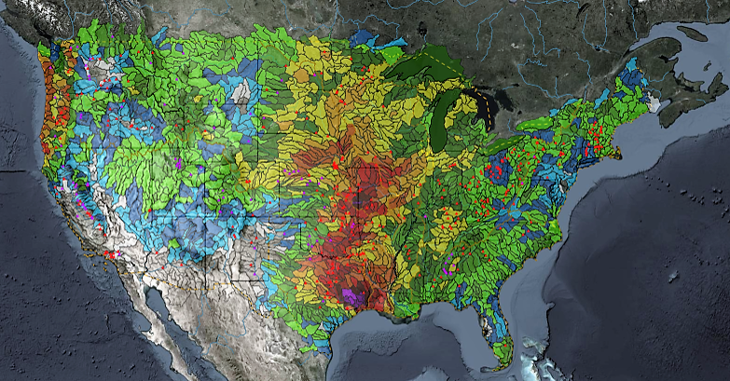
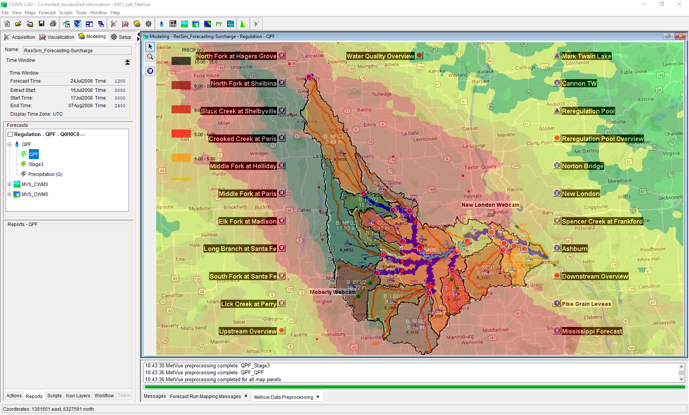

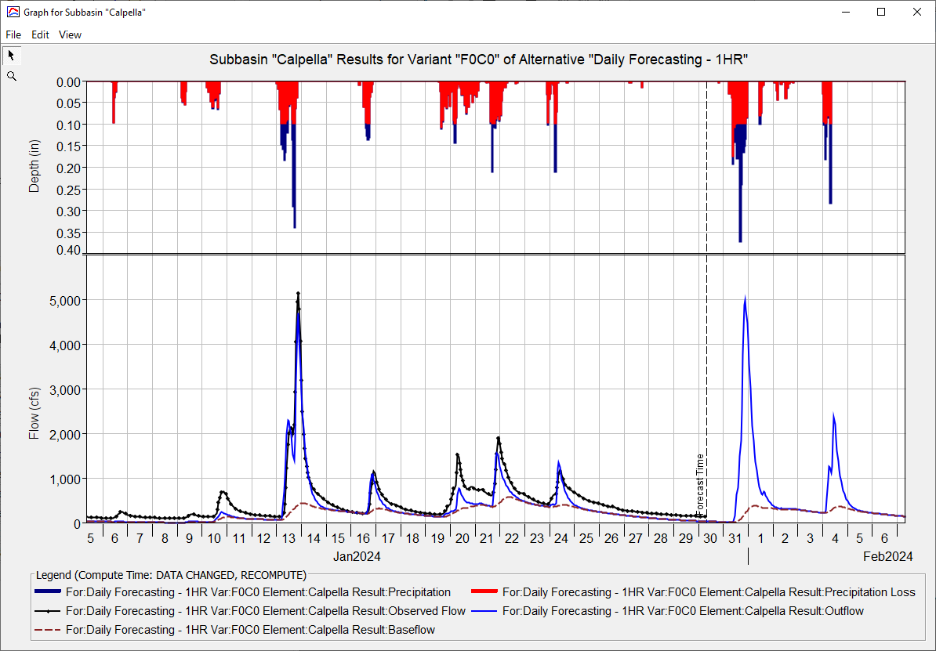
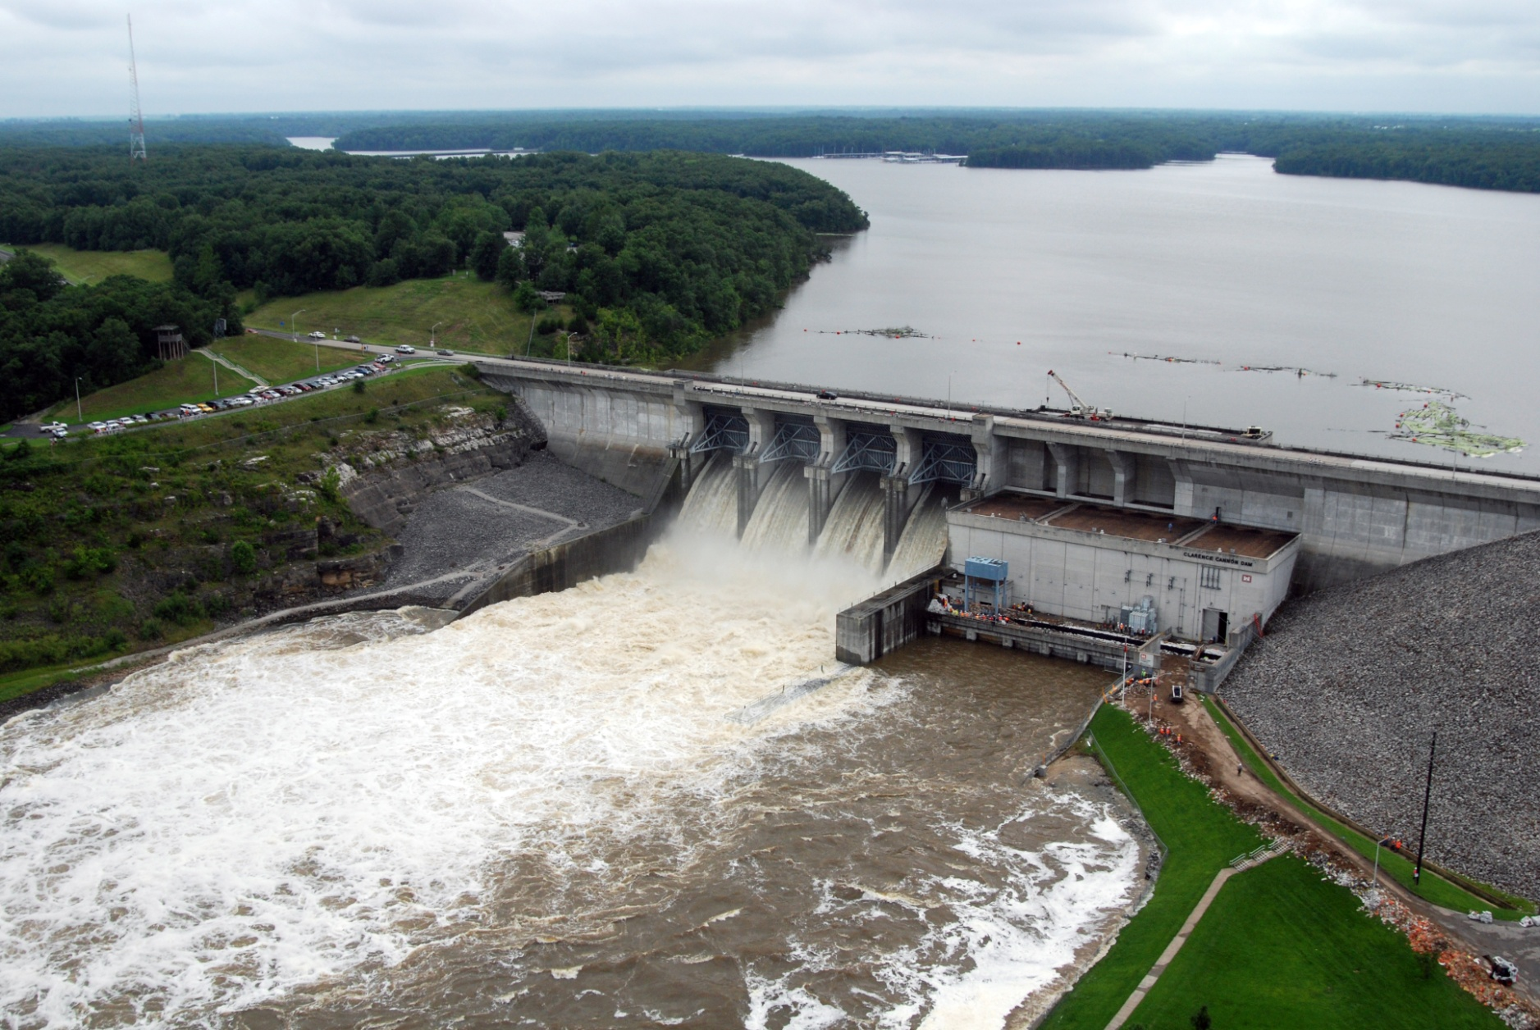
HEC-ResSim in CWMS
Russell Errett, P.E.
Hydrologic Engineering Center
CWMS Prospect Course

Slide 2
Overview
  Learn basic concepts of using HEC-ResSim in CWMS for making real-time reservoir operation decisions
  Introduction to HEC-ResSim
    What is ResSim?
    What can ResSim do?
    Why do we want it in CWMS?
  Integrating an HEC-ResSim model into CWMS
    A brief review of importing, linking, etc.
  Using HEC-ResSim for Real-Time Decision Making
    Data Considerations
    How real-time modeling differs from planning studies
    Regulation Schedule/Plan
    The OSI

Slide 3
Introduction to HEC-ResSim

Slide 4
What is HEC-ResSim?
  HEC-ResSim is a software program designed for simulating the operations of one or more reservoirs in a river system for a variety of operational goals and constraints.
Notes:
Introduction to ResSim
What is ResSim?
HEC-ResSim is a software program designed for simulating the operations of one or more reservoirs in a river system for a variety of operational goals and constraints.
The acronym “ResSim” stands for Reservoir Simulation.
ResSim is designed for modeling reservoir operations. It can handle one reservoir or many.
It can handle at-site operations or system operations.
And, because it is rule-based, it can handle multiple objectives at once.
ResSim simulates the reservoir operations timestep by timestep.
It is NOT an optimization model, so it doesn’t look at the whole time window and try to determine an “optimal” release plan.

Slide 5
What can HEC-ResSim do?
  It can determine the releases of one or more reservoirs for an observed, synthetic, or predicted flow event using a defined operation scheme and/or a prescribed release schedule.
  It uses mass-balance computations to determine the resulting pool elevation and storage for each reservoir.
  It can route and combine inflows and the determined releases through the modeled river system using hydrologic routing.
Notes:
Introduction to ResSim
What can ResSim do?
ResSim performs a variety of computations for determining reservoir operations
It can determine the releases of one or more reservoirs for an observed, synthetic, or predicted flow event using a defined operation scheme and/or a prescribed release schedule.
It uses mass-balance computations to determine the resulting pool elevation and storage for each reservoir.
It can route and combine inflows and the determine flows through the modeled river system using hydrologic routing.
More Informally…
ResSim makes release decisions on a time-step by time-step basis
It uses a rule-based operation scheme to make the release decisions -or-
It uses a prescribed release schedule (release overrides)
It computes the ending pool elevation and storage, time-step by time-step
It routes and combines flows through the river network.
It uses hydrologic routing (as opposed to hydraulic routing)
Although not as physically accurate as hydraulic routing, it is faster and provides needed information for many operational decisions

Slide 6
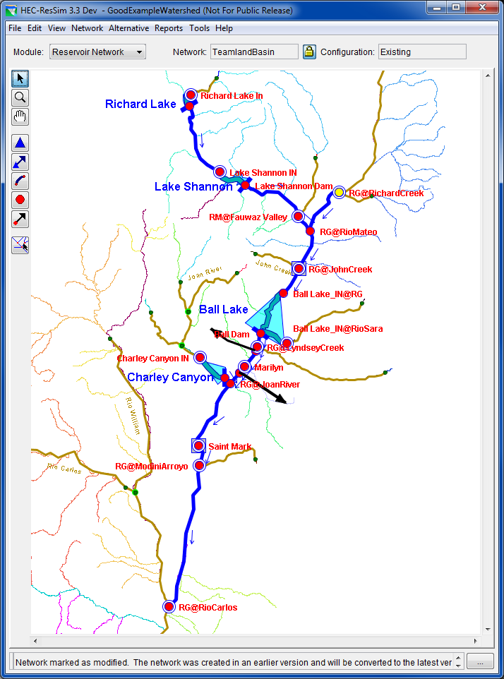
The Reservoir Network
The HEC-ResSim schematic…
  Reservoirs
    Pool Definition
    Hierarchical Outlet Structure
    Operation Plans
  Junctions/Control Points
    Inflows
    Outflow
    Stage lookup
  Routing Reaches & Diversions
    Provide Connectivity
    Hydrologic Routing
Notes:
Introduction to ResSim
Reservoir Networks
The ResSim Schematic…
ResSim’s Reservoir Network – is the key element of the ResSim model. It describes the model schematic and contains the physical and operational data for each model element of the schematic, including:
Reservoirs
Reservoir pool and outlet definitions
Reservoir Operation Plans (the rules, zones, allocation, etc)
Junctions
Inflows - Inflows into the river system are identified at the Junctions.
Outflow - Junctions sum up inflows to produce a single outflow
Stage Lookup - Junctions can also be provide a rating curve for looking up Stage from the computed Flow.
Routing Reaches and Diversions
Provide Connectivity
Hydrologic Routing
Routing reaches and diversions move water through the river network (from one junction to the next) using hydrologic routing.
Diversions take water away from a junction in the network… and may optionally return it elsewhere in the network.
This slide includes a screen shot of the Model Schematic from the ResSim Network Module. Describe the visual clues included in the map schematic…
Inflow, Control Points, Diversion arrowheads (connectivity)

Slide 7
Rule-Based Reservoir Operations
  Guide-Curve
    A Seasonal or Variable Target Pool Elevation
  Basic Guide Curve Operation
    “Within physical limits, get the reservoir pool elevation to guide curve as fast as possible.”
  Operating Zones
    Divide the storage pool into operational zones.
    A prioritized set of rules within each zone limits or overrides basic guide curve operation.
Notes:
Introduction to ResSim
Rule-based Reservoir Operations
The ResSim operation scheme is defined by 4 fundamental elements:
A Guide-Curve
A seasonal or Variable Target Pool Elevation
the target pool elevation (or storage) throughout the year – thus, a curve (or annually repeating pattern)
Basic Guide Curve Operation
“Within physical limits, get the reservoir pool elevation to guide curve as fast as possible.”
i.e., get to the target pool elevation and stay there
Operating Zones
Divide the storage pool into operational zones.
A prioritized set of rules within each zone limits the basic guide curve operation
Different layers of the reservoir pool (storage) have different operating objectives. The guide curve naturally divides the pool into two primary zones – Flood Control and Conservation (reserved space vs reserved water).
The different operating objectives are represented by different sets of operating rules placed in each zone…

Slide 8
Rule-Based Reservoir Operations
The Rules
  Release Function – local (at-site) objectives
  Downstream Control Function – downstream objectives
  Rates of Change – on release or elevation
  Induced Surcharge - Emergency Gate Regulation
  Hydropower – local and system
  Pump Schedule
  Tandem
  Prescribed Release
  User-Scripted
Notes:
Introduction to ResSim
Rule-based Reservoir Operations
Rules
ResSim has a variety of predefined rule types including:
Complex Local & Downstream Flow Objectives
Release or Pool Elevation Rates of Change
Emergency Gate Regulation (Induced Surcharge)
Local and System Hydropower Requirements
Pump Schedule
Parallel and Tandem Reservoir Systems
Prescribed Release
User-Scripted release objectives

Slide 9
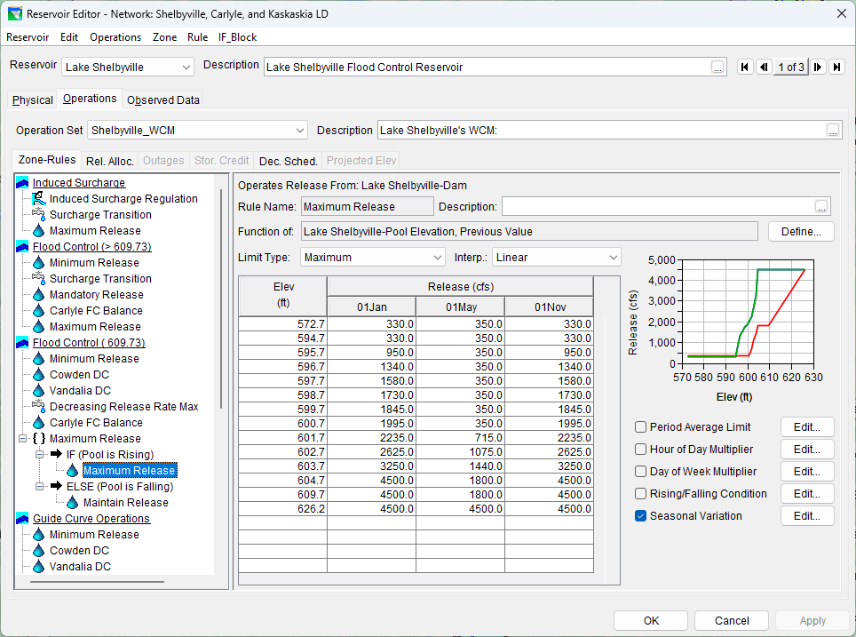
Reservoir Editor
Notes:
Introduction to ResSim
ResSim’s Reservoir Editor – Operations tab
This slide is a screen shot of the Reservoir Editor, Operations tab, Zone-Rules subtab. Describe the features of this tab…
Zone-Rules tree
Bold zone is the guide curve
Italic zone is the Inactive Zone (a special zone below which the reservoir cannot “operationally” release water)
The Edit Pane – changes with the selection in the tree
The Menus – change with the selection of the Major Tab
The other subtabs – additional modifiers on the operations

Slide 10
Alternatives
  Reservoir Network Selection
  Run Control
    Alternative Type , Compute Timestep, Compute Options
  Operations
    Operation set per Reservoir, System Storage Balance
  Lookback
    Starting Conditions – Pool Elevation, Releases
  Time Series
    Local Inflows, Lookback Time Series, External Variables
Notes:
Introduction to ResSim
ResSim Alternatives
Reservoir Network Selection
Alternatives …are based on a Reservoir Network. And include:
Run Control data
Alternative Type – Standard, Ensemble, Monte Carlo, etc.
Compute Timestep – 5min to 1 day, 1 hour is typical for real-time
Compute Options – instantaneous vs period average, plus unreg and holdouts.
Operations
(Select an) Operation set per Reservoir
(Select a) Storage Balance plan per Reservoir System
Lookback - aka…Initial Conditions
Elevation or Storage
Releases per outlet, Diversion flow, state variables.
Each conditions can be defined with a Constant or Time Series.
In Real-time modeling, use of Time Series for these Initial Conditions wherever you have real-time observed data in the database
Time Series
Local Inflows
Lookback Time Series
External Variables needed for the operations

Slide 11
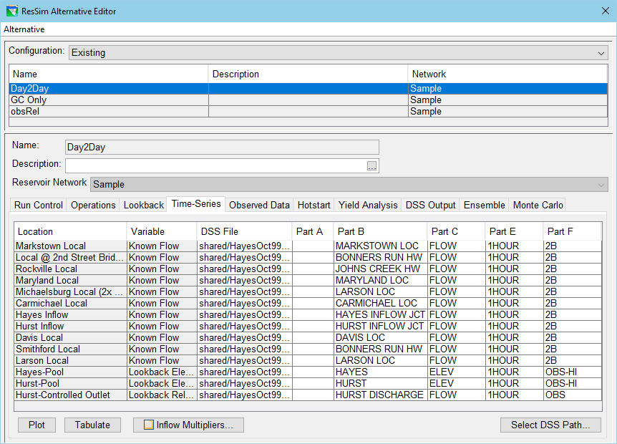
Alternative Editor
Notes:
Introduction to ResSim
ResSim’s Alternative Editor
This slide shows a screen shot of the ResSim Alternative editor at the Time-Series tab. Describe the features of this tab…
Upper panel: Existing Alternative list – includes the Reservoir Network identification, which it is the foundation of the alternative
Lower Panel: The selected alternative “editor” made up of several tabs for specifying the various aspects of the alternative. The first four are the most important:
Run Control
Operations
Lookback
Time-Series
Although each of the tabs are important, the Time-Series tab has some aspects worth noting:
The time series list includes several different types of required input based on the information specified in the network and on the Operations and Lookback tabs. These include:
Known Flows
Lookback Elevation, Lookback Release
Input Time Series
Others… (Lookback Diversion, Input Evap,…)
Inflow Multipliers button – for increasing or decreasing the inflows globally or one by one.

Slide 12
Simulation and Analysis
  Simulation
    a specified Time Window
    a set of alternatives to analyze
  Analysis Tools
    Context-sensitive Plots
    Release Decision Report
    Summary Reports
    Customized Plots
    User-defined Reports
    HEC-DSSVue
    The Operations Support Interface (OSI)
Notes:
Introduction to ResSim
Simulation and Analysis
To compute and analyze the results of an alternative, the user must create a “simulation” (A ResSim concept) or “forecast” (the equivalent in CWMS).
A Simulation or Forecast is specified by:
a Time Window
a set of alternatives to be computed and analyzed.
Once an alternative has been computed, a variety of tools are available to analyze the results
Analysis Tools
Context-sensitive Plots
Release Decision Report
Summary Reports
Customized Plots
User-defined Reports
HEC-DSSVue/CWMSVue

Slide 13
HEC-ResSim’s Major Features
  Graphical System Schematic, tightly integrated with CWMS (and HEC-WAT)
  Hierarchical Outlet Structure
  Diversions and Diverted Outlets
  Release Allocation – Outlet Prioritization
  Zone-Based Prioritized Operation Rule Set
  Compute Intervals: 5min – 1day
  Customizable Plots and Reports
  Induced Surcharge Operation
  Scheduled Local & System Hydropower
  Tandem and Parallel System Operations
  Pump-back Storage Operation
  Conditional (If-then-else) Rule Activation
  User-Scripted Rules & State Variables
  Customizable Operations Support Interface (OSI)
Notes:
Introduction to ResSim
ResSim’s Major Features allow users to model a wide variety of situations
Graphical System Schematic, tightly integrated with CWMS. Includes an active schematic that provides access to model editors and output, from both ResSim and the CWMS
Hierarchical Outlet Structure. The benefits and limitations of this feature include:
Ability to separate power releases from spillway or sluice gate releases
Inability to operate to gates settings, ResSim is presently all about flow
Diversions and Diverted Outlets.
Diversions are from the river
Diverted outlets are from the (reservoir) pool.
Diversions are single minded. In other models, when using diversions at a reservoir, they take water away before the reservoir can decide what to do with it. Diverted outlets allow the modeler to prioritize and determine the pool diversions with the other reservoir releases.
Release Allocation – Outlet Prioritization
When the rules don’t care where the water is released from, the release allocation can take over.
Zone-Based Prioritized Operation Rule Set
The operation rules are specified per reservoir “zone”. This allows the rules/objectives to change depending on how full (or empty) the reservoir is.
Compute Interval Range: 5min – 1day
Typical intervals for real-time operation are 1hr, 6hr, or 1day. But really flashy systems may need 15 min or less. 6hr may be used when the operations are coordinated with the Weather Service forecast (which is usually published on a 6hr interval)
Customizable Plots and Reports
A standard set of plots and reports are available.
But, the standard plots allow the user to customize what they want to see and then save their custom plot configuration for later use as a “User Plot”
And, a report builder is available for creating customized tables of output in a generalized report format.

Slide 14
HEC-ResSim’s Role in CWMS
Simulate Real-Time Reservoir Operations
  Much of a water manager’s function is to operate the district’s reservoirs. CWMS is intended to support that effort.
  CWMS, therefore, needed a modernized and integrated reservoir simulation model.
  To meet that need, HEC-ResSim was developed in parallel with CWMS and its design requirements were strongly influenced by the water management community.
  A good HEC-ResSim model for CWMS should provide the water manager a good first guess to use when determining the upcoming release schedule for their reservoirs.
Notes:
Introduction to ResSim
ResSim’s Major Features allow users to model a wide variety of situations
Graphical System Schematic, tightly integrated with CWMS. Includes an active schematic that provides access to model editors and output, from both ResSim and the CWMS
Hierarchical Outlet Structure. The benefits and limitations of this feature include:
Ability to separate power releases from spillway or sluice gate releases
Inability to operate to gates settings, ResSim is presently all about flow
Diversions and Diverted Outlets.
Diversions are from the river
Diverted outlets are from the (reservoir) pool.
Diversions are single minded. In other models, when using diversions at a reservoir, they take water away before the reservoir can decide what to do with it. Diverted outlets allow the modeler to prioritize and determine the pool diversions with the other reservoir releases.
Release Allocation – Outlet Prioritization
When the rules don’t care where the water is released from, the release allocation can take over.
Zone-Based Prioritized Operation Rule Set
The operation rules are specified per reservoir “zone”. This allows the rules/objectives to change depending on how full (or empty) the reservoir is.
Compute Interval Range: 5min – 1day
Typical intervals for real-time operation are 1hr, 6hr, or 1day. But really flashy systems may need 15 min or less. 6hr may be used when the operations are coordinated with the Weather Service forecast (which is usually published on a 6hr interval)
Customizable Plots and Reports
A standard set of plots and reports are available.
But, the standard plots allow the user to customize what they want to see and then save their custom plot configuration for later use as a “User Plot”
And, a report builder is available for creating customized tables of output in a generalized report format.

Slide 15
Questions
Help additional Training
https://usace.dps.mil/sites/KMP-WM/SitePages/Corps-Water-Management-System-(CWMS).aspx
https://www.hec.usace.army.mil/confluence/cwmsdocs
https://discourse.hecdev.net/c/cwms/5
TDL-CELRH-EC-GW-W-USACE CWMS Modeling | General | Microsoft Teams

