Slide 1
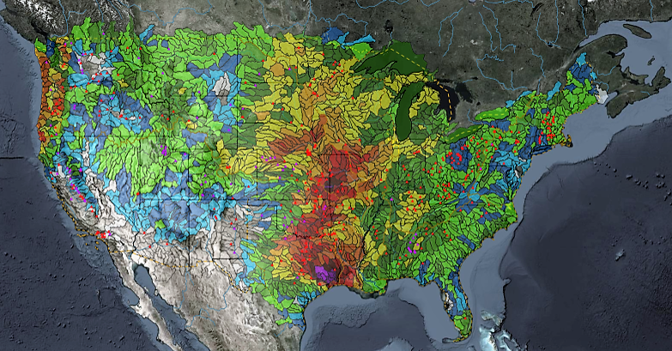
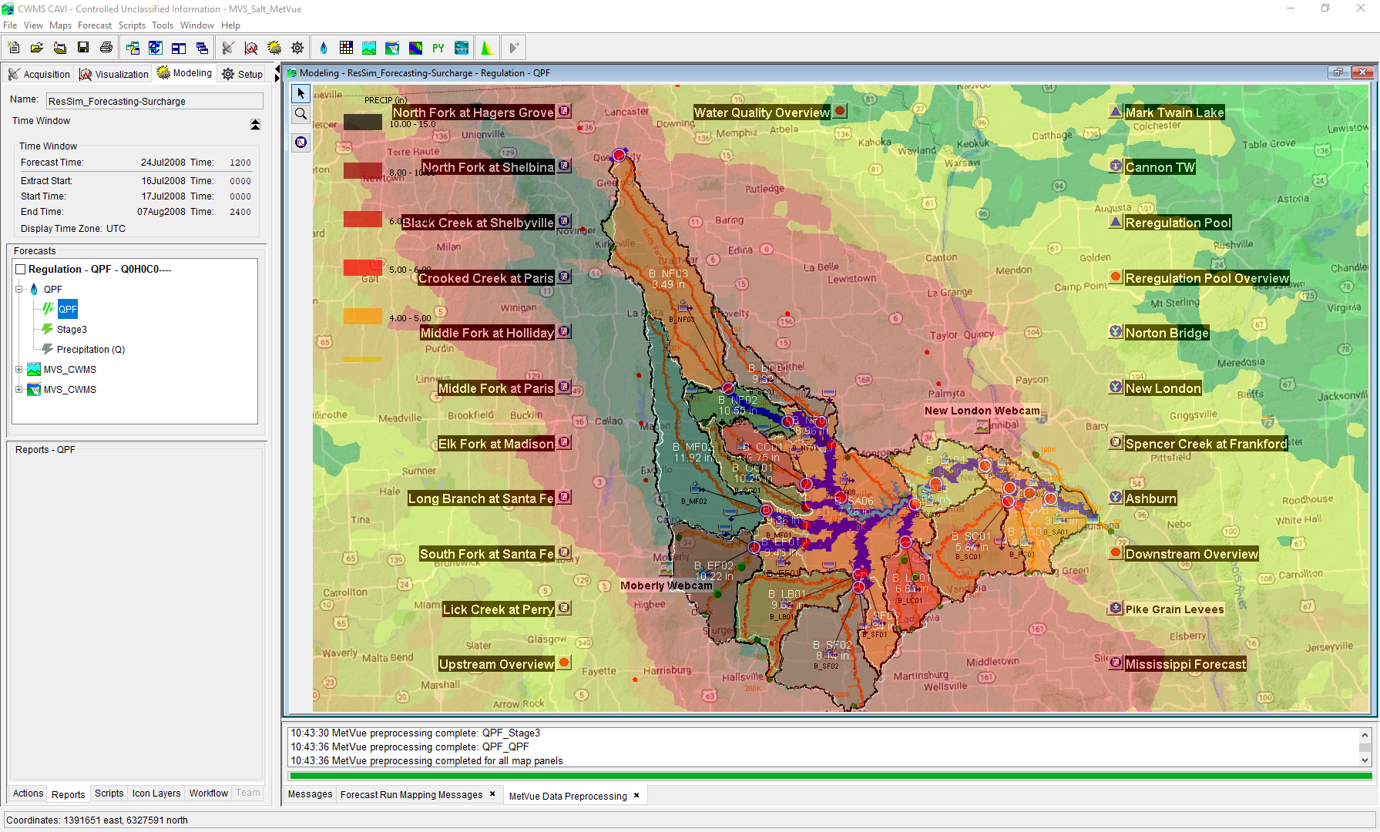

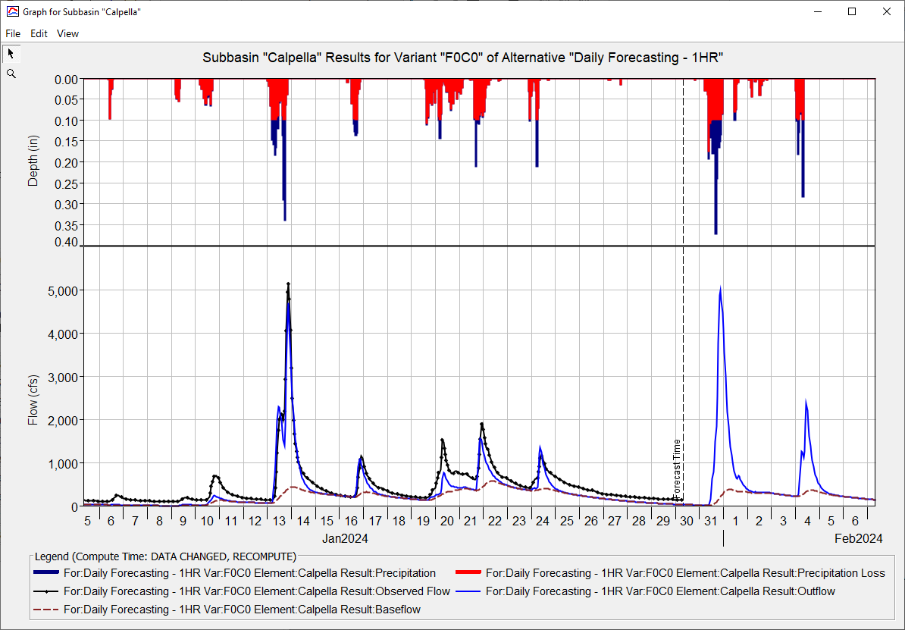
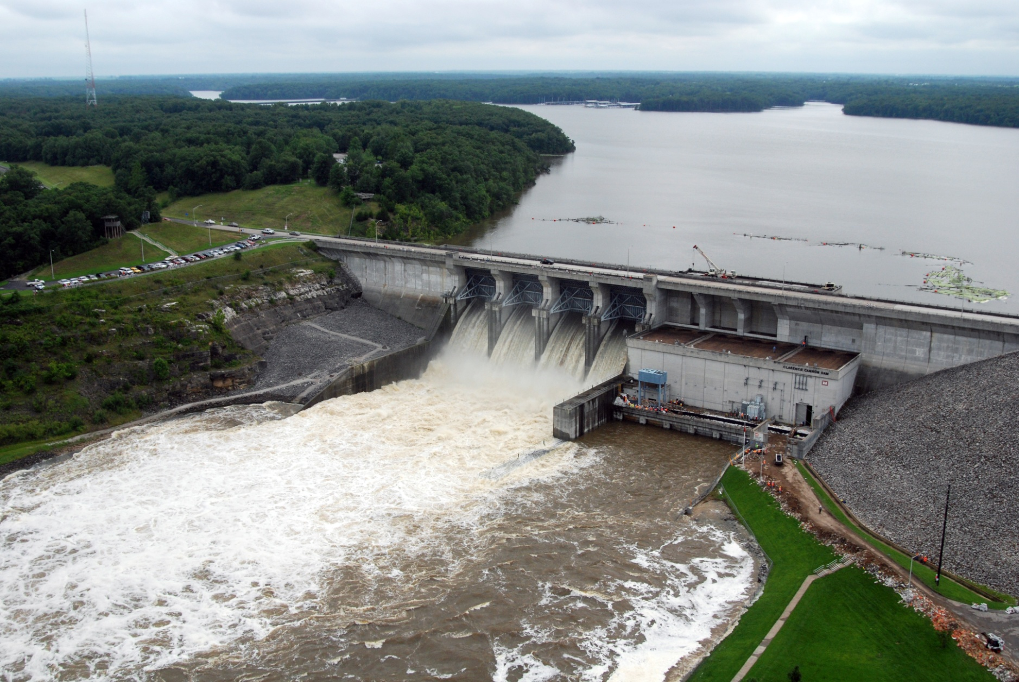
HEC-ResSim in CWMS
Russell Errett, P.E.
Hydrologic Engineering Center
CWMS Prospect Course

Slide 2
Overview
  Learn basic concepts of using HEC-ResSim in CWMS for making real-time reservoir operation decisions
  Introduction to HEC-ResSim
    What is ResSim?
    What can ResSim do?
    Why do we want it in CWMS?
  Integrating an HEC-ResSim model into CWMS
    A brief review of importing, linking, etc.
  Using HEC-ResSim for Real-Time Decision Making
    Data Considerations
    How real-time modeling differs from planning studies
    Regulation Schedule/Plan
    The OSI

Slide 3
Integrating an HEC-ResSim model into CWMS

Slide 4
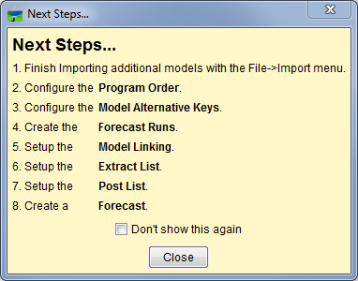
Watershed Setup - A Process…
Notes:
Integrating a ResSim model into CWMS
Watershed Setup – A Process
This slide shows the Next Steps dialog. This dialog is displayed by the CAVI after you (first) create a new watershed. It is a reminder of the steps you need to take to assemble a watershed for use in CWMS…
Import any additional models
Define the Program Order
Note: steps 1 & 2 are swappable. It may be more logical to specify the program order before importing the models.
Assign Key Letters
Create a Forecast Run. Assemble the model alternatives into a sequence. Only “lettered” alternatives can be used
Model Linking. Establish the data flow between the models
Configure the Extract Groups. Create the extract groups so that the data needed by your models will be available for the compute
Setup your Post Lists decide what you want to store back to the database from your forecasts. Complete this after models are up and running smoothly
Create a Forecast. The forecast will exercise the extract. Test the data and model linking by computing, correct any problems, retest…
Save. Talk about saving here, even though the illustration doesn’t…
Save to Base – either the forecast run or the individual models. This will ensure that any changes you made to get the forecast running are available for the next forecast.

Slide 5
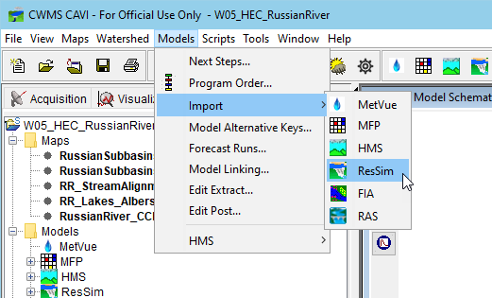
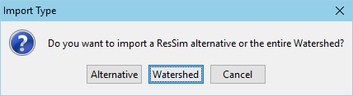
Importing Models
Notes:
Integrating a ResSim model into CWMS
Importing Models
This slide shows the Models menu from the CAVI, the submenu under import, and the query dialog you will see when you select ResSim to import.
Models Menu, Import… Each model in the Program Order should be in the imported if available, but… If ResSim is going to be used, Import the ResSim model FIRST.
a ResSim watershed and a CWMS watershed share a common framework. Because of this, a CWMS watershed can (and should) be created from a ResSim watershed
When a ResSim watershed is imported, the CWMS watershed gets the ResSim watershed’s maps, stream alignment, and configuration information as well as the ResSim model data – networks, alternatives, & simulations
When Importing a ResSim model, you will be asked if you want to import just an alternative or a whole watershed.
If the CWMS watershed does not yet have a ResSim model, pick Watershed.
If you have already imported a ResSim watershed but want to add a new alternative or update an existing one from the original source watershed, pick Alternative.
“from the original watershed” should be stressed here. This is because there are a number of foundational aspects of the watershed that should be consistent between the existing CWMS watershed and the ResSim watershed you are importing from. These include the configurations and a variety of overlapping files – especially networks.

Slide 6
Importing…
Watershed versus Alternative
Watershed
Alternative
Everything from the watershed is brought in – no questions asked…
  Stream Alignment
  Configurations & Elements
  Networks
  Alternatives
  Simulations
  Maps
  HEC-DSS Files
  More
Only the Alternative and its network files are brought in
  No Stream Alignment
  No Configurations & Elements
A valid stream alignment must already exist in the watershed
  Importer tries to place network elements on the correct streams…
  …and tries to tie them to existing configuration elements.
Notes:
Integrating a ResSim model into CWMS
Importing Watershed vs Alternative
Watershed – everything is brought in from the standard folders of the watershed, no questions asked. This includes the:
Stream Alignment
Configurations and Schematic Elements (not so sure about this one..)
Reservoir Networks
Alternatives
Simulations.
Maps
Shared folder – DSS files.
HOWEVER, any additional folders you’ve added to the watershed may not be imported (copied) into the CWMS watershed so review new watershed carefully.
Alternative – only the files associated with the alternative and its network are imported (copied) into the CWMS watershed.
No Stream Alignment
No Configurations
The Alternative Importer tries to associate all network elements to their streams so a valid stream alignment must already be in the watershed.
The importer also tries to associate the network with its configuration, so if the configurations are not already in the watershed, the links to the configuration elements will be broken; this is not a problem for CWMS, but may be of concern if the CWMS watershed is later used as the basis for a study model.

Slide 7
Revising a ResSim Alternative for CWMS
Revise Lookback settings (Use Observed Data):
  For each reservoir…
    Set Lookback Elevation to Time Series
    Set Lookback Release to Time Series
      If time series do not exist for every outlet
        Set ONE Controlled Outlet to Time Series
        Set all other outlets to Constant - Set those constants to zero
    If time series does not exist or are not reliable for pool elevation and/or outflow, advanced options exist to estimate one or both variables
      Lookback Elevation:
        Set to Guide Curve
        Function of Release (needs an initial pool elevation to start)
          Start with Constant
          Start with Time Series
          Start with Guide Curve
      Lookback Release
        Function of Elevation
Notes:
Integrating a ResSim Model into CWMS
Revising a ResSim Alternative for use in CWMS – Use Observed Data
(before or after import, this is what you should consider to make the alternative appropriate for real-time use).
But – we aware – in CWMS 3.x, ResSim alternatives can continue to be used in standalone, so some of your changes could affect how the alternative works in standalone.
Revise the Lookback settings:
The lookback settings are the Initial Conditions for your reservoirs. You should use current observed data for your real-time model.
For each reservoir…
Set Elevation to Time Series
Set ONE outlet to Time Series
Set all other outlets to Constant - Set those constants to zero
Note – there are lots of caveats to these last two instructions. What are some of them?
Controlled outlet – gates, spillway, power plant
Observed total flow vs observed individual flow – is there a gage? Is the observed estimated?
Uncontrolled outlets

Slide 8
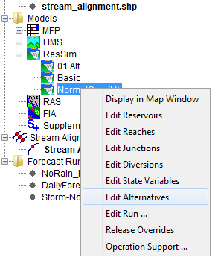
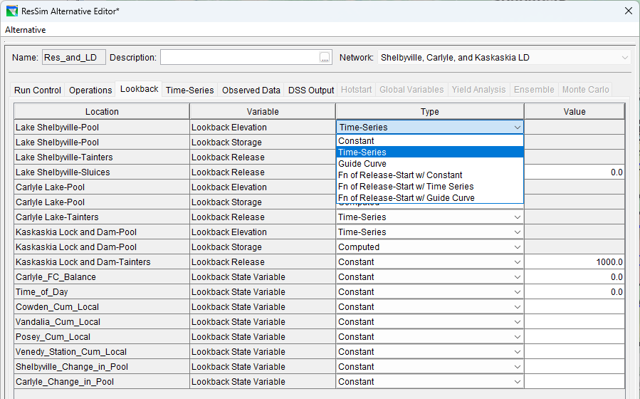
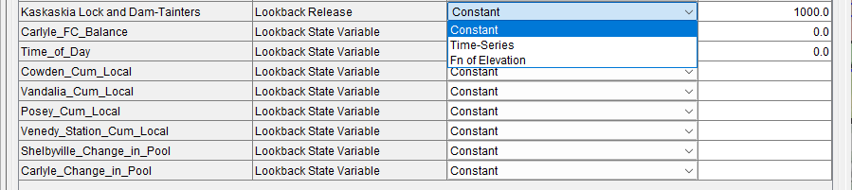
Revising an Alternative for CWMS
Notes:
Integrating a ResSim Model into CWMS
Revising a ResSim Alternative for use in CWMS, continued
This slide contains 2 screen shots:
one of the context menu from the Alternative in the CAVI setup tab’s model tree
one of the Lookback Tab of the Alternative Editor
If the ResSim modeler created the watershed for use in CWMS, then the alternatives may already be “ready to go”. Check ‘em anyway. To do so,
right click on the ResSim alternative in the models tree and select Edit Alternatives…
The ResSim alternative editor for the selected alternative will open. Go to the Lookback Tab.
Make sure that for each reservoir, the reservoir pool elevation (or storage) and the release from at least one outlet are set to Time Series.
Set the other outlet releases to zero (0.0)
Explain WHY these entries should be set to Time Series and discuss data availability.
Explain how constant vs time-series affects the real-time regulator. Talk about the exceptions.

Slide 9
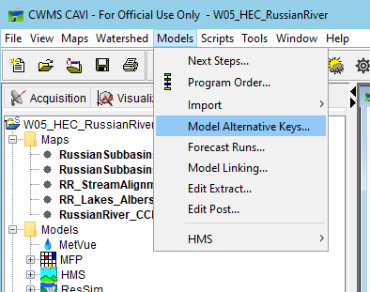
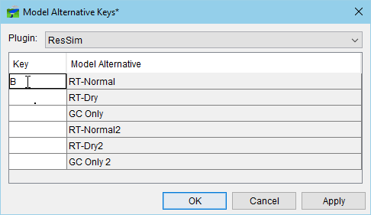
Assigning Model alternative Keys
Notes:
Integrating a ResSim Model into CWMS
Assigning Key Letters
A “key” must assigned to each alternative that is going to be used in a CWMS forecast run
It must be an single alpha-numeric character: A-Z and 0-9
Not case sensitive
Each character can only be used once per model but can be reused by another model. E.g., Both HMS and ResSim could have alts with the key “B”
The forecast run assembles a “key string” from the individual alternatives’ keys that were selected to form the run
Each alternative’s substring of the run’s key string is used to label the F-Part of the DSS pathname of each output record that they produce at compute time.

Slide 10
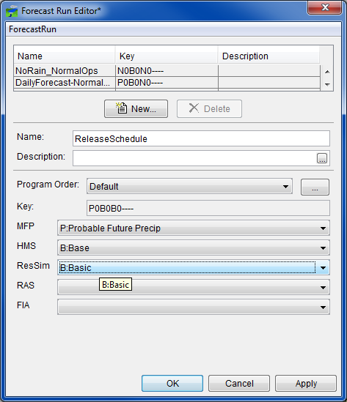
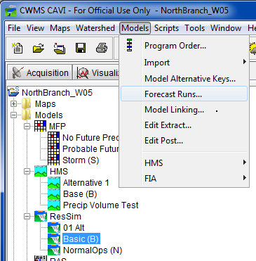
Creating Forecast Runs
Notes:
Integrating a ResSim Model into CWMS
Creating Forecast Runs
this slide contains 2 screen shots:
one of the Models menu from the from the Modeling Tab of the CAVI
one of the Forecast Run Editor
Explain the following…
To Create a Forecast Run Open the Forecast Run Editor from the Models menu (select Forecast Runs…)
Click New.
Give the new forecast run a Name. Be descriptive, but not too long
Select the model alternatives
Click Apply or OK.
Not all models of the program sequence must be “filled in” with an alternative; you can decide which models you want to include or not include in a particular forecast run.
For example you may just want a RAS/FIA forecast run to use only during flood events. This run might use data from other forecast runs. This would ensure you not running them unnecessarily in a daily forecast
Another example could be to leave out HMS and MFP because you only want to use flows from the local RFC for ResSim’s inflows.

Slide 11
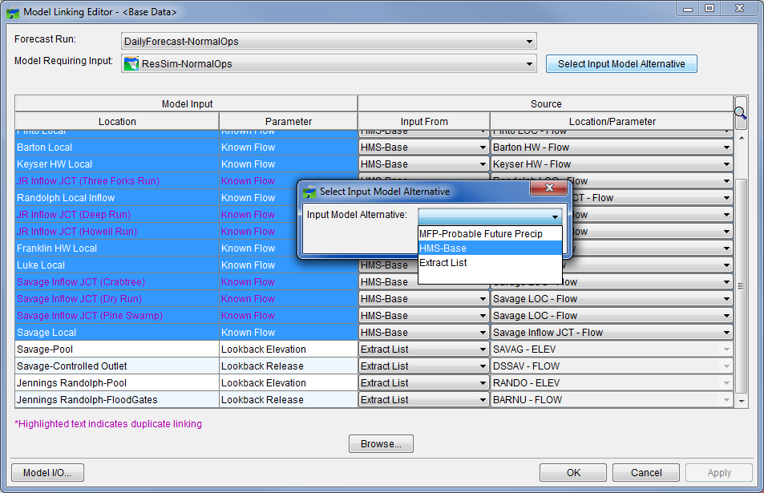
Model Linking
Extract vs Model Input
  Known Flow
    More than likely is linked to HMS
    Could be extract if RFC flows are used
      The Know Flow time series must cover the entire simulation time window (lookback and forecast)
  Lookback Elevation and Release
    More than likely is linked to Extract
      Only needs to cover the lookback time window
Notes:
Integrating a ResSim Model into CWMS
Model Linking.
This slide illustrates the Model Linking Editor. The model being linked is ResSim, the “Known Flow” rows are highlighted and the “Select Input Model Alternative but has been selected so that the dropdown dialog is shown
Be careful – the list of input that ResSim generates is in sections…
The local inflows, then the Lookback and Operations’ Input Time Series, then the Observed data. All listed inputs are required EXCEPT the observed.
Set the “Input From” and set the source for each row of required input
The first several rows of the list are the inflows (“Known Flow” is ResSim’s parameter name for inflow data).
You should select these rows as a group,
then click on the “Select Input Model Alternative” button.
A small dialog with a dropdown list will appear
Select the model in the sequence that will be producing the inflows for your ResSim model then press Ok.
This data is usually produced (for the whole time window of the forecast or simulation) by HMS (a rainfall runoff model) which precedes ResSim in the CWMS program order.
The NOAA-NWS RFC may be producing the forecasted inflows for your forecast run. In this condition, there is no preceding model that generates them, so “Input From” should be set to Extract List.
When you perform a “mass” linking this way, another small dialog will appear that asks if you are sure you want to “link” all those rows to the selected alternative. Unless you accidently picked the wrong model alternative, click Yes.
The other is a portion of the table in the model linking editor…

Slide 12
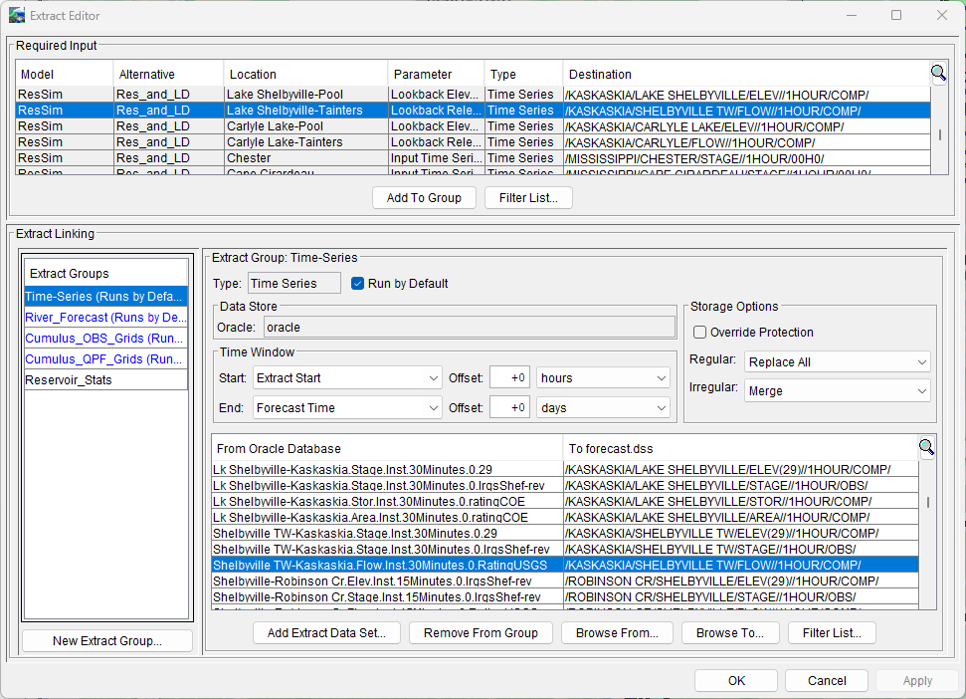
Configuring the Extract
Notes:
Integrating a ResSim Model into CWMS
Configuring the Extract
This slide is a screen shot of the Extract Editor
Focus on the ResSim “required inputs”: Lookback Data! And maybe operational info…
Discuss time step, time window, and data type.
Time series, grids
15 min data vs hourly or daily
Instantaneous versus period average
Explain how this affects which group a given record should be added to.
Interpolation
Extract Offsets

Slide 13
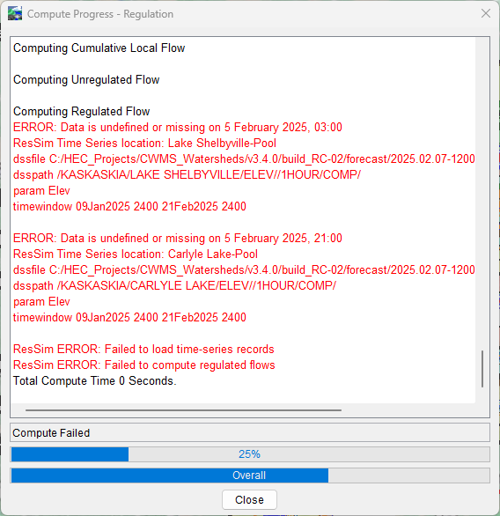
Compute
Progress Dialog
  Watch for messages
    Red Text are ERRORs
    Yellow/Orange Text are Warnings
    Black Text is informational
  Most Errors are caused by the input data
    Fill in missing data
    Link to a different data source
    Adjust the extract time window, add offset.
    Re-Run the Extract
Notes:
Integrating a ResSim Model into CWMS
Compute, Continued
Watch the Compute Progress Dialog. When Done (success or failure)…
Spend some time reading the messages in the Compute Progress Dialog
(usually) Red Text are ERRORs – a red message usually indicates a problem that halts the compute. The problem must be resolved before you can get a complete compute.
Yellow/Orange Text are Warnings - understand the warnings – these usually won’t stop the compute but your results may be questionable
Black Text is informational - become familiar with the messages, there’s important “progress” information in there
Look for more information generated by the compute in:
Message Box of the CAVI, Compute Log, Console Log, Model Server Log
Most Errors are caused by the input data
Analyze and Correct Any Errors
For Example “known release TS empty or invalid”
means: a time series record is empty, missing, or has “validity” flags raised. And…”known release”.. What’s that? A Lookback release? Or a local flow?
But look deeper… at the messages around the error messages.
See if you are being told which model element the TS is for.
Do you know where ResSim is in its compute process? (Init, cumloc, unreg, reg, holdouts?)
Is there a time window message or a date and time in the message?
If so, check the message’s time info against the compute time window in the control panel (and at the beginning of the Progress dialog’s ResSim messages) Use DSSVue to check if the time-series record exists in the forecast.dss file and if it does, check if there’s missing data.

Slide 14
Questions
Help additional Training
https://usace.dps.mil/sites/KMP-WM/SitePages/Corps-Water-Management-System-(CWMS).aspx
https://www.hec.usace.army.mil/confluence/cwmsdocs
https://discourse.hecdev.net/c/cwms/5
TDL-CELRH-EC-GW-W-USACE CWMS Modeling | General | Microsoft Teams

