Slide 1
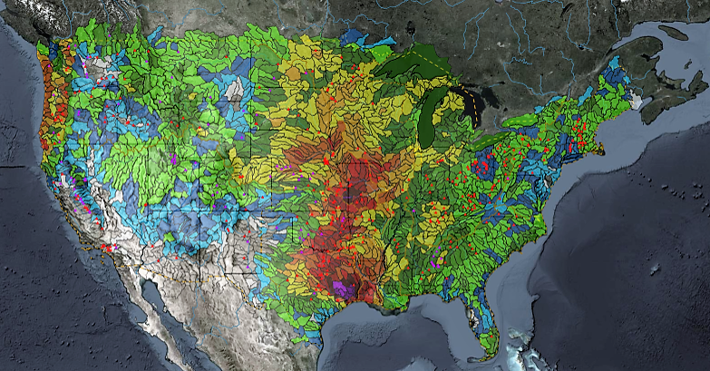
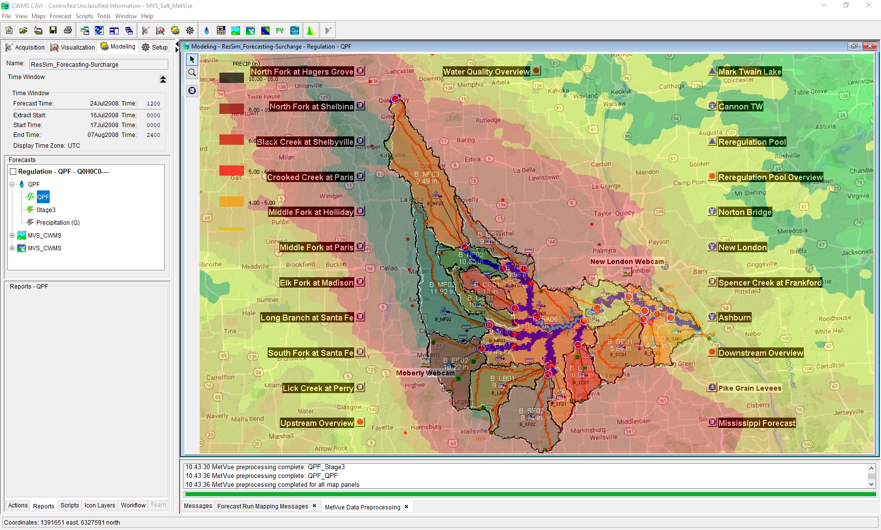

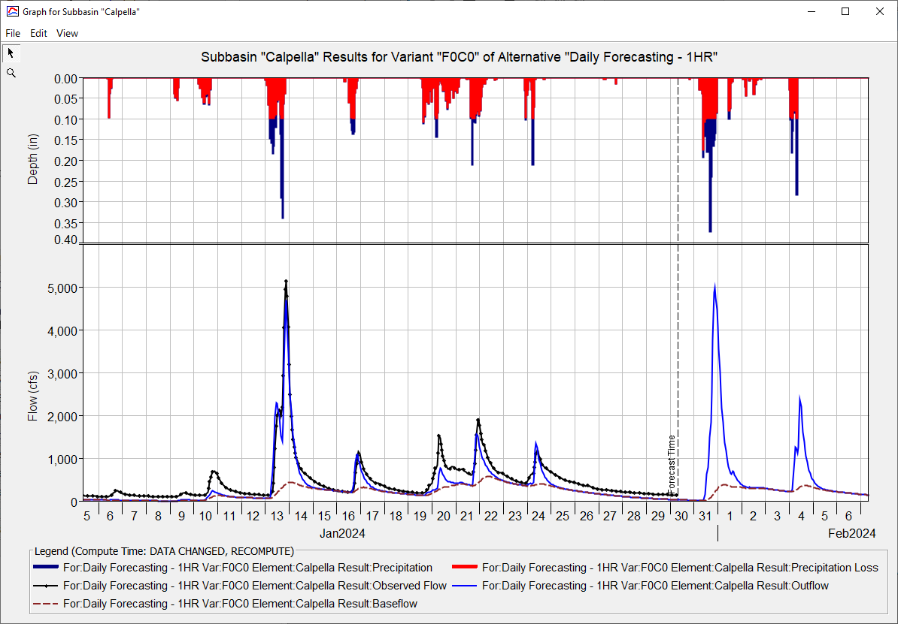
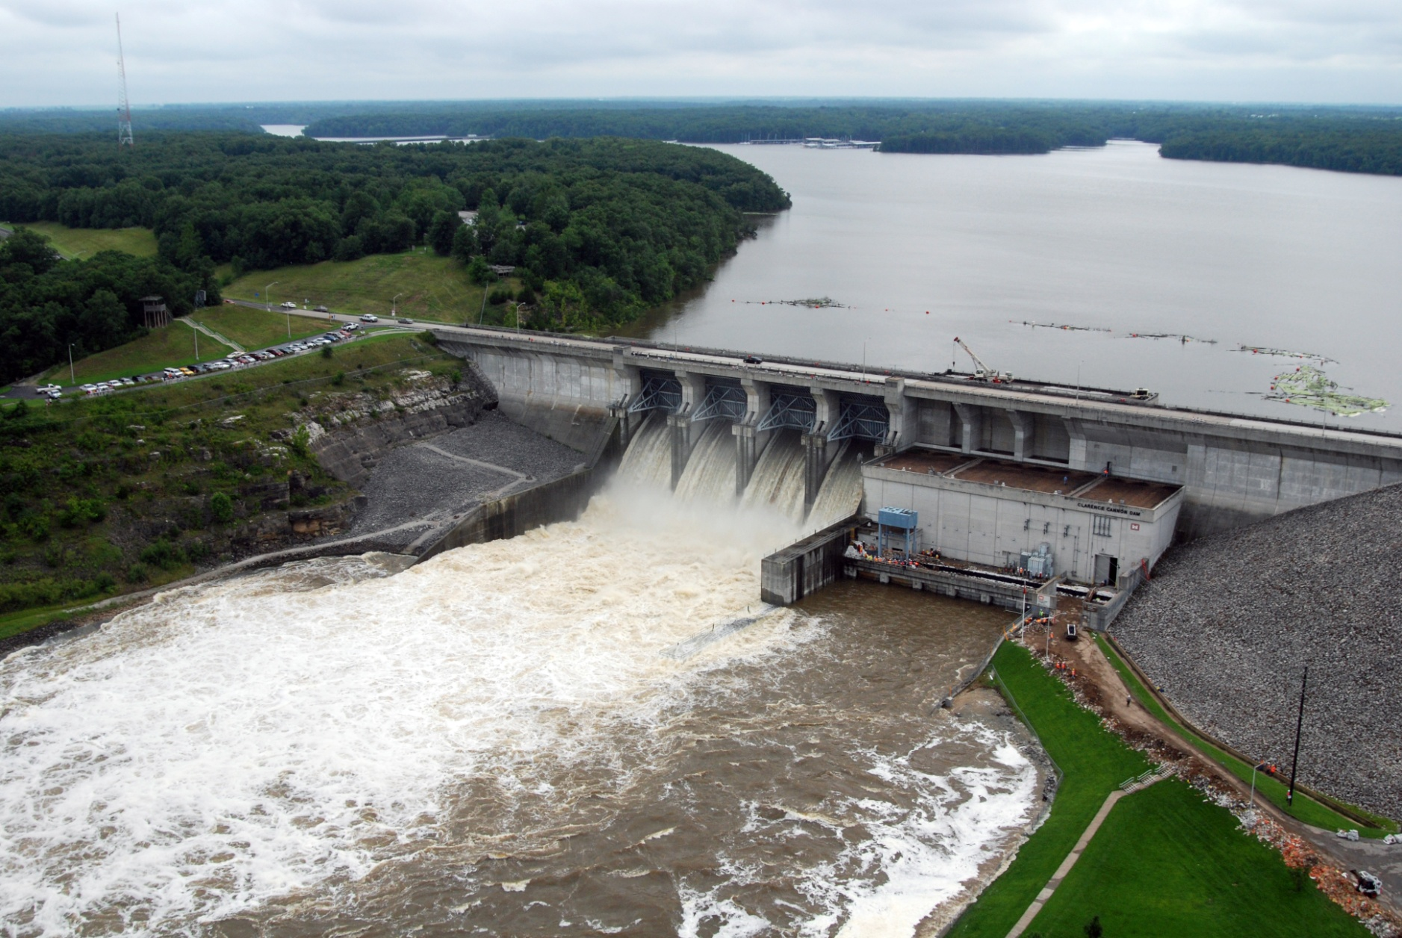
HEC-ResSim in CWMS
Russell Errett, P.E.
Hydrologic Engineering Center
CWMS Prospect Course

Slide 2
Overview
Learn basic concepts of using HEC-ResSim in CWMS for making real-time reservoir operation decisions
Introduction to HEC-ResSim
What is ResSim?
What can ResSim do?
Why do we want it in CWMS?
Integrating an HEC-ResSim model into CWMS
A brief review of importing, linking, etc.
Using HEC-ResSim for Real-Time Decision Making
Data Considerations
How real-time modeling differs from planning studies
Regulation Schedule/Plan
The OSI

Slide 3
Using HEC-ResSim for Real-Time Decision making

Slide 4
Real-Time Modeling Procedure
Review Data
Check status of the data streams and the basin’s gages
Familiarize yourself with current basin conditions and weather forecast
Review the current and forecasted precipitation (and snow?) grids
Identify an appropriate forecast time window – esp. lookback and forecast times
Notes:
ResSim for Real Time Decision Making
Real Time Modeling Procedure
Review Data
Check Status of the data streams and the basin’s gages
Familiarize yourself with Current Basin Conditions and Weather Forecast
Review the current and forecasted precip (and snow?) grids
Identify an appropriate forecast time window – esp lookback and forecast times

Slide 5
Real-Time Modeling Procedure
Review Current Data
Identify an appropriate forecast time window
Create a Forecast
Use the time window you identified
Include at least two Forecast Runs
No Future Precipitation
Expected (Probable) and/or Possible Future Precipitation
Add additional offsets to the Time Window, if needed
Compute all runs through HEC-ResSim
Notes:
ResSim for Real Time Decision Making
Real Time Modeling Procedure - continued
Review Data
Check Status of the data streams and the basin’s gages
Familiarize yourself with Current Basin Conditions and Weather Forecast
Review the current and forecasted precip (and snow?) grids
Identify an appropriate forecast time window – esp lookback and forecast times
Create a Forecast
Use the time window you identified
Include at least two Forecast Runs
No Future Precip
Expected (Probable) and/or Possible Future Precip
Add additional offsets to the Time Window, if needed
Compute all runs through ResSim

Slide 6
Real-Time Modeling Procedure
For each Forecast Run, Analyze the Reservoir Operations
Review Standard and Custom Plots, Reports, OSI
Make modifications to the HEC-ResSim model as needed to develop an appropriate Release Schedule
Release Overrides - OSI
Rule and/or Zone adjustments
Physical Parameter updates
Save to Base
If changes made are needed for future forecast runs
Rule and/or Zone adjustments
Physical Parameter updates
Notes:
ResSim for Real Time Decision Making
Real Time Modeling Procedure, continued.
For each Forecast Run, Analyze the Reservoir Operations
Review Standard and Custom Plots, Reports, OSI
Make modifications as needed to develop an appropriate Release Schedule
Release Overrides
Rule and/or Zone adjustments
Physical Parameter updates
Save – To – Base!
At this point, saving is selective – do I or don’t I?
Go over what gets saved for ResSim – Everything related to the Alternative ( including the overrides?)

Slide 7
Tools for Analyzing Results
Active Schematic
Standard Plots & the Release Decision Report
Element Specific
Found on context menu from schematic elements
Standard Reports
Summary Reports – by Element Type, Some Statistics
Found on the Reports tab when you’ve selected a HEC-ResSim alternative in the Forecast runs tree
CWMS-Vue/HEC-DSSVue
Access to more detailed ResSim output
Filter by F part…
Notes:
ResSim for Real Time Decision Making
Tools for Analyzing ResSim Results…
Active Schematic
Standard Plots & the Release Decision Report
Element Specific
Found on shortcut (right click) menu from schematic elements
Standard Reports
Summary Reports – Flows per Element Type, Some Statistics
Found on the Reports tab when you’ve selected a ResSim alternative in the Forecast runs tree
CWMSVue/DSSVue
Access to more detailed ResSim output
Filter by F part

Slide 8
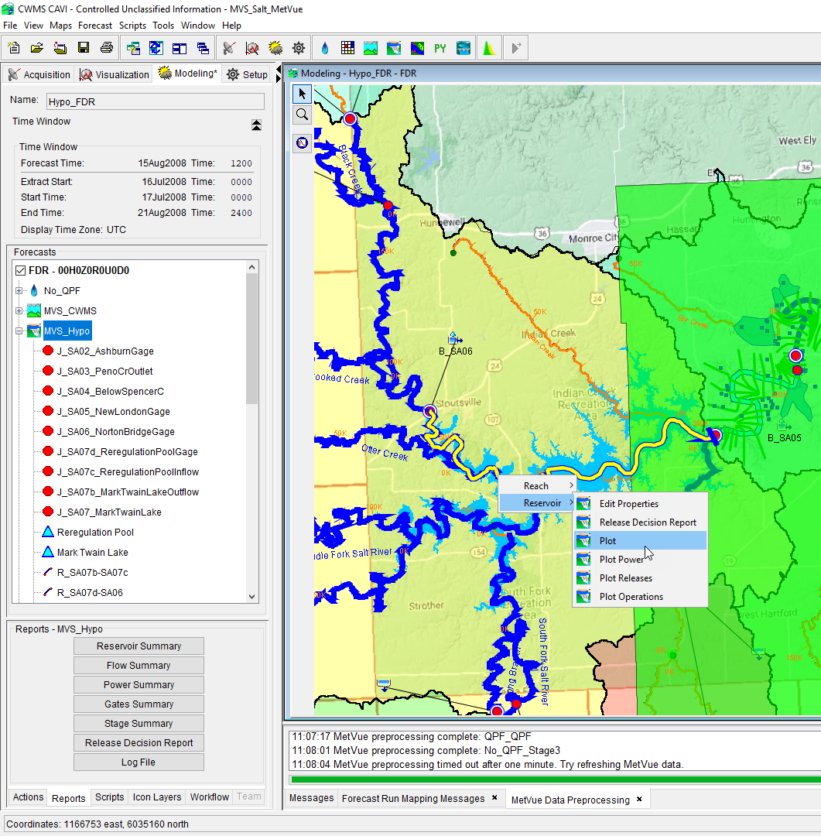
Viewing Results
Output is available from:
Forecast Run Alternative modeling tree
Reports Tab below modeling tree
From the modeling schematic in the CAVI Modeling map window
Opening the specific model from the standalone application
Or opening the forecast.dss file via CWMS-Vue and sorting the results based upon the model results F-Part
View Results

Slide 9
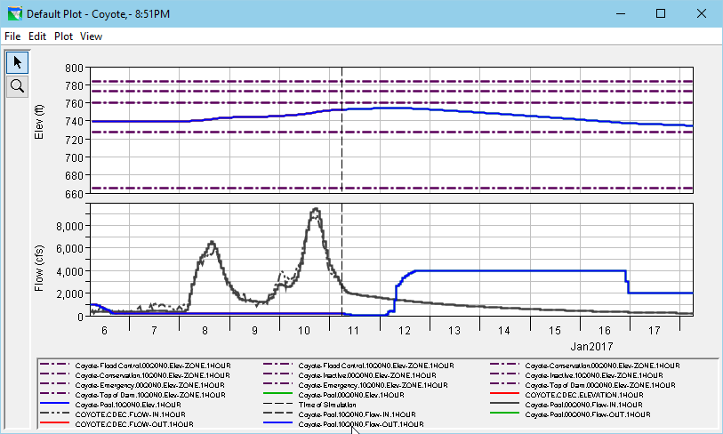
The Standard Reservoir Plot
Notes:
ResSim for Real Time Decision Making
The Standard Reservoir Plot
This slide is a screen shot of a standard Reservoir plot. Describe how the plot is arranged (and how to interpret it.)
In the upper viewport, the computed elevation of the selected reservoir and its operating zones are plotted
In the lower viewport, the computed inflow and outflow from the reservoir (pool) are plotted.
Other common option for reviewing results
tabulating from the default plots – File menu
customizing the plot – Edit and Plot menus
Remind them about the CWMS graphics lecture and workshop on Wednesday

Slide 10
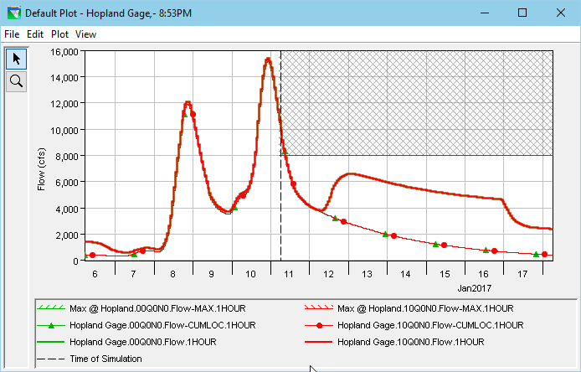
The Standard Junction Plot
Notes:
ResSim for Real Time Decision Making
The Standard Junction Plot
This slide is a screen shot of a standard Junction plot. Describe how the plot is arranged (and how to interpret it.) Point out how to read the plot, emphasize…
The Junction’s (out)Flow
Limiting Rules
Flow-Cumloc

Slide 11
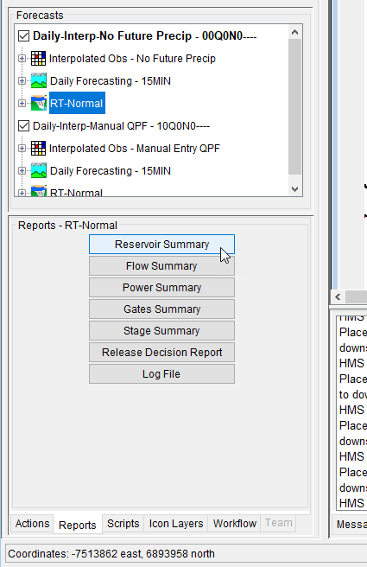
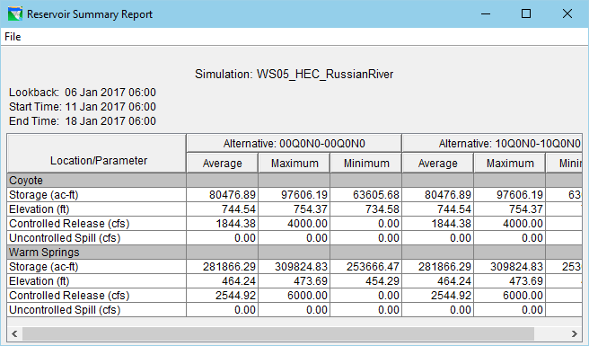
The Reports Tab
Notes:
ResSim for Real Time Decision Making
The Reports Tab
This slide is has two screen shots:
One of the Forecast Control Panel (run tree and subtabs, with the Reports Tab selected)
One of the Reservoir Summary Report
Point out the sub-tabs of the Forecast Control Panel
Explain that some are context sensitive to the selection in the Runs Tree
For ResSim, the Reports tab contains links to ResSim’s Summary Reports

Slide 12
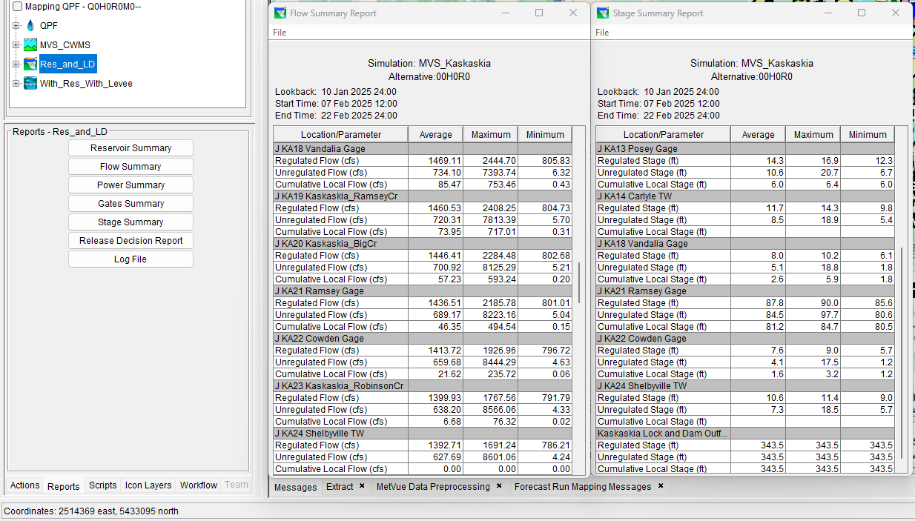
The Reports Tab
Summary Reports:
Reservoir Summary report is available for any network with a reservoir
Flow Summary report is available for any ResSim network
Power Summary report requires a hydropower house to be associated to a reservoir
Gates Summary Report is available if gates curves have been defined in the Physical Properties
Stage Summary report is available for junctions with stage-discharge rating curves defined
Notes:
ResSim for Real Time Decision Making
The Reports Tab
This slide is has two screen shots:
One of the Forecast Control Panel (run tree and subtabs, with the Reports Tab selected)
One of the Reservoir Summary Report
Point out the sub-tabs of the Forecast Control Panel
Explain that some are context sensitive to the selection in the Runs Tree
For ResSim, the Reports tab contains links to ResSim’s Summary Reports

Slide 13
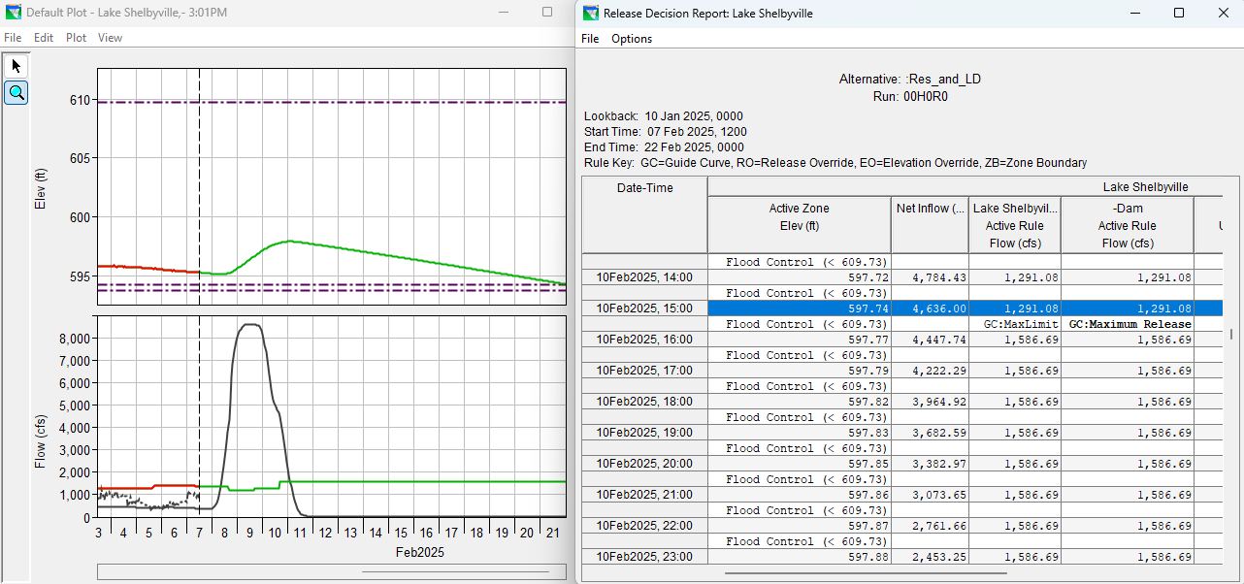
The Release Decision Report
Notes:
ResSim for Real Time Decision Making
The Release Decision Report is designed to tell you what led to the release decisions at each timestep.
This slide is a screen shot of the Release Decision Report. Describe how the report is arranged (and how to interpret it.)
The start of the report = time of forecast
The two lines/rows per timestep
One row for what it did
And one for why it did it
The columns for zone, elevation, and each level of the outlet hierarch
The bold vs std text – explain that bold text indicates a user specified rule
The codes – like GC to be Guide Curve Operation, MinLim, PhysMaxCap

Slide 14
Questions Help additional Training
https://usace.dps.mil/sites/KMP-WM/SitePages/Corps-Water-Management-System-(CWMS).aspx
https://www.hec.usace.army.mil/confluence/cwmsdocs
https://discourse.hecdev.net/c/cwms/5
TDL-CELRH-EC-GW-W-USACE CWMS Modeling | General | Microsoft Teams

