Slide 1
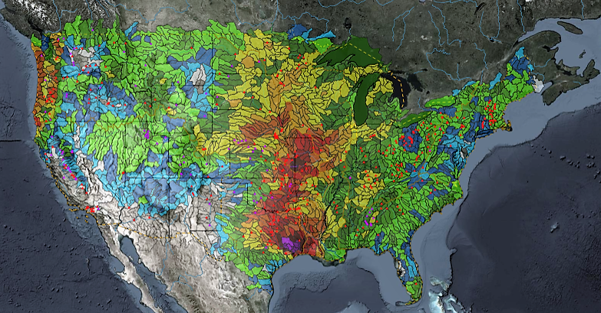
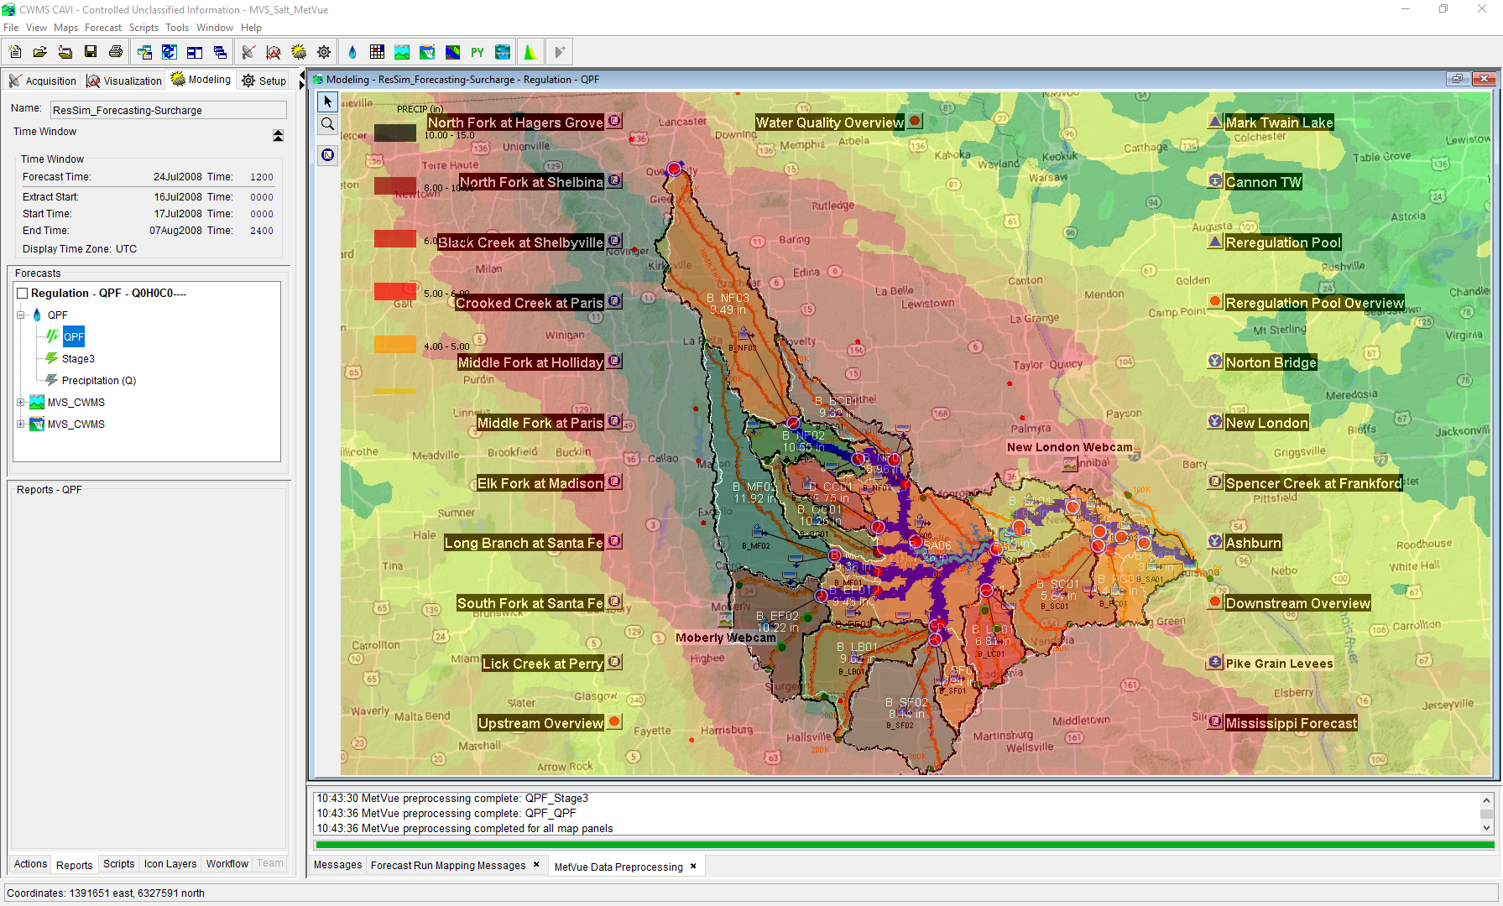

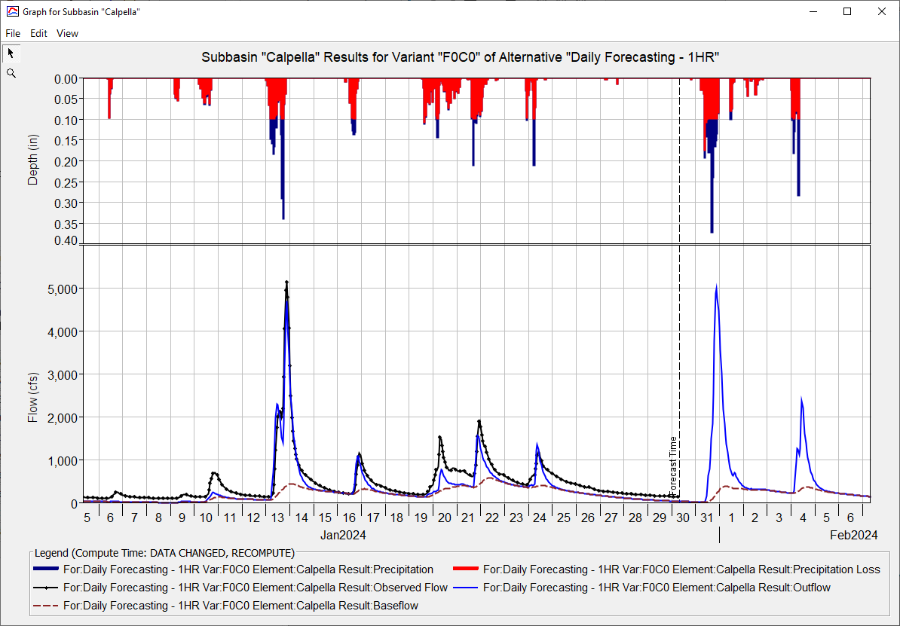
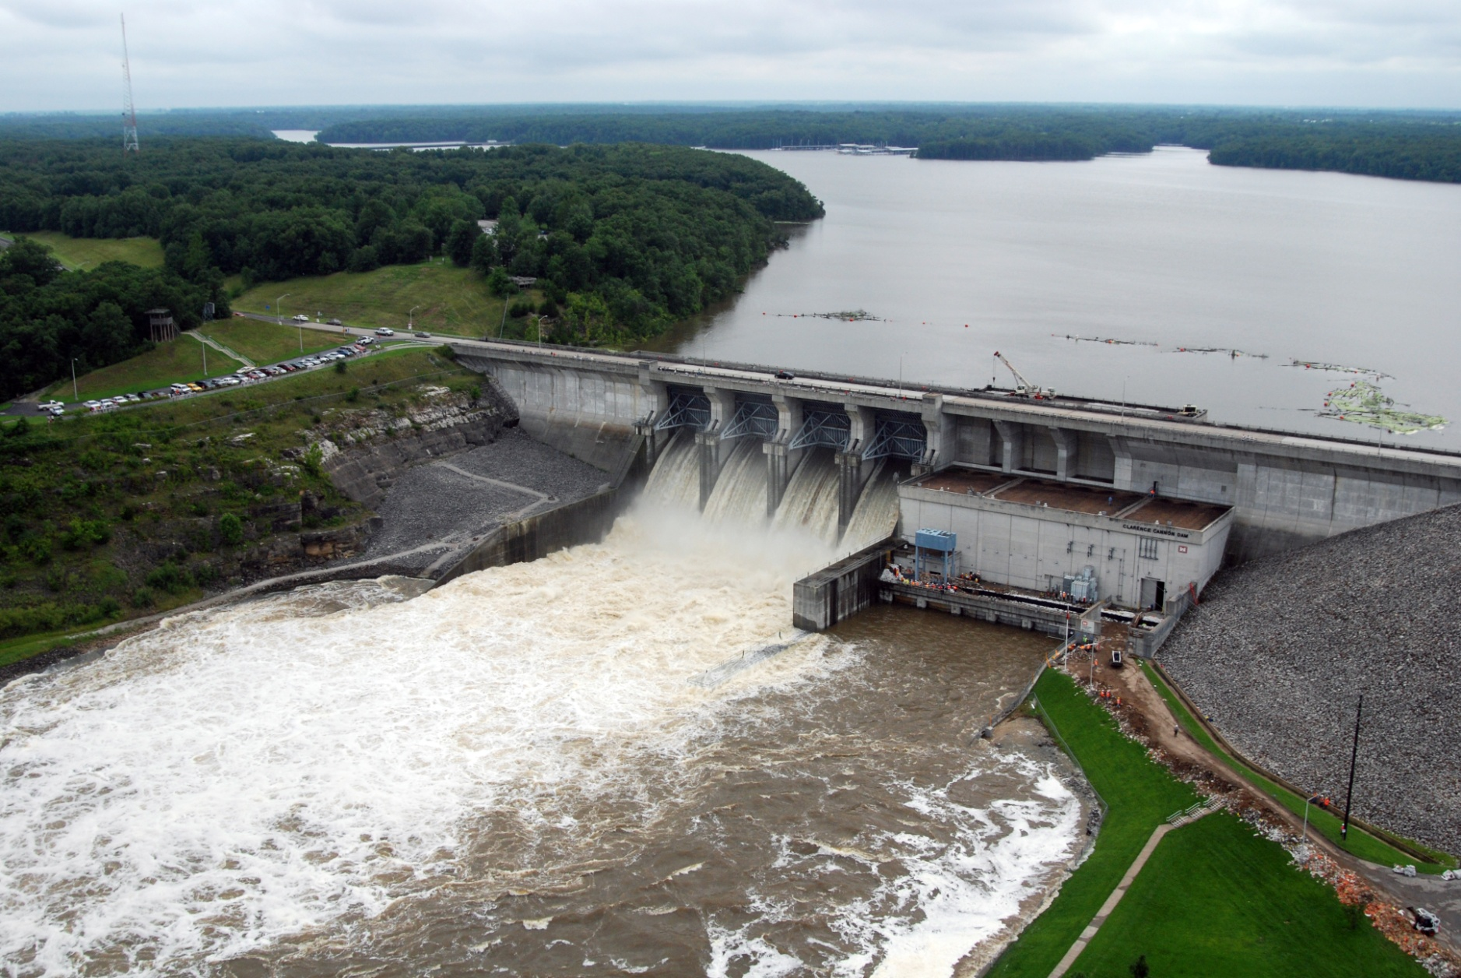
HEC-ResSim in CWMS
Russell Errett, P.E.
Hydrologic Engineering Center
CWMS Prospect Course

Slide 2
Overview
  Learn basic concepts of using HEC-ResSim in CWMS for making real-time reservoir operation decisions
  Introduction to HEC-ResSim
    What is ResSim?
    What can ResSim do?
    Why do we want it in CWMS?
  Integrating an HEC-ResSim model into CWMS
    A brief review of importing, linking, etc.
  Using HEC-ResSim for Real-Time Decision Making
    Data Considerations
    How real-time modeling differs from planning studies
    Regulation Schedule/Plan
    The OSI

Slide 3
Release Overrides

Slide 4
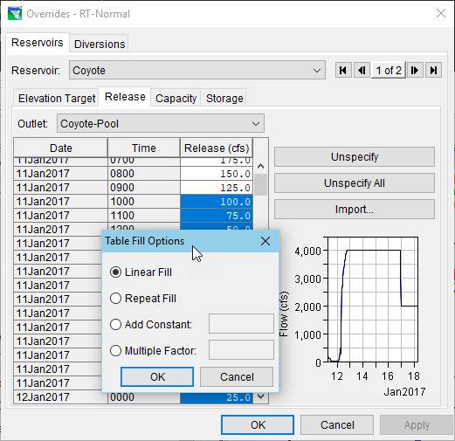
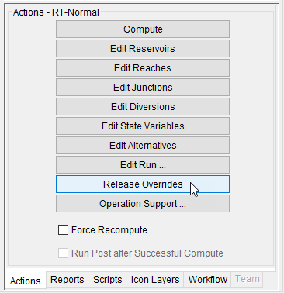
Release Overrides
Notes:
ResSim for Real Time Decision Making
This slide contains a screen shot of the CAVI’s Actions tab and another of the ResSim Overrides Editor.
Release Overrides allow the user to specify an exact operation constrained only by physical capacity (I.e., the rules, zones, and guide curve are ignored for the time step at which you have specified the overrides)
Why override the Releases?
Mimic gate settings
Evaluate influence of a NOT by the book release schedule
The rules “aren’t cutting it”.
Trials vs Alternatives –
Acknowledge that CWMS 3.0 cannot do trials
Suggest possibility of a “base” alternative, and one or more to tinker with
Process of defining overrides
COMPUTE (if you haven’t already)
Hand enter new values
Enter value in selected cell, select range, fill-repeat
Enter value in first and last cell of a range, fill-linear
Use a Fill-Factor or Fill–add Constant option for a range
Ok & RECOMPUTE

Slide 5
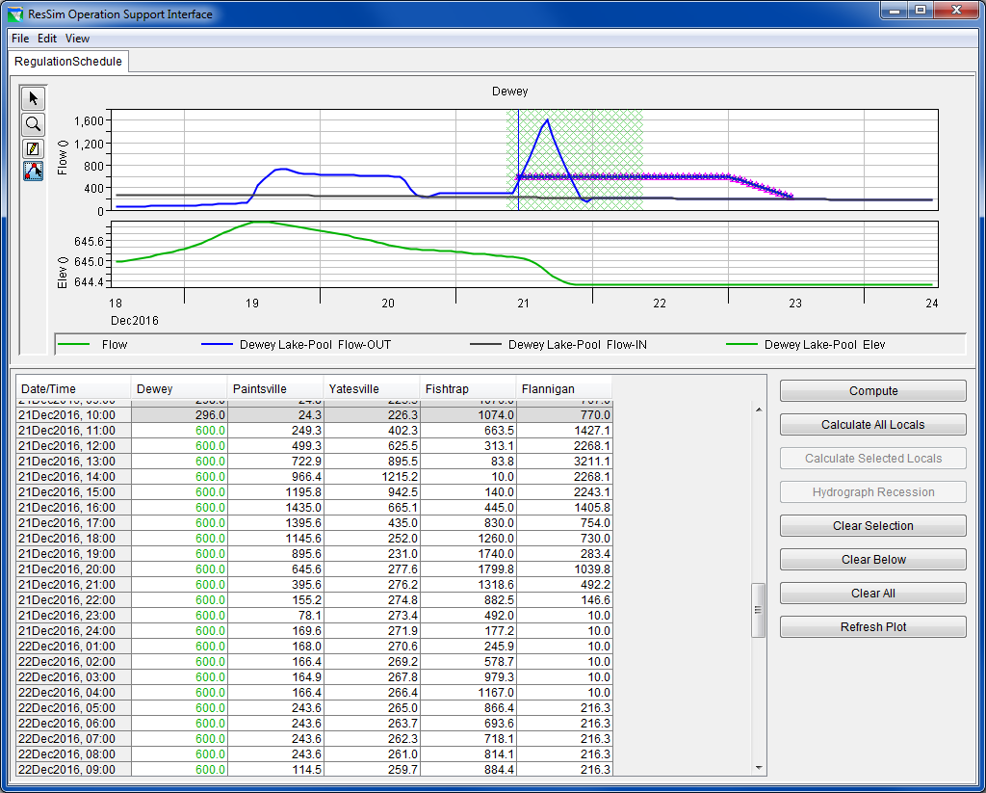
Operations Support Interface (OSI)
Notes:
ResSim for Real Time Decision Making
Operations Support Interface (OSI)
This slide shows a screen shot a fully setup OSI…
The OSI is a fully configurable interface for building your own Release Overrides Editor – It is more like a ‘dashboard’ for defining your regulation schedule.
Select the ResSim alternative in a Forecast. Launch the OSI from the Action buttons.
If the OSI is blank, add a Tab from the Edit menu
Add a Variable – this is the “variable” you are overriding, like a Reservoir Release.
Give it a Name and Description, and Set the Element Type - Reservoir
Select the Element and Select the Variable (Type) – Release, Press OK
Click on a value in the column that was added for your variable in the OSI’s table. Notice what happens to the plot in the upper part of the OSI
Edit your Variable
Add Additional relevant Time Series to be displayed in plot
Add a Max Target for your Variable.
Press OK. Click to another variable’s column and then back to this one or Click Refresh Plot. Notice what happens to the plot.
Enter an override of a reservoir release
Use the graphical editing tool (the 4th one) and draw in your override or enter the override values in the table. (You end drawing by right-clicking on your last point)
Press Compute to see the results of the overrides you entered
Consider adding a second tab to show the elevation (and stage) at key control points in the watershed.
A separate handout is available that covers these steps. Hand it out or go over it if you can’t do a demo.

Slide 6
OSI – Operations Support Interface
  Configured by the User
  Intended for:
    Developing Overrides
  Tabs are for organizing variables
  Variables are for editing or displaying data
    Reservoir Overrides
    Computed Results

Slide 7
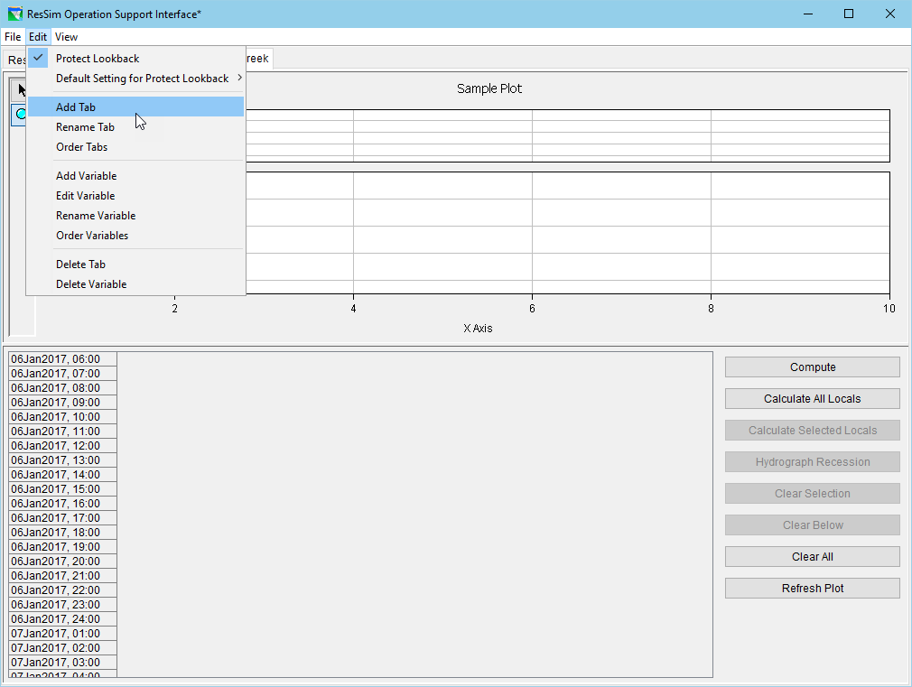
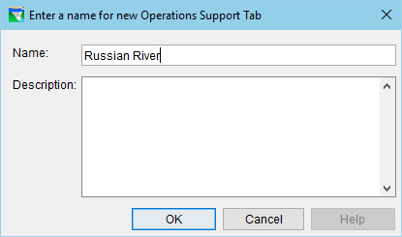
OSI – Adding a Tab

Slide 8
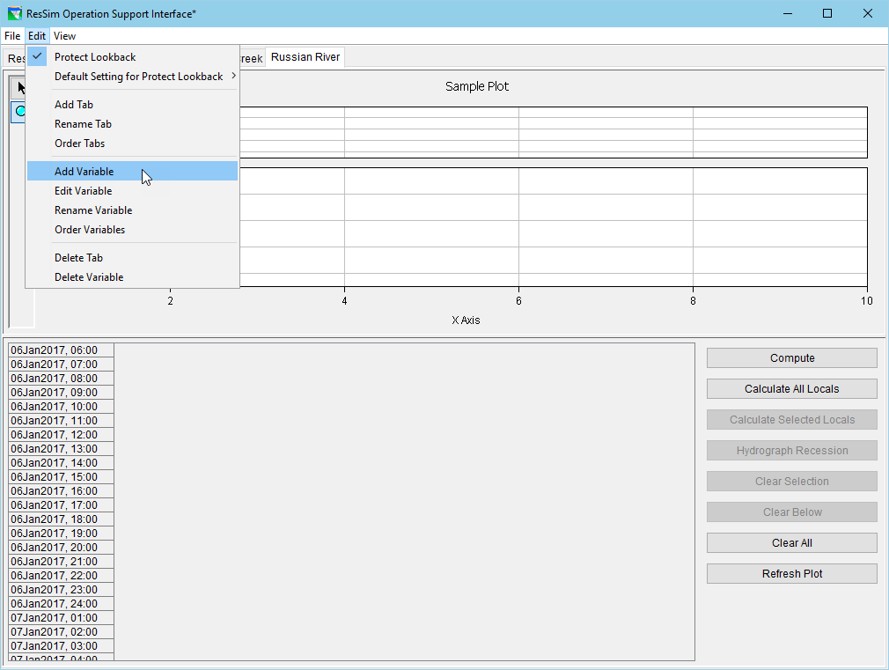
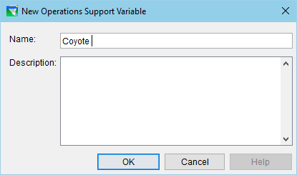
OSI – Adding a Variable

Slide 9
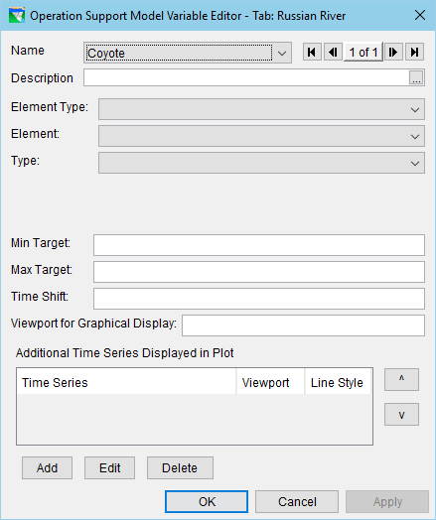
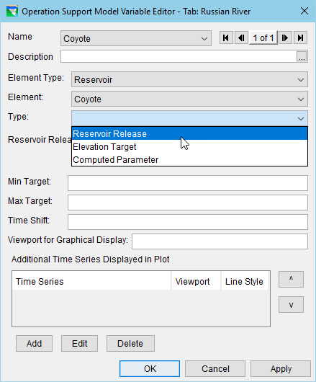
OSI – Setting up the Variable

Slide 10
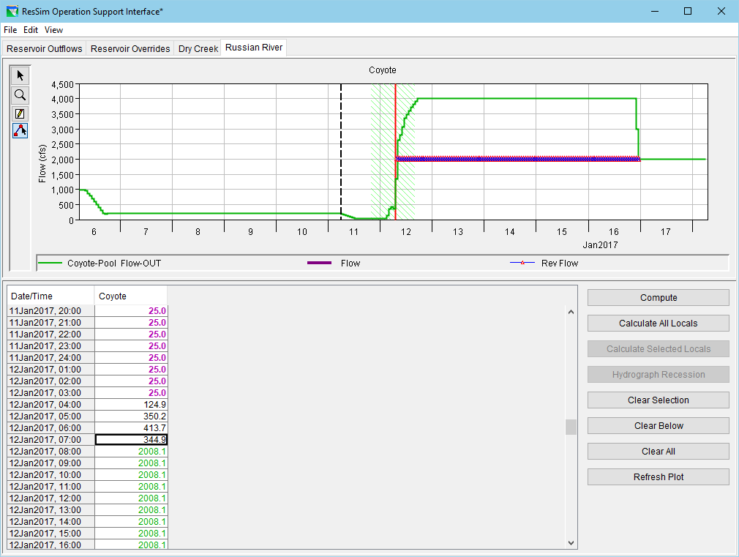
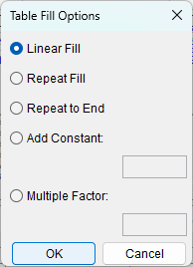
OSI – Entering Overrides

Slide 11
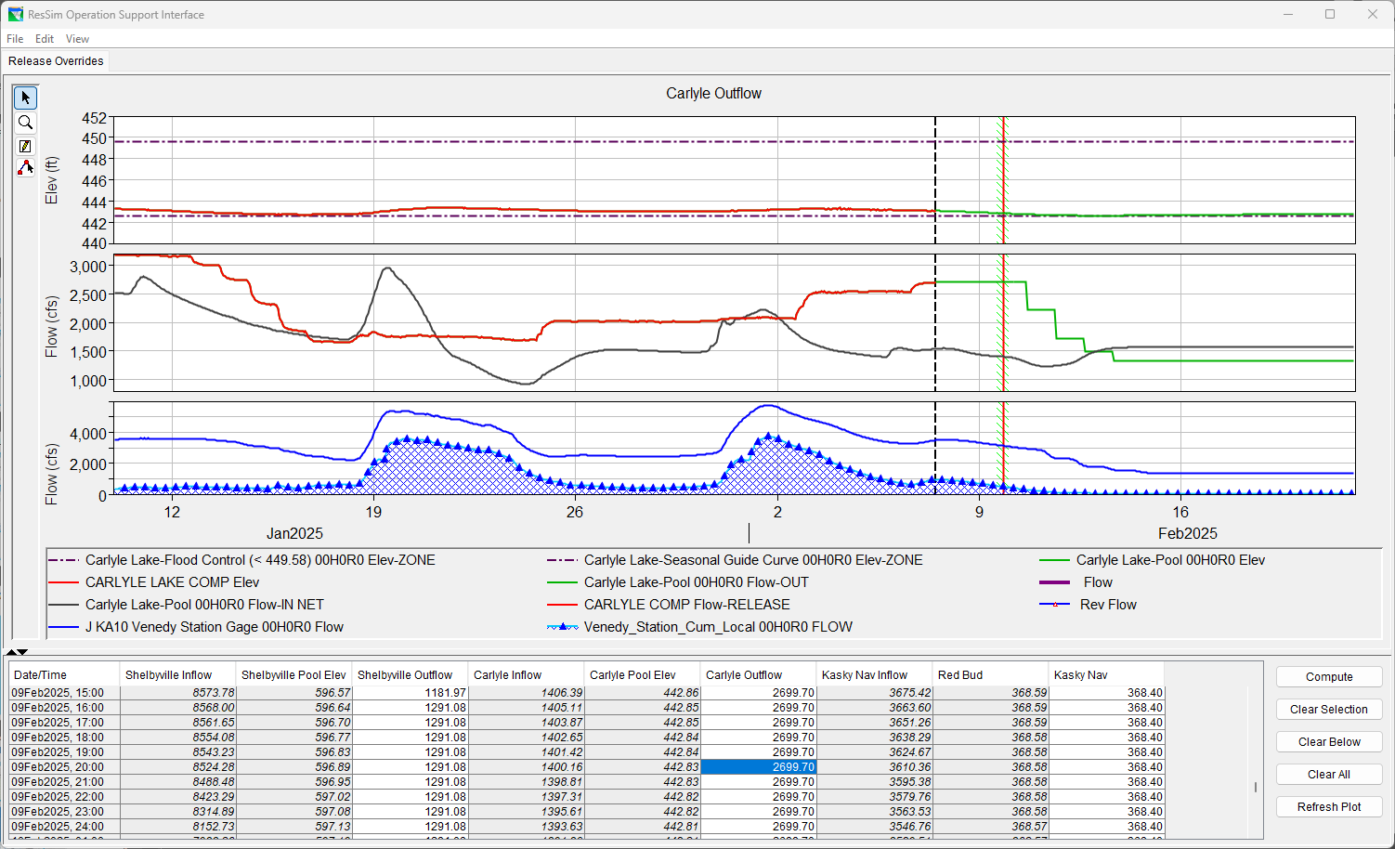
OSI – Configuration Examples

Slide 12
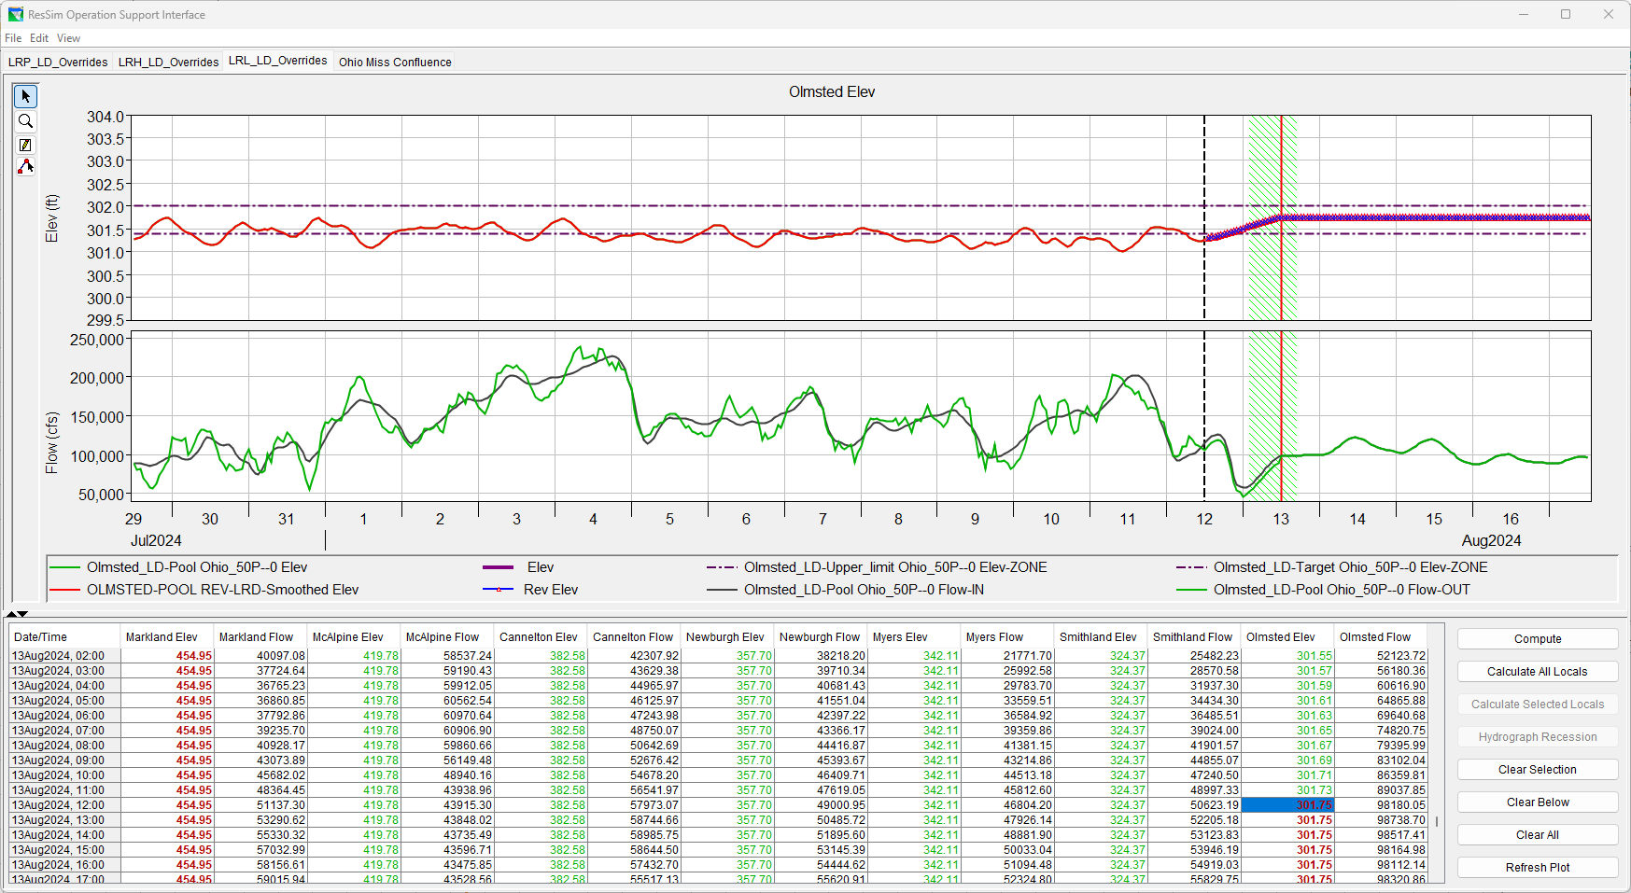
OSI – Configuration Examples

Slide 13
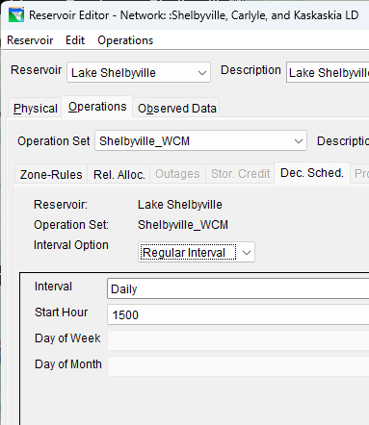
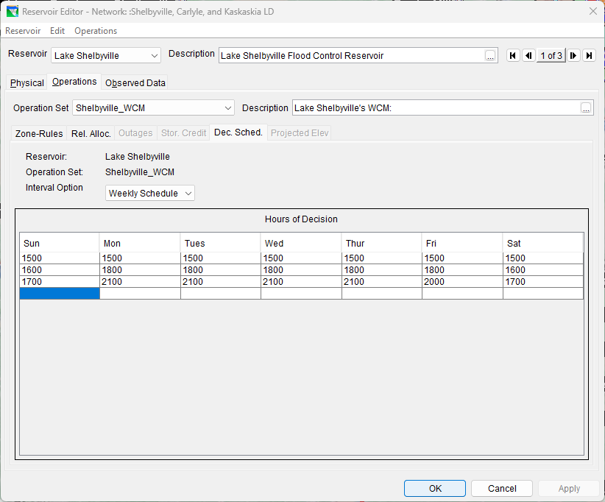
Capabilities & Limitations
Gates & Gate Operations
  Time Series of Gate Openings (with gate curves)
  Flows are what the program wants to be at the end of the timestep, not some reasonable gate setting for an ordered gate usage
Time Step
  Decision Interval
    Each Time-Step (default)
    Regular Interval
      1hr, 6hr, Daily, etc.
    Weekly Schedule
      Set the times of day based
        upon the day of week
        when changes can occur
Notes:
ResSim Capabilities & Limitations
Gates & Gate Operations
Time Series of Gate Openings (with gate curves)
Flows are what the program wants to be at at the end of the timestep, not some reasonable gate setting for an ordered gate usage
Time Step
New Decision each Time-Step
Decision Interval, limited…
Others?

Slide 14
Summary
  HEC-ResSim is the integrated reservoir simulation model included in the CAVI’s suite of real-time decision support tools.
  HEC-ResSim Model Integration includes…
    Revising the ResSim Alternatives’ Lookback settings
    Establishing the model linking to HMS results and observed data
    Configuring the Extract groups
  Using HEC-ResSim for Real-time Decision Support involves…
    Analyzing the model’s releases
    Performing “What-if” analysis
    Developing a realistic release schedule
    Testing and revising your schedule
Notes:
Summary
ResSim is the integrated reservoir simulation model included in the CAVI’s suite of real-time decision support tools.
ResSim Model Integration includes…
Revising the ResSim Alternatives’ Lookback settings
Establishing the model linking to HMS results and observed data
Configuring the Extract groups
Using ResSim for Real-time Decision Support involves…
Analyzing the model’s releases
Performing “What-if” analysis
Developing a realistic release schedule
Testing and revising your schedule

Slide 15
Questions
Help additional Training
https://usace.dps.mil/sites/KMP-WM/SitePages/Corps-Water-Management-System-(CWMS).aspx
https://www.hec.usace.army.mil/confluence/cwmsdocs
https://discourse.hecdev.net/c/cwms/5
TDL-CELRH-EC-GW-W-USACE CWMS Modeling | General | Microsoft Teams

