Slide 1
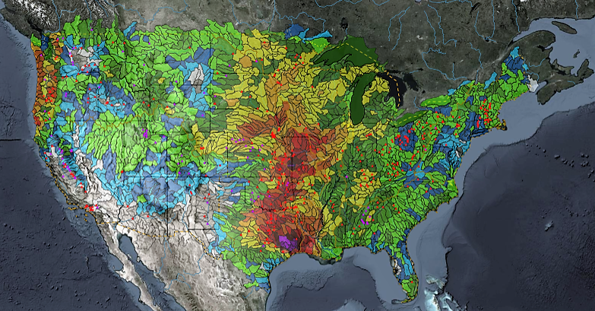
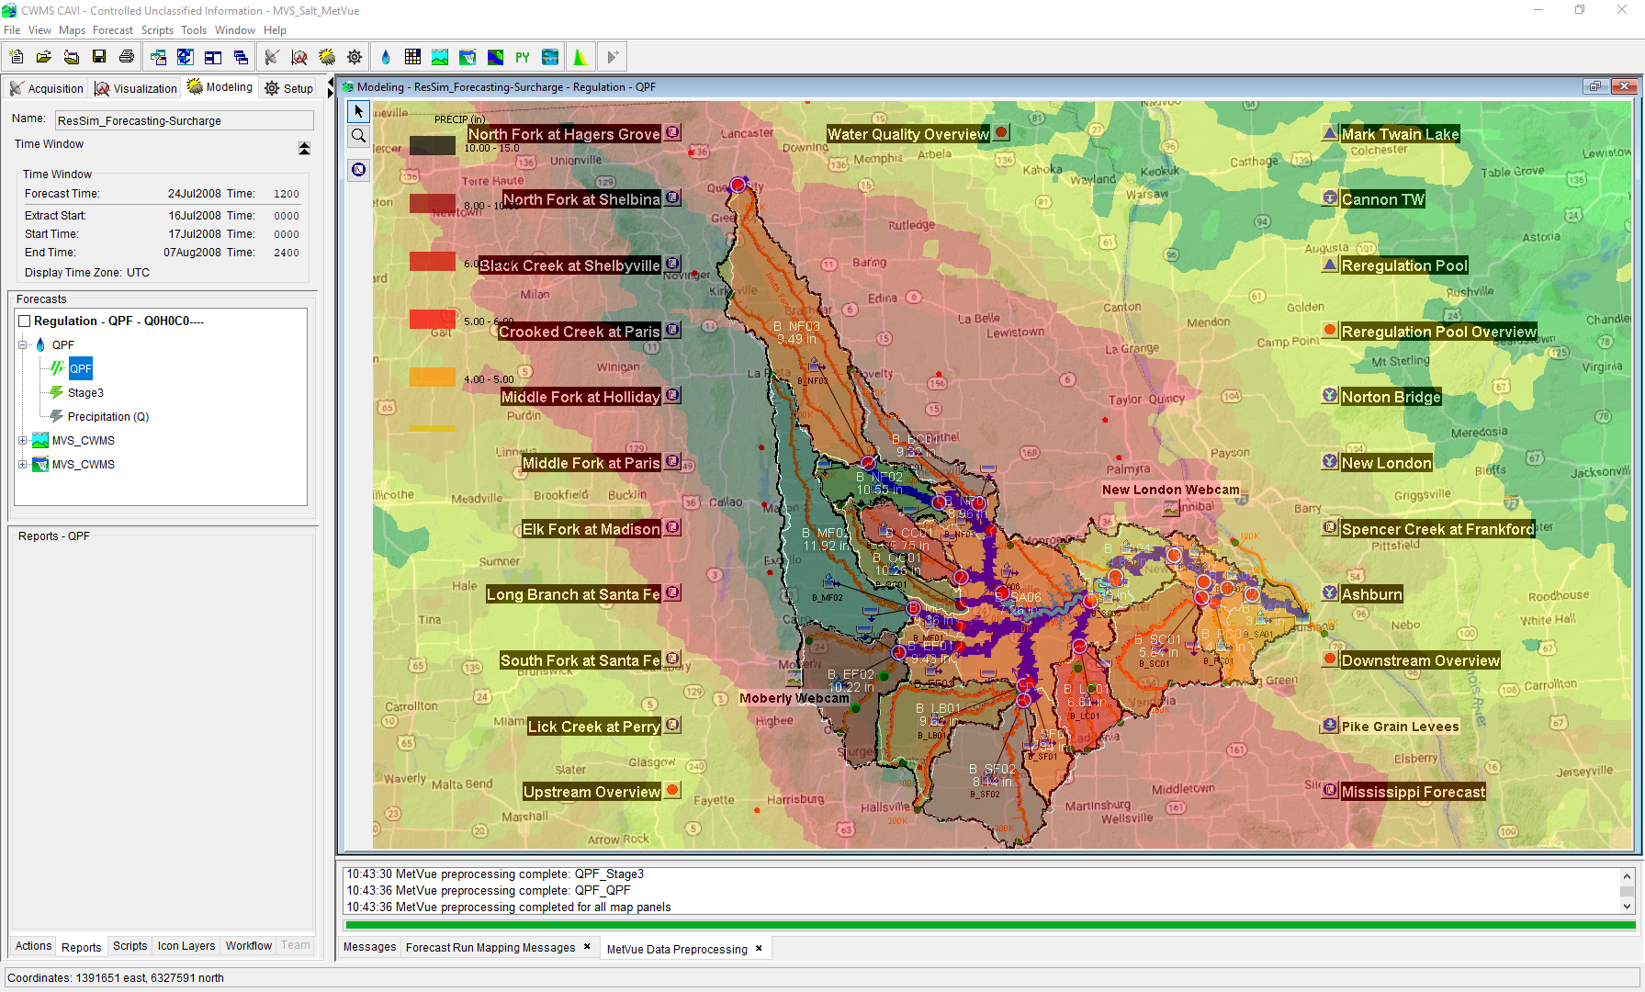

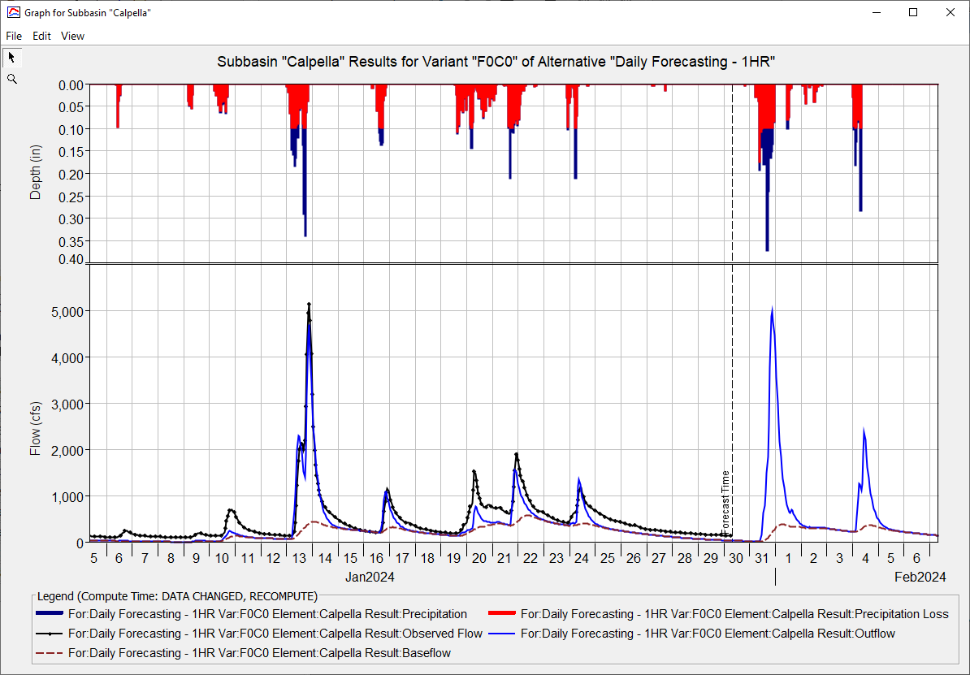
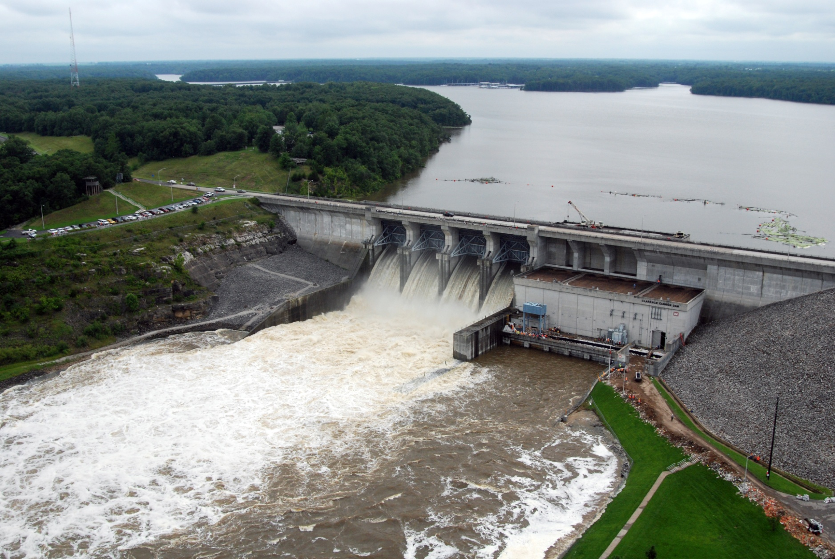
Russian River Watershed Overview
Kat Feingold
Hydrologic Engineering Center
CWMS Prospect Course

Slide 2
Outline
Russian River Watershed Review
Geography, Land Use, Hydraulic Structures
Russian River Climatology
Typical Climate, Flood and Drought Histories
Flood prone locations
Russian River Real-Time Data Sources

Slide 3
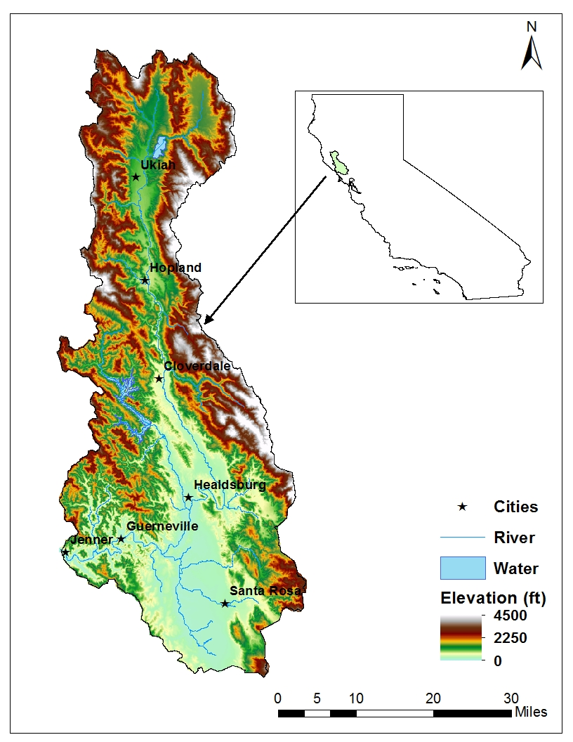
Geography
North Coast of CA
Mendocino Range to the west, Mayacamas Mtns. to the east
Area: 1,485 mi²
~100 mi. long,
12-32 miles wide
Multiple Tributaries
Big Sulphur Creek, Maacama Creek, Dry Creek, Matanzas Creek, Santa Rosa Creek, Mark West Creek, Laguna de Santa Rosa, Austin Creek
Notes:
The river starts as two forks (East and West) in the north, which join just downstream of Lake Mendocino. The river runs directly south for most of its course, before heading west to the coast before it reaches Santa Rosa. Major tributaries are listed from north to south.
Major cities include (from largest to smallest): Santa Rosa, Rohnert Park, Windsor, Ukiah, Healdsburg, Cloverdale, Guerneville.

Slide 4
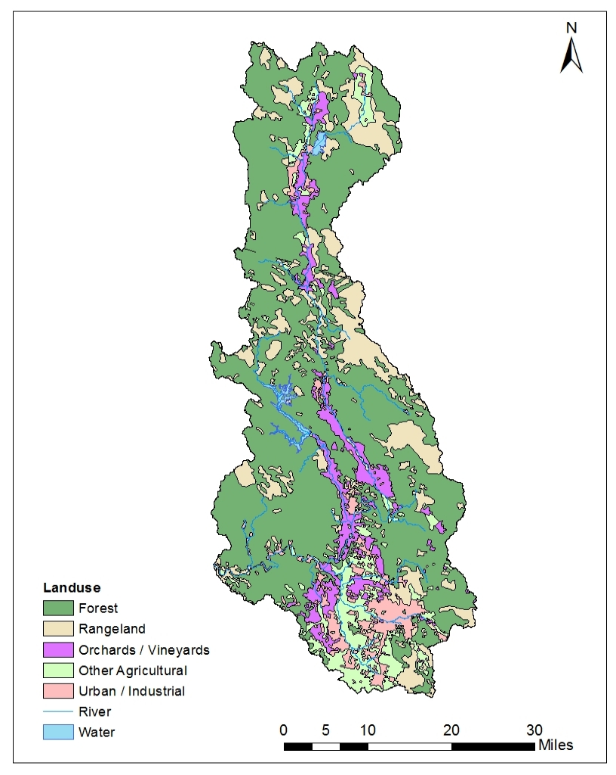
Land Use
Predominantly forested, especially in northern areas
Agricultural and rangeland located in valley and plains
Majority of urban population centered in southern end
Notes:
Economic output is predominately agriculture, including (from highest to lowest) wine grapes, pears, apples, field crops, sheep, cattle, and poultry. The population in the watershed has grown from around 65,000 in 1950 to over 400,000 people today.

Slide 5
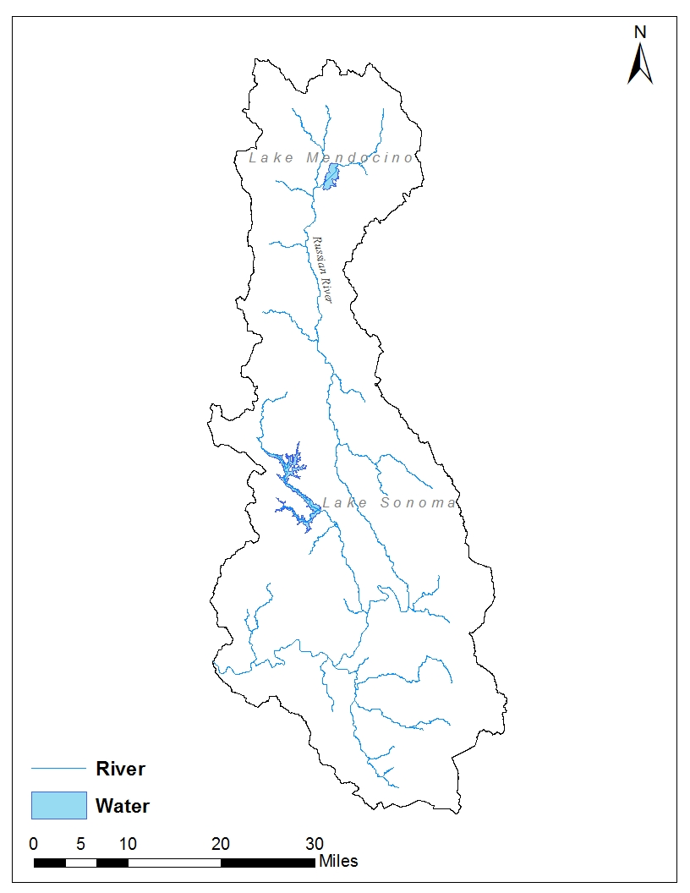
Major Dams & Diversions
Lake Mendocino
Coyote Valley Dam
Lake Sonoma
Warm Springs Dam
Potter Valley Project
SCWA Infiltration Ponds
Notes:
Lake Mendocino is located on the East Fork of the Russian River, just upstream of the confluence with the West Fork. The Dam is a 160’ tall, 3,500’ long earthfill dam, and began operation in January 1959. The gross pool storage is 122,400 acre-feet, although about 50,000 acre-feet of storage is maintained for flood control during the winter months. The dam is operated for flood control, water supply, irrigation, hydropower, and recreation. It has only spilled once since its construction, during the December 1964 storm.
Lake Sonoma is located at the confluence of Warm Springs Creek and Dry Creek, 14 miles above Dry Creek’s confluence with the Russian River. Construction of Warm Springs Dam began in 1970, but was not completed until October 1982. The dam is a 319’ tall, 3,000’ long rolled earth embankment and The gross pool storage is 381,000 acre-ft. The dam is operated for flood control, water supply, and recreation. It has never spilled.
Flows in the East Fork of the Russian River are supplemented by the Potter Valley project, an interbasin water transfer from the main stem of the Eel River. Historically, the Potter Valley project has supplied about 159,000 acre-ft annually to the Russian River watershed. However, recent FERC relicensing of the Eel River dams has required more flow to remain in the Eel, thus reducing the average diversion to 90,000 acre-ft (http://www.pottervalleywater.org/index.html). Furthermore, increased precipitation variability from climate change will likely further reduce the annual reliable yield.
Sonoma County Water Agency operates a temporary inflatable dam on the river near Windsor. This is primarily used as part of groundwater recharge project. An additional temporary dam is erected on the river near Guerneville during the summer for recreation purposes.

Slide 6
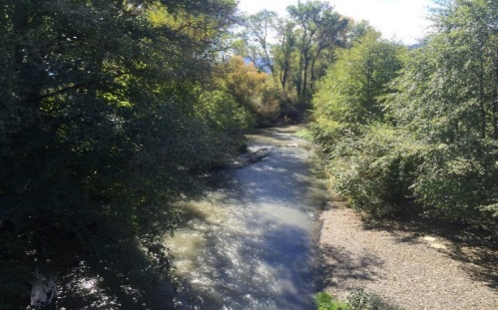
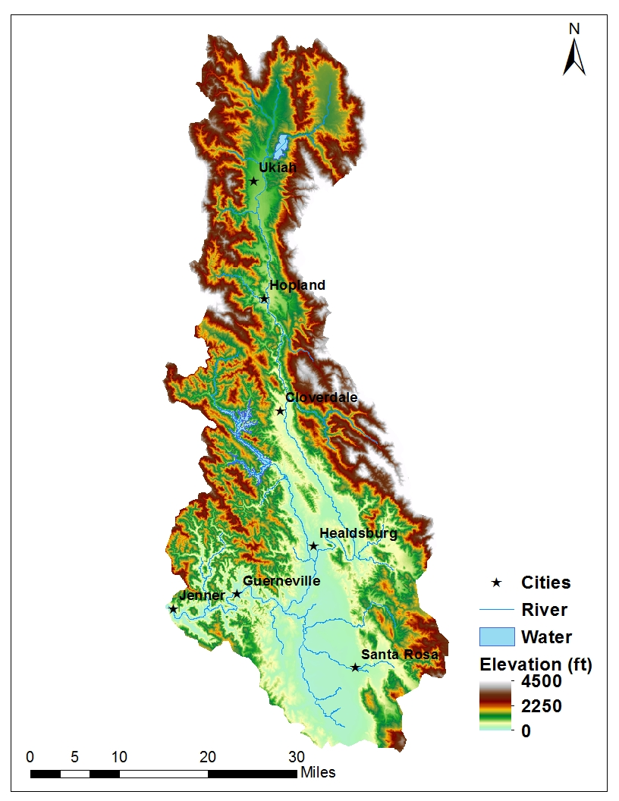
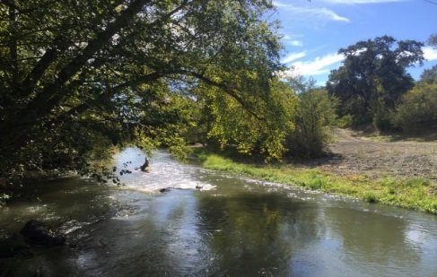
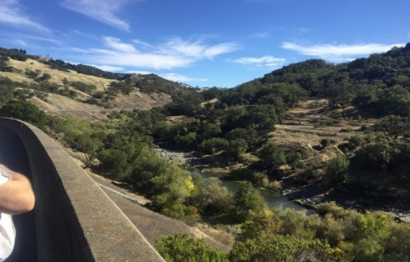
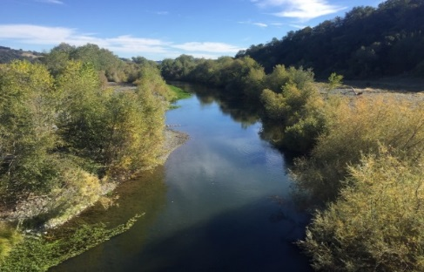
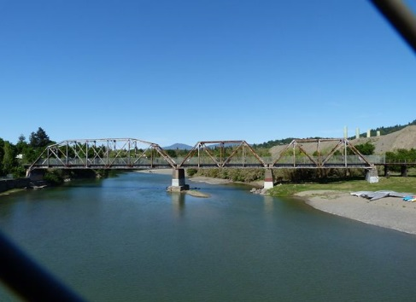
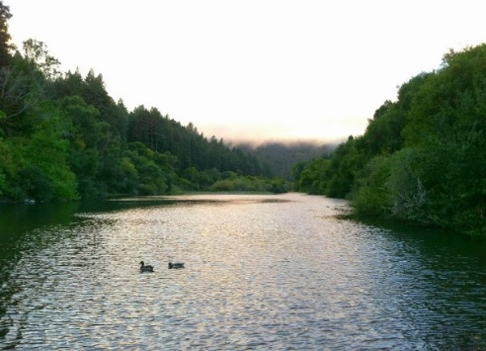
Channel Description
Near Ukiah
Near Hopland
South of Hopland
Near Cloverdale
Near Monte Rio / Guerneville
Near Healdsburg
Notes:
Channel capacities in the broad valleys of the watershed are relatively low and prone to some flooding, but increase in the deeper canyon areas. Bankfull capacities in the Ukiah Valley are about 7,000 cfs, 8,000 cfs in the Hopland Valley, 10,000 cfs in the Alexander Valley (Cloverdale-Healdsburg), 20,000 cfs near and south of Healdsburg, and 35,000 cfs near Guerneville.
The Russian River through the Ukiah area is very uniform. Channel bed slopes are on the order of 7 to 8 ft/mi, with average channel bottom widths around 100 feet and top widths in the range of 150 to 250 feet. The channel bed material is sand and gravel. Main channel banks are heavily vegetated with trees, brush, and weeds. The channel overbank areas are mostly farmland and very flat laterally, with a width about 2 miles wide.
Below Hopland the river enters a canyon and the floodplain constricts, to less than 500 feet in some areas. The channel bed slope is much steeper in this area, around 25 ft/mi. Channel bottom widths range from 60 to 100 feet, with top widths varying from 100 to 200 feet. The channel bed is comprised mostly of gravel and some sand. In some areas, the bed is comprised of very large gravel and boulders. In most areas the channel banks still have thick groves of trees and brush, while some areas the banks are lined with large rocks.
The channel and floodplain opens up again near Cloverdale, with topography similar to the Ukiah area, albeit with a slightly wider channel and floodplain. There is a long and sinuous canyon area above the town of Healdsburg, where channel slopes steepen to 8 to 10 ft/mi. Channel widths are narrower, and the floodplain consists of steep mountainous banks, with a few small open areas of farmland.
Well below Healdsburg the floodplain again narrows. The channel becomes much deeper in this region of the watershed. Overbank areas are very short and steep, comprised mostly of thick trees. Along this region there are several small towns, including Forestville, Guerneville, and Monte Rio. Channel slopes are in the 1 to 2 ft/mi range. The channel ends at the Pacific Ocean, near the town of Jenner. Channel bottom widths range from 300 to 800 feet, with top widths up to 1500 feet. The channel is sandy material on the bottom, with some open areas and trees along the banks.
All photos by Wesley Walker, except the river near Healdsburg (http://historicbridges.org/bridges/browser/photos.php?bridgebrowser=california/healdsburgrr/&gallerynum=2&gallerysize=2) and Monte Rio (David R. Millar, http://www.millarandcompany.com/community/area/Monte+Rio/)

Slide 7
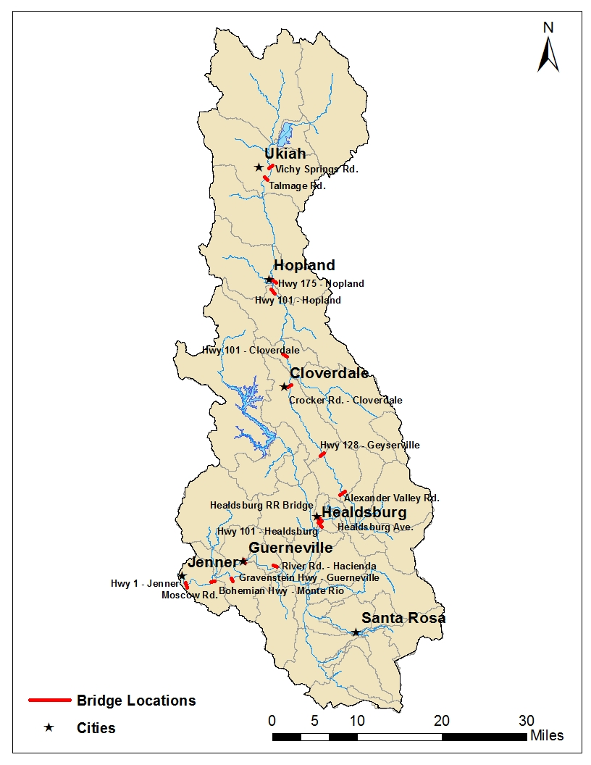
Bridge Locations
18 Permanent Bridges on main stem
Located largely near large towns / cities
Severe floods can overtop bridges, especially near Hopland & Guerneville

Slide 8
Climate
90% of precipitation and runoff occurs between November and April
Annual totals can range significantly from year to year
50”+ in the mountainous regions
38” at Lake Mendocino
30” in Santa Rosa
No significant snowpack
Typical of CA climatology: droughts and floods
Major Floods: Dec. 1955, Dec. 1964, Feb. 1986, Jan. 1995, Jan. 1997, Dec. 2005
Major Droughts: 1928-34,1959-60,1976-77, 1987-1992, 2007-2009, 2012-2015
Notes:
Flood producing storms occur in the winter and are typically the result of the southerly migration of the Aleutian lower pressure systems or atmospheric river events. Rainfall is often enhanced by orographic effects of the Coast Range and frontal convergence lifting mechanisms.
Forecast Informed Reservoir Operations (FIRO) is a multi-agency study (Scripps, NOAA, USACE, SCWA, USGS, DWR, BoR, NWS) being completed to determine the viability of adjusting the Water Control Manual to improve flood-control and water supply operations. FIRO envisions modern observation and prediction technology that could provide water managers more lead time to selectively retain or release water from reservoirs based on longer-term forecasts. Optimizing reservoir operations potentially benefits water supply and environmental flows without diminishing flood control or dam safety.
Plot taken from (http://cw3e.ucsd.edu/FIRO/)

Slide 9
Flood Prone Locations
Flooding is of large concern in the lower reaches of the river, particularly in the Guerneville area, but also near Hopland.
Most flooding in the northern reaches inundates agricultural property.
Flood control releases from Lake Mendocino and Lake Sonoma are minimized to attempt to keep flow:
Less than 35,000 cfs at Guerneville
Less than 8,000 cfs at Hopland.
Laguna de Santa Rosa acts as a natural storage basin during flooding, limiting effects in the southern part of the watershed, near Santa Rosa.
Notes:
Downstream of the Laguna, the river is particularly prone to flooding near the resort towns of Rio Nido, Guerneville, and Duncan Mills. Flooding begins to occur in Guerneville when the river reaches 35,000 cfs.

Slide 10
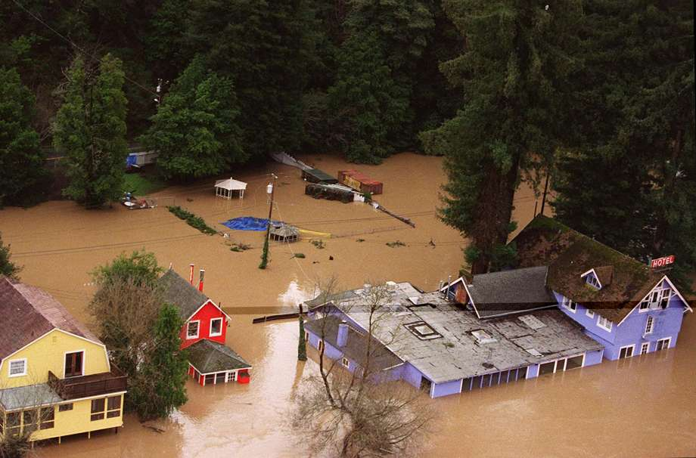
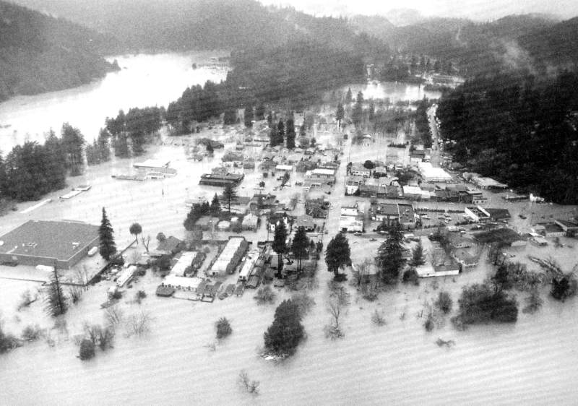
Flooding
Monte Rio 1997
Guerneville 1986
Notes:
Monte Rio flooding 1997 (SF Chronicle, 2015)
Guerneville flooding 1986 (The Press Democrat)

Slide 11
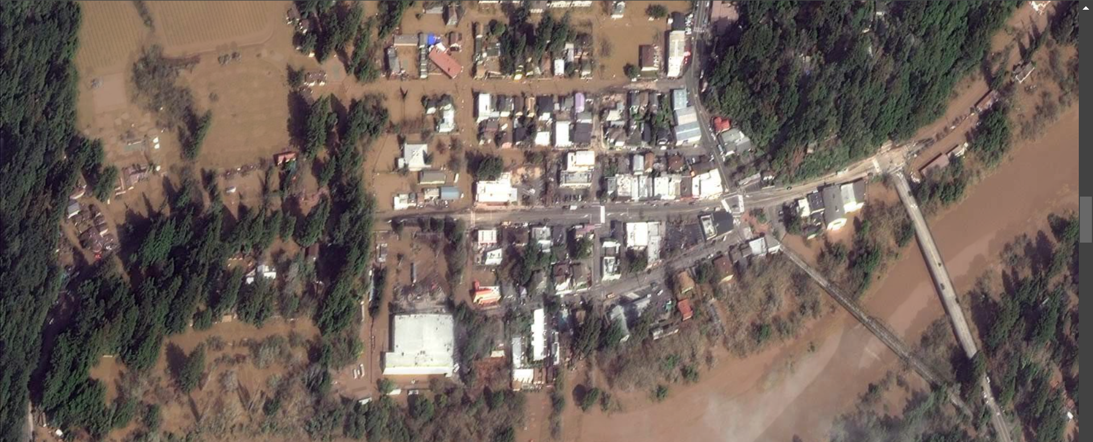
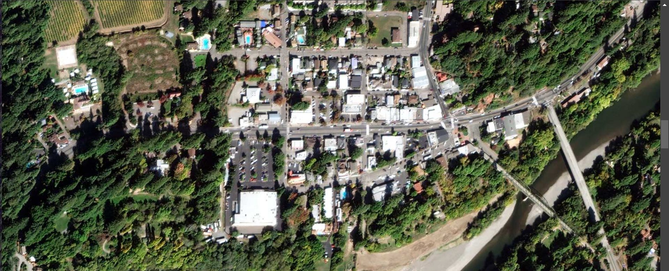
2019 Atmospheric River Flooding
Notes:
In Feburary of 2019 an atmospheric river-fueled storm moved into Northern California. Over a 48-hour span, the storm dropped as much as 2 feet of rain in some places.
Turning Guerneville into an island and forcing evacuations

Slide 12
2019 Atmospheric River Flooding
Notes:
In Feburary of 2018 an atmospheric river-fueled storm moved into Northern California. Over a 48-hour span, the storm dropped as much as 2 feet of rain in some places.
Turning Guerneville into an island and forcing evacuations

Slide 13
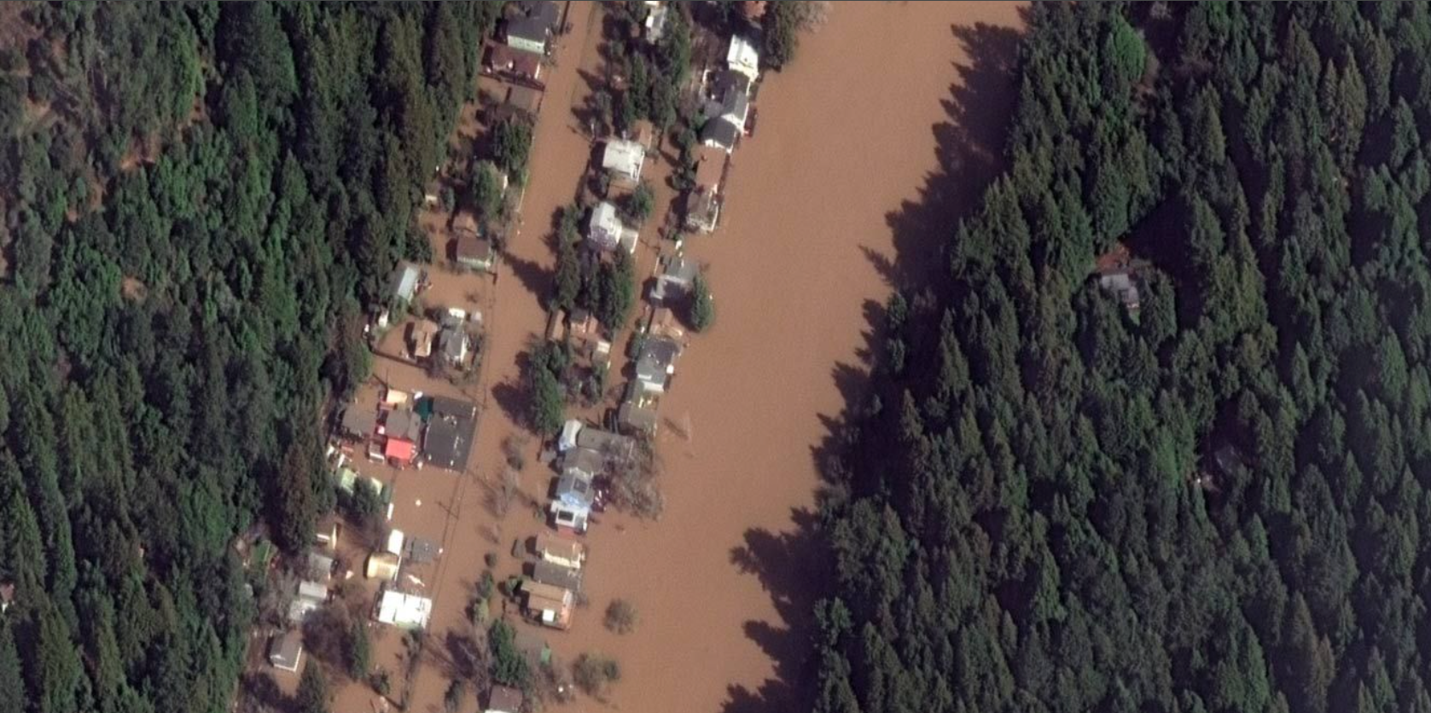
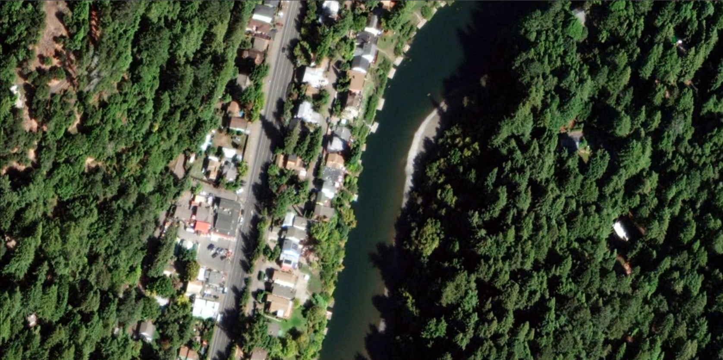
2019 Atmospheric River Flooding

Slide 14
2019 Atmospheric River Flooding

Slide 15
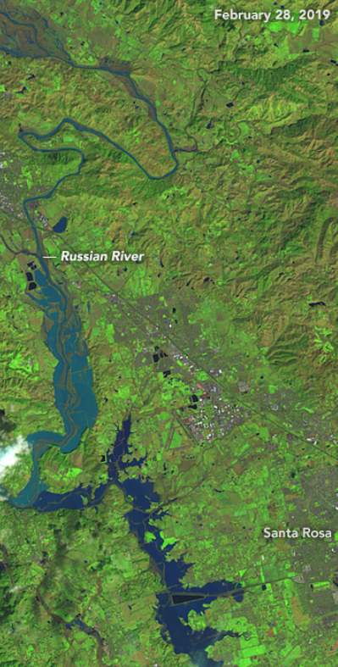
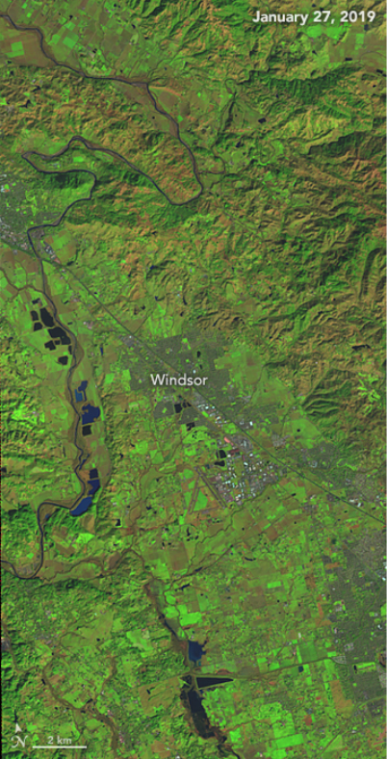
2019 Atmospheric River Flooding

Slide 16
2019 Atmospheric River Flooding

Slide 17
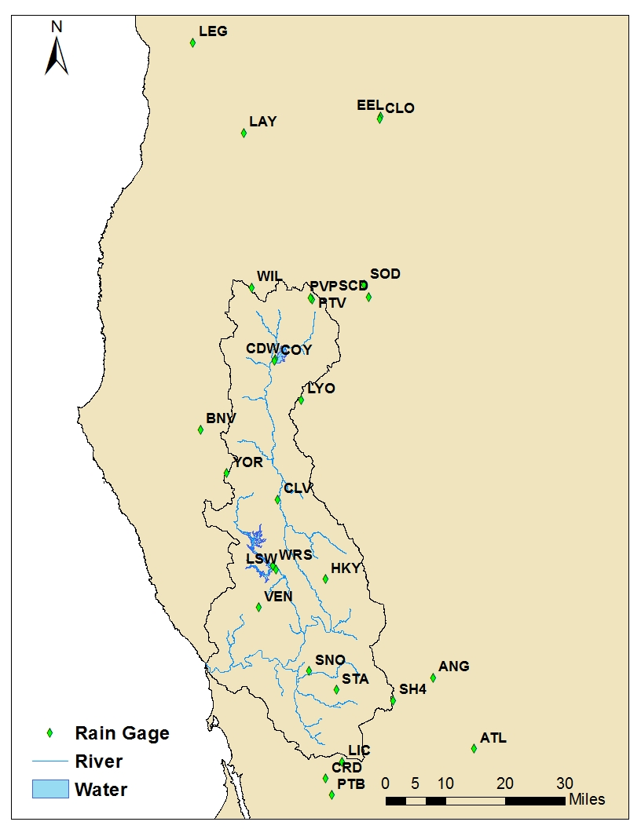
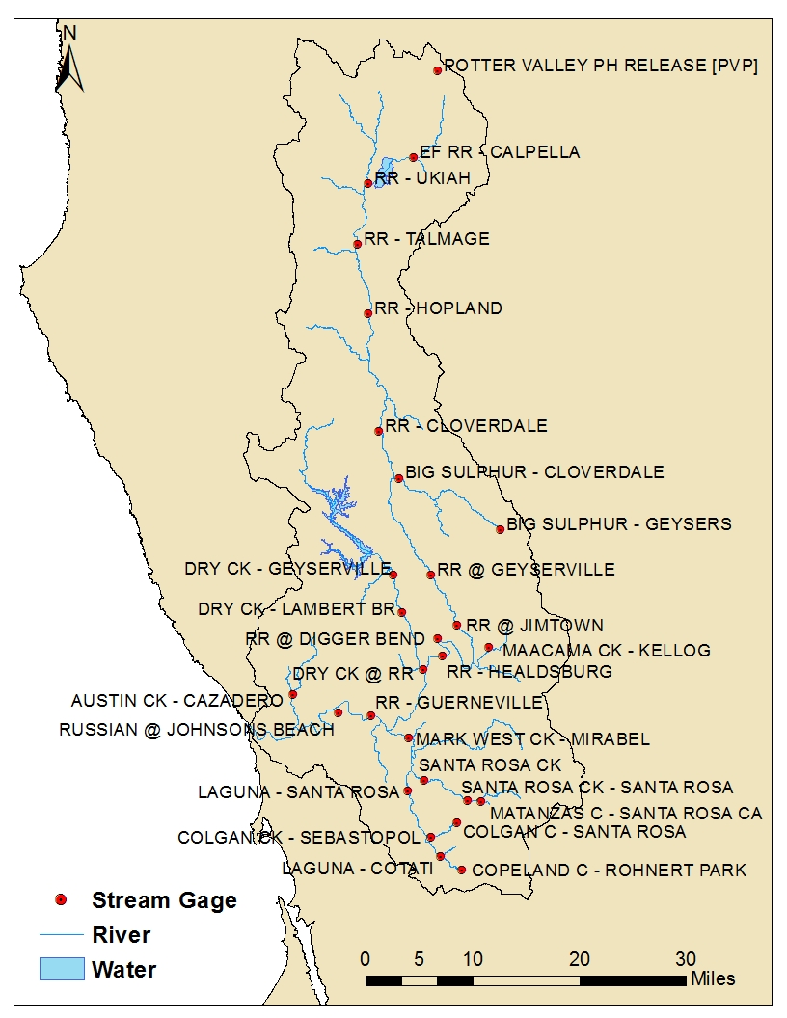
Gages & Data Sources
Notes:
27 rain gages: 30min/1hr data [CDEC]; Poor Radar Data
25 stream gages: 15 min data [USGS]
Reservoir Inflow, Outflow, Elevation, Storage, & Potter Valley Release: 1hr data [CDEC]
GageInterp generates 2km grid sets for the watershed from precipitation gage data

Slide 18
Questions Help additional Training
https://usace.dps.mil/sites/KMP-WM/SitePages/Corps-Water-Management-System-(CWMS).aspx
https://www.hec.usace.army.mil/confluence/cwmsdocs
https://discourse.hecdev.net/c/cwms/5
TDL-CELRH-EC-GW-W-USACE CWMS Modeling | General | Microsoft Teams

