Slide 1
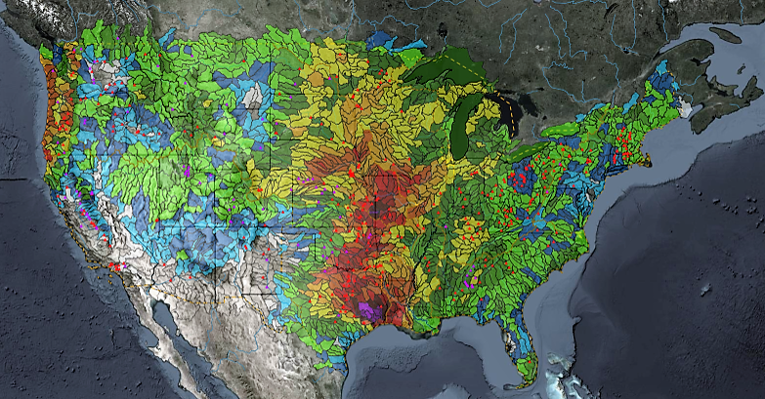
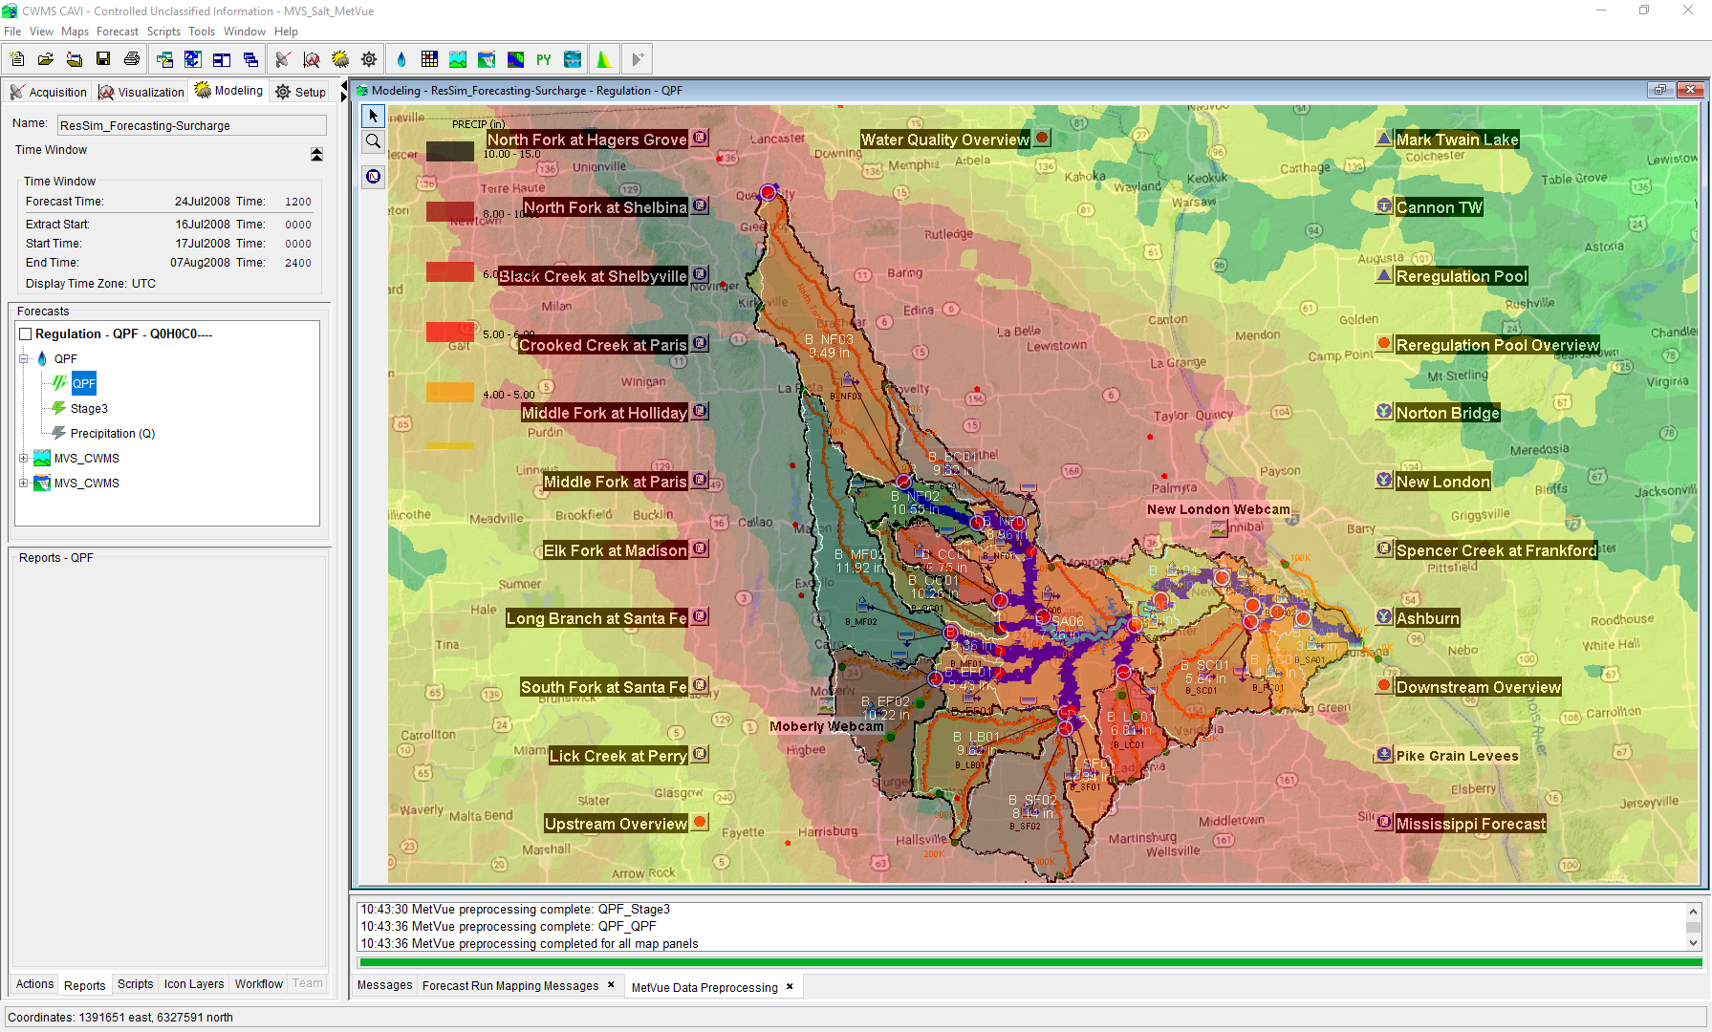

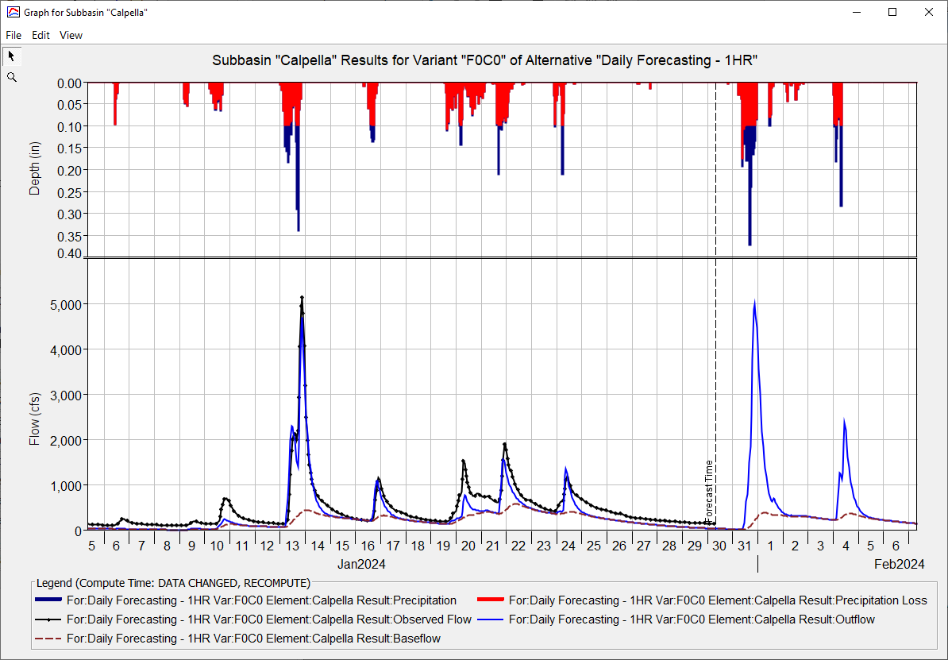
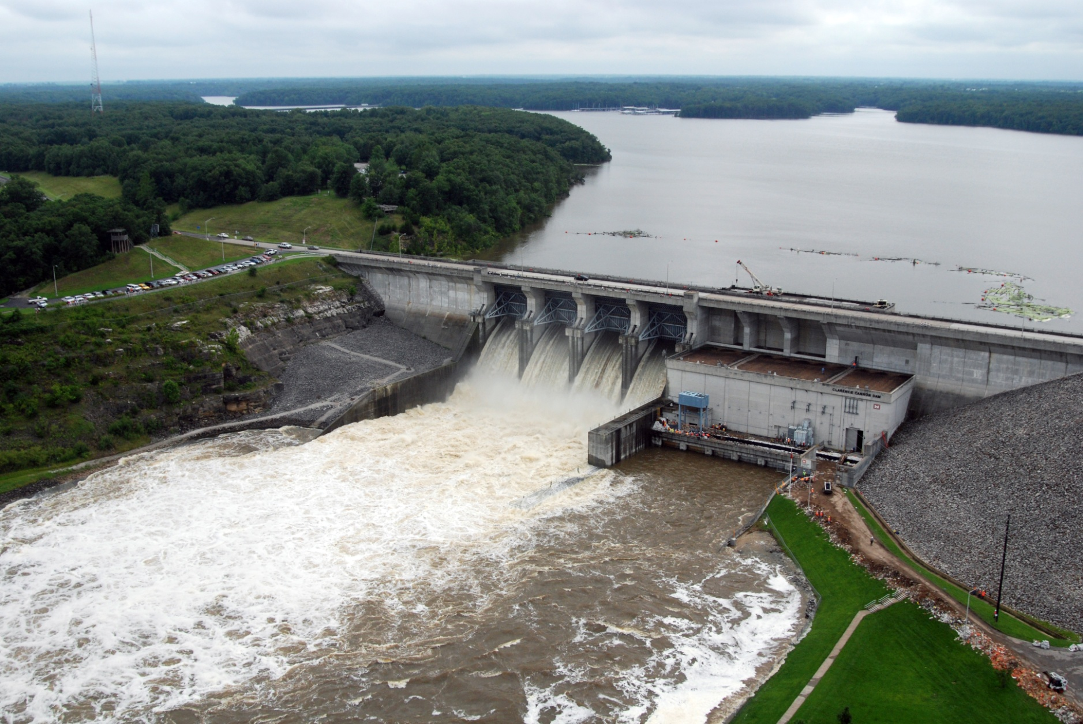
Russian River Watershed Overview
Kat Feingold
Hydrologic Engineering Center
CWMS Prospect Course

Slide 2
Outline
Russian River Watershed Review
Geography, Land Use, Hydraulic Structures
Russian River Climatology
Typical Climate, Flood and Drought Histories
Flood prone locations
Russian River Real-Time Data Sources

Slide 3
Climate
90% of precipitation and runoff occurs between November and April
Annual totals can range significantly from year to year
50”+ in the mountainous regions
38” at Lake Mendocino
30” in Santa Rosa
No significant snowpack
Typical of CA climatology: droughts and floods!
Major Floods: Dec. 1955, Dec. 1964, Feb. 1986, Jan. 1995, Jan. 1997, Dec. 2005
Major Droughts: 1928-34,1959-60,1976-77, 1987-1992, 2007-2009, 2012-2015
Notes:
Flood producing storms occur in the winter and are typically the result of the southerly migration of the Aleutian lower pressure systems or atmospheric river events. Rainfall is often enhanced by orographic effects of the Coast Range and frontal convergence lifting mechanisms.
Forecast Informed Reservoir Operations (FIRO) is a multi-agency study (Scripps, NOAA, USACE, SCWA, USGS, DWR, BoR, NWS) being completed to determine the viability of adjusting the Water Control Manual to improve flood-control and water supply operations. FIRO envisions modern observation and prediction technology that could provide water managers more lead time to selectively retain or release water from reservoirs based on longer-term forecasts. Optimizing reservoir operations potentially benefits water supply and environmental flows without diminishing flood control or dam safety.
Plot taken from (http://cw3e.ucsd.edu/FIRO/)

Slide 4
Flood Prone Locations
Flooding is of large concern in the lower reaches of the river, particularly in the Guerneville area, but also near Hopland.
Most flooding in the northern reaches inundates agricultural property.
Flood control releases from Lake Mendocino and Lake Sonoma are minimized to attempt to keep flow:
Less than 35,000 cfs at Guerneville
Less than 8,000 cfs at Hopland.
Laguna de Santa Rosa acts as a natural storage basin during flooding, limiting effects in the southern part of the watershed, near Santa Rosa.
Notes:
Downstream of the Laguna, the river is particularly prone to flooding near the resort towns of Rio Nido, Guerneville, and Duncan Mills. Flooding begins to occur in Guerneville when the river reaches 35,000 cfs.

Slide 5
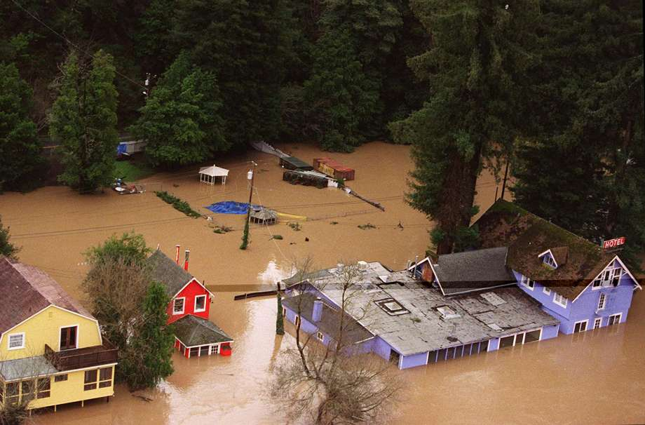
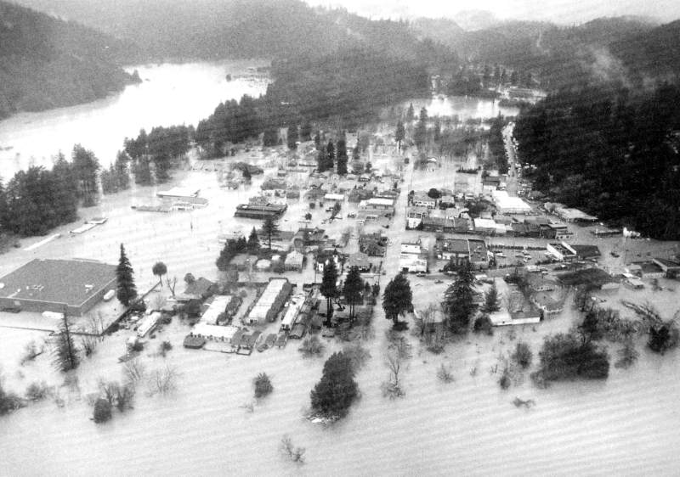
Flooding
Monte Rio 1997
Guerneville 1986
Notes:
Monte Rio flooding 1997 (SF Chronicle, 2015)
Guerneville flooding 1986 (The Press Democrat)

Slide 6
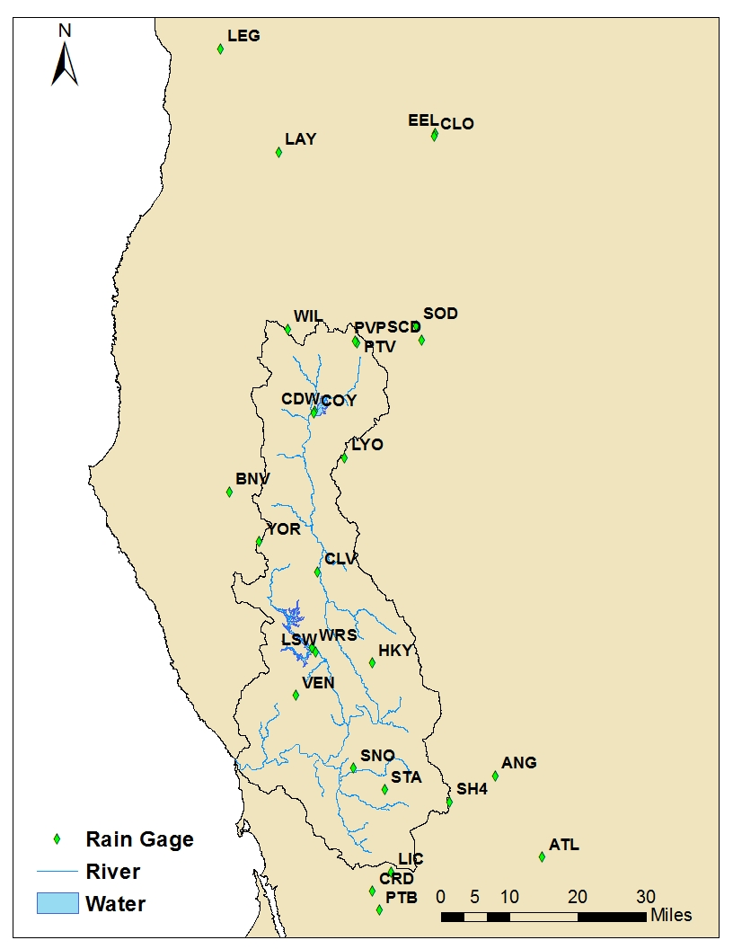
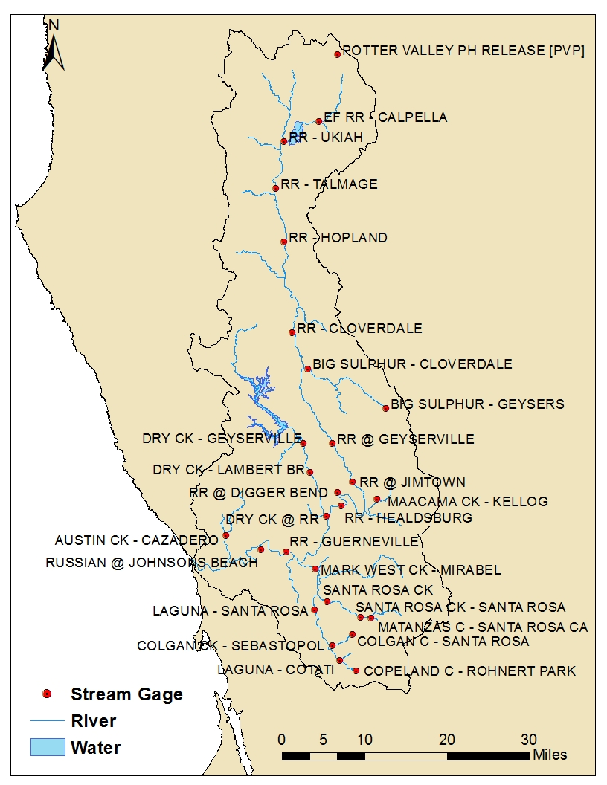
Gages & Data Sources
Notes:
27 rain gages: 30min/1hr data [CDEC]; Poor Radar Data
25 stream gages: 15 min data [USGS]
Reservoir Inflow, Outflow, Elevation, Storage, & Potter Valley Release: 1hr data [CDEC]
GageInterp generates 2km grid sets for the watershed from precipitation gage data

Slide 7
Questions Help additional Training
https://usace.dps.mil/sites/KMP-WM/SitePages/Corps-Water-Management-System-(CWMS).aspx
https://www.hec.usace.army.mil/confluence/cwmsdocs
https://discourse.hecdev.net/c/cwms/5
TDL-CELRH-EC-GW-W-USACE CWMS Modeling | General | Microsoft Teams

