Slide 1
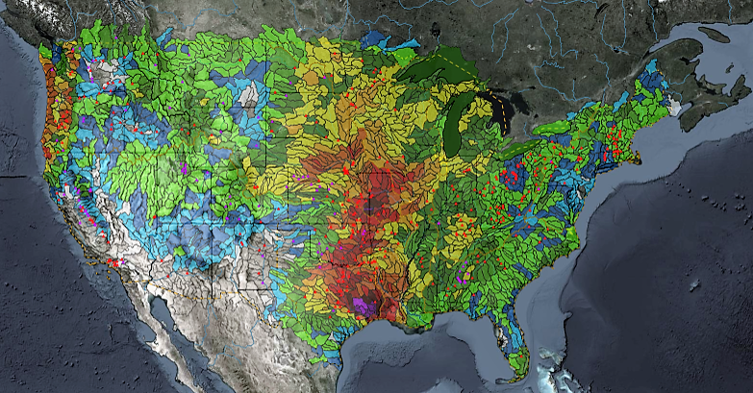
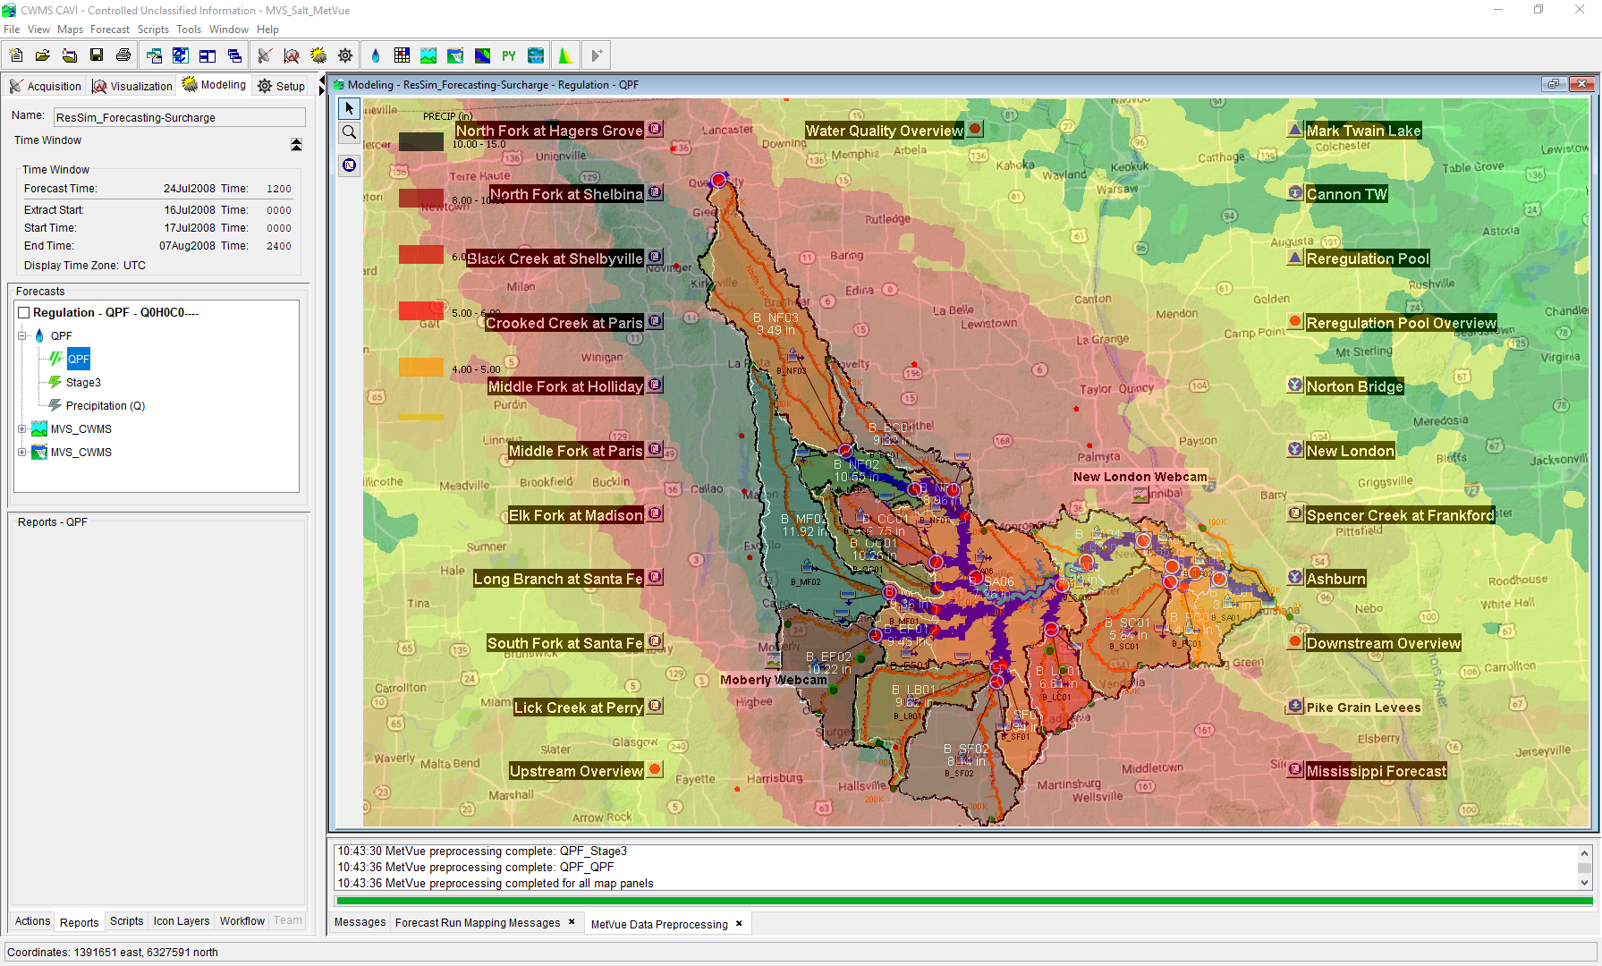

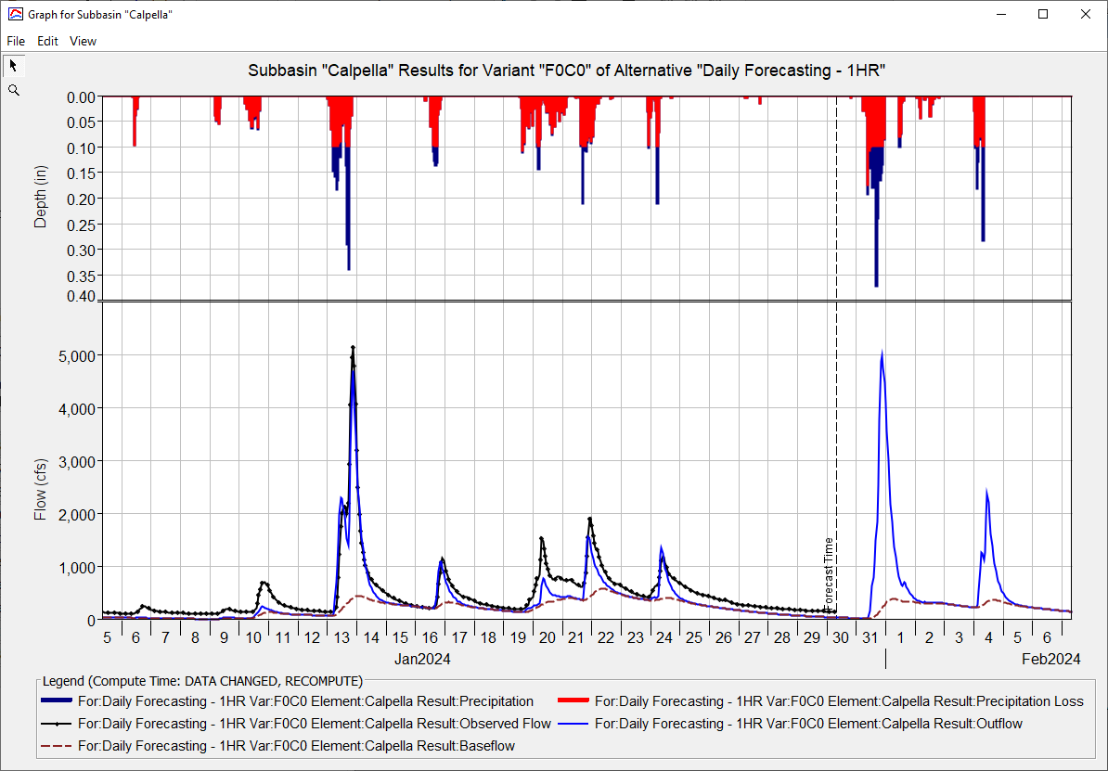
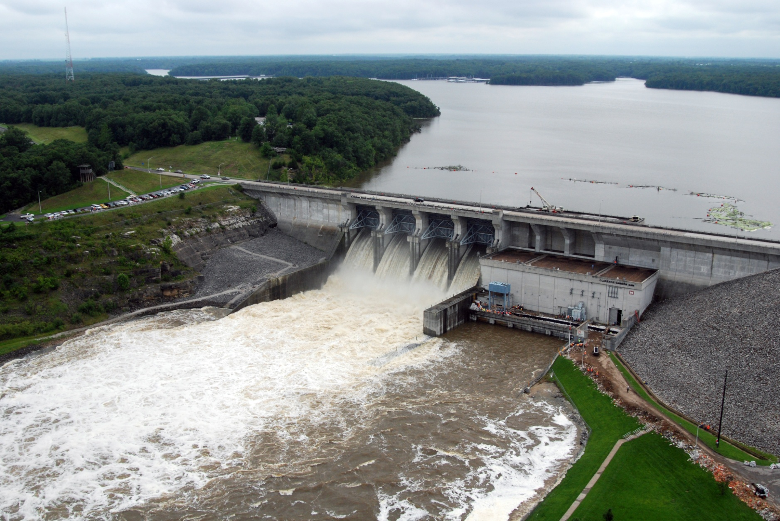
CWMS CAVI Orientation
Matt Fleming, P.E.
Hydrologic Engineering Center
CWMS Prospect Course

Slide 2
Objective
Learn about the Control and Visualization Interface

Slide 3
Overview
Introduce the CWMS Control and Visualization Interface (CAVI)
Screen Components
Layers
Time-Series Icons
Scripts
Introduce CAVI components and modules
Modules
Purpose and use
Available tools

Slide 4
General CAVI Components

Slide 5
CAVI Purpose
Serves as the main interface to CWMS
Access and manipulate data and models:
View status of data feeds and gauge quality
Validate data
View hydro-meteorological conditions of the watershed
Plot, tabulate, and edit data
Run models and view results
CAVI organizing unit is called the “Watershed”, which contains data and models

Slide 6
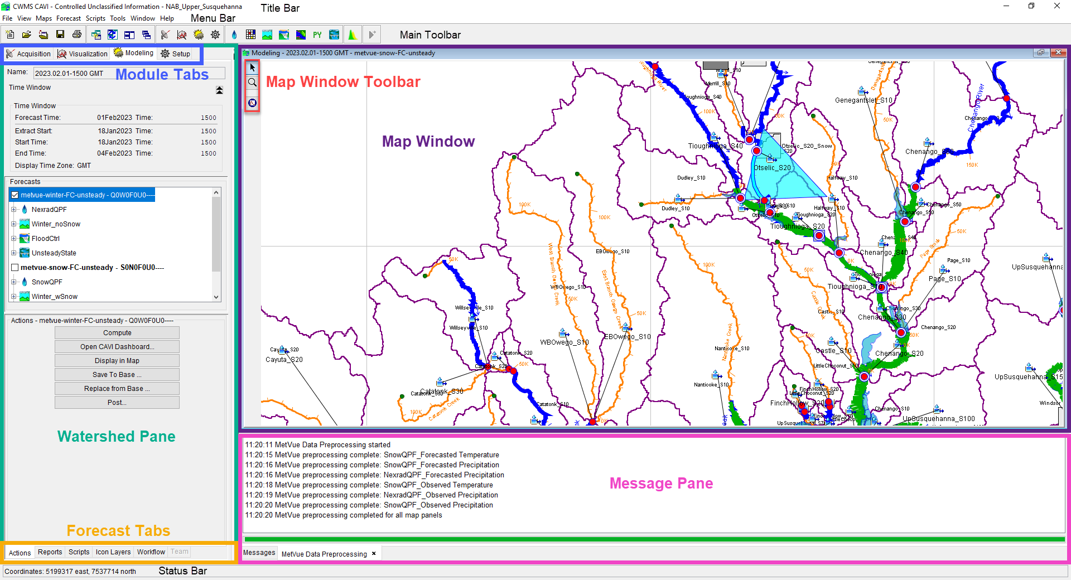
Screen components
Menu
Module Tab
Tool bar buttons
Map Panel
Control Panel
Map mouse functionality and tools
Map status line
Message area

Slide 7
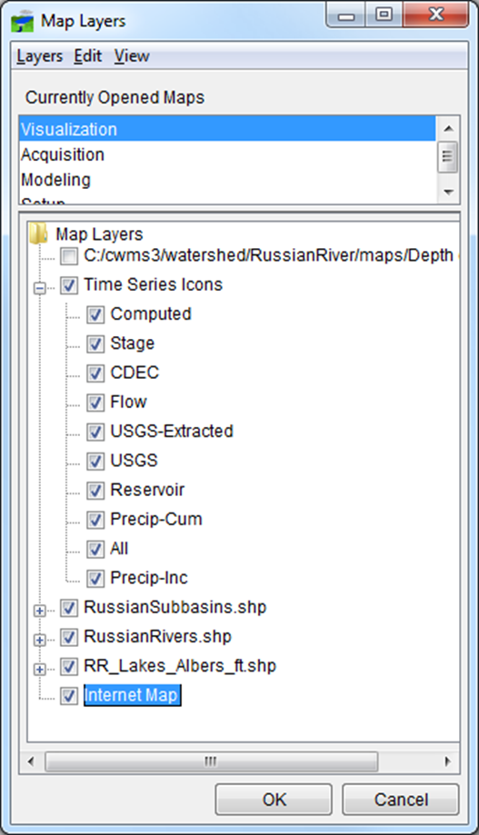
Layers
A “Layer” is a set of objects drawn in the CAVI map(s).
Example layers include:
Background images or map layers
Internet Map
Aerial photos or other geo-referenced images
Subbasin, stream outline maps (e.g., shapefiles)
County/political boundaries
Grids (precipitation, temperature, etc.)
From the visualization tab
“Stream Alignment”
Model representation
Time-series icons can be divided into sub-layers:
Flow, stage, or precipitation layers
Raw or validated data layer
Thumbnail plot or color bar layer

Slide 8
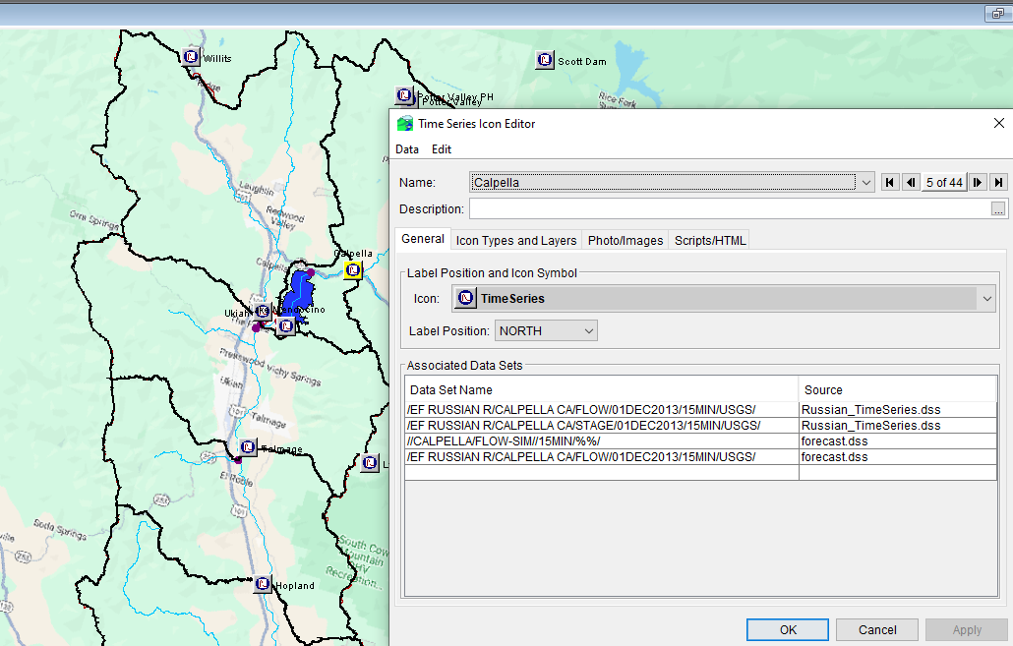
Time-series icons
A time-series icon represents a location that is associated with one or more data sets
The data sets are usually time-series data and can be from Oracle or HEC-DSS
Observed raw data from Oracle
Validated data from Oracle
Model results from HEC-DSS
Paired curve data may be displayed from an icon (but not with time-series data in the same icon).
Icons can show an image, document, a live video with the icon, etc

Slide 9


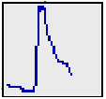
Time-series icons
Each time-series icon data set is associated with an icon style for each module:
Graphic Symbol
Dot
Thumbnail Plot
Quality Color Bar
Threshold Color Bar
None
For example, a flow data set may be represented by:
A quality color bar in Data Acquisition
A thumbnail plot in Data Visualization
A graphic symbol in Model Interface

Slide 10
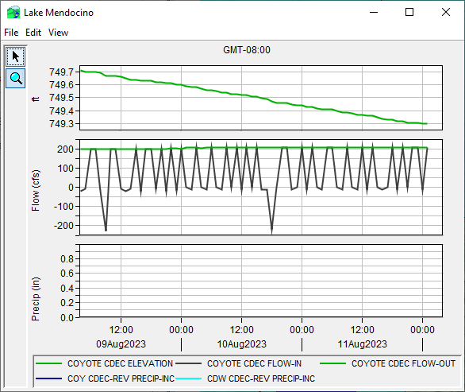
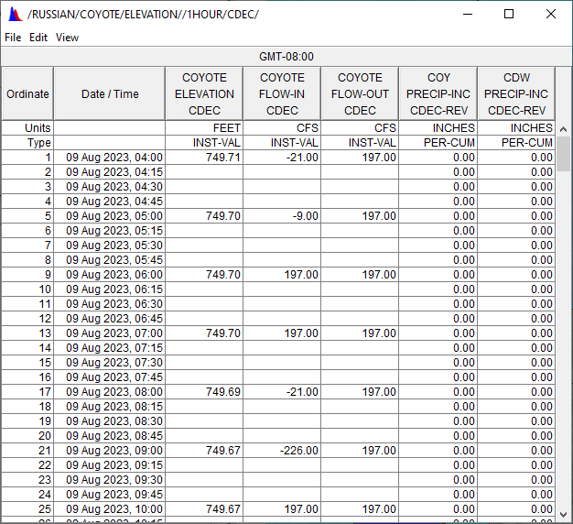
Time-series plots and Tables

Slide 11
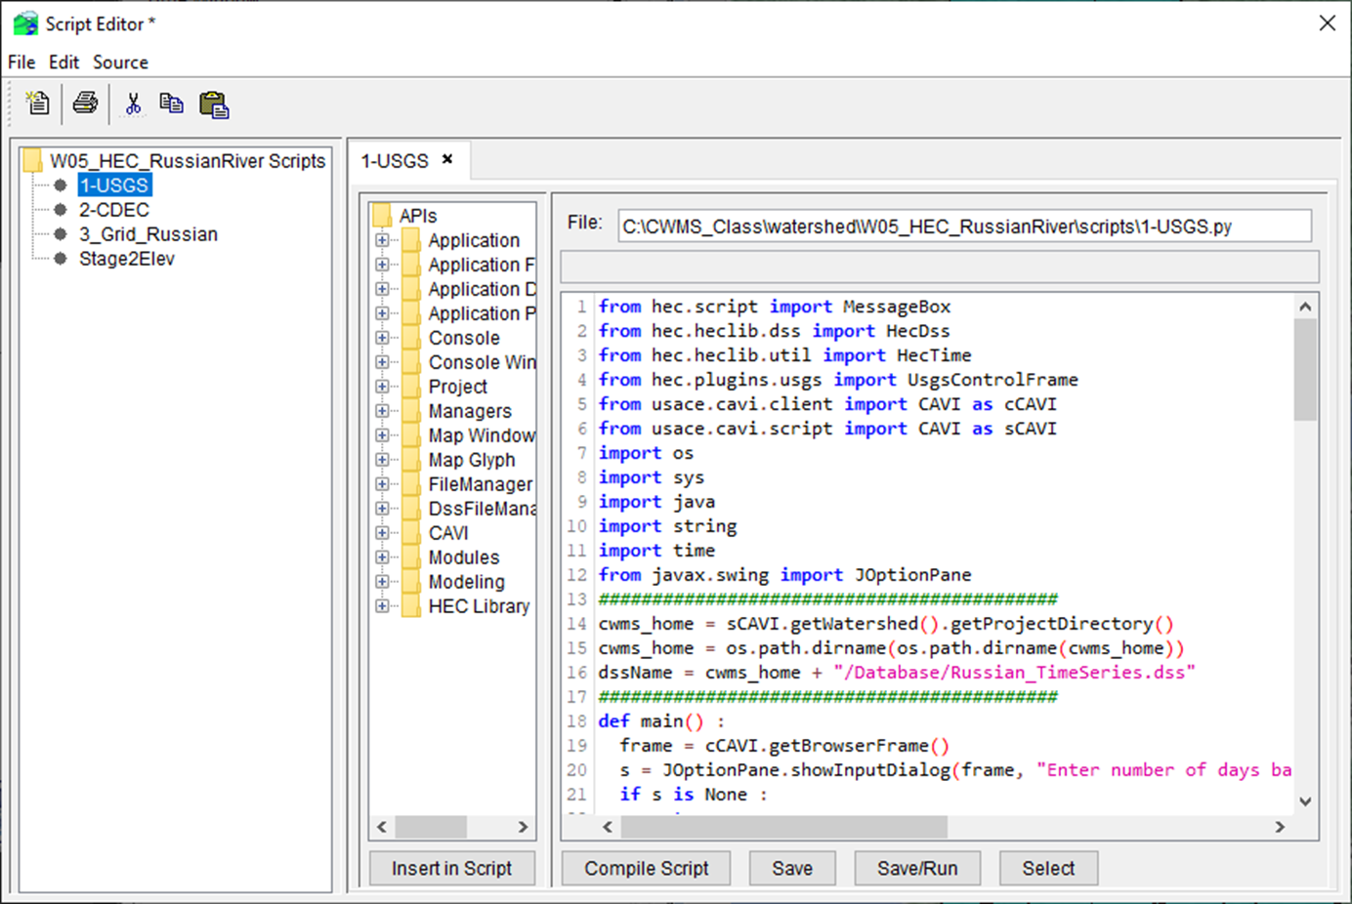
scripts
Scripts are a set of text instructions to perform common tasks:
Plots of data from different locations (e.g., main steam gages)
Setup/edit scripts from the “Scripts” menu
Run scripts from:
“Script Buttons” in a separate window or in the lower portion of the control panel
From a “script schedule” for automatic execution

Slide 12
CAVI Modules

Slide 13
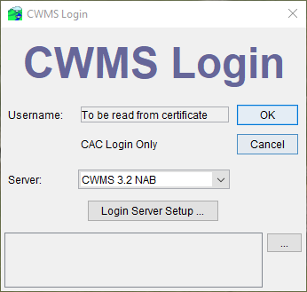
Cavi login
You can login to access data from the CWMS Oracle database on the server or run locally if you have the data (already downloaded or from some other source)

Slide 14
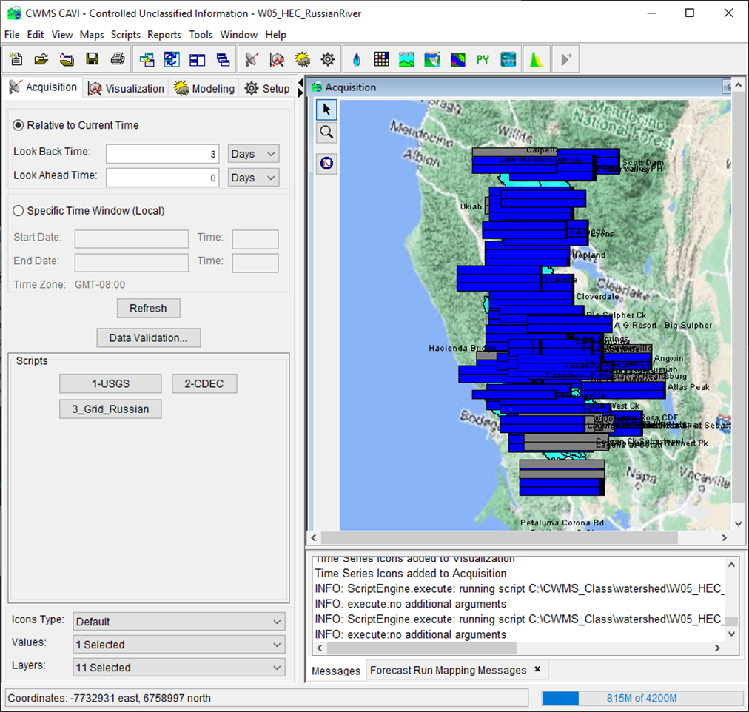
Data acquisition module purpose
View status of the data streams
Status for each data stream represented by the color of a corresponding button on the control panel
Last data stream status shown in the alert message line
View status and quality of data from individual gauges
Quality color bar time-series icons reflect data quality at primary gauge locations
Time window identified and set in the control panel
Icons can be set to update automatically (e.g., every 5 minutes)
Validate (edit) data from gauges
Identify usable observed data time window for modeling (i.e., select forecast time and lookback time)

Slide 15
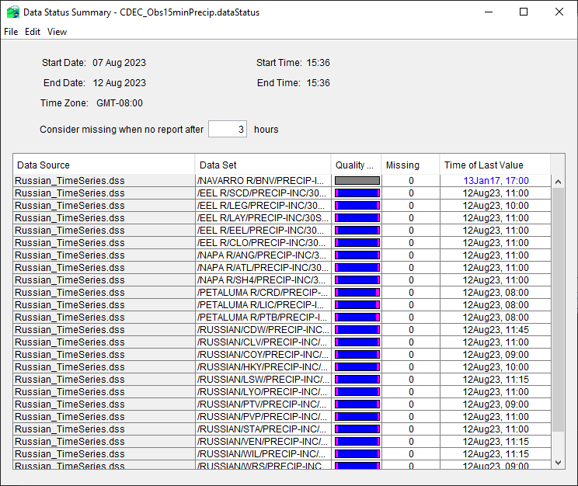
Data status summary table
Provides a quality color bar, number missing, and time of last value for each data set in a list of data sets
Can have as many different lists as desired, with no limit to the number of data sets in a list
Use by data analyst to evaluated data for all locations
Used by modelers to choose the forecast time

Slide 16
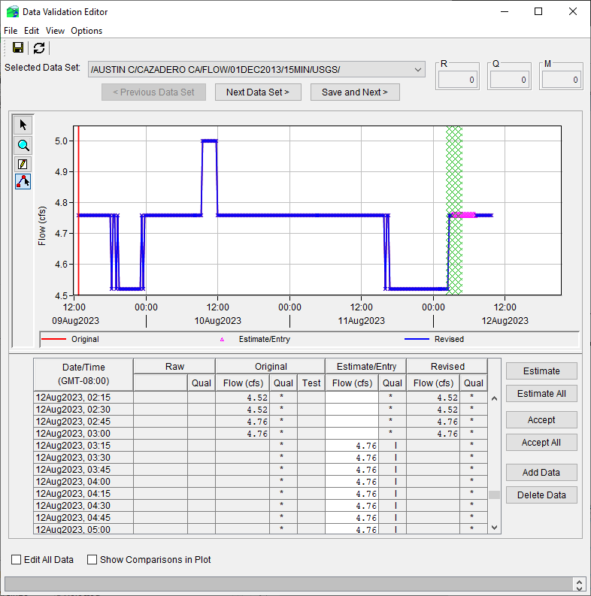
Data validation editor
Combined graphical/tabular editor
Used to accept/reject/estimate/enter gage data
Run in “ad hoc” mode or list driven
“ad hoc” by selecting series icons (shift-right mouse click), then press Validation button
Pre-defined list
Filter list (selections) according to quality
Plot other gages for comparison

Slide 17
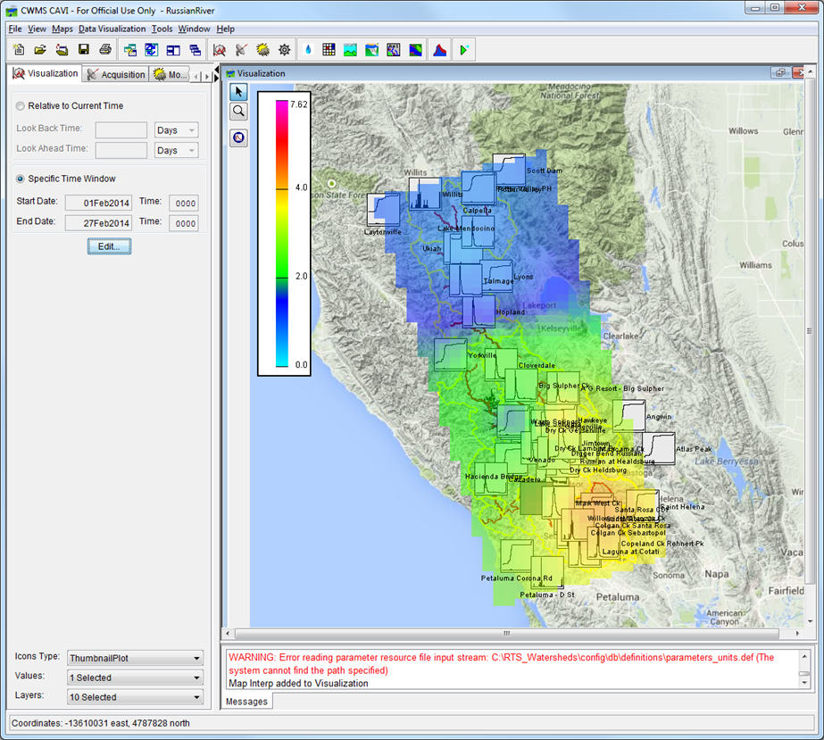
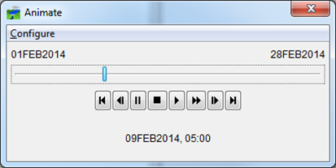
Data visualization module
View hydro-meteorological state of the watershed
Animation of precipitation or temperature
Combined “slider bar” and “VCR controls” allow user to play, fast forward, step through, etc. through gridded precipitation hours
Placing the mouse over a grid cell shows the amount of rain for that cell for that hour
“Thumbnail” plots of data at key locations (flow, stage, reservoir data)

Slide 18
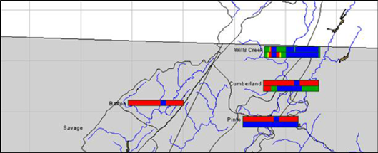
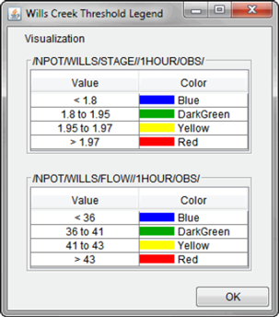
Data visualization module
Threshold color bars depict data values over time as colors are compared to defined limits
Example:
Green – below warning stage
Orange – above warning, below flood stage
Red – above flood stage
User defined threshold limits and colors
Limits and colors given in the time-series icon legend

Slide 19
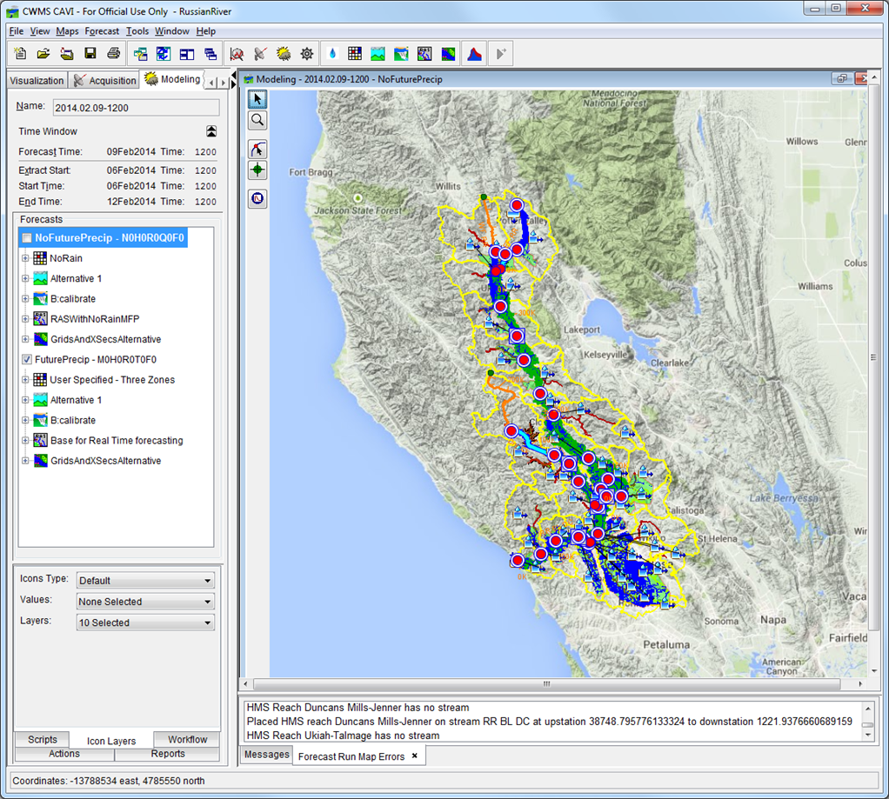
Modeling module
Model watershed and projects to:
Forecast future flows and stages
Determine inundation areas and flood depths
Simulate reservoir operations
Evaluate economic impacts
Evaluate “what if” alternatives:
What if there is more rain than forecasted?
How does a change in my reservoir operation affect downstream locations?
Results can be posted to Oracle

Slide 20
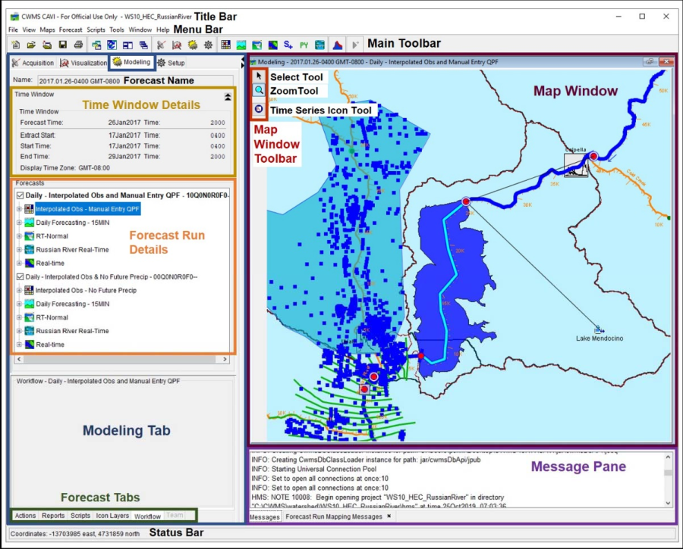
Modeling Module
Model run:
Meteorology (HEC-MetVue)
Hydrology (HEC-HMS)
Reservoir Analysis (HEC-ResSim)
Hydraulics (HEC-RAS)
Economics (HEC-FIA)
Inundation maps (RAS Mapper)
Adjust model parameters native editors
View and compare results from plots or tables (via time-series icons) or from model reports
Parameters can be adjusted to improve results
Loss rates/baseflow
Reservoir release overrides
Manning's n values

Slide 21
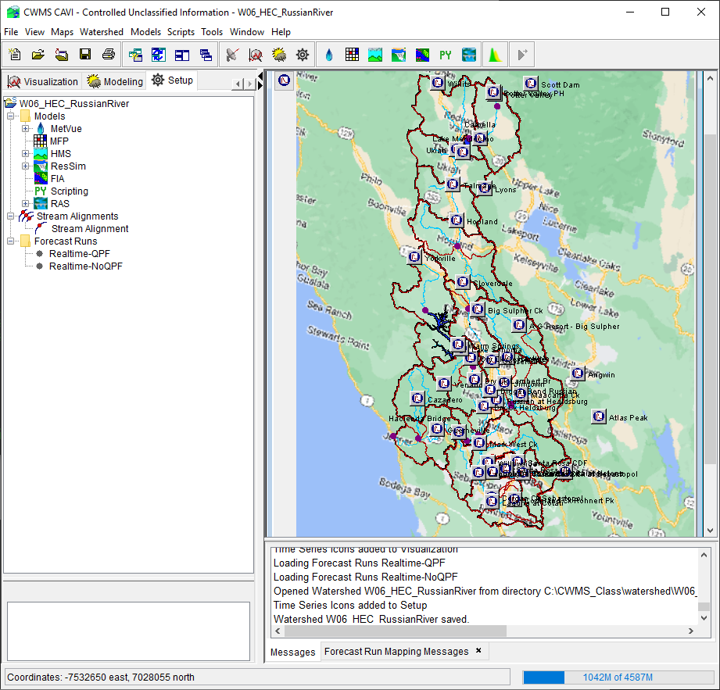
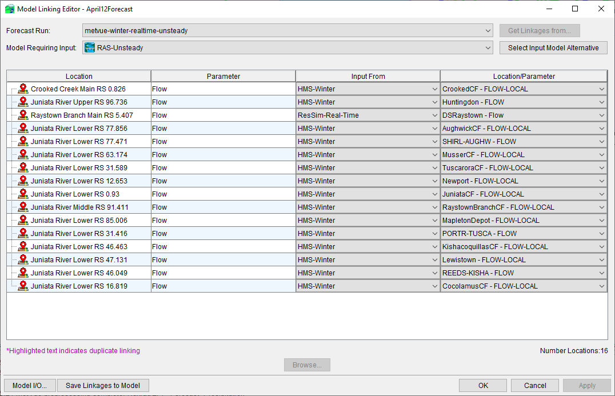
Watershed Setup Module
Load background maps
Import models
Setup “run alternatives”
Link models (data from a → data to)
Build extract/post lists
Add and configure time-series icons

Slide 22
Summary
CAVI (Control and Visualization Interface) serves as the front end of CWMS
CAVI is organized into functional modules
Time-series icons represent data sets at a location
A layer represents a set of objects drawn on the CAVI screen (such as background maps or a set of icons)
Each module has several tools available to aid the user
Modeling module provides a mechanism to forecast flows/stages, operate reservoirs, evaluate “what if” alternatives, etc.
Scripts provide a mechanism to perform repeated tasks

Slide 23
Questions Help additional Training
https://usace.dps.mil/sites/KMP-WM/SitePages/Corps-Water-Management-System-(CWMS).aspx
https://www.hec.usace.army.mil/confluence/cwmsdocs
https://discourse.hecdev.net/c/cwms/5
TDL-CELRH-EC-GW-W-USACE CWMS Modeling | General | Microsoft Teams
“Just keep CWMS’ing”

