Slide 1
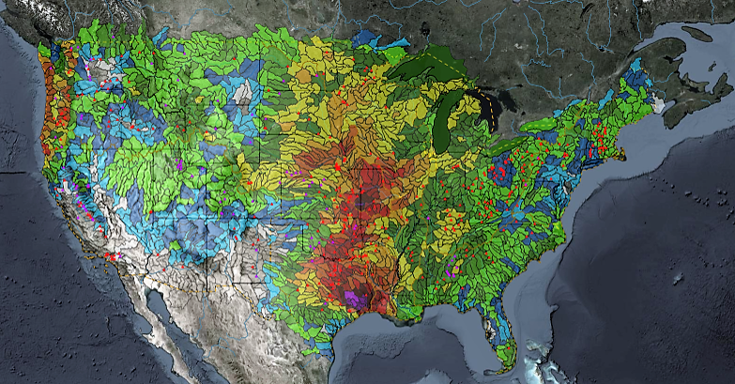
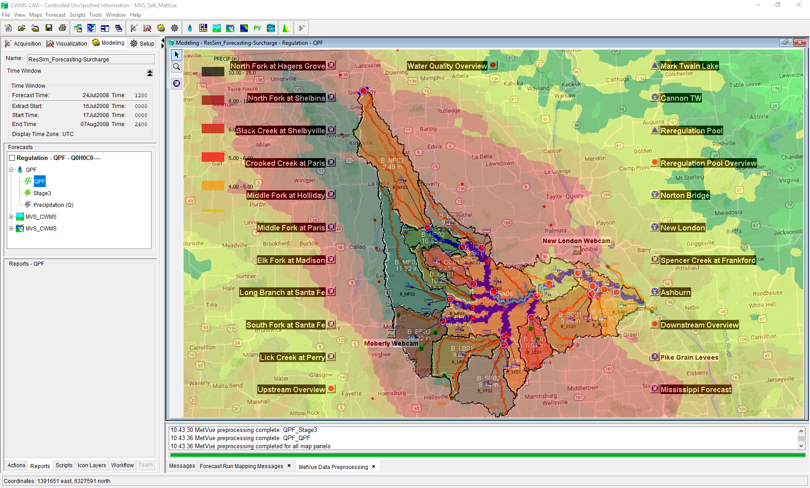

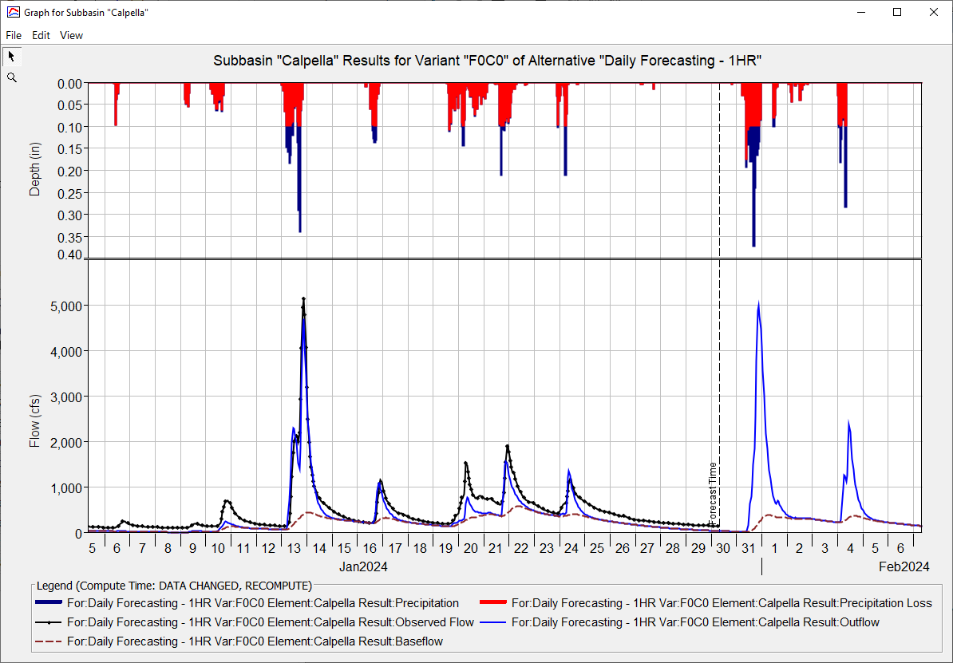
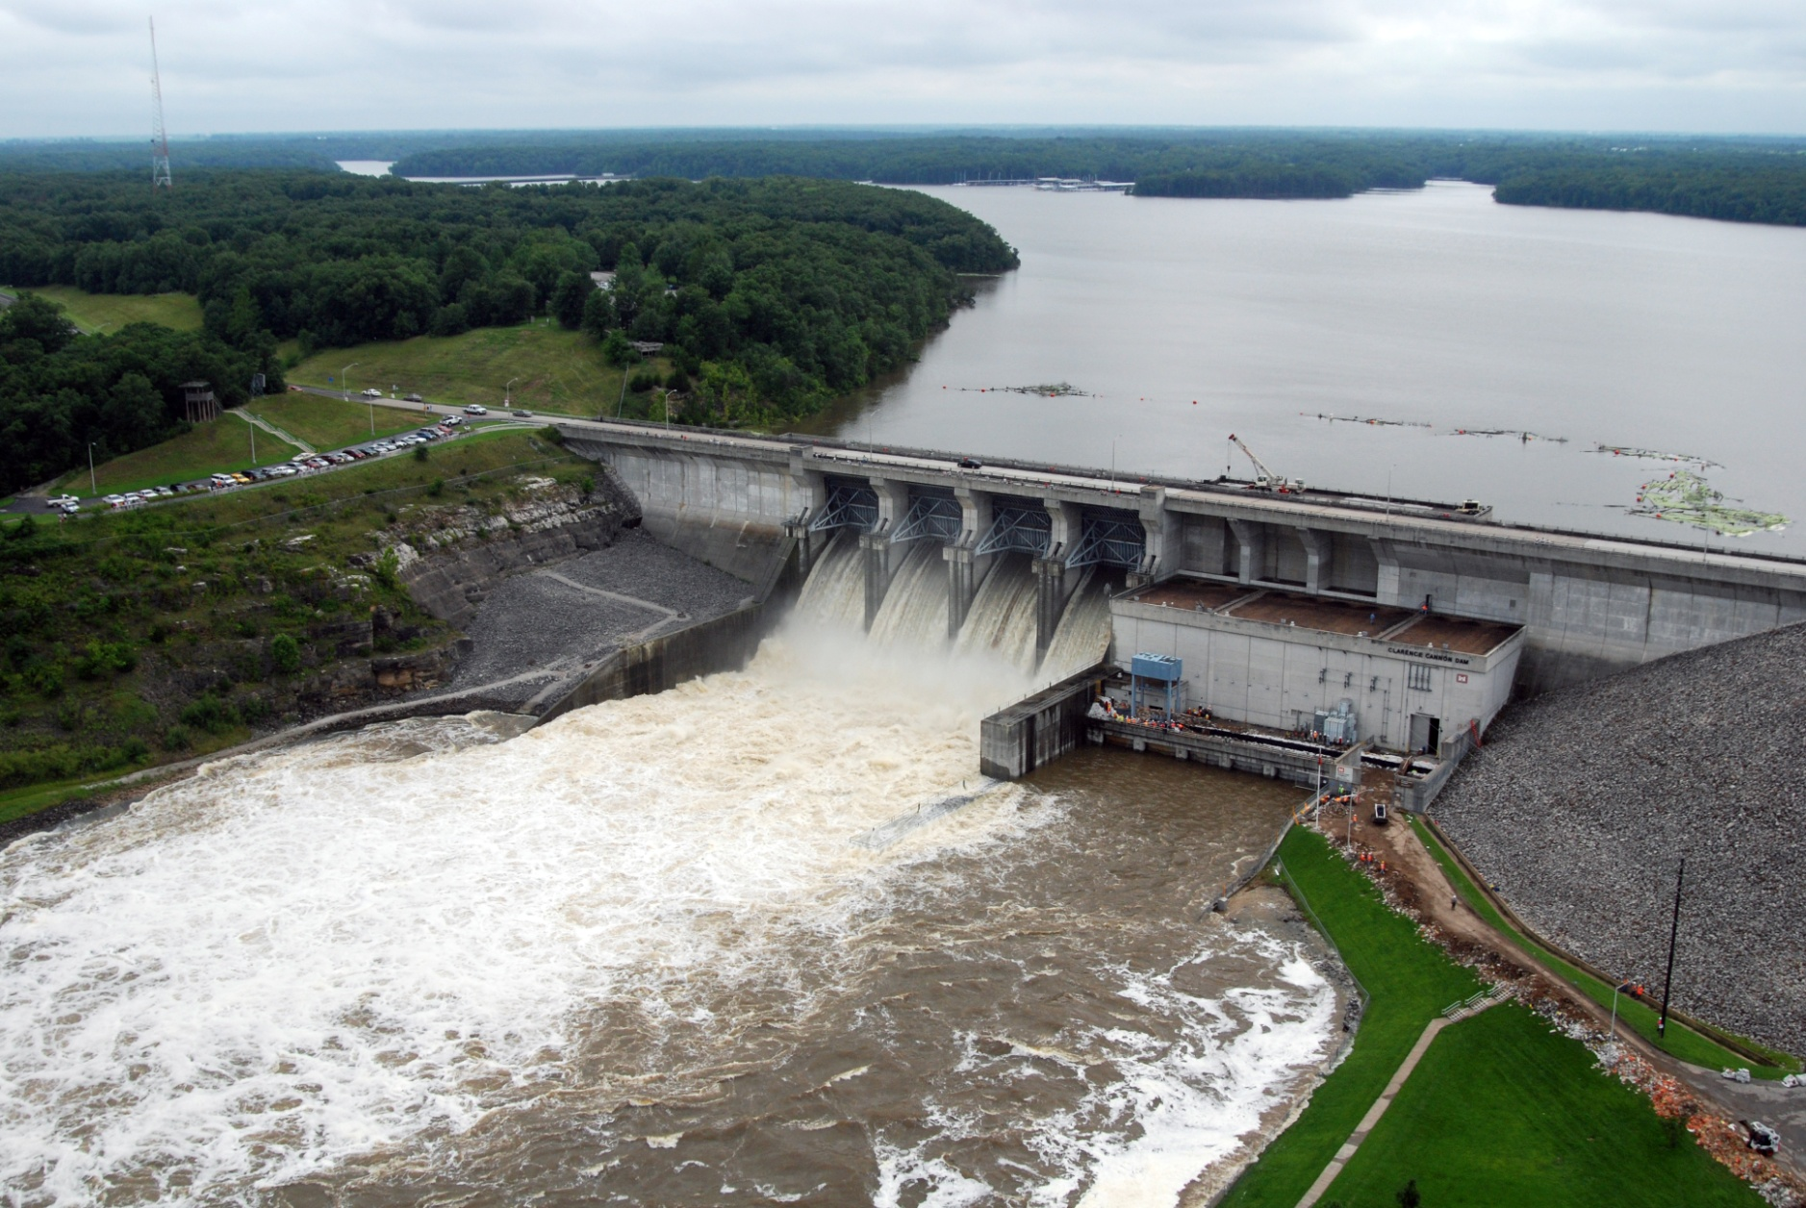
CWMS CAVI Orientation
Matt Fleming, P.E.
Hydrologic Engineering Center
CWMS Prospect Course
Overview

Slide 2
Objective
  Learn about the Control and Visualization Interface

Slide 3
Overview
Introduce the CWMS Control and Visualization Interface (CAVI)
  Screen Components
  Layers
  Time-Series Icons
  Scripts
Introduce CAVI components and modules
  Modules
    Purpose and use
  Available tools

Slide 4
Questions
Help additional Training
https://usace.dps.mil/sites/KMP-WM/SitePages/Corps-Water-Management-System-(CWMS).aspx
https://www.hec.usace.army.mil/confluence/cwmsdocs
https://discourse.hecdev.net/c/cwms/5
TDL-CELRH-EC-GW-W-USACE CWMS Modeling | General | Microsoft Teams
“Just keep CWMS’ing”

