Slide 1
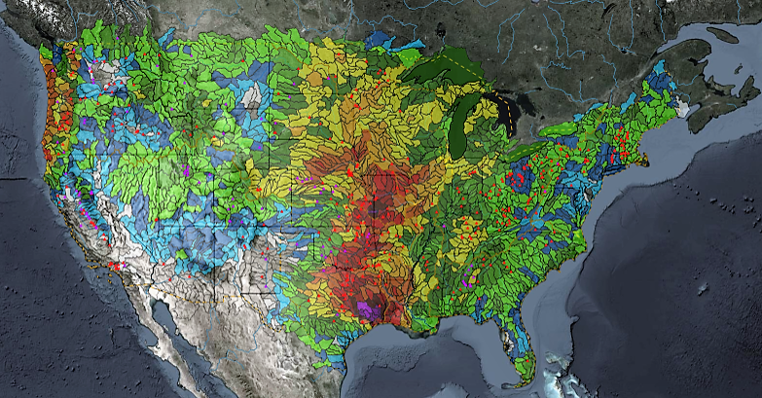
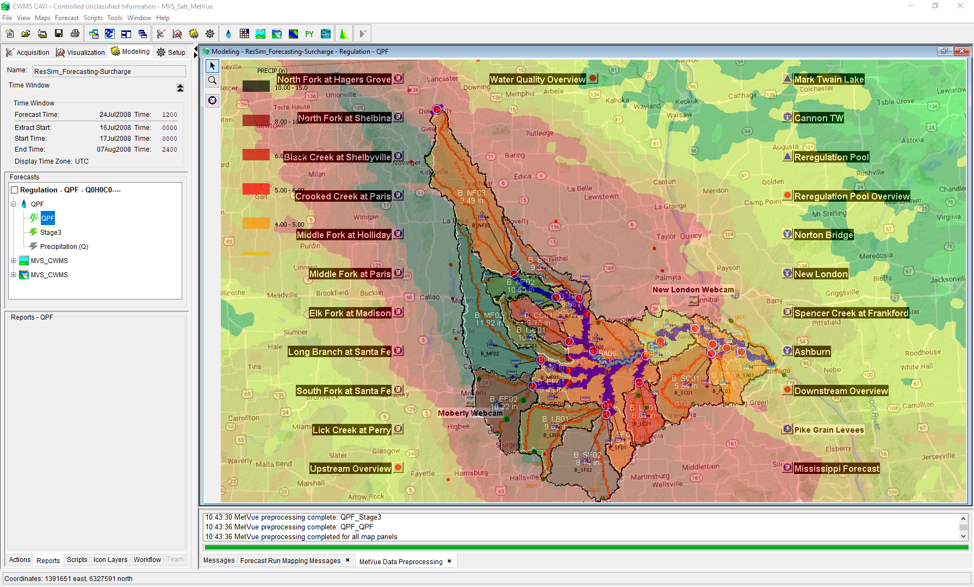

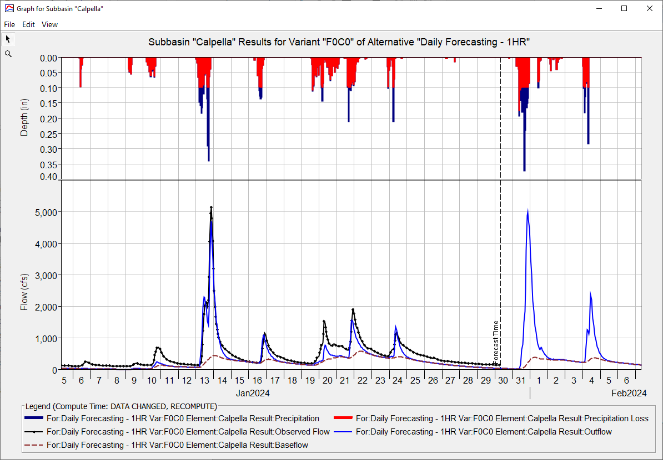
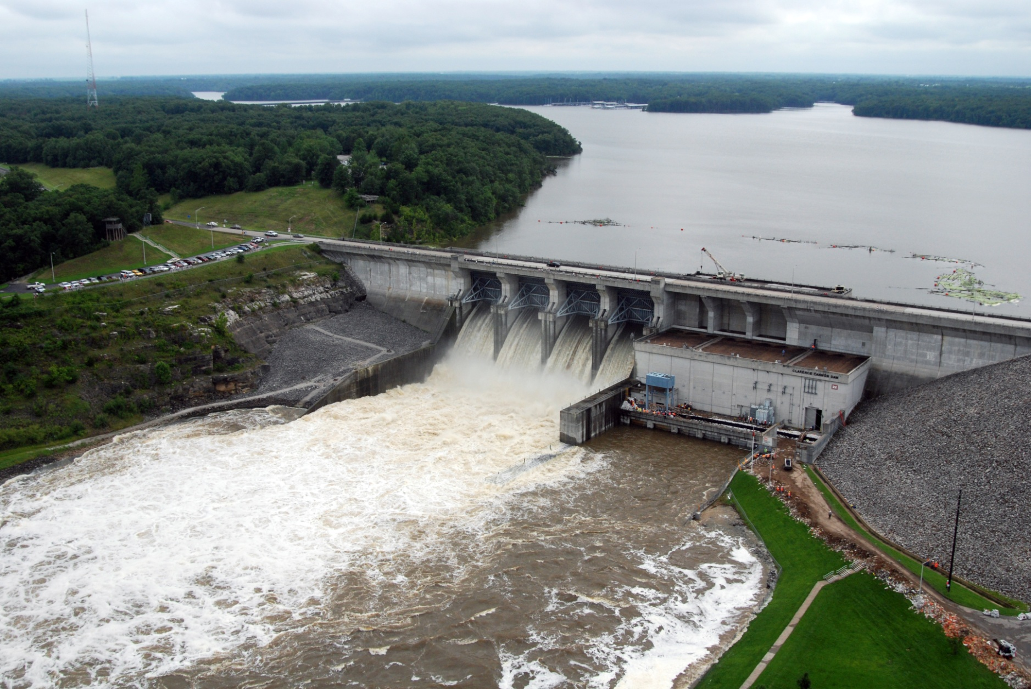
CWMS CAVI Orientation
Matt Fleming, P.E.
Hydrologic Engineering Center
CWMS Prospect Course
CAVI Components

Slide 2
Overview
Introduce the CWMS Control and Visualization Interface (CAVI)
Screen Components
Layers
Time-Series Icons
Scripts
Introduce CAVI components and modules
Modules
Purpose and use
Available tools

Slide 3
CAVI Purpose
Serves as the main interface to CWMS
Access and manipulate data and models:
View status of data feeds and gauge quality
Validate data
View hydro-meteorological conditions of the watershed
Plot, tabulate, and edit data
Run models and view results
CAVI organizing unit is called the “Watershed”, which contains data and models

Slide 4
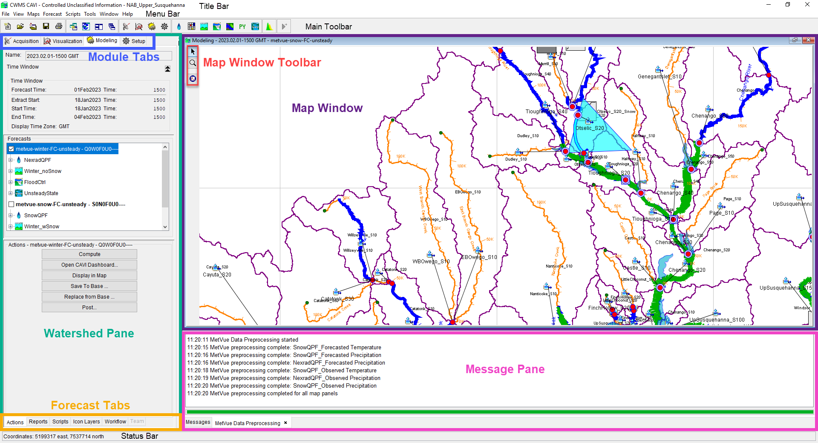
Screen components
Menu
Module Tab
Tool bar buttons
Map Panel
Control Panel
Map mouse functionality and tools
Map status line
Message area

Slide 5
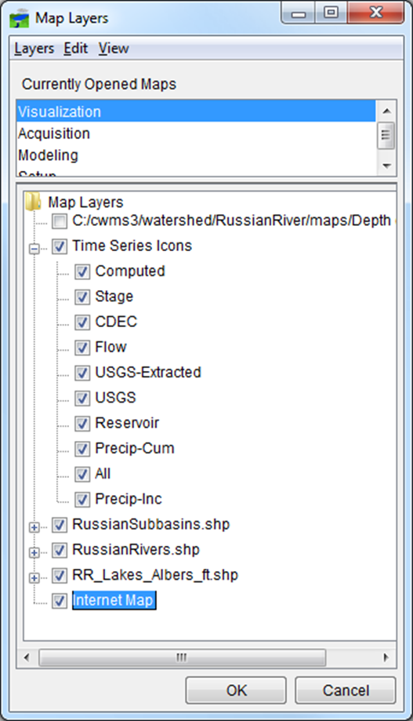
Layers
A “Layer” is a set of objects drawn in the CAVI map(s).
Example layers include:
Background images or map layers
Internet Map
Aerial photos or other geo-referenced images
Subbasin, stream outline maps (e.g., shapefiles)
County/political boundaries
Grids (precipitation, temperature, etc.)
From the visualization tab
“Stream Alignment”
Model representation
Time-series icons can be divided into sub-layers:
Flow, stage, or precipitation layers
Raw or validated data layer
Thumbnail plot or color bar layer

Slide 6
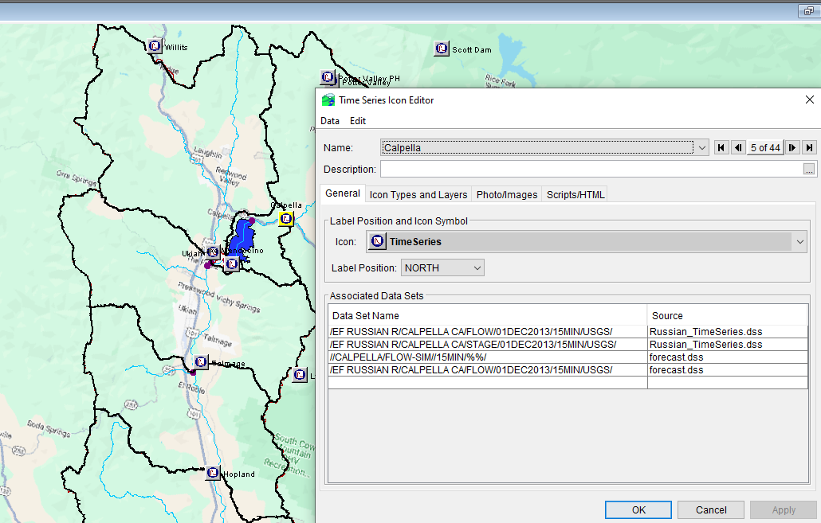
Time-series icons
A time-series icon represents a location that is associated with one or more data sets
The data sets are usually time-series data and can be from Oracle or HEC-DSS
Observed raw data from Oracle
Validated data from Oracle
Model results from HEC-DSS
Paired curve data may be displayed from an icon (but not with time-series data in the same icon).
Icons can show an image, document, a live video with the icon, etc

Slide 7


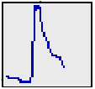
Time-series icons
Each time-series icon data set is associated with an icon style for each module:
Graphic Symbol
Dot
Thumbnail Plot
Quality Color Bar
Threshold Color Bar
None
For example, a flow data set may be represented by:
A quality color bar in Data Acquisition
A thumbnail plot in Data Visualization
A graphic symbol in Model Interface

Slide 8
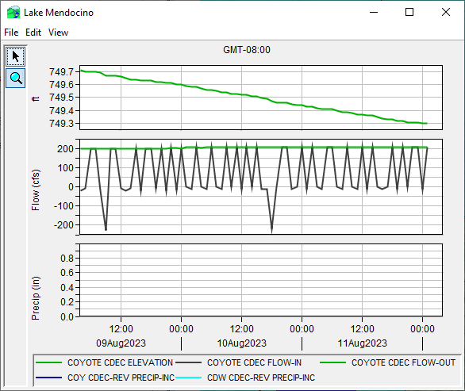
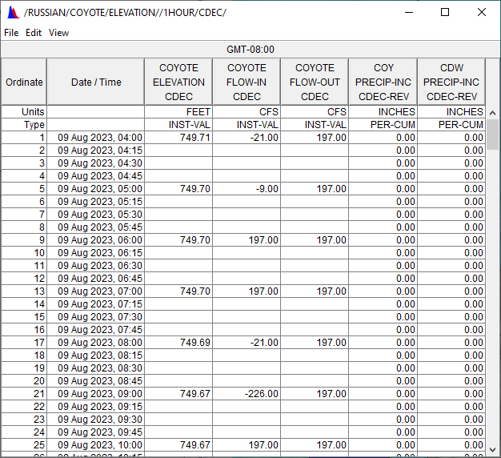
Time-series plots and Tables

Slide 9
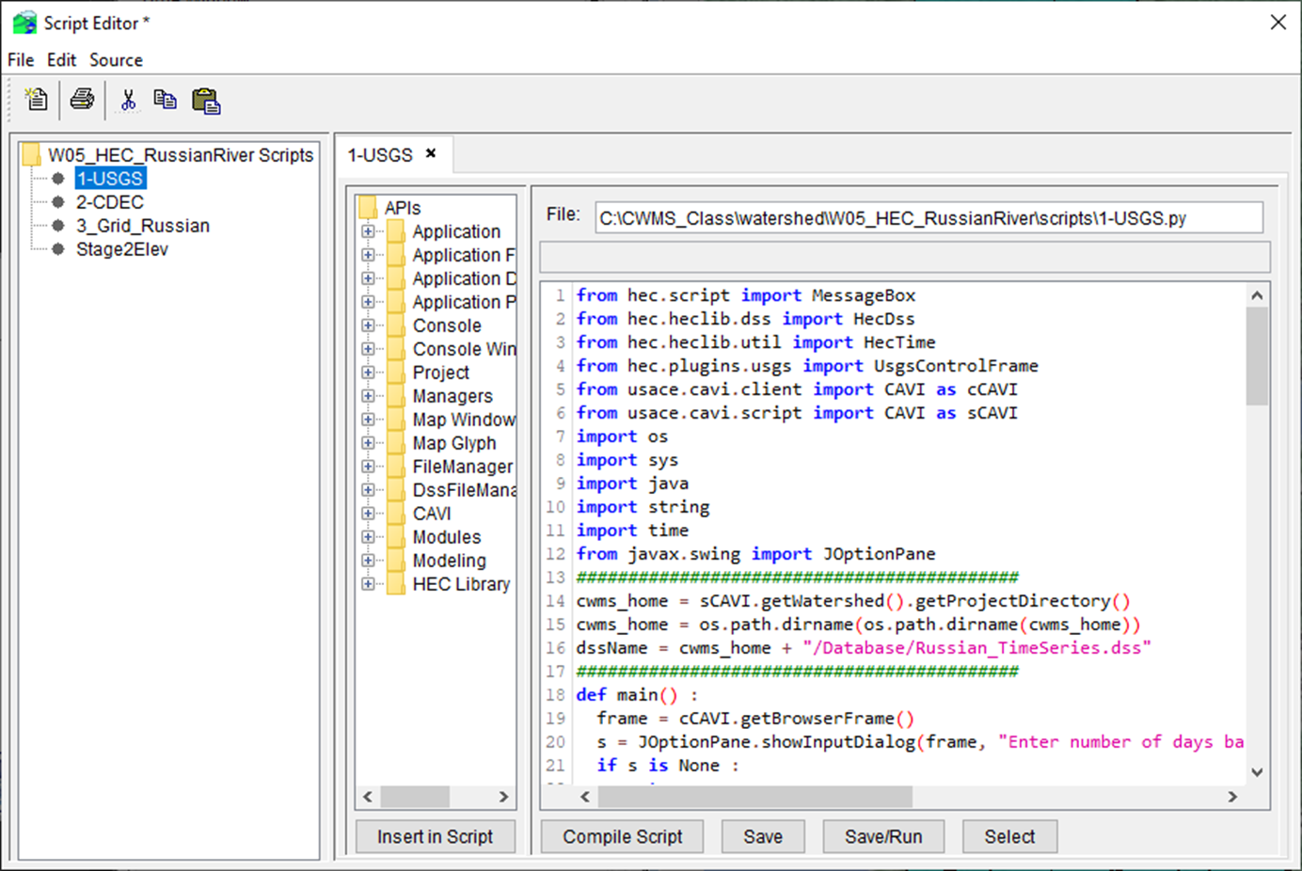
scripts
Scripts are a set of text instructions to perform common tasks:
Plots of data from different locations (e.g., main steam gages)
Setup/edit scripts from the “Scripts” menu
Run scripts from:
“Script Buttons” in a separate window or in the lower portion of the control panel
From a “script schedule” for automatic execution

Slide 10
Questions Help additional Training
https://usace.dps.mil/sites/KMP-WM/SitePages/Corps-Water-Management-System-(CWMS).aspx
https://www.hec.usace.army.mil/confluence/cwmsdocs
https://discourse.hecdev.net/c/cwms/5
TDL-CELRH-EC-GW-W-USACE CWMS Modeling | General | Microsoft Teams
“Just keep CWMS’ing”

