Slide 1
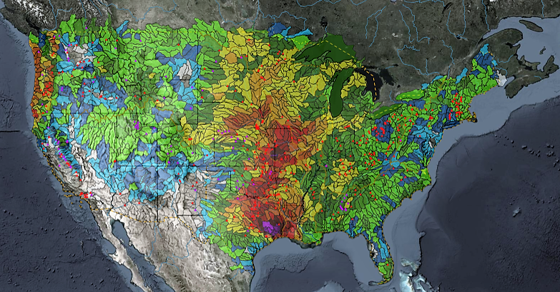
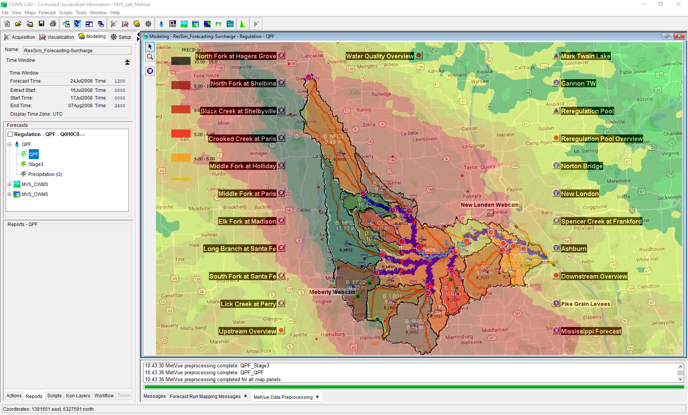

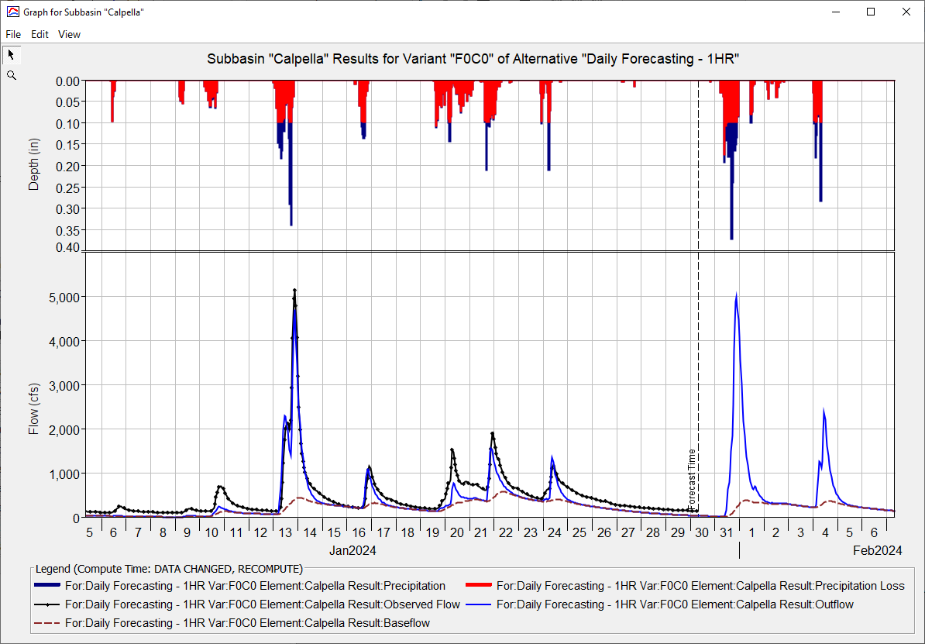
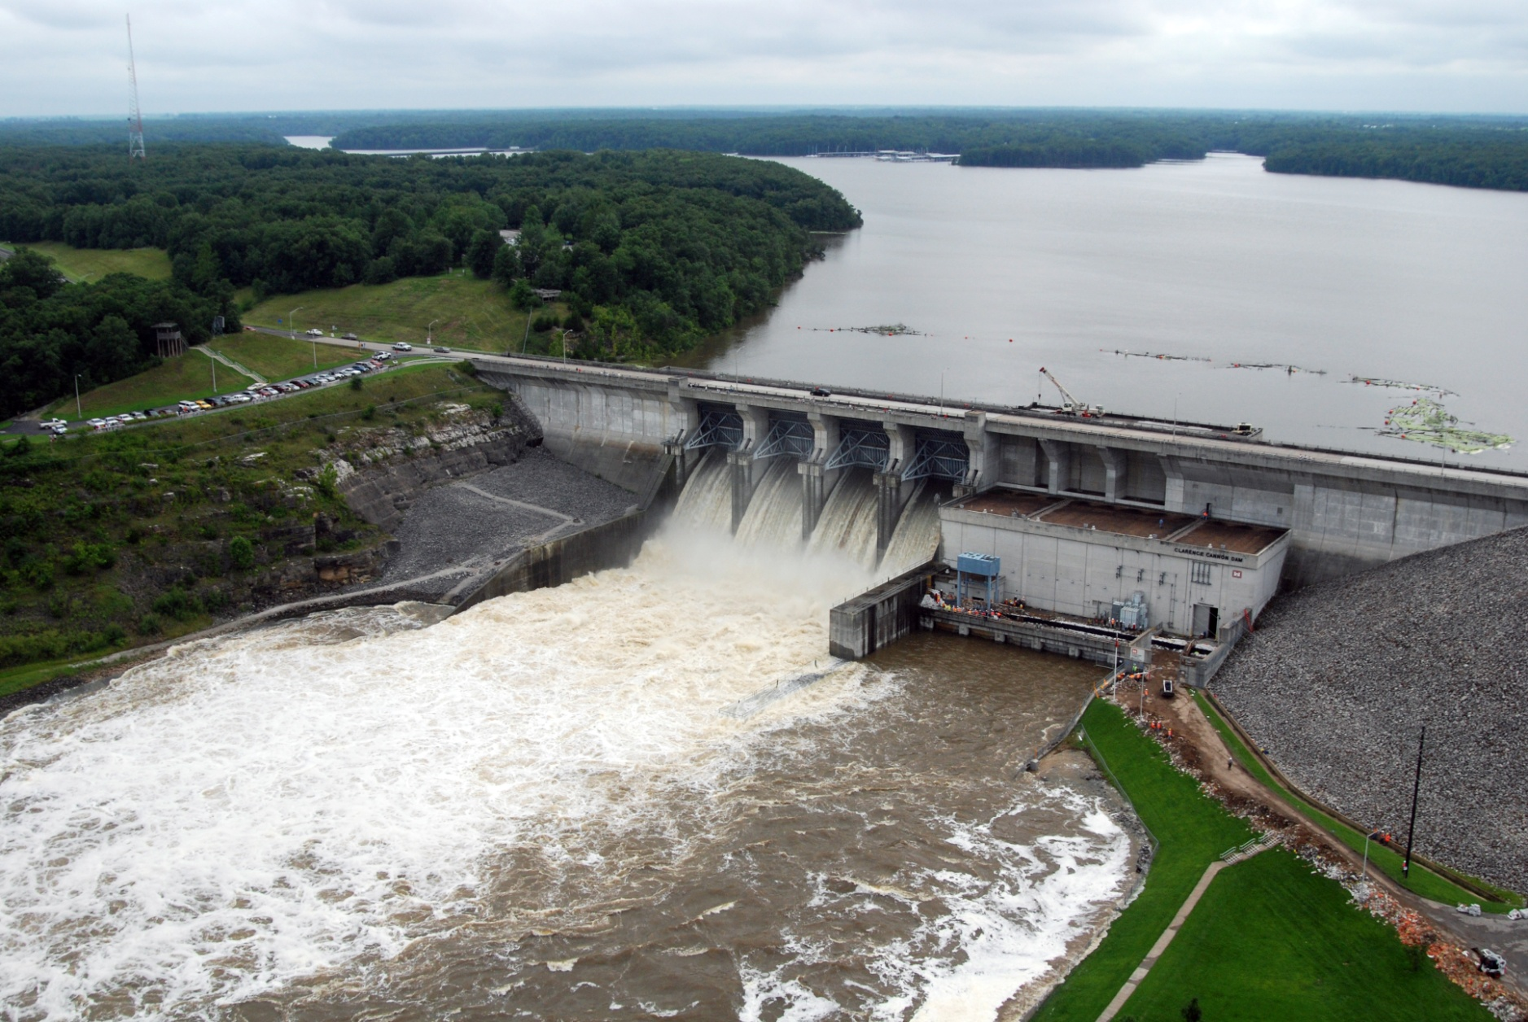
CWMS CAVI Orientation
Matt Fleming, P.E.
Hydrologic Engineering Center
CWMS Prospect Course
CAVI Modules

Slide 2
Overview
Introduce the CWMS Control and Visualization Interface (CAVI)
Screen Components
Layers
Time-Series Icons
Scripts
Introduce CAVI components and modules
Modules
Purpose and use
Available tools

Slide 3
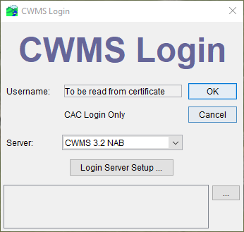
Cavi login
You can login to access data from the CWMS Oracle database on the server or run locally if you have the data (already downloaded or from some other source)

Slide 4
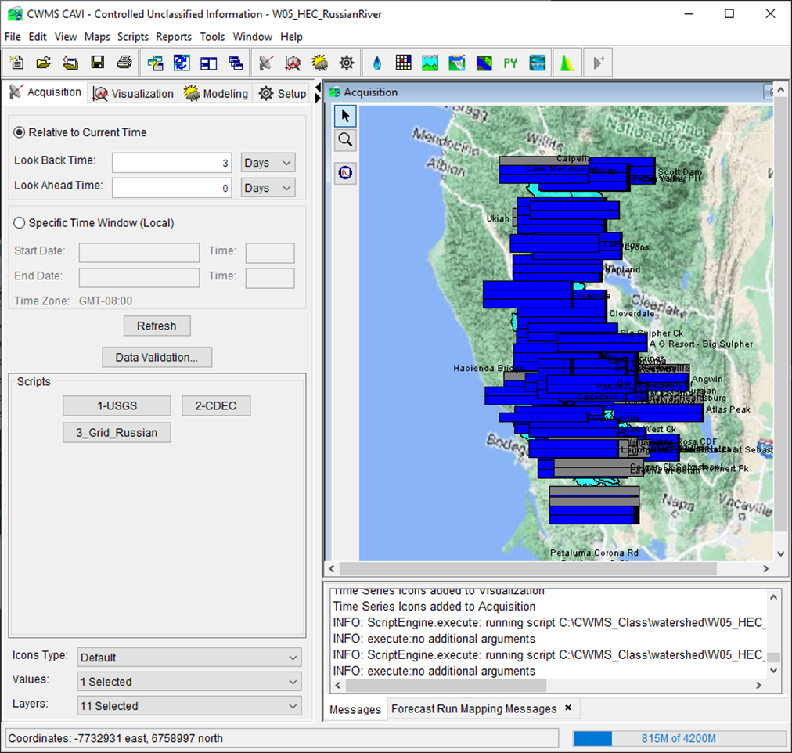
Data acquisition module purpose
View status of the data streams
Status for each data stream represented by the color of a corresponding button on the control panel
Last data stream status shown in the alert message line
View status and quality of data from individual gauges
Quality color bar time-series icons reflect data quality at primary gauge locations
Time window identified and set in the control panel
Icons can be set to update automatically (e.g., every 5 minutes)
Validate (edit) data from gauges
Identify usable observed data time window for modeling (i.e., select forecast time and lookback time)

Slide 5
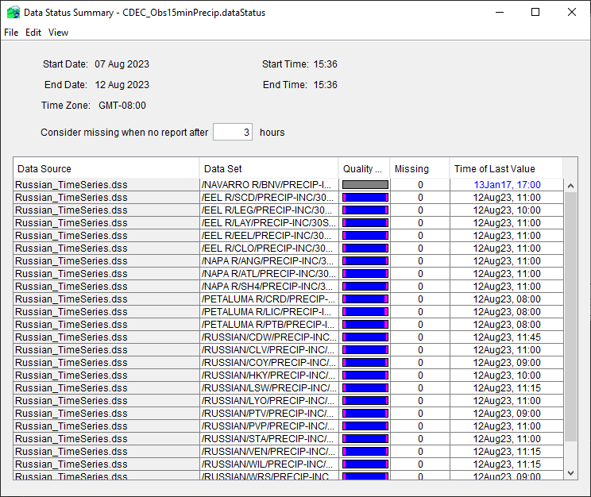
Data status summary table
Provides a quality color bar, number missing, and time of last value for each data set in a list of data sets
Can have as many different lists as desired, with no limit to the number of data sets in a list
Use by data analyst to evaluated data for all locations
Used by modelers to choose the forecast time

Slide 6
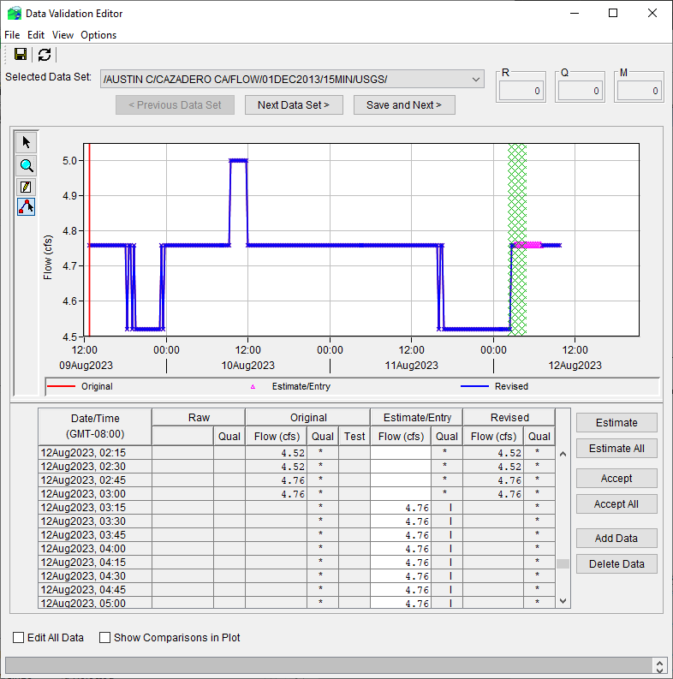
Data validation editor
Combined graphical/tabular editor
Used to accept/reject/estimate/enter gage data
Run in “ad hoc” mode or list driven
“ad hoc” by selecting series icons (shift-right mouse click), then press Validation button
Pre-defined list
Filter list (selections) according to quality
Plot other gages for comparison

Slide 7
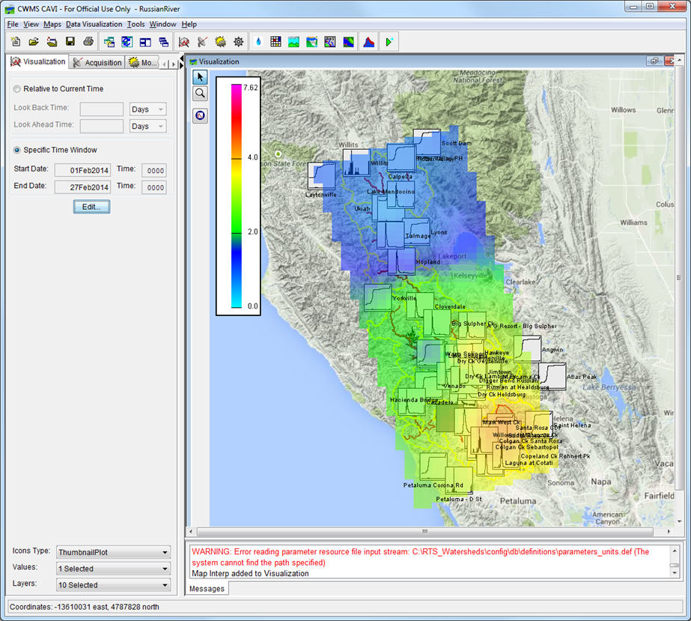
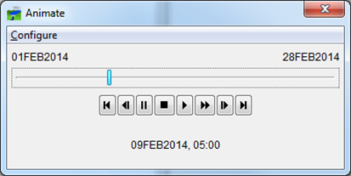
Data visualization module
View hydro-meteorological state of the watershed
Animation of precipitation or temperature
Combined “slider bar” and “VCR controls” allow user to play, fast forward, step through, etc. through gridded precipitation hours
Placing the mouse over a grid cell shows the amount of rain for that cell for that hour
“Thumbnail” plots of data at key locations (flow, stage, reservoir data)

Slide 8
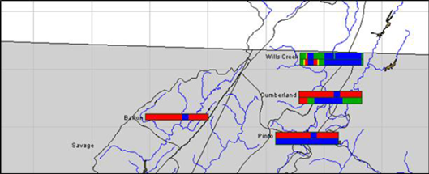
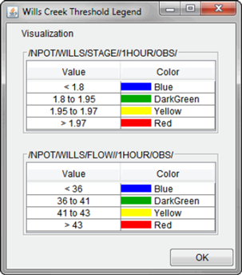
Data visualization module
Threshold color bars depict data values over time as colors are compared to defined limits
Example:
Green – below warning stage
Orange – above warning, below flood stage
Red – above flood stage
User defined threshold limits and colors
Limits and colors given in the time-series icon legend

Slide 9
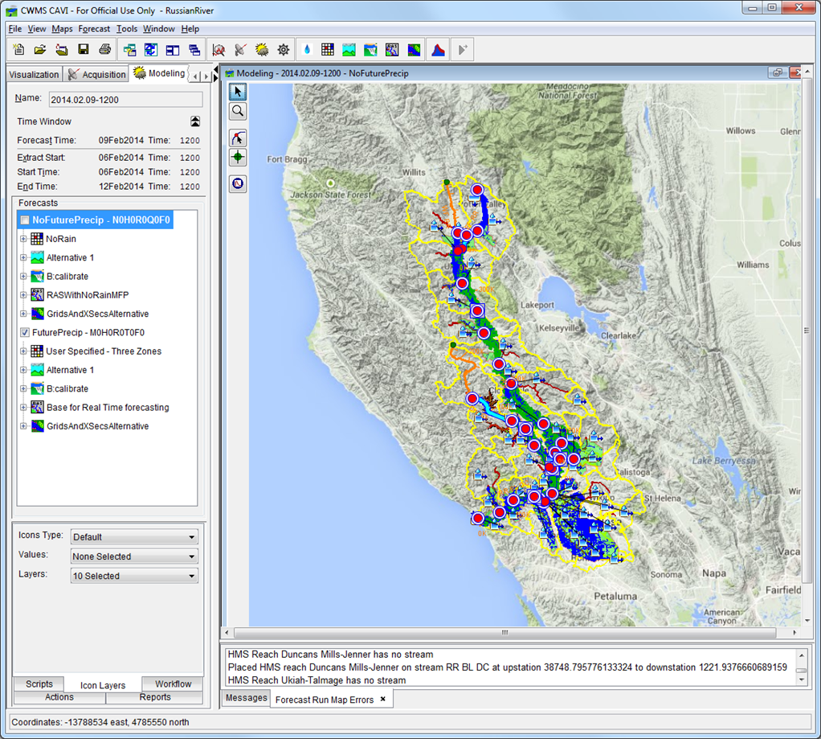
Modeling module
Model watershed and projects to:
Forecast future flows and stages
Determine inundation areas and flood depths
Simulate reservoir operations
Evaluate economic impacts
Evaluate “what if” alternatives:
What if there is more rain than forecasted?
How does a change in my reservoir operation affect downstream locations?
Results can be posted to Oracle

Slide 10
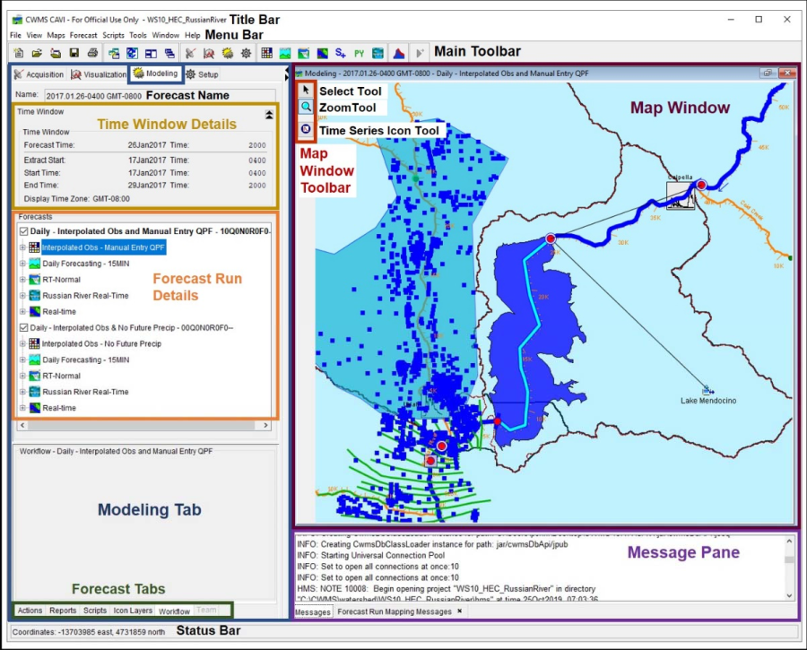
Modeling Module
Model run:
Meteorology (HEC-MetVue)
Hydrology (HEC-HMS)
Reservoir Analysis (HEC-ResSim)
Hydraulics (HEC-RAS)
Economics (HEC-FIA)
Inundation maps (RAS Mapper)
Adjust model parameters native editors
View and compare results from plots or tables (via time-series icons) or from model reports
Parameters can be adjusted to improve results
Loss rates/baseflow
Reservoir release overrides
Manning's n values

Slide 11
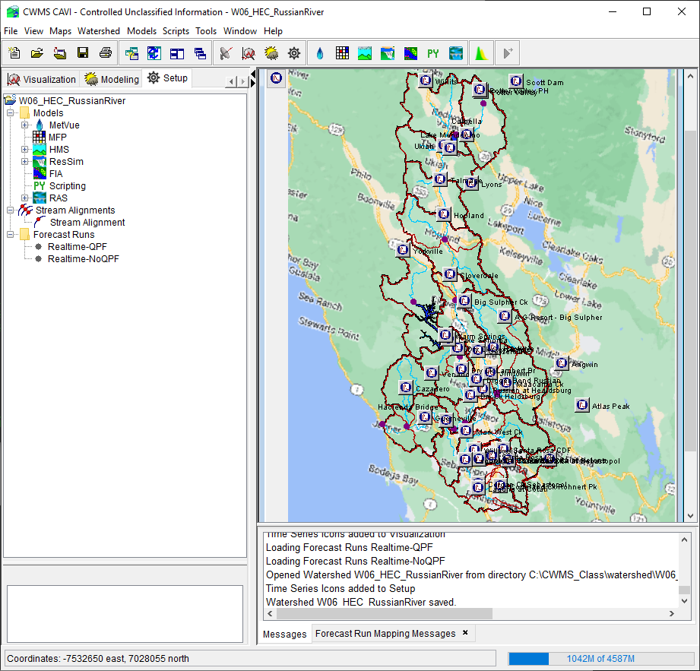
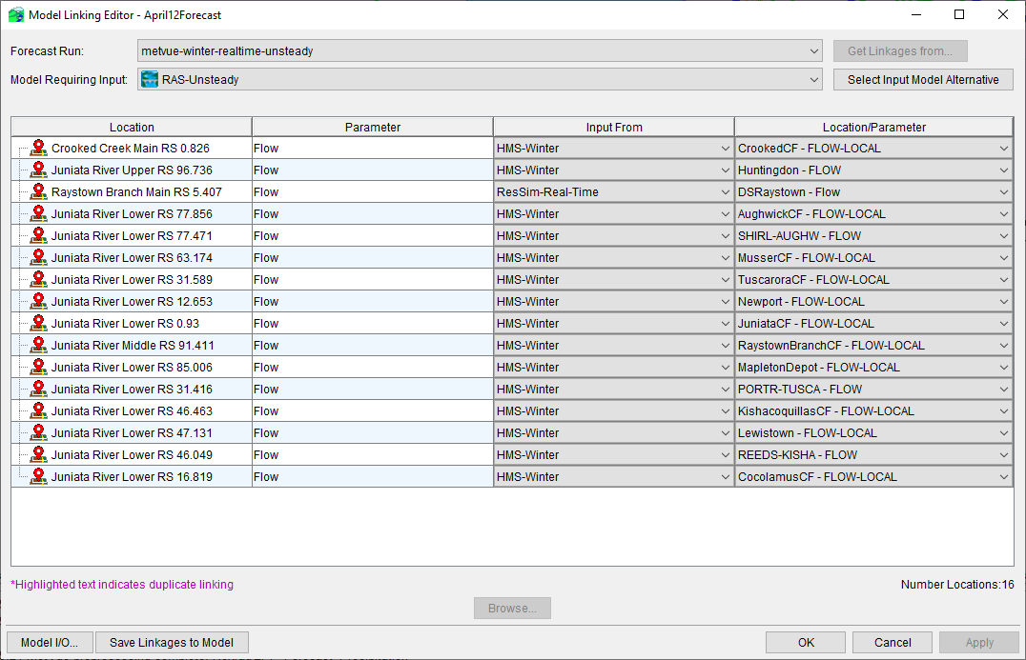
Watershed Setup Module
Load background maps
Import models
Setup “run alternatives”
Link models (data from a → data to)
Build extract/post lists
Add and configure time-series icons

Slide 12
Questions Help additional Training
https://usace.dps.mil/sites/KMP-WM/SitePages/Corps-Water-Management-System-(CWMS).aspx
https://www.hec.usace.army.mil/confluence/cwmsdocs
https://discourse.hecdev.net/c/cwms/5
TDL-CELRH-EC-GW-W-USACE CWMS Modeling | General | Microsoft Teams
“Just keep CWMS’ing”

