Slide 1
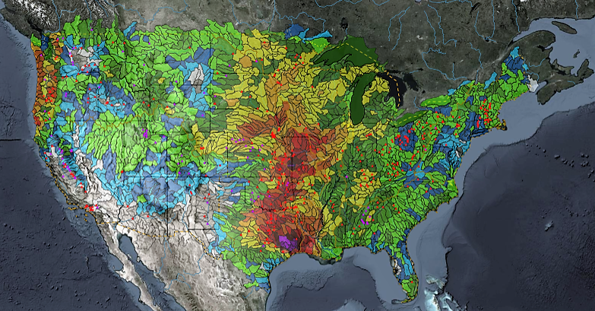
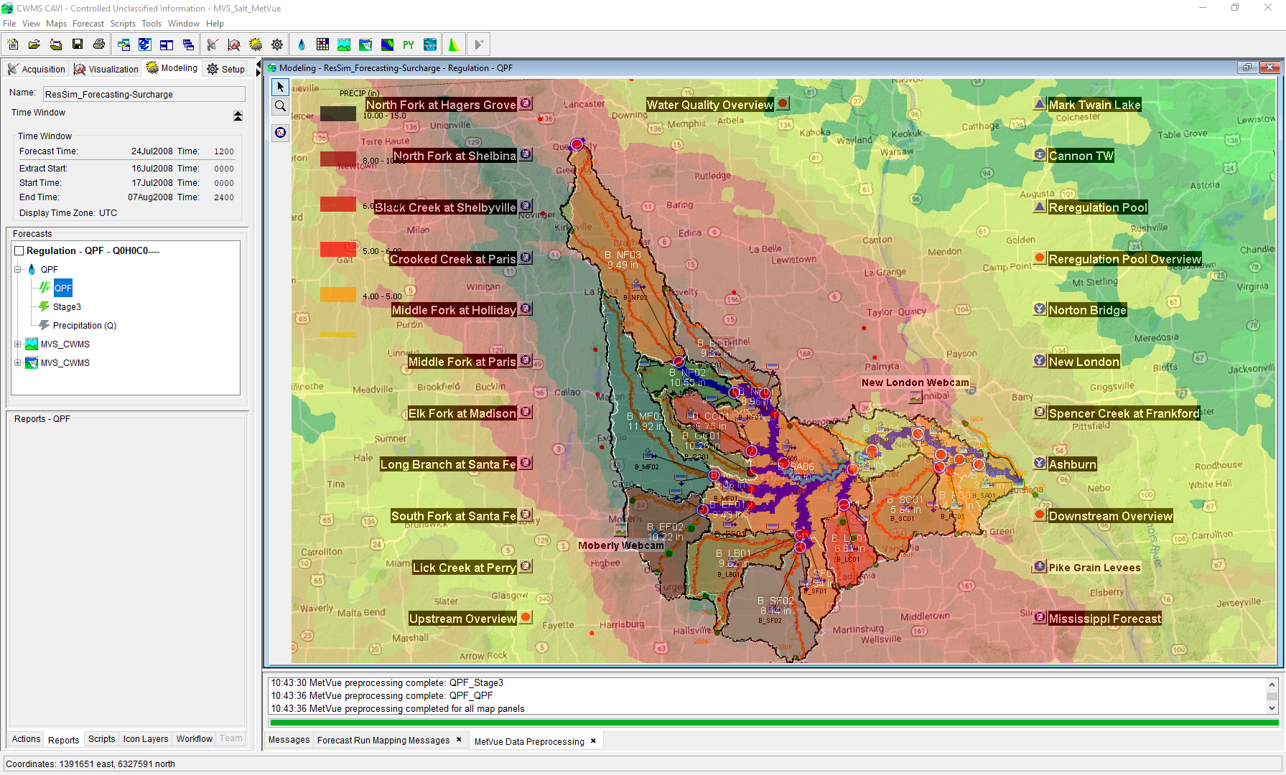

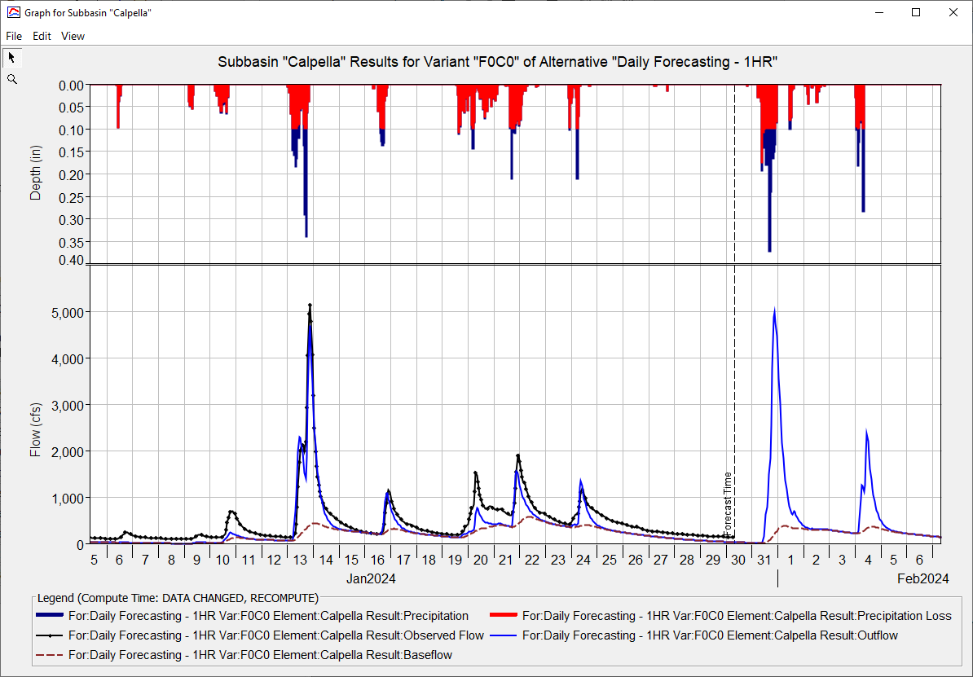
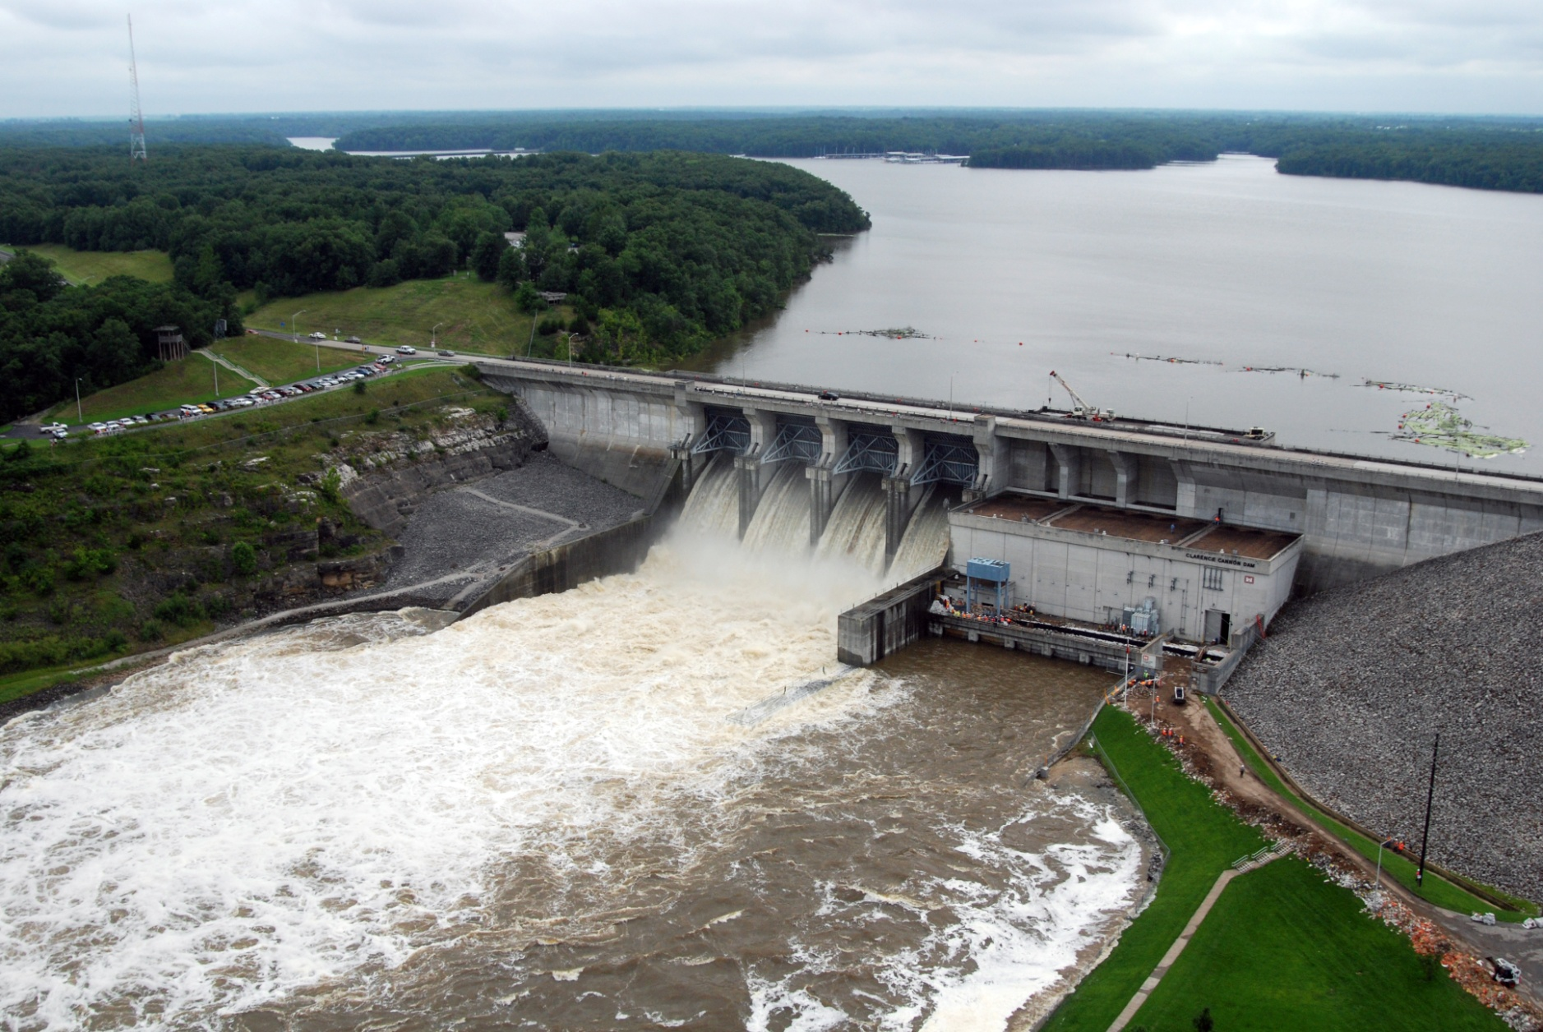
CWMS Real-Time Modeling
Russell Errett, P.E.
Hydrologic Engineering Center
CWMS Prospect Course

Slide 2
Overview
Identify basic concepts for building a new CAVI watershed and about running real-time forecast simulation models in CWMS
Quick overview on CAVI watershed model development
Steps to create new CAVI watershed for use in real-time modeling
Using CWMS for real-time modeling
Creating a forecast
Time windows and forecast times
Data Status Summary Report
Editing and running models
Evaluating results
Time-series icons for model results
Saving models and results

Slide 3
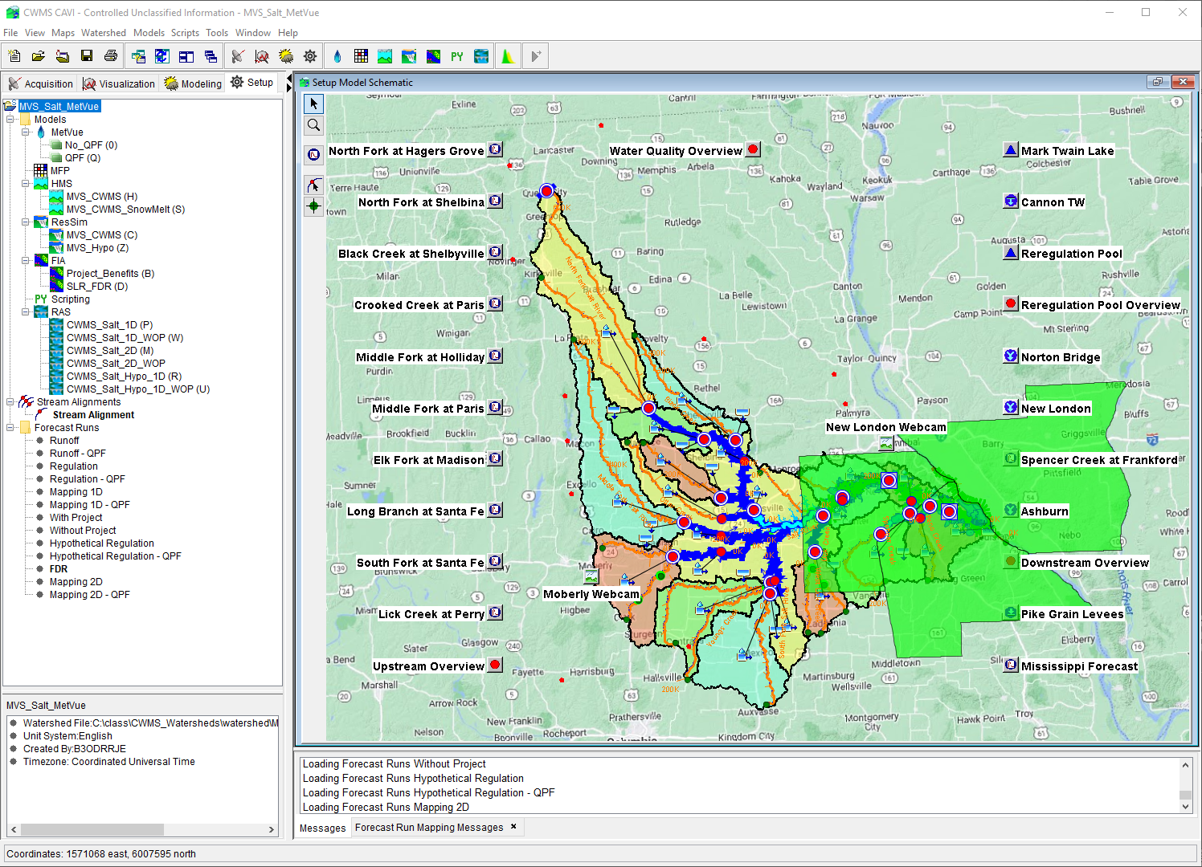
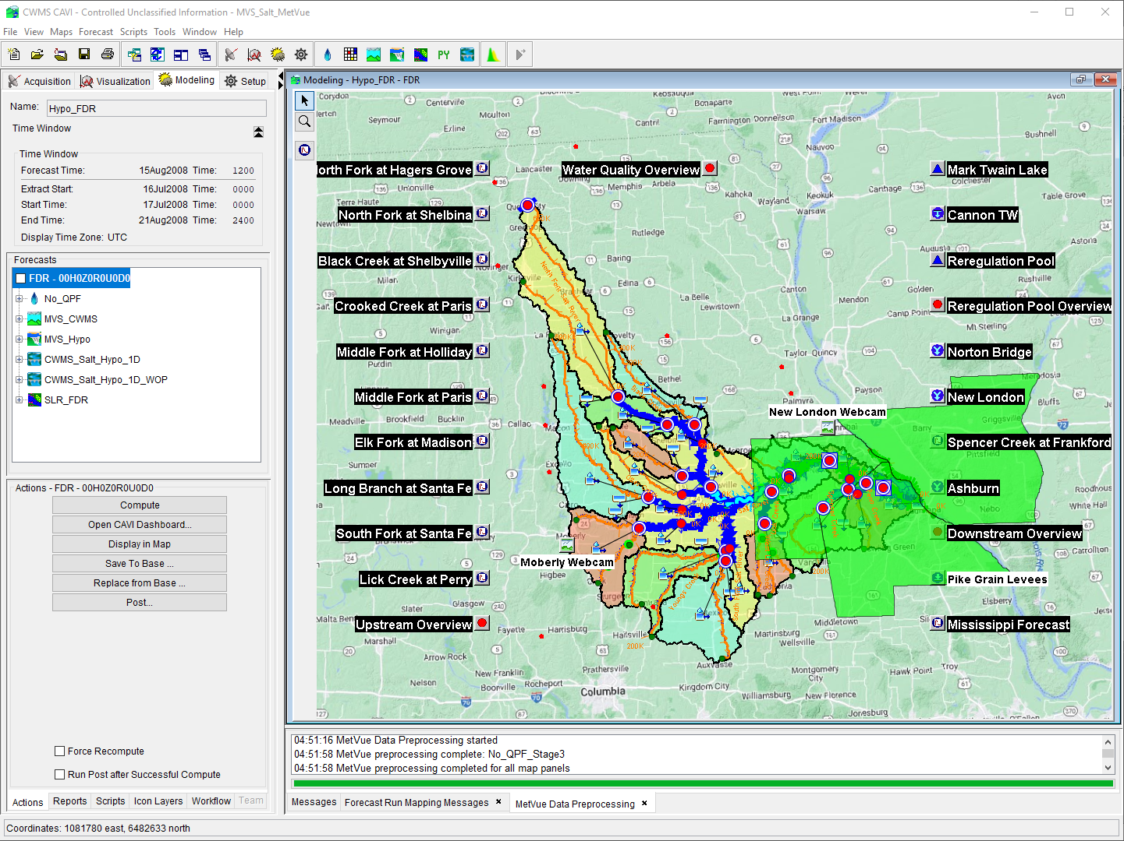
CWMS Modeling

Slide 4
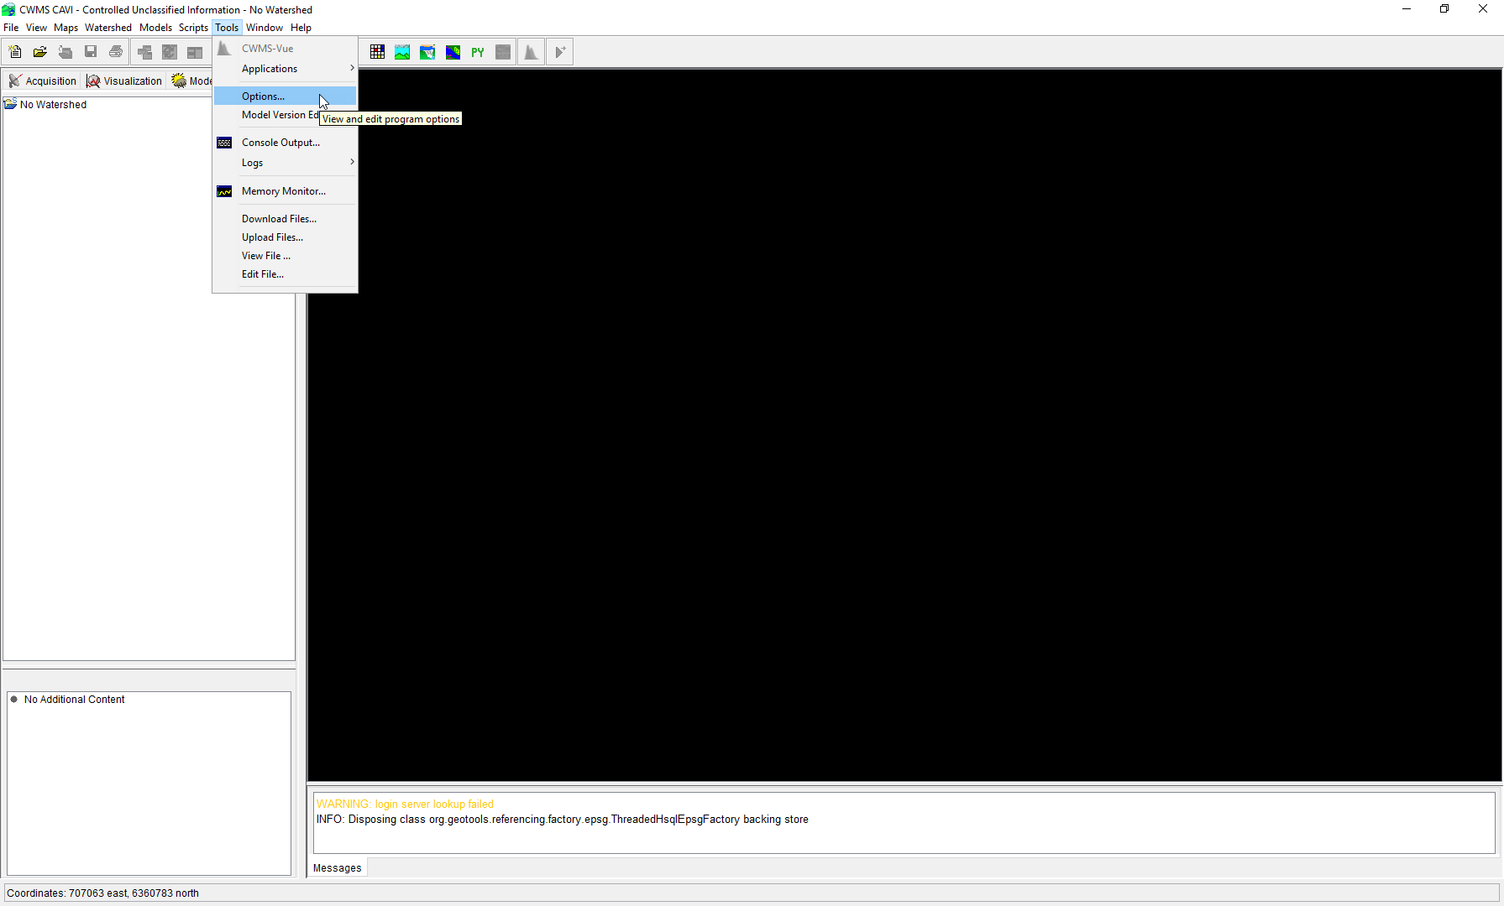
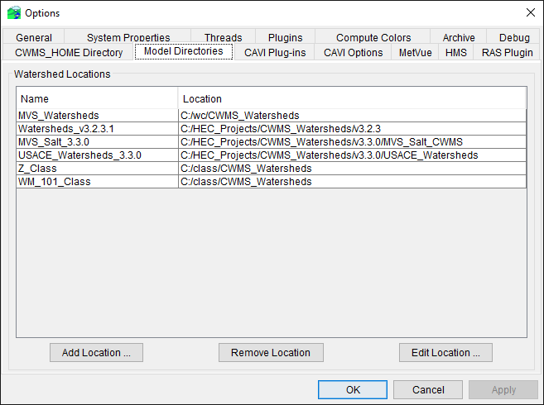
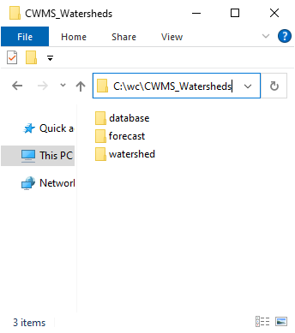
Defining CAVI Watershed Locations
X

Slide 5
CAVI Modeling SETUP

Slide 6
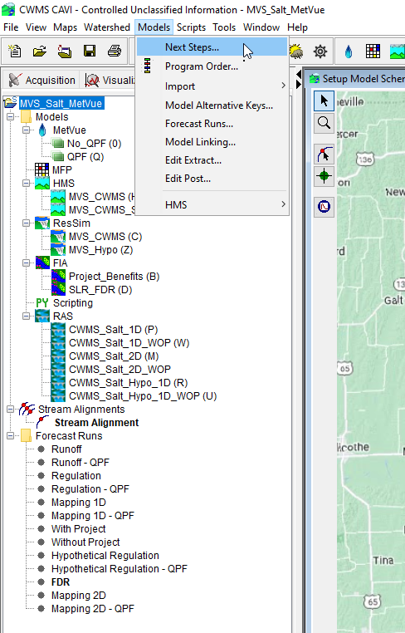
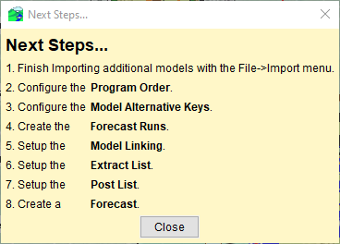
CWMS Modeling Setup
These are the key steps if you are building a CWMS watershed from scratch
From the Setup Tab create a watershed from File→New Watershed
Import all the standalone models into the CAVI
MetVue, HMS, ResSim, RAS, FIA
Define Program Order
Define Model Alternative Keys
MetVue requires additional steps prior to assigning a model alternative key (discussed later)
Create Forecast Run Alternatives (i.e., what models to run together)
Setup Model Linking
Setup Extract Lists
Setup Post Lists (can be done later)
Create a Forecast and test and resolve any steps above

Slide 7
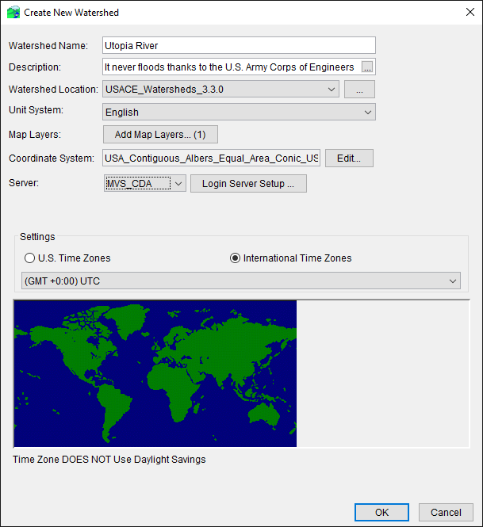
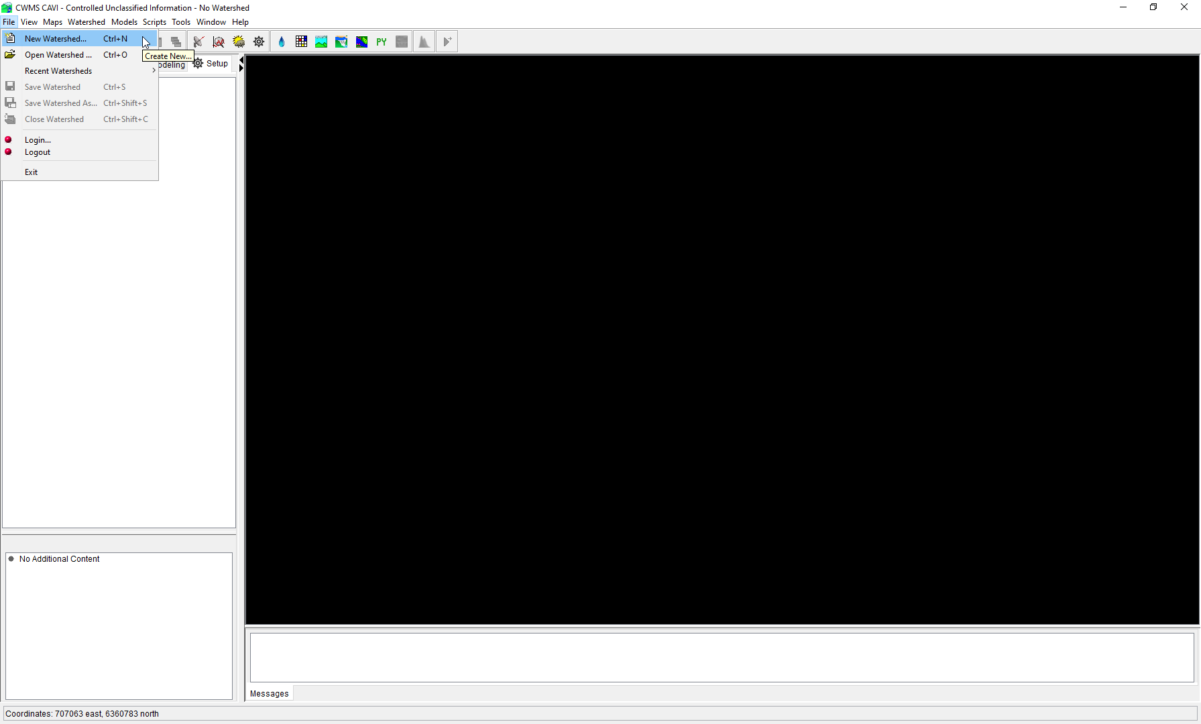
Creating a New CAVI Watershed

Slide 8
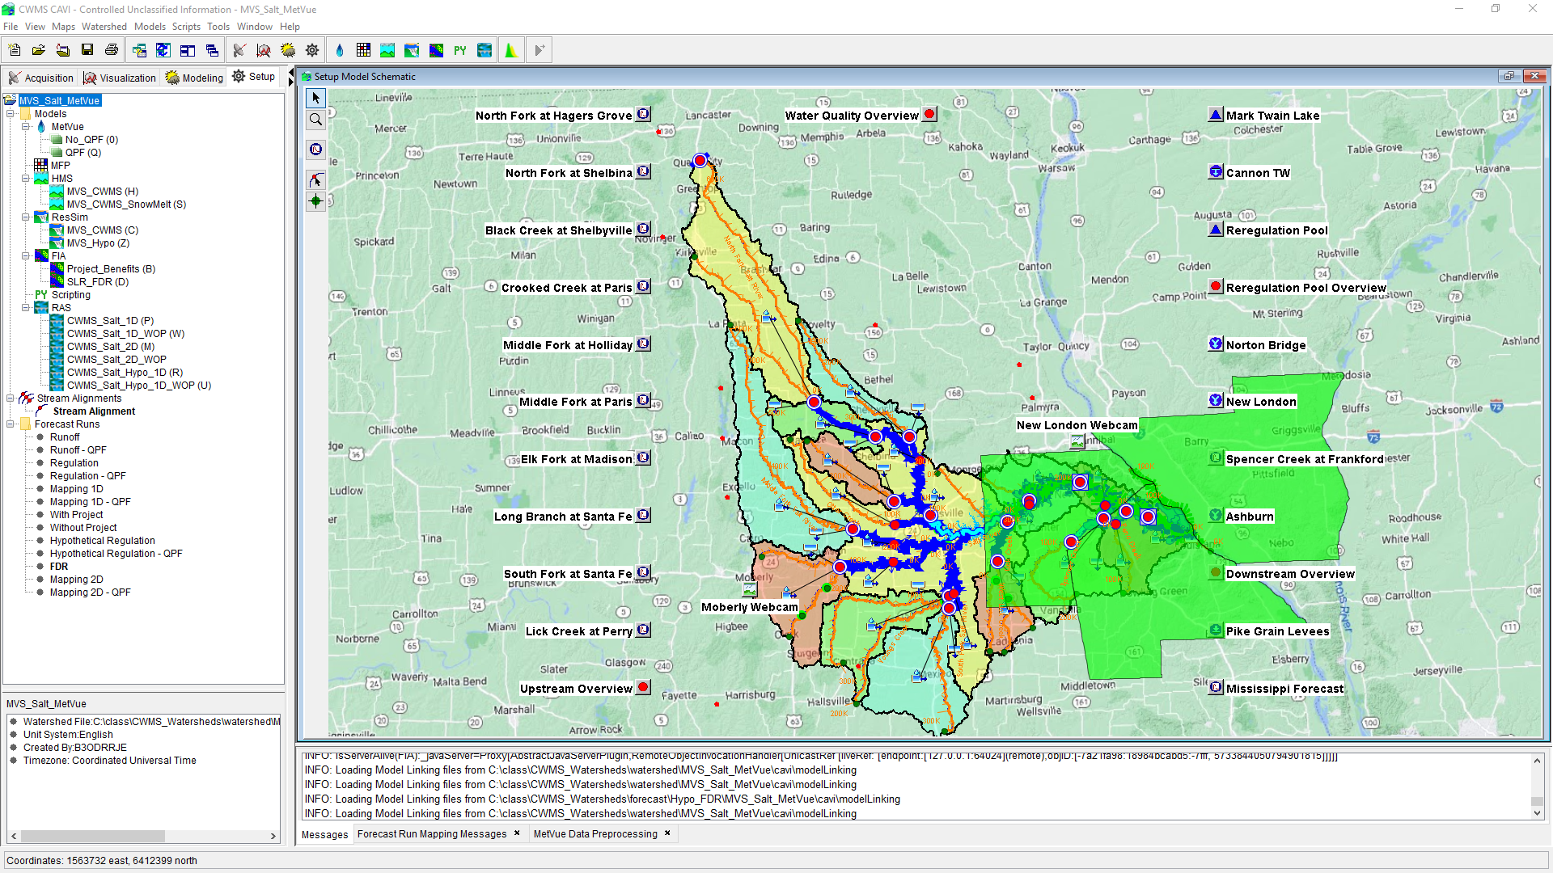
CAVI Modeling Setup

Slide 9
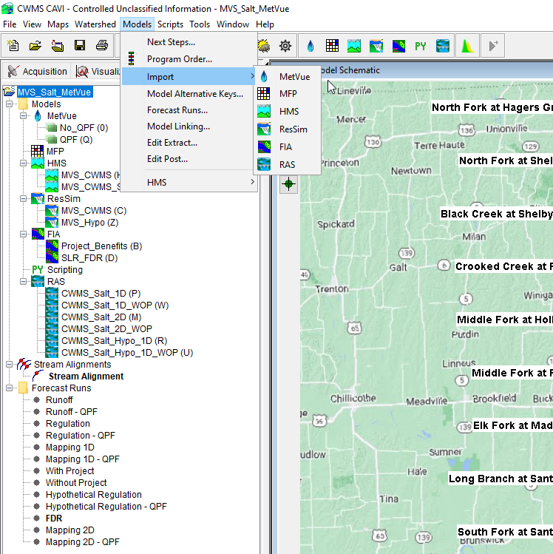
CAVI Model Imports

Slide 10
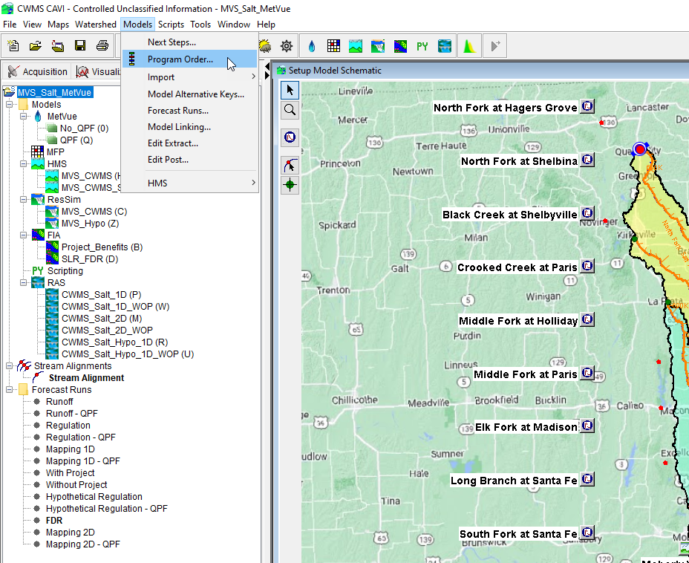
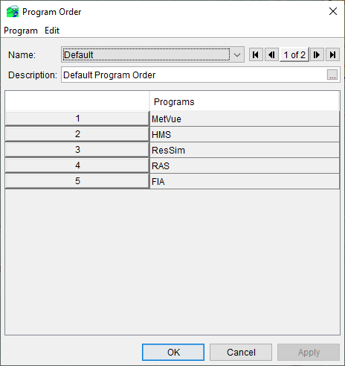
CAVI Program Order

Slide 11
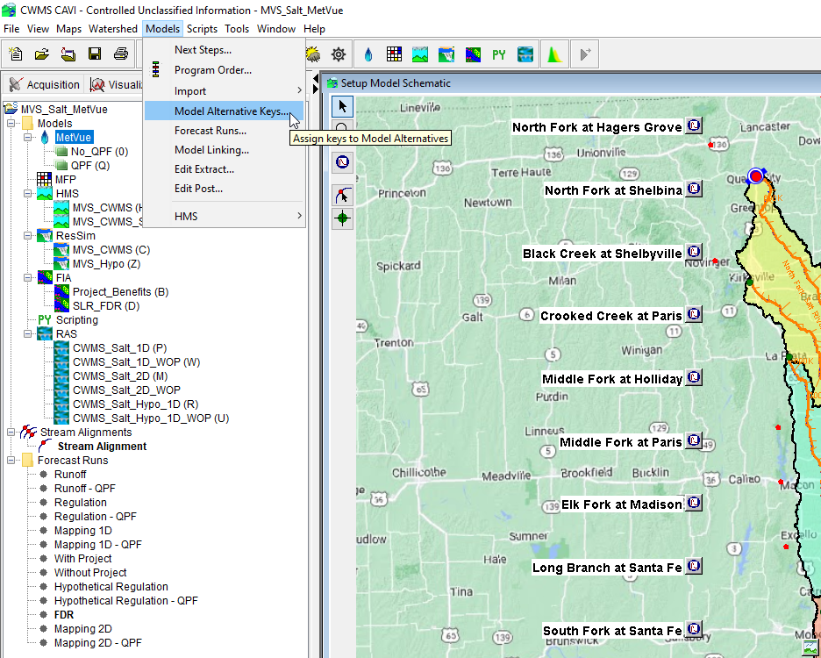
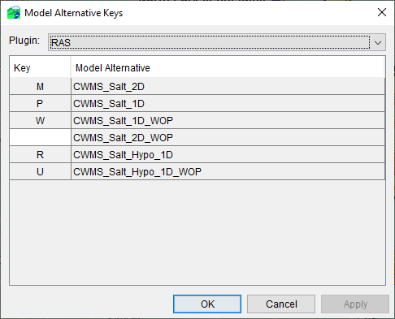
CAVI Model Alternative Keys

Slide 12
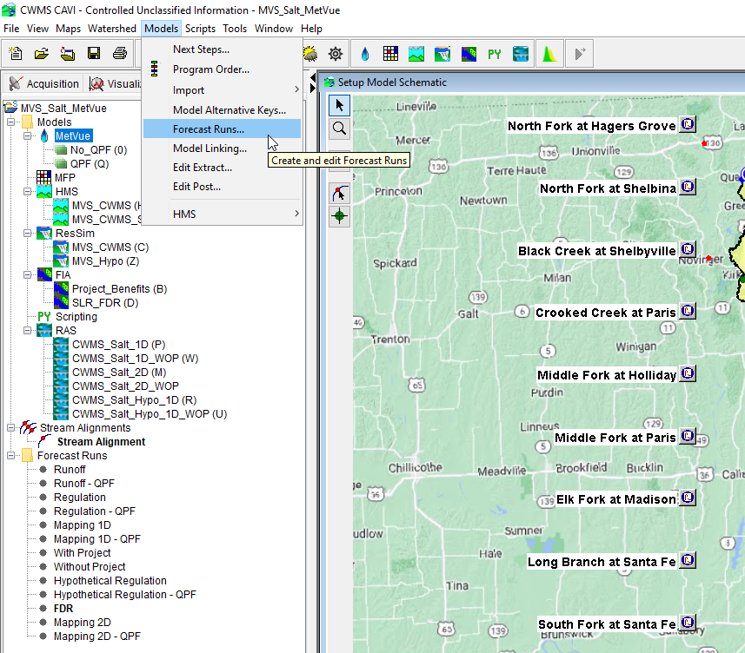
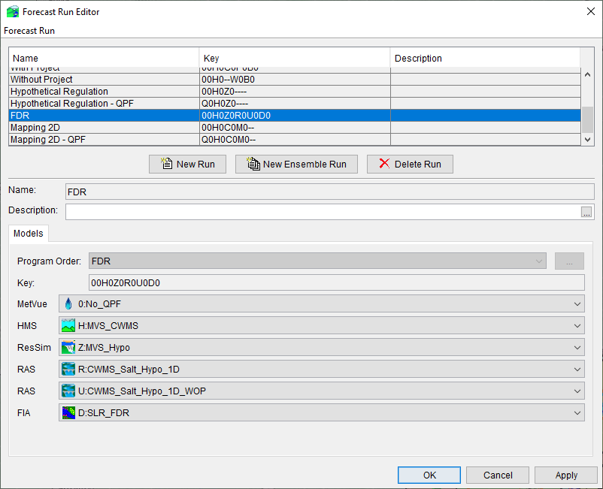
CAVI Forecast Run Alternatives

Slide 13
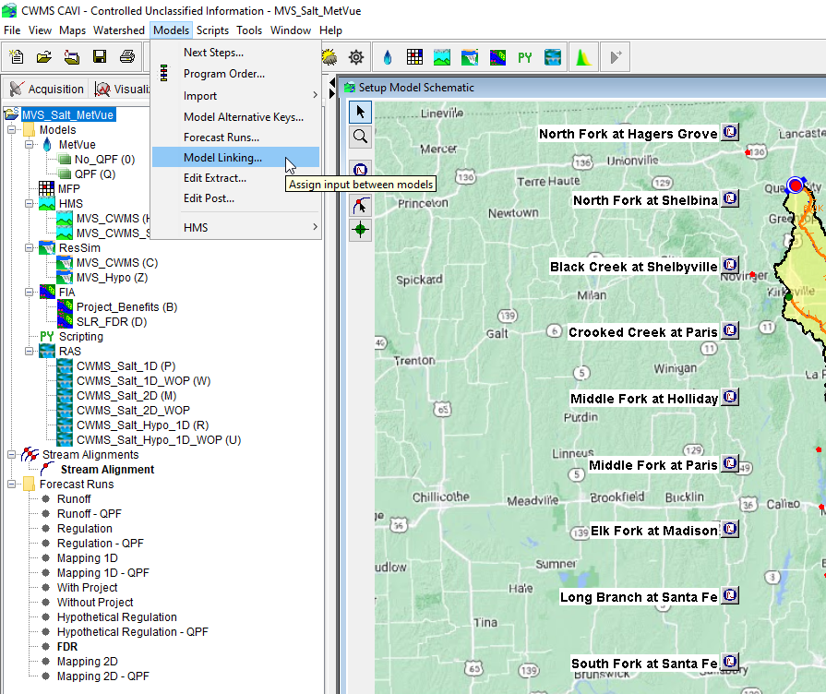
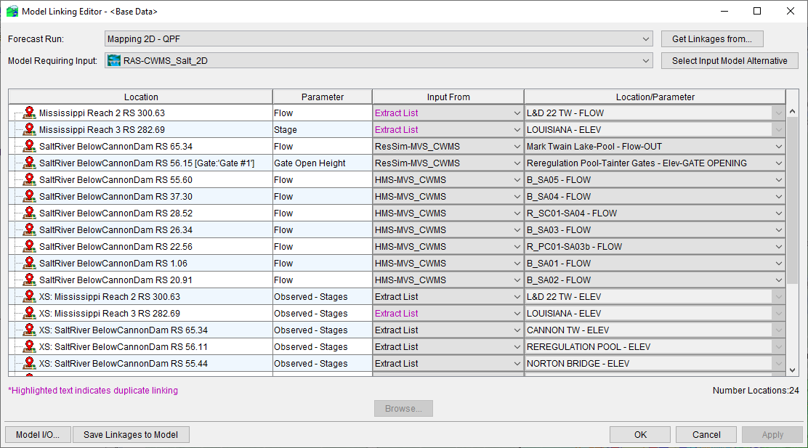
CAVI Model Linking

Slide 14
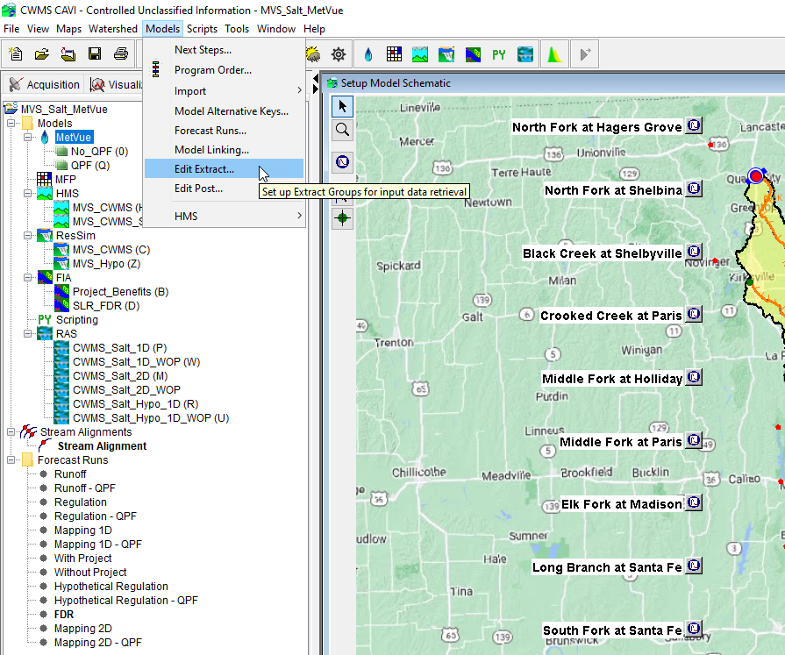
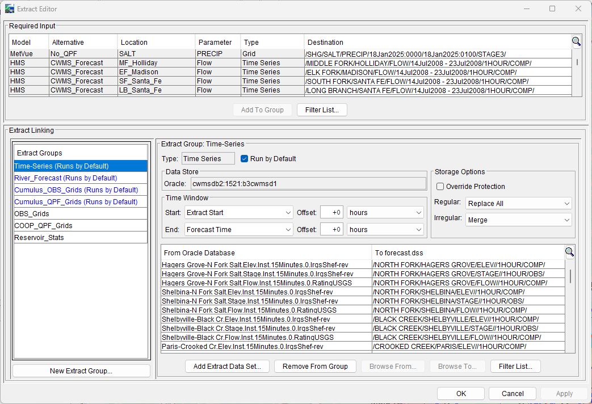
CAVI Extract Lists

Slide 15
CWMS Real-Time Modeling

Slide 16
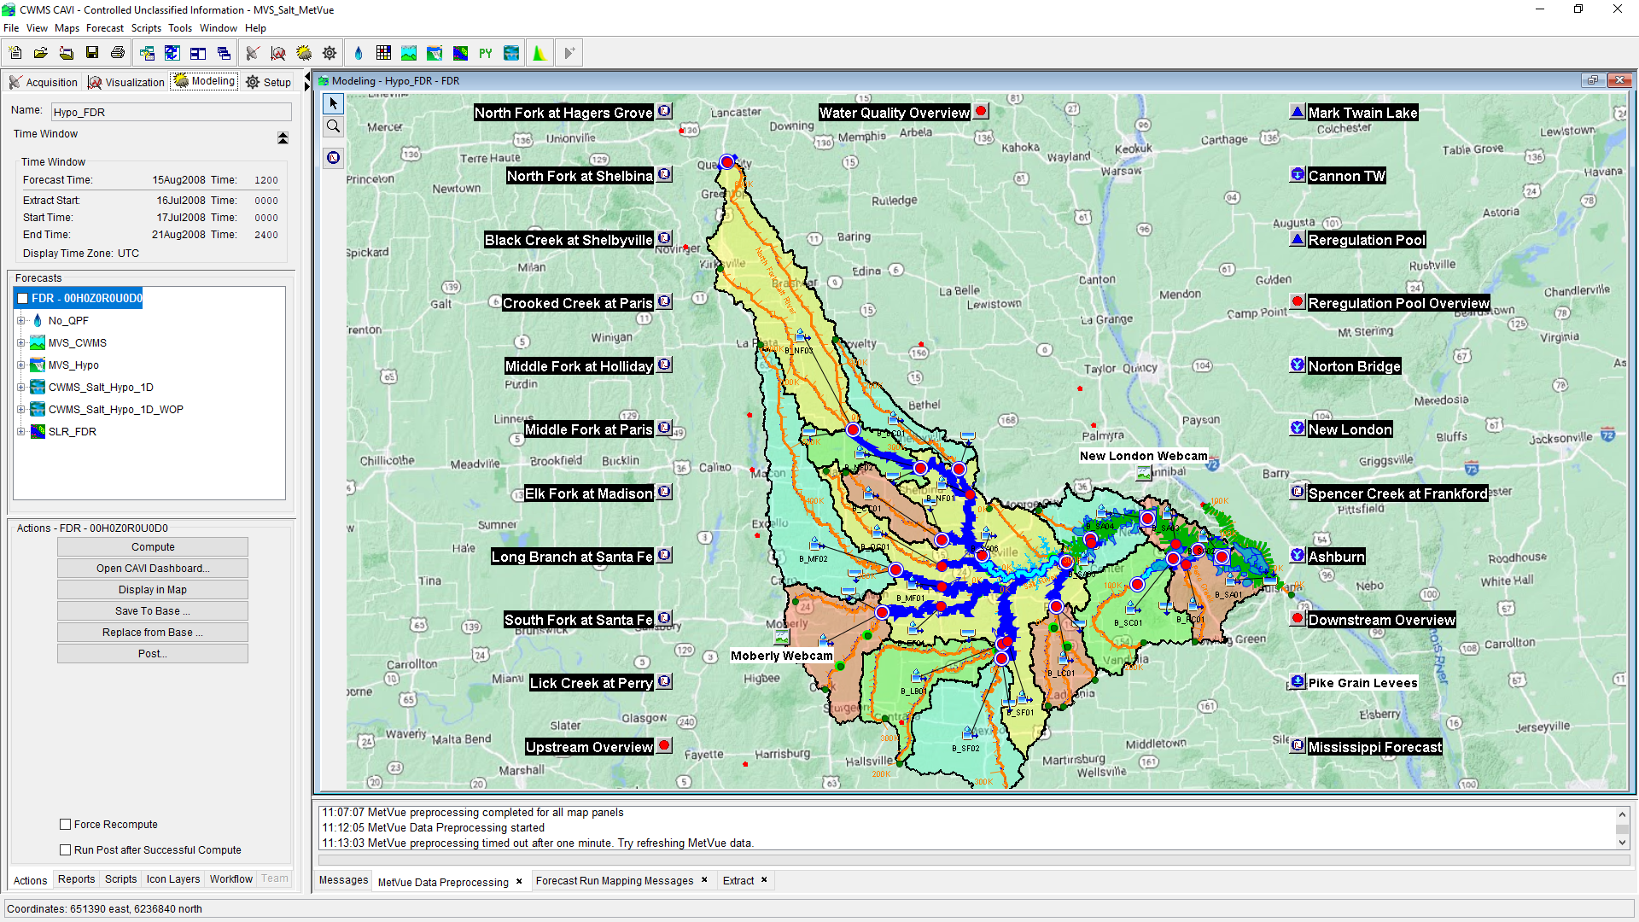
CWMS Modeling

Slide 17
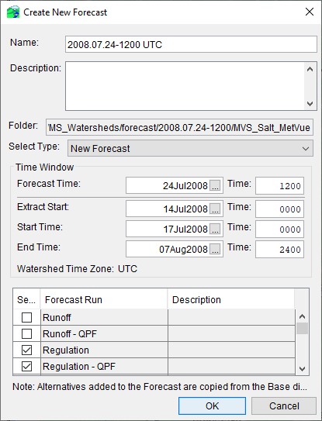
Create a Forecast
A forecast can be created once:
All the necessary models are imported
A forecast run alternative is created
Model linking is accomplished
This step can be done from the modeling tab within an active forecast
Extract lists are developed
Forecast directory will be created
Default name is Forecast Time in YYYY.MM.DD-HHMM TZ
Model alternative files used in the forecast run alternatives selected are copied to the forecast directory
Data will be extracted from source location to the forecast.dss file (as defined in extract list)
Oracle
CDA
Cumulus
Local and/or Remote DSS files

Slide 18
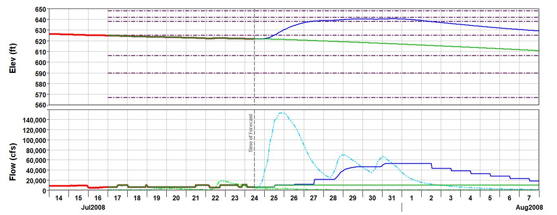
Time Windows
Model Simulation Window
OBS
No QPF
QPF
Forecast Data
Observed Data
Extract Start
Start Time
Forecast Time
End Time

Slide 19
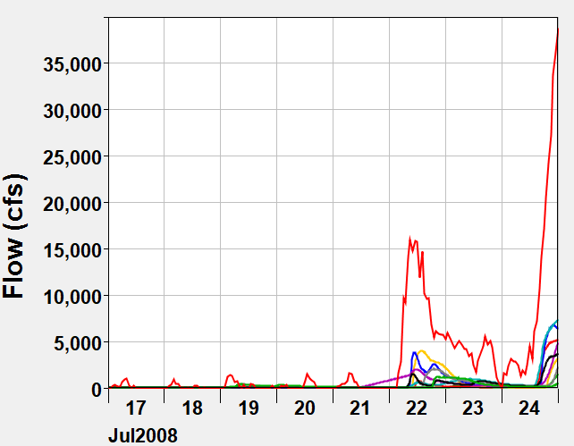
Start Time
Start Time is the time that the models begin simulating
Choose a time that:
Is far enough before time of forecast so that water has time to route through the routing reaches (i.e., time for water to flow from upper junction to lowest junction)
Prior to start of event in question
Typically, 4-10 days
Notes:
Time Windows and Forecast Times
4. Starting date/time of the simulation. AKA – lookback time.
Where the observed data used in the simulation begins. HMS and RAS start simulating at this time.
CWMS is event-oriented. In order to calibrate HMS loss rate and base flow parameters, the start time should be prior to the start of the rainfall for the initial forecast of the event.
Typically greater than 6 hours, and less than 2 weeks.
For HMS, If it’s been raining for an extended period:
Select an appropriate lull in the storm.
Set your initial loss rate low, close to the constant loss rate.
Set your base flow to what it was prior to the event. (it won’t have much effect at this point)
Set an appropriate recovery rate in the “Deficit-Constant” HMS/HFP editor
If it hasn’t rained yet:
Generally, set the starting time to greater than the routing time from the top of the watershed to the outlet.
Long enough to estimate base flow parameters.
For ResSim, the lookback window should be at least as long as it takes to route flow from the upstream-most reservoir to the downstream-most control point.
For RAS, the lookback period should reflect a period of reasonably steady flows throughout the basin.

Slide 20
Extract Start
Extract Start is often the same as the Start Time
Typically used when a value just before the start time is needed for a computation.
Observed data is in varying time steps, some longer than the compute interval
Observed data has an offset from the interval so a value is not extracted at the start time.
Your compute is period average, but your data is instantaneous, so a “start of period” value is needed to compute the first period’s average.
Or you just want to see more observed data than will be used in the simulation.

Slide 21
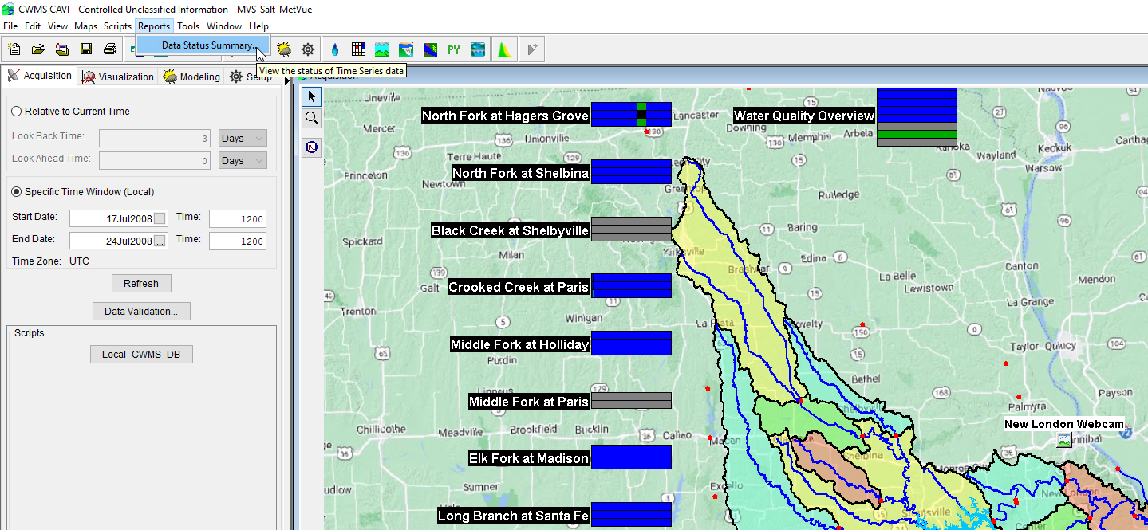
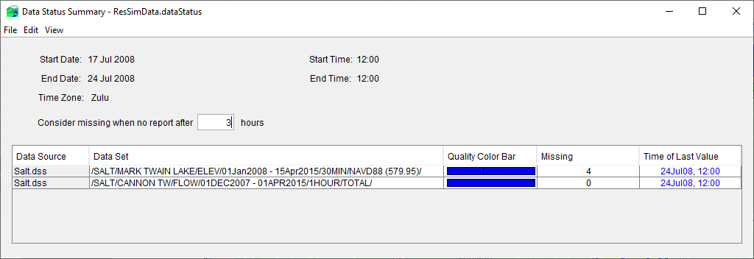
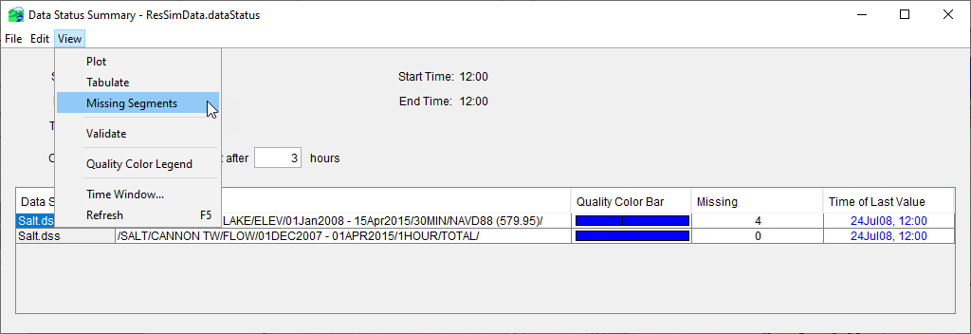
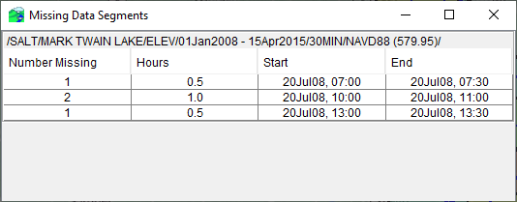
Data Status Summary Report

Slide 22
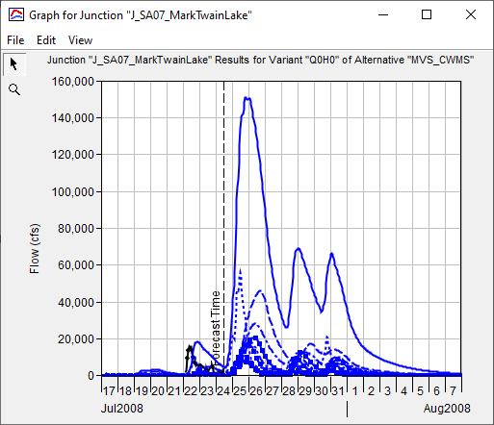
Forecast Time
Forecast Time is the time at which observed data runs out and you are predicting stream flow and river and reservoir stages
For real-time forecasting, typically not earlier than previous hour
Need time for all the stream gage data within the watershed to be transmitted and processed
Time for all the gridded data to be processed
Many offices have a default/standardized initialization time used for daily forecasting
For example 07:00 am local time
12:00 UTC for Central Time Zone

Slide 23
End Time
End Time is the time where models stop simulating (i.e., end of forecast)
Many offices have a default/standardized initialization time used for End Time
For example, the length of forecast will dictate the End Time
i.e., Forecast length of 5-days, 7-days, or 14-days
Other questions and data constraints can influence length of forecast or End Time
How long to evacuate flood storage
Drought forecasting
How much and accuracy of existing meteorological forecast data
Limitations in model computational time
i.e., detailed 2D RAS models running for 2 weeks versus 6 months of data

Slide 24
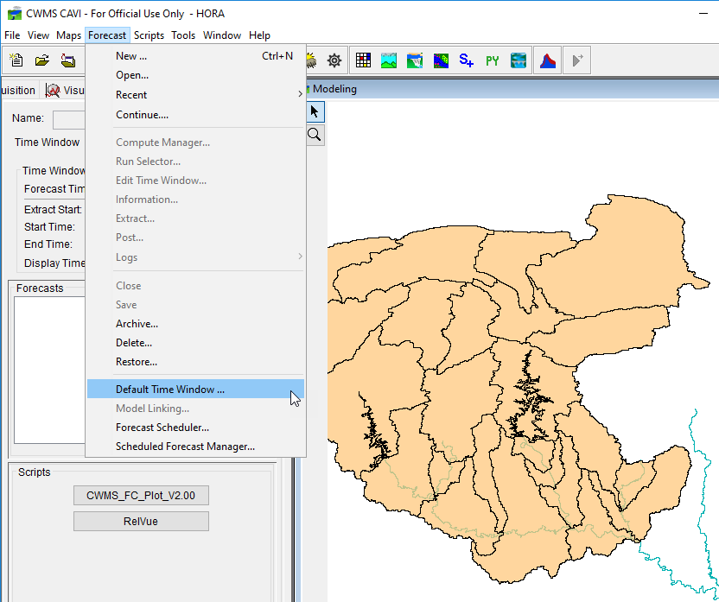
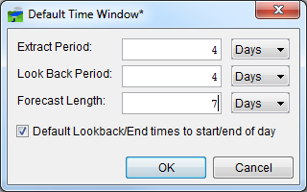
Default Time Window

Slide 25
CAVI Watershed Folder Structure
The CAVI works only with files in preselected folders called Watershed Locations
There are 3 sets of folders created within a Watershed Location
watershed
Watersheds are created and stored in a folder named “watershed”
The watershed folder is often referred to as “Base” or “Setup”
Watershed = Base = Setup
forecast
When a forecast is created, a subset of the watershed is copied to the forecast folder
database
Folder to store supplemental DSS records (i.e. ratings, cumulus grids, USGS downloaded data, etc.) or any other reference material to support modeling (SOPs, contact list, etc.)

Slide 26
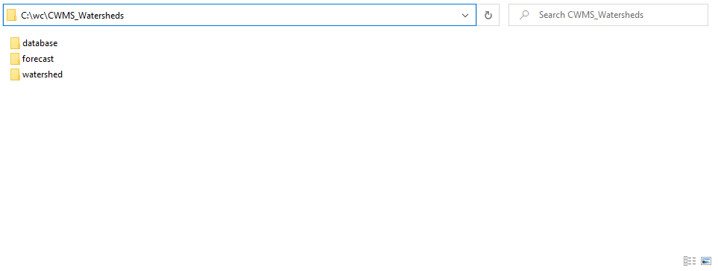
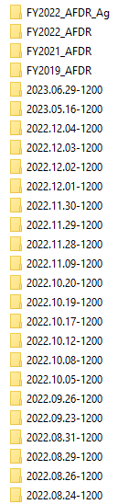
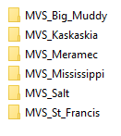
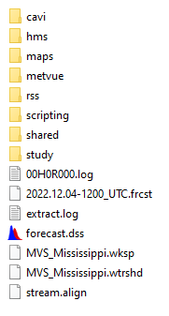
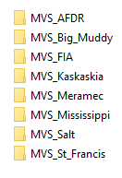
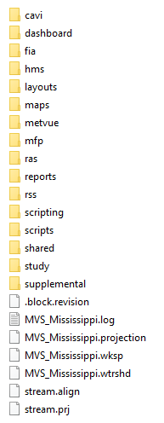
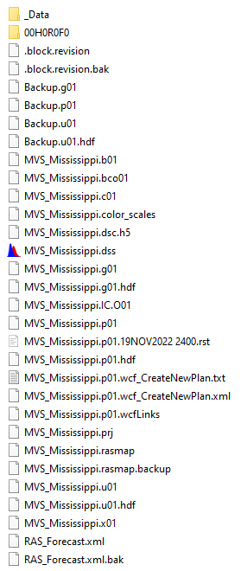
CAVI Watershed Folder Structure

Slide 27
Computing the Models

Slide 28
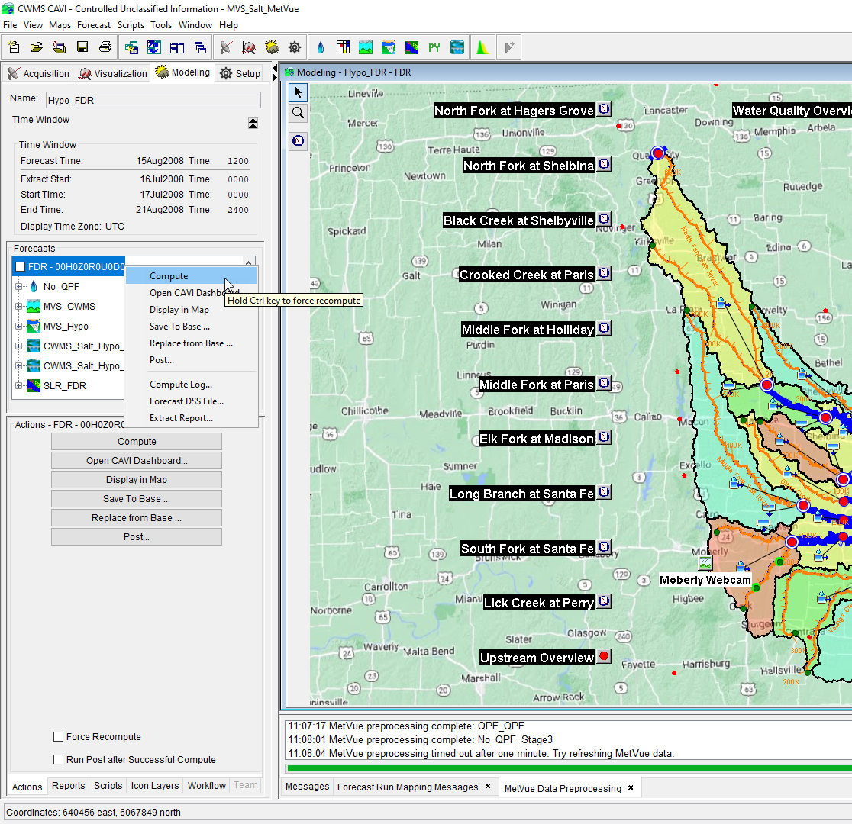
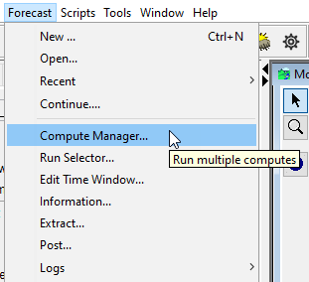
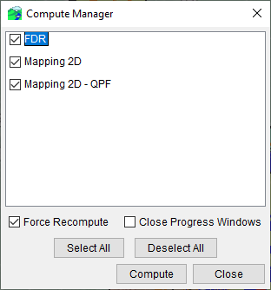
Computing the Models
3 ways to compute CWMS models from a forecast:
Highlight forecast run alterative OR individual model alternative:
Right click and Compute
Compute from Actions Tab below
Hold Control to force recompute for either option
Navigate to Forecast→Compute Manager
Select one or multiple forecast alternatives to have the CAVI compute
These are not computed simultaneously, rather in sequence
Notes:
Editing And Running Models
Run all models for a forecast run by selecting the forecast, and then:
Right clicking and selection the “Compute” menu.
Selecting the Compute Button in the Actions Panel.
Run an individual model by selecting the model in the Forecast run panel, then pressing the “Compute” button in the Actions panel.
Will run any models in the sequence before it that needs to be run.
Select “Force Recompute” checkbox to force all prior models to be re-computed.
You can also hold the Control key on the keyboard when you click the compute button to force a recompute.

Slide 29
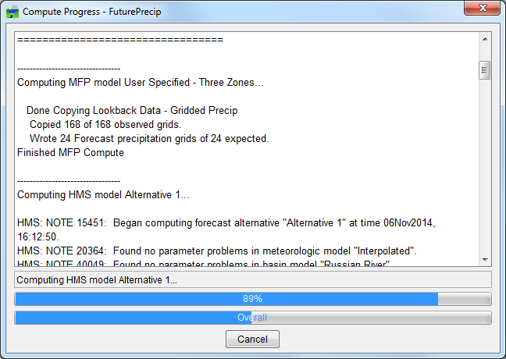
Computing the Models
Notes:
Editing And Running Models
After choosing to compute, the compute progress dialog will open.
This dialog box gives useful output detailing any issues found throughout the forecast run for any of the models being computed.

Slide 30
Viewing the Results

Slide 31
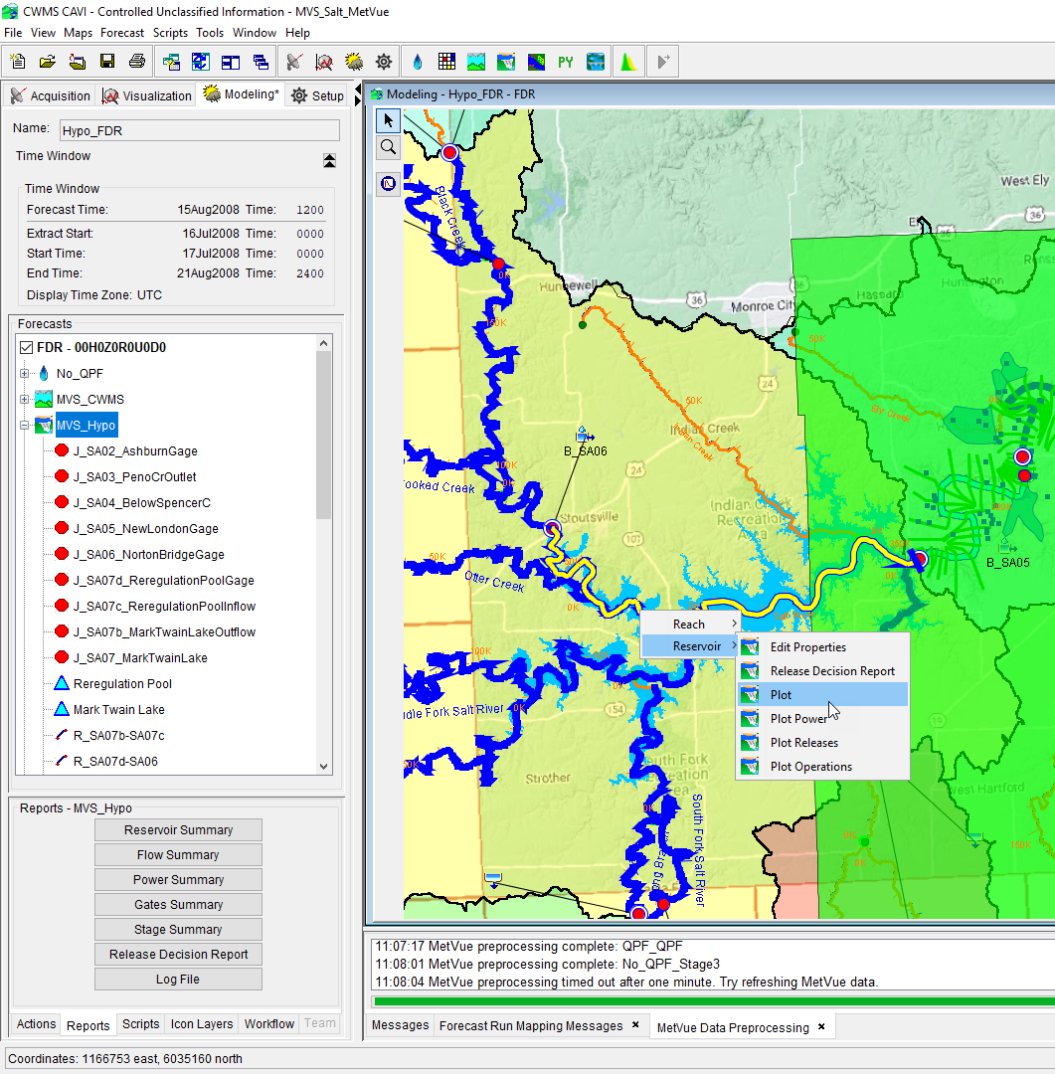
Viewing Results
Output is available from:
Forecast Run Alternative modeling tree
Reports Tab below modeling tree
From the modeling schematic in the CAVI Modeling map window
Opening the specific model from the standalone application (i.e., HMS, ResSim, RAS)
Or opening the forecast.dss file via CWMS-Vue and sorting the results based upon the model results F-Part
View Results

Slide 32
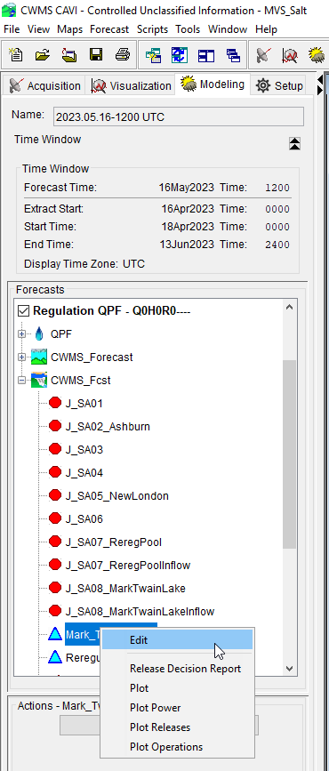
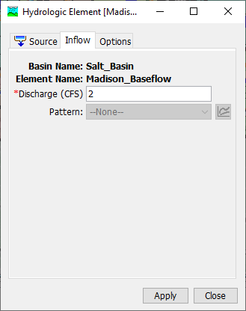


Edit Model Parameters
Multiple ways to get to access model editors

Slide 33
Saving and Posting Results

Slide 34
Saving to Base & Replace From Base
Save To Base
Replace From Base
If you have made changes and want them available for future forecast creations
Changes such as:
Adjustments to guide curve or zones
Adjustments to Max-Min Release rules
Rating curve updates with models
HMS zonal parameters
RAS roughness coefficient calibrations
If you make changes and cannot undo them
Too many changes in the HMS zonal parameter editor
Modifications to ResSim rules or zones that you want undo
RAS model modifications that need undone
Cross-Sectional edits
Manning's n changes
Roughness coefficients
Check with your office’s procedure on leveraging these options
Some offices prohibit Saving to Base to preserve the Base directory

Slide 35




SavE to Base & Replace From Base

Slide 36
Posting Results
Posting results allow for other CAVI watersheds to extract modeled data and to exchange data to other users for other purposes
Posting to CDA GIS dashboards to access (EOC, EMs, Division, etc.)
Posting to CDA or CWMS database allows for exchange with other downstream watersheds for boundary conditions
Inter-district watersheds, downstream district, or exchange with NWS via shef
Posting to database or remote DSS file for evaluating forecast accuracy
Versioning of time-series (i.e., many forecast under same time-series)

Slide 37


Posting Results

Slide 38
CWMS Forecasting Methodologies

Slide 39
CWMS Forecasting Methodologies
There are a couple competing methodologies for performing daily CWMS forecasting (not a competition…or is it)
Create a new forecast each day
Fresh extract of data (time-series and gridded data)
Many offices set the lookback is at least 30 days back (i.e., initial conditions have less influence on current conditions
This methodology is advantageous if you have multiple watersheds to run and manage as keeping up with various start times and when to reset can be difficult
Continuous forecasting
Initialize the CAVI forecast at a time between events when initial baseflow is at it’s lowest
Move Forecast Time and End Time by one day for daily forecasting
Extract only the missing data needed (i.e., last 24 hrs)
This methodology is advantageous if you have only one or a limited number of watersheds to run and manage

Slide 40

Team Forecasting
Team forecasting improves:
The ability to sync CAVI watershed updates amongst multiple Water Managers
Syncing and sharing active forecasts with Water Managers and H&H modelers
Hydrology Team → Reservoir Regulation Team → Hydraulic Team → Economist
Team Forecasting can be used for archiving CAVI watershed models as a backup

Slide 41


Team Forecasting

Slide 42



? ? ? Questions ? ? ?

