Slide 1
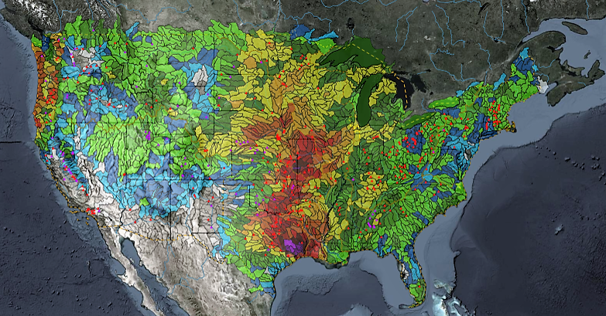
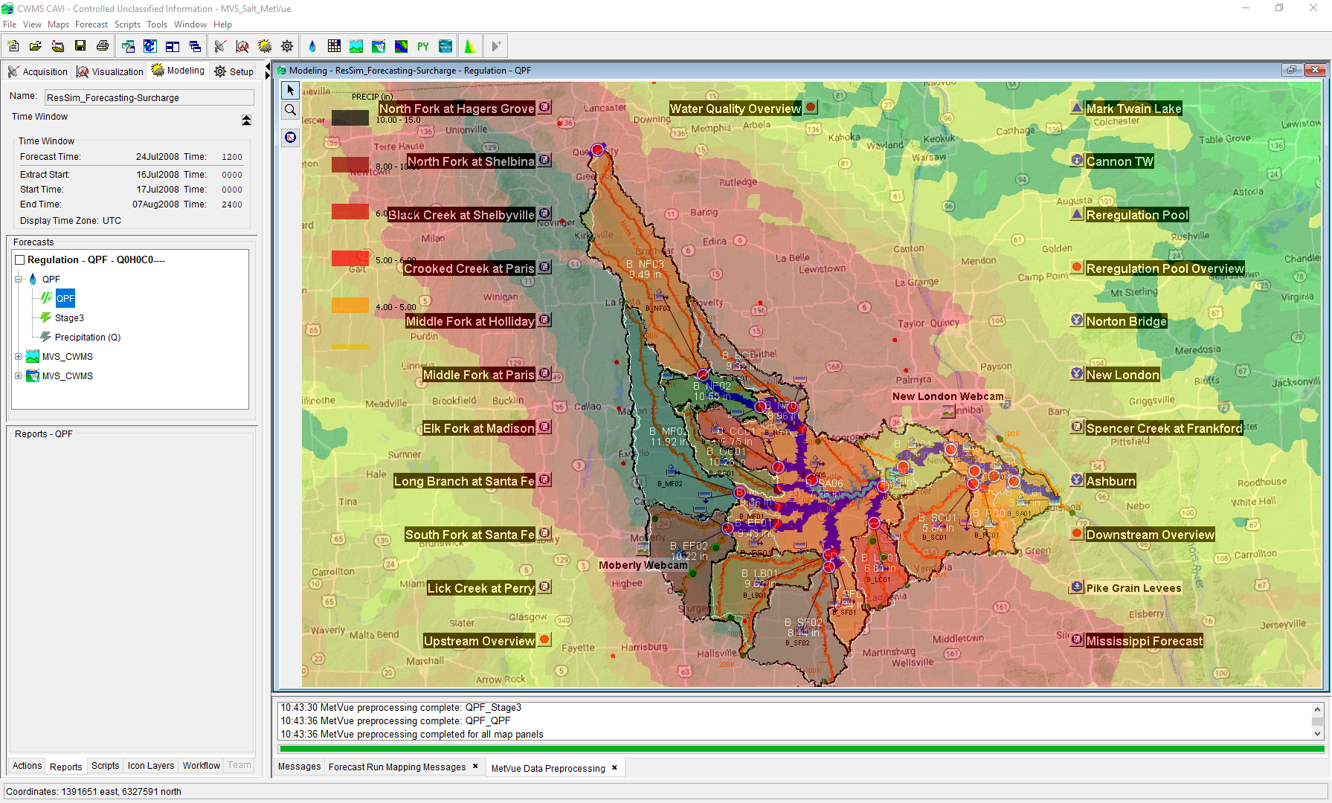

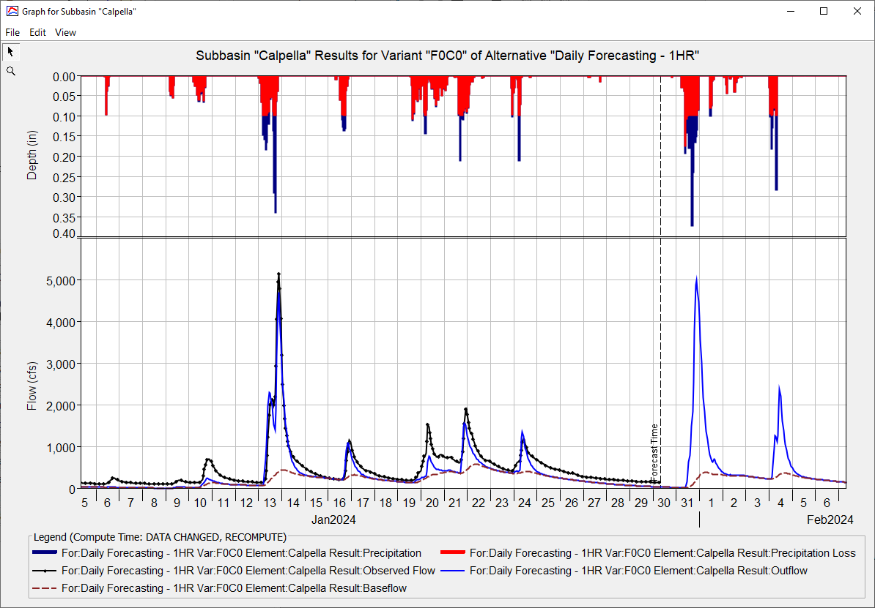
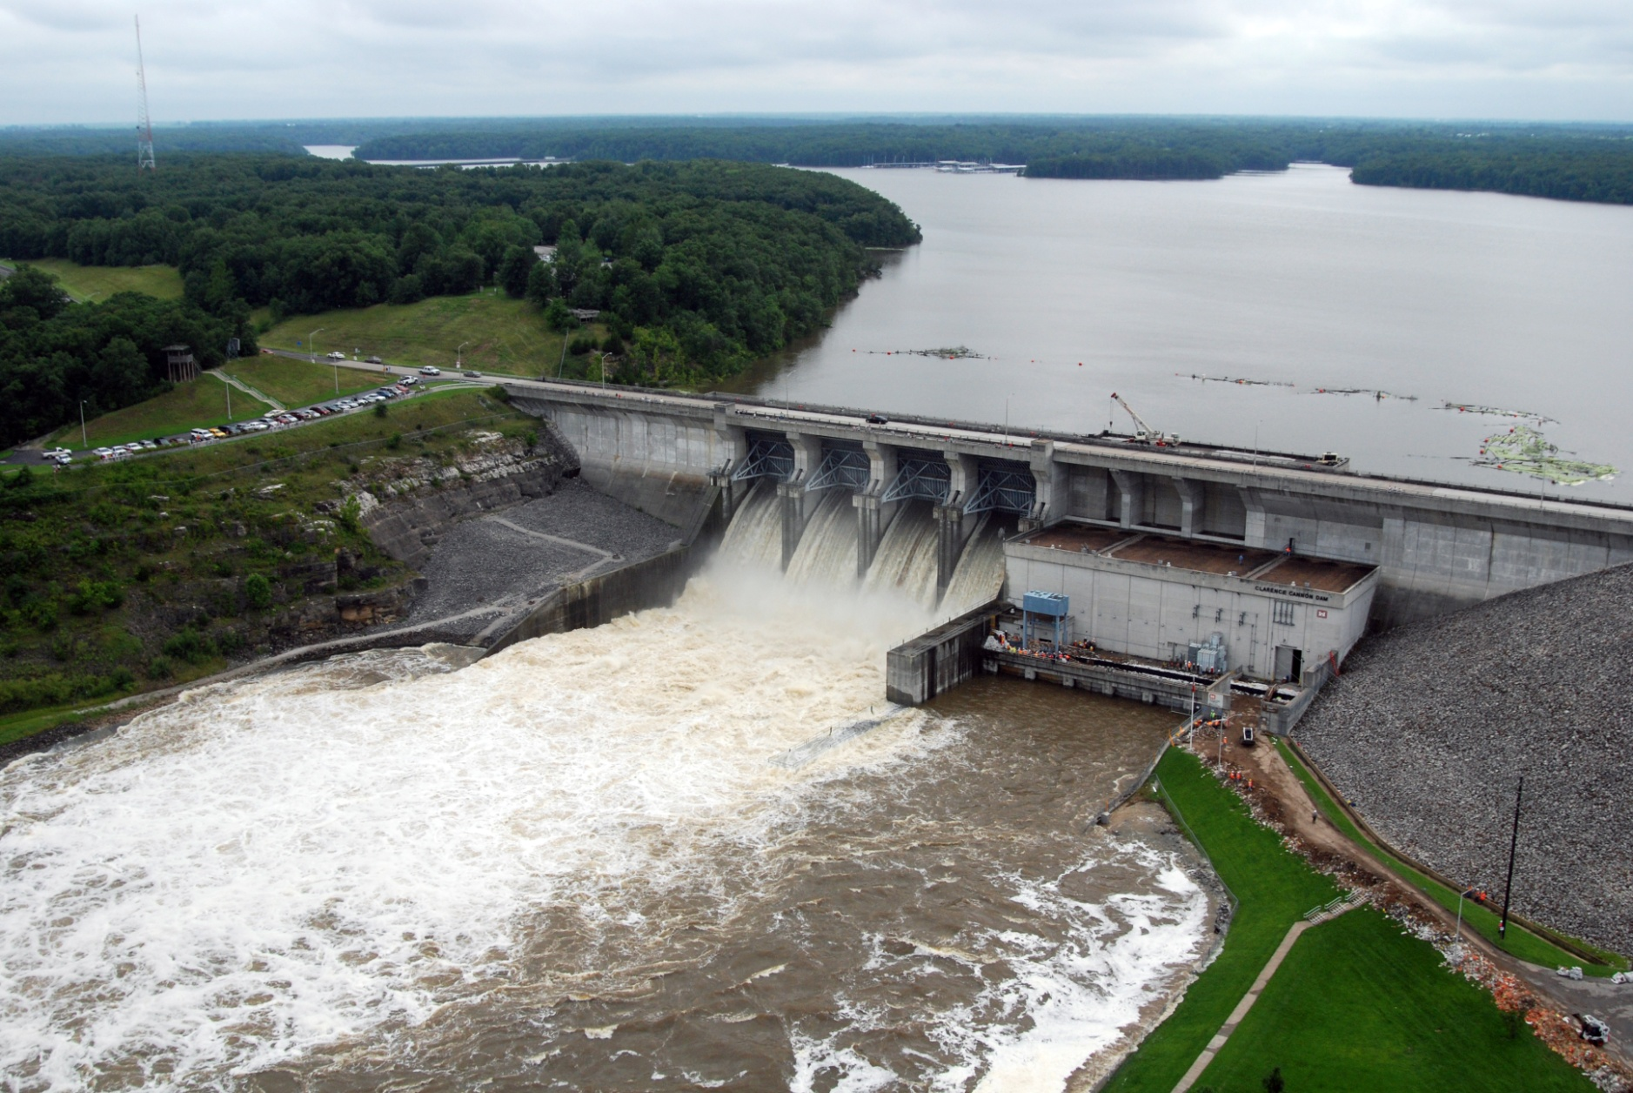
CWMS Real-Time Modeling
Russell Errett, P.E.
Hydrologic Engineering Center
CWMS Prospect Course

Slide 2
Overview
  Identify basic concepts for building a new CAVI watershed and about running real-time forecast simulation models in CWMS
  Quick overview on CAVI watershed model development
    Steps to create new CAVI watershed for use in real-time modeling
  Using CWMS for real-time modeling
    Creating a forecast
    Time windows and forecast times
    Data Status Summary Report
    Editing and running models
    Evaluating results
    Time-series icons for model results
    Saving models and results

Slide 3
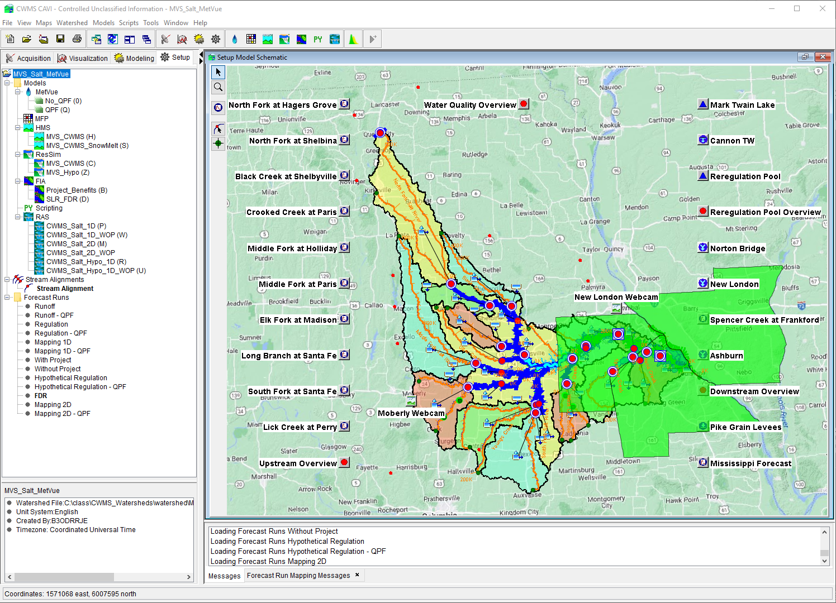
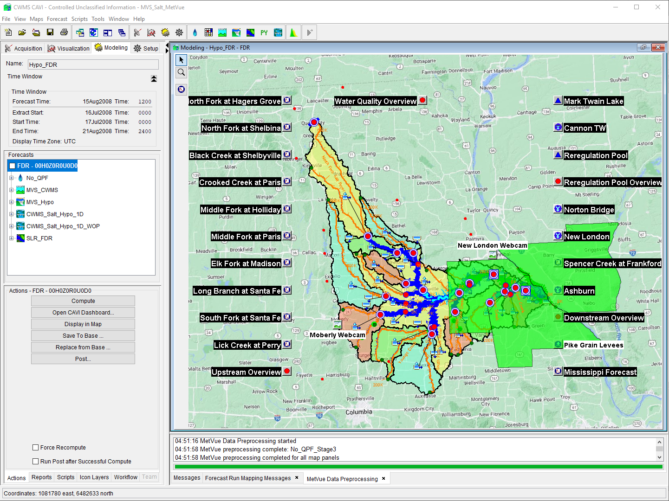
CWMS Modeling

Slide 4
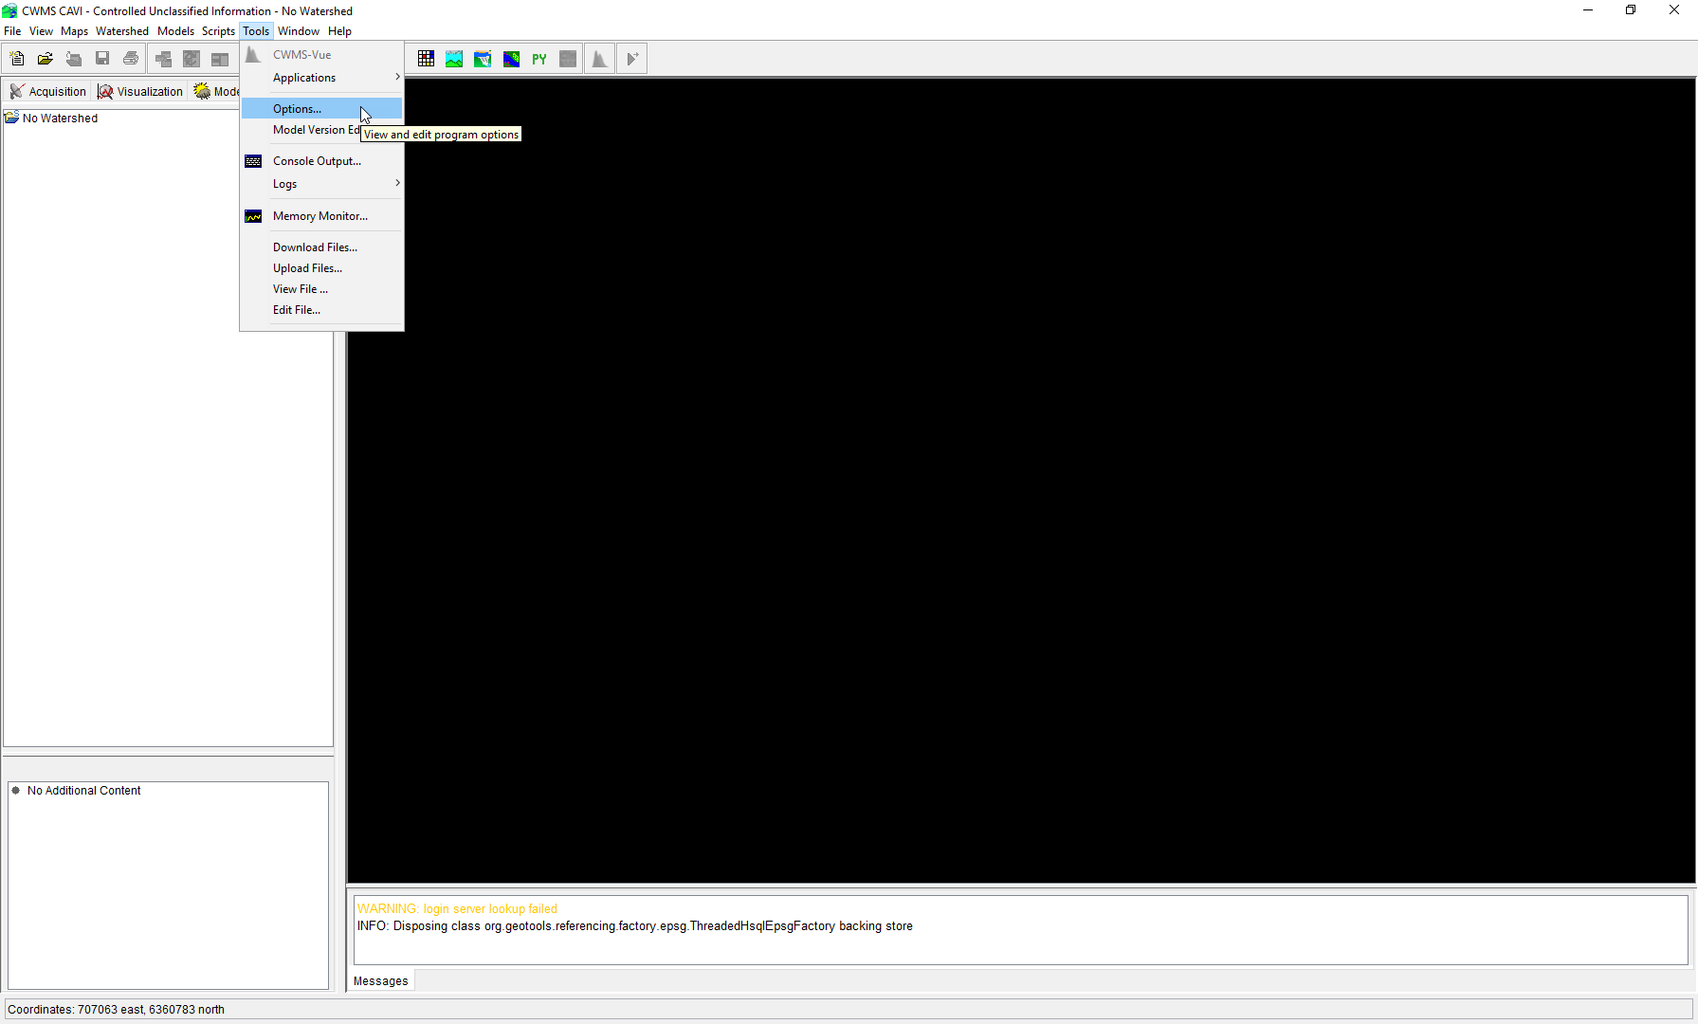
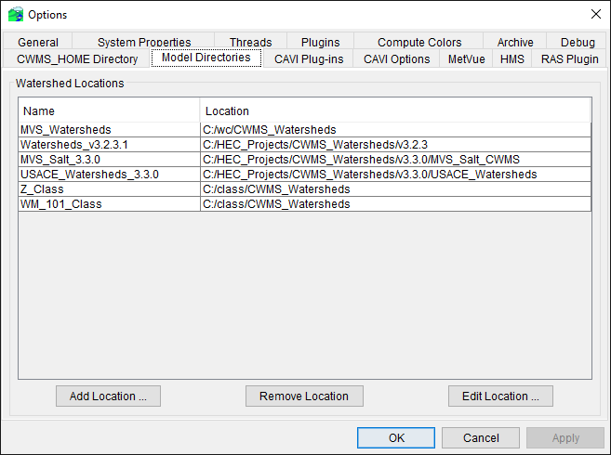
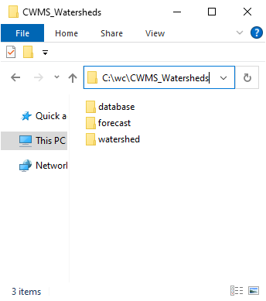
Defining CAVI Watershed Locations
X

Slide 5
CAVI Modeling SETUP

Slide 6
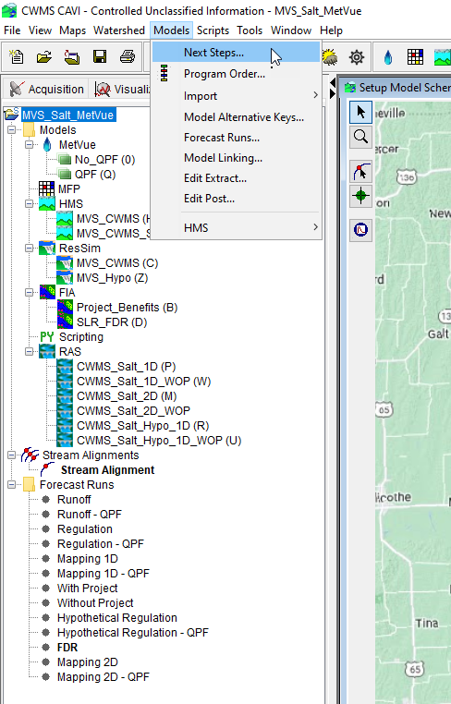
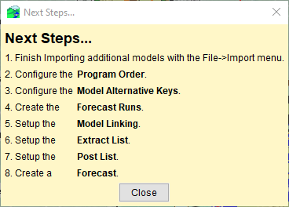
CWMS Modeling Setup
  These are the key steps if you are building a CWMS watershed from scratch
  From the Setup Tab create a watershed from File→New Watershed
  Import all the standalone models into the CAVI
    MetVue, HMS, ResSim, RAS, FIA
  Define Program Order
  Define Model Alternative Keys
    MetVue requires additional steps prior to assigning a model alternative key (discussed later)
  Create Forecast Run Alternatives (i.e., what models to run together)
  Setup Model Linking
  Setup Extract Lists
  Setup Post Lists (can be done later)
  Create a Forecast and test and resolve any steps above

Slide 7
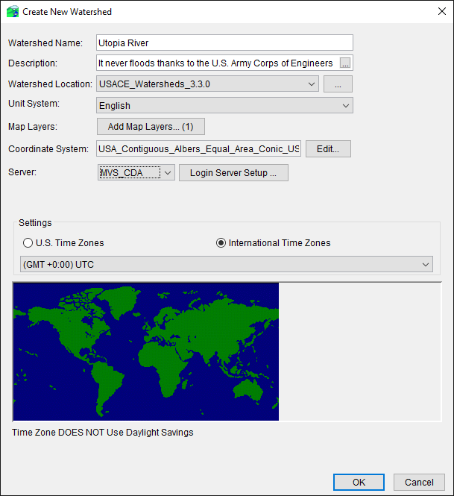
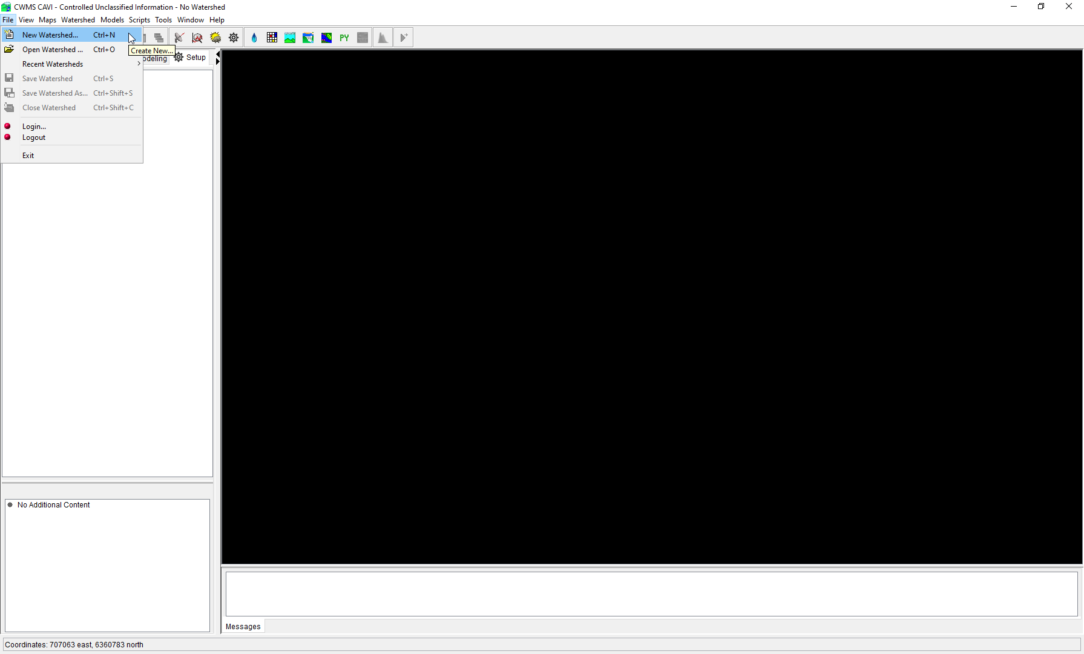
Creating a New CAVI Watershed

Slide 8
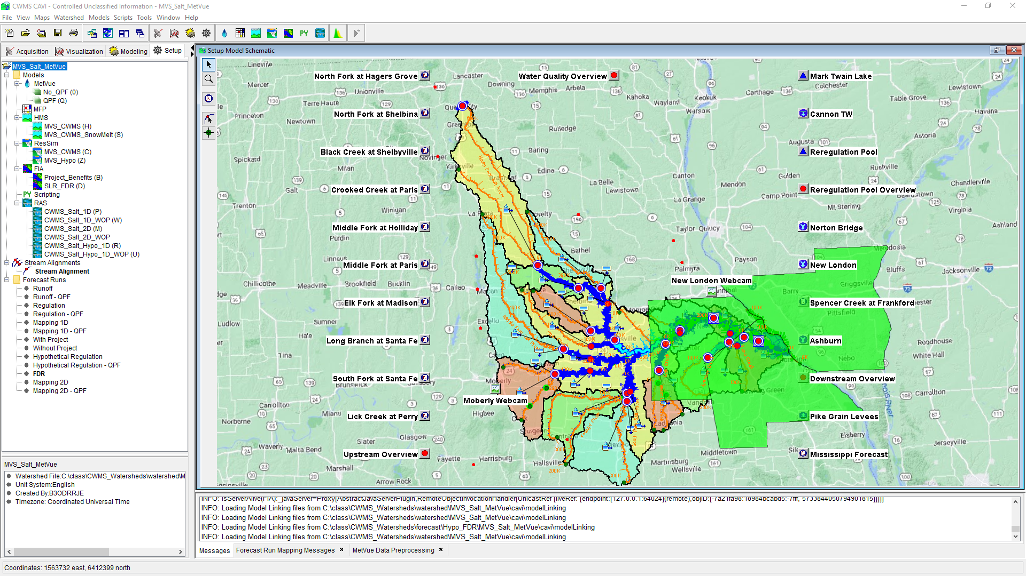
CAVI Modeling Setup

Slide 9
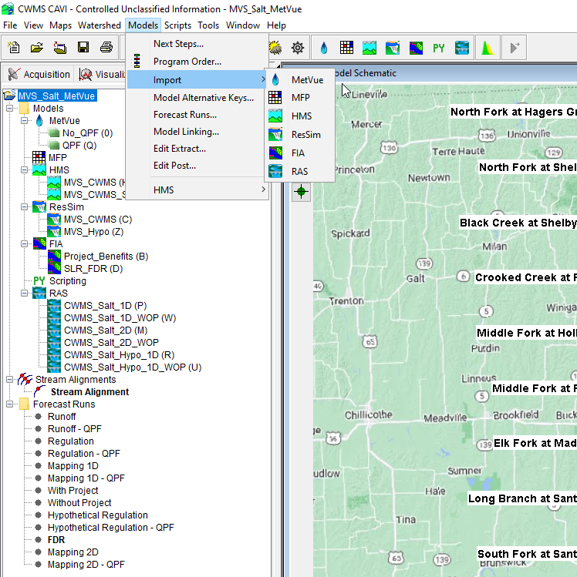
CAVI Model Imports

Slide 10
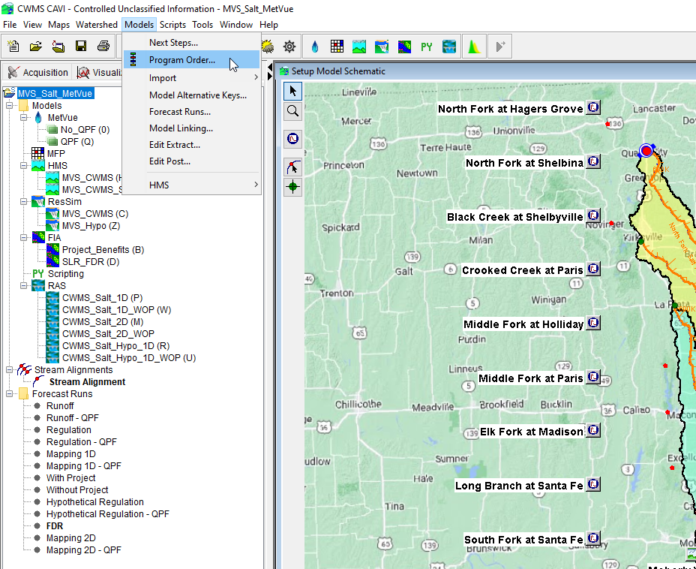
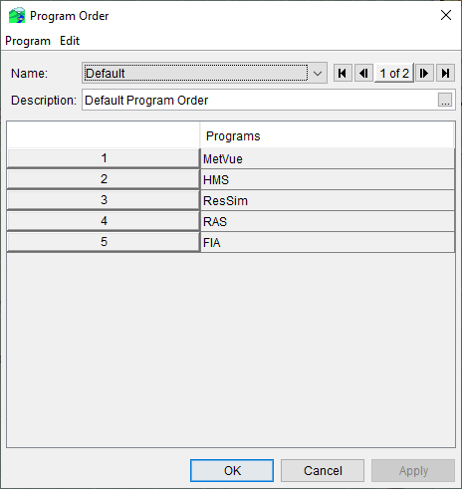
CAVI Program Order

Slide 11
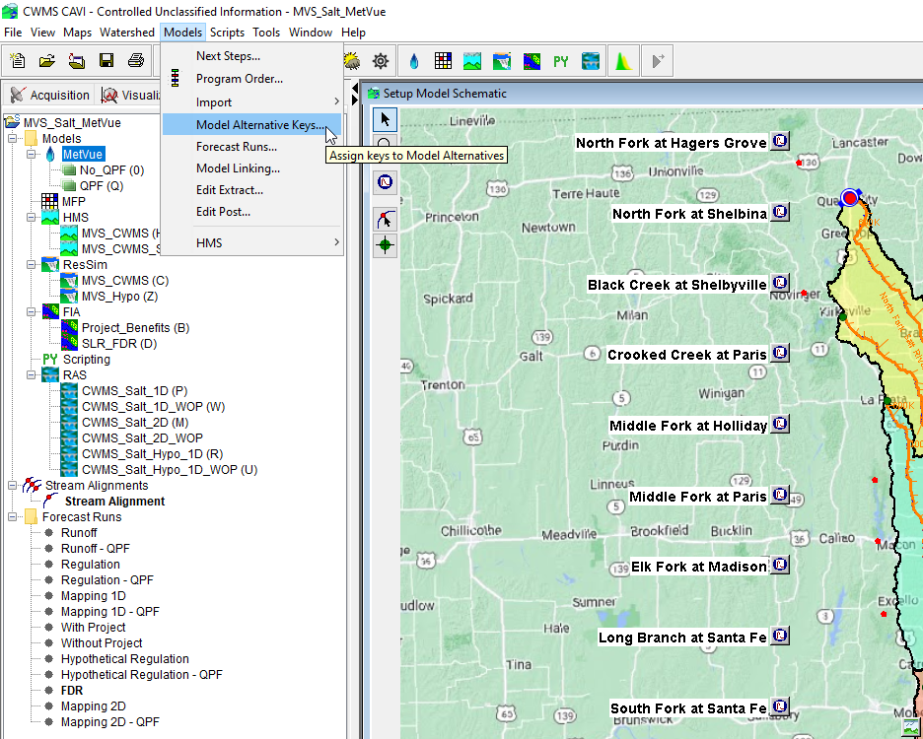
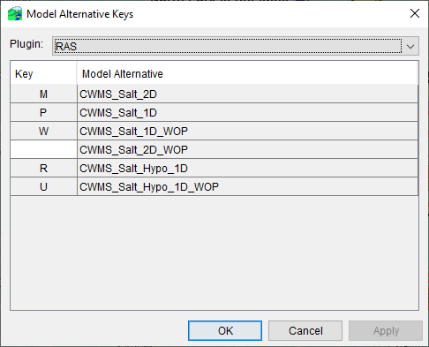
CAVI Model Alternative Keys

Slide 12
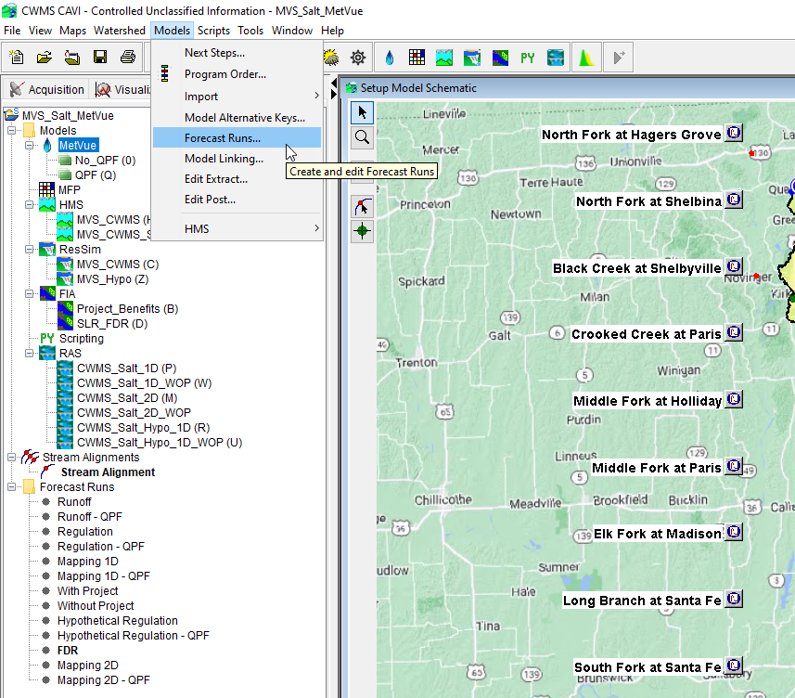
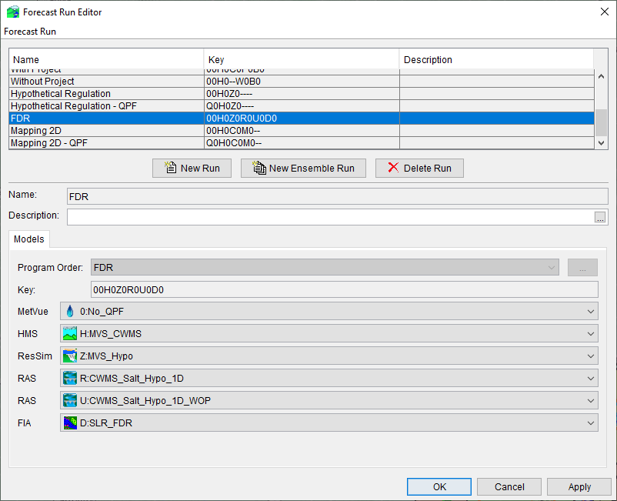
CAVI Forecast Run Alternatives

Slide 13
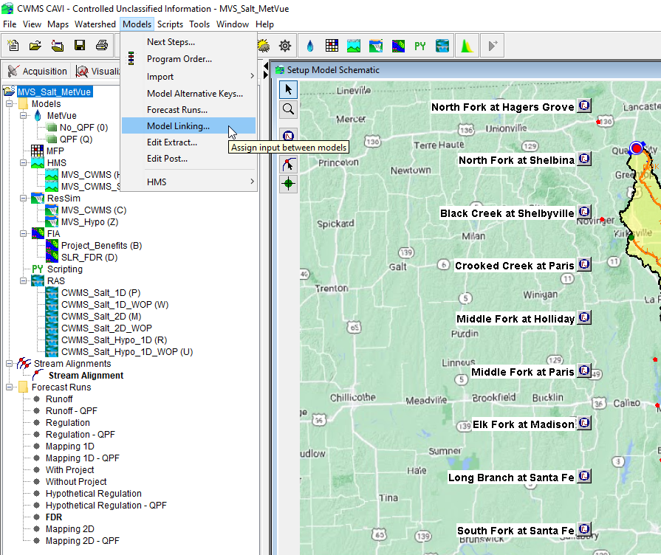
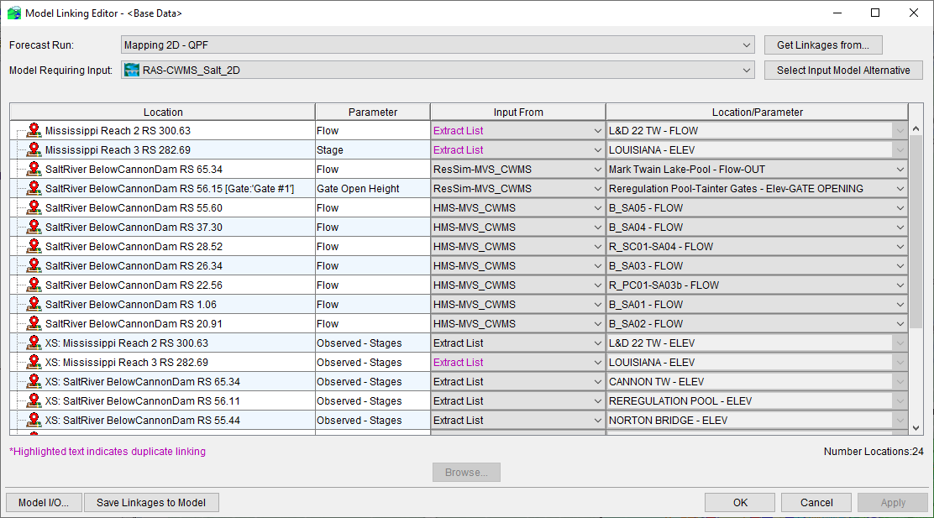
CAVI Model Linking

Slide 14
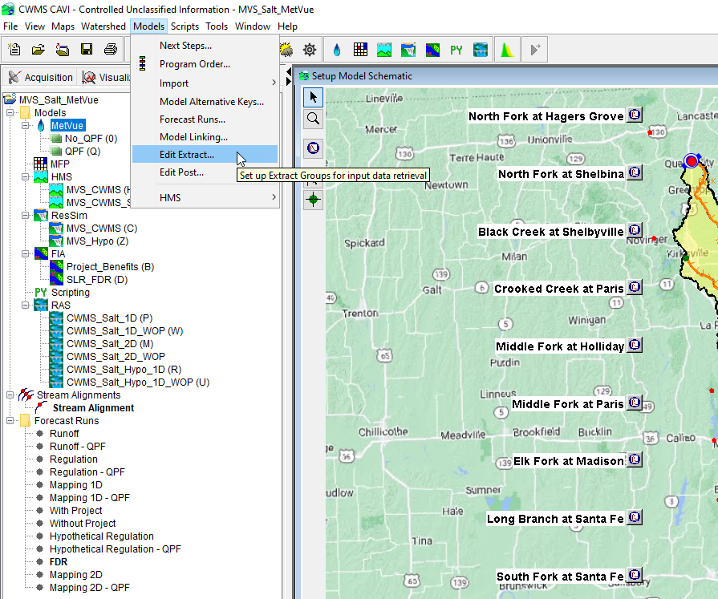
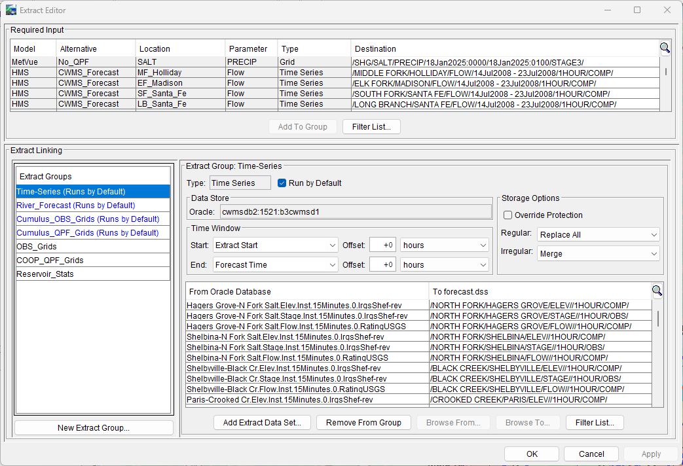
CAVI Extract Lists

Slide 15
Questions
Help additional Training
https://usace.dps.mil/sites/KMP-WM/SitePages/Corps-Water-Management-System-(CWMS).aspx
https://www.hec.usace.army.mil/confluence/cwmsdocs
https://discourse.hecdev.net/c/cwms/5
TDL-CELRH-EC-GW-W-USACE CWMS Modeling | General | Microsoft Teams

