Slide 1
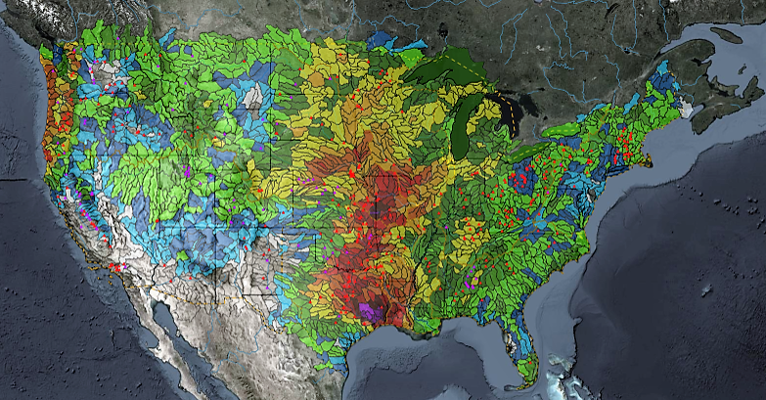
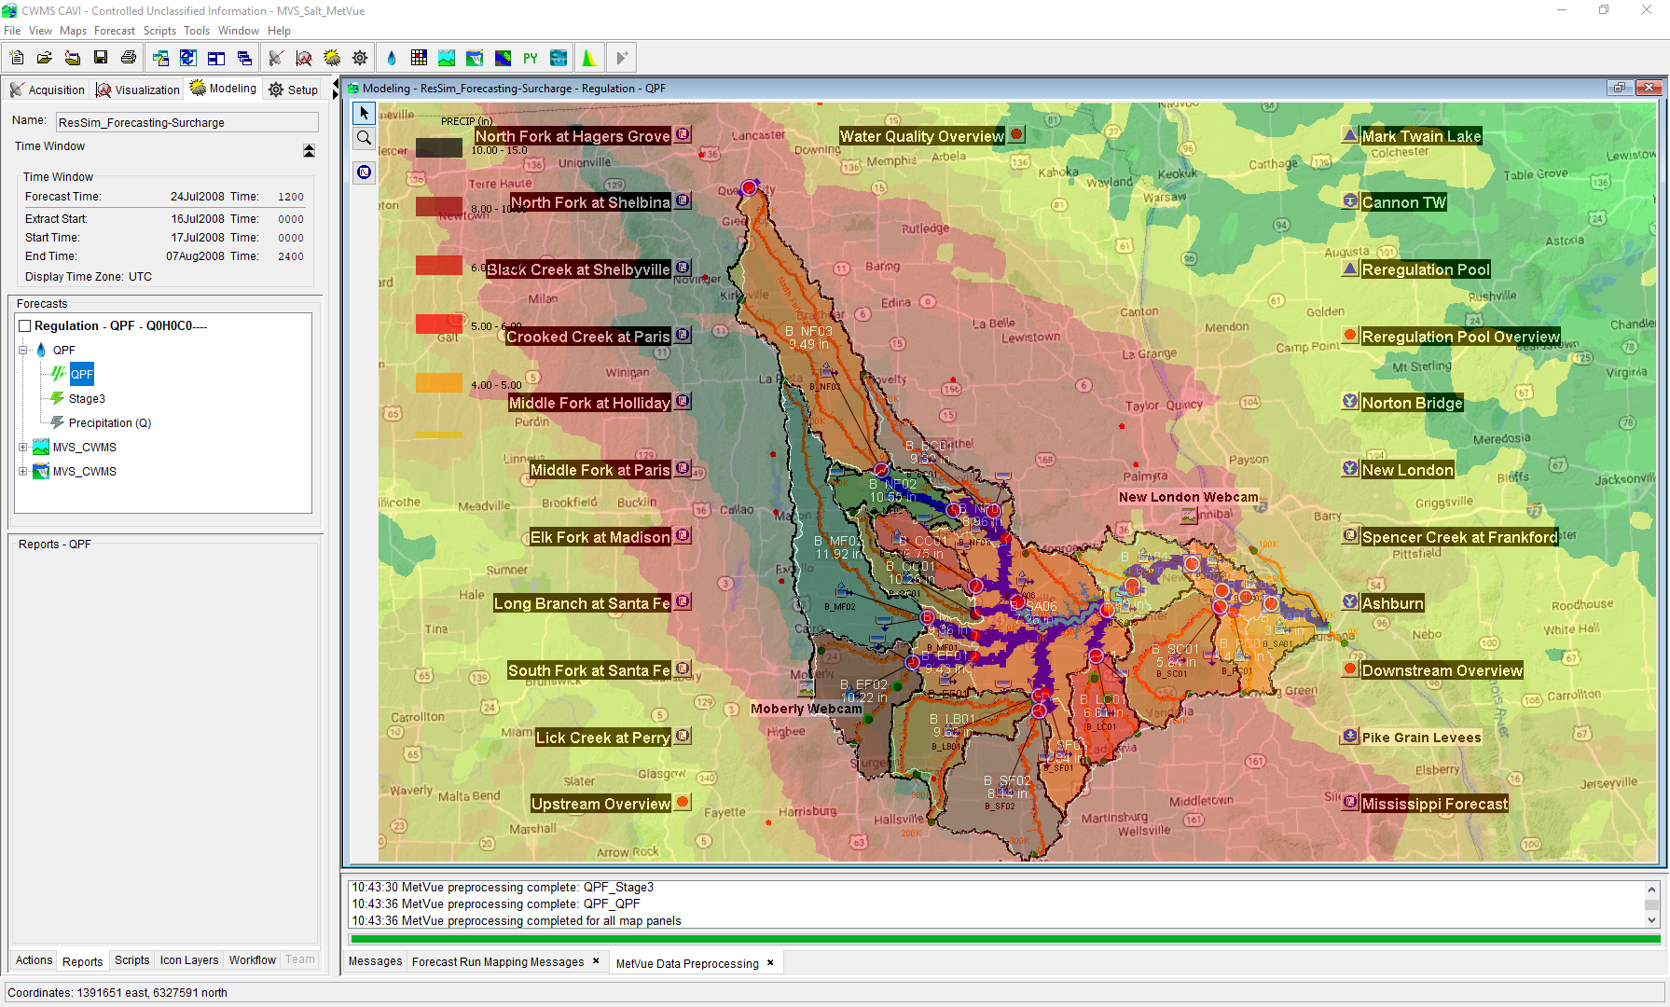

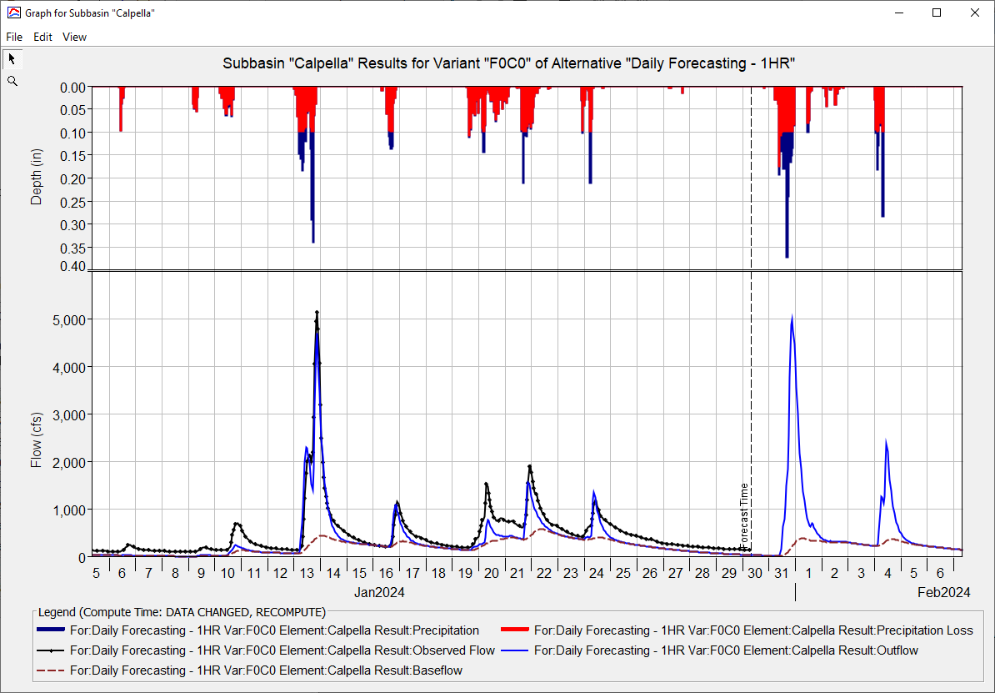
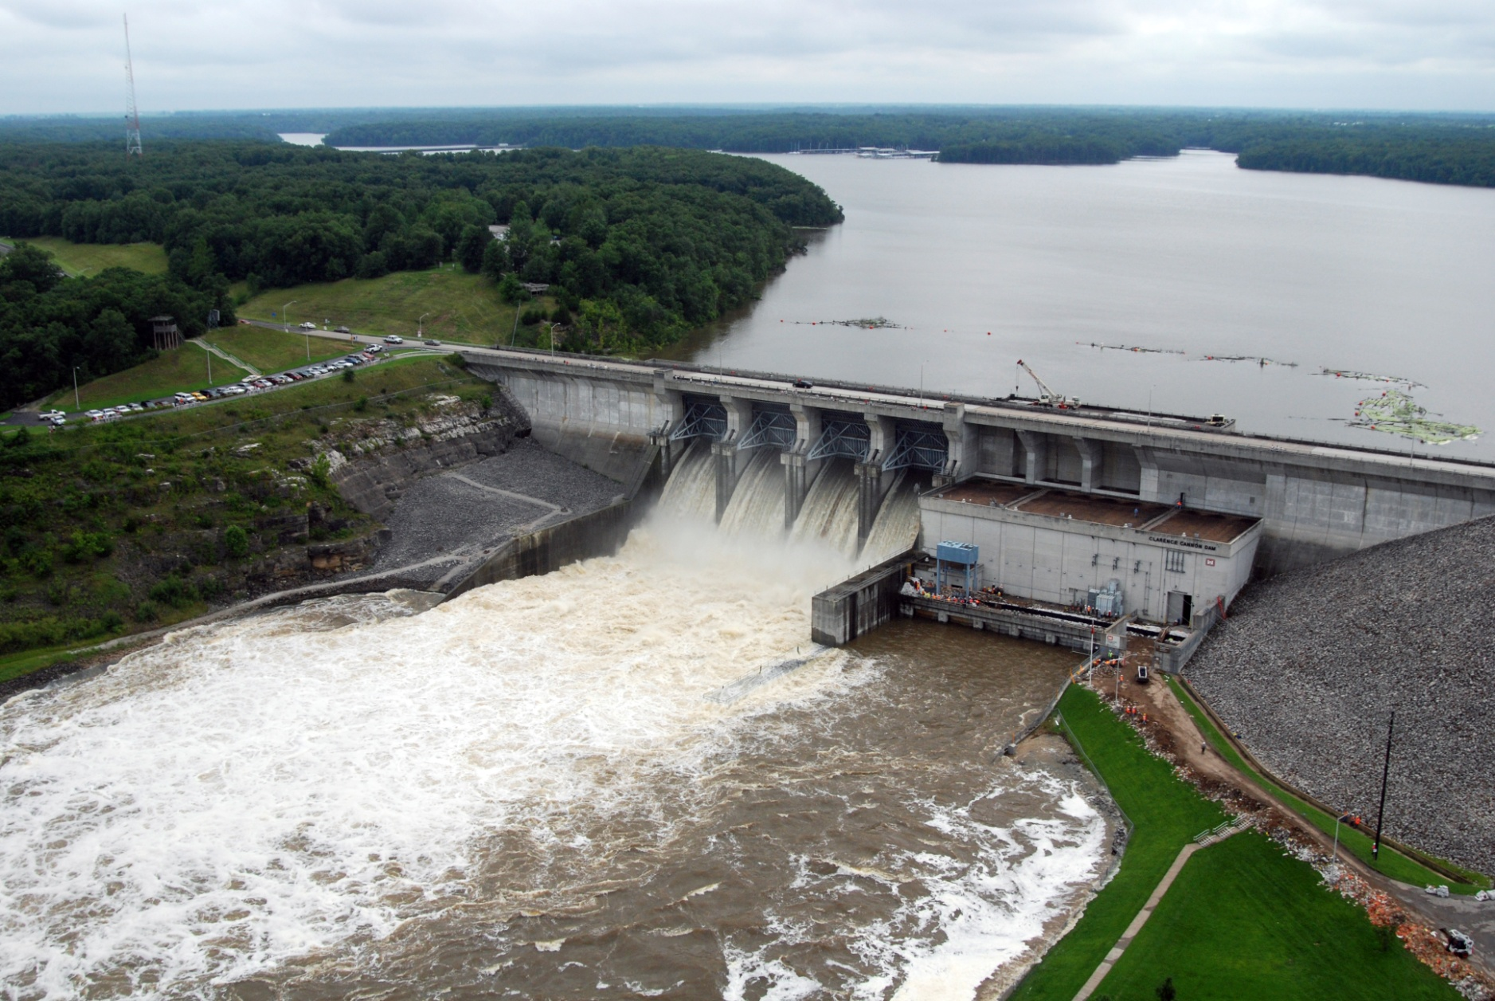
CWMS Real-Time Modeling
Russell Errett, P.E.
Hydrologic Engineering Center
CWMS Prospect Course

Slide 2
Overview
  Identify basic concepts for building a new CAVI watershed and about running real-time forecast simulation models in CWMS
  Quick overview on CAVI watershed model development
    Steps to create new CAVI watershed for use in real-time modeling
  Using CWMS for real-time modeling
    Creating a forecast
    Time windows and forecast times
    Data Status Summary Report
    Editing and running models
    Evaluating results
    Time-series icons for model results
    Saving models and results

Slide 3
CWMS Real-Time Modeling

Slide 4
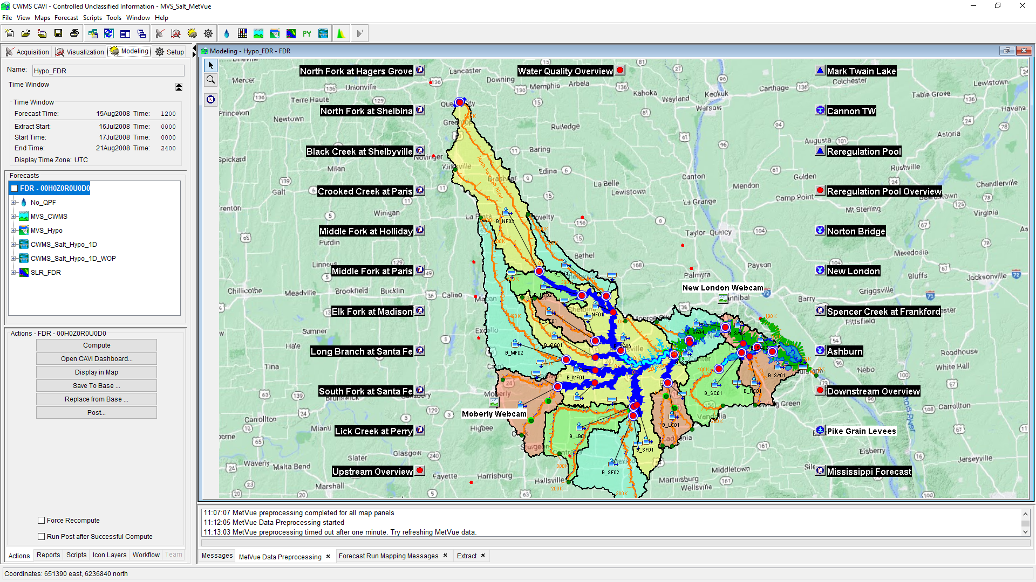
CWMS Modeling

Slide 5
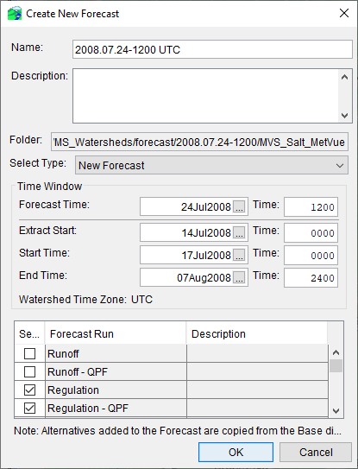
Create a Forecast
  A forecast can be created once:
    All the necessary models are imported
    A forecast run alternative is created
    Model linking is accomplished
      This step can be done from the modeling tab within an active forecast
    Extract lists are developed
  Forecast directory will be created
    Default name is Forecast Time in YYYY.MM.DD-HHMM TZ
  Model alternative files used in the forecast run alternatives selected are copied to the forecast directory
  Data will be extracted from source location to the forecast.dss file (as defined in extract list)
    Oracle
    CDA
    Cumulus
    Local and/or Remote DSS files

Slide 6
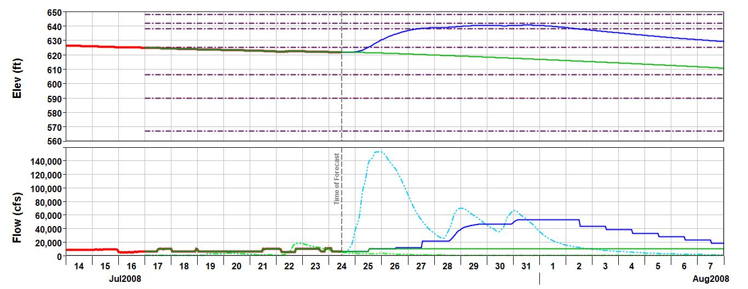
Time Windows
Model Simulation Window
OBS
No QPF
QPF
Forecast Data
Observed Data
Extract Start
Start Time
Forecast Time
End Time

Slide 7
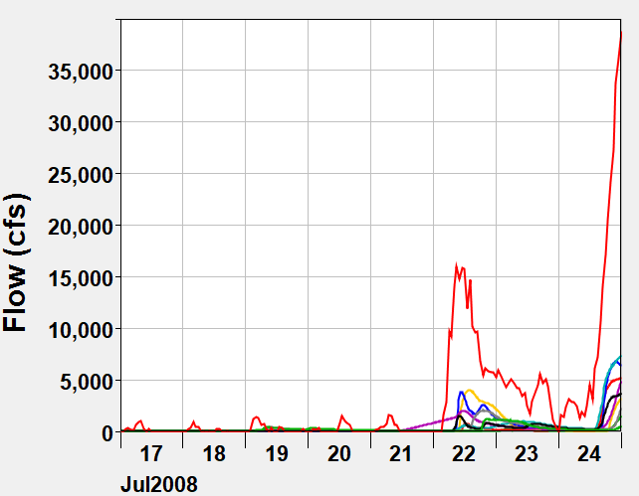
Start Time
  Start Time is the time that the models begin simulating
  Choose a time that:
    Is far enough before time of forecast so that water has time to route through the routing reaches (i.e., time for water to flow from upper junction to lowest junction)
    Prior to start of event in question
    Typically, 4-10 days
Notes:
Time Windows and Forecast Times
4. Starting date/time of the simulation. AKA – lookback time.
Where the observed data used in the simulation begins. HMS and RAS start simulating at this time.
CWMS is event-oriented. In order to calibrate HMS loss rate and base flow parameters, the start time should be prior to the start of the rainfall for the initial forecast of the event.
Typically greater than 6 hours, and less than 2 weeks.
For HMS, If it’s been raining for an extended period:
Select an appropriate lull in the storm.
Set your initial loss rate low, close to the constant loss rate.
Set your base flow to what it was prior to the event. (it won’t have much effect at this point)
Set an appropriate recovery rate in the “Deficit-Constant” HMS/HFP editor
If it hasn’t rained yet:
Generally, set the starting time to greater than the routing time from the top of the watershed to the outlet.
Long enough to estimate base flow parameters.
For ResSim, the lookback window should be at least as long as it takes to route flow from the upstream-most reservoir to the downstream-most control point.
For RAS, the lookback period should reflect a period of reasonably steady flows throughout the basin.

Slide 8
Extract Start
  Extract Start is often the same as the Start Time
  Typically used when a value just before the start time is needed for a computation.
    Observed data is in varying time steps, some longer than the compute interval
    Observed data has an offset from the interval so a value is not extracted at the start time.
    Your compute is period average, but your data is instantaneous, so a “start of period” value is needed to compute the first period’s average.
  Or you just want to see more observed data than will be used in the simulation.

Slide 9
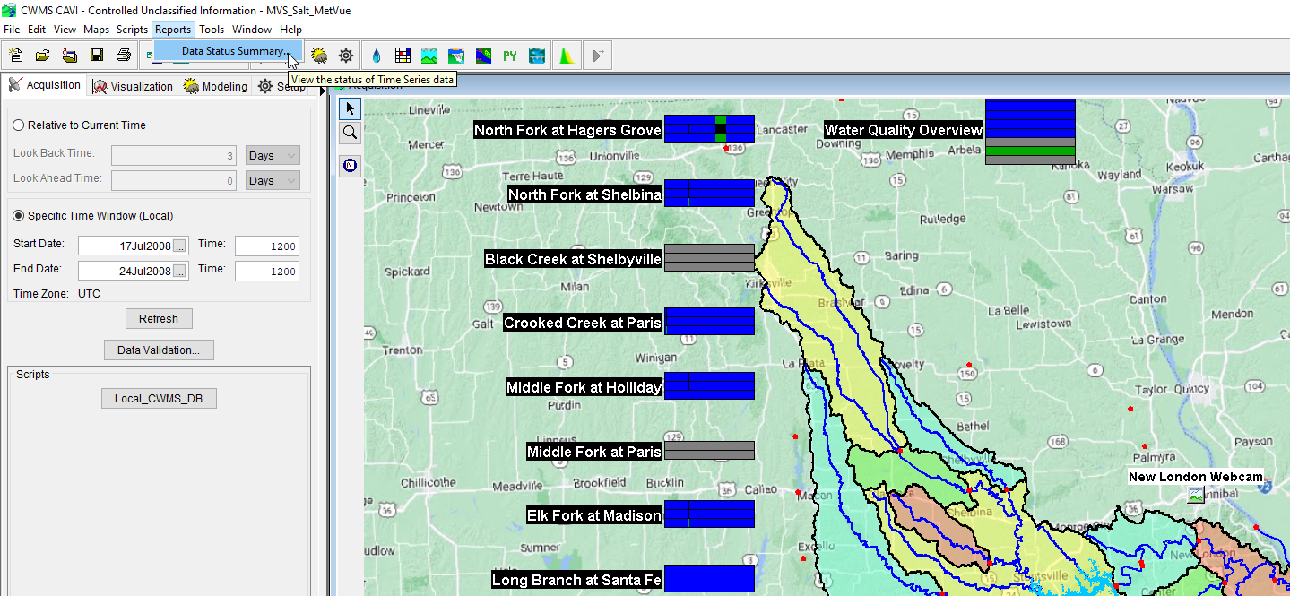
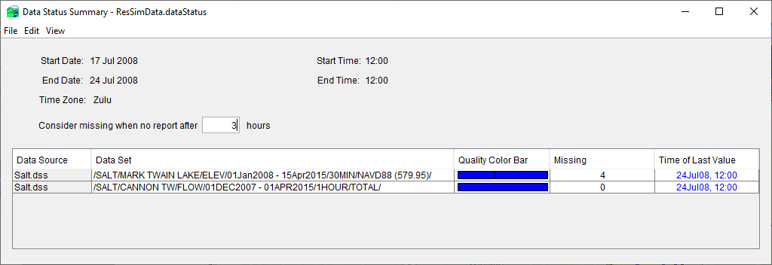
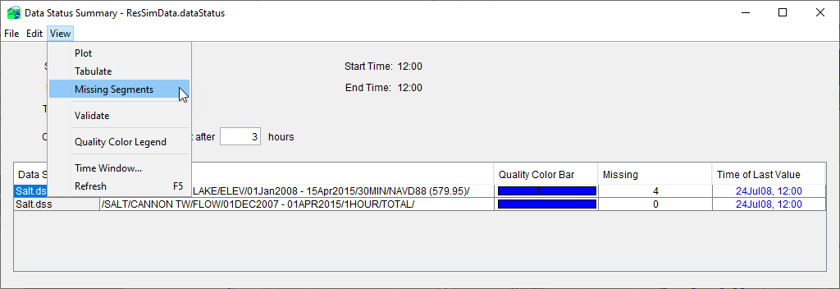
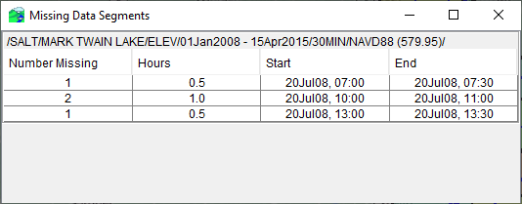
Data Status Summary Report

Slide 10
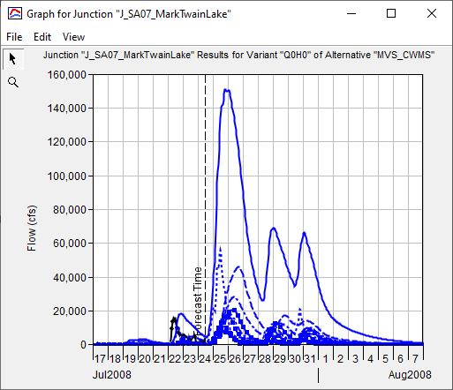
Forecast Time
  Forecast Time is the time at which observed data runs out and you are predicting stream flow and river and reservoir stages
  For real-time forecasting, typically not earlier than previous hour
    Need time for all the stream gage data within the watershed to be transmitted and processed
    Time for all the gridded data to be processed
  Many offices have a default/standardized initialization time used for daily forecasting
    For example 07:00 am local time
      12:00 UTC for Central Time Zone

Slide 11
End Time
  End Time is the time where models stop simulating (i.e., end of forecast)
  Many offices have a default/standardized initialization time used for End Time
    For example, the length of forecast will dictate the End Time
      i.e., Forecast length of 5-days, 7-days, or 14-days
  Other questions and data constraints can influence length of forecast or End Time
    How long to evacuate flood storage
    Drought forecasting
    How much and accuracy of existing meteorological forecast data
    Limitations in model computational time
      i.e., detailed 2D RAS models running for 2 weeks versus 6 months of data

Slide 12
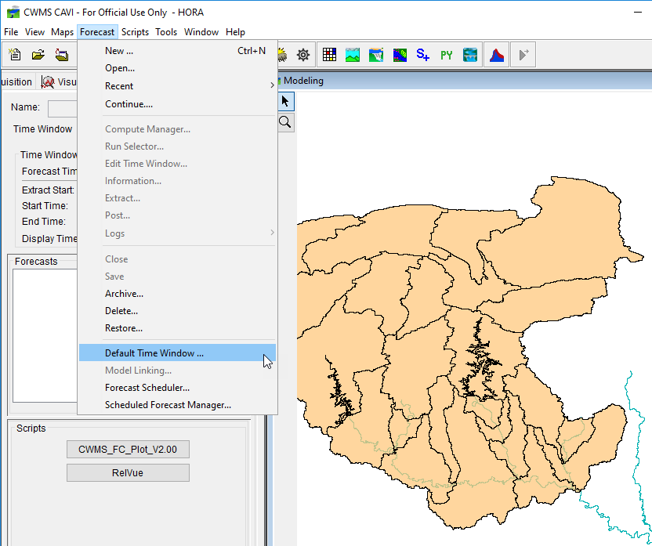
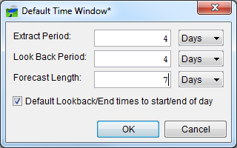
Default Time Window

Slide 13
Questions
Help additional Training
https://usace.dps.mil/sites/KMP-WM/SitePages/Corps-Water-Management-System-(CWMS).aspx
https://www.hec.usace.army.mil/confluence/cwmsdocs
https://discourse.hecdev.net/c/cwms/5
TDL-CELRH-EC-GW-W-USACE CWMS Modeling | General | Microsoft Teams

