Slide 1
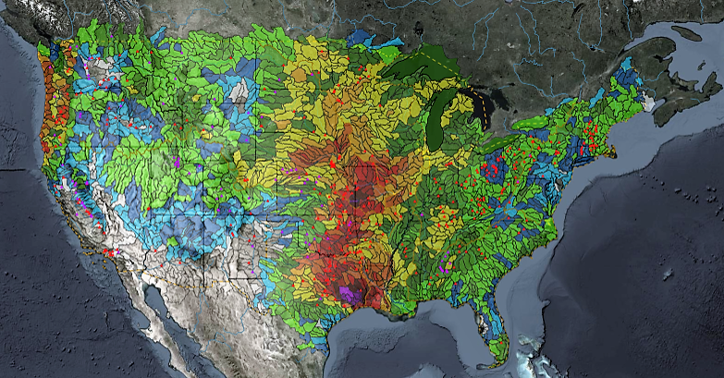
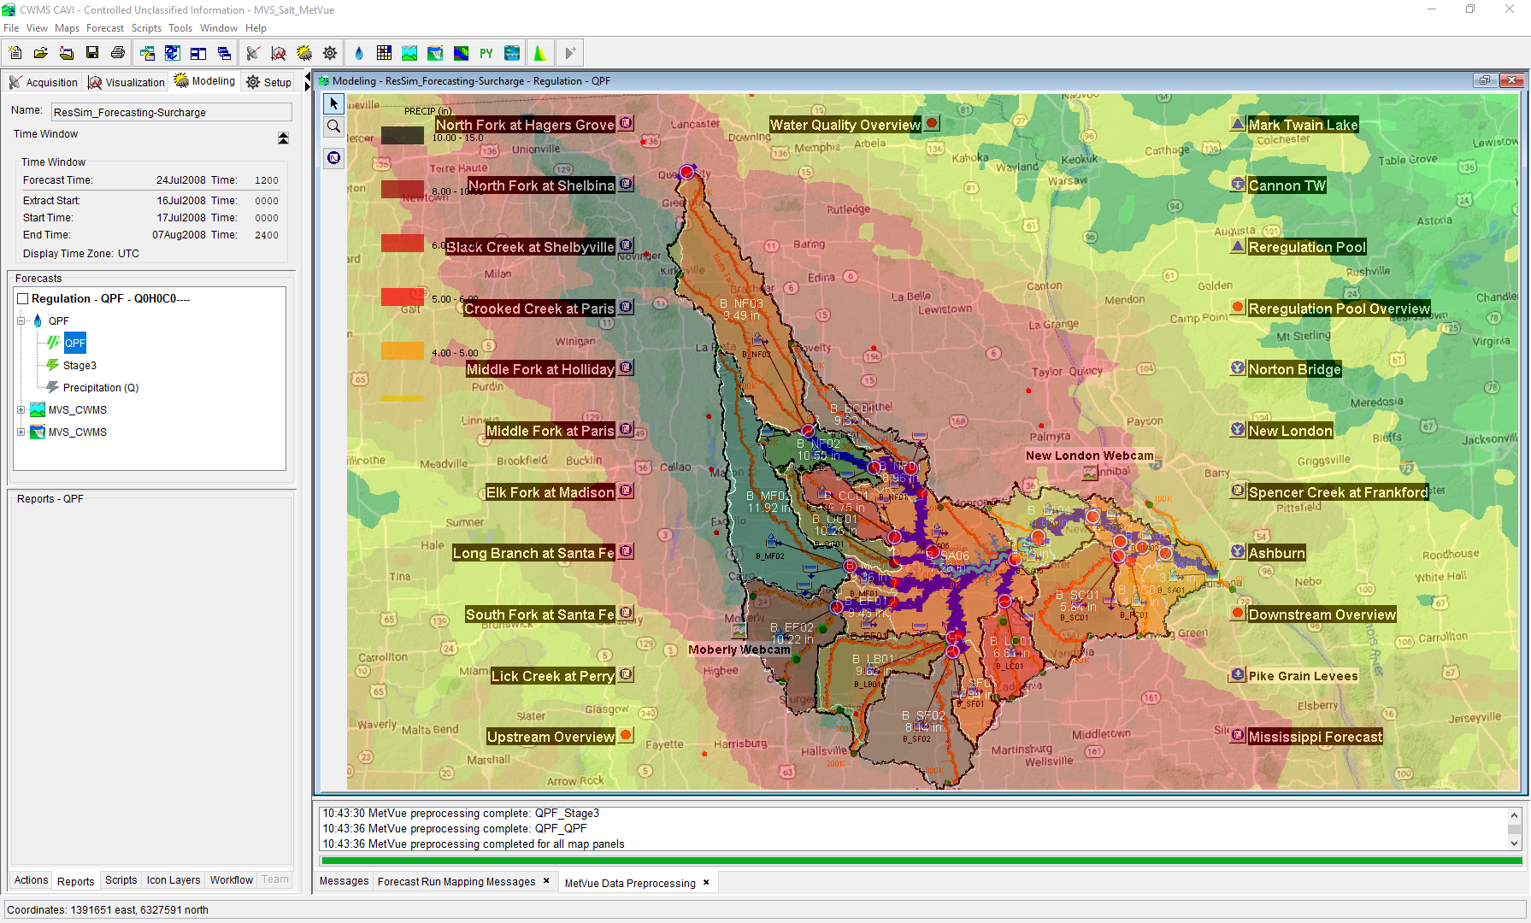

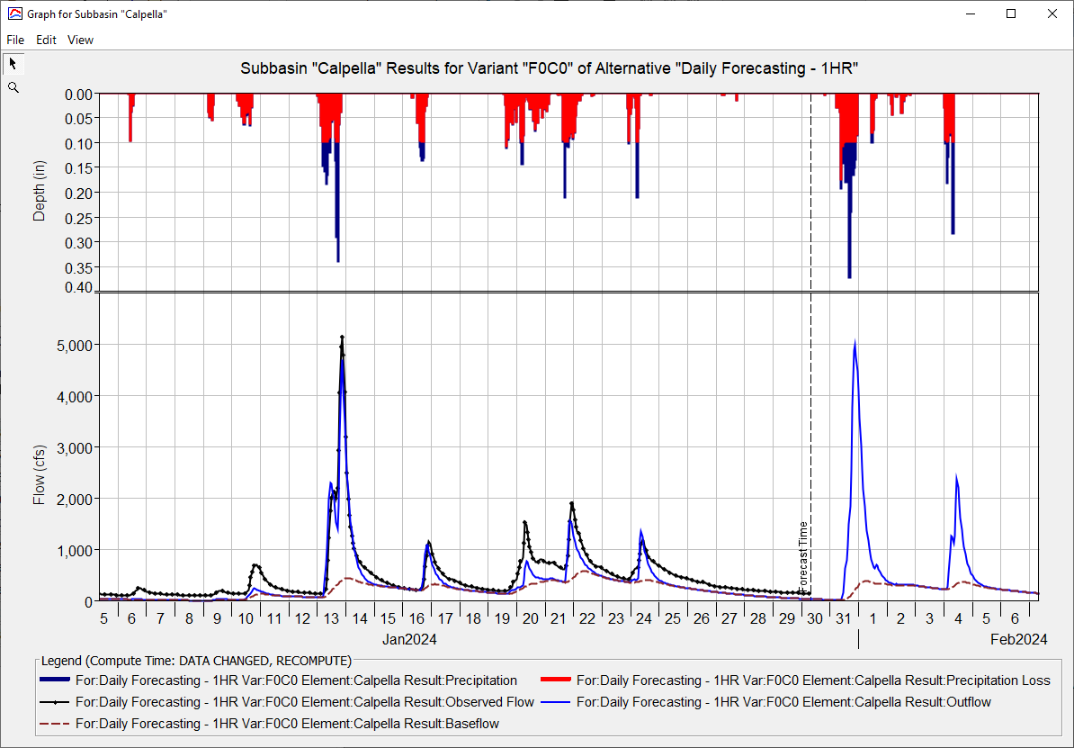
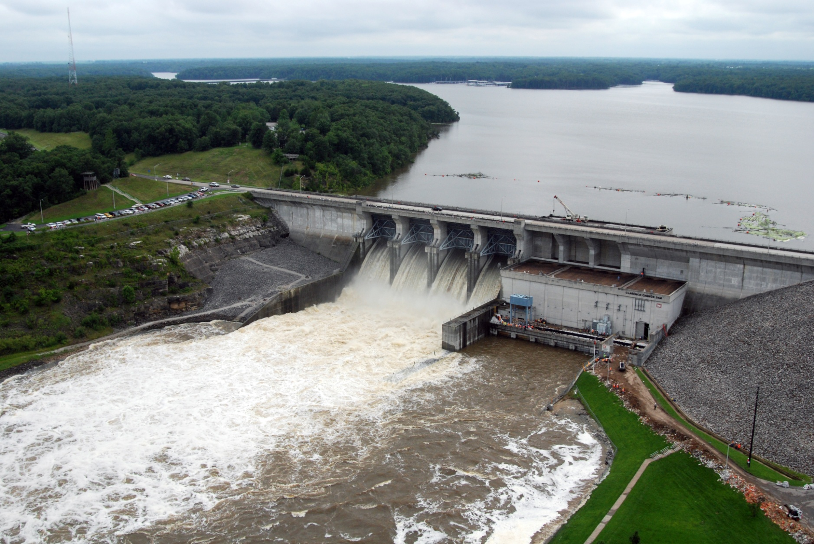
CWMS Real-Time Modeling
Russell Errett, P.E.
Hydrologic Engineering Center
CWMS Prospect Course

Slide 2
Overview
Identify basic concepts for building a new CAVI watershed and about running real-time forecast simulation models in CWMS
Quick overview on CAVI watershed model development
Steps to create new CAVI watershed for use in real-time modeling
Using CWMS for real-time modeling
Creating a forecast
Time windows and forecast times
Data Status Summary Report
Editing and running models
Evaluating results
Time-series icons for model results
Saving models and results

Slide 3
Computing the Models

Slide 4
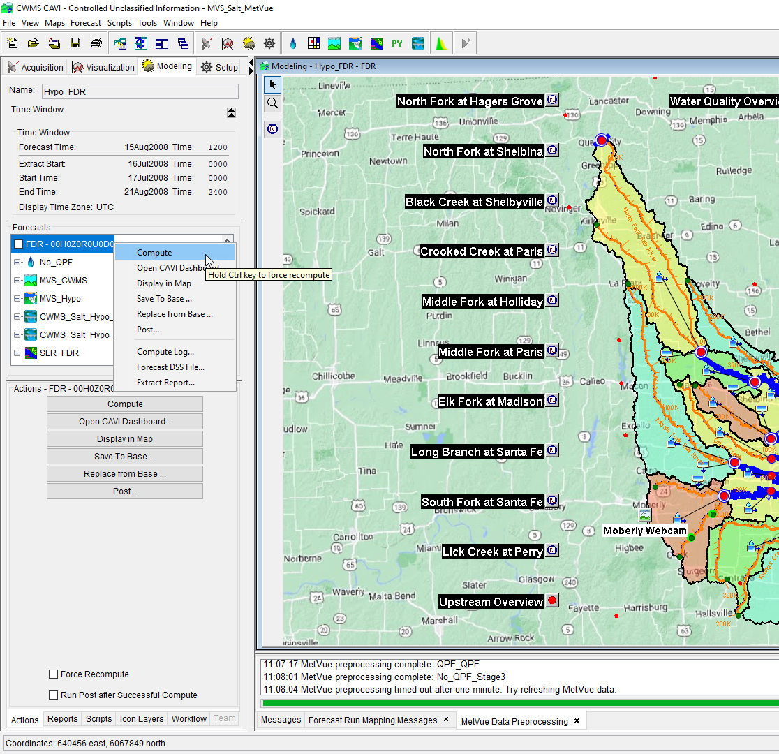
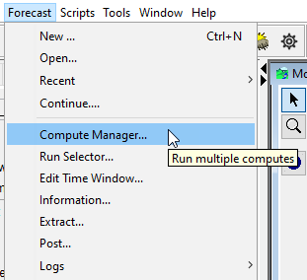
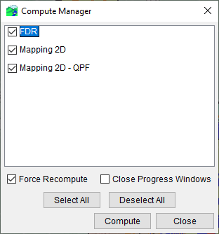
Computing the Models
3 ways to compute CWMS models from a forecast:
Highlight forecast run alterative OR individual model alternative:
Right click and Compute
Compute from Actions Tab below
Hold Control to force recompute for either option
Navigate to Forecast→Compute Manager
Select one or multiple forecast alternatives to have the CAVI compute
These are not computed simultaneously, rather in sequence
Notes:
Editing And Running Models
Run all models for a forecast run by selecting the forecast, and then:
Right clicking and selection the “Compute” menu.
Selecting the Compute Button in the Actions Panel.
Run an individual model by selecting the model in the Forecast run panel, then pressing the “Compute” button in the Actions panel.
Will run any models in the sequence before it that needs to be run.
Select “Force Recompute” checkbox to force all prior models to be re-computed.
You can also hold the Control key on the keyboard when you click the compute button to force a recompute.

Slide 5
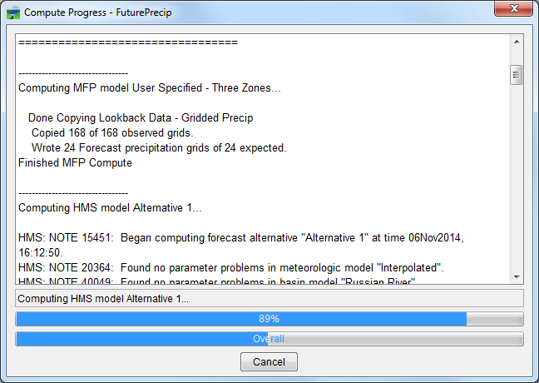
Computing the Models
Notes:
Editing And Running Models
After choosing to compute, the compute progress dialog will open.
This dialog box gives useful output detailing any issues found throughout the forecast run for any of the models being computed.

Slide 6
Viewing the Results

Slide 7
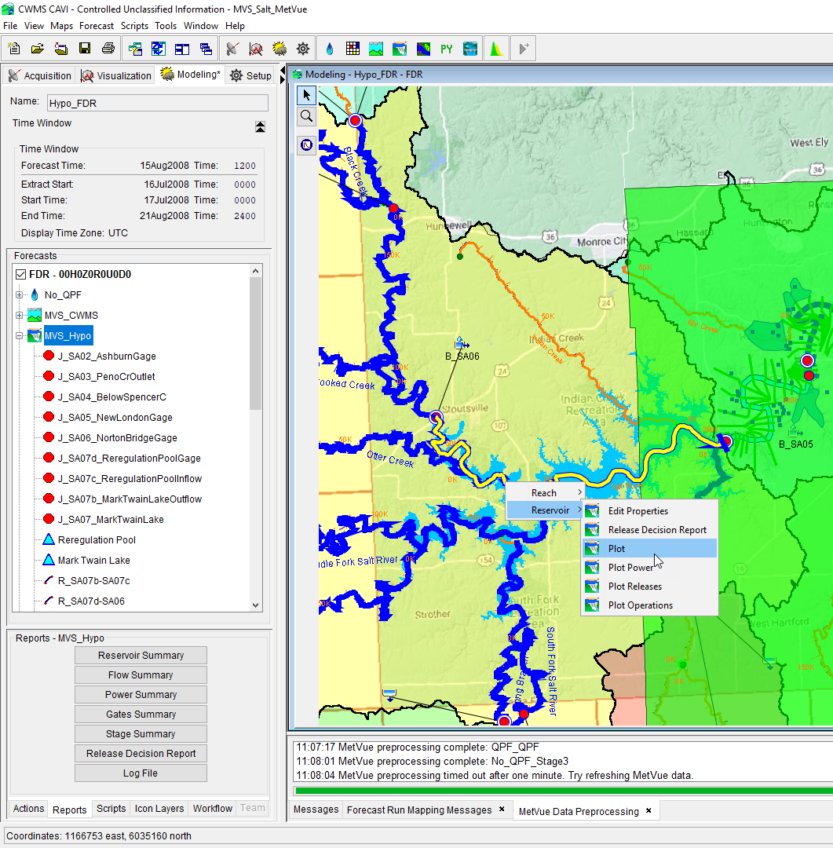
Viewing Results
Output is available from:
Forecast Run Alternative modeling tree
Reports Tab below modeling tree
From the modeling schematic in the CAVI Modeling map window
Opening the specific model from the standalone application (i.e., HMS, ResSim, RAS)
Or opening the forecast.dss file via CWMS-Vue and sorting the results based upon the model results F-Part
View Results

Slide 8
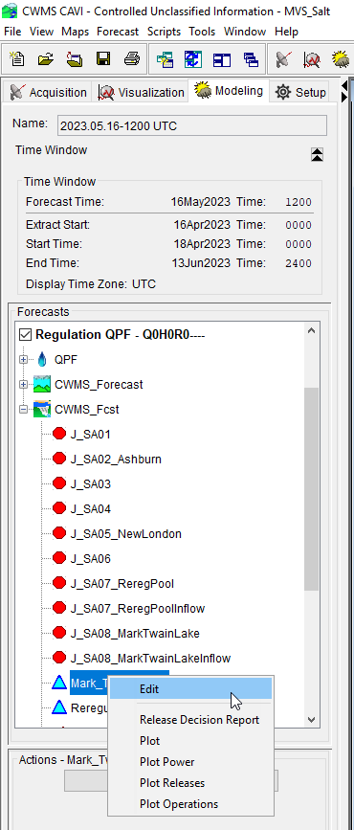
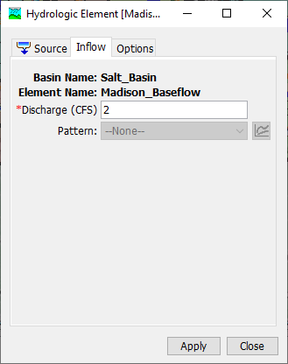
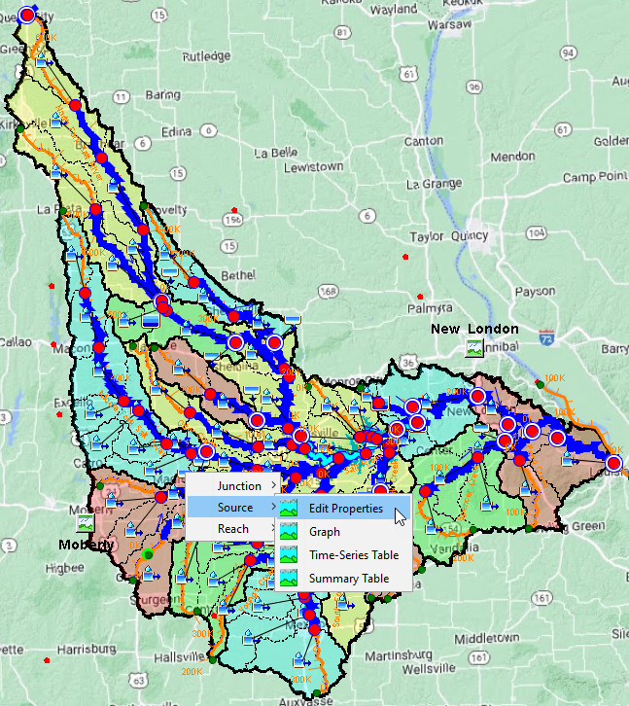
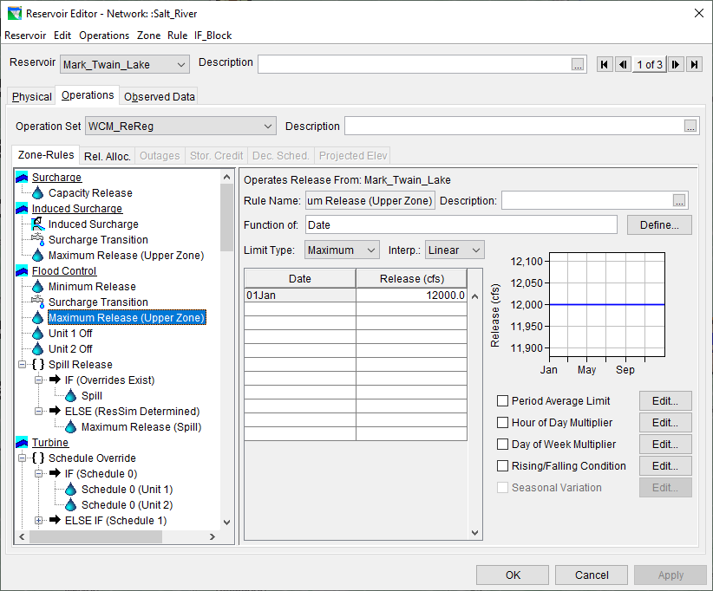
Edit Model Parameters
Multiple ways to get to access model editors

Slide 9
Questions Help additional Training
https://usace.dps.mil/sites/KMP-WM/SitePages/Corps-Water-Management-System-(CWMS).aspx
https://www.hec.usace.army.mil/confluence/cwmsdocs
https://discourse.hecdev.net/c/cwms/5
TDL-CELRH-EC-GW-W-USACE CWMS Modeling | General | Microsoft Teams

