Slide 1
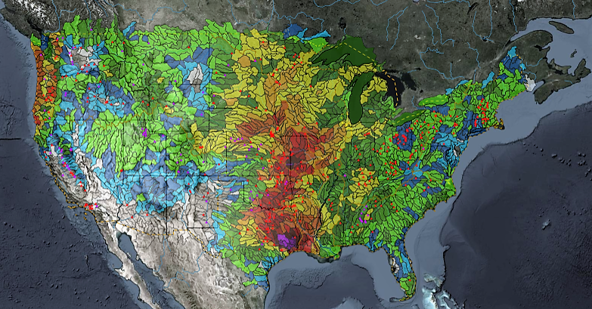
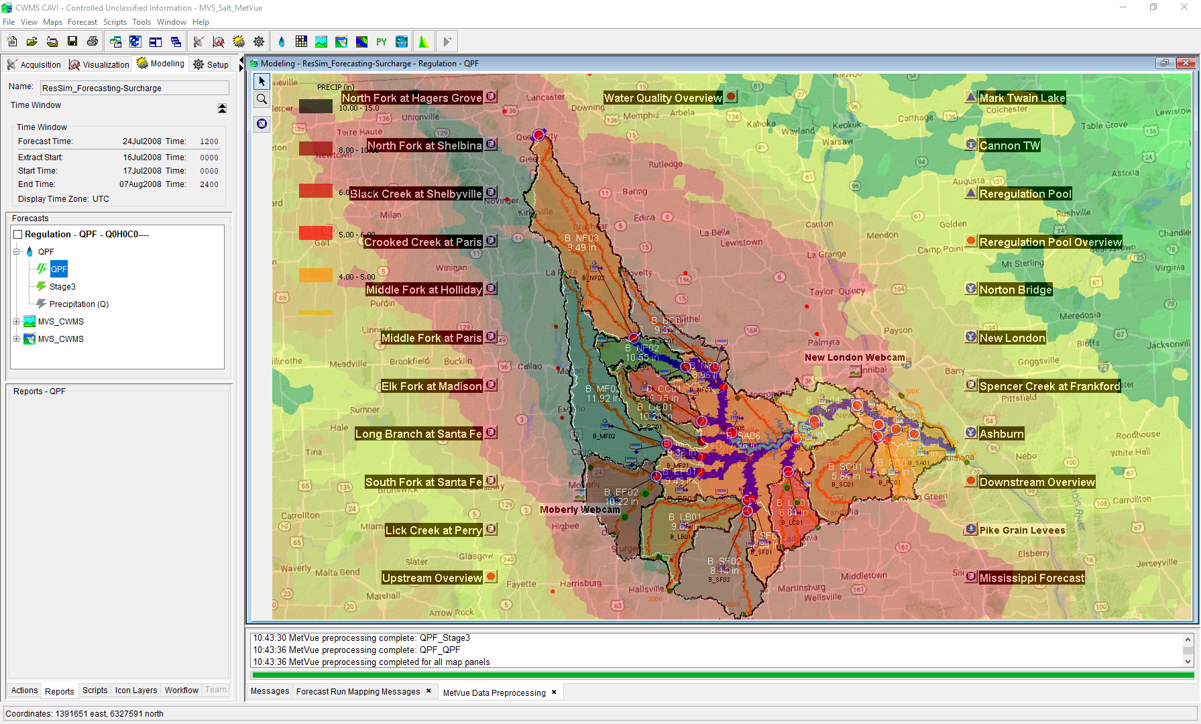

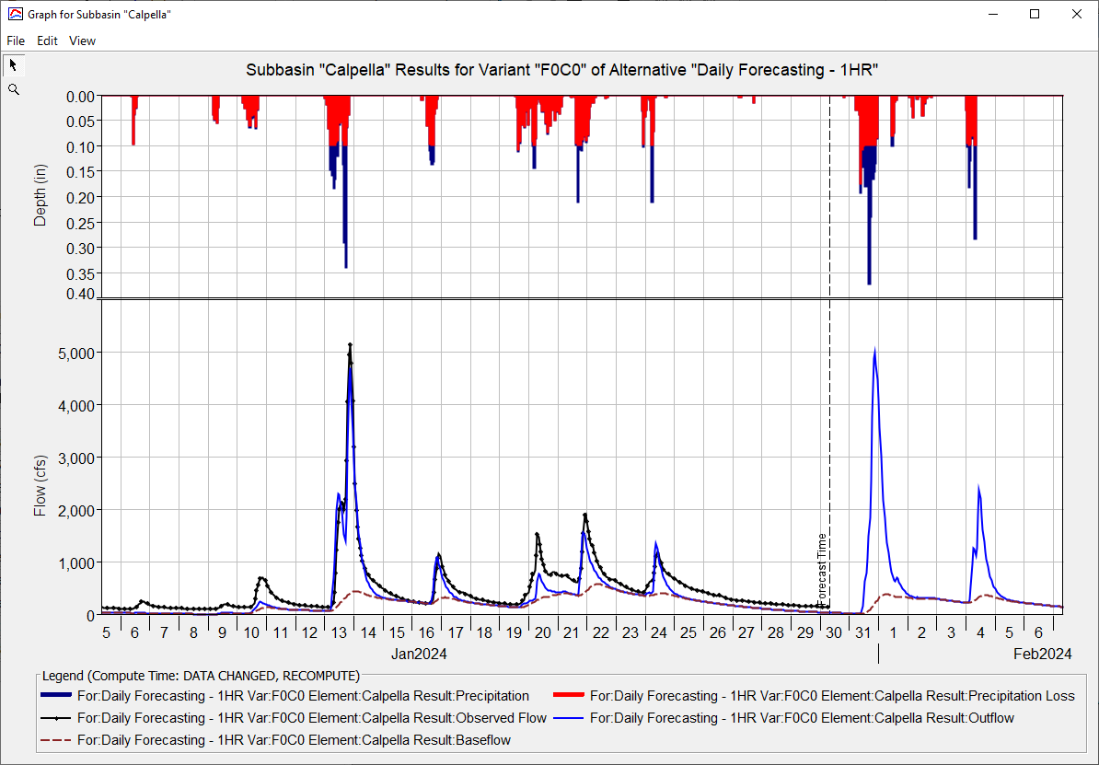
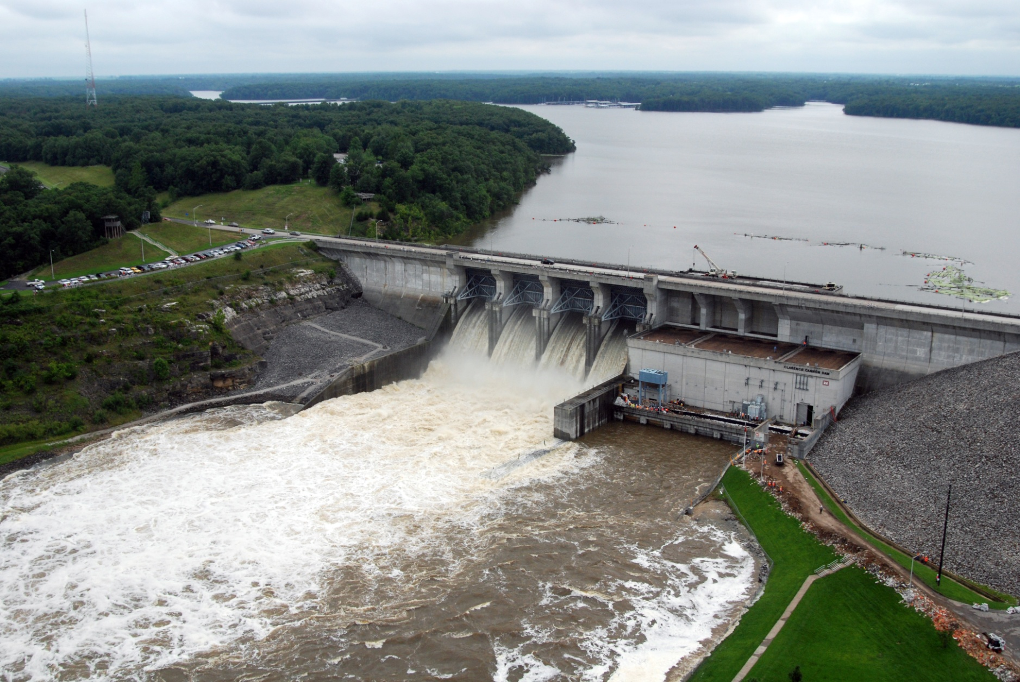
CWMS Real-Time Modeling
Russell Errett, P.E.
Hydrologic Engineering Center
CWMS Prospect Course

Slide 2
Overview
Identify basic concepts for building a new CAVI watershed and about running real-time forecast simulation models in CWMS
Quick overview on CAVI watershed model development
Steps to create new CAVI watershed for use in real-time modeling
Using CWMS for real-time modeling
Creating a forecast
Time windows and forecast times
Data Status Summary Report
Editing and running models
Evaluating results
Time-series icons for model results
Saving models and results

Slide 3
Saving and Posting Results

Slide 4
CAVI Watershed Folder Structure
The CAVI works only with files in preselected folders called Watershed Locations
There are 3 sets of folders created within a Watershed Location
watershed
Watersheds are created and stored in a folder named “watershed”
The watershed folder is often referred to as “Base” or “Setup”
Watershed = Base = Setup
forecast
When a forecast is created, a subset of the watershed is copied to the forecast folder
database
Folder to store supplemental DSS records (i.e. ratings, cumulus grids, USGS downloaded data, etc.) or any other reference material to support modeling (SOPs, contact list, etc.)

Slide 5
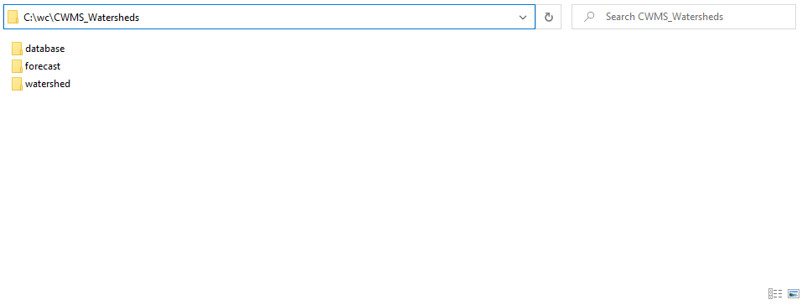
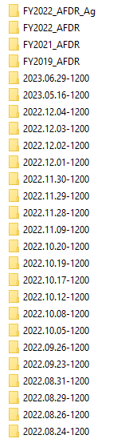
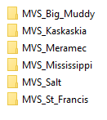
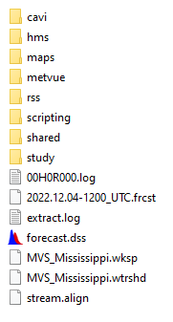
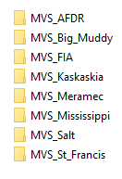
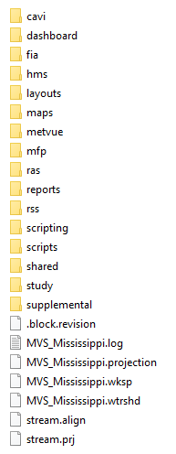
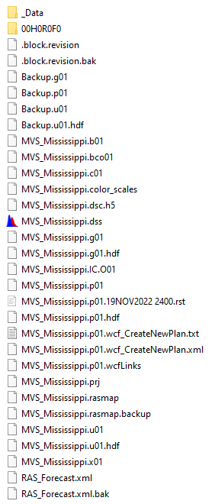
CAVI Watershed Folder Structure

Slide 6
Saving to Base & Replace From Base
Save To Base
Replace From Base
If you have made changes and want them available for future forecast creations
Changes such as:
Adjustments to guide curve or zones
Adjustments to Max-Min Release rules
Rating curve updates with models
HMS zonal parameters
RAS roughness coefficient calibrations
If you make changes and cannot undo them
Too many changes in the HMS zonal parameter editor
Modifications to ResSim rules or zones that you want undo
RAS model modifications that need undone
Cross-Sectional edits
Manning's n changes
Roughness coefficients
Check with your office’s procedure on leveraging these options
Some offices prohibit Saving to Base to preserve the Base directory

Slide 7
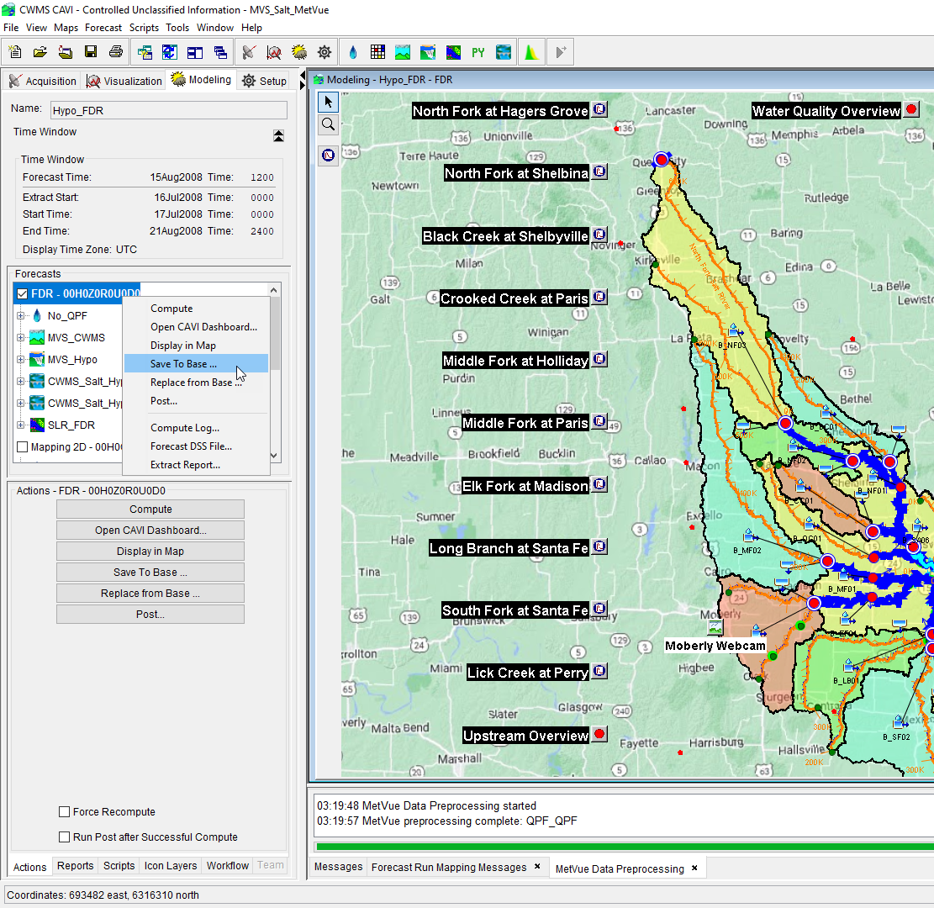

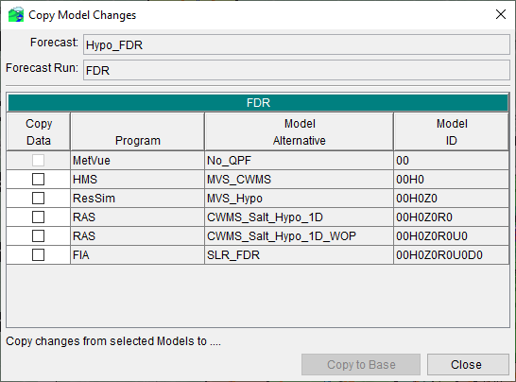
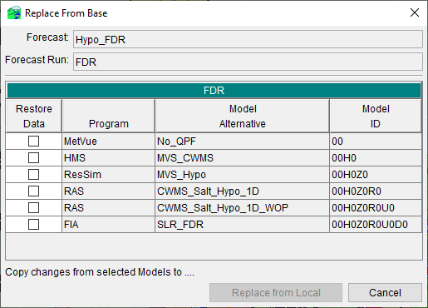
SavE to Base & Replace From Base

Slide 8
Posting Results
Posting results allow for other CAVI watersheds to extract modeled data and to exchange data to other users for other purposes
Posting to CDA GIS dashboards to access (EOC, EMs, Division, etc.)
Posting to CDA or CWMS database allows for exchange with other downstream watersheds for boundary conditions
Inter-district watersheds, downstream district, or exchange with NWS via shef
Posting to database or remote DSS file for evaluating forecast accuracy
Versioning of time-series (i.e., many forecast under same time-series)

Slide 9
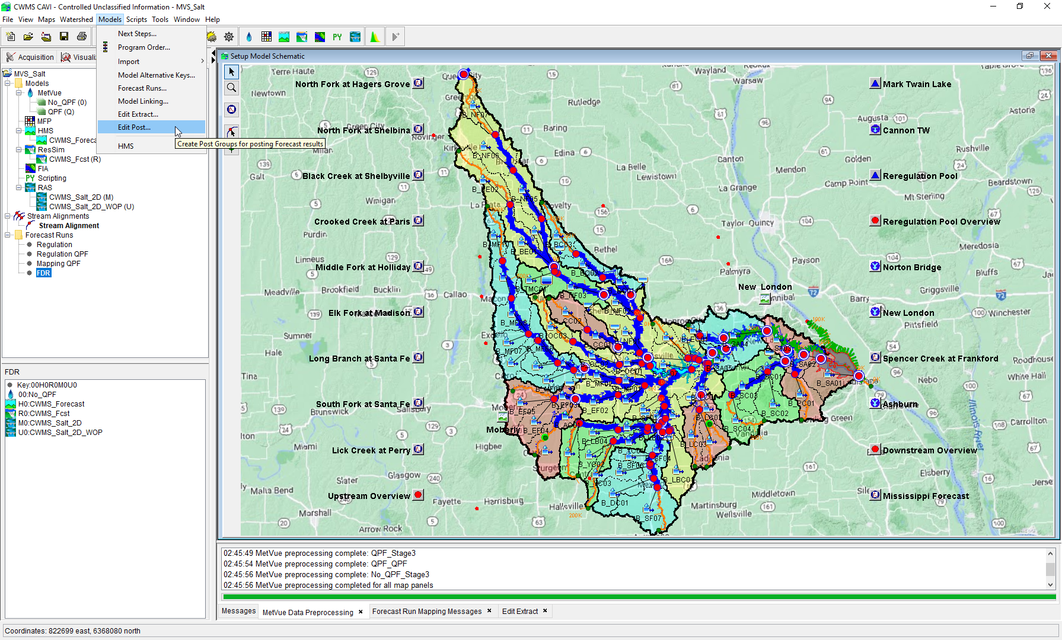
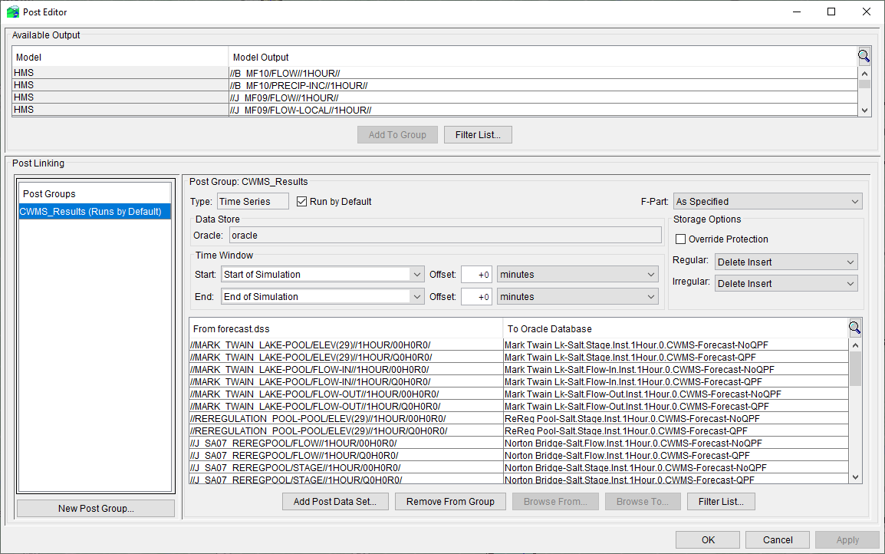
Posting Results

Slide 10
CWMS Forecasting Methodologies

Slide 11
CWMS Forecasting Methodologies
There are a couple competing methodologies for performing daily CWMS forecasting (not a competition…or is it)
Create a new forecast each day
Fresh extract of data (time-series and gridded data)
Many offices set the lookback is at least 30 days back (i.e., initial conditions have less influence on current conditions
This methodology is advantageous if you have multiple watersheds to run and manage as keeping up with various start times and when to reset can be difficult
Continuous forecasting
Initialize the CAVI forecast at a time between events when initial baseflow is at it’s lowest
Move Forecast Time and End Time by one day for daily forecasting
Extract only the missing data needed (i.e., last 24 hrs)
This methodology is advantageous if you have only one or a limited number of watersheds to run and manage

Slide 12
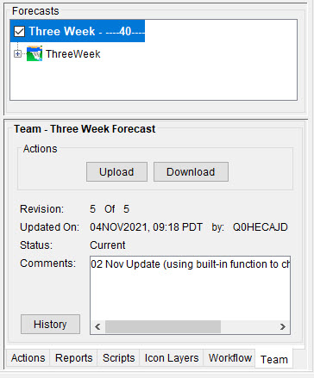
Team Forecasting
Team forecasting improves:
The ability to sync CAVI watershed updates amongst multiple Water Managers
Syncing and sharing active forecasts with Water Managers and H&H modelers
Hydrology Team → Reservoir Regulation Team → Hydraulic Team → Economist
Team Forecasting can be used for archiving CAVI watershed models as a backup

Slide 13
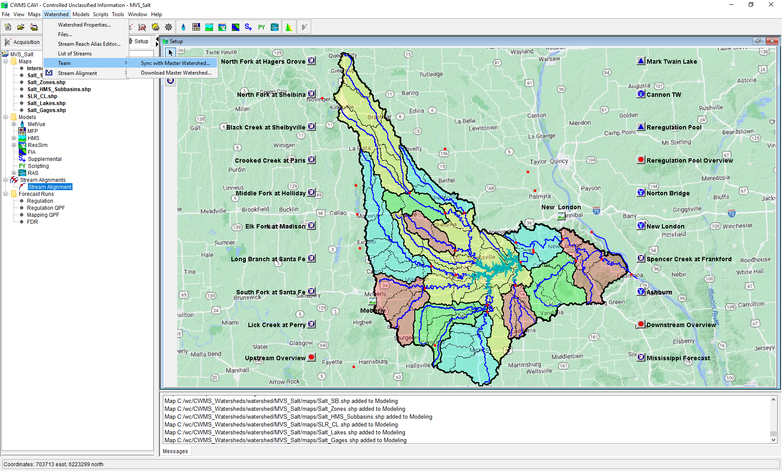
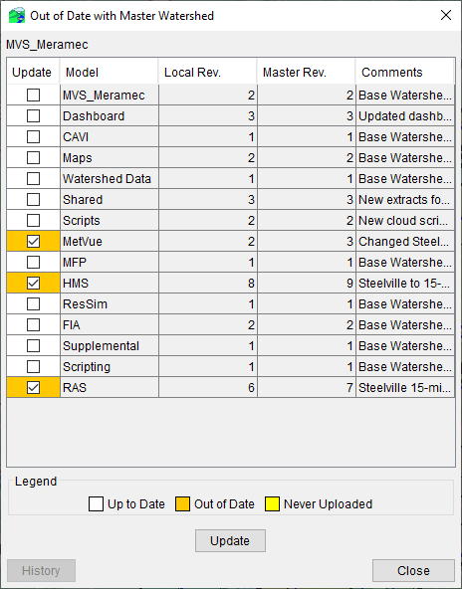
Team Forecasting

Slide 14
Questions Help additional Training
https://usace.dps.mil/sites/KMP-WM/SitePages/Corps-Water-Management-System-(CWMS).aspx
https://www.hec.usace.army.mil/confluence/cwmsdocs
https://discourse.hecdev.net/c/cwms/5
TDL-CELRH-EC-GW-W-USACE CWMS Modeling | General | Microsoft Teams

