Slide 1
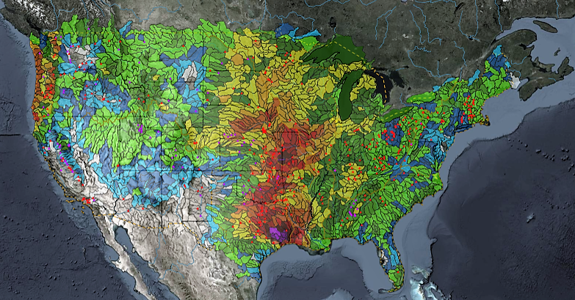
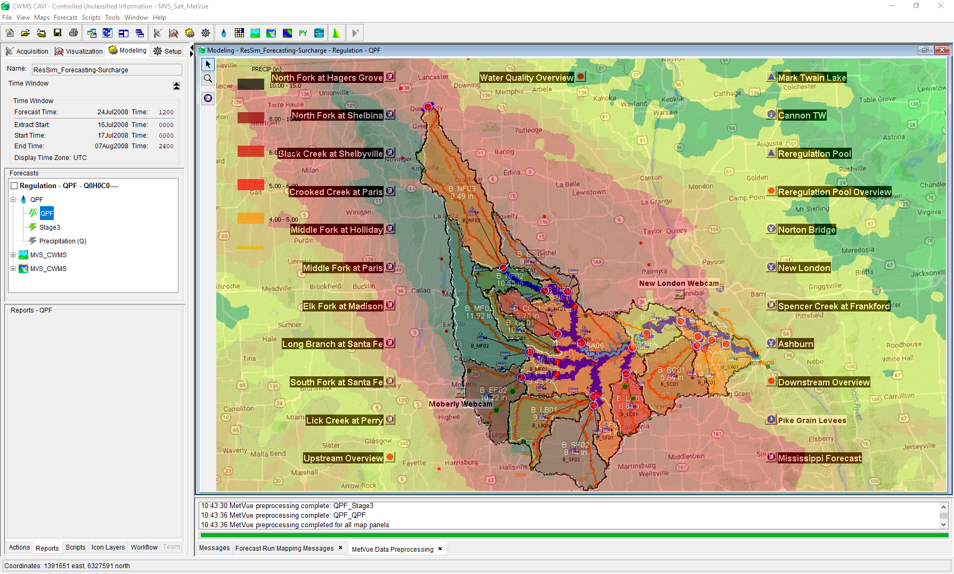

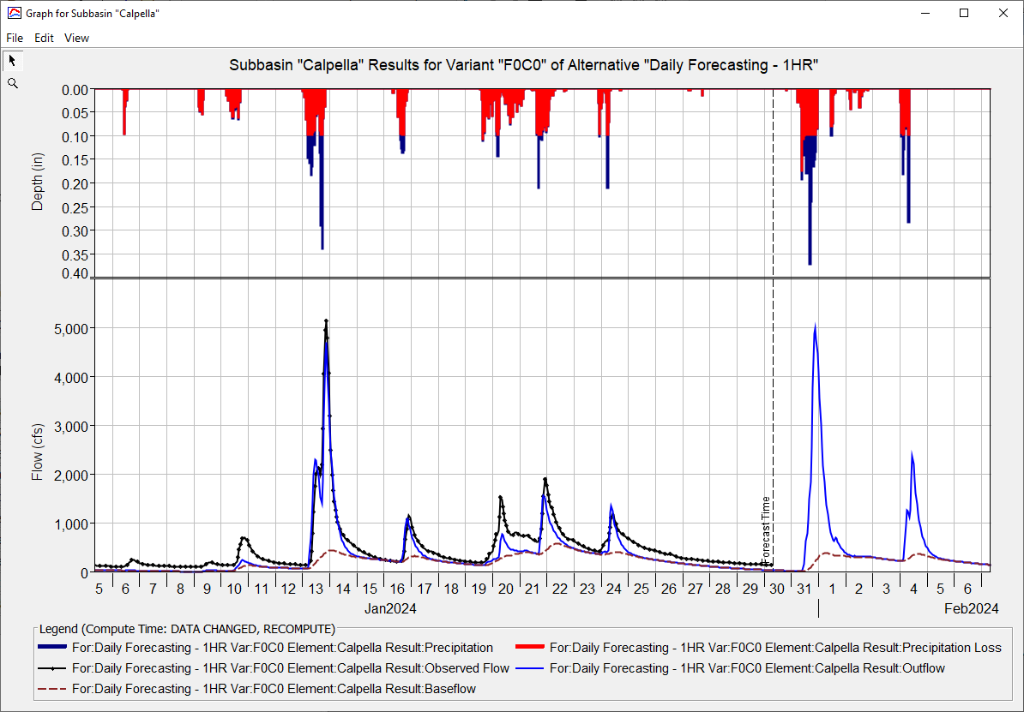
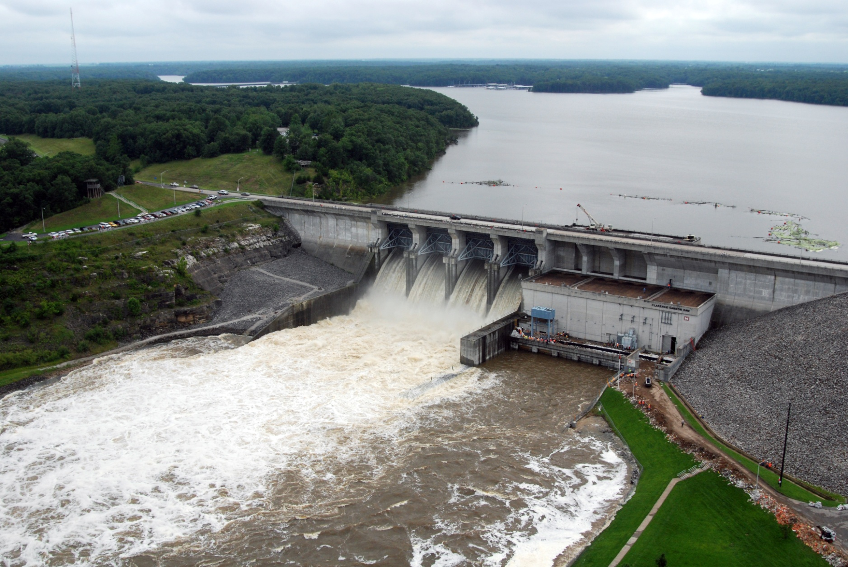
ST. Louis District CWMS Implementation
Russell Errett, P.E.
Hydrologic Engineering Center
CWMS Prospect Course

Slide 2
Overview
St. Louis District Overview
Review of CWMS Implementation within the St. Louis District
Application of CWMS with the St. Louis District
Examples of CWMS usage
Evaluation of performance of CWMS vs Legacy

Slide 3
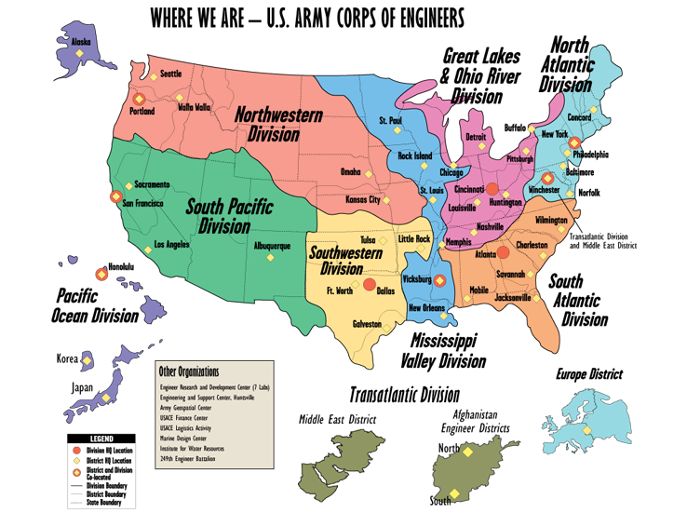
USACE Boundaries

Slide 4
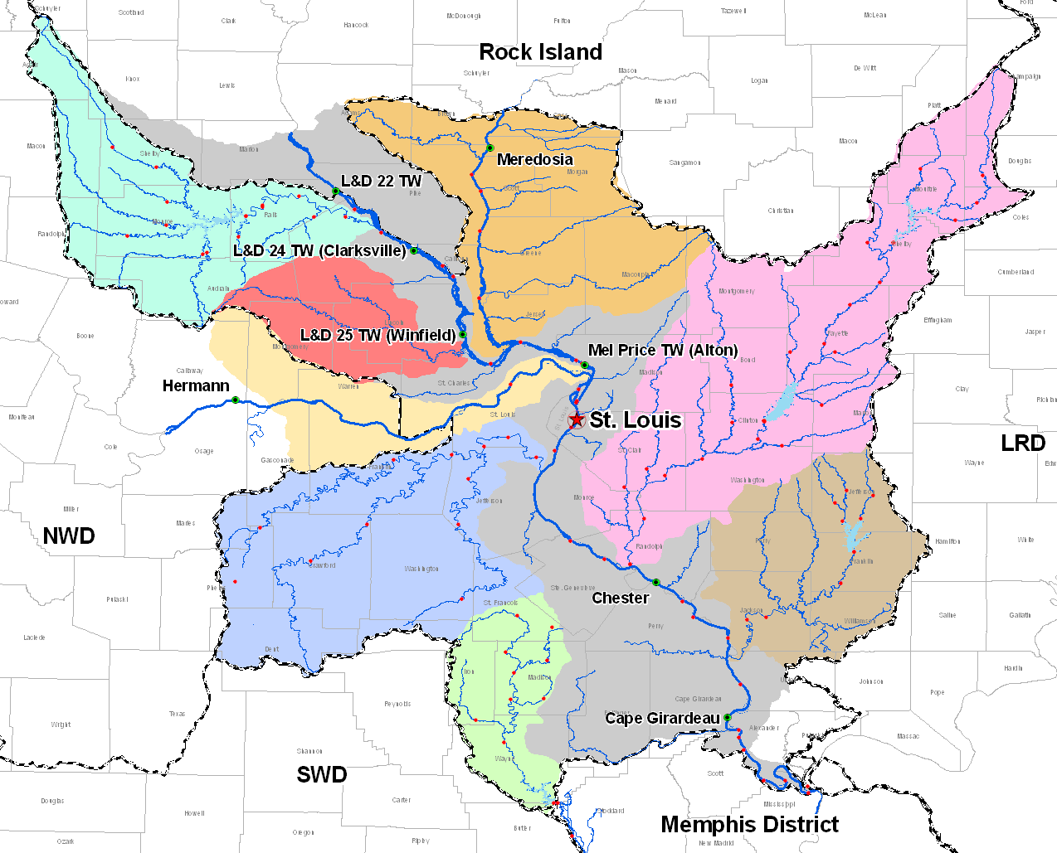
St. Louis District
Mark Twain Lake
Illinois River
Lake Shelbyville
Carlyle Lake
Missouri River
Mississippi River
Rend Lake
Wappapello Lake

Slide 5
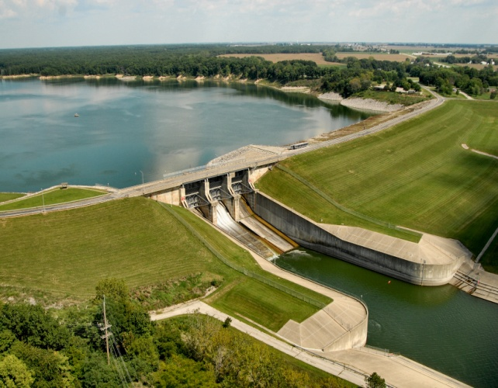
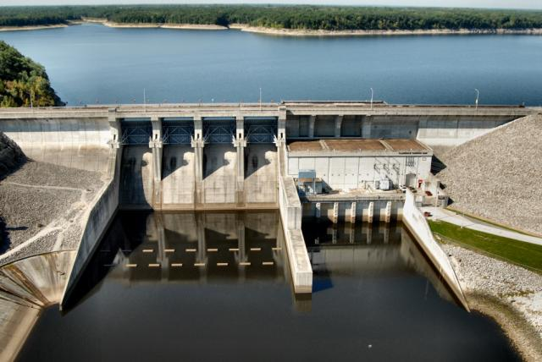
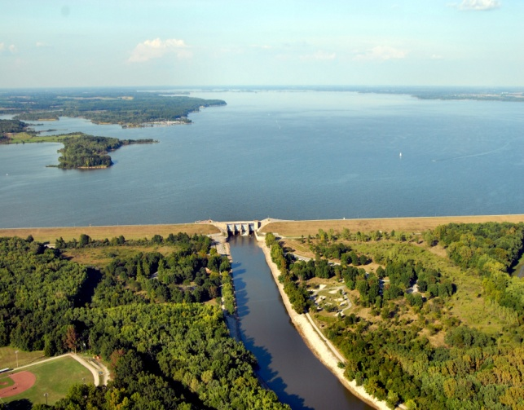
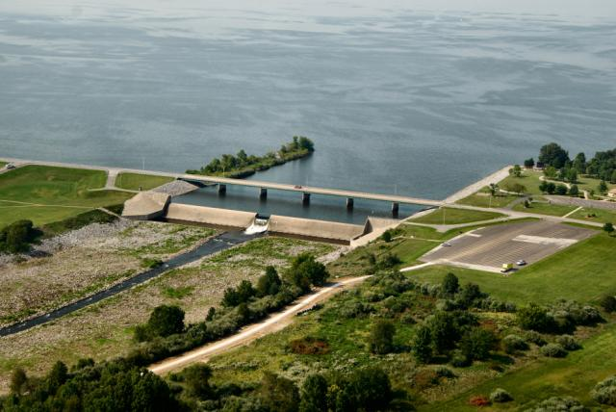
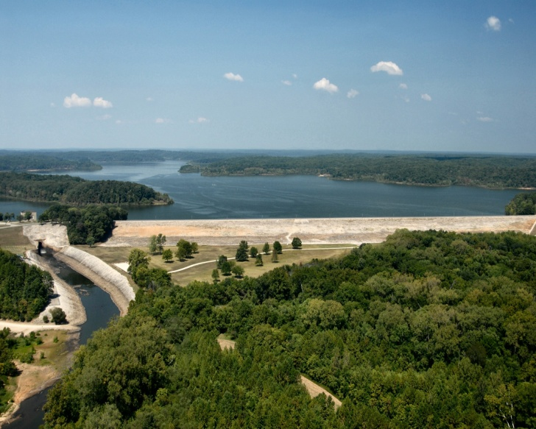
Reservoirs
Lake Shelbyville
Carlyle Lake
Illinois River
Mark Twain Lake
Missouri River
Rend Lake
Wappapello Lake
Mississippi River

Slide 6
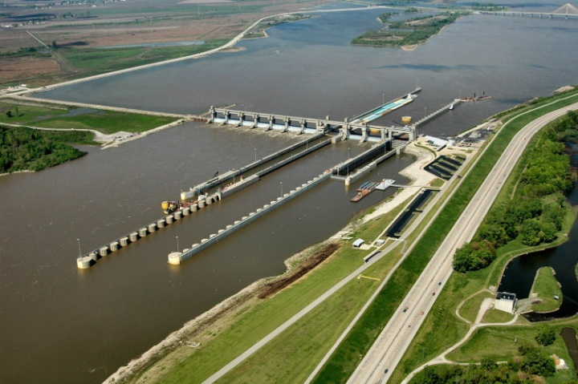
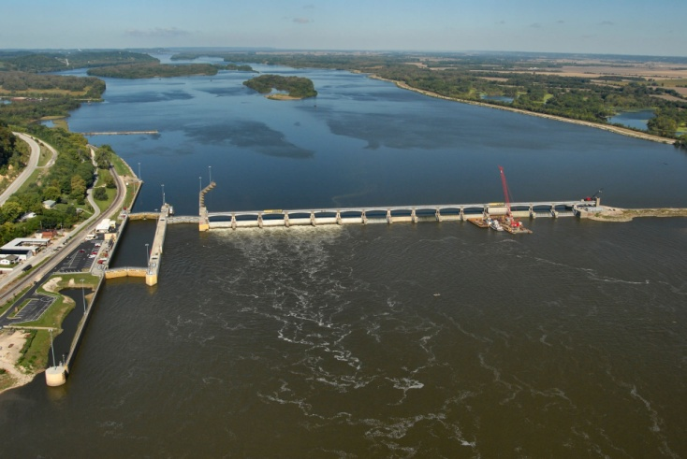
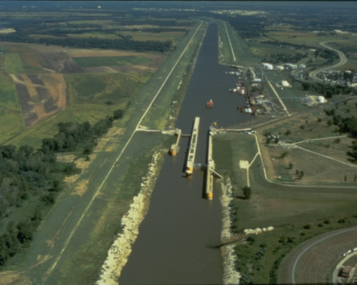
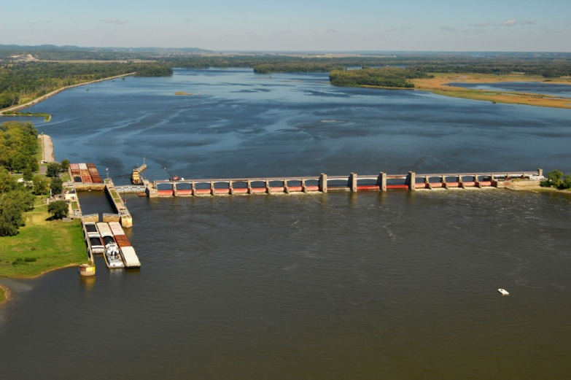
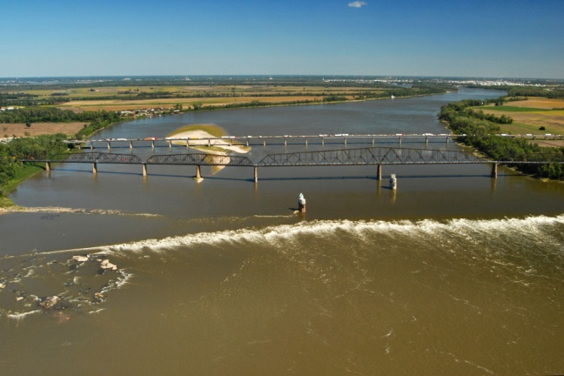
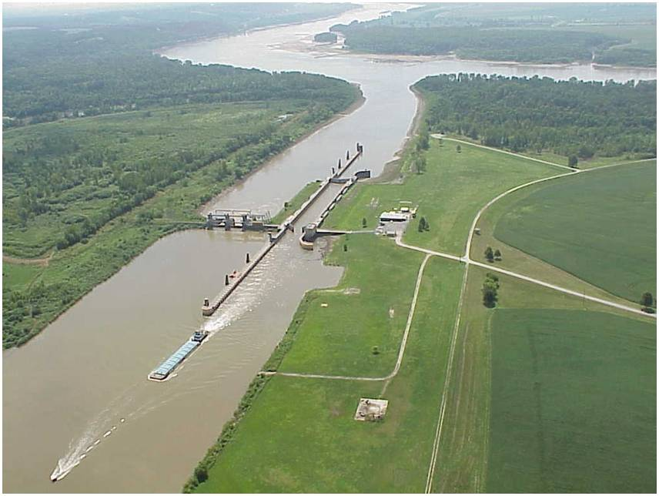
Locks and Dams
Melvin Price
Locks & Dam
L&D 24
Locks 27
Illinois River
Missouri River
Mississippi River
Low Water Dam 27
Kaskaskia L&D
L&D 25

Slide 7
Viewing Precipitation

Slide 8
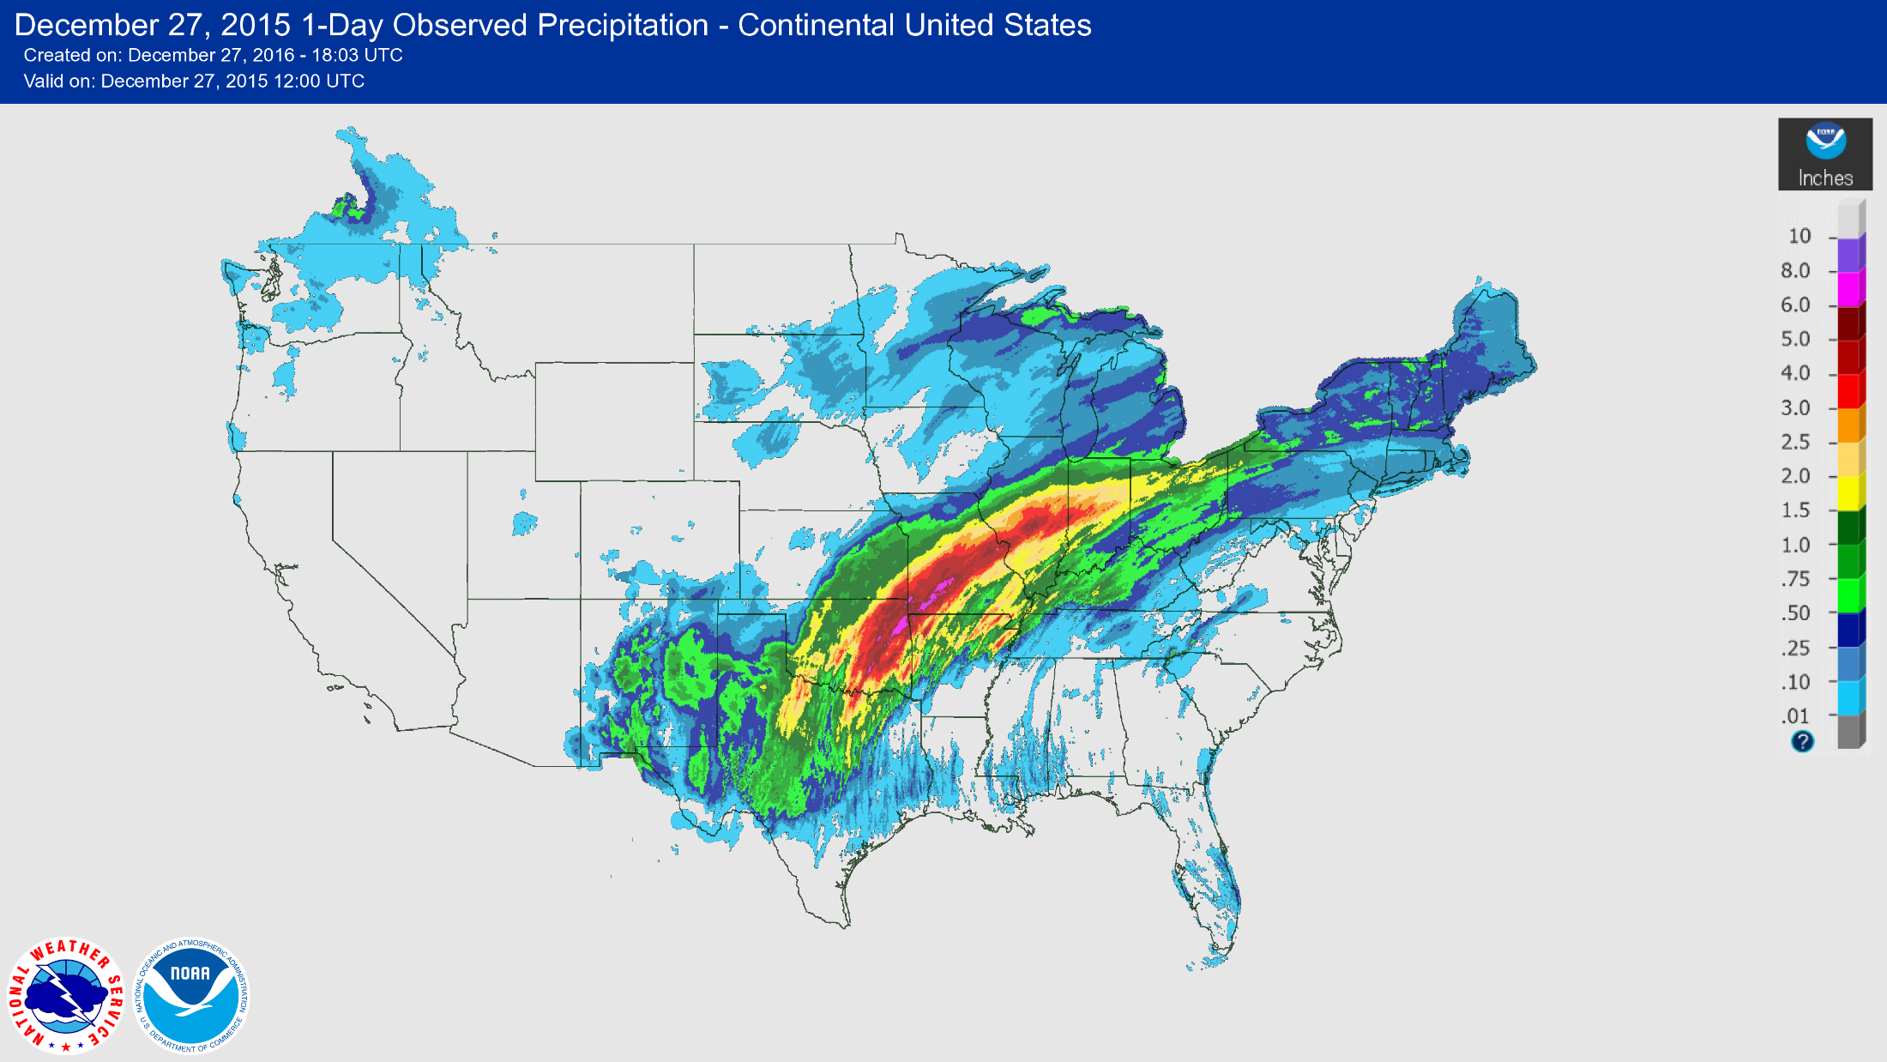
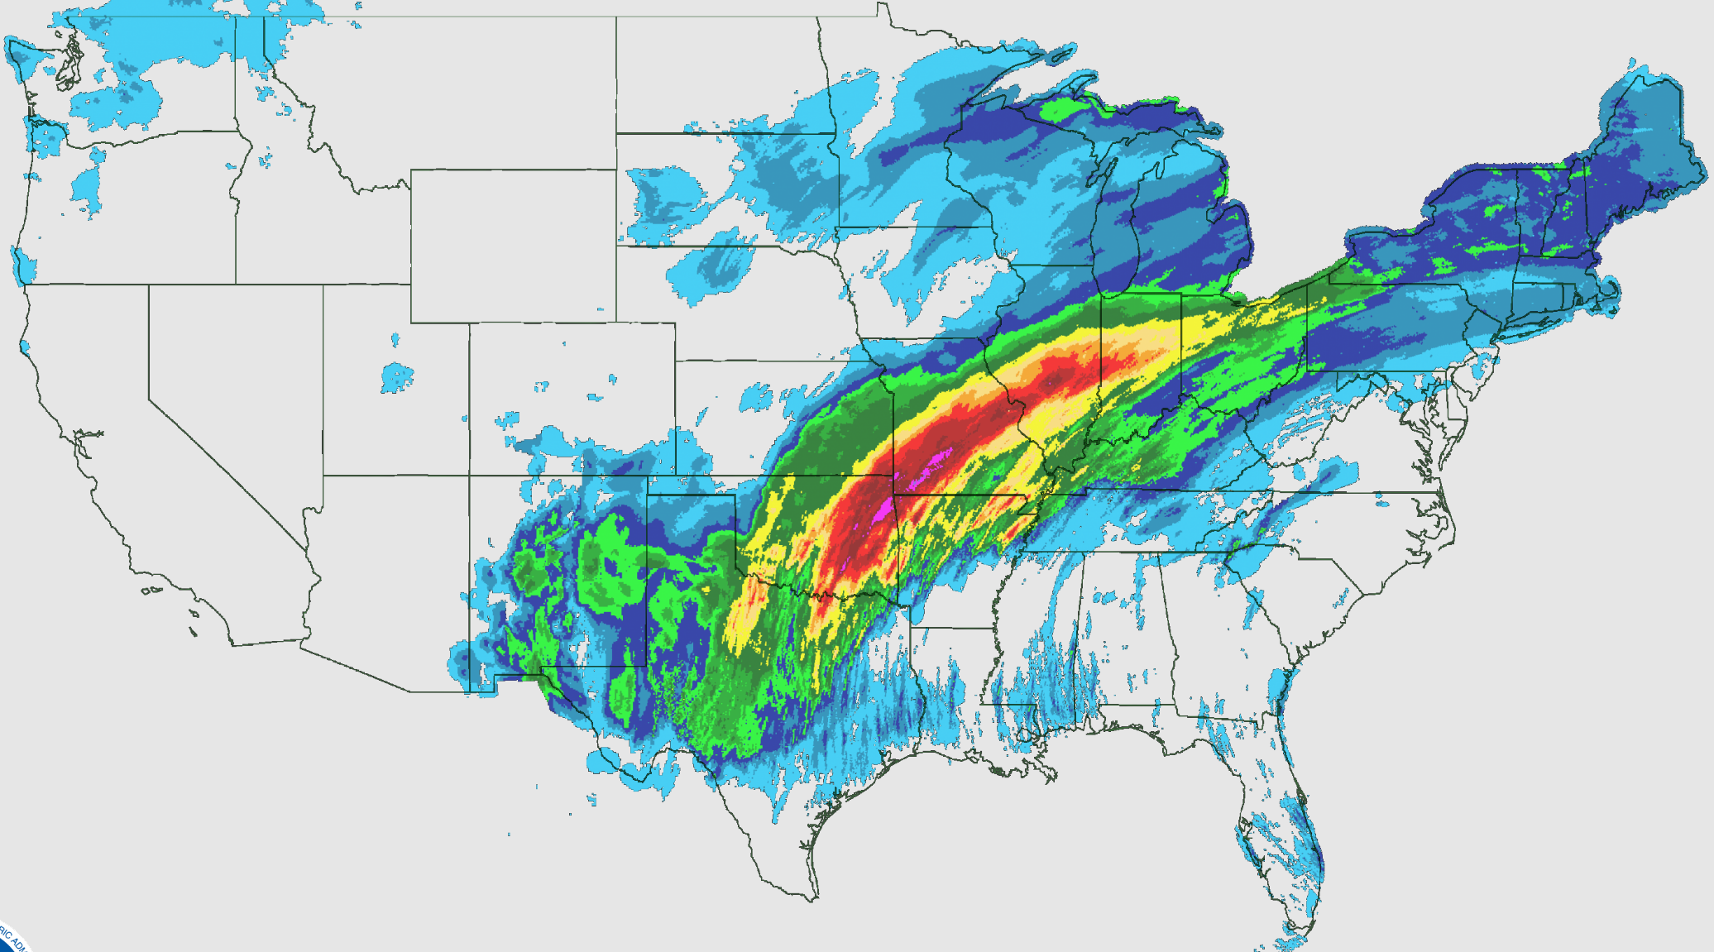

Observed Precipitation

Slide 9
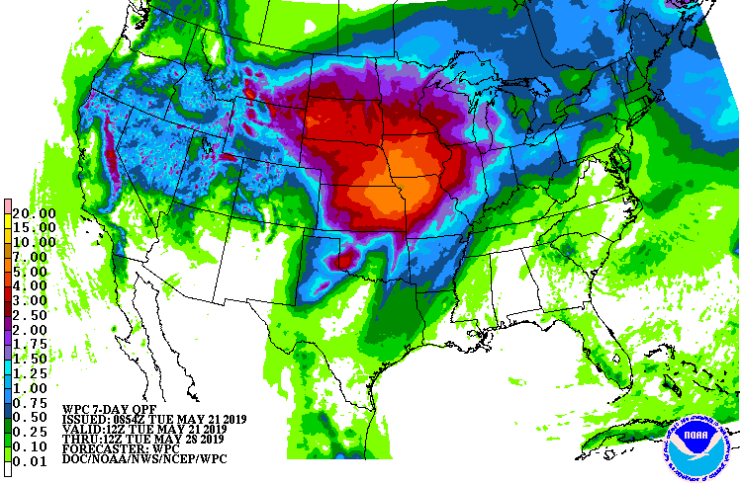
7-Day QPF

Slide 10
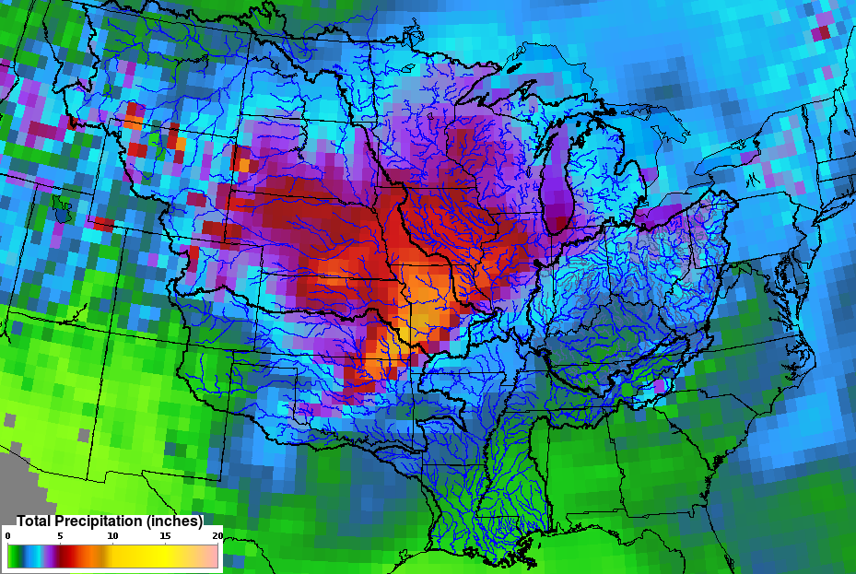
16-Day QPF

Slide 11
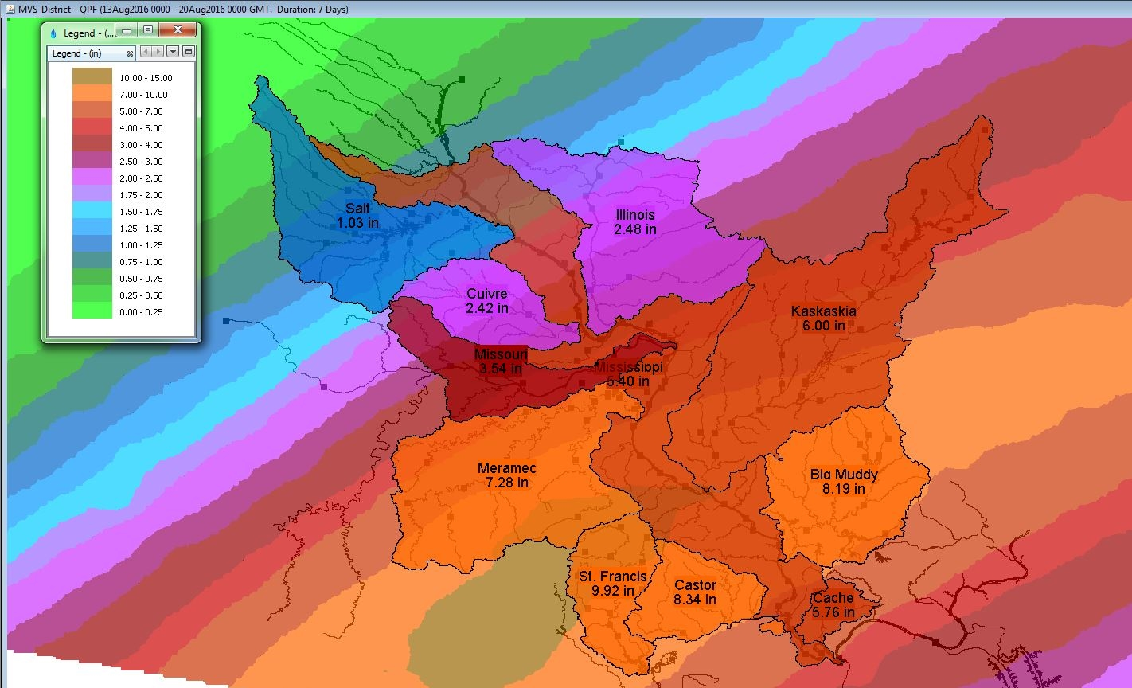
Gridded Precipitation

Slide 12
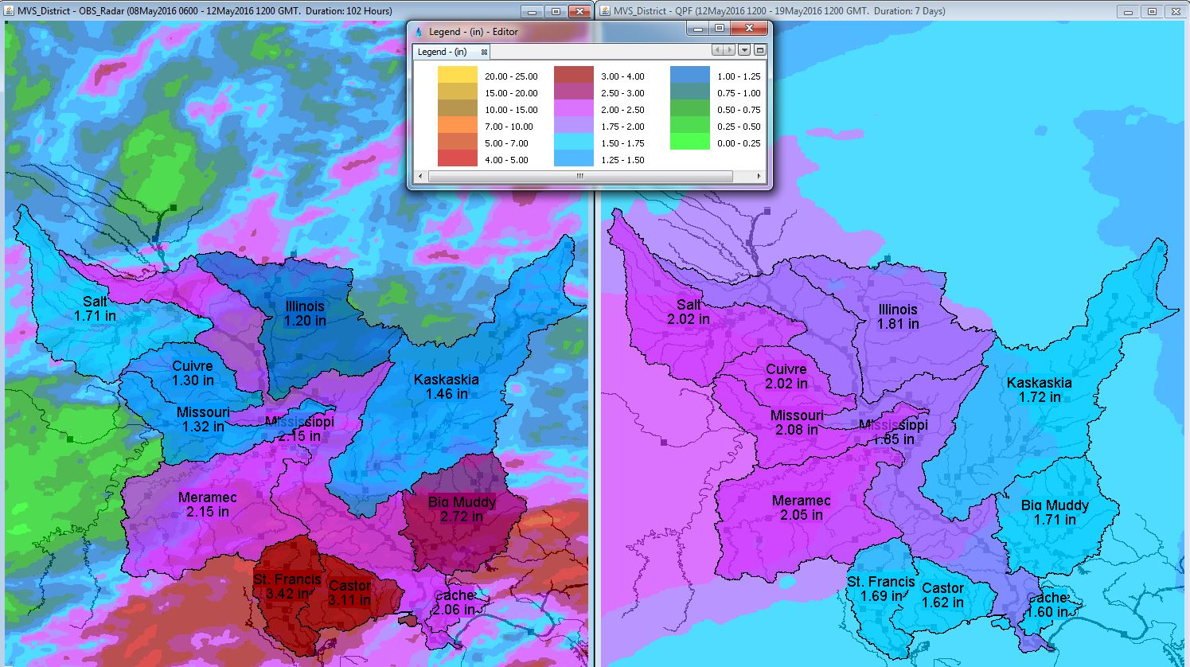
Gridded Precipitation

Slide 13
Questions Help additional Training
https://usace.dps.mil/sites/KMP-WM/SitePages/Corps-Water-Management-System-(CWMS).aspx
https://www.hec.usace.army.mil/confluence/cwmsdocs
https://discourse.hecdev.net/c/cwms/5
TDL-CELRH-EC-GW-W-USACE CWMS Modeling | General | Microsoft Teams

