Slide 1
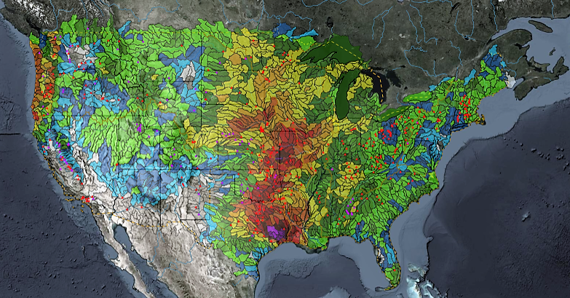
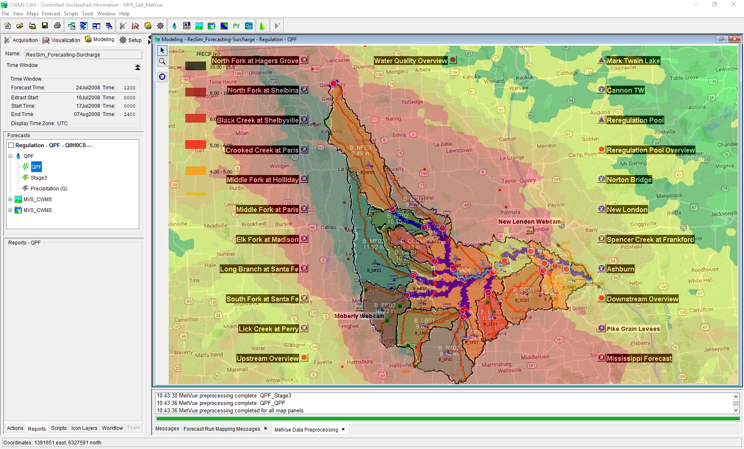

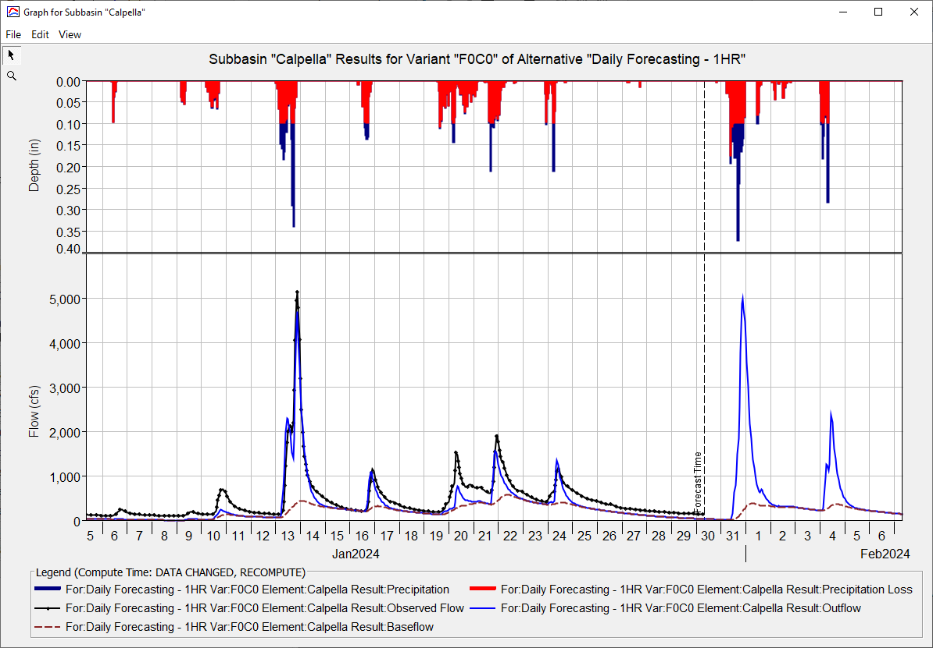
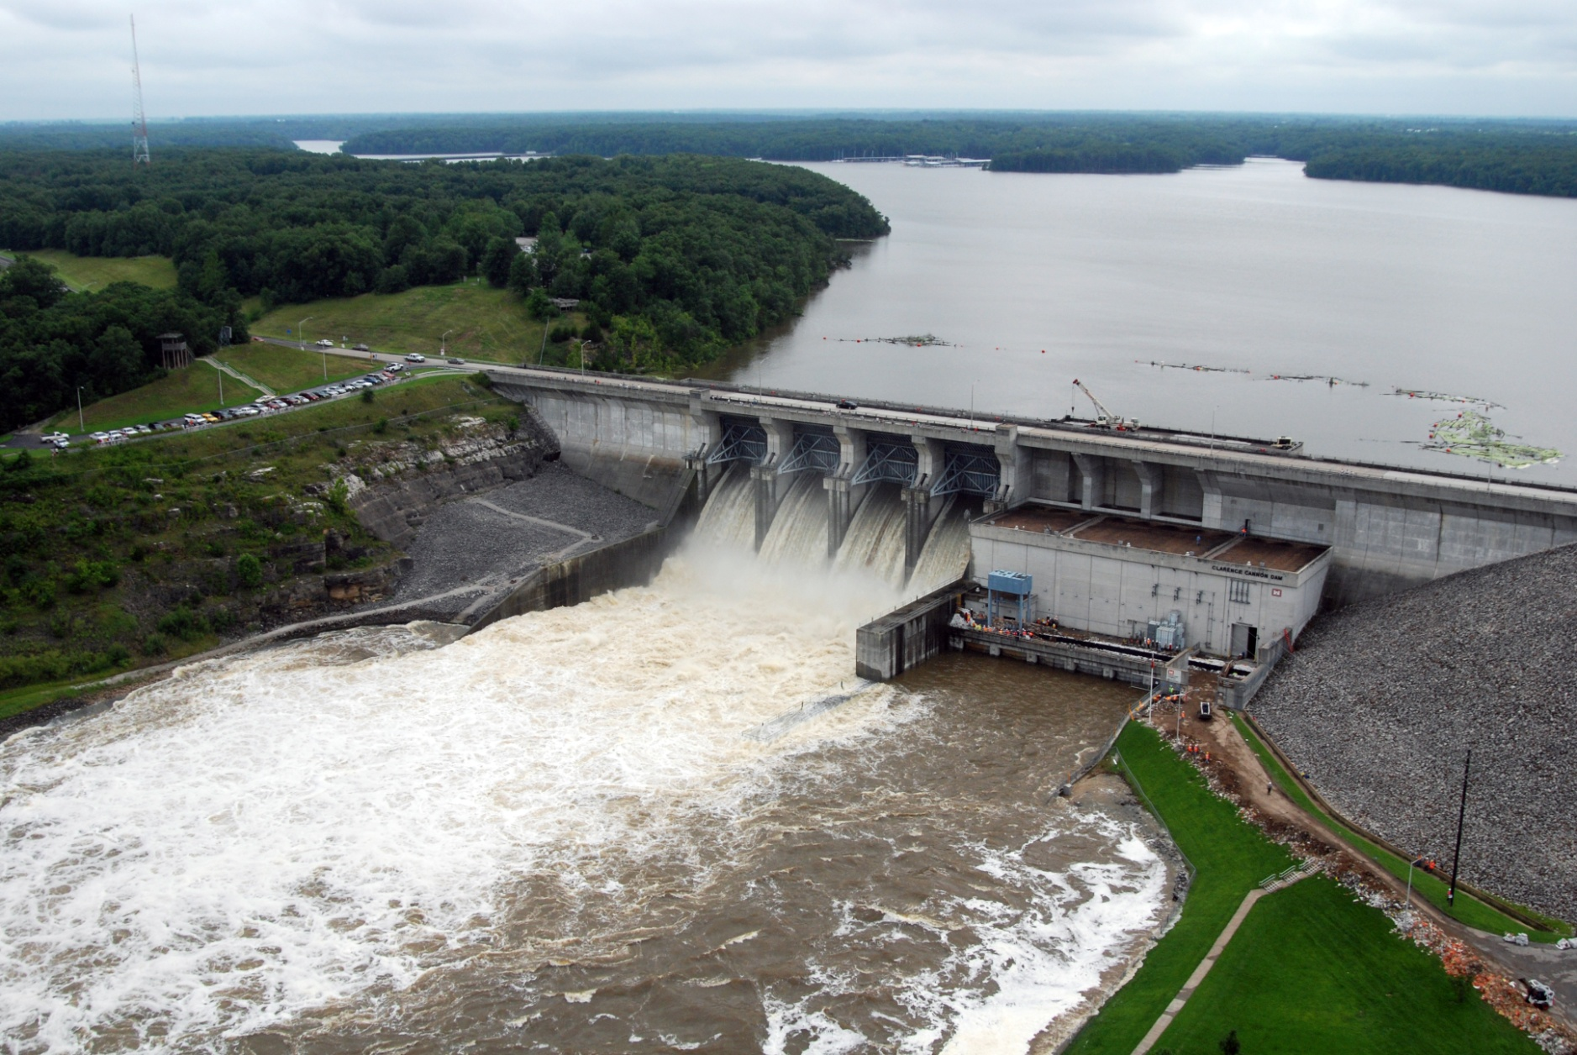
ST. Louis District CWMS Implementation
Russell Errett, P.E.
Hydrologic Engineering Center
CWMS Prospect Course

Slide 2
Overview
St. Louis District Overview
Review of CWMS Implementation within the St. Louis District
Application of CWMS with the St. Louis District
Examples of CWMS usage
Evaluation of performance of CWMS vs Legacy

Slide 3
CAVI Forecasting

Slide 4
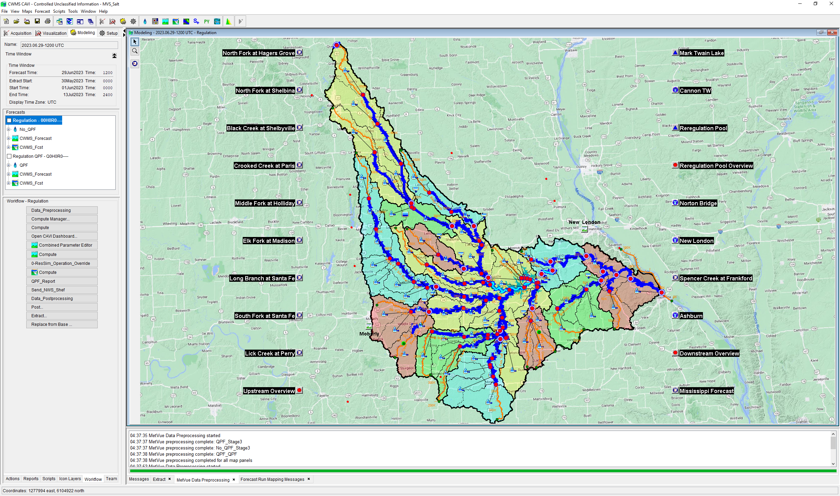
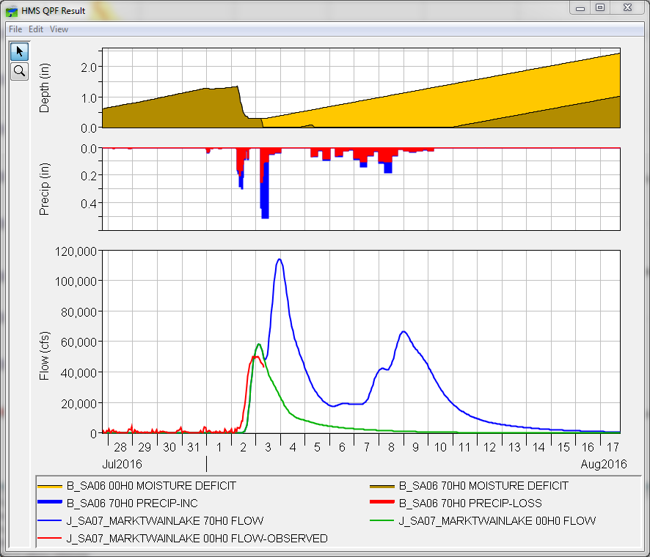
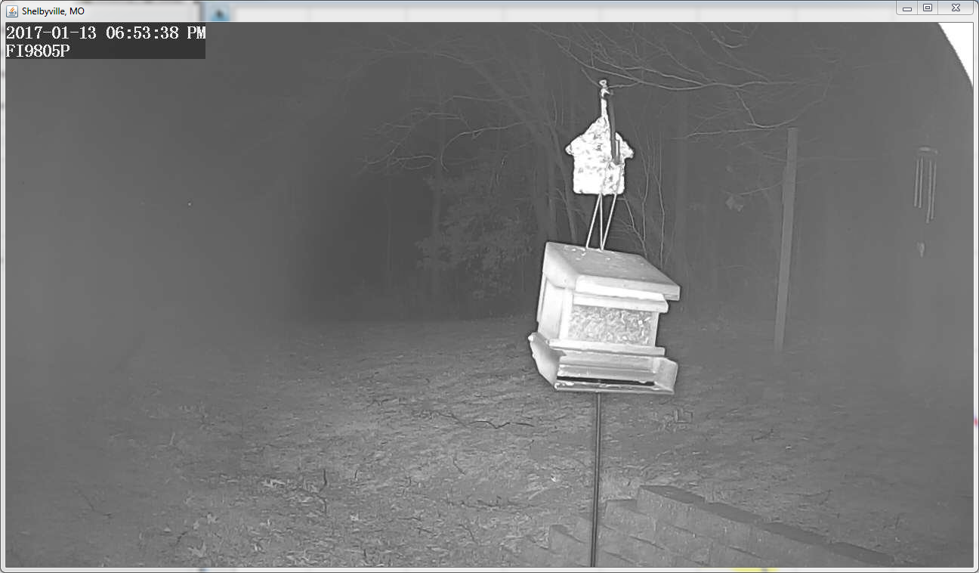
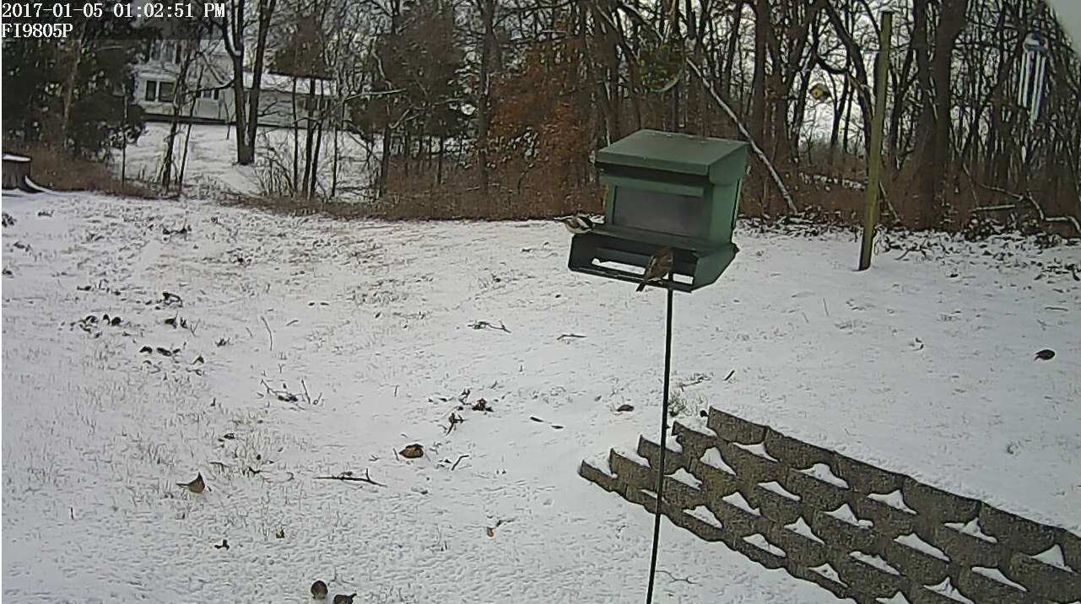
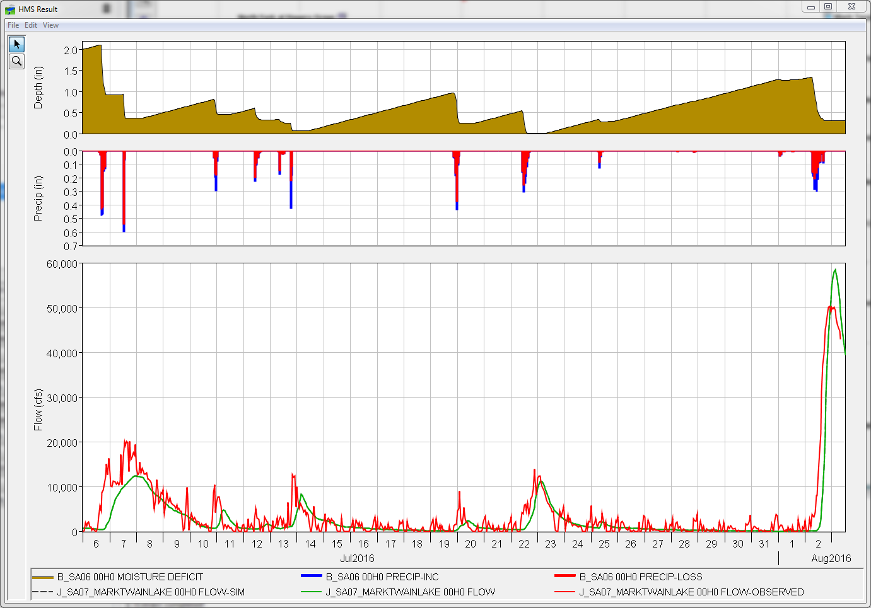
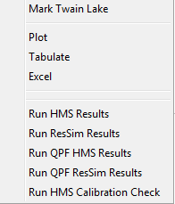
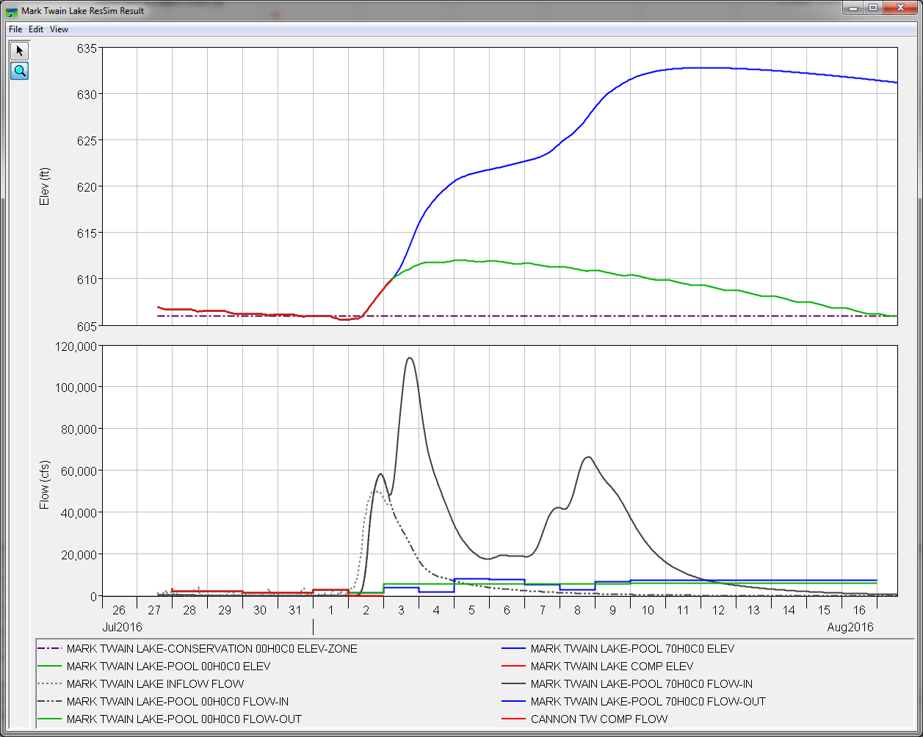
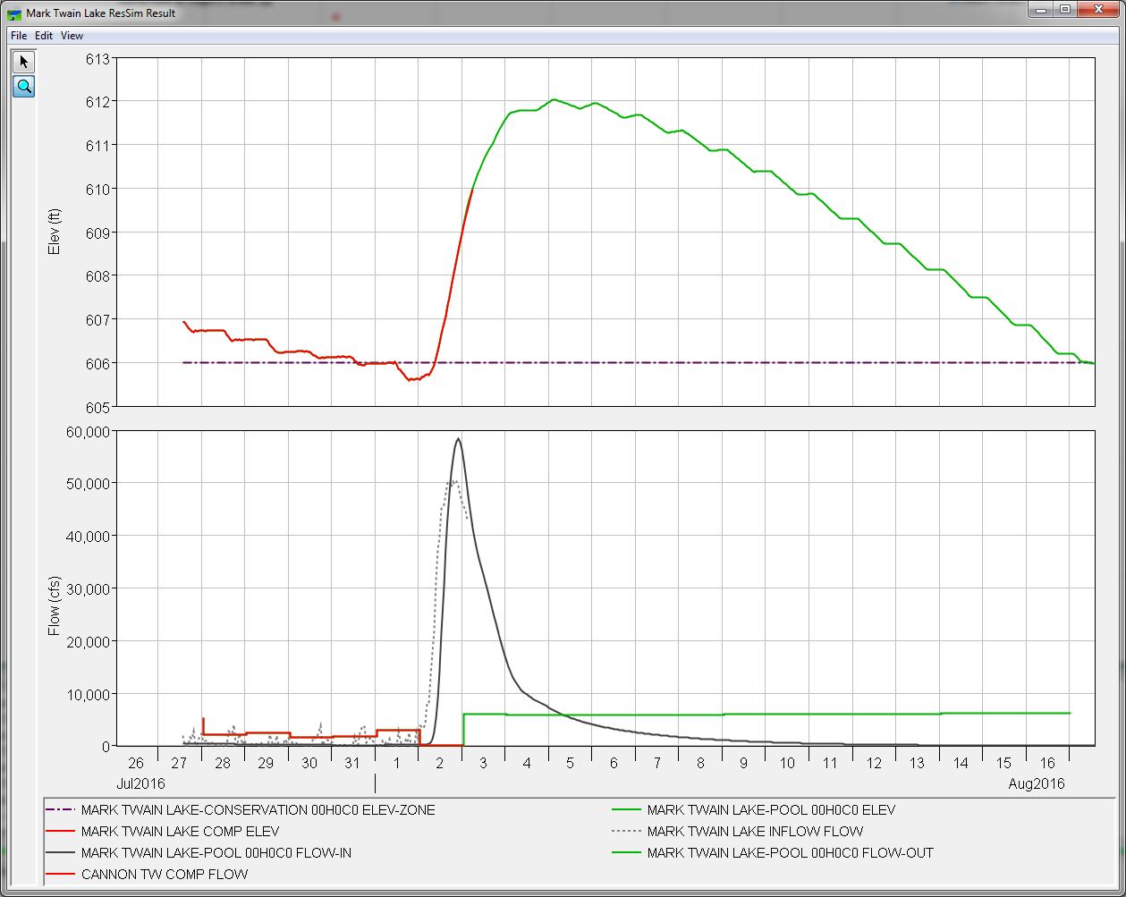
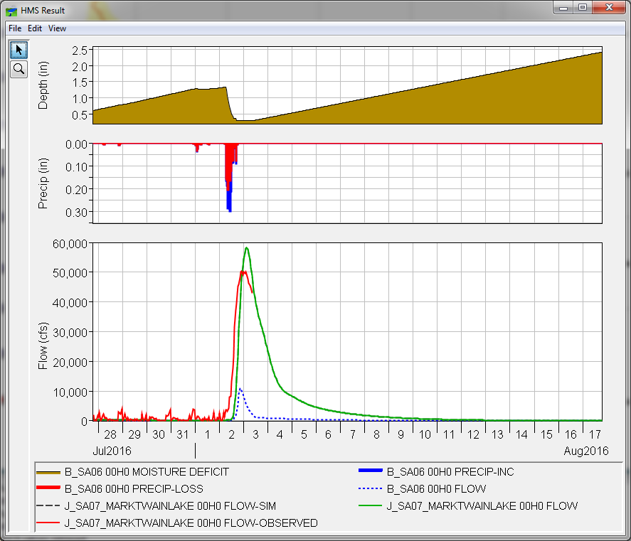
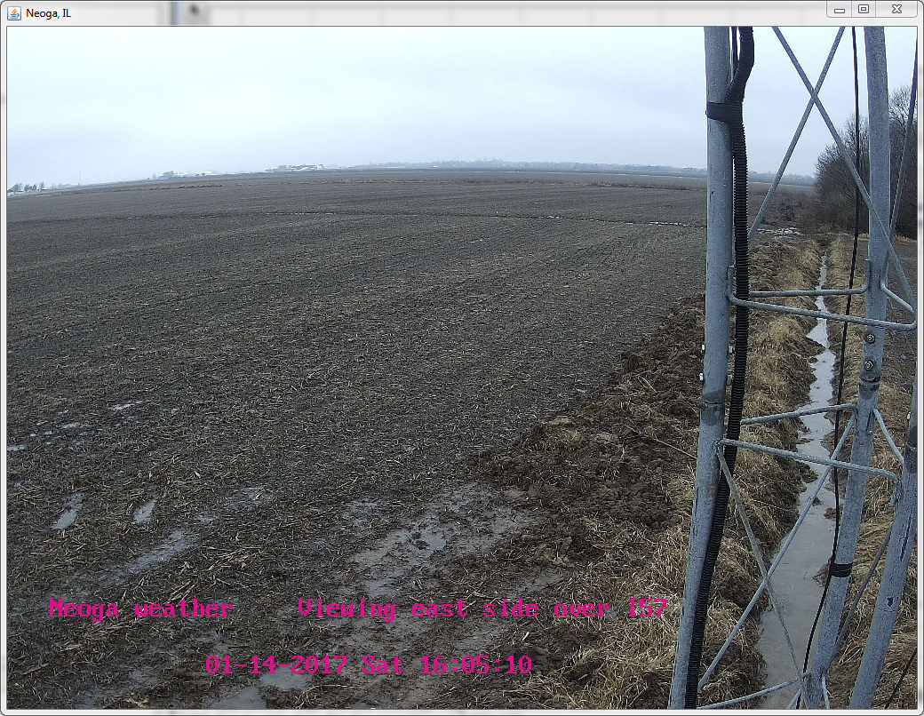
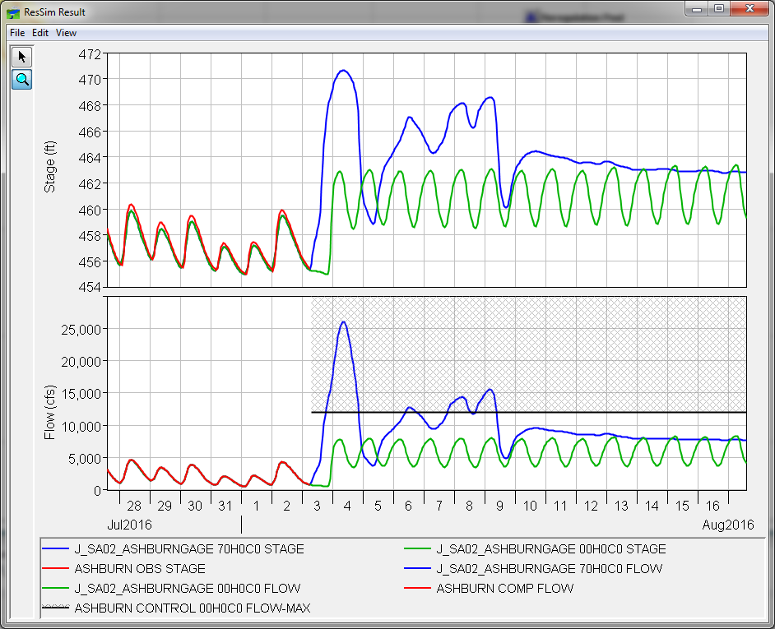
CAVI Modeling
Notes:
Intro: The more clicks it takes for a Water Manager to get to the answer, the less likely they are to use it. Meaning, if it takes 10 clicks to get to a good answer, but 2 to get to an OK answer, then they will likely use the OK answer versus going through the extra 8 clicks to get to the better answer.

Slide 5
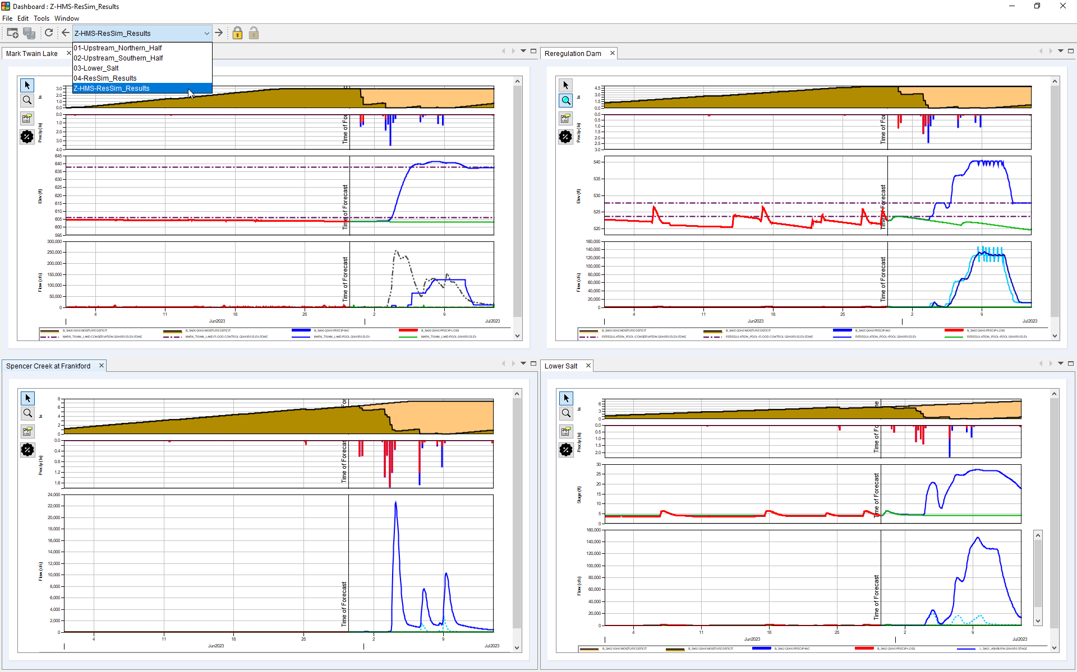
CAVI Dashboard
Notes:
Time:

Slide 6
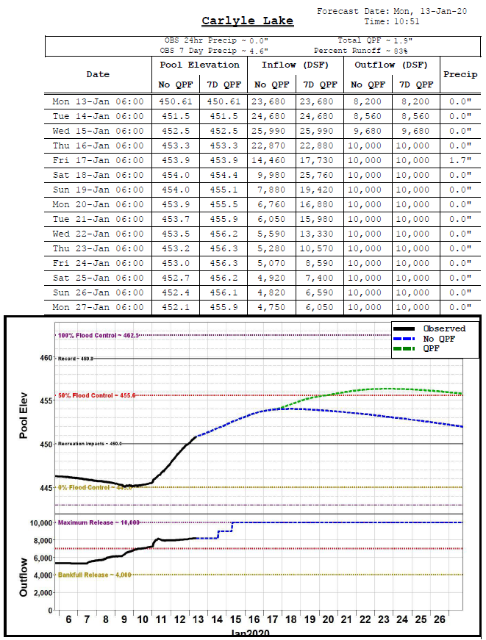
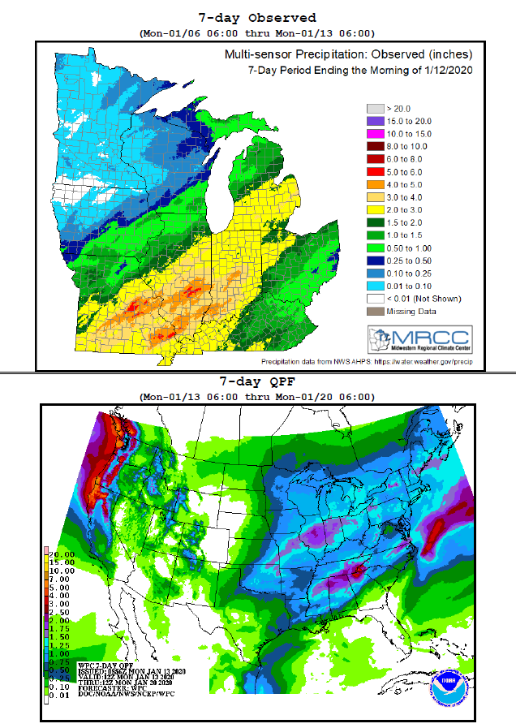


Upward Reporting

Slide 7
Questions Help additional Training
https://usace.dps.mil/sites/KMP-WM/SitePages/Corps-Water-Management-System-(CWMS).aspx
https://www.hec.usace.army.mil/confluence/cwmsdocs
https://discourse.hecdev.net/c/cwms/5
TDL-CELRH-EC-GW-W-USACE CWMS Modeling | General | Microsoft Teams

