Slide 1
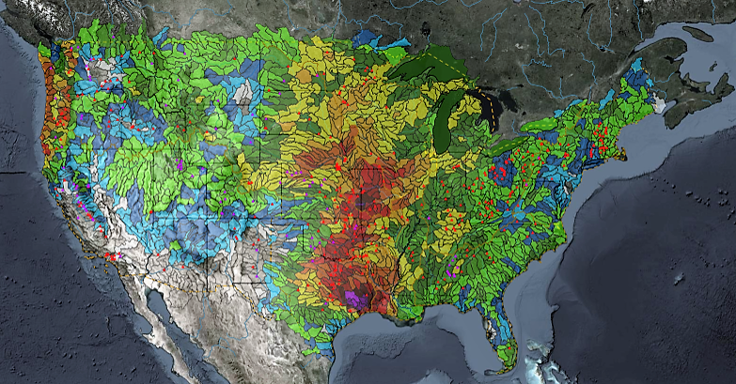
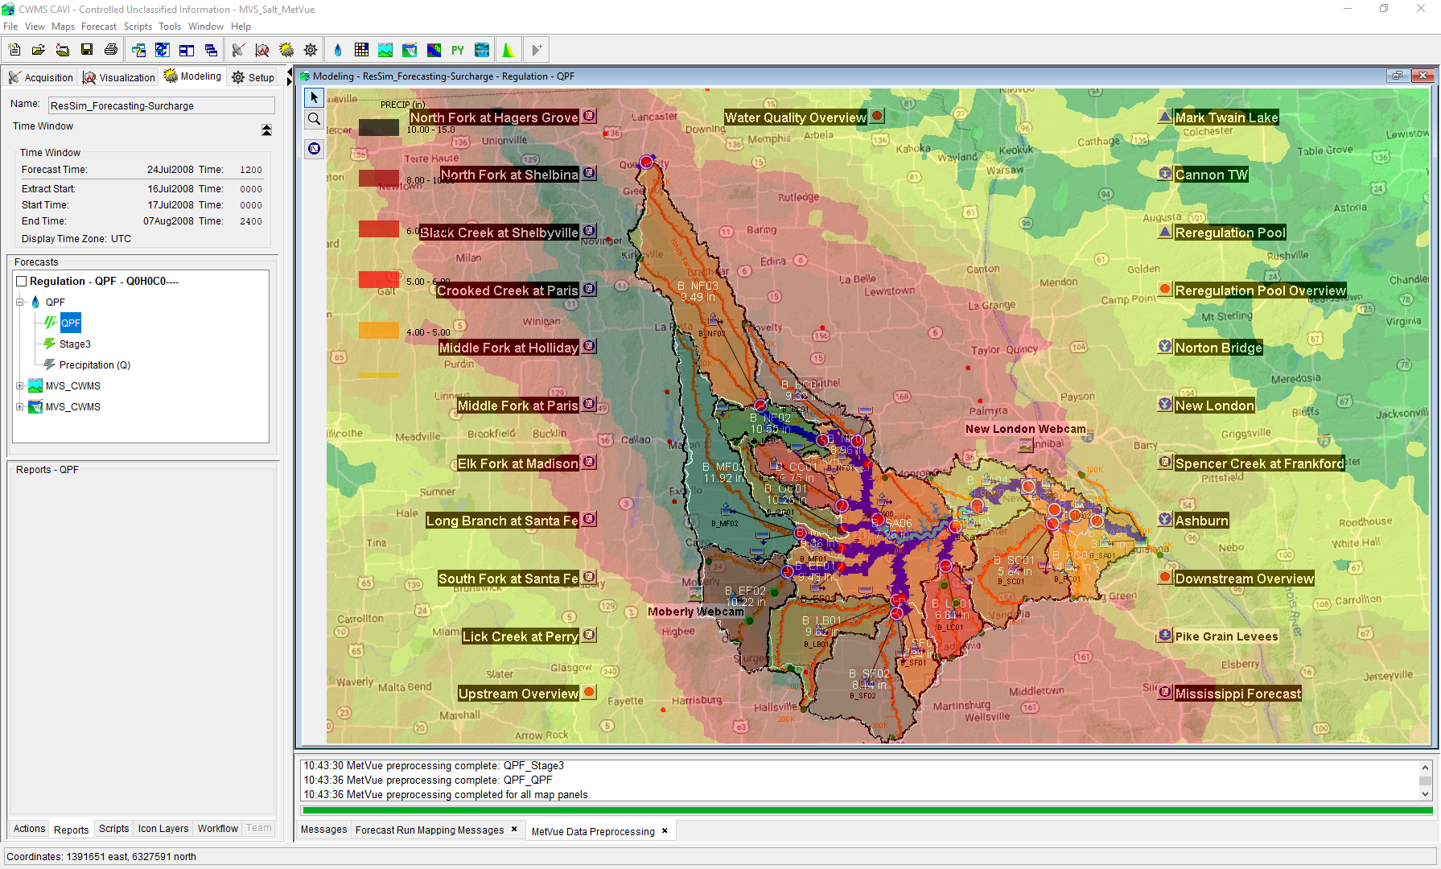

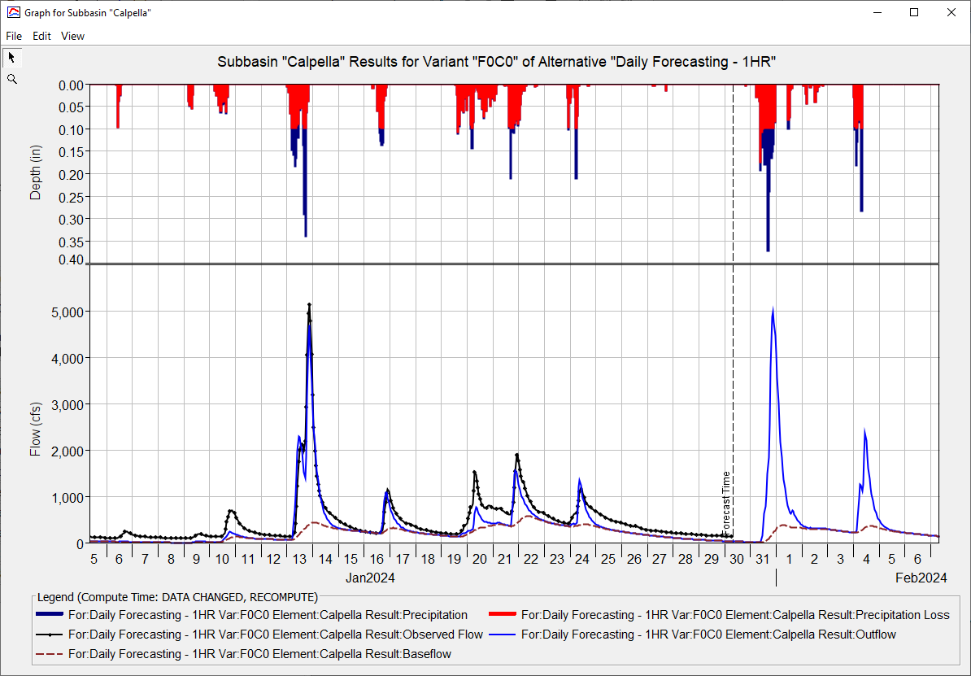
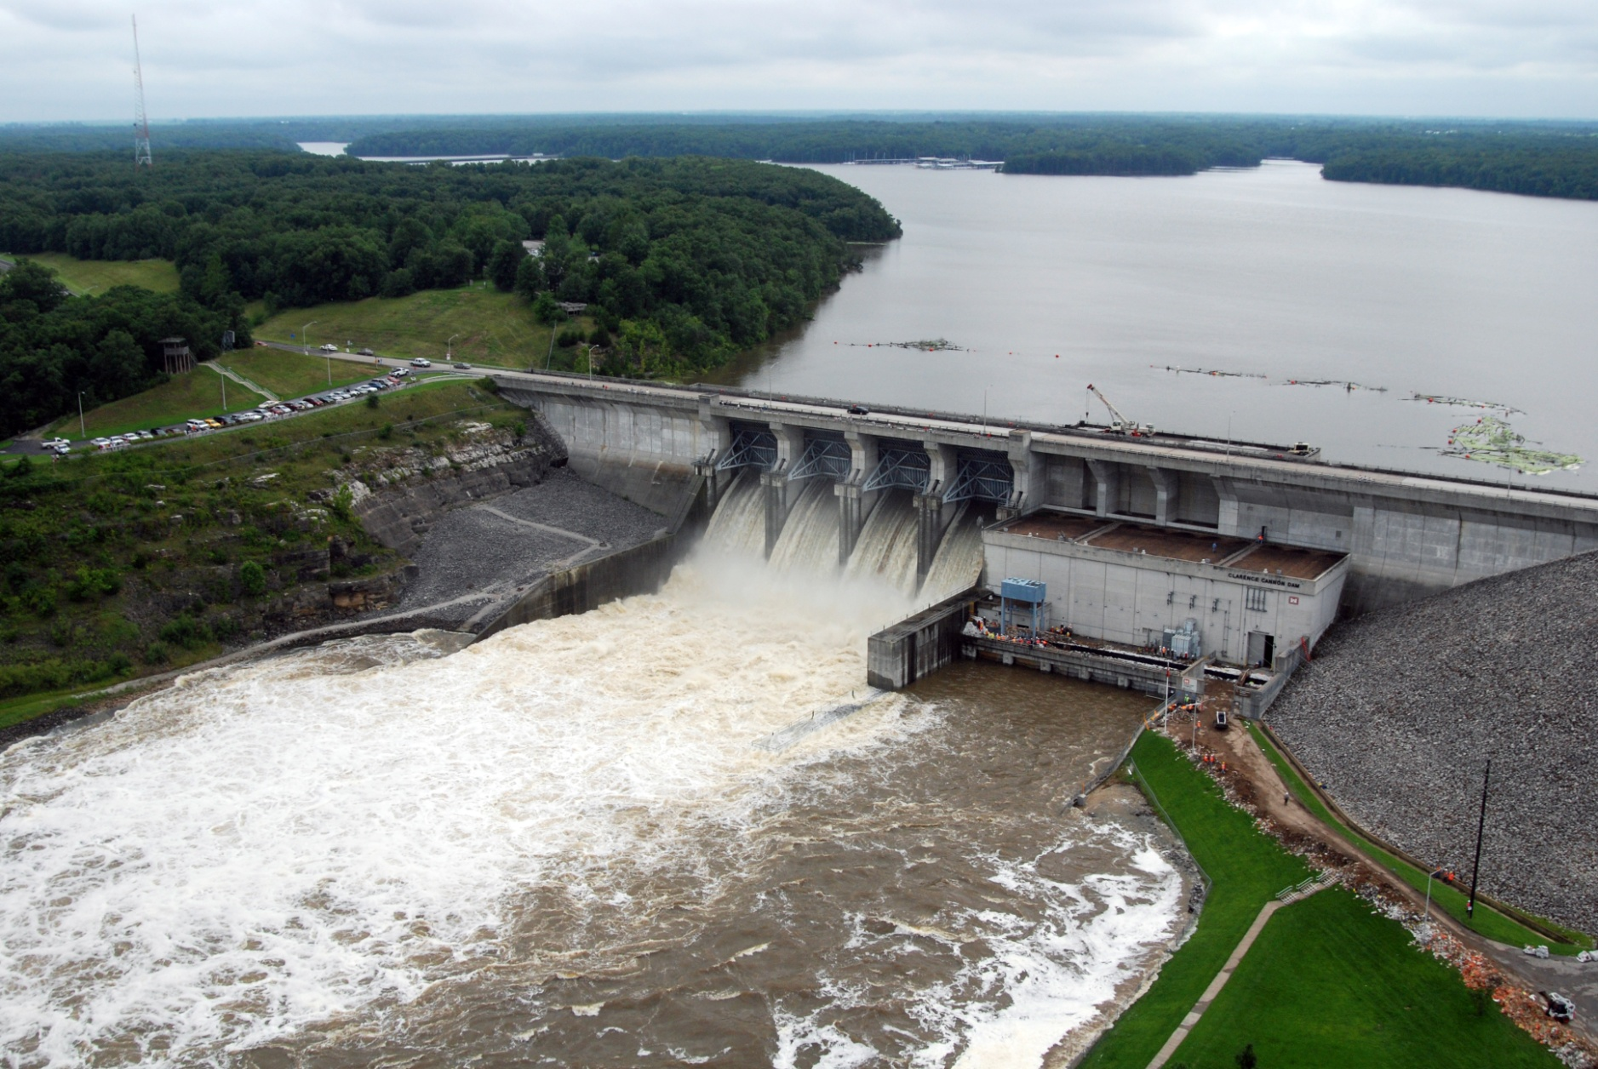
ST. Louis District CWMS Implementation
Russell Errett, P.E.
Hydrologic Engineering Center
CWMS Prospect Course

Slide 2
Overview
St. Louis District Overview
Review of CWMS Implementation within the St. Louis District
Application of CWMS with the St. Louis District
Examples of CWMS usage
Evaluation of performance of CWMS vs Legacy

Slide 3
CWMS → CWMS

Slide 4
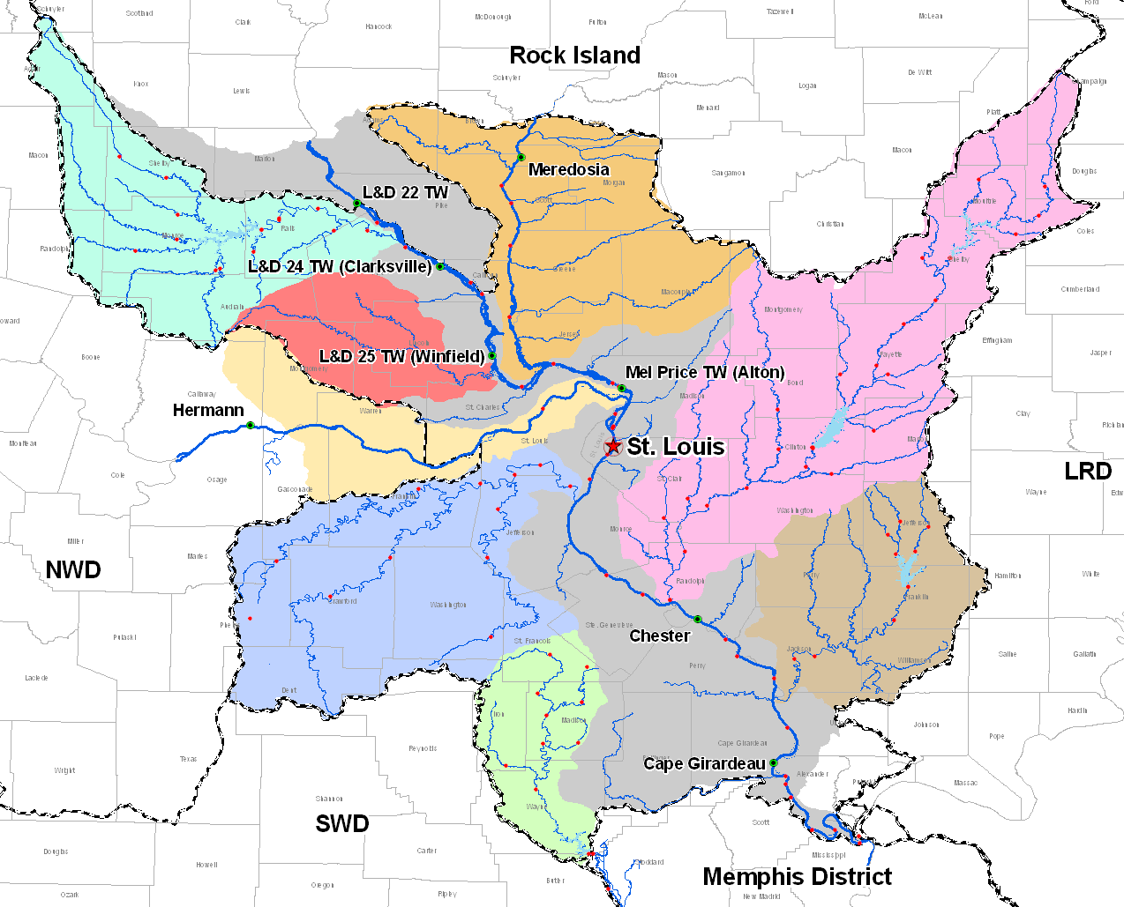
MVS Mississippi CWMS
Mississippi River at L&D 22
Illinois River at Valley City
Salt River at New London
Illinois River
Missouri River at Hermann
Kaskaskia River at Venedy Station
Missouri River
Meramec River at Eureka
Big Muddy River at Murphysboro
Mississippi River
Ohio River at Cairo

Slide 5
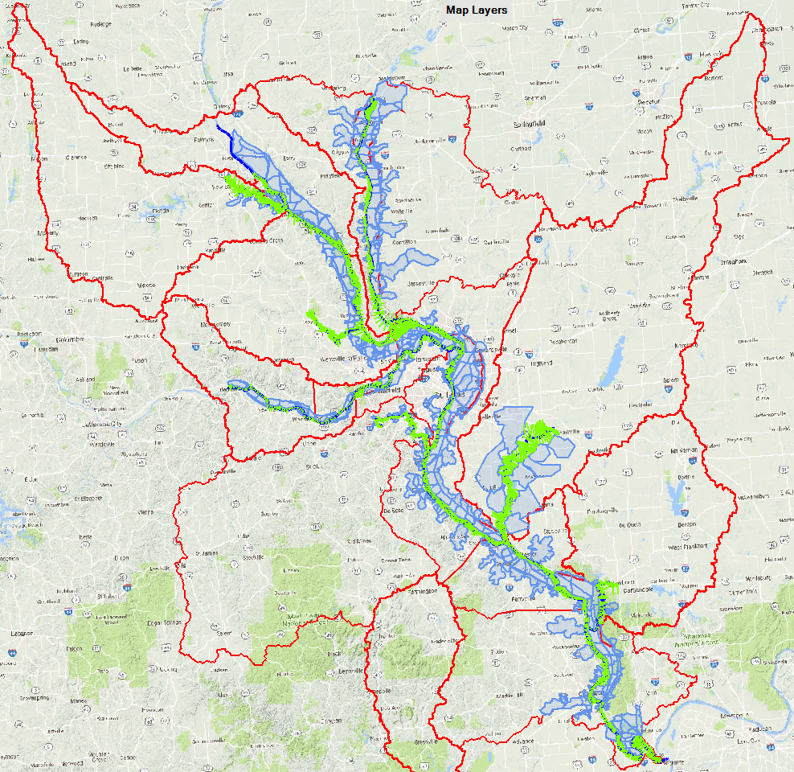
MVS Mississippi RAS

Slide 6
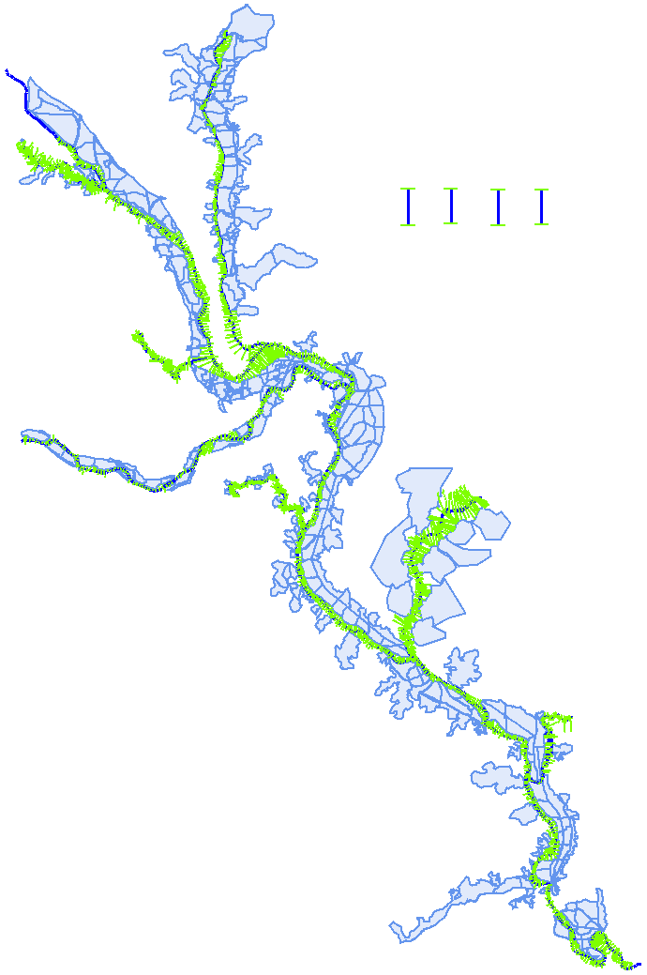
MVS Mississippi CWMS
Mississippi River at L&D 22
Illinois River at Valley City
Salt River at New London
Illinois River
Missouri River at Hermann
Kaskaskia River at Venedy Station
Missouri River
Meramec River at Eureka
Big Muddy River at Murphysboro
Mississippi River
Ohio River at Cairo

Slide 7
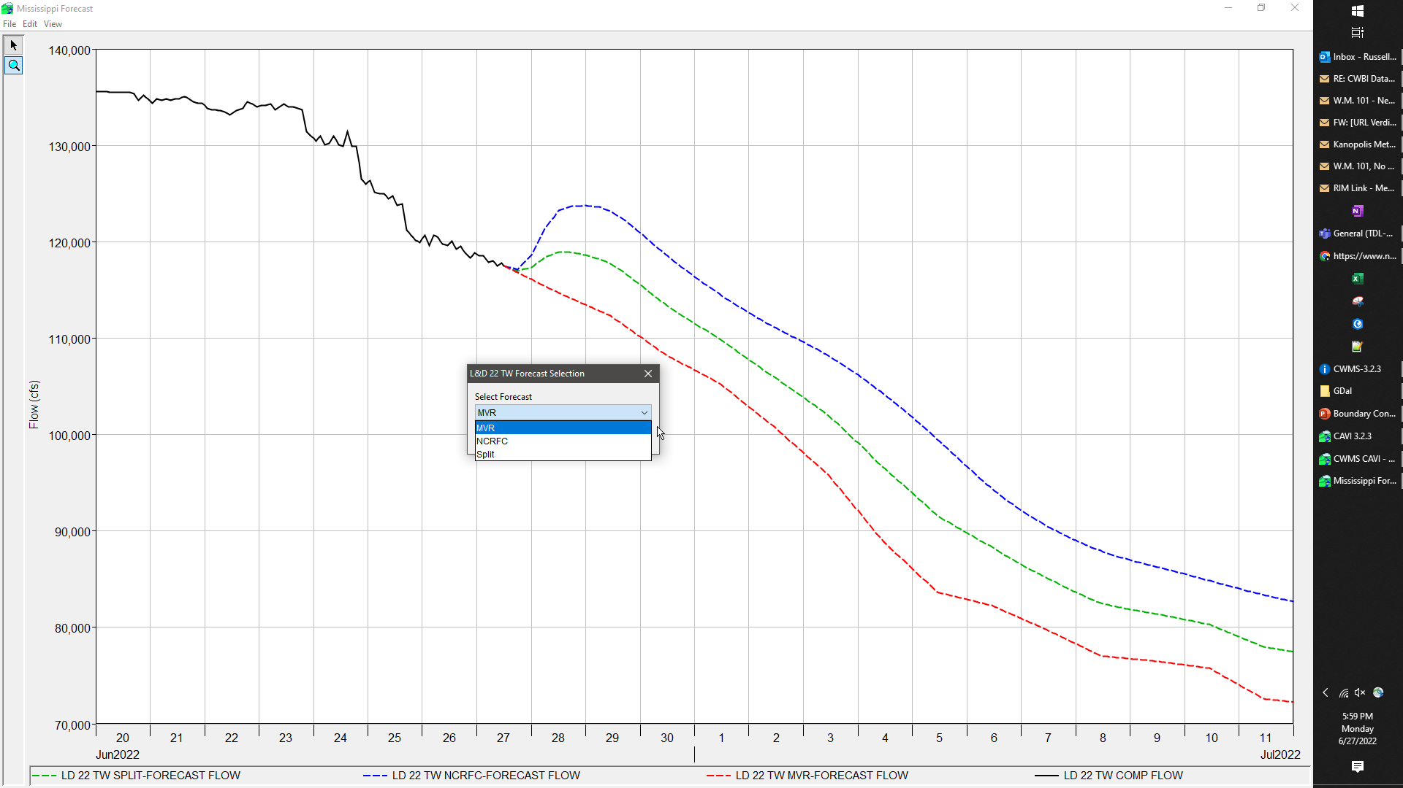
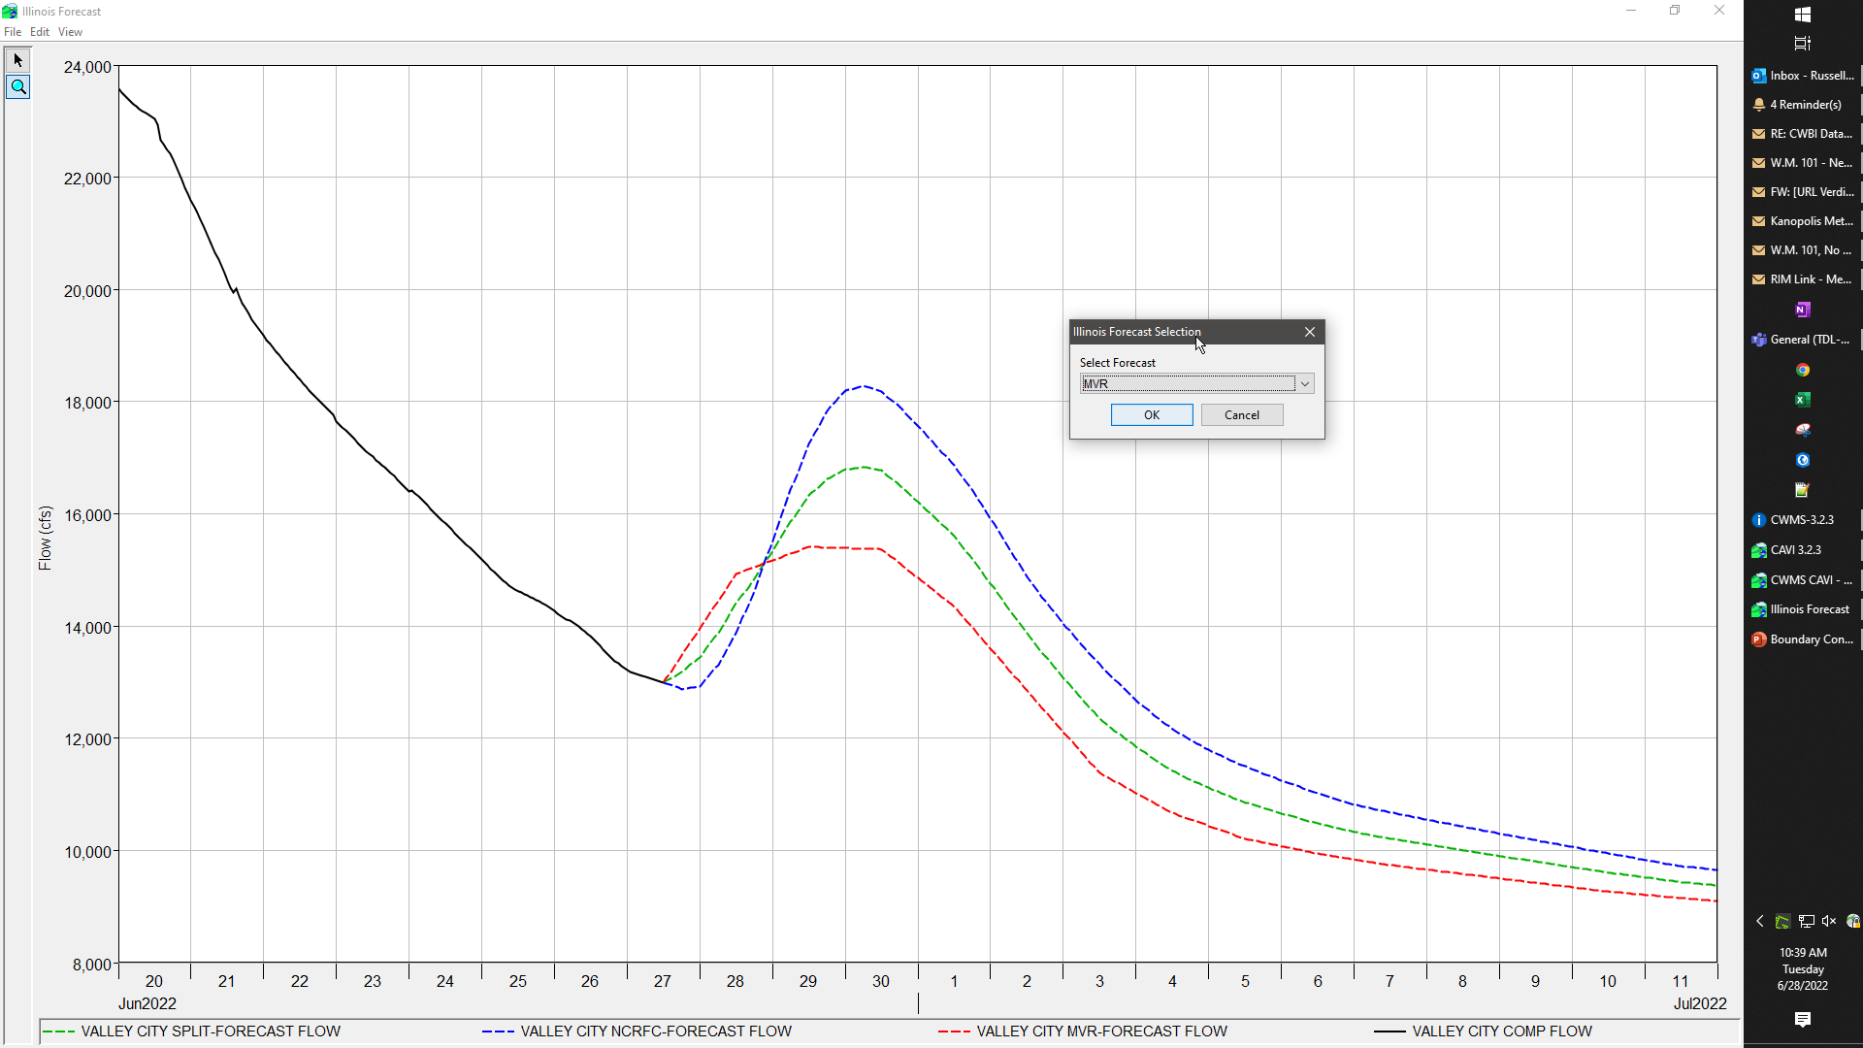
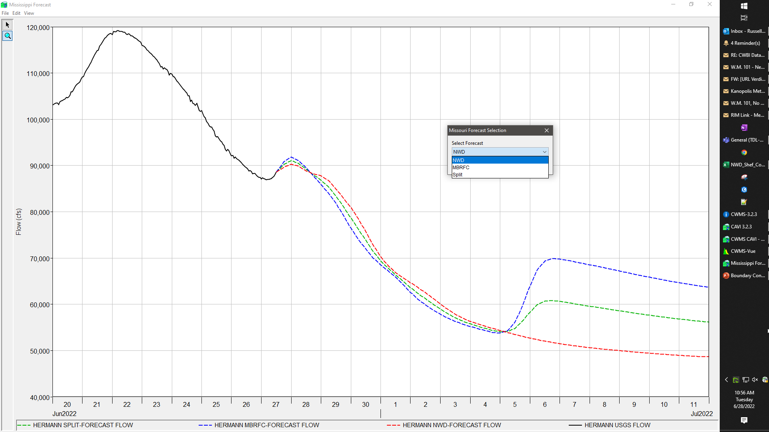
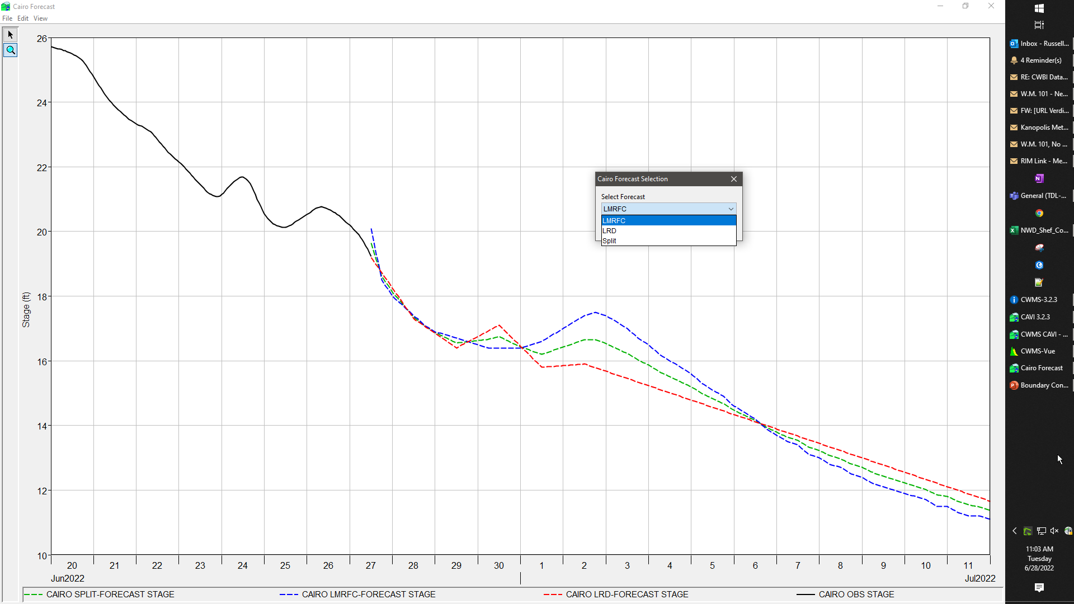
Boundary Forecast Script

Slide 8
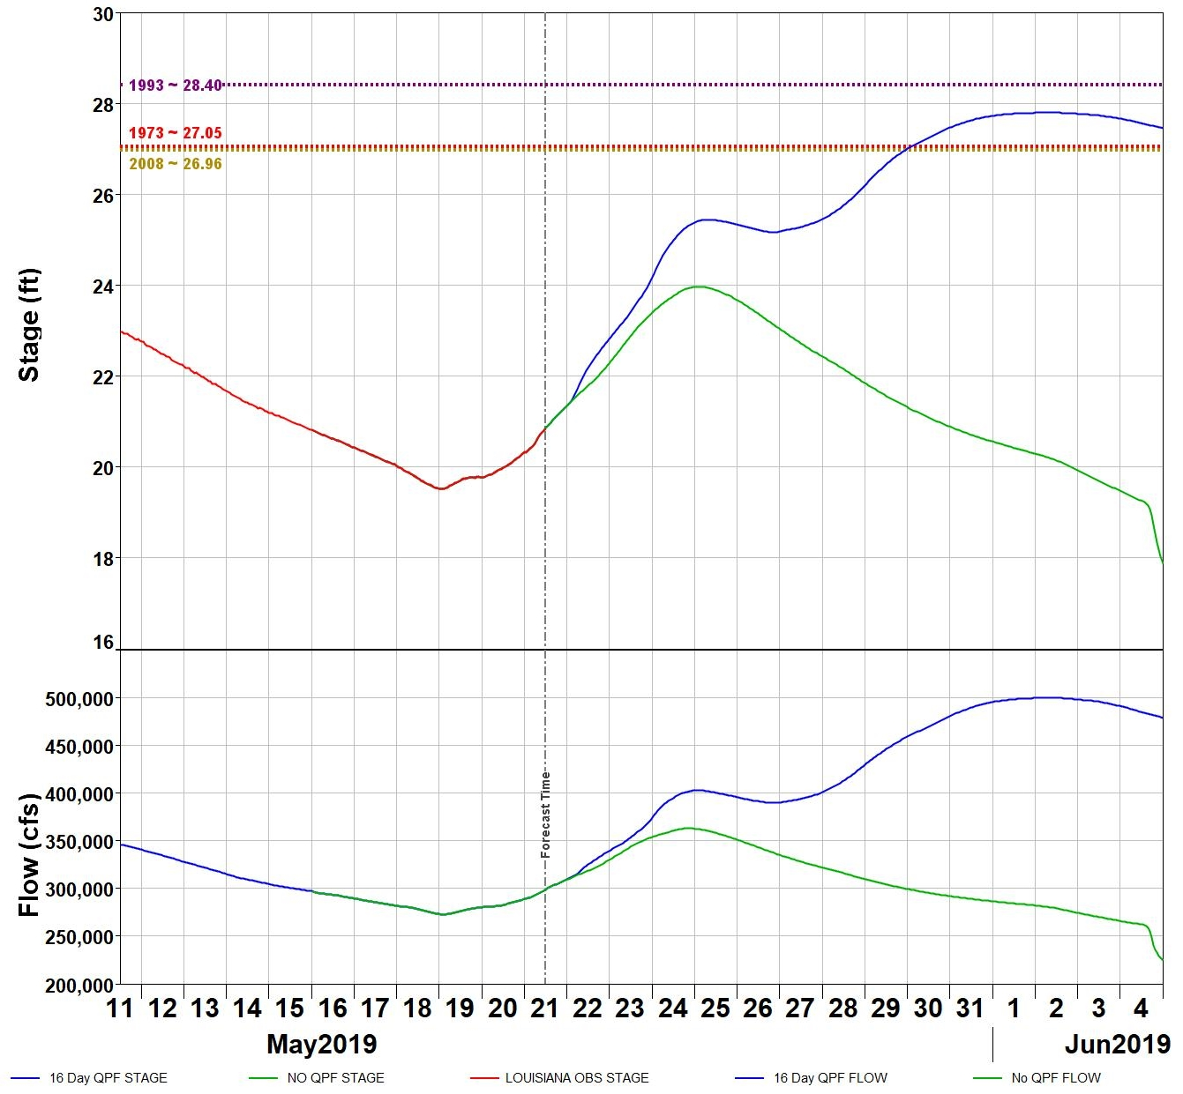
Mississippi at Louisiana

Slide 9
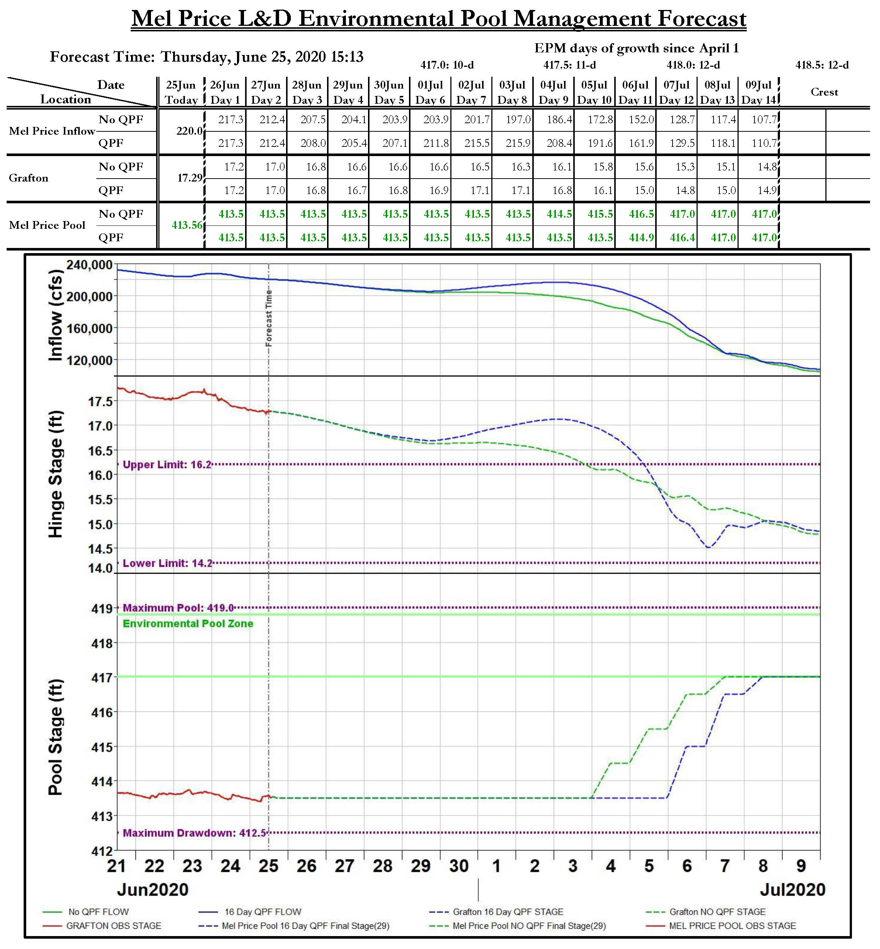
Environmental Pool Management

Slide 10
Questions Help additional Training
https://usace.dps.mil/sites/KMP-WM/SitePages/Corps-Water-Management-System-(CWMS).aspx
https://www.hec.usace.army.mil/confluence/cwmsdocs
https://discourse.hecdev.net/c/cwms/5
TDL-CELRH-EC-GW-W-USACE CWMS Modeling | General | Microsoft Teams

