Slide 1
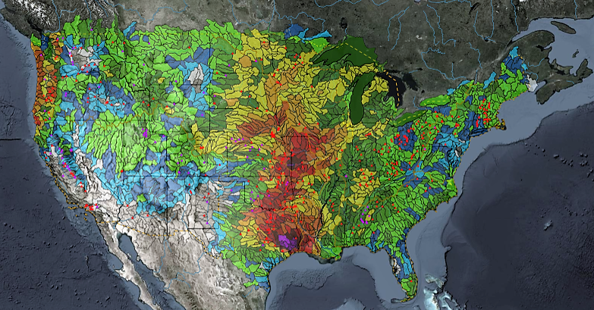
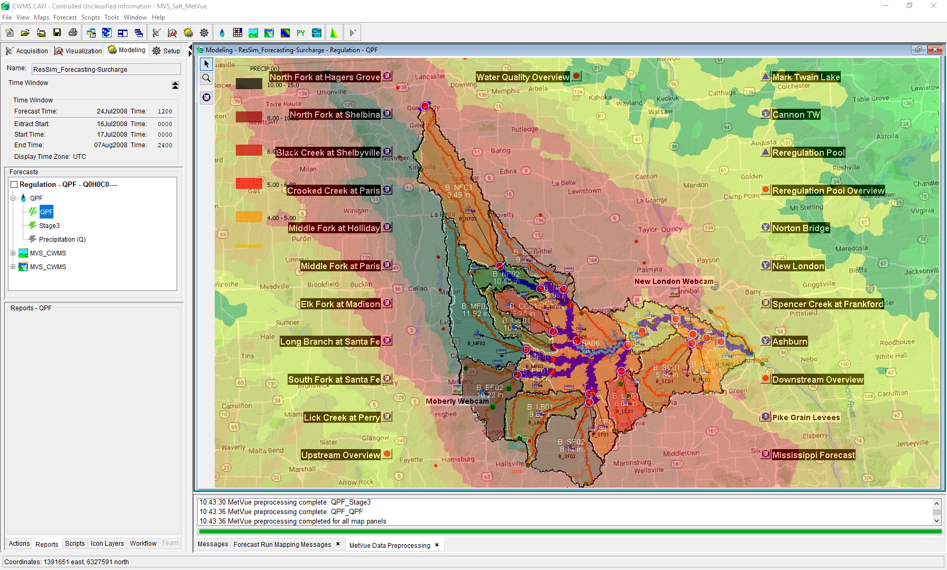

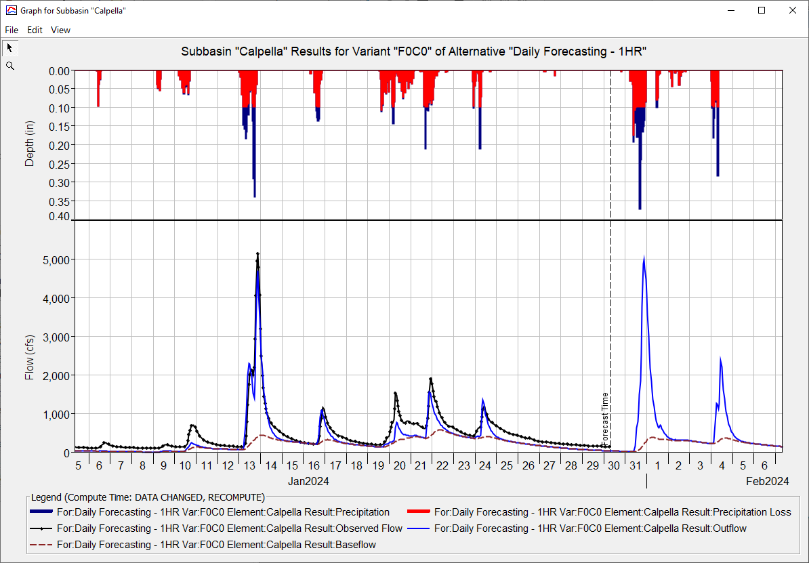
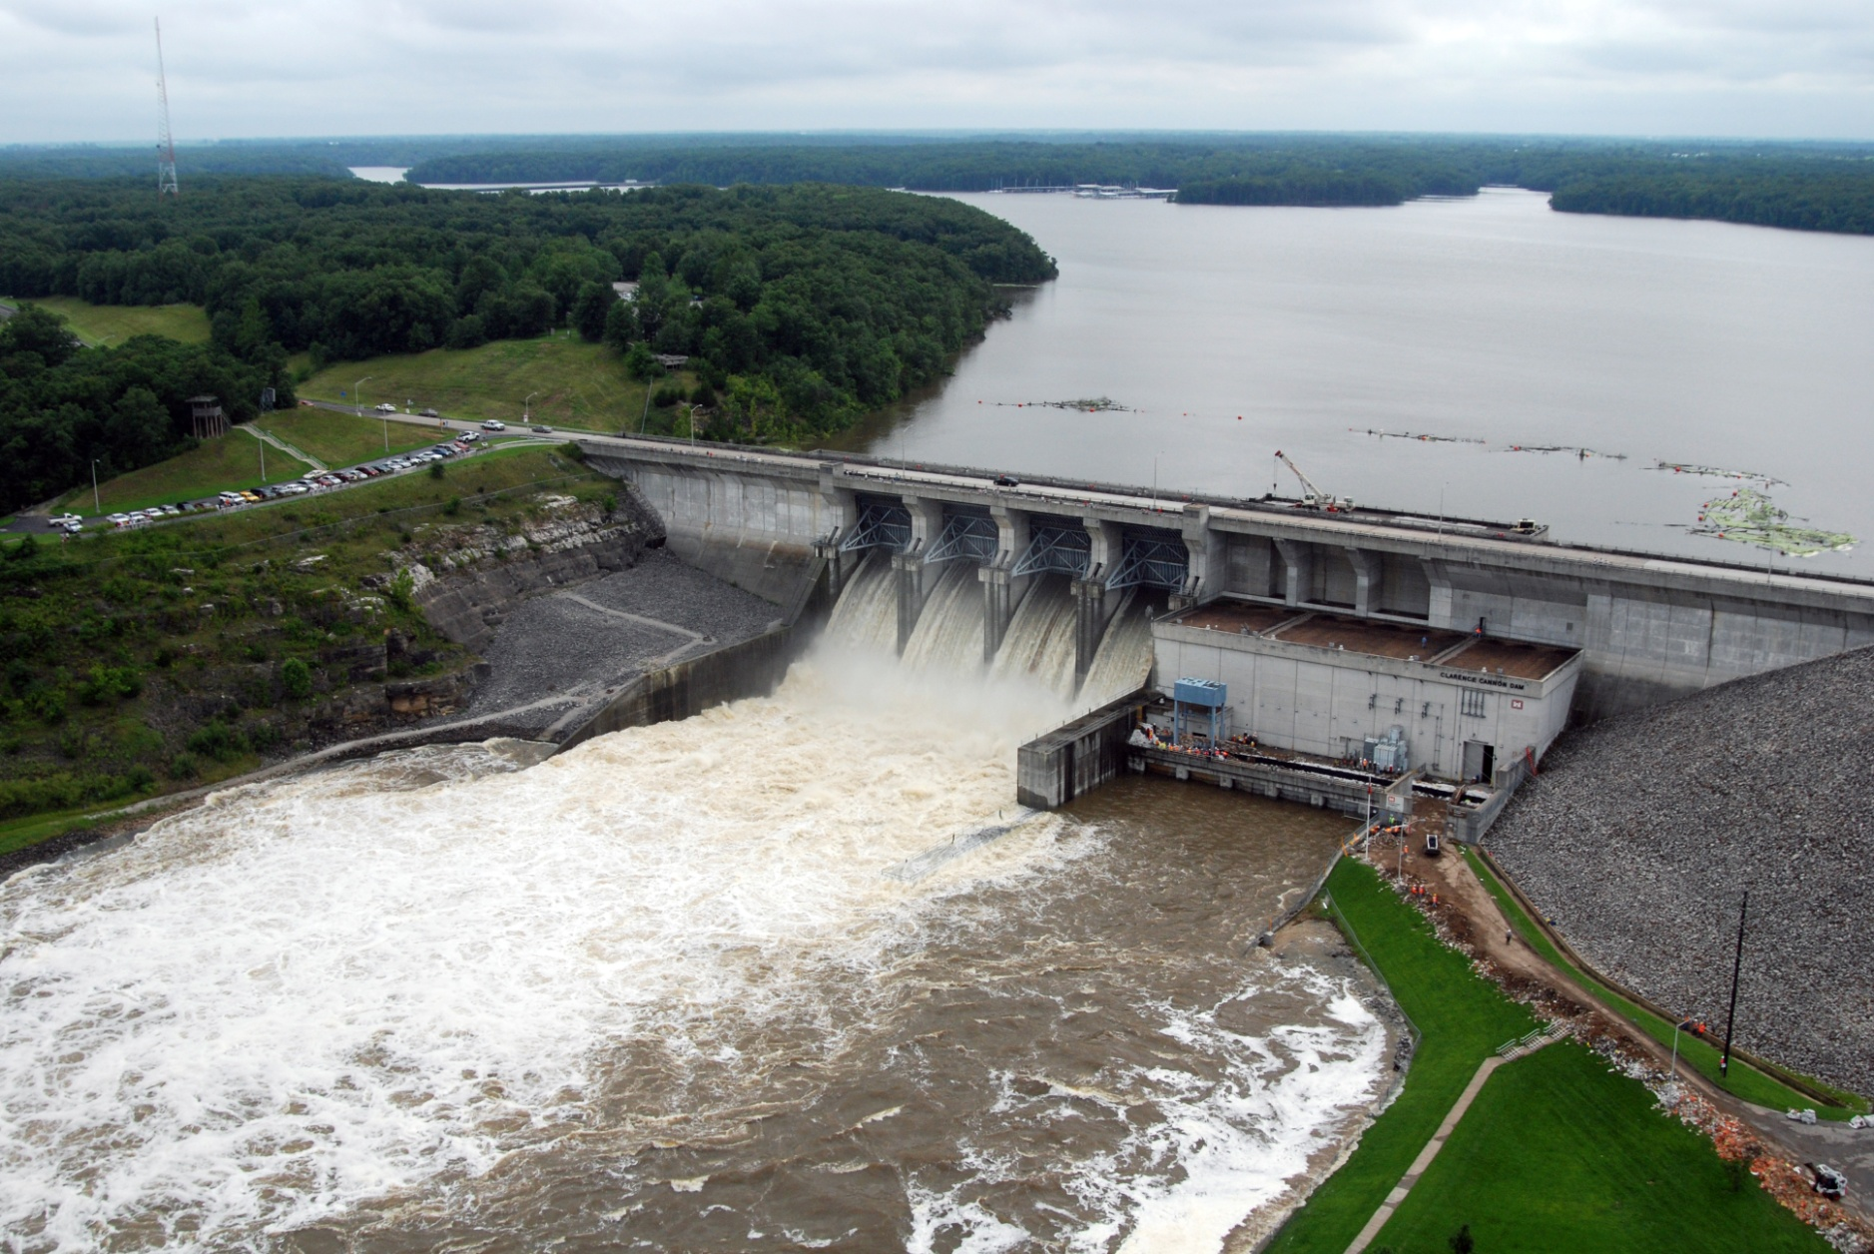
ST. Louis District CWMS Implementation
Russell Errett, P.E.
Hydrologic Engineering Center
CWMS Prospect Course

Slide 2
Overview
St. Louis District Overview
Review of CWMS Implementation within the St. Louis District
Application of CWMS with the St. Louis District
Examples of CWMS usage
Evaluation of performance of CWMS vs Legacy

Slide 3
CWMS Forecast Evaluation

Slide 4
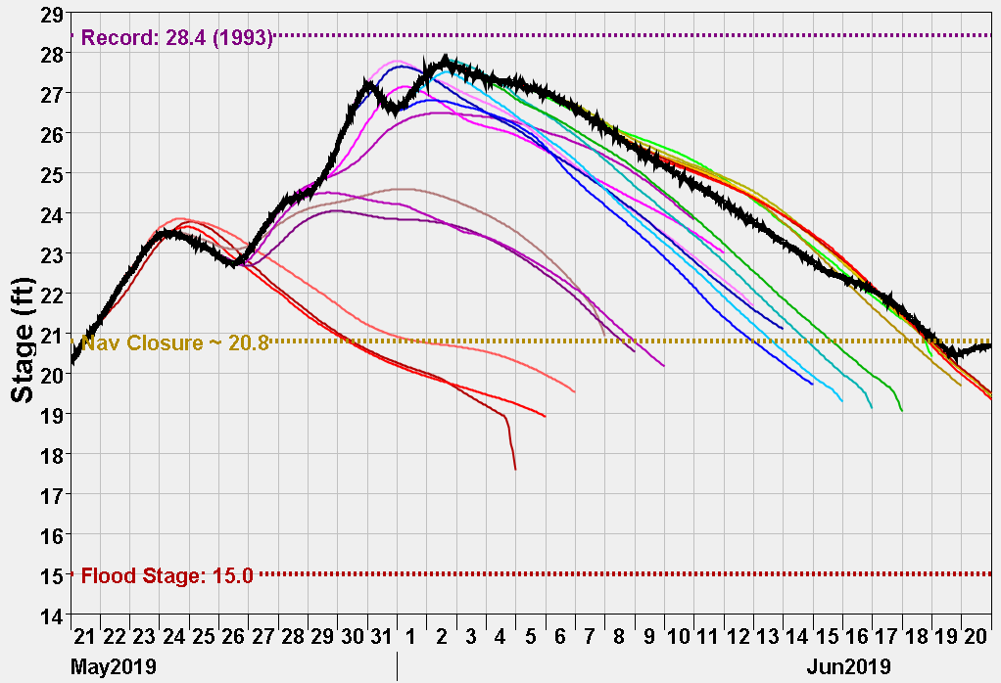
Mississippi at Louisiana

Slide 5
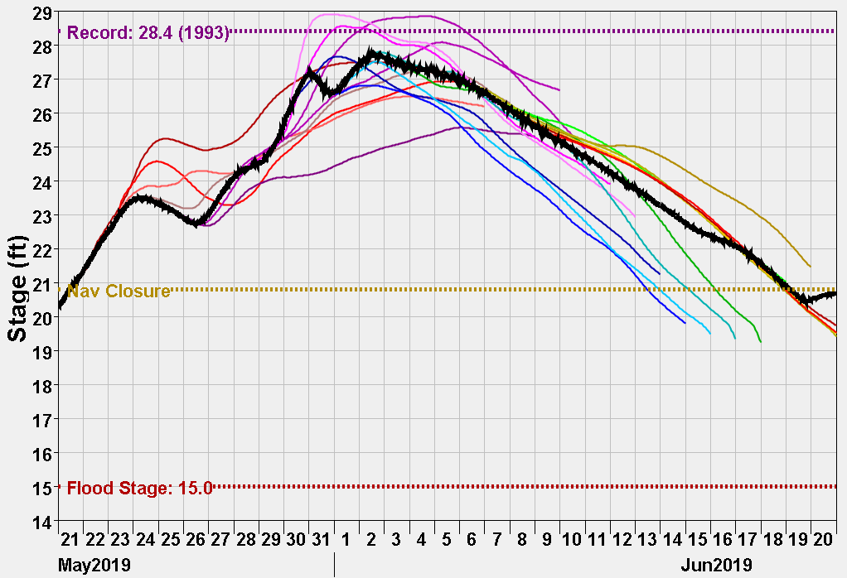
Mississippi at Louisiana (16d QPF)

Slide 6
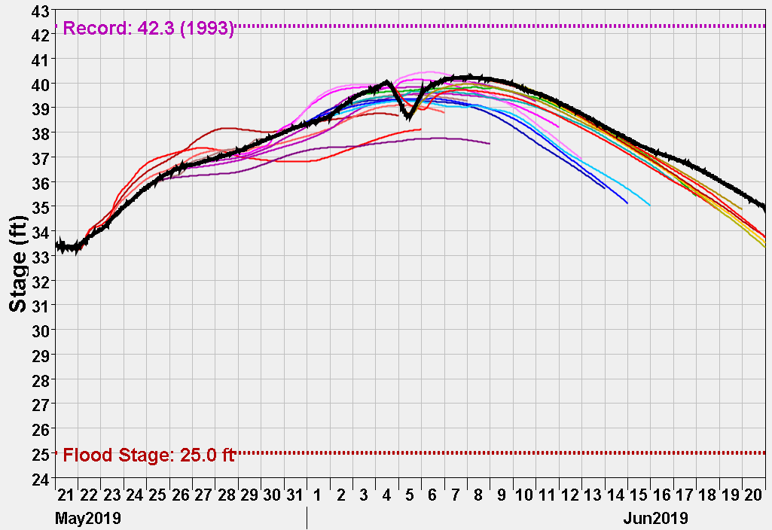
Illinois River at Hardin (16d QPF)

Slide 7
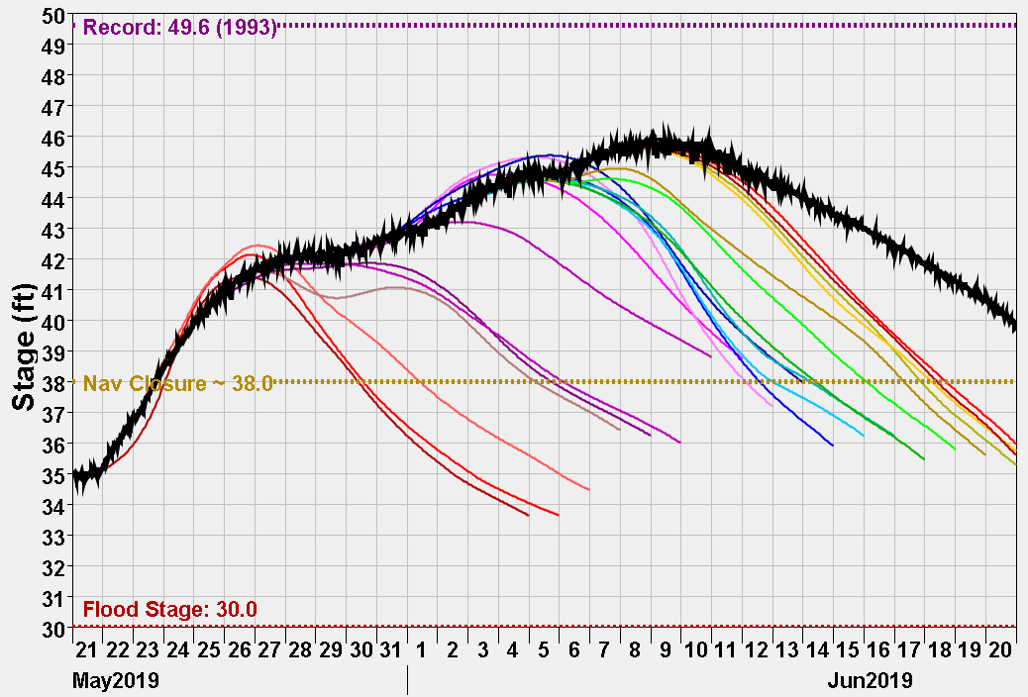
Mississippi at St. Louis

Slide 8
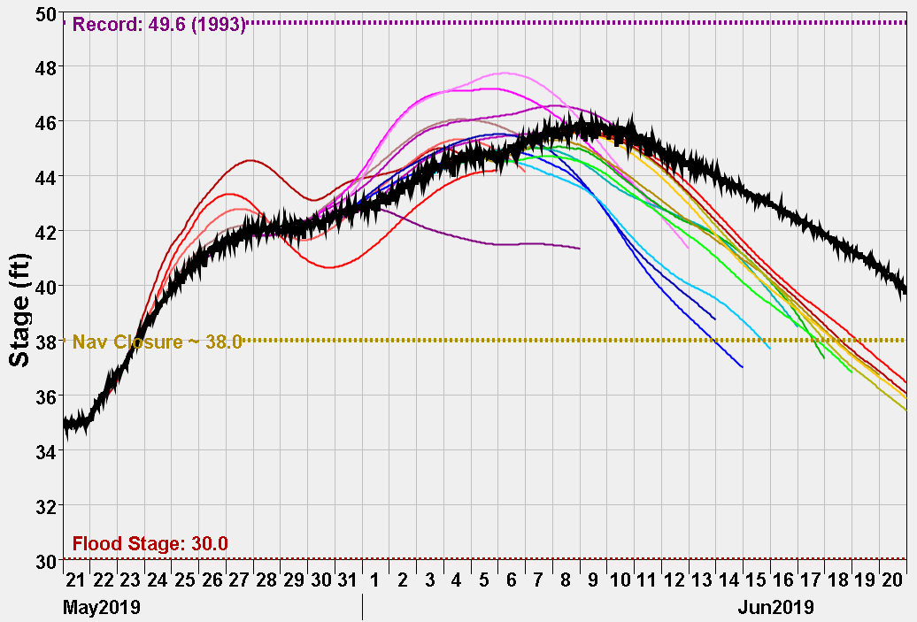
Mississippi at St. Louis (16d QPF)

Slide 9
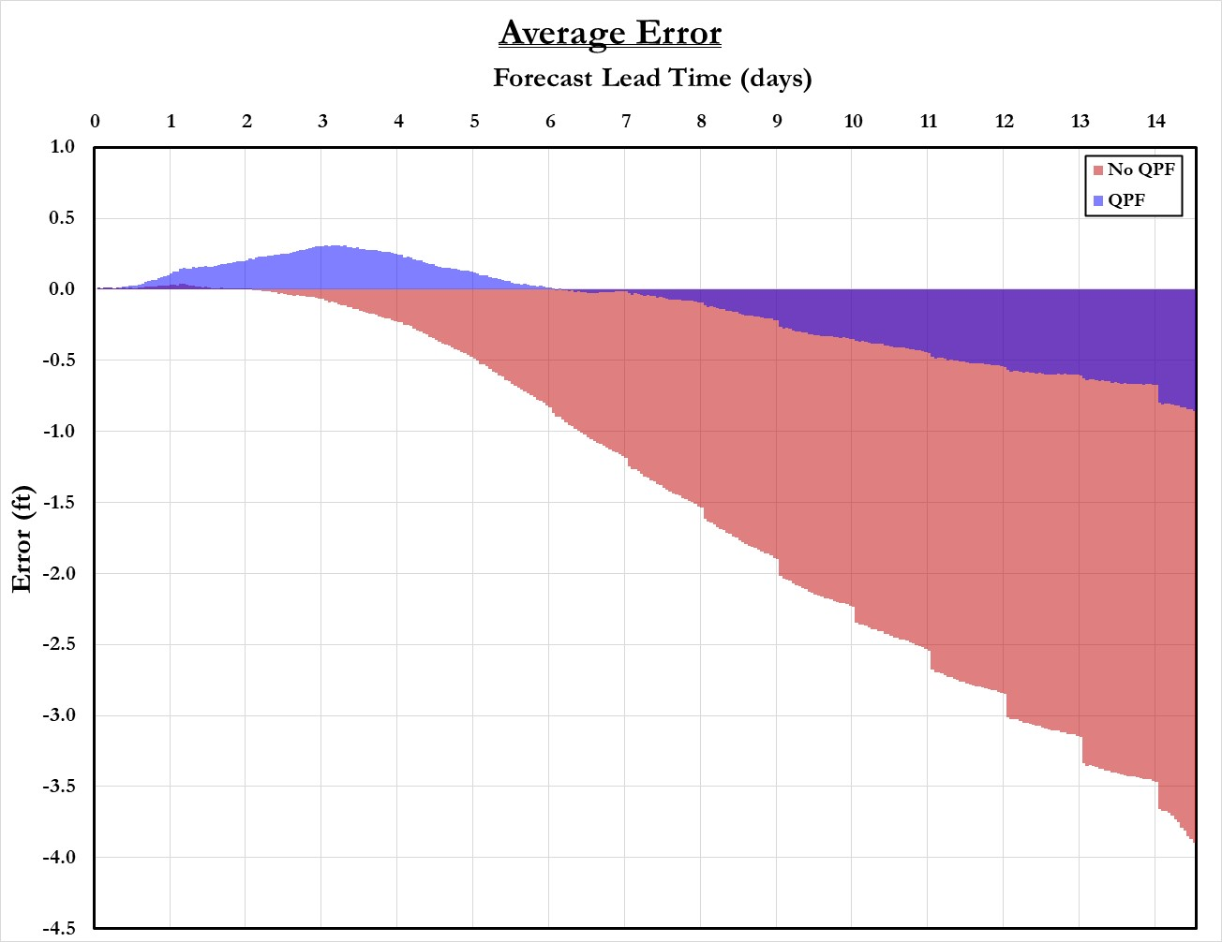
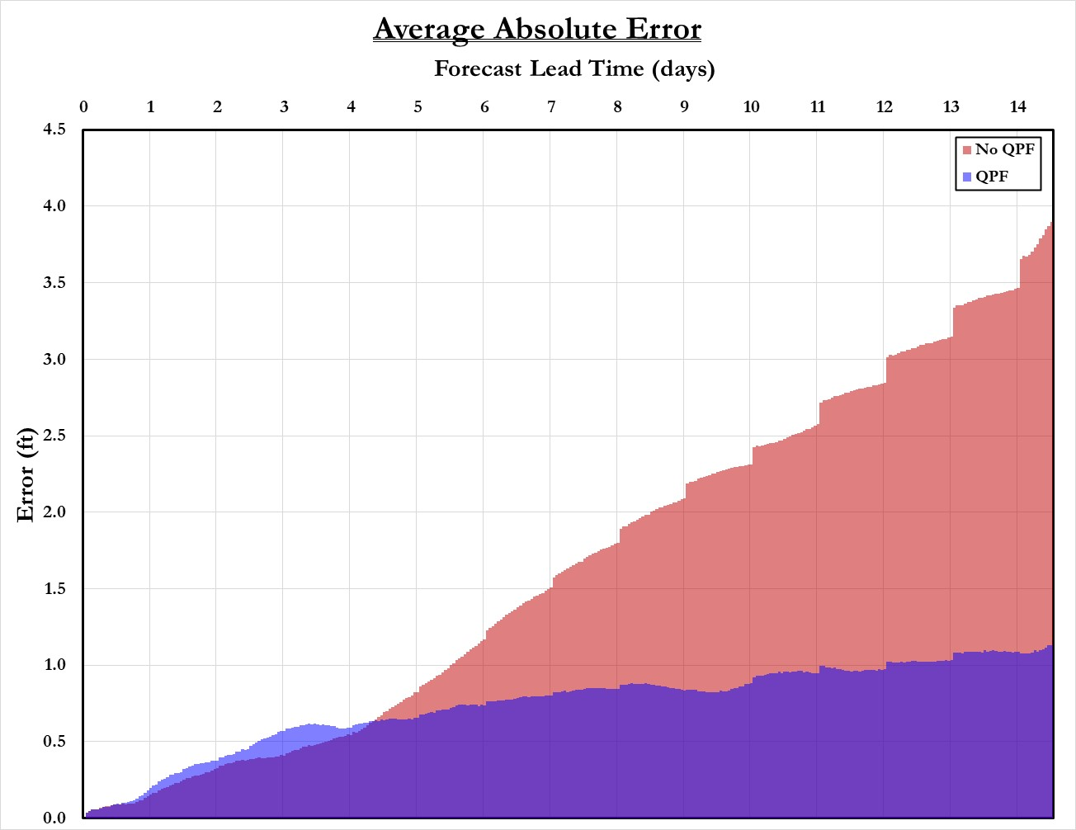
Mississippi at Louisiana Forecast Statistics (2019 Event)

Slide 10
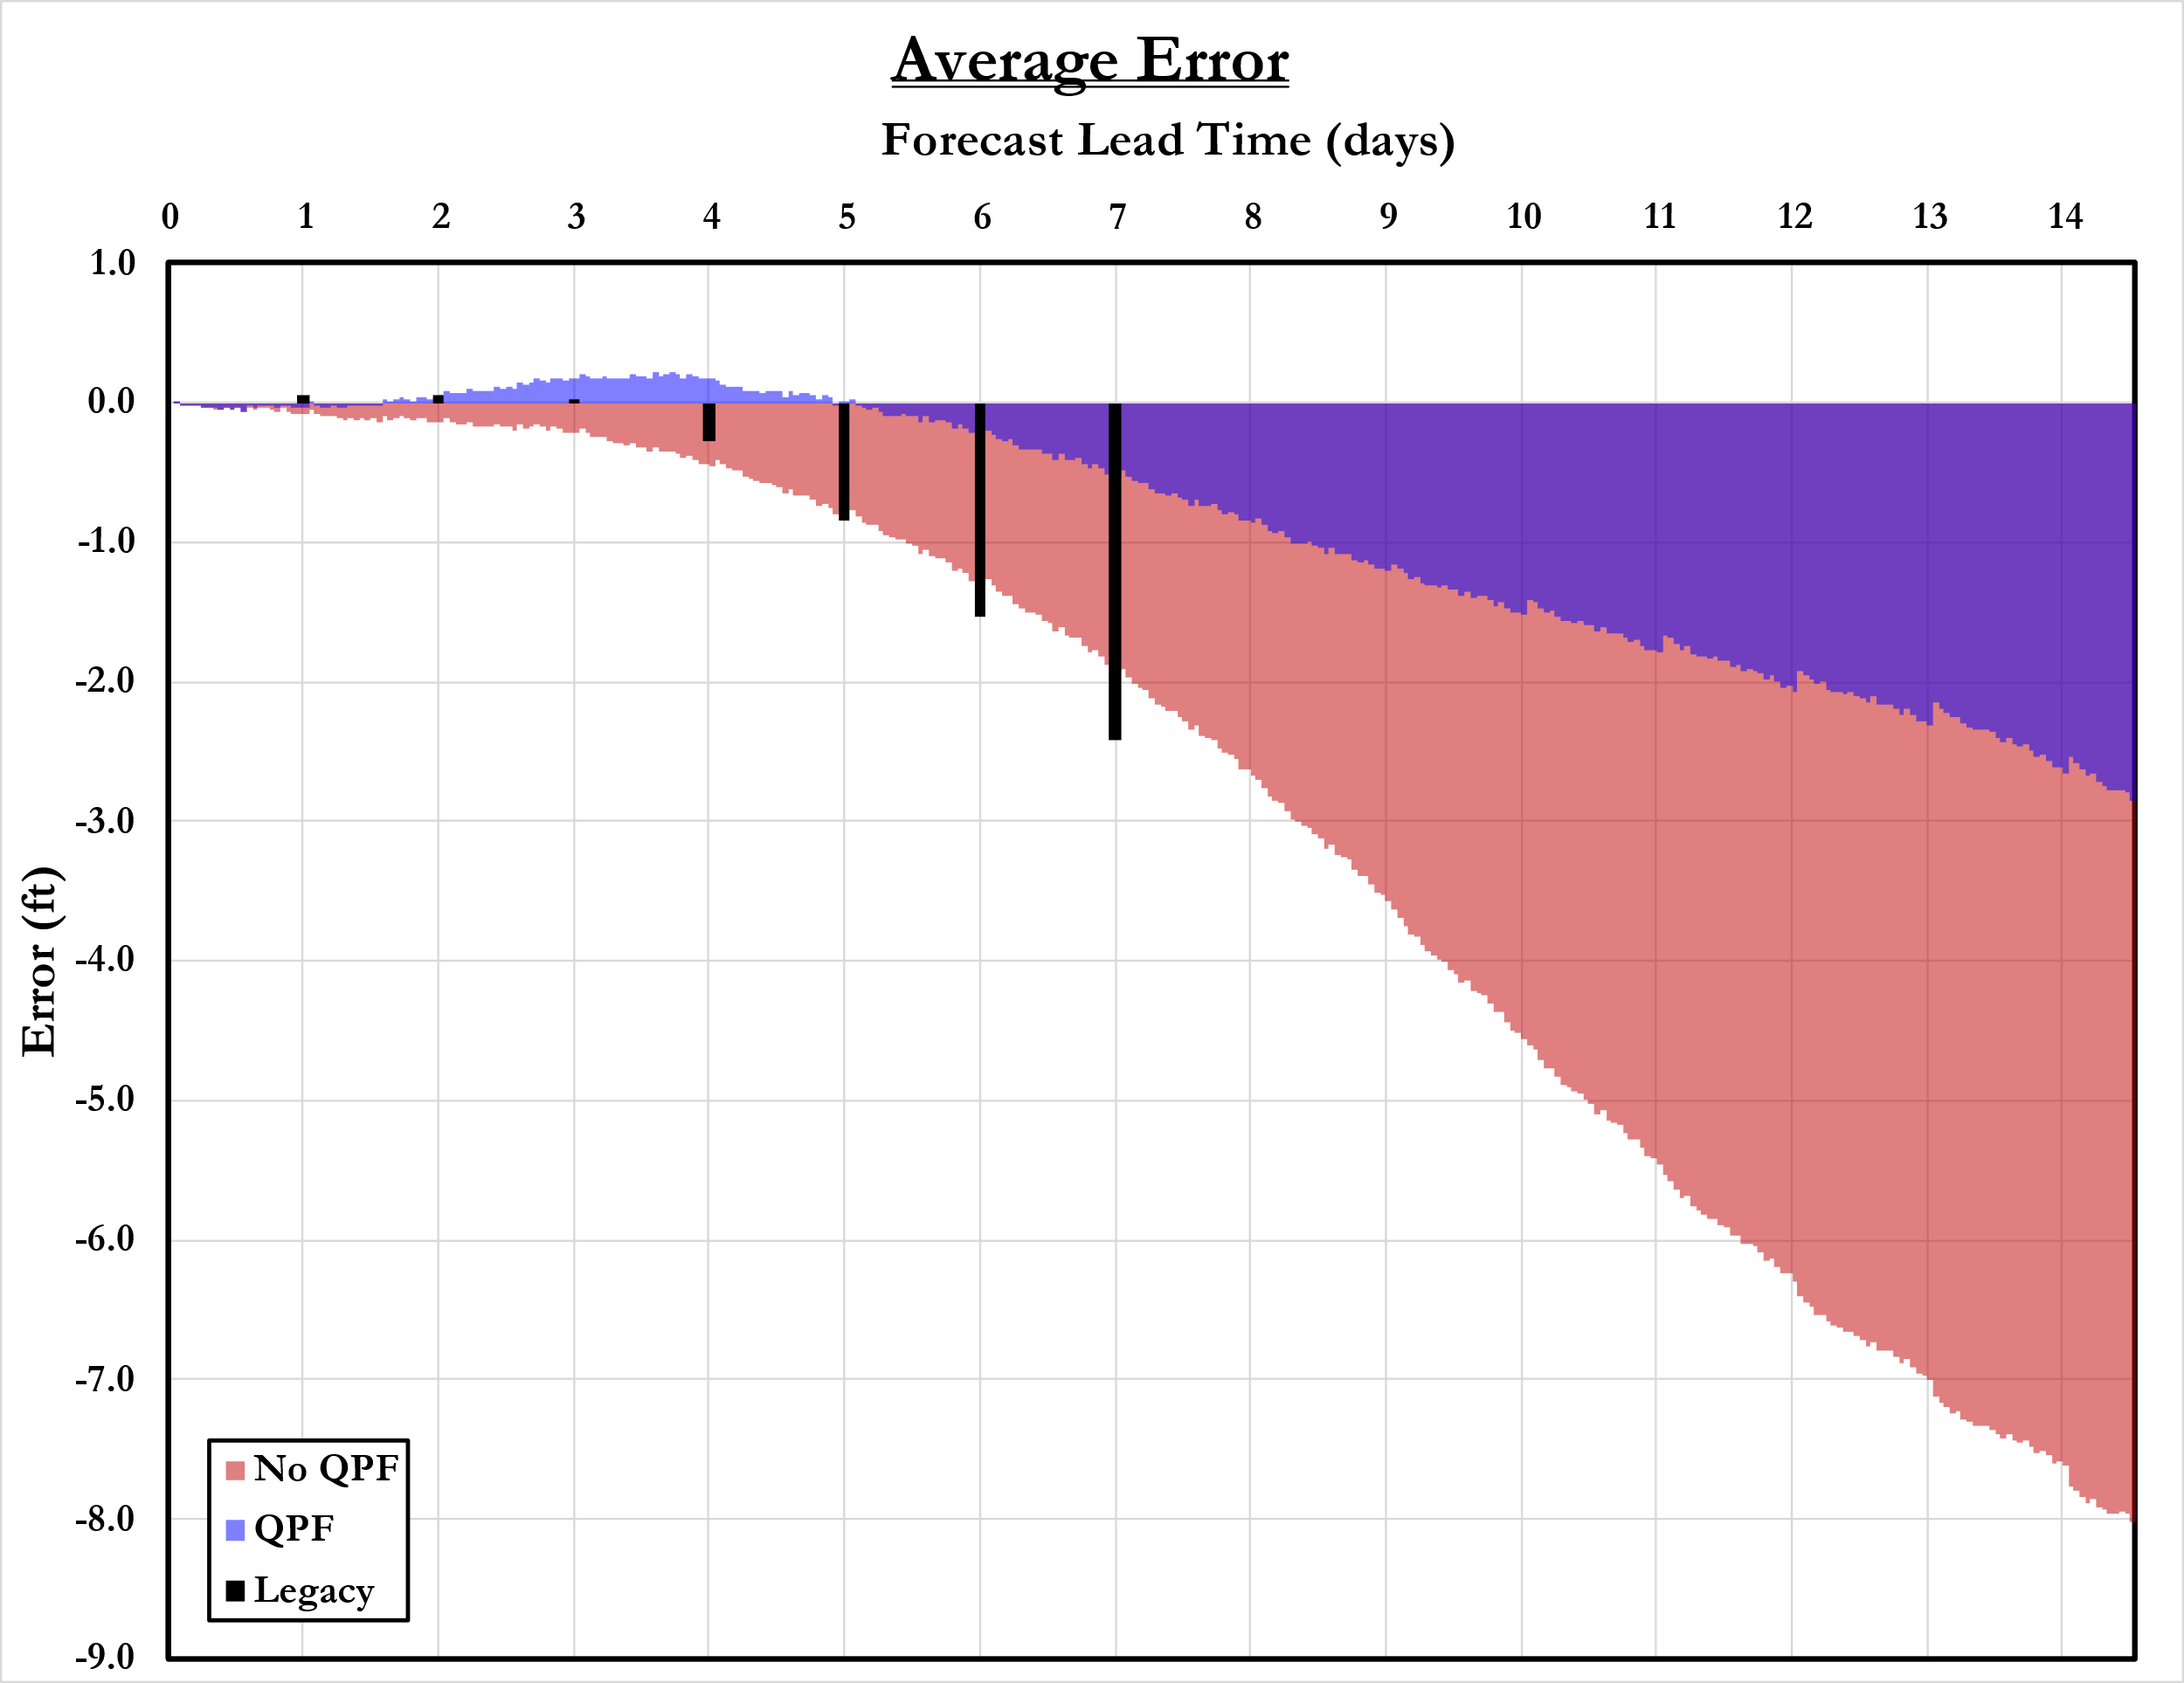
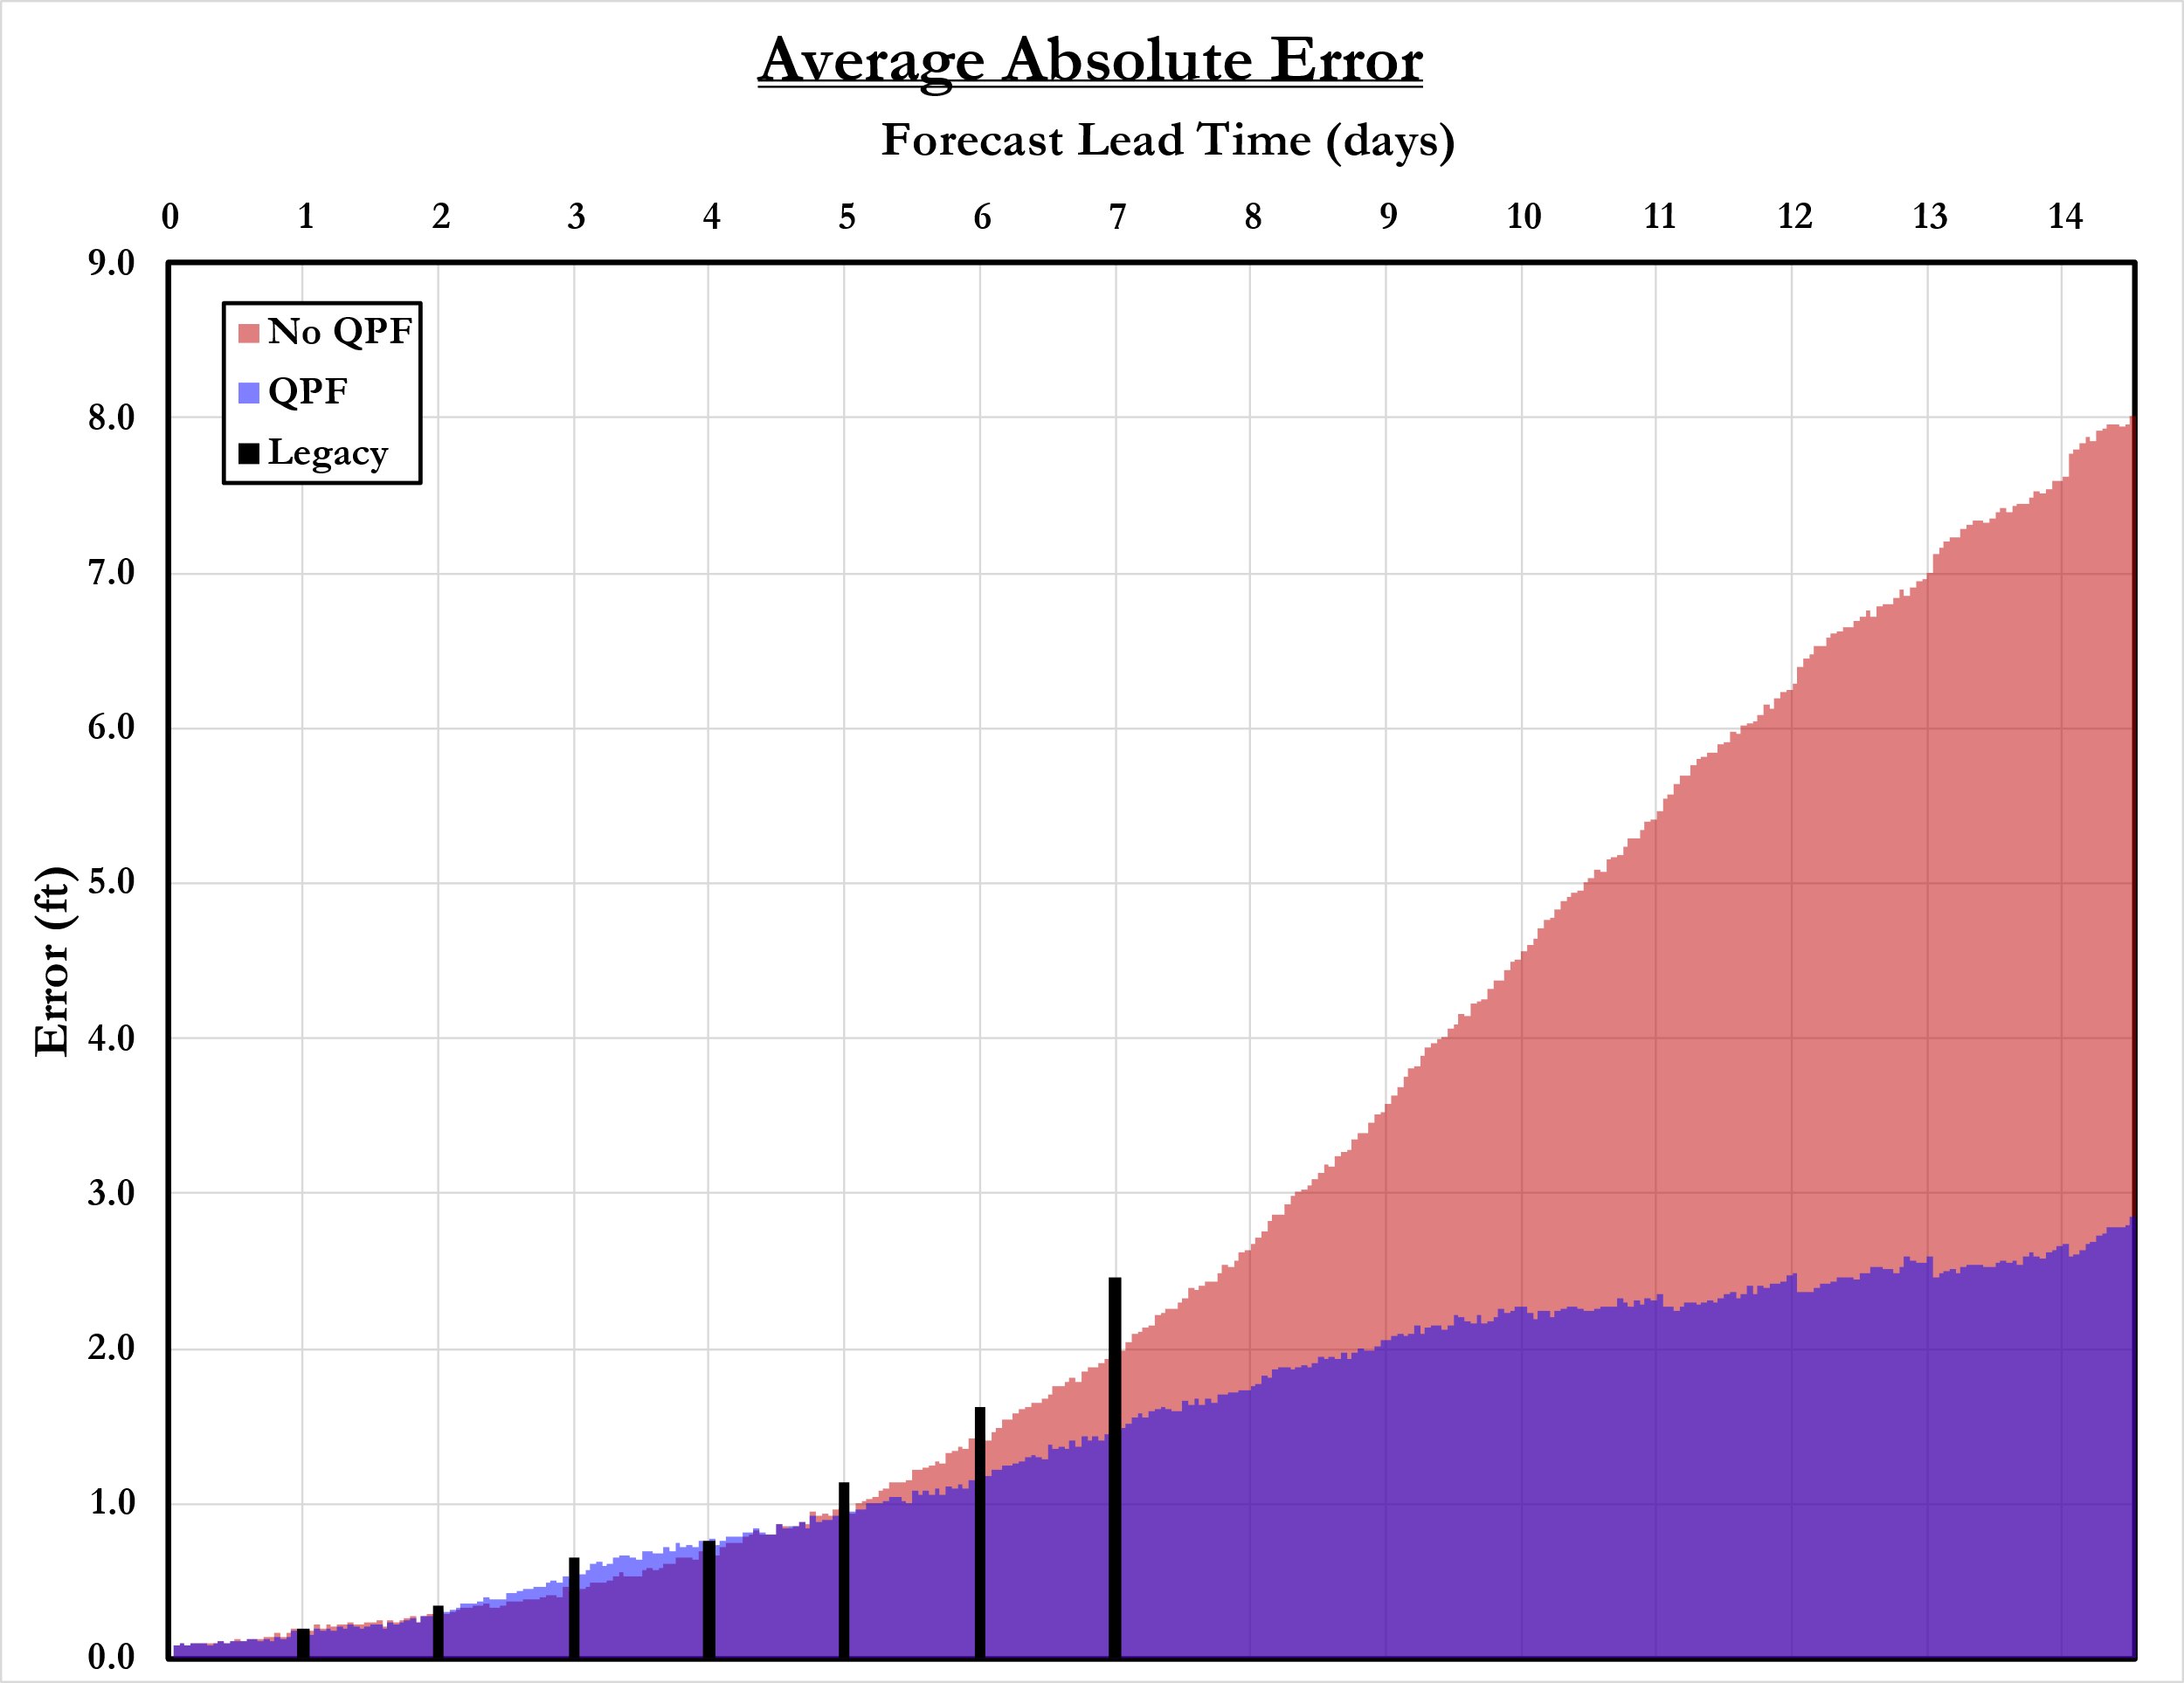
Mississippi at St. Louis Forecast Statistics (2019 Event)

Slide 11
Questions Help additional Training
https://usace.dps.mil/sites/KMP-WM/SitePages/Corps-Water-Management-System-(CWMS).aspx
https://www.hec.usace.army.mil/confluence/cwmsdocs
https://discourse.hecdev.net/c/cwms/5
TDL-CELRH-EC-GW-W-USACE CWMS Modeling | General | Microsoft Teams

