Slide 1
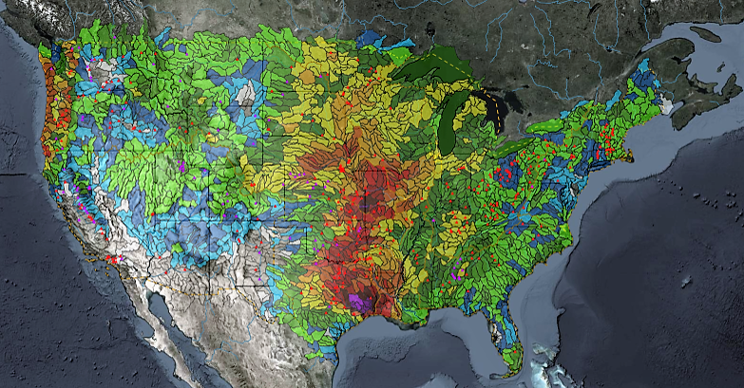
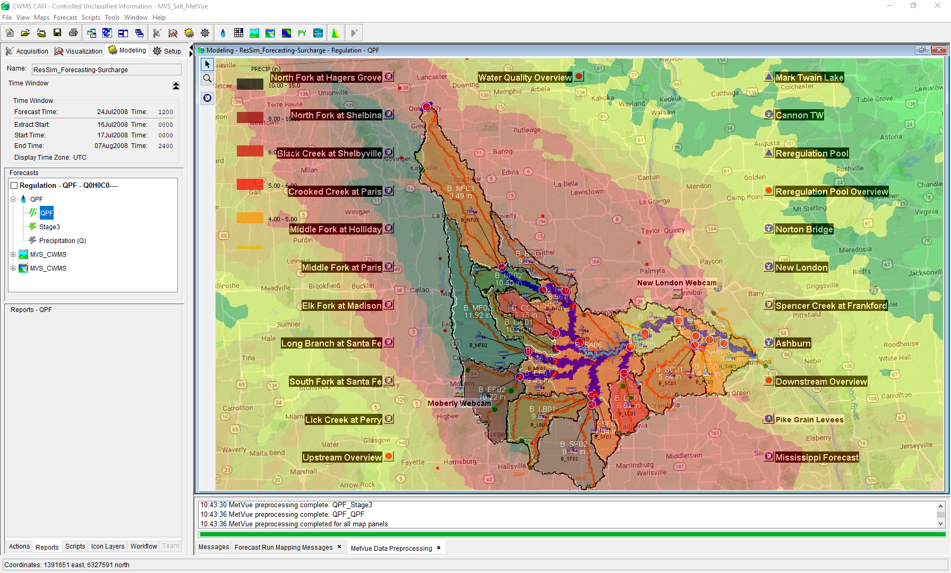

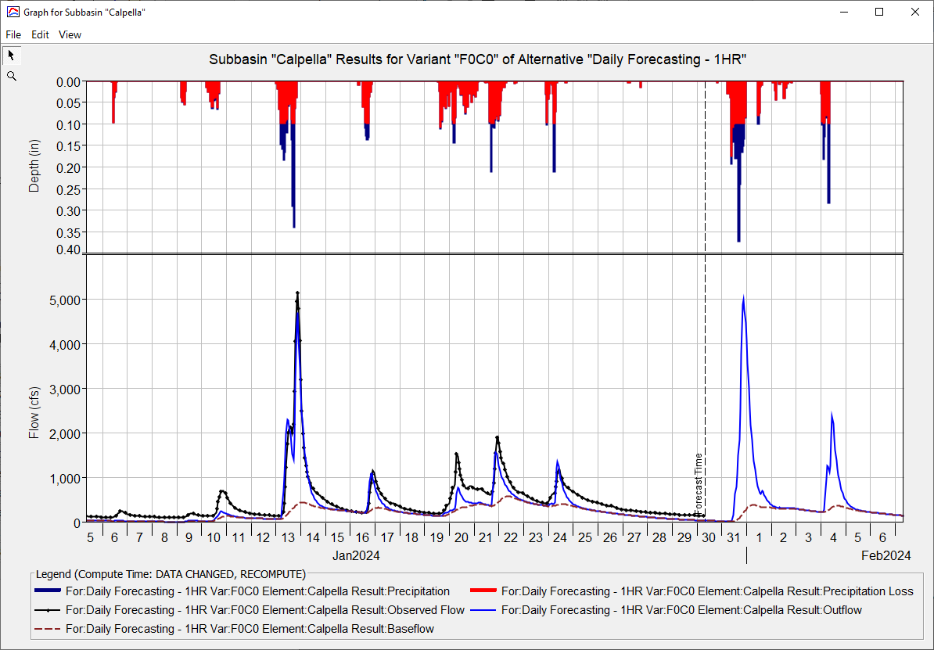
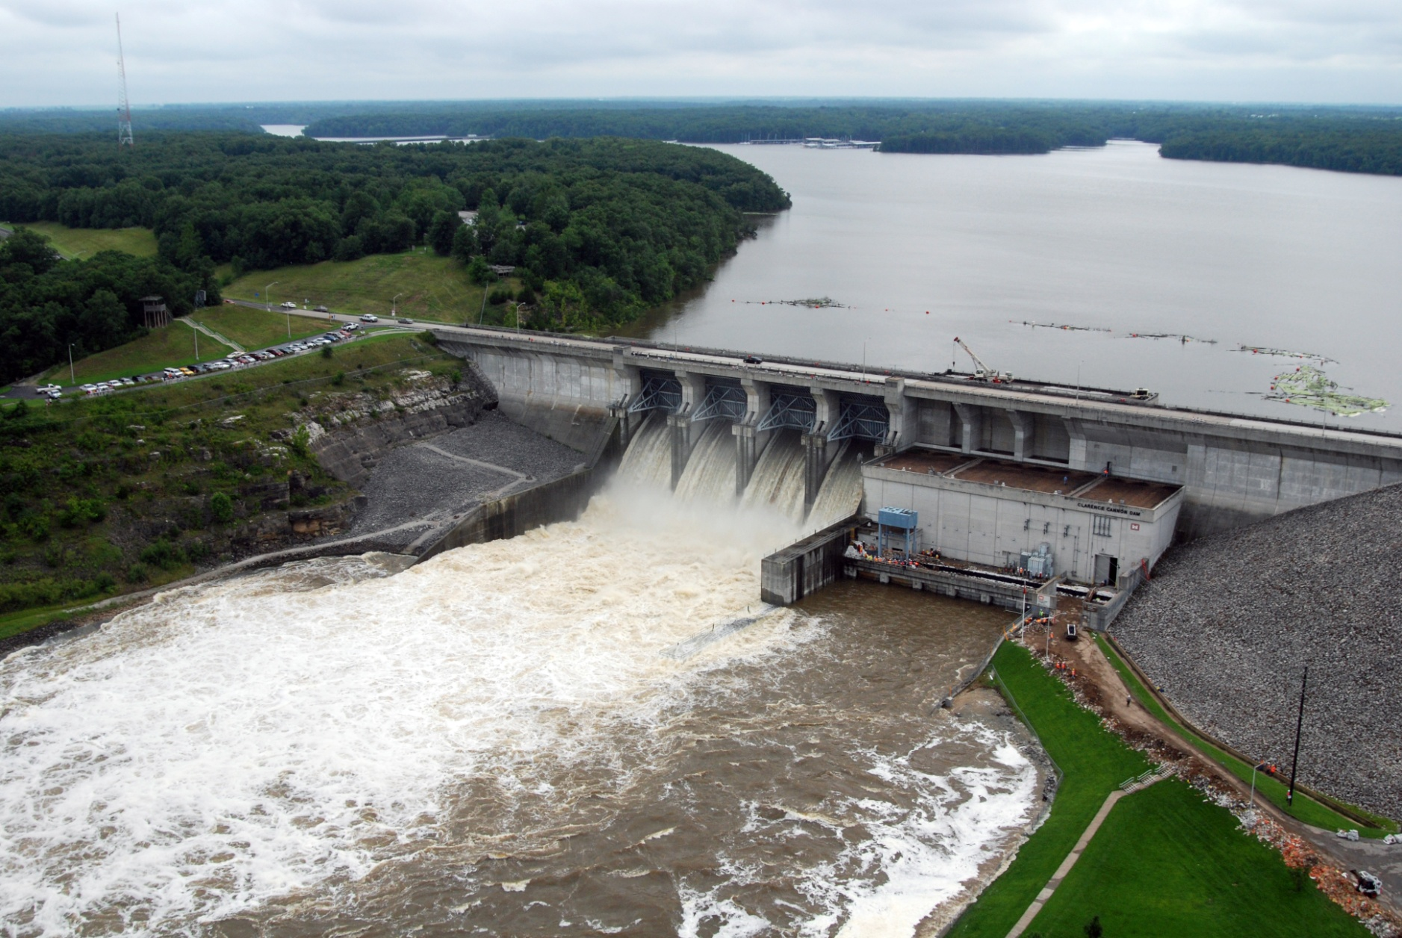
ST. Louis District CWMS Implementation
Russell Errett, P.E.
Hydrologic Engineering Center
CWMS Prospect Course

Slide 2
Overview
St. Louis District Overview
Review of CWMS Implementation within the St. Louis District
Application of CWMS with the St. Louis District
Examples of CWMS usage
Evaluation of performance of CWMS vs Legacy

Slide 3
Annual Flood Damages Reduced (AFDR)

Slide 4
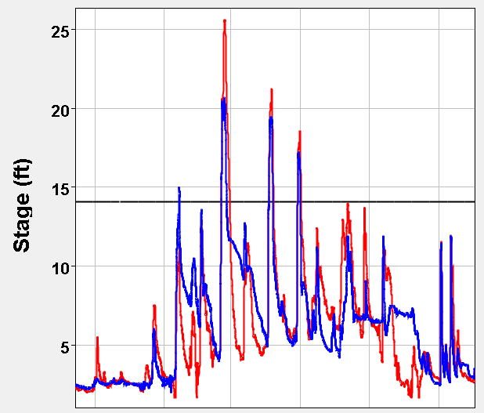
Legacy Method
Water Control provides with and without reservoir project stages
Legacy routing model
 | Actual / Date |  | WOP / Date
Kaskaskia
Vandalia | 20.6 | 23-Feb | 26.2 | 21-Feb
 | 19.4 | 05-Apr | 22.0 | 06-Apr
 | 17.2 | 29-Apr | 19.8 | 30-Apr
 | 11.9 | 12-Jun | 16.2 | 12-Jun
 | 11.9 | 13-Jul | 15.8 | 14-Jul
 | 11.9 | 11-Sep | 15.3 | 11-Sep

Slide 5
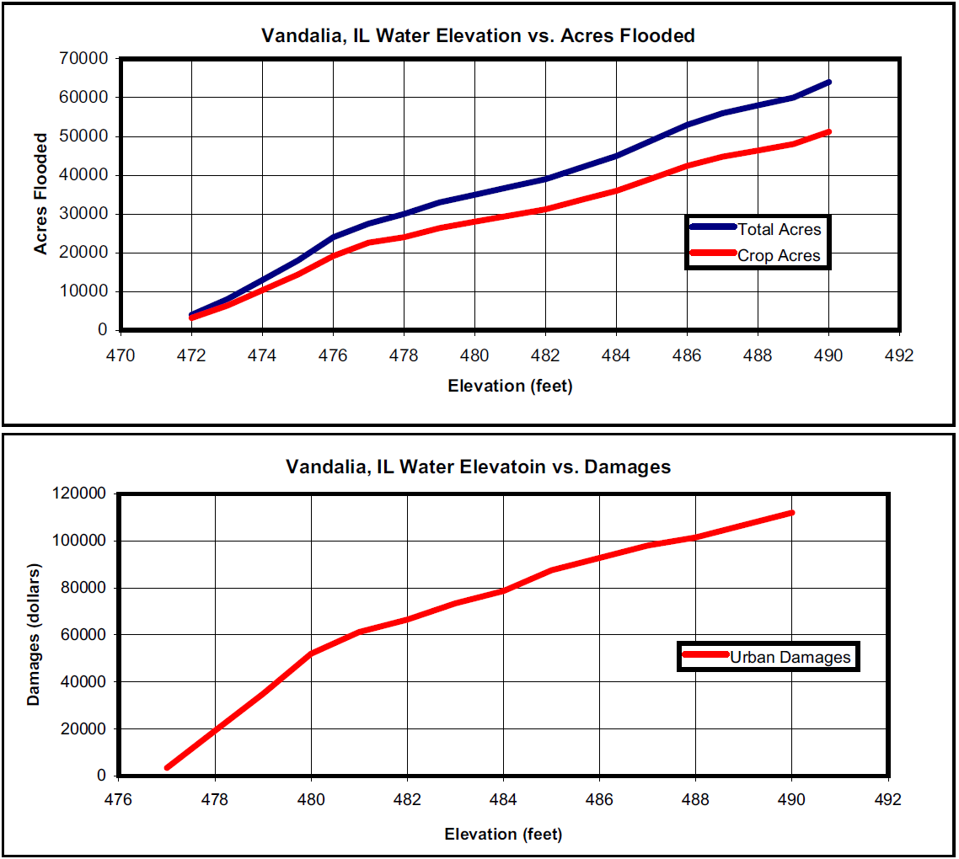
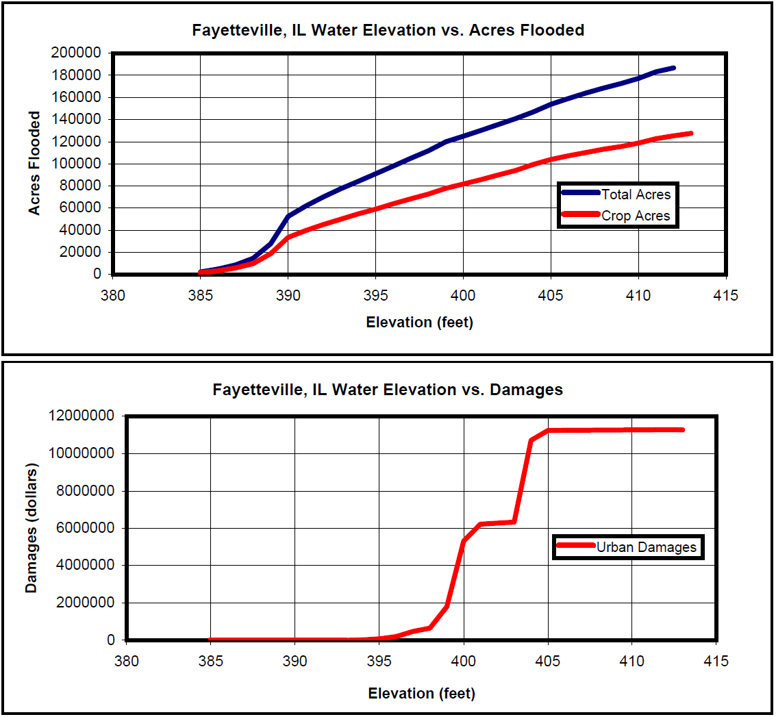
Elevation Damage Curves

Slide 6
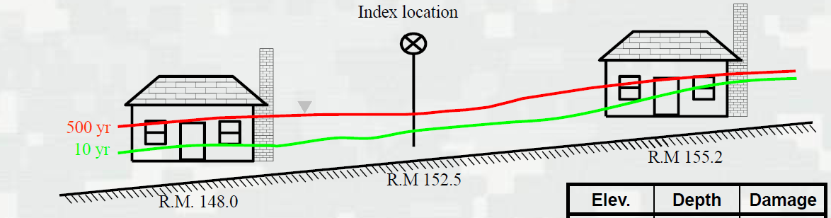
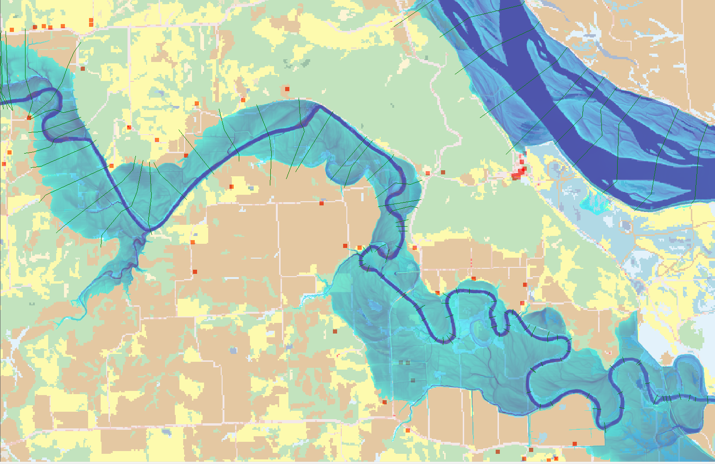
HEC-FIA Method
Salt River Basin FY-16 Annual Damages Reduced
 | Structures | Agriculture | Total Damages
With Project | $668,410 | $60,740 | $729,150
Without Project | $1,177,200 | $3,105,550 | $4,281750
Project Benefits | $508,790 | $3,043,810 | $3,552,600
Percent of Total | 14.3% | 85.7%
Without Project
With Project
Agriculture
Structures

Slide 7
Summary
CWMS Implementation
clear definition of what CWMS Implementation
flexibility to accomplish CWMS Implementation
MVS CWMS Implementation Example
Monitoring data and watershed conditions
CAVI model forecasting
Reporting
Flood forecasting & inundation mapping
Evaluation of CWMS forecasts
Annual Flood Damages Reduced

Slide 8
Questions Help additional Training
https://usace.dps.mil/sites/KMP-WM/SitePages/Corps-Water-Management-System-(CWMS).aspx
https://www.hec.usace.army.mil/confluence/cwmsdocs
https://discourse.hecdev.net/c/cwms/5
TDL-CELRH-EC-GW-W-USACE CWMS Modeling | General | Microsoft Teams

