Slide 1
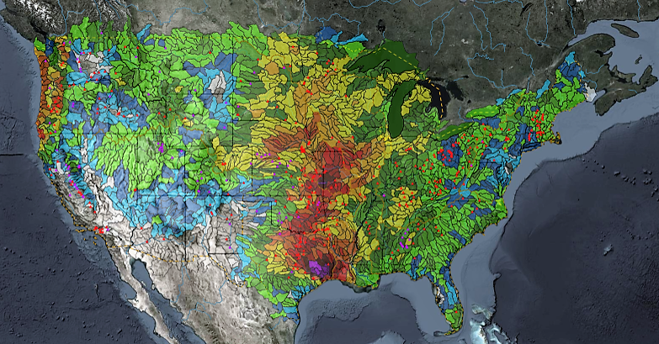
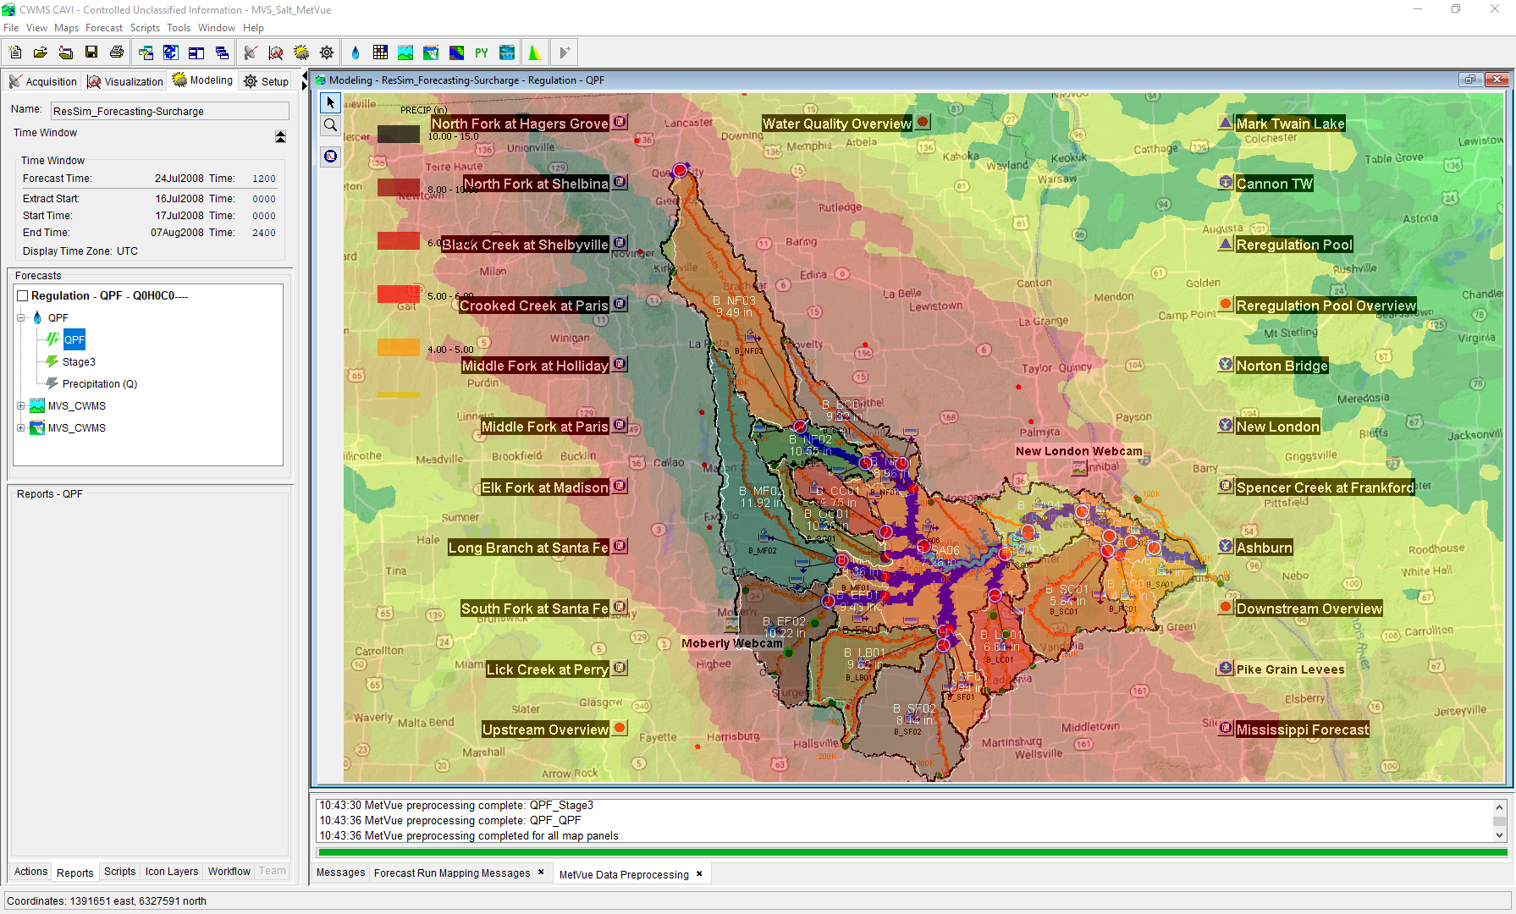

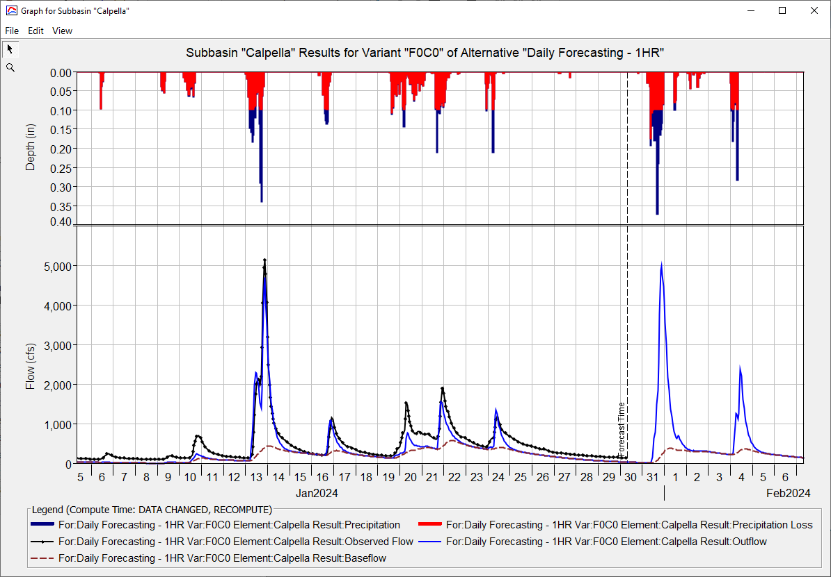
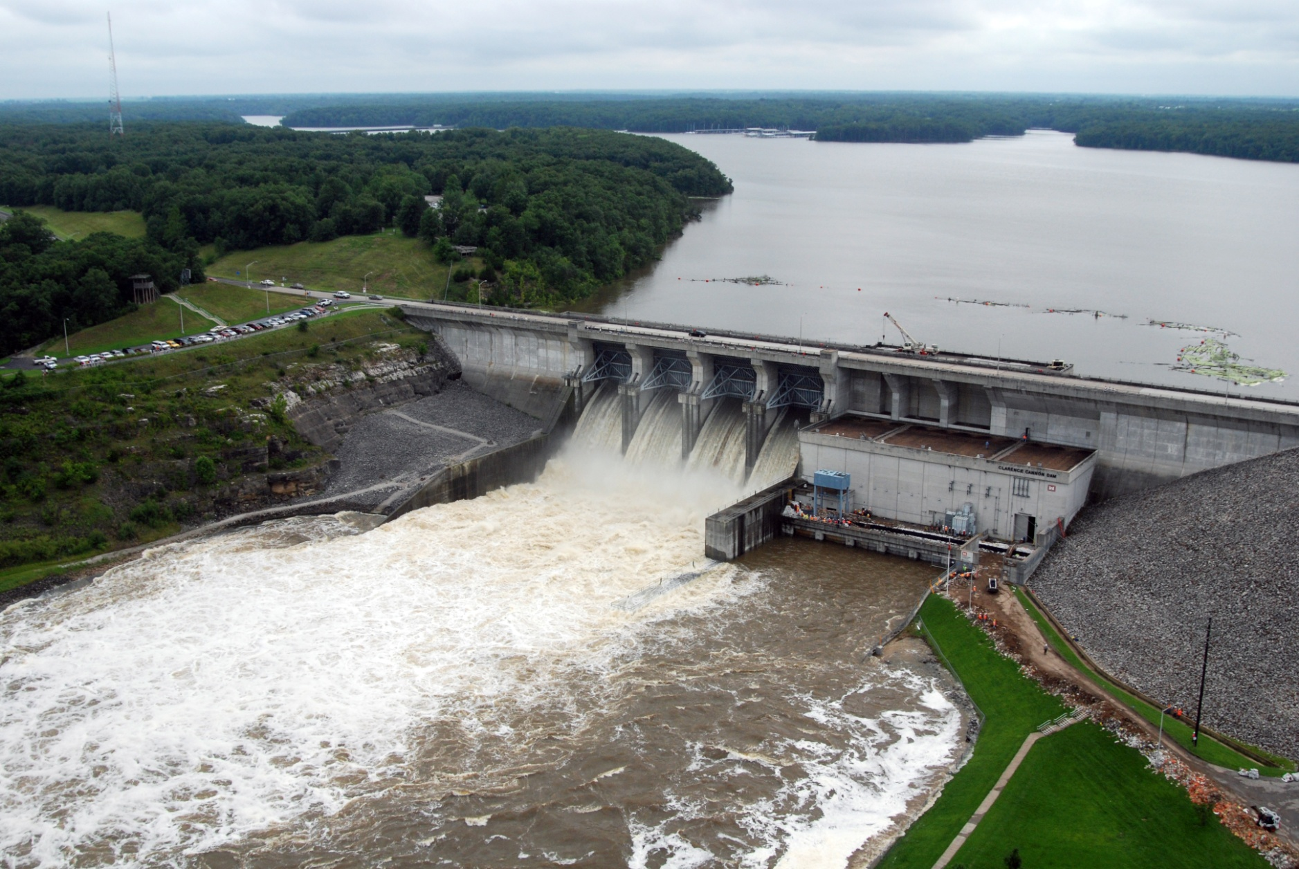
Forecasting with Ensembles in CWMS
Simon Evans, P.E., CFM
Hydrologic Engineering Center
CWMS Prospect Course

Slide 2
Overview
Sources of Ensemble Forecasts
HEC-ResSim Ensemble Compute
CAVI Ensemble Compute
Ensemble Forecast Processor
Ensemble Viewer

Slide 3
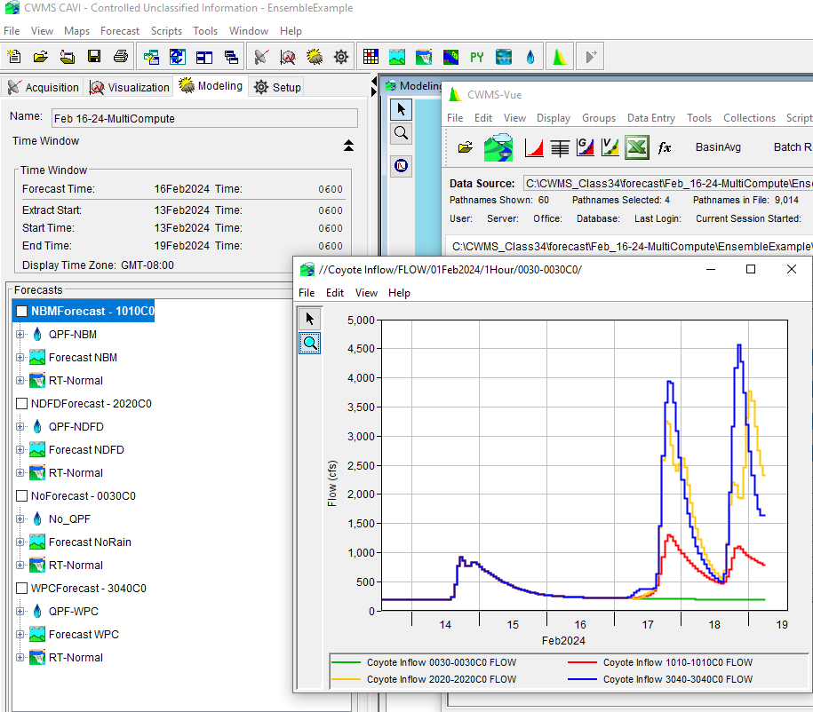
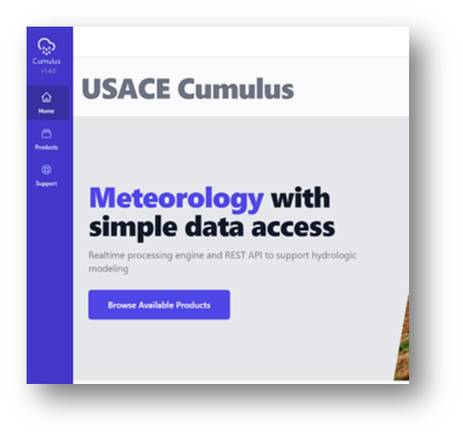
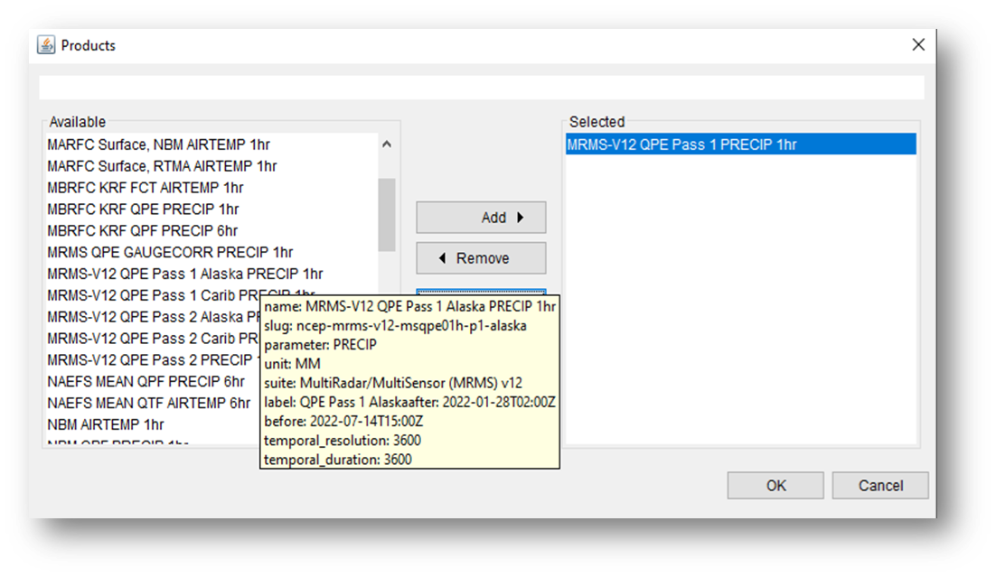
CUMULUS
CWMS supports Cumulus directly:
CorpsNet/VPN access with CAC authentication
https://cumulus.corps.cloud/
HRRR – 1hr
NBM – 1hr
NDFD – 6hr
WPC – 6hr
NAEFS – 6hr

Slide 4
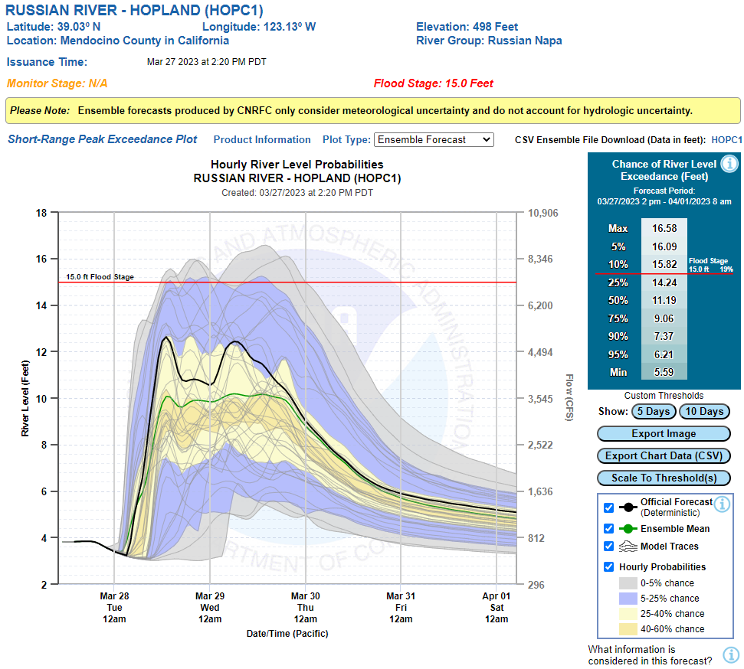
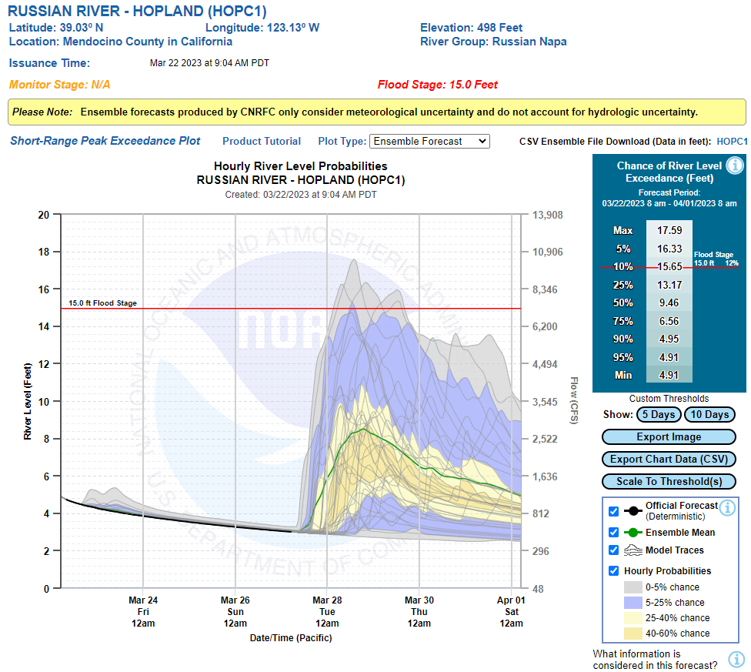
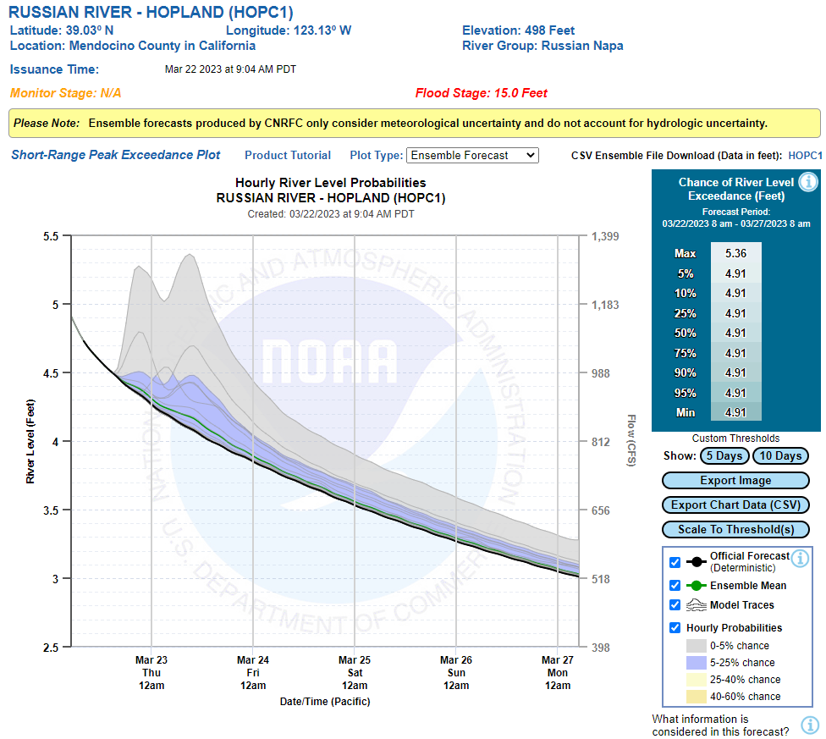
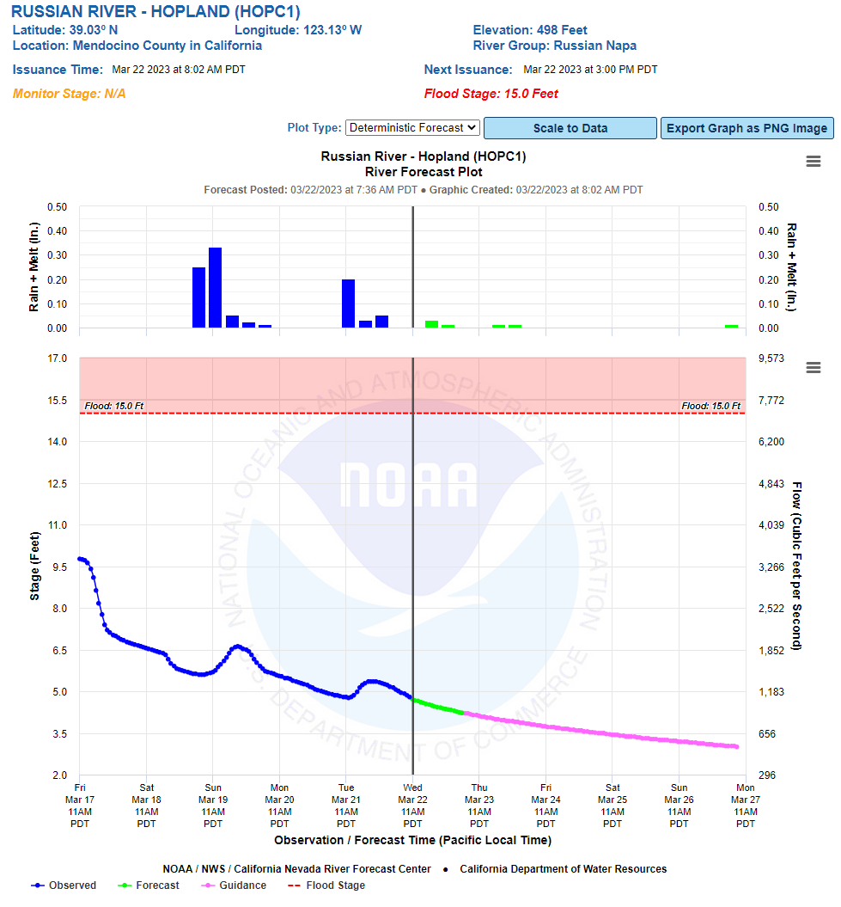
Russian River – Hopland
California Nevada RFC
March Ensemble Forecast
Ensemble Forecast - 5 Day
Ensemble Forecast - 10 Day
Deterministic Forecast

Slide 5
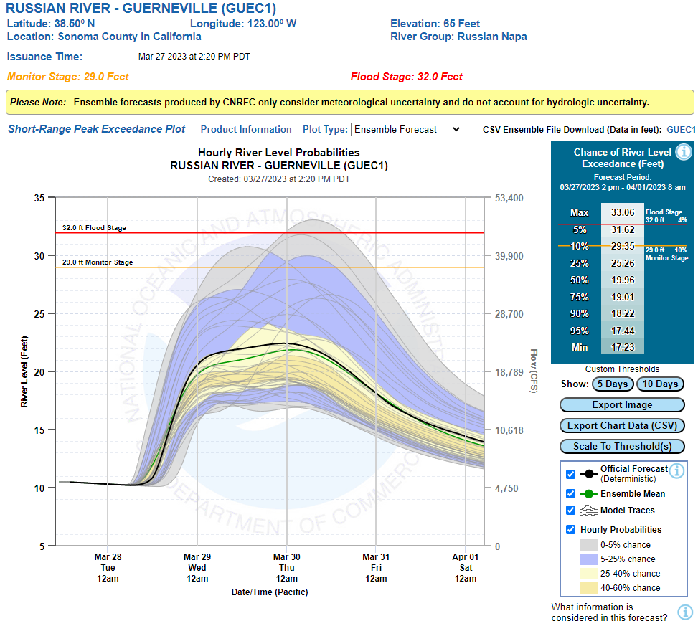
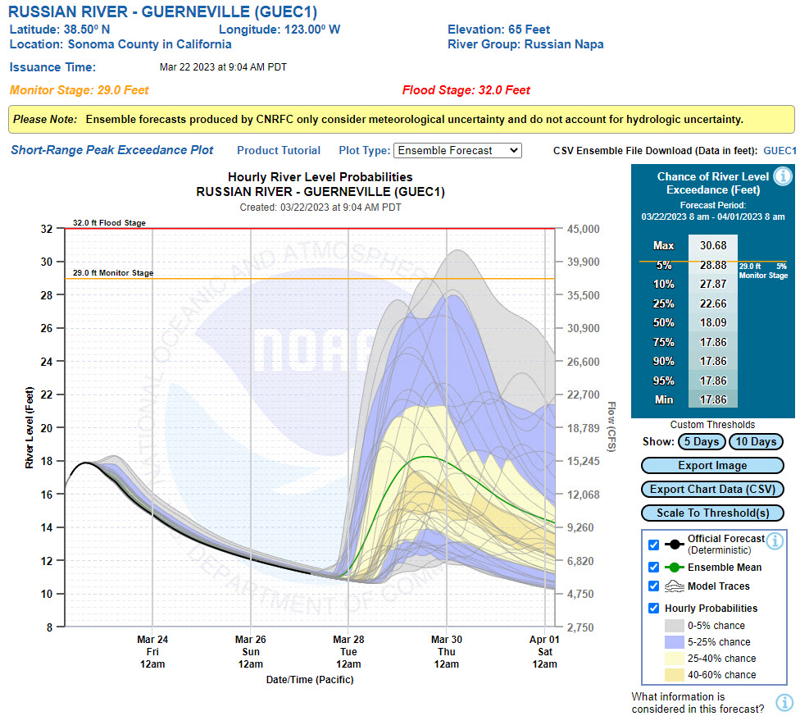
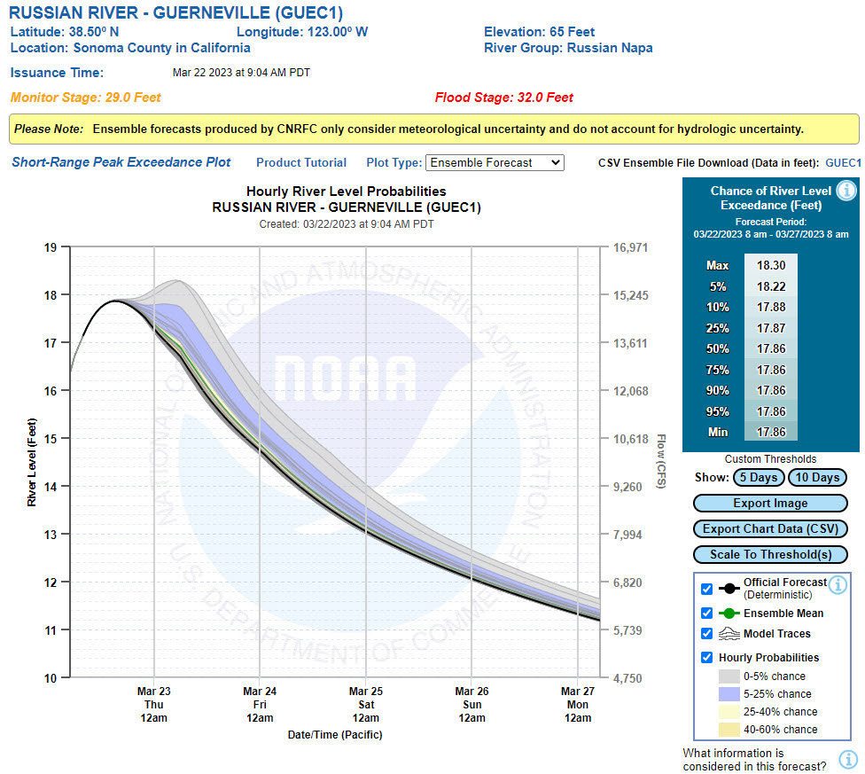
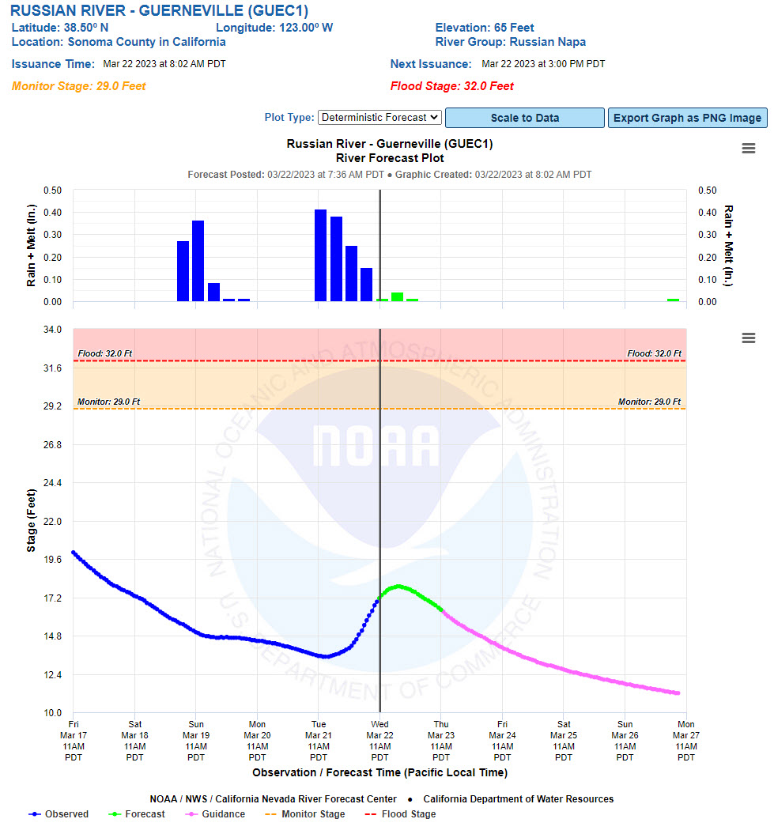
Russian River – Guerneville
California Nevada RFC
March Ensemble Forecast
Ensemble Forecast - 5 Day
Ensemble Forecast - 10 Day
Deterministic Forecast

Slide 6
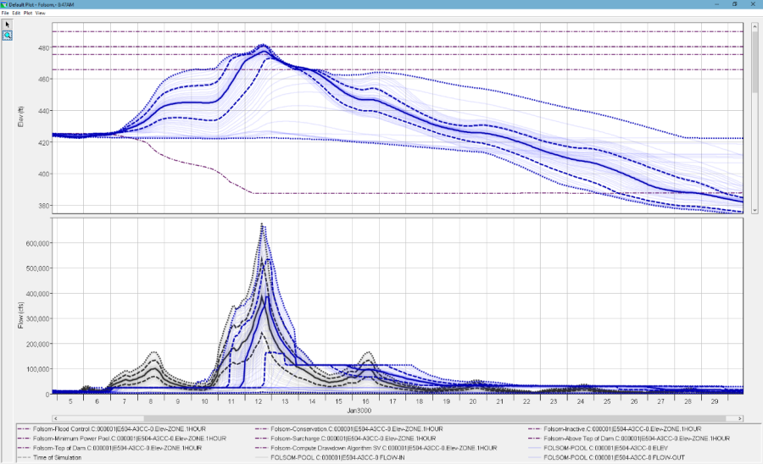

HEC-ResSIm Ensemble Compute
HEC-ResSim
DSS
1
DSS
1
2
2
3
3
n
n
Ensemble
of Input
Reservoir Inflows
Ensemble
of Computed Reservoir Outflows

Slide 7
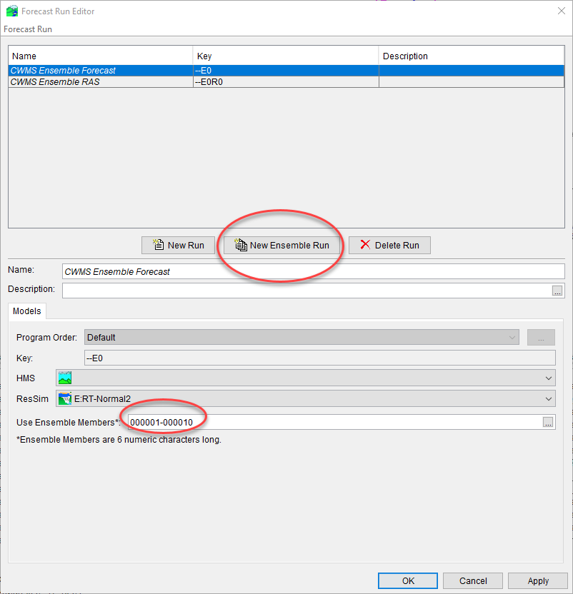
CAVI Ensemble Compute
What does it do?
Each trace used sequentially in an isolated pass through the Program Order
Each trace generates a separate watershed “run” folder in the forecast
Results in separate forecast.dss files, then rolled into a master forecast.dss at end.
Current Limitations
Ensemble input data only from HEC-DSS, not CWMS Database
Gridded ensembles not yet supported
Lacks dedicated tools for reviewing and analyzing results

Slide 8
Ensemble Forecast Processor (EFP)
What does it do?
New plugin first available in CWMS 3.4
Based on HEC-WAT FIRO Forecast Processor
Part of the Program Order
Allow user to specify locations within the watershed to calculate statistical metrics from ensemble time series.
Metrics can be used as input to other applications within the CWMS forecast

Slide 9
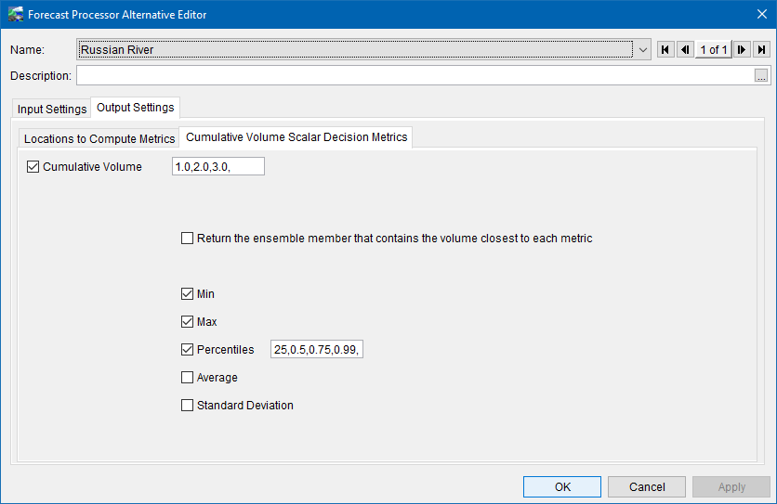
Ensemble Forecast Processor
Metrics to be computed can either be Scalar or time series
Scalar metrics:
Can be used to influence rules in ResSim Alternative (FIRO)
User defined alternatives
Based on Prado FIRO Case Study approach

Slide 10
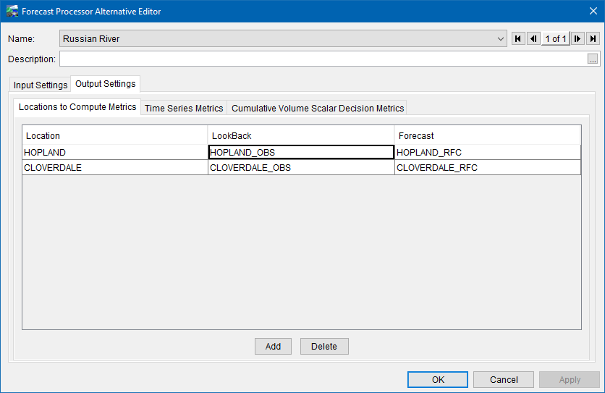
Ensemble Forecast Processor
Time Series metrics
Allow for reduced number of ensemble members to be used for input to other models
For a chosen metric(s) return the specific ensemble member that has the closest volume
If applicable merge observed time series with the returned ensemble member

Slide 11
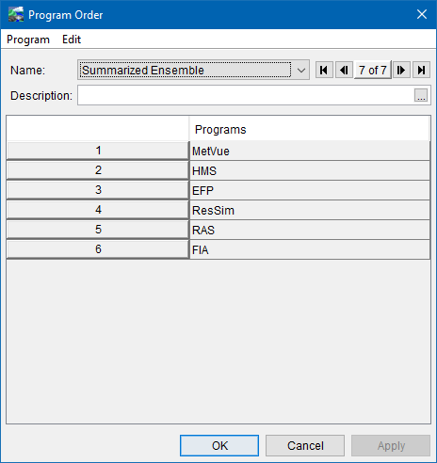
Summarized ensemble forecast
Ensemble CSV
Ensemble DSS
Raw
HEFS Data
Extract
Gridded DSS
HEC-MetVue
+
HEC-HMS
Uncontrolled Flows
Ensemble DSS
DSS
Ensemble Forecast
Processor (EFP)
Metric Data
Metric Data + Uncontrolled Flows
HEC-ResSim
Regulated Flows
Regulated Flows
HEC-RAS + HEC-FIA

Slide 12
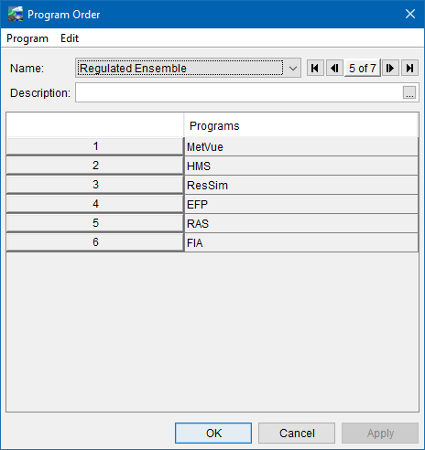
Regulated ensemble forecast
Ensemble CSV
Ensemble DSS
Raw
HEFS Data
Extract
Gridded DSS
HEC-MetVue
+
HEC-HMS
Uncontrolled Flows
Ensemble DSS + Uncontrolled Flows
DSS
Ensemble
HEC-ResSim
Regulated Ensemble DSS
Ensemble Forecast
Processor (EFP)
Regulated Ensemble DSS
Ensemble Summary
Ensemble Summary
HEC-RAS + HEC-FIA

Slide 13
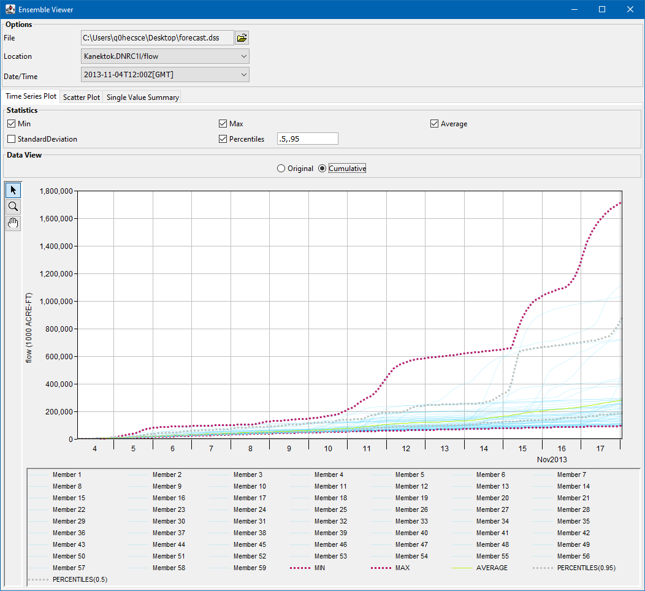
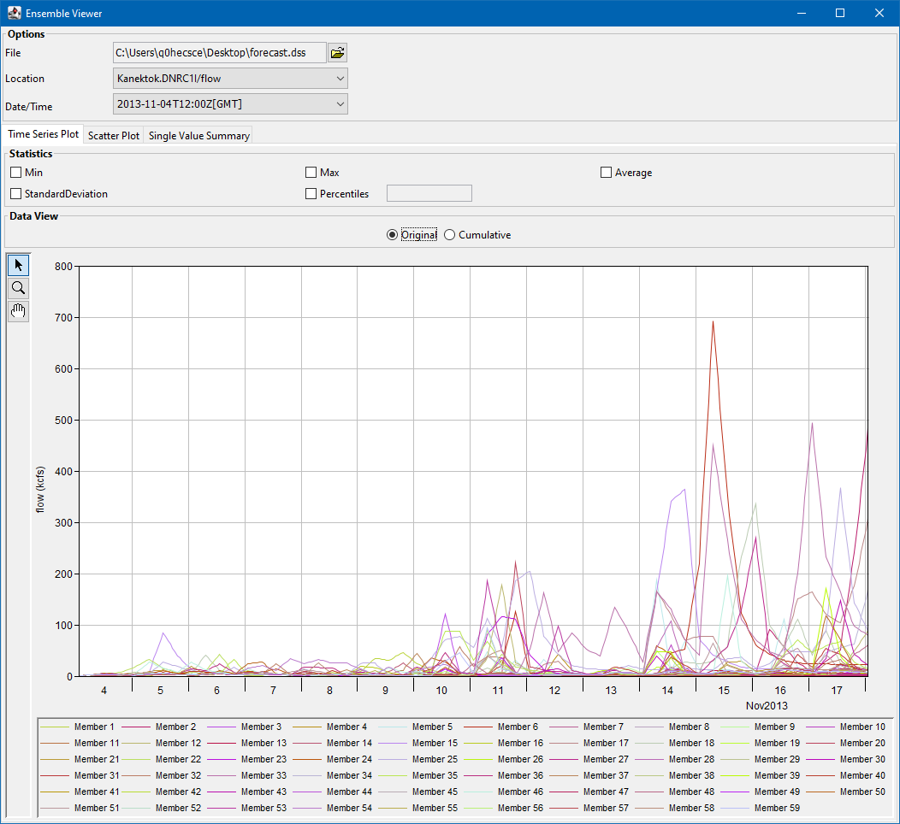
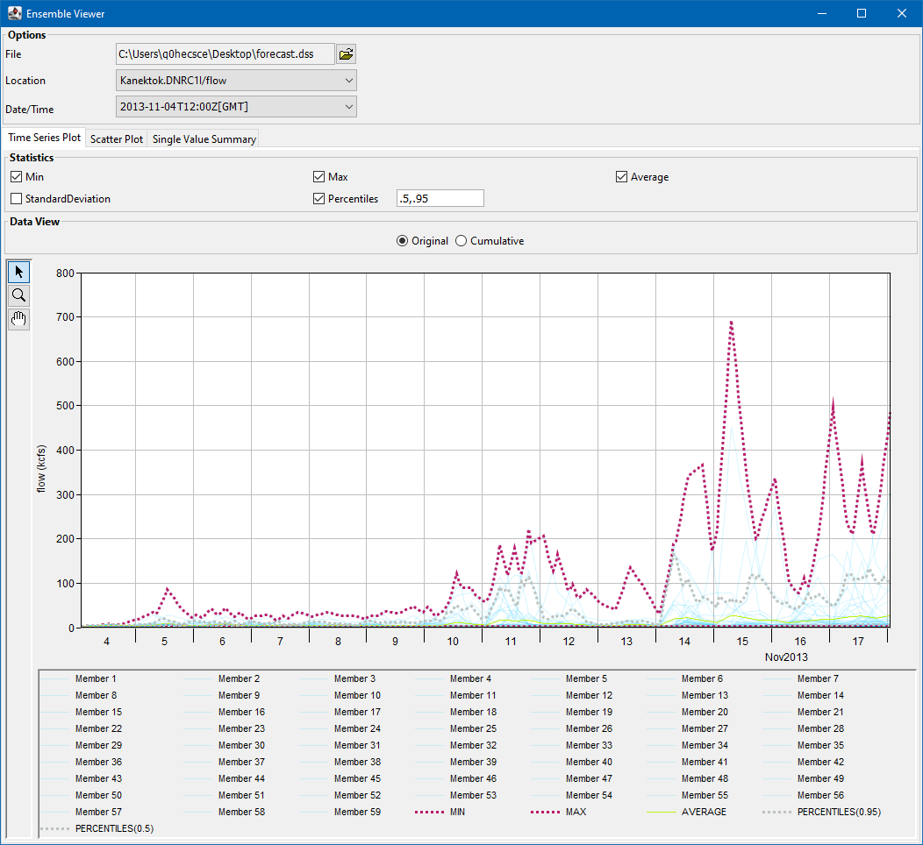
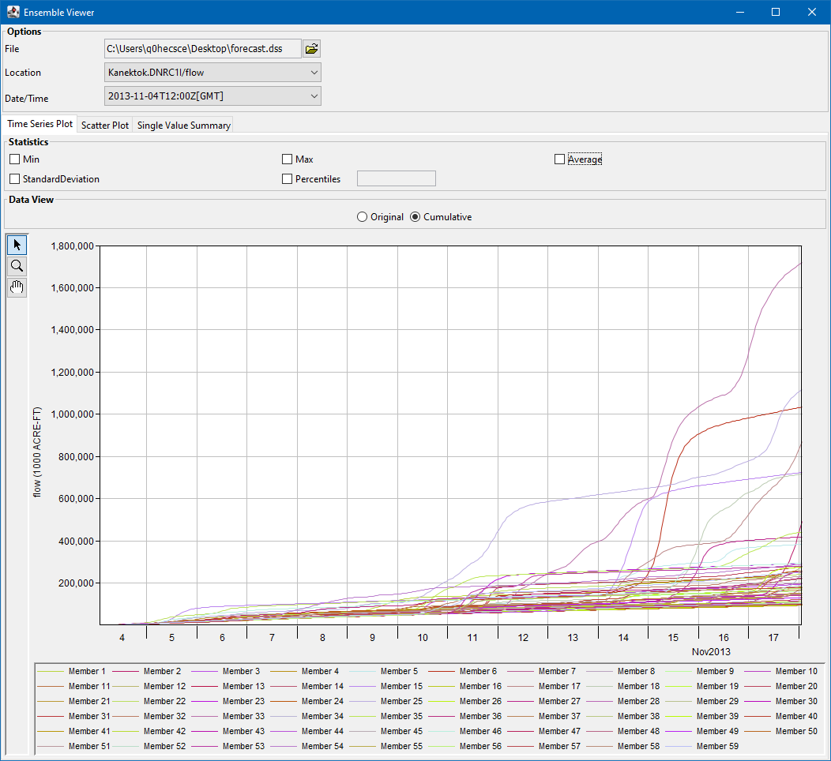
Ensemble Viewer
Allows user to view ensemble time series
Ability to view ensemble metrics that summarize the ensembles as a single summary time series, single value for each ensemble, or as a single summary value
Available from the CAVI under > Tools

Slide 14
Questions Help additional Training
https://usace.dps.mil/sites/KMP-WM/SitePages/Corps-Water-Management-System-(CWMS).aspx
https://www.hec.usace.army.mil/confluence/cwmsdocs
https://discourse.hecdev.net/c/cwms/5
TDL-CELRH-EC-GW-W-USACE CWMS Modeling | General | Microsoft Teams

