Slide 1
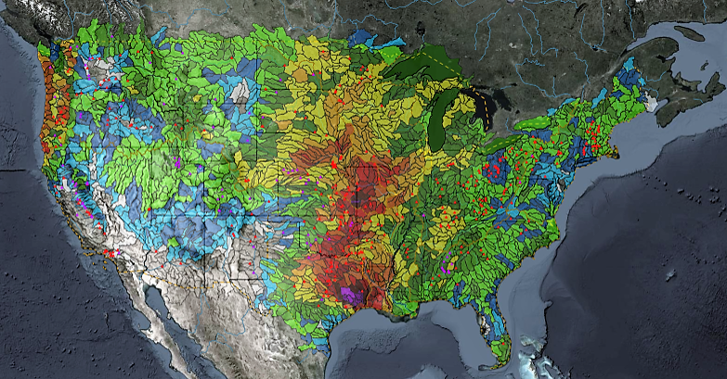
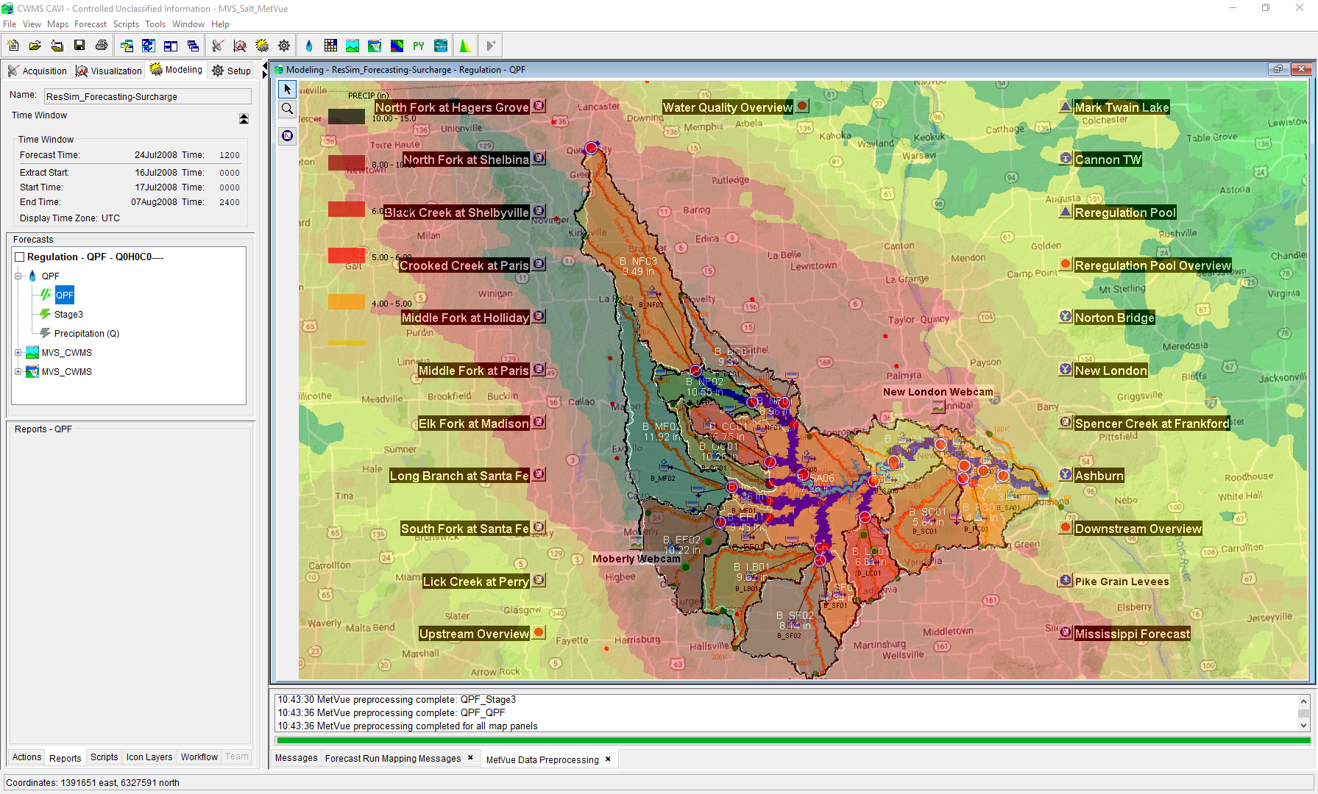

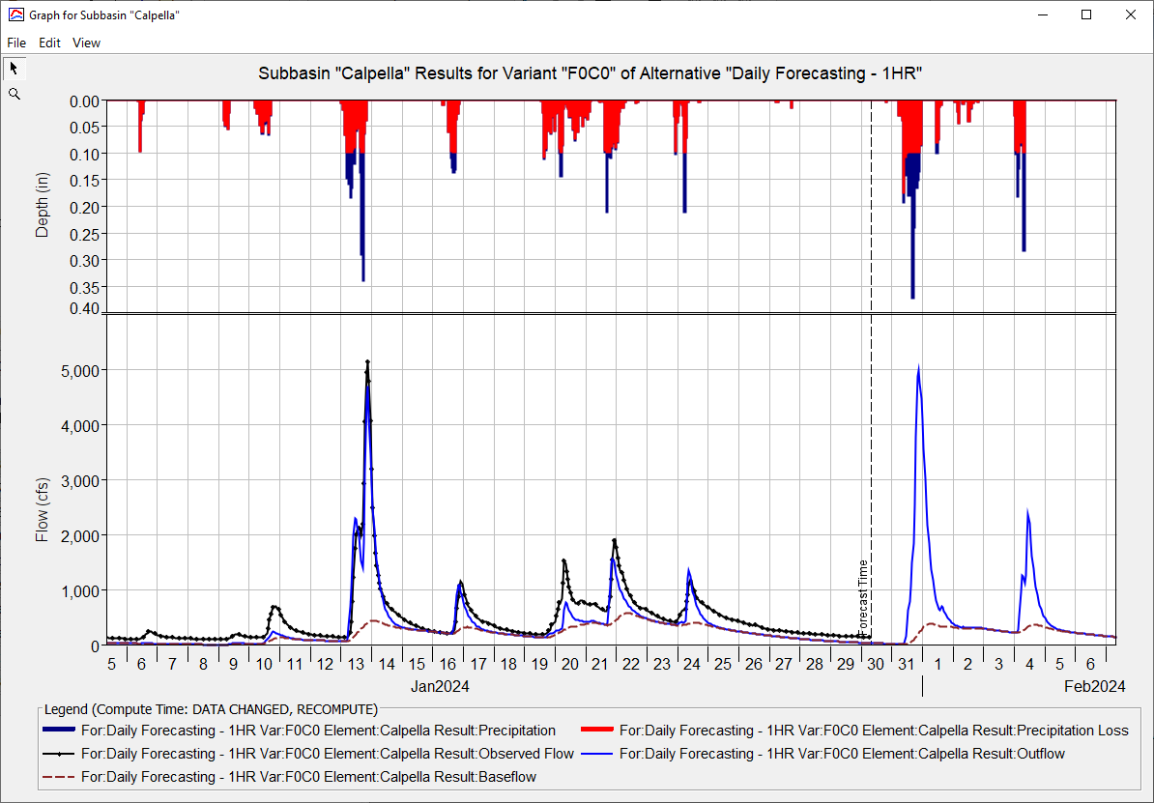
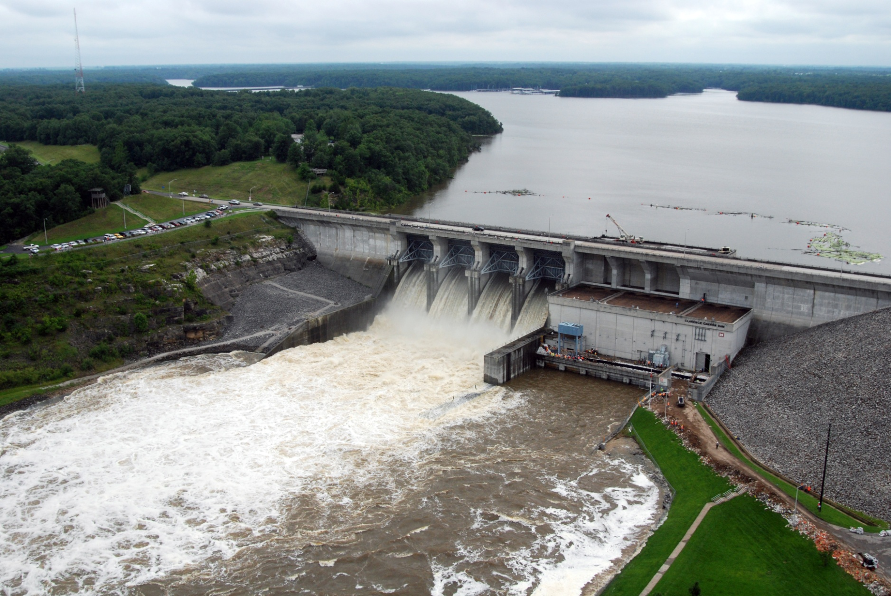
HEC-FIA for CWMS
Simon Evans, P.E., CFM
Hydrologic Engineering Center
CWMS Prospect Course

Slide 2
Objective
Identify basic concepts of using HEC-FIA to estimate potential flood impacts in real-time

Slide 3
Outline
  What is HEC-FIA and its purpose in CWMS?
  What are the inputs to HEC-FIA?
  What are the damage computations in HEC-FIA?
  What are the various reports available in HEC-FIA?
  Brief introduction to Flood Damages Reduced calculations in HEC-FIA

Slide 4

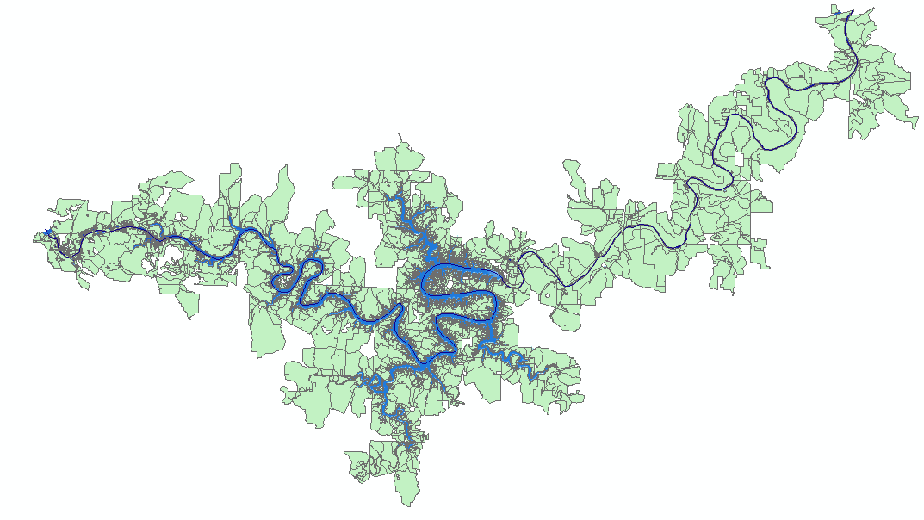
What is HEC-FIA?
Hydrologic Engineering Center – Flood Impact Analysis
HEC-FIA is a single event software package
HEC-FIA calculates structure losses, indirect economic losses, direct economic losses, life loss, impact/responses, and agriculture losses
.
.
.
.
.
.
.
.
.
.
.
.
.
.
.
.
.
.
National Structure Inventory
.
.
NASS

Slide 5
Why should we include FIA in CWMS?
  What was the original purpose for the creation of USACE?
  Why was the purpose changed?
  How does that impact Water Managers?
  If we reduce stage by 1 foot at a gage, how much difference does it make?

Slide 6
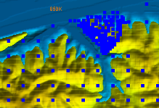
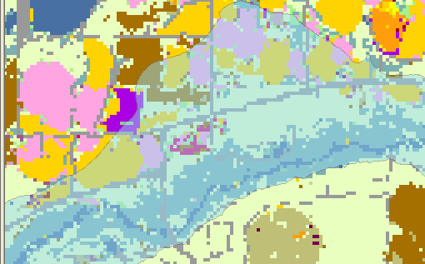
Economic inputs
  Spatially referenced structure inventory (no more aggregated index points)
  Spatial agriculture data
  Data to support calculations
    Damage functions
    Crop types and growing trends
    Population information

Slide 7
National Data sources
  Always ask for better data from the District
    Agriculture Data
      National Agriculture Statistical Survey
      Crop Production functions from state or local sources
    Structure Data
      National Structure Inventory/HAZUS Import
    Terrain Data
      Same as HEC-RAS

Slide 8
Hydraulic Inputs
  HEC-ResSim Output
    HEC-DSS Flow Hydrographs at Common Computation Points
    HEC-DSS Stage Hydrographs at Common Computation Points
  HEC-RAS Output
    HEC-DSS Stage Hydrographs at Cross Sections (Unsteady RAS)
    HEC-DSS Stage at each Cross Section (Steady RAS)
    Gridded Data
      Maximum Depth
      Arrival time of inundation
      Duration
      Max Depth times Velocity

Slide 9
The Hydrograph
Arrival
Time
Stage
Duration
Max Depth
Important Threshold
Time (t)

Slide 10
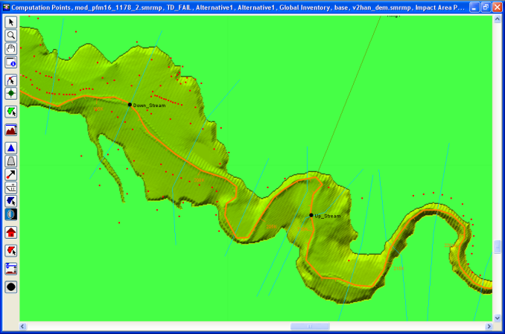
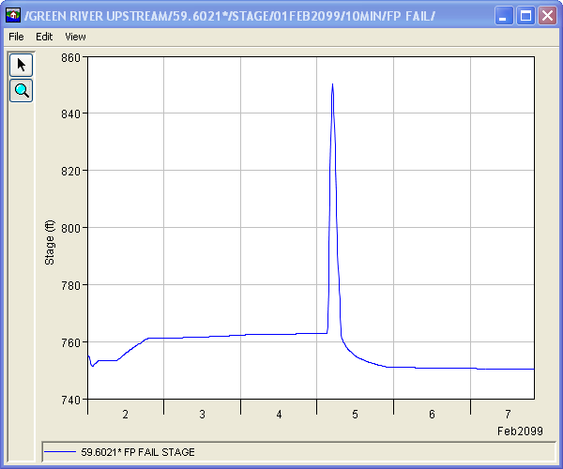
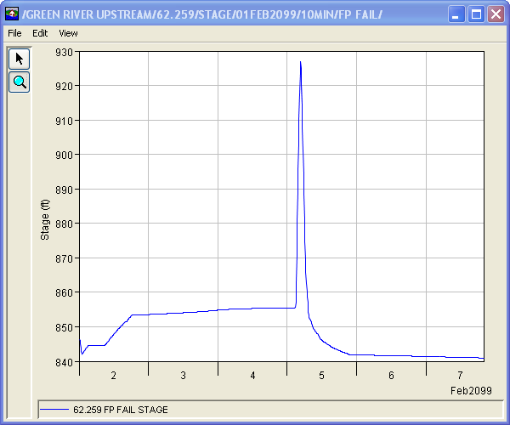
How do stage hydrographs work?
925 ft
847 ft

Slide 11
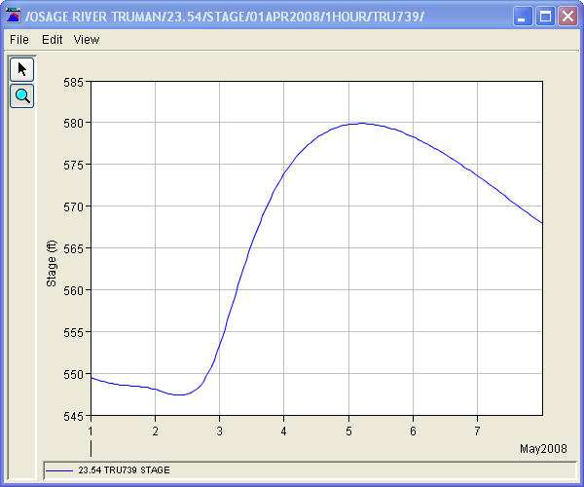
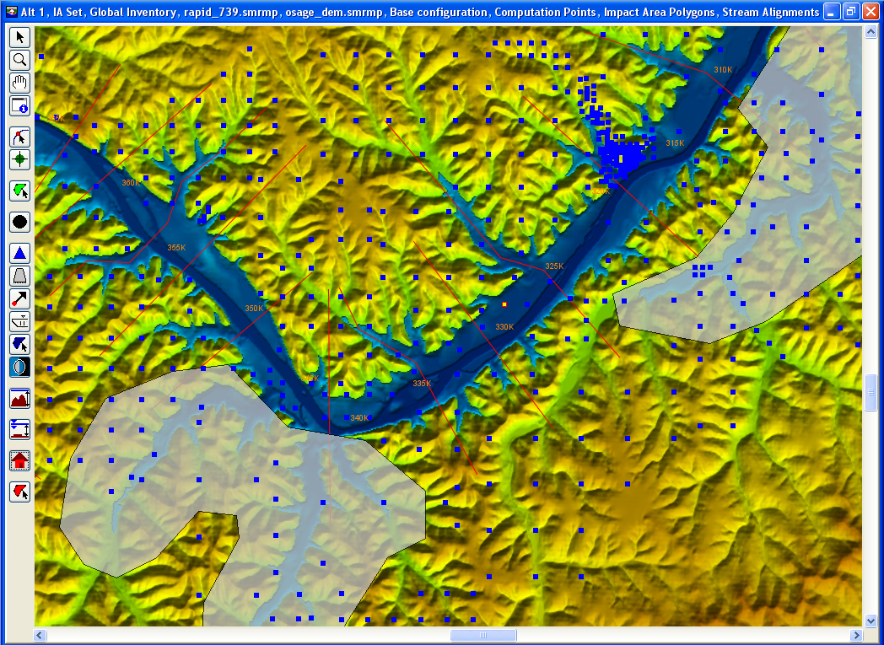
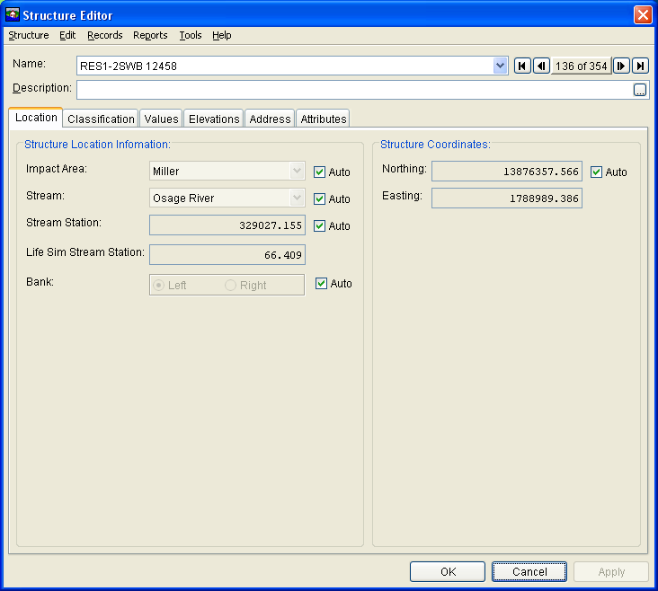
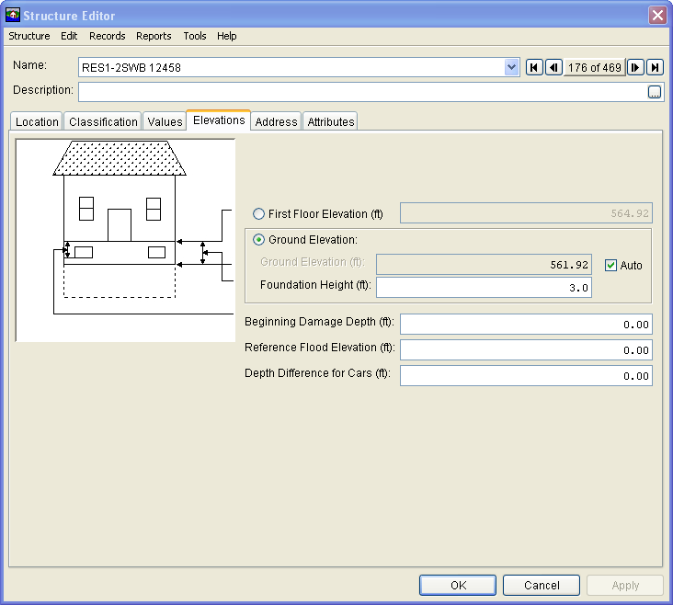
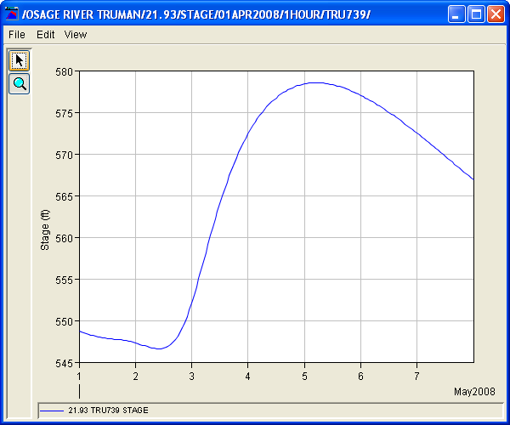
Cross-section Hydrographs

Slide 12
Storage Area Hydrographs

Slide 13
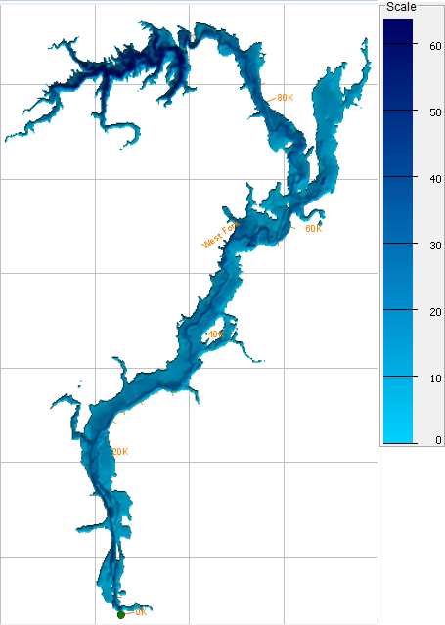
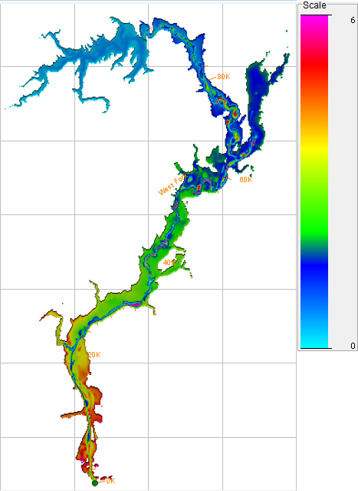
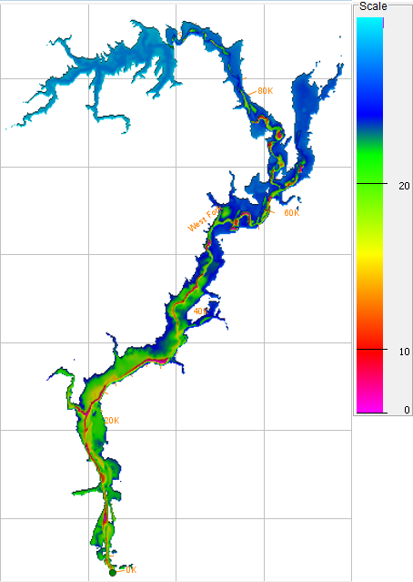
Gridded Data
Maximum Depth
Arrival Time
Duration

Slide 14
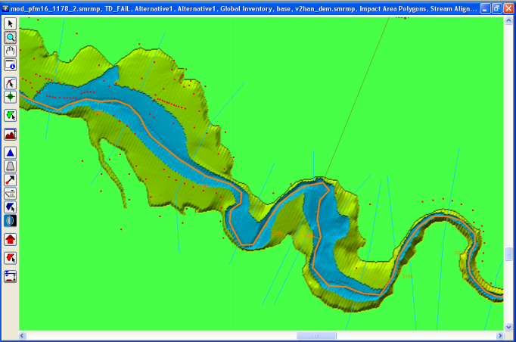
Summary H&H Inputs
  Gridded data: depth, arrival, and duration
  Stage Hydrographs (HEC-ResSim CCPs or HEC-RAS Cross Sections)

Slide 15
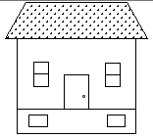
Economic Damage
Stage
Damage
Damage
Maximum Depth
Stage
Time (t)

Slide 16
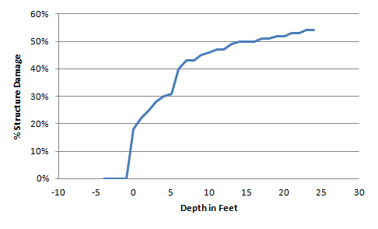

Economic Damage Methodology
42%
x $100,000 = $42,000
7 ft

Slide 17
Crop Damage Methodology
Crop Loss %
Duration
Date
Agriculture
Arrival
Time
Stage
Time (t)

Slide 18
Impact response curves
Impact Response Curve
If stage equals or exceeds this value then alert the authorities that the Town will be flooded.
Stage
Arrival
Time
Important Threshold
Time (t)

Slide 19
Impact Response Curves
Stage
Recession
Time 1
Arrival
Time 1
Arrival
Time 2
Recession
Time 2
Important Threshold
Time (t)

Slide 20
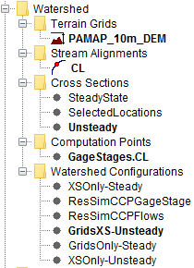
Why are there different Methods?
  To link HEC-FIA to different HEC-ResSim or HEC-RAS outputs
  To compute different types of calculations
  To provide flexibility for applying same consequence
    model for real-time or planning or other analyses
.
.
Inflow, Q_{i}
Inflow, Q_{i}
Inflow, Q_{i}
.
.
Inflow, Q_{i}
Time
Time
Time
.
Time
.
Reservoir 1
.
.
Inflow, Q_{i}
Reservoir 2
Inflow, Q_{i}
Time
Time
.
Inflow, Q_{i}
Inflow, Q_{i}
Time
Ouflow, Q_{o}
Time
Time

Slide 21
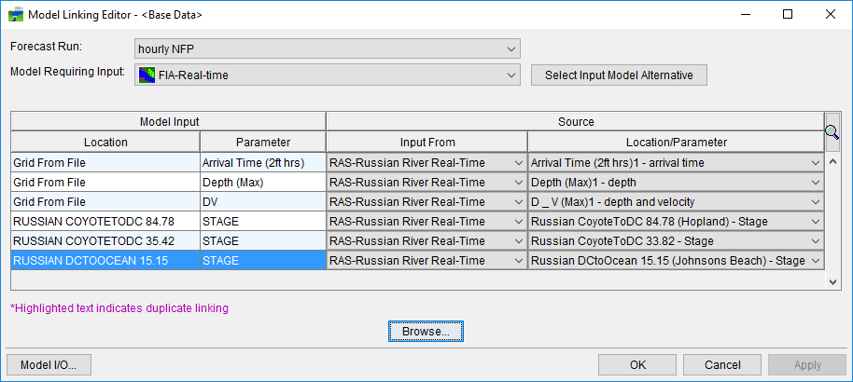
Linking HEC-FIA in CWMS
  Must link output from prior model to serve as input for a given HEC-FIA alternative

Slide 22
What Outputs are available?
  Individual Structure Damage Report
  Aggregated Consequences Summary Report
  Critical Infrastructure Report
  Impact Response Report
    By Rule
    By location
    Summary table
  Interactive Map Elements (i.e., zoom to structure)
  DBF and SHP files for custom products and analyses
  ECAM (indirect economics)

Slide 23
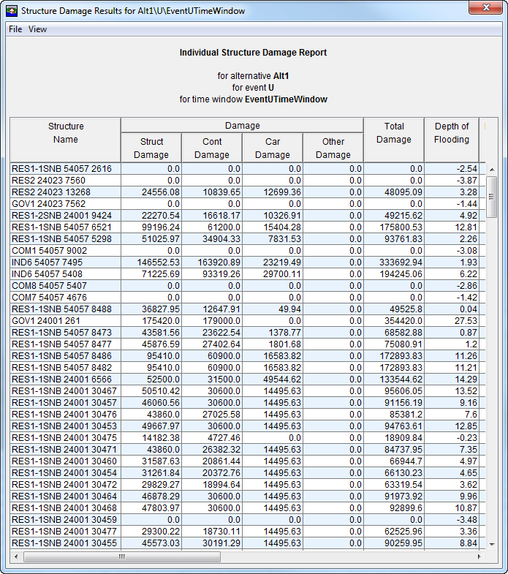
Individual Structure damage Report

Slide 24
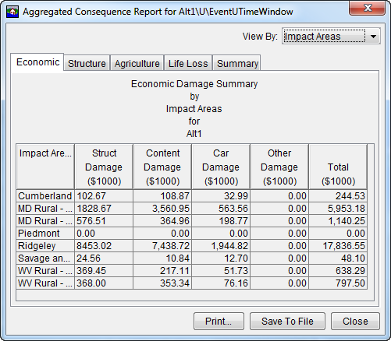
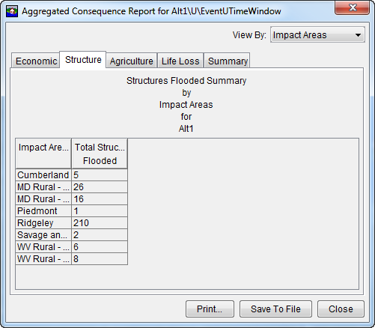
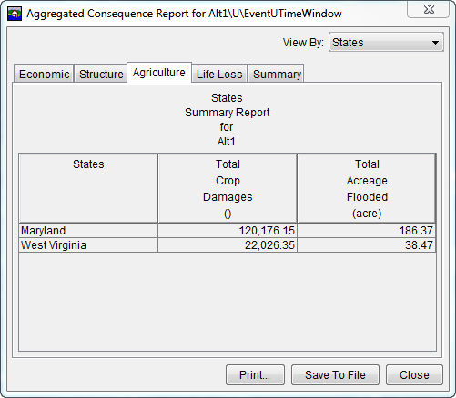
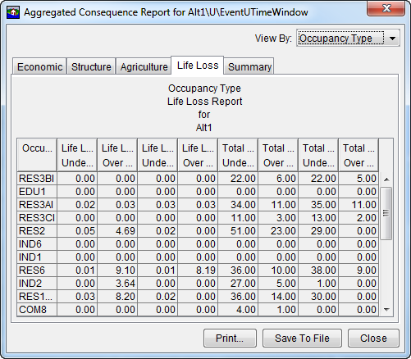
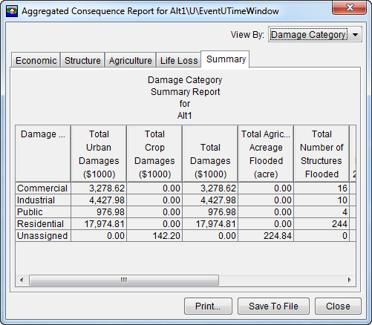
Aggregated Consequence Summary

Slide 25
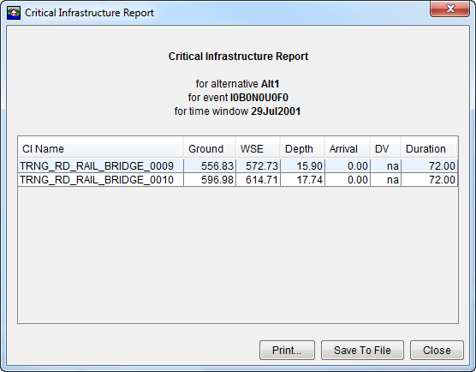
Critical infrastructure report

Slide 26
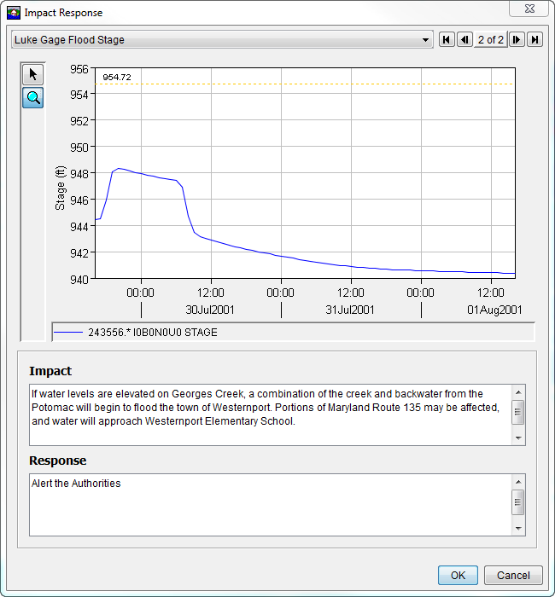
Impact response Report

Slide 27
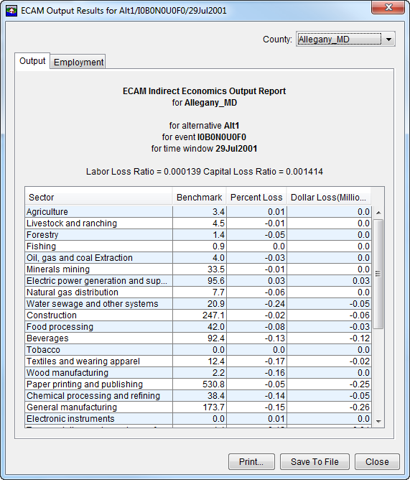
ECAM (indirect Economics)

Slide 28
Summary – Computes and inputs
  HEC-FIA computes single event damages, estimating life and economic losses:
    Structure loss
    Agricultural loss
    Indirect economic loss
    Life Loss
  HEC-FIA inputs include:
    National inventories of agricultural, structures, and terrain data
    Hydraulic data
      Stage hydrographs
      Gridded Data (Maximum Depth, Arrival Time, and Duration)

Slide 29
Summary – Method and Results
  HEC-FIA economic damage estimate methodology is a function of maximum depth
  HEC-FIA Output Reports include:
    Individual Structure Damage Report
    Aggregated Consequences Damage Report
    Critical Infrastructure Report
    Impact Response Report
    ECAM (Indirect Economics) Report

Slide 30
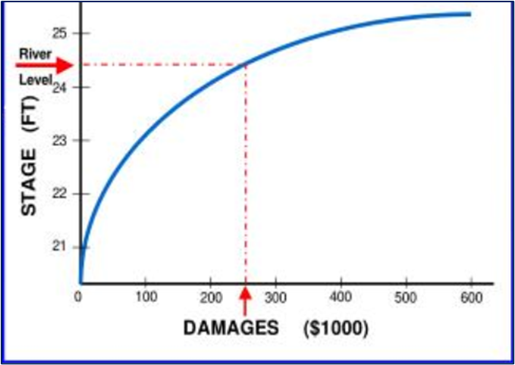
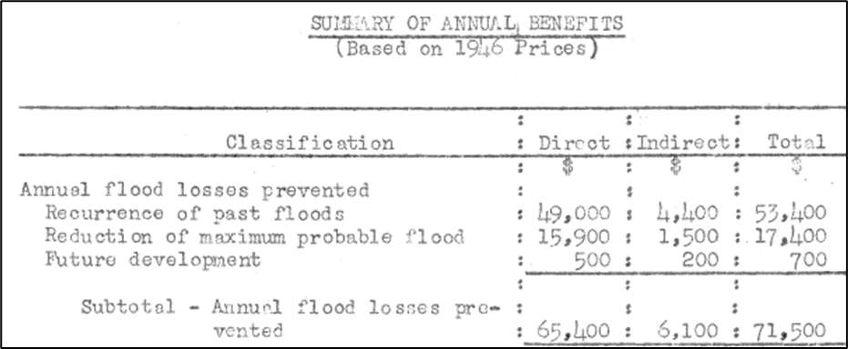
Flood Damages Reduced - Legacy
  Legacy Methodology
    Index location Damage Curves
    Lots of data baked into single location
      Long reaches
      Mixed Consequence types
      Hydraulics
    Shortfalls
      Outdated
      Often undocumented
      Black Box approach

Slide 31
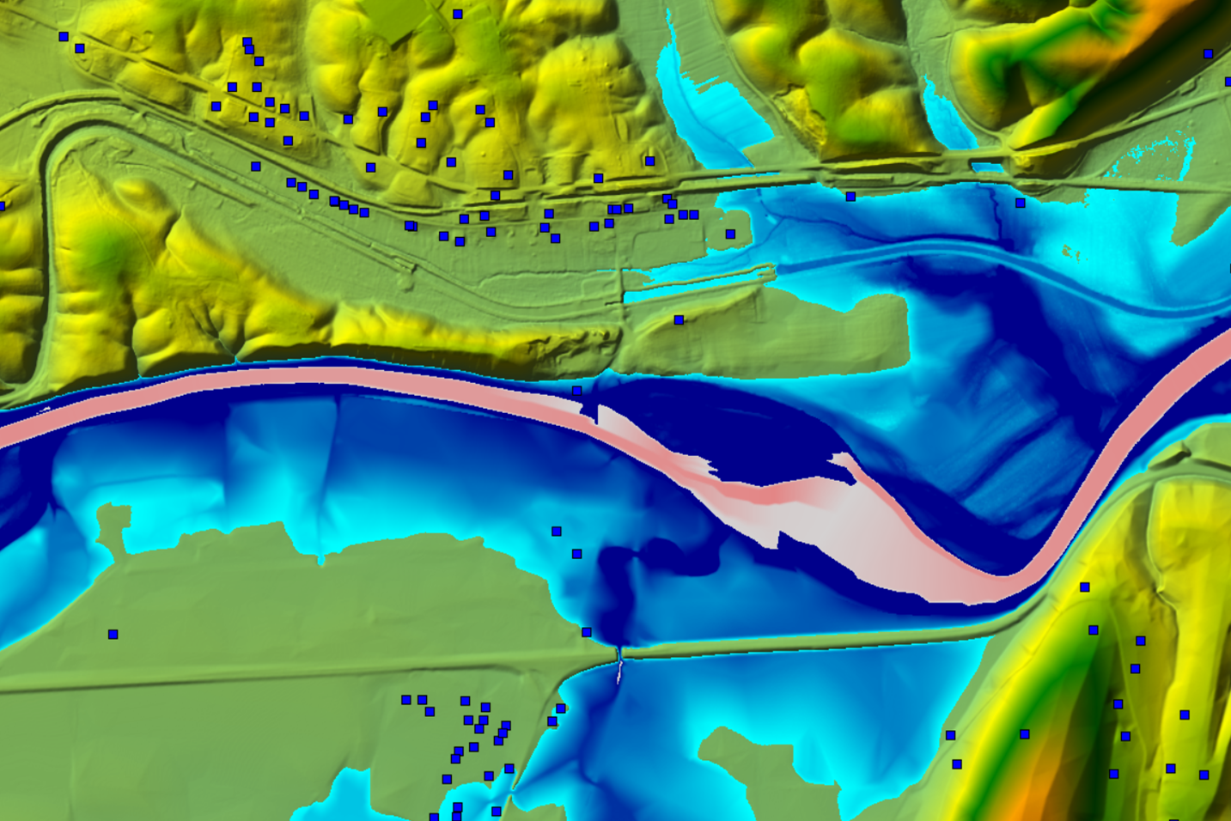
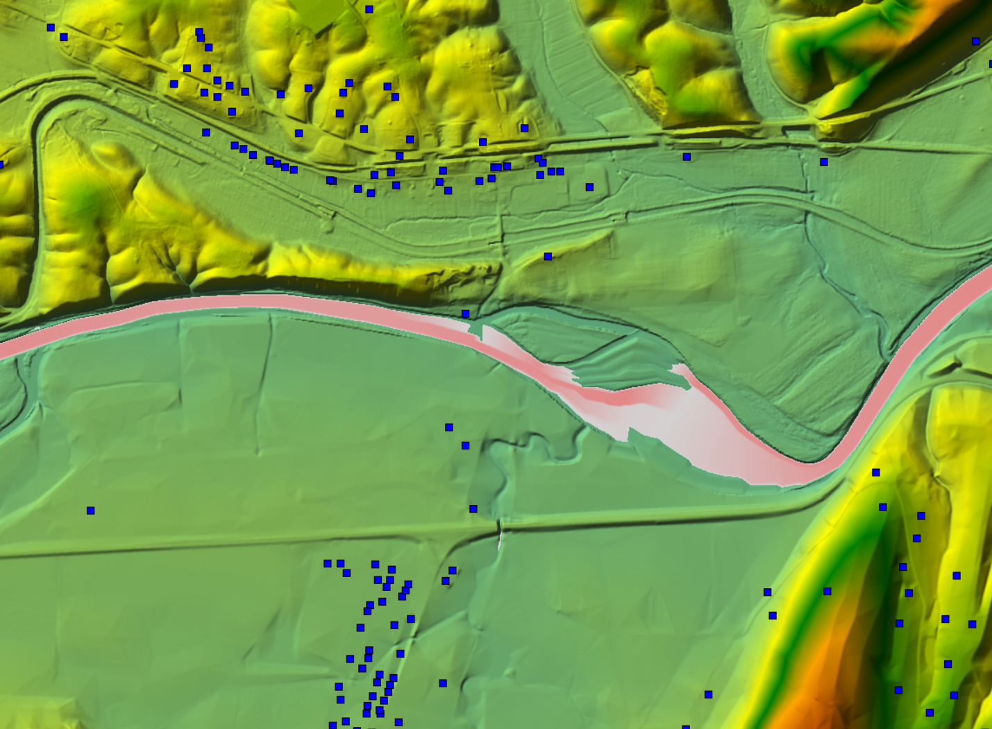

Flood Damages Reduced in CWMS

Slide 32
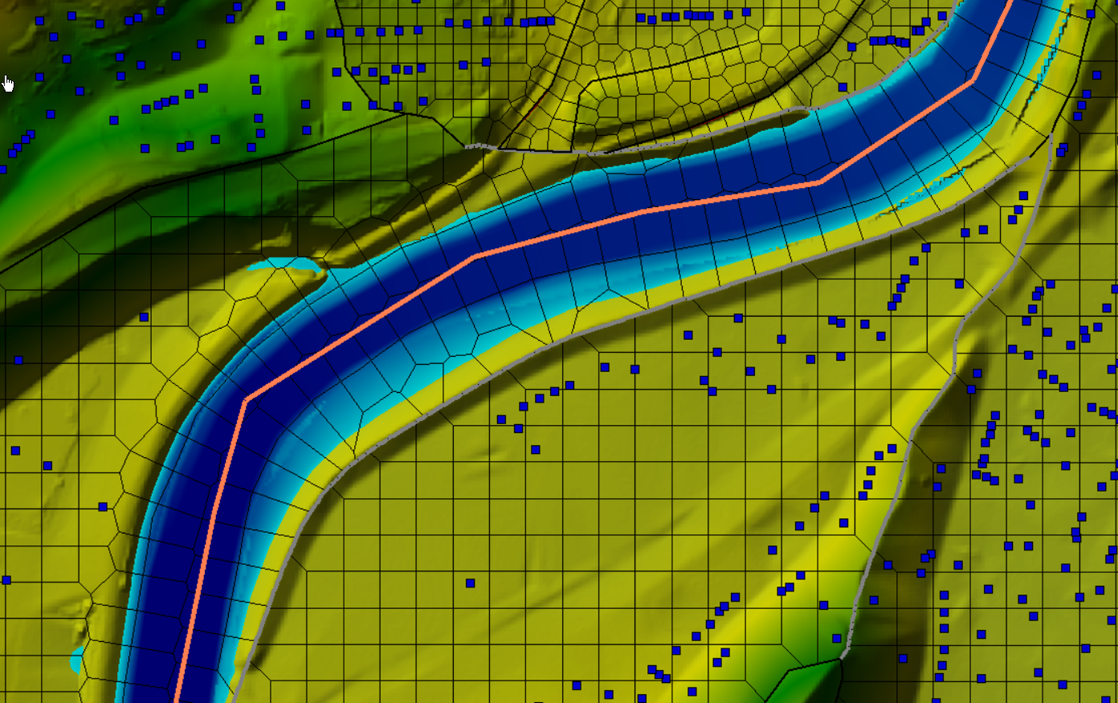
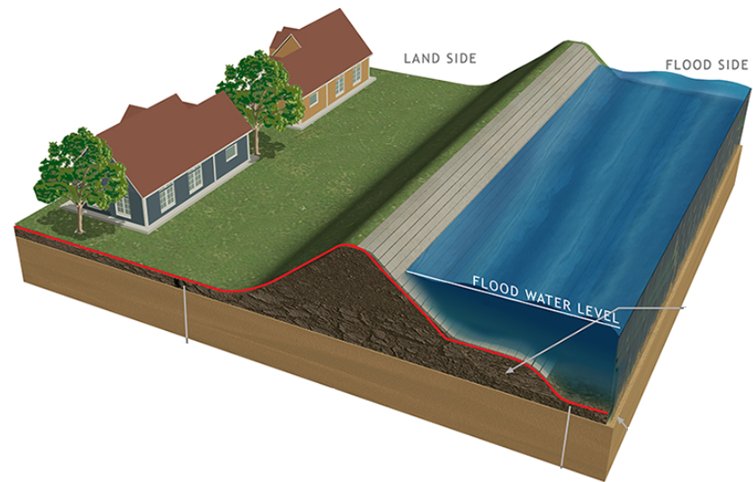

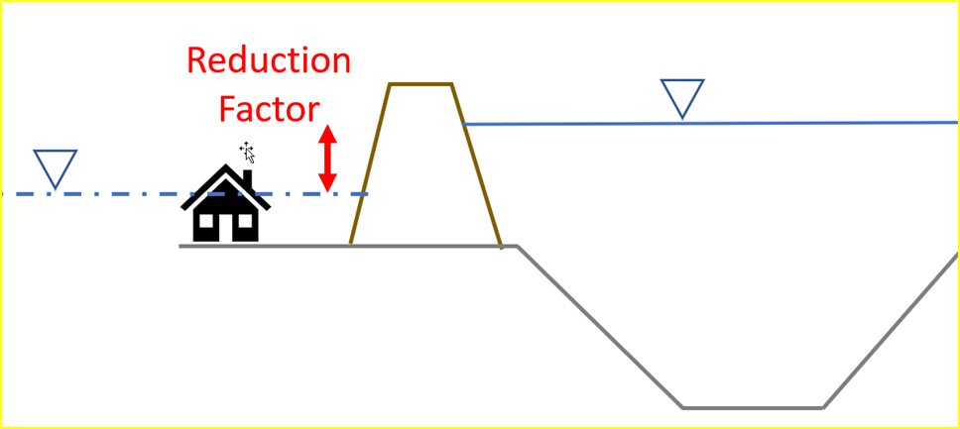

HEC-FIA Without Levee Estimate
Stream Alignment
Regulated
(with levees)
Unregulated
(with levees)
Levee Area

Slide 33

Flood damages reduced in HEC-FIA
  New approach available in HEC-FIA 3.3
  Accepts 4 inundations
  Accepts RAS native HDF results
    No bulky “saved to disk” results
Reg
Unreg
Reg
W/O LEVEE
Unreg
W/O LEVEE

Slide 34
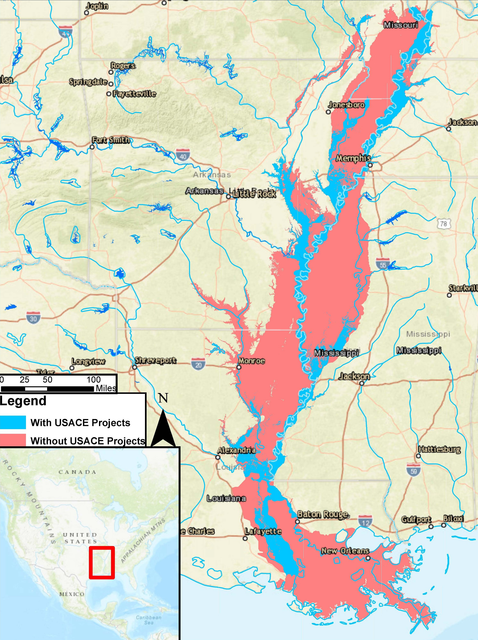
Flood damages reduced in HEC-FIA

Slide 35
Questions
Help additional Training
https://usace.dps.mil/sites/KMP-WM/SitePages/Corps-Water-Management-System-(CWMS).aspx
https://www.hec.usace.army.mil/confluence/cwmsdocs
https://discourse.hecdev.net/c/cwms/5
TDL-CELRH-EC-GW-W-USACE CWMS Modeling | General | Microsoft Teams

