Slide 1
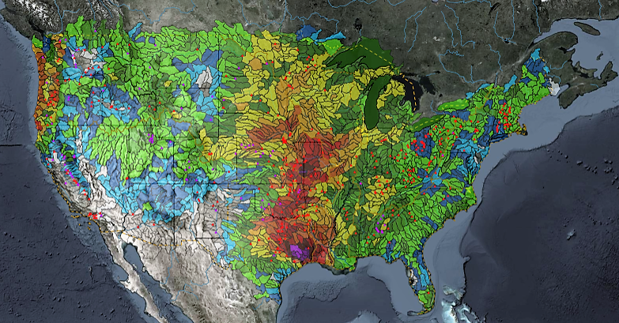
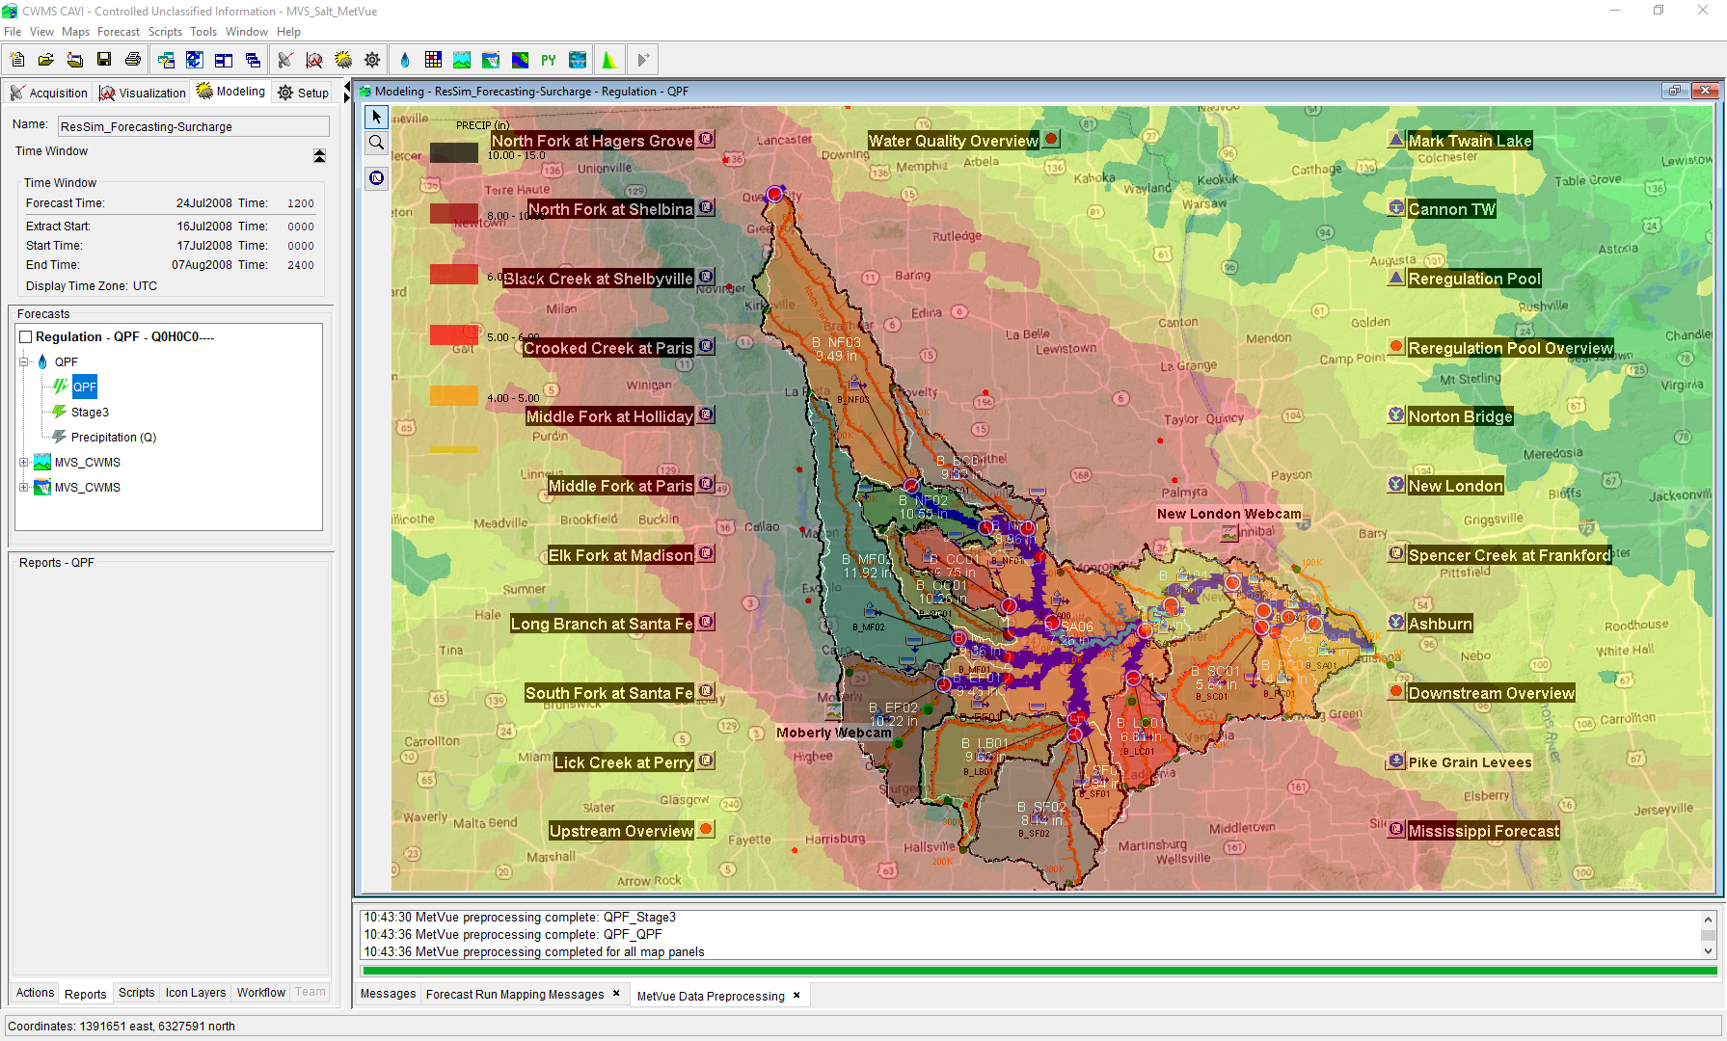

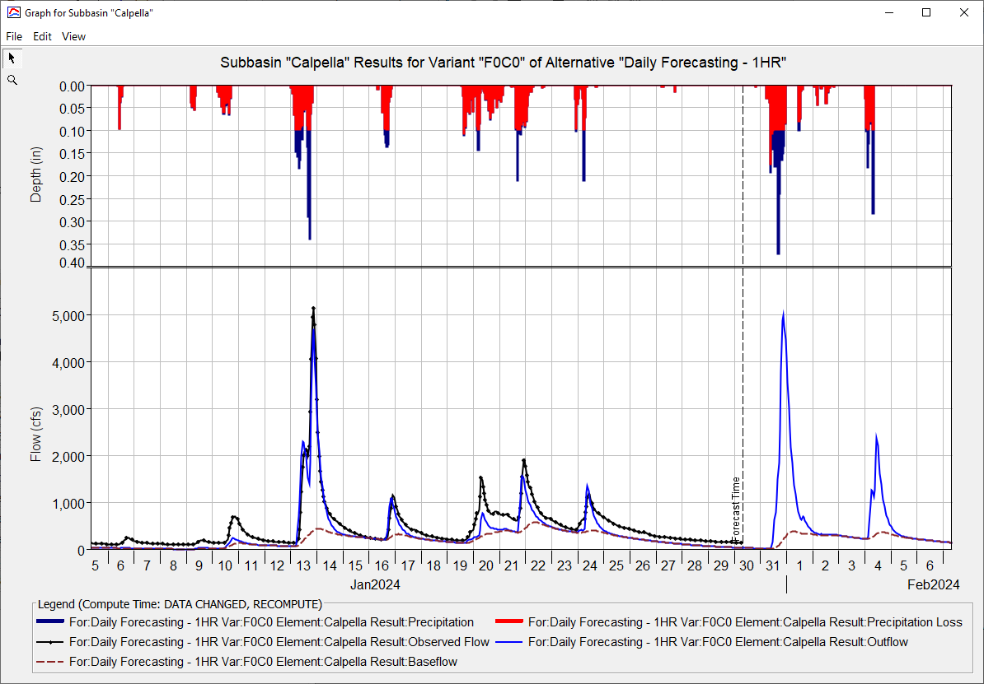
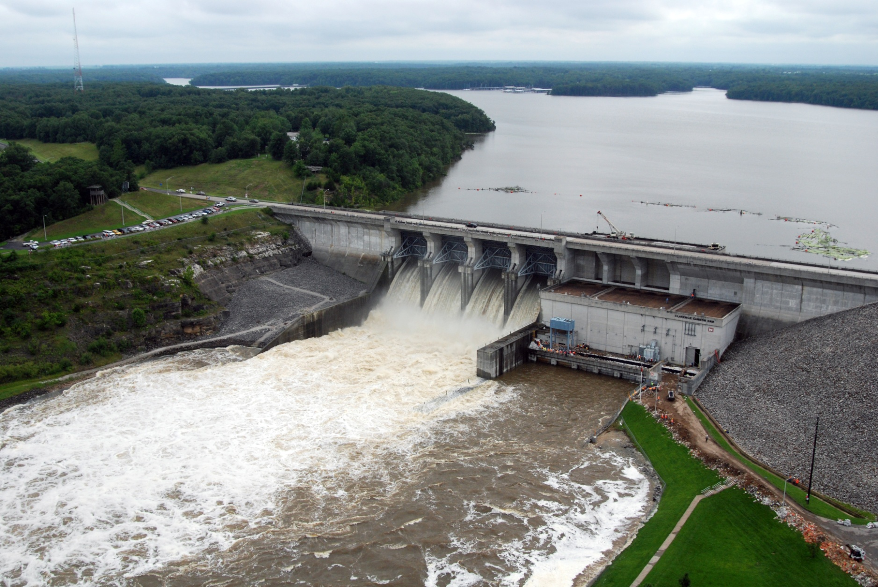
Baltimore District CWMS Real-Time Applications
Simon Evans, P.E., CFM
Hydrologic Engineering Center
CWMS Prospect Course

Slide 2
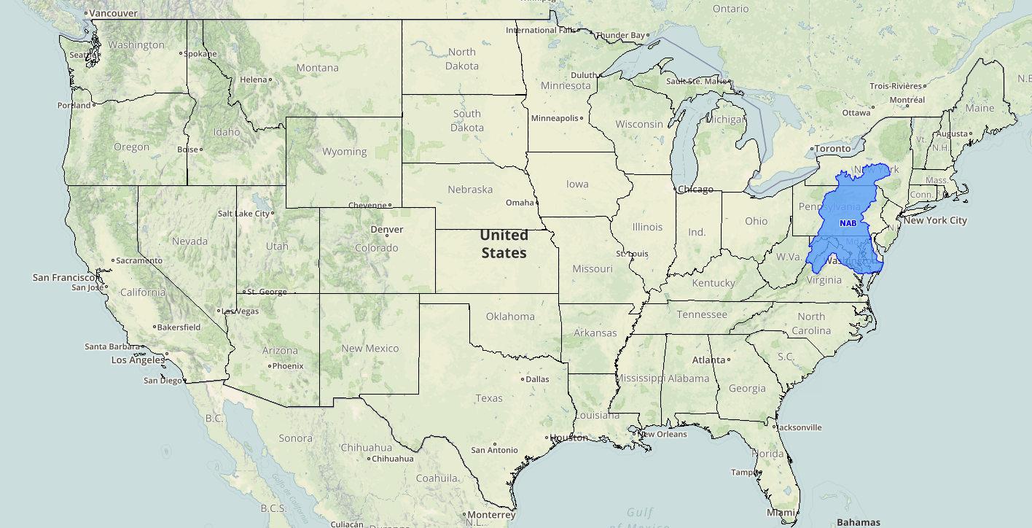
District Background

Slide 3
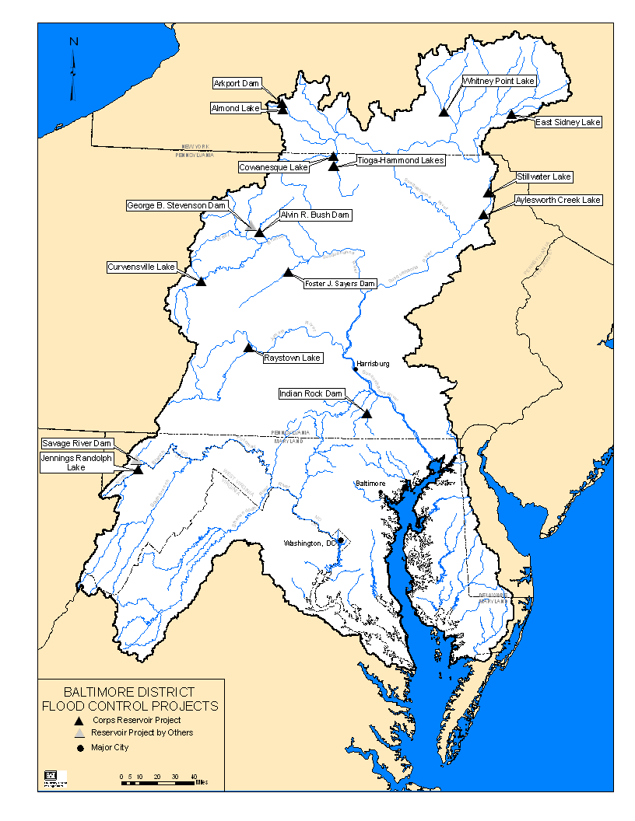
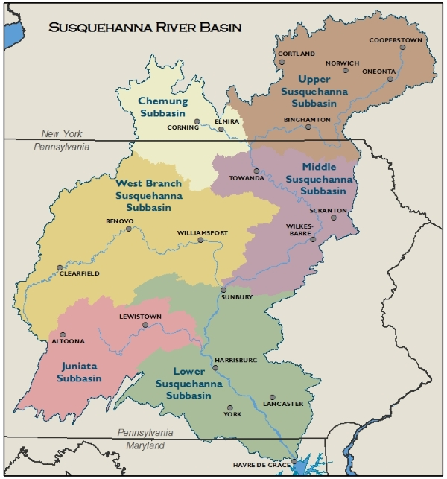
District Background
Two main river systems across five states
Susquehanna River Basin (5 separate watershed models)
Potomac River Basin (1 watershed model)
17 projects
2 are State owned and operated
Project Purposes
Flood Control
Water Quality
Water Supply
Recreation
Hydropower (Non-Federal)

Slide 4
NAB CWMS History
Late 1990’s
NAB one of four sites selected to test the first ever version of CWMS (1997)
The Bald Eagle Creek watershed was selected by HEC for their internal model testing
Goal was to replicate WCDS data validation, storage and visualization
Modeling was not part of the daily reservoir decision making process
Early 2000’s
NAB begins initial CWMS model development (Juniata River Basin)
2010-2020
2013 thru 2018 - Watershed models for NAB developed through the National CWMS Implementation Plan
Began working on model implementation in 2018
Pilot tested the T7 implementation and been on T7 as production server since FY19
Help HEC test various versions of CWMS;
involved since 3.2.1
Last Few Years
Continued daily CWMS modeling
Improved snowmelt modeling in HMS
Improved reporting and frequency of forecasting
Implemented FDR across all watersheds
Refreshed older HEC-RAS models
Currently “GREEN” – but always more to improve

Slide 5
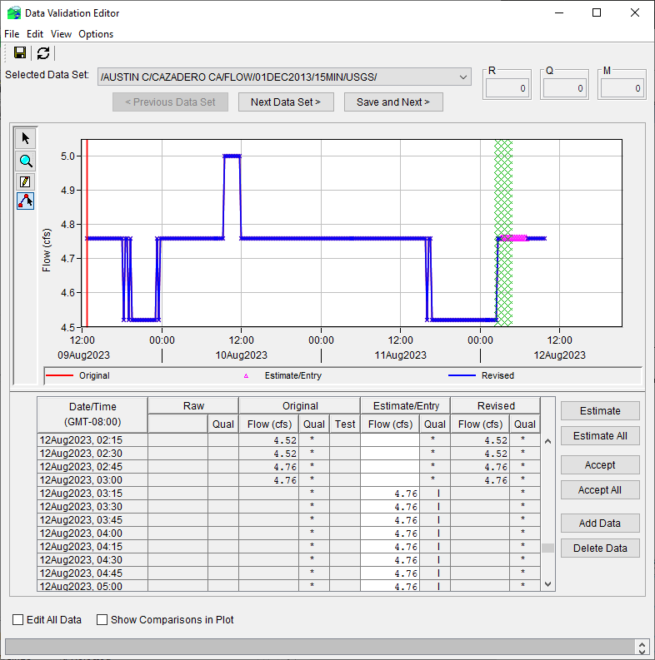
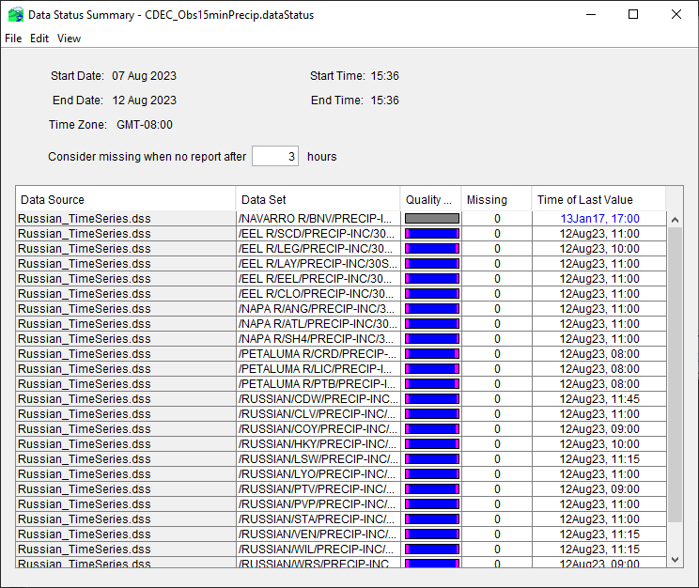
DATA VALIDATION
Group effort
Use Data Status Summary Table and Data Validation Editor from the CAVI
Multiple lists per watershed to focus on critical data to run a forecast

Slide 6
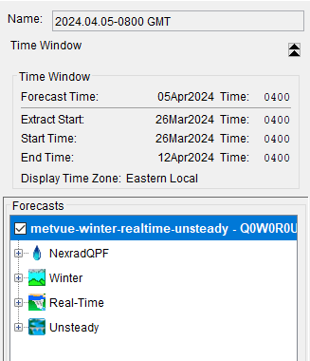
Forecasting Routine
THE GOAL (non-flood) → Run a watershed 3 days a week between 2 modelers → Each model gets run once a week
Start a forecast
calibrate
overrides
Start a forecast
calibrate
overrides
1
2
3
1
2
3
Start new forecast every day
Pick a time window
Lookback important!
How long is your forecast?
Extract data
Is data available for the extent selected?
Multiple extract lists available
Separate list for snow parameters

Slide 7
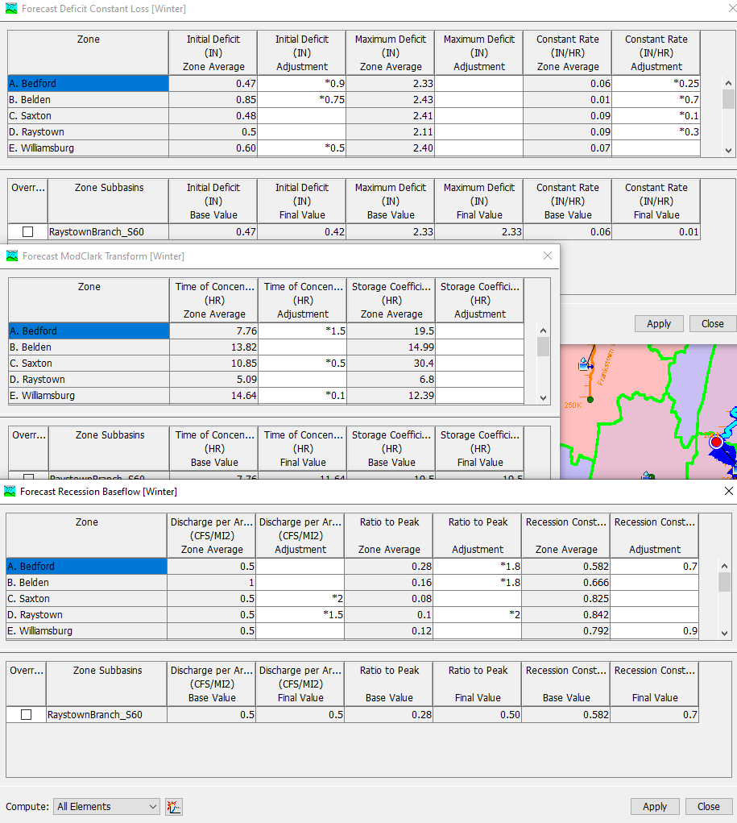
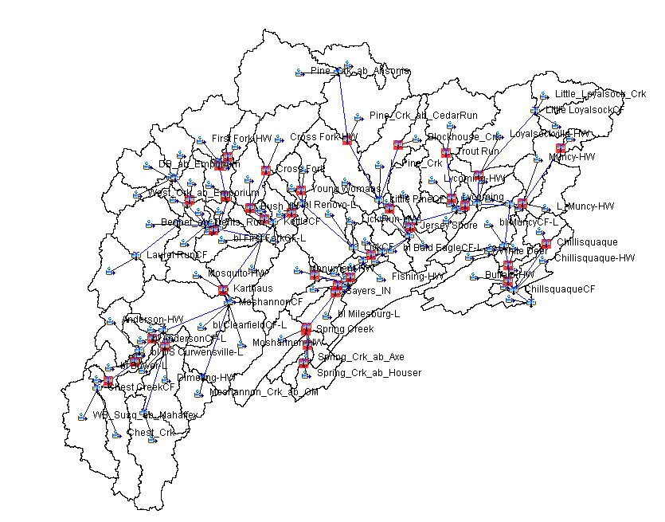
Forecasting Routine
THE GOAL (non-flood) → Run a watershed 3 days a week between 2 modelers → Each model gets run once a week
Start a forecast
CALIBRATE
overrides
2
overrides
1
3
3
Constantly re-calibrating
Watersheds are flashy and events move through over the course of several days
All six models have snow-melt forecasting capabilities
Share the .forecast file in HMS between modelers
Watershed/hms/forecast/.forecast
Challenges:
Calibrating after long dry periods
Gage availability

Slide 8
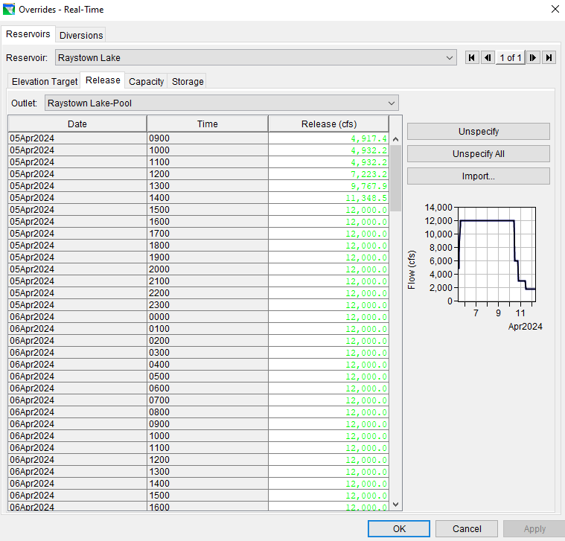
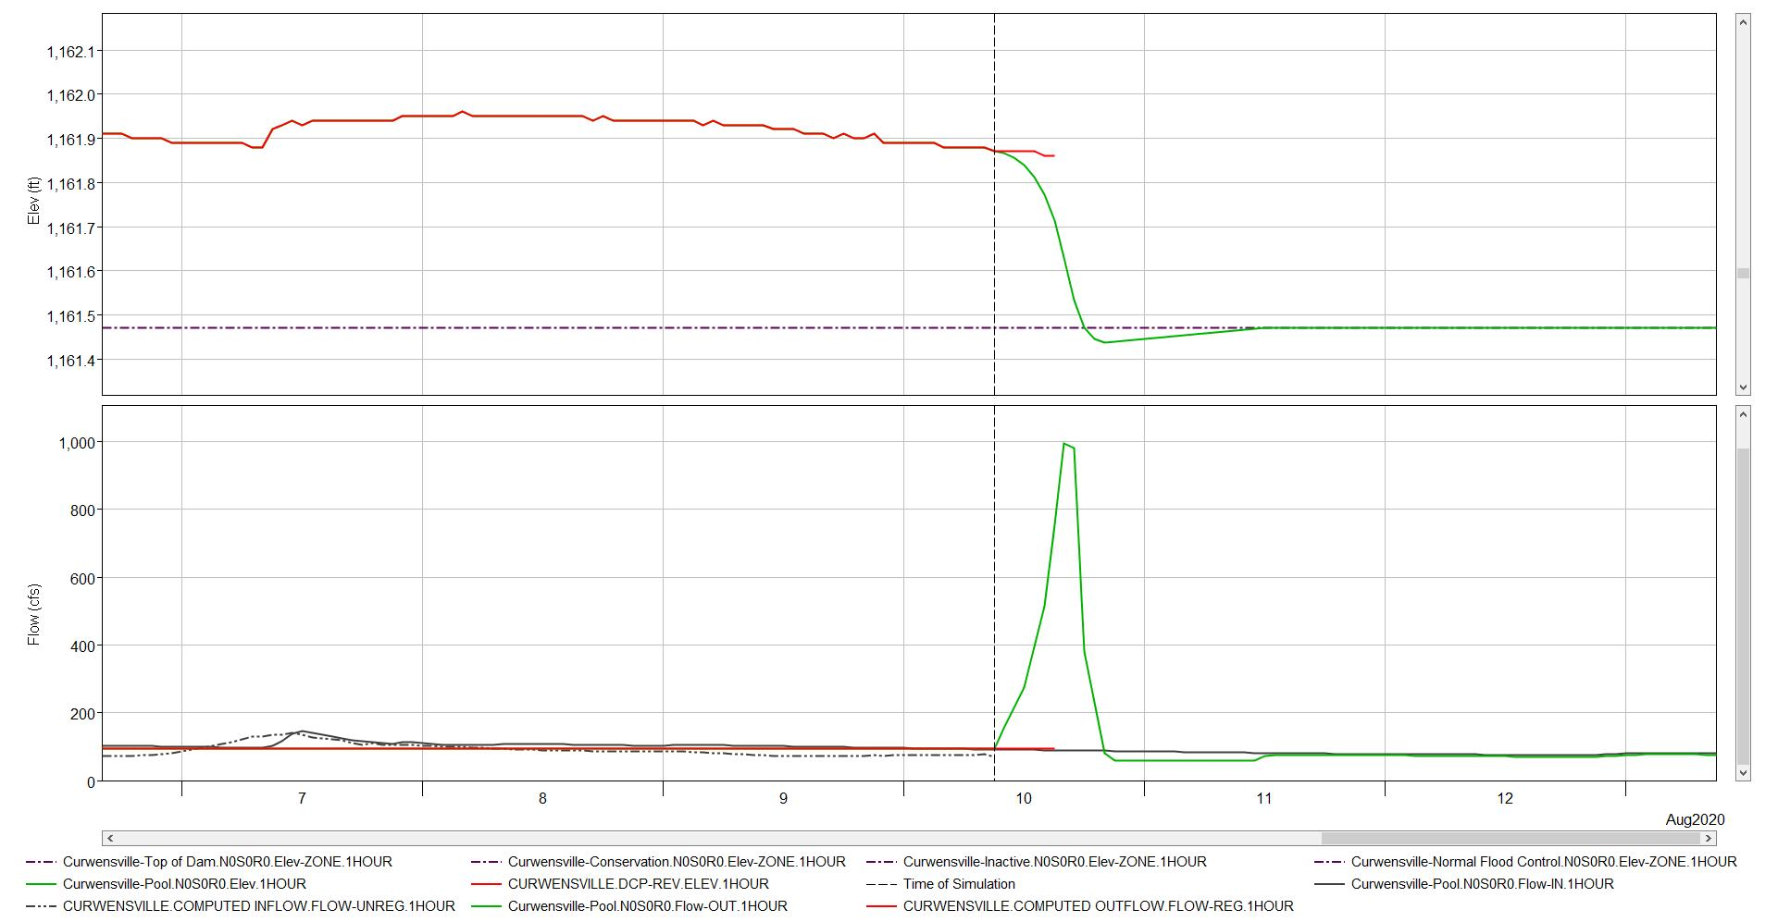
Forecasting Routine
THE GOAL (non-flood) → Run a watershed 3 days a week between 2 modelers → Each model gets run once a week
Start a forecast
calibrate
overrides
1
2
3
Most common reasons for overrides needed:
Lake levels allowed to be maintained higher than conservation pool
Recreational releases are not included in ResSim
Adjusting flow changes to a daily adjustment instead of hourly
Importance of these changes:
Removing incorrect spikes in reservoir outflow
Realistic releases are important when lake elevation predictions are needed

Slide 9
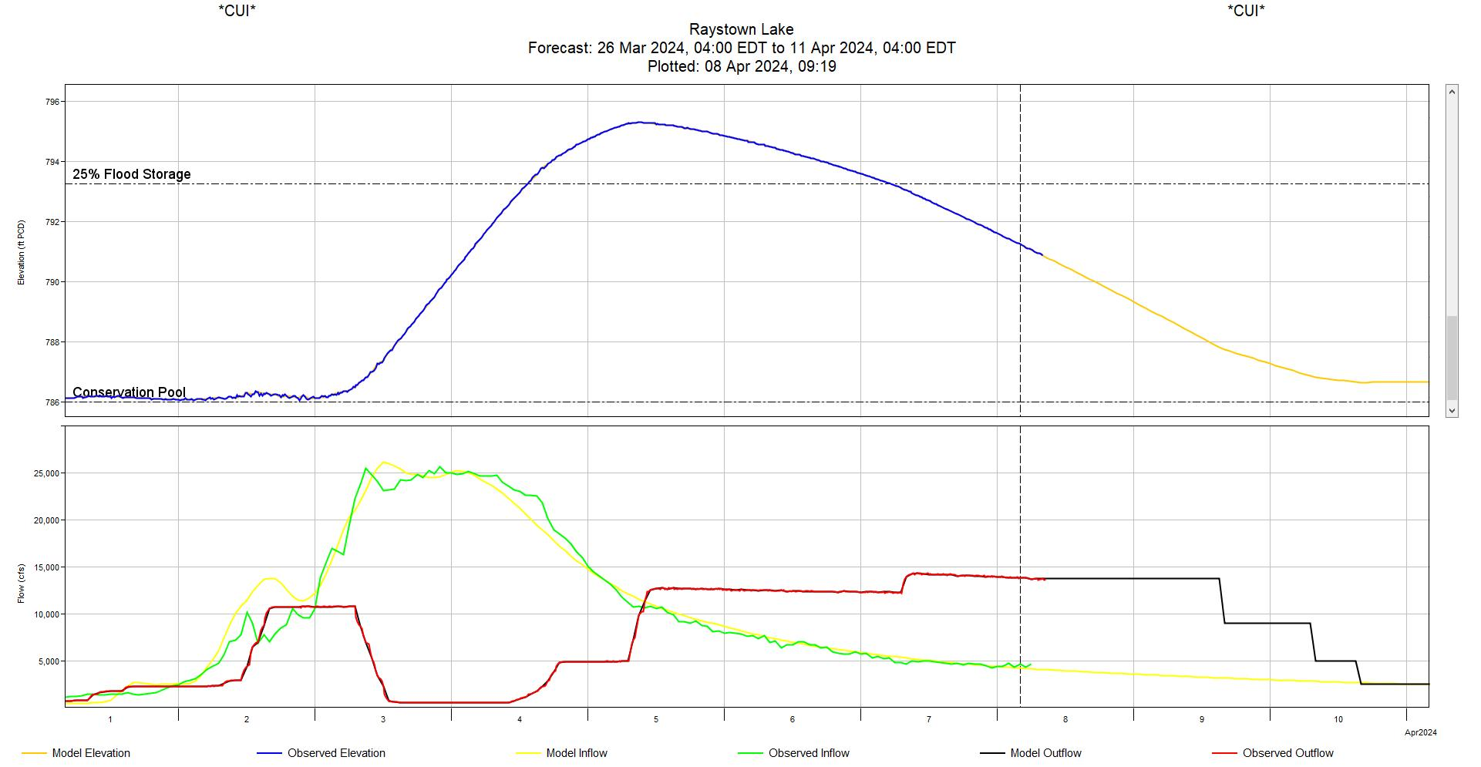
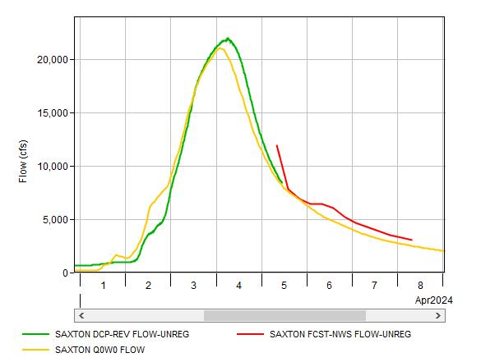
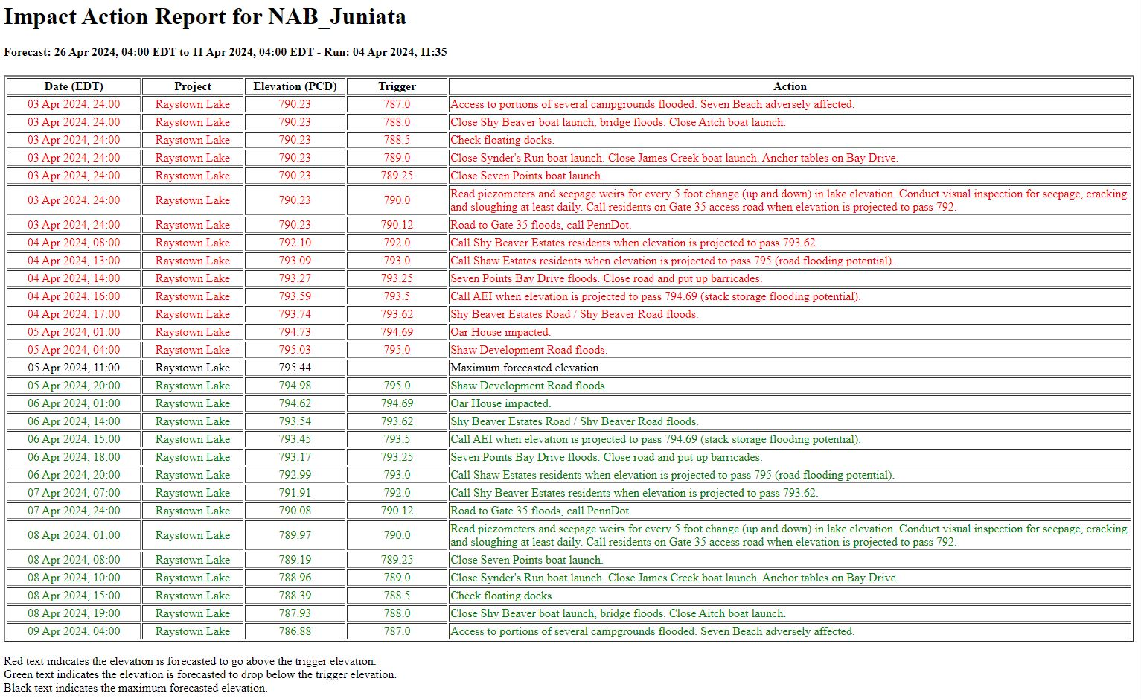
Forecast Products
RESERVOIR PLOTS
AHPS COMPARISON PLOTS
IMPACT ACTION TABLE
Scripted to follow a specific template we prefer and familiar with
Provides lake elevation forecast
Provides forecasted flow regime
Typically, either a 3-day, week or two-week lookout
Extract AHPS forecasts into forecast.dss file
Share comparison with water managers to help convey how reliable the forecast might be
A script run from the CAVI
Lists all actions at the project needed at a specific elevation
Red actions are on the rising side, green actions are on the falling side
Lists the max elevation within the forecast window

Slide 10
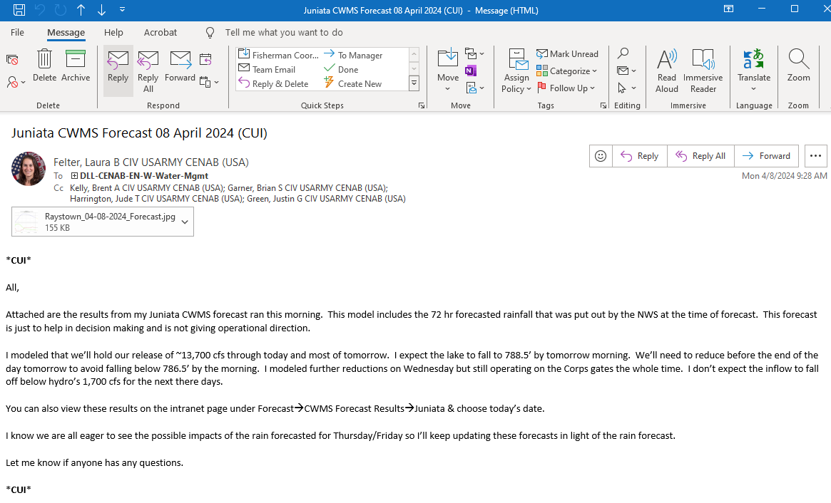
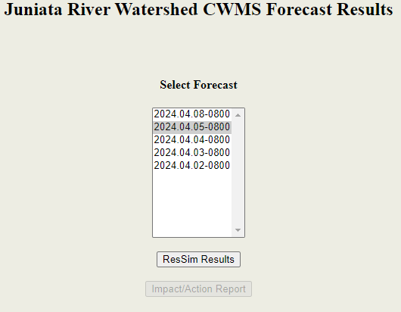

Sharing Forecasts
Email forecast narrative
Caveats, assumptions, overrides, and plots
Send to water management staff, dam operators, project managers, and Geotech staff
Send separately to Emergency Management staff
Post forecast results to internal water management page
+
=

Slide 11
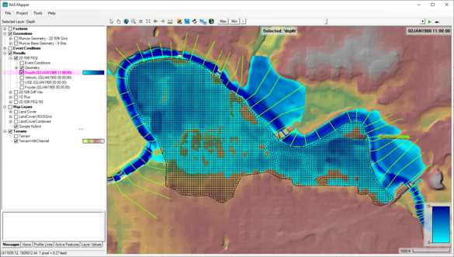
Inundation Mapping + HEC-FIA
HEC-RAS computed when needed during events – less frequently than the other models
Inundation mapping produced and upload to FIM based on District determined thresholds
FIA – not run during a forecast but used after events to calculate Flood Damages Reduced

Slide 12
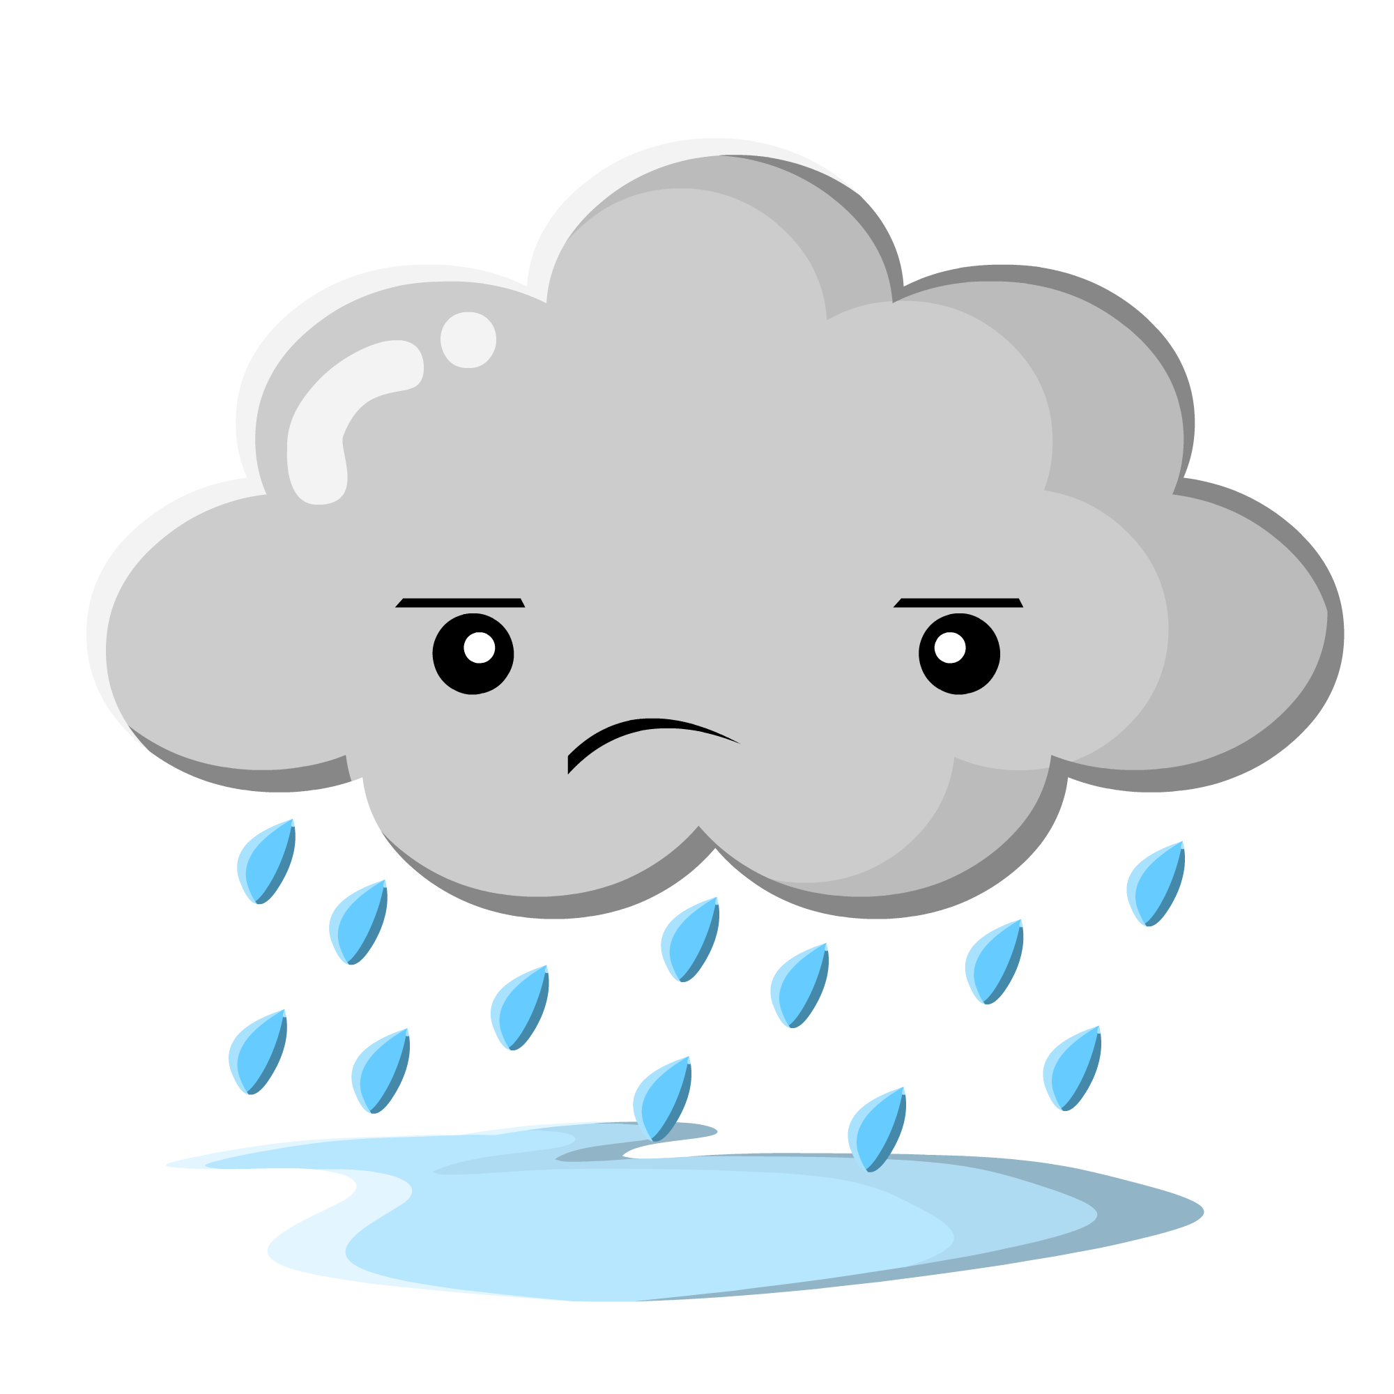
Challenges
Time & availability to run models frequently
enough when balancing other responsibilities
Training other Water Managers to run forecasts
During an event we currently only have two proficient modelers
Four of our watershed models flow into a fifth model
Have to pass model results from the 4 into the 5th.
This also effects our ability get holdouts at all locations in the watershed in order to properly assign benefits to projects that affect multiple sub watersheds.

Slide 13
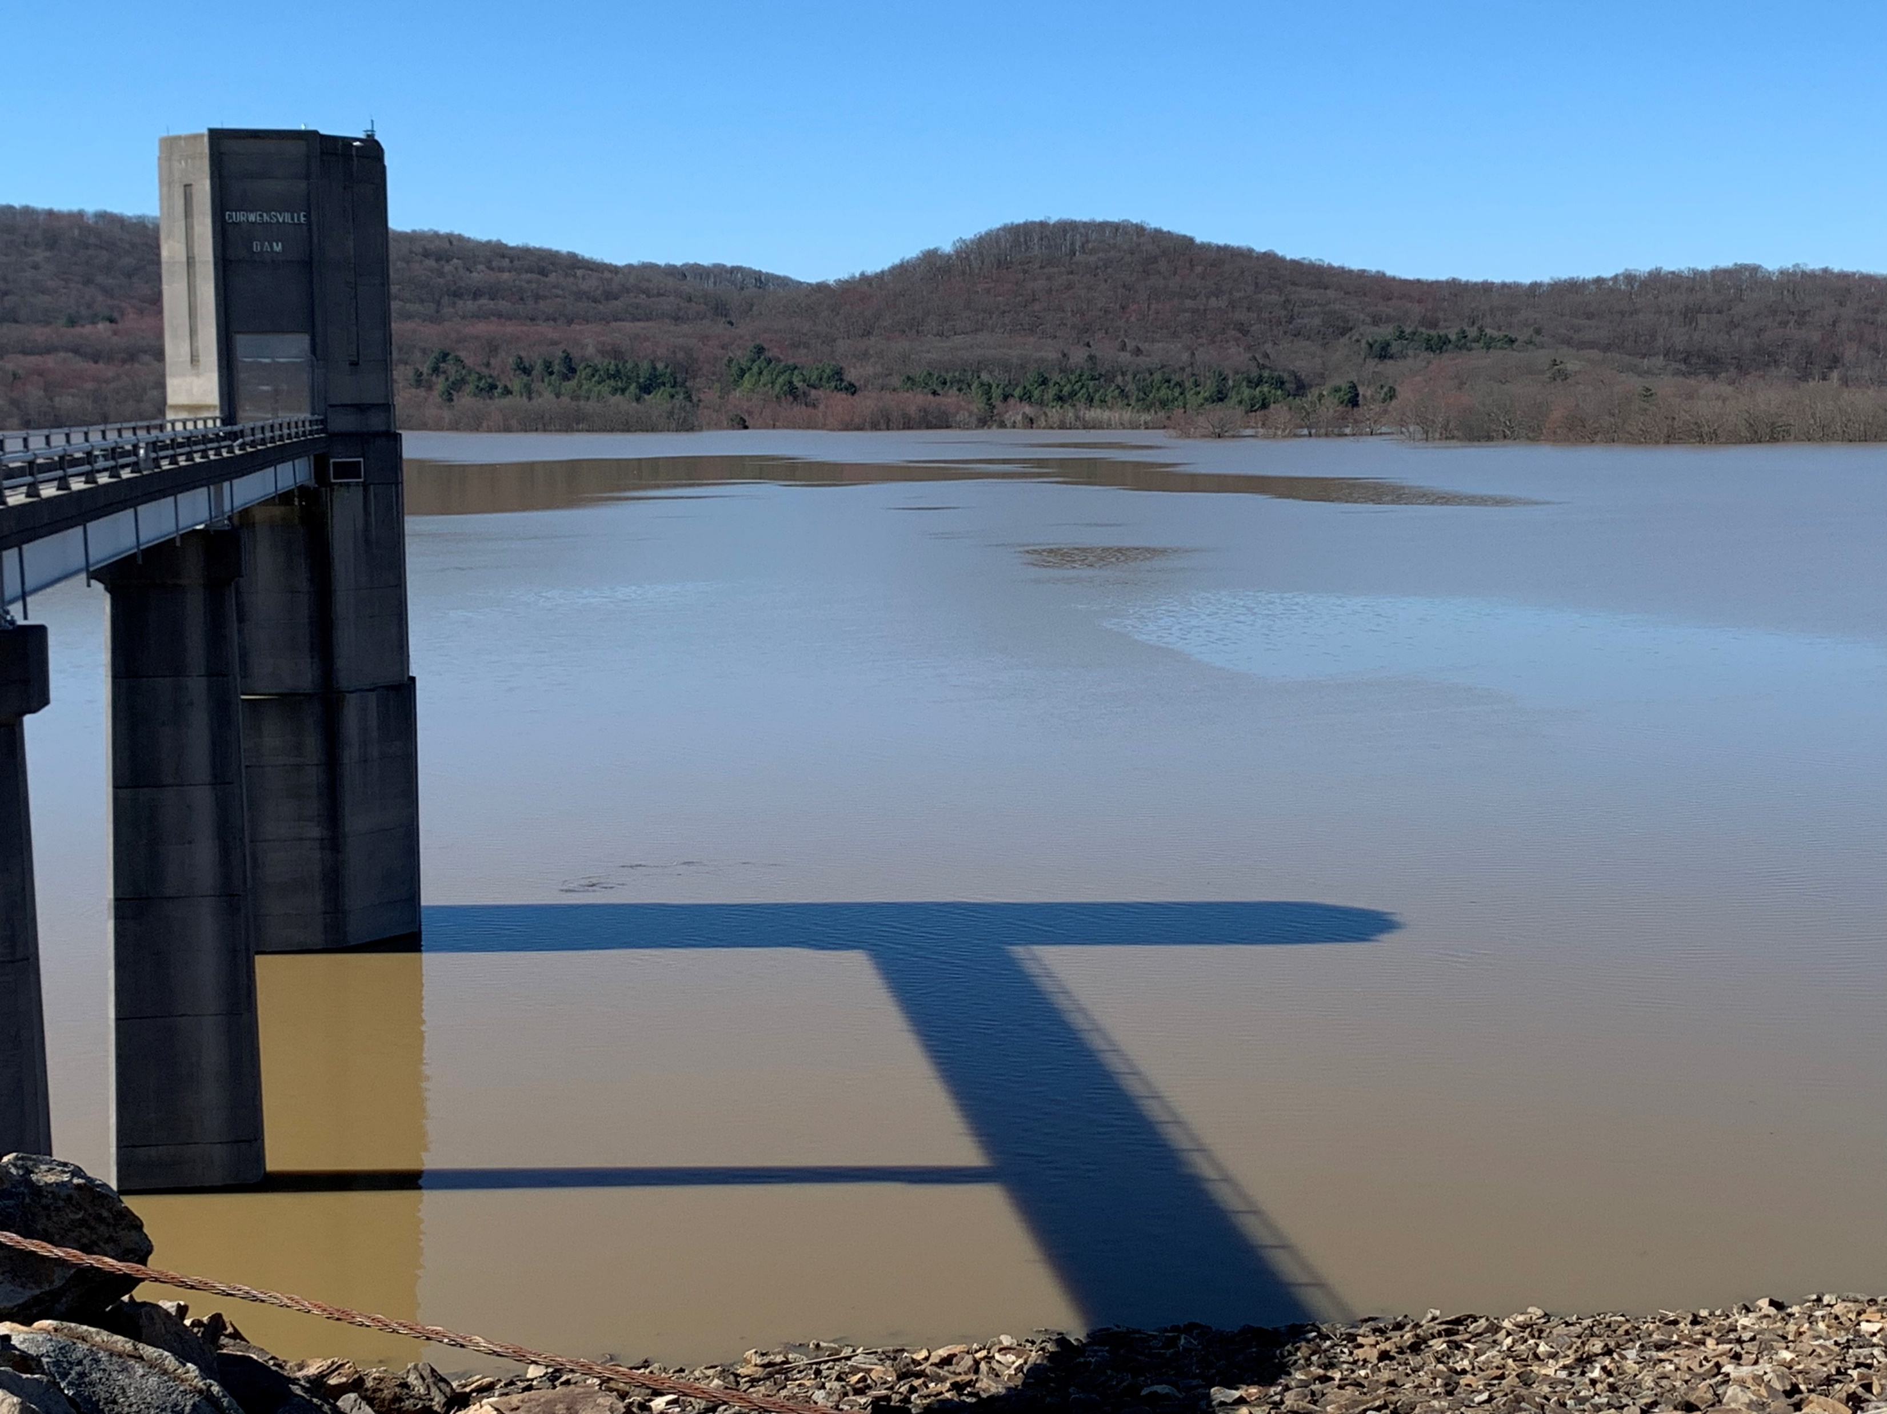
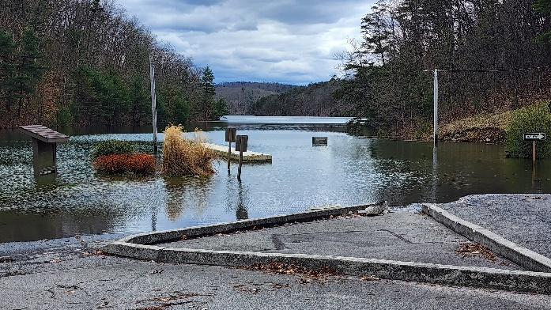
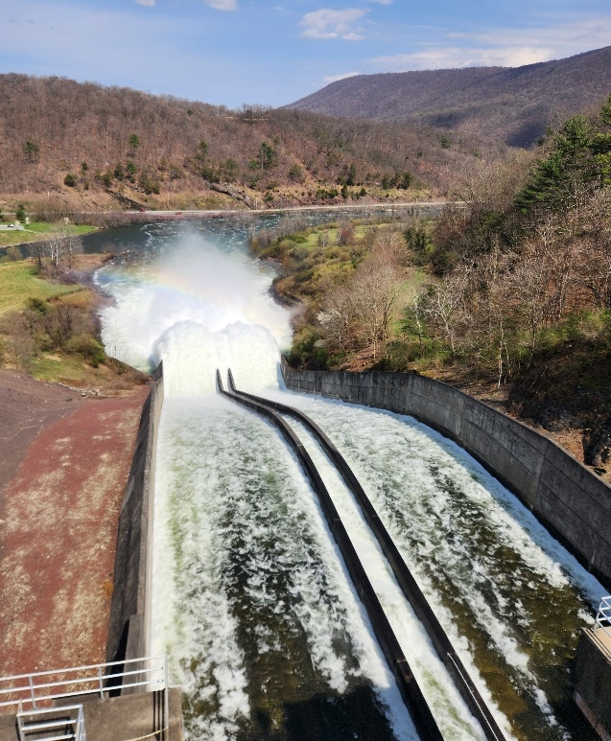
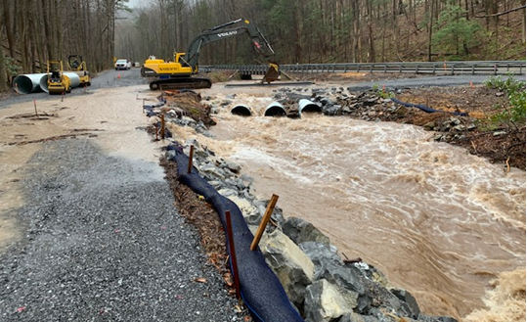
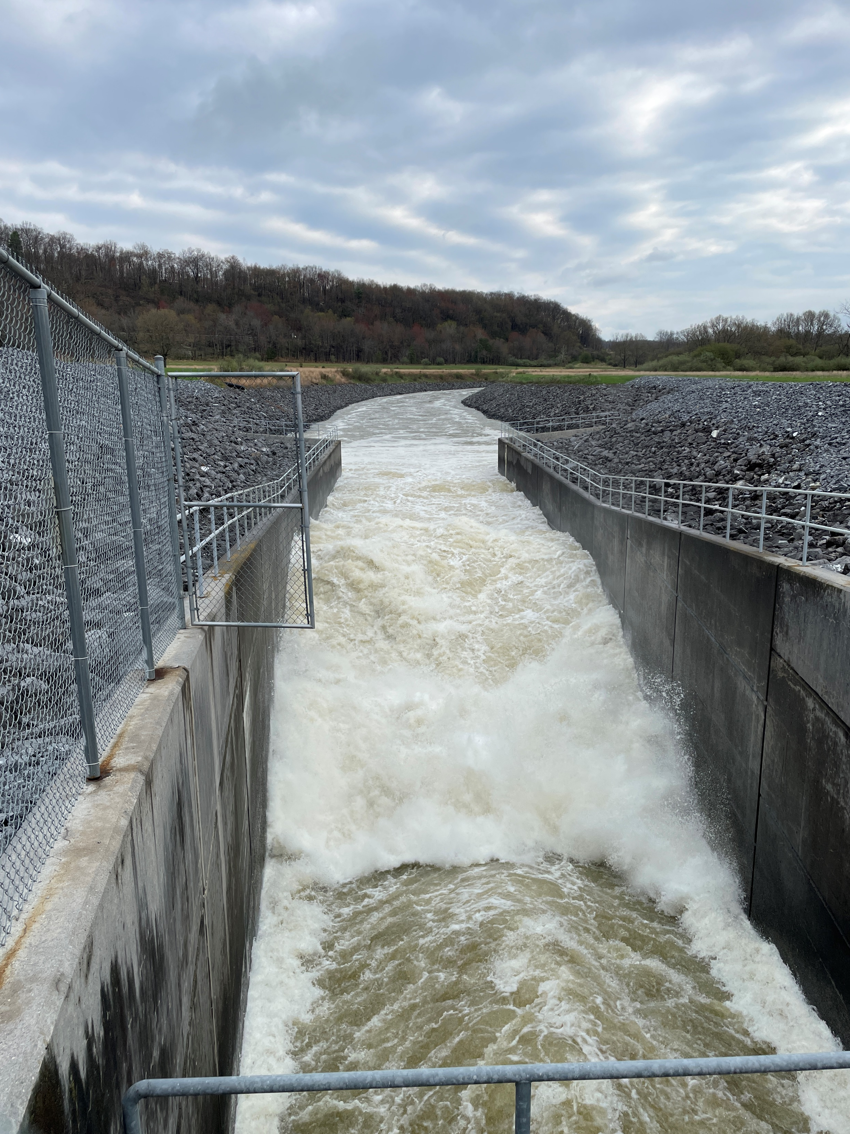
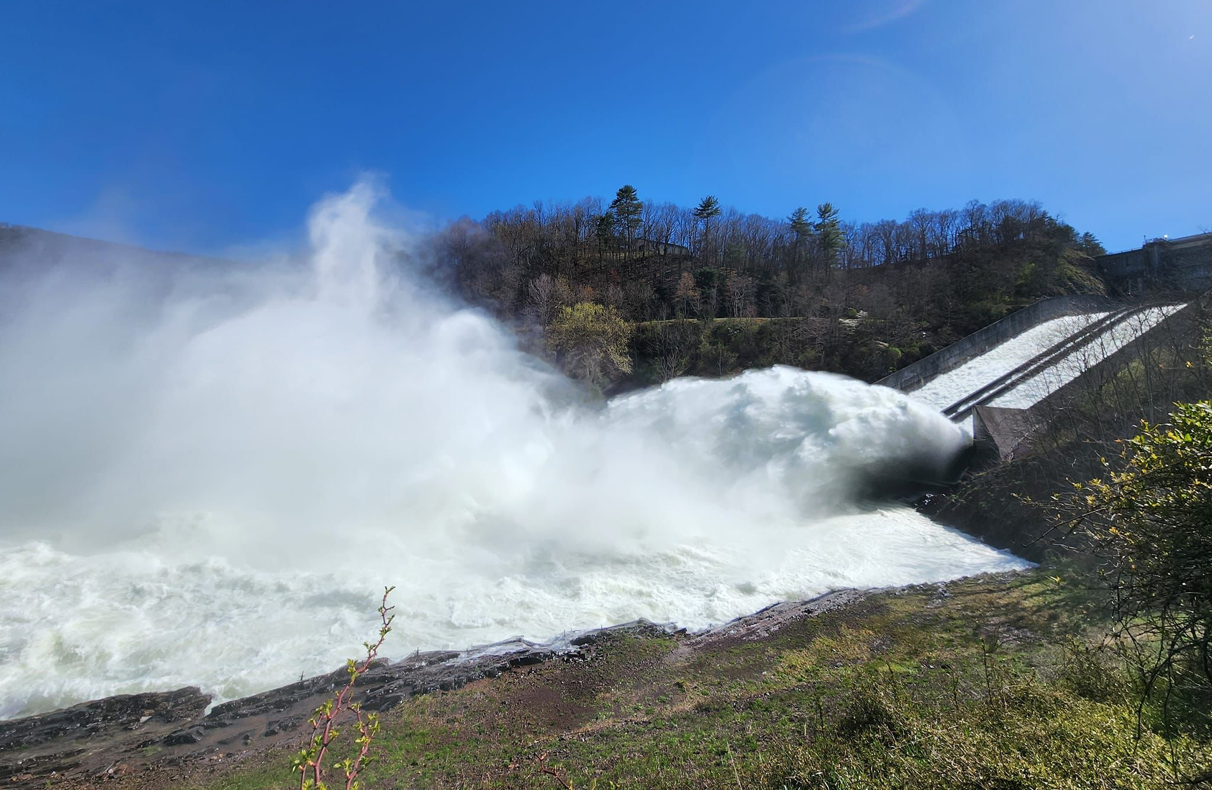
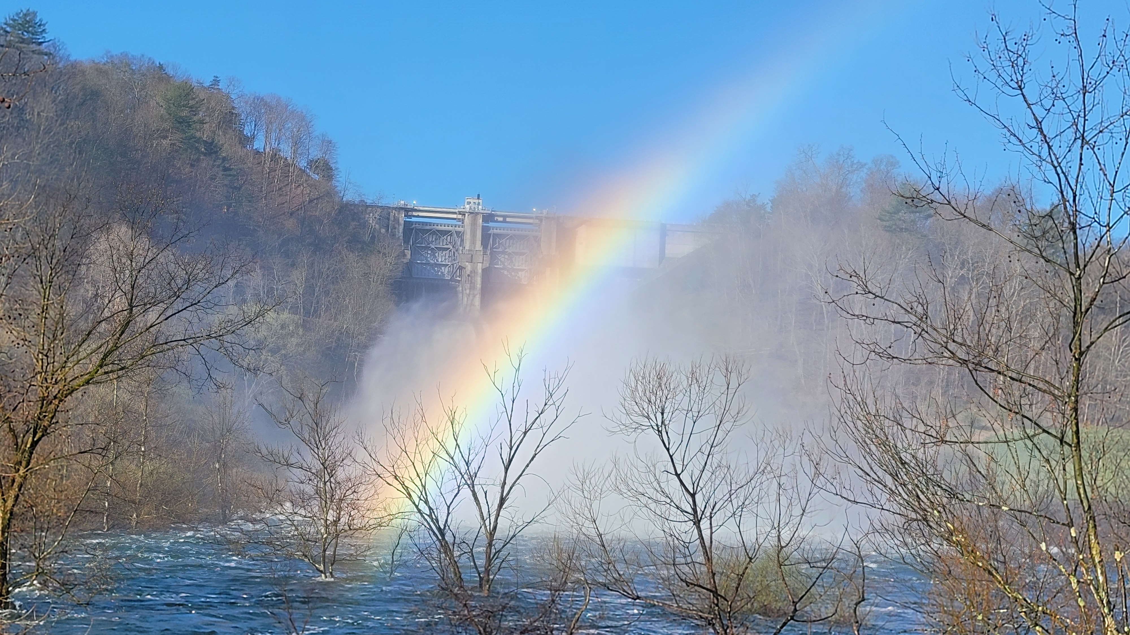
APRIL 2024 FLOOD EVENT 4-5” or rainfall over 4 days
Curwensville Lake
peaked at 51% flood storage used
43’ high (57,500 ac-ft)
3rd highest pool of record
Release = ~4,000 cfs
Release = ~13,000 cfs
Raystown Lake
peaked at 40% flood storage used
20’ high (154,400 ac-ft)
7th highest pool of record

Slide 14
Questions Help additional Training
https://usace.dps.mil/sites/KMP-WM/SitePages/Corps-Water-Management-System-(CWMS).aspx
https://www.hec.usace.army.mil/confluence/cwmsdocs
https://discourse.hecdev.net/c/cwms/5
TDL-CELRH-EC-GW-W-USACE CWMS Modeling | General | Microsoft Teams

