Slide 1
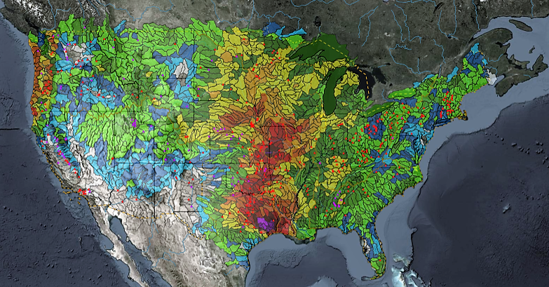
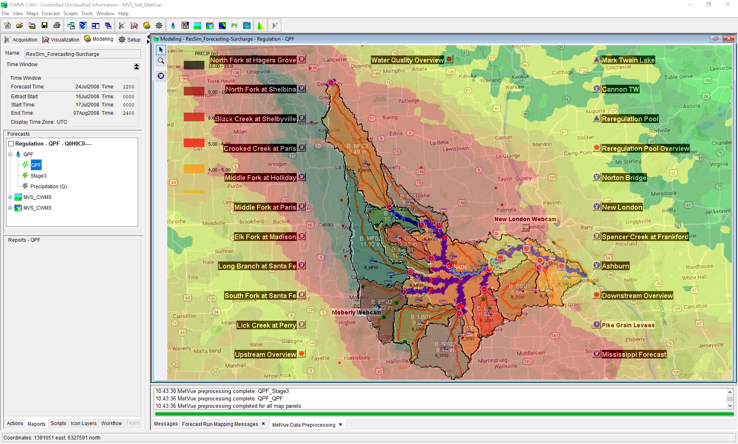

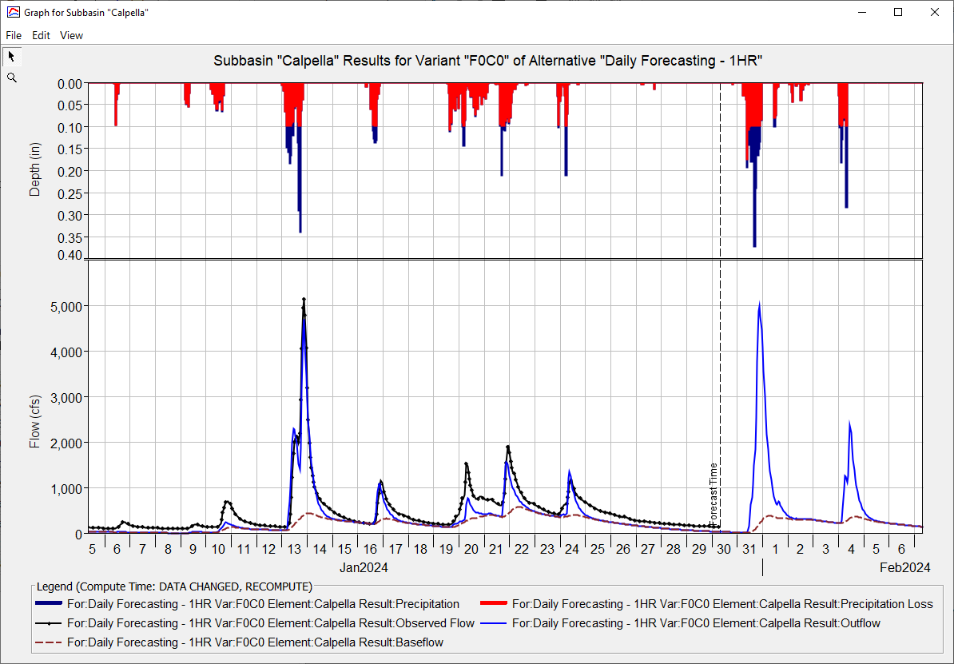
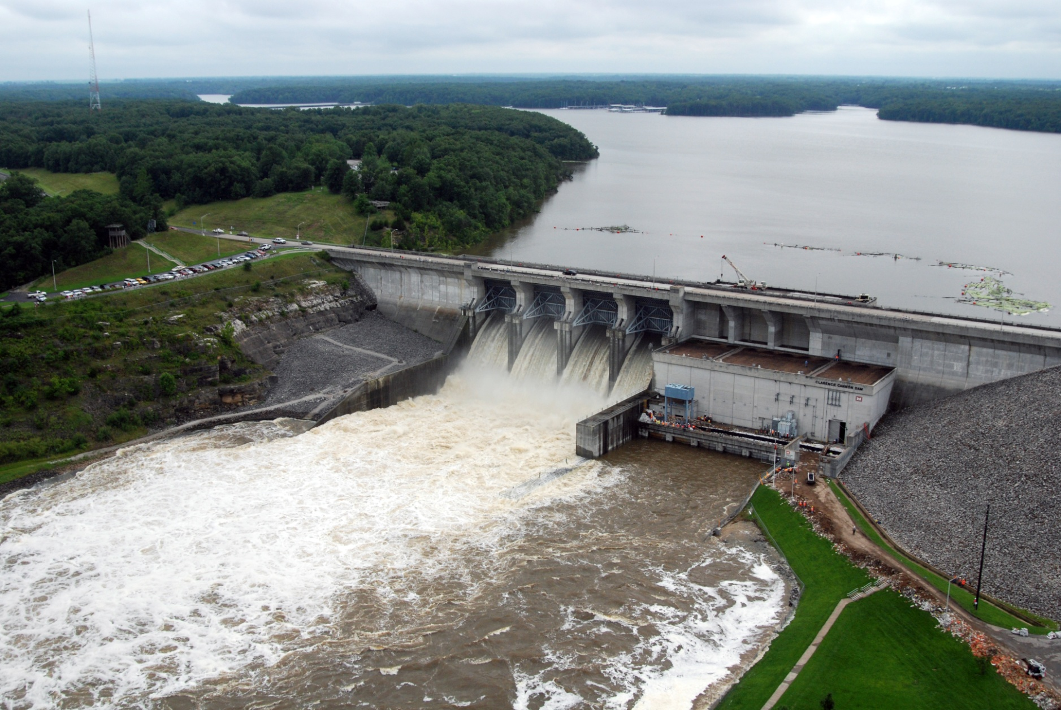
HEC-FIA for CWMS
Simon Evans, P.E., CFM
Hydrologic Engineering Center
CWMS Prospect Course
HEC-FIA Overview

Slide 2
Objective
Identify basic concepts of using HEC-FIA to estimate potential flood impacts in real-time

Slide 3
Outline
What is HEC-FIA and its purpose in CWMS?
What are the inputs to HEC-FIA?
What are the damage computations in HEC-FIA?
What are the various reports available in HEC-FIA?
Brief introduction to Flood Damages Reduced calculations in HEC-FIA

Slide 4

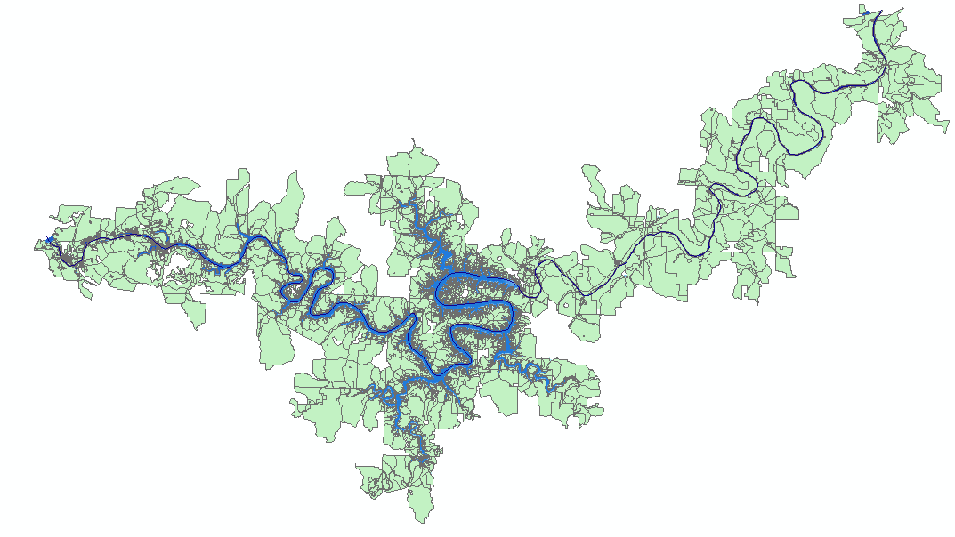
What is HEC-FIA?
Hydrologic Engineering Center – Flood Impact Analysis
HEC-FIA is a single event software package
HEC-FIA calculates structure losses, indirect economic losses, direct economic losses, life loss, impact/responses, and agriculture losses
.
.
.
.
.
.
.
.
.
.
.
.
.
.
.
.
.
.
National Structure Inventory
.
.
NASS

Slide 5
Why should we include FIA in CWMS?
What was the original purpose for the creation of USACE?
Why was the purpose changed?
How does that impact Water Managers?
If we reduce stage by 1 foot at a gage, how much difference does it make?

Slide 6
Questions Help additional Training
https://usace.dps.mil/sites/KMP-WM/SitePages/Corps-Water-Management-System-(CWMS).aspx
https://www.hec.usace.army.mil/confluence/cwmsdocs
https://discourse.hecdev.net/c/cwms/5
TDL-CELRH-EC-GW-W-USACE CWMS Modeling | General | Microsoft Teams

