Slide 1
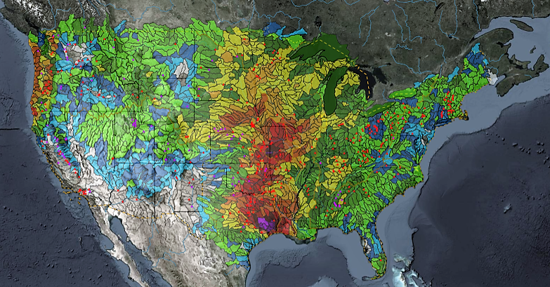
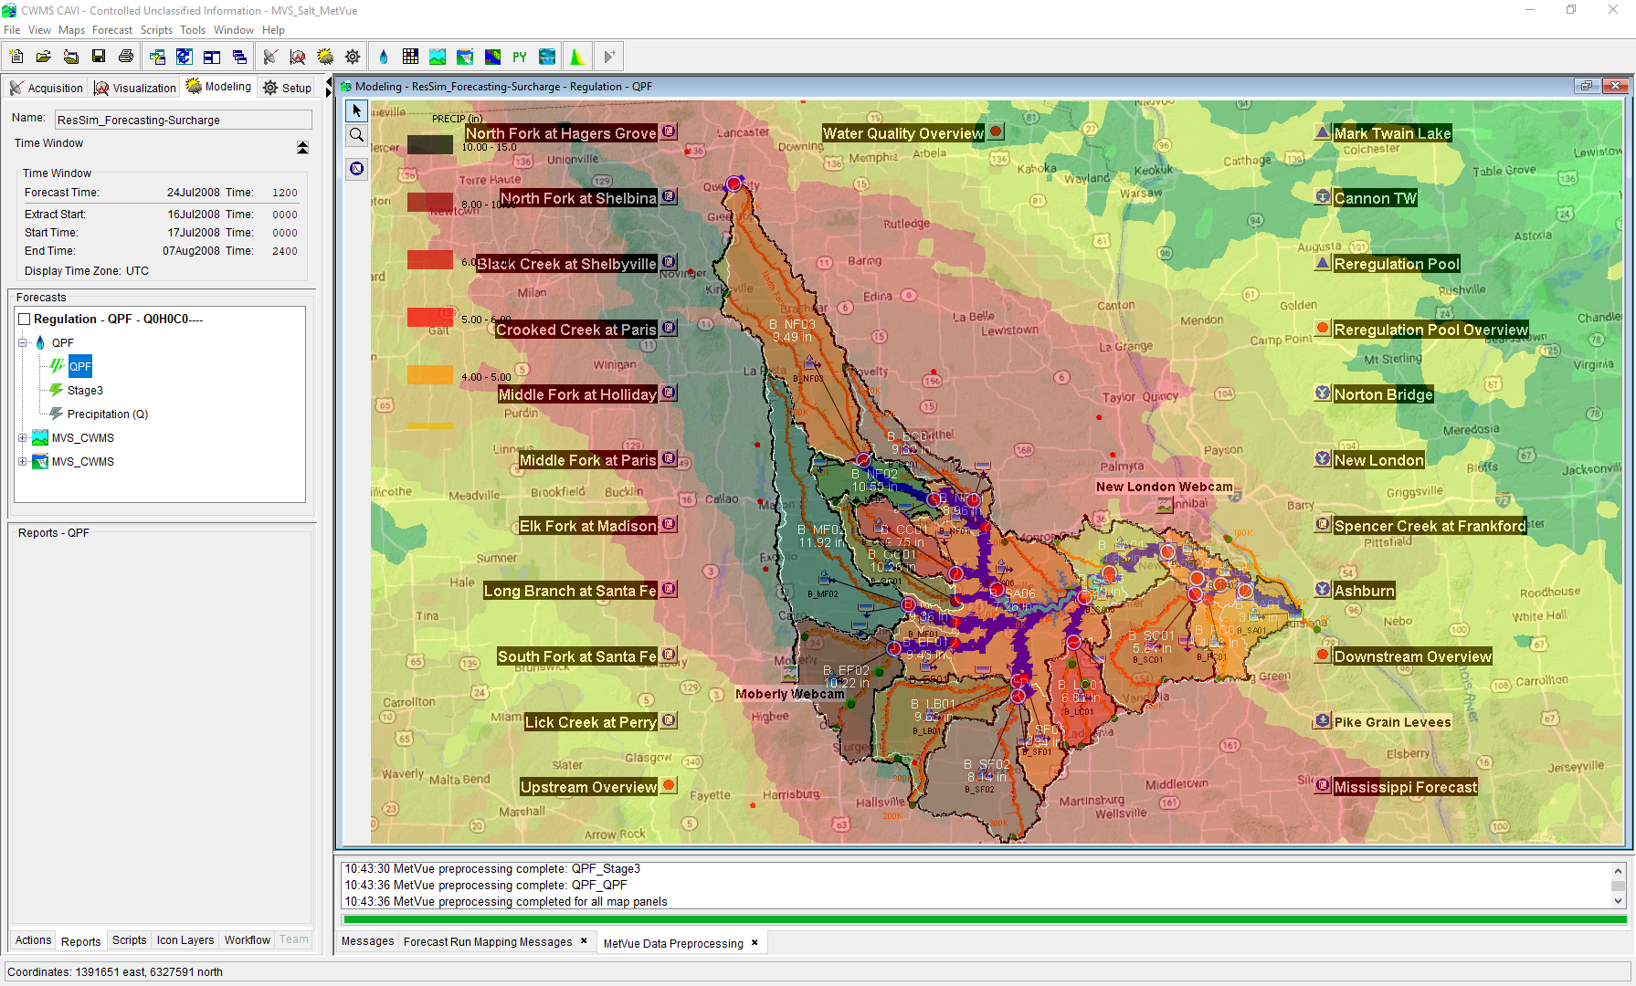

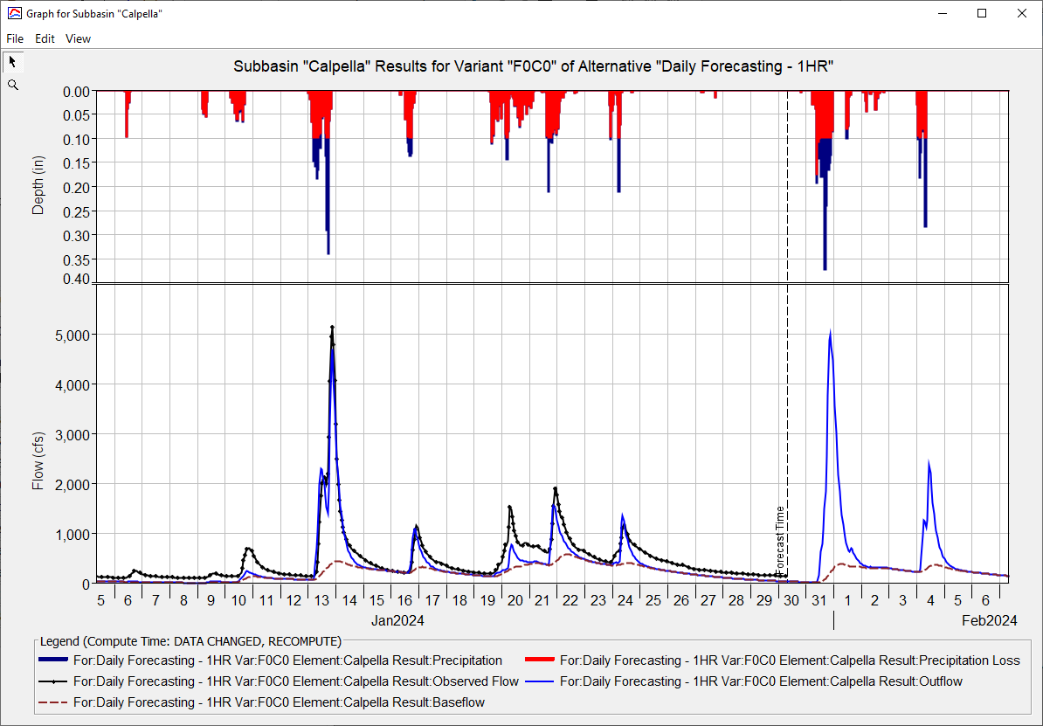
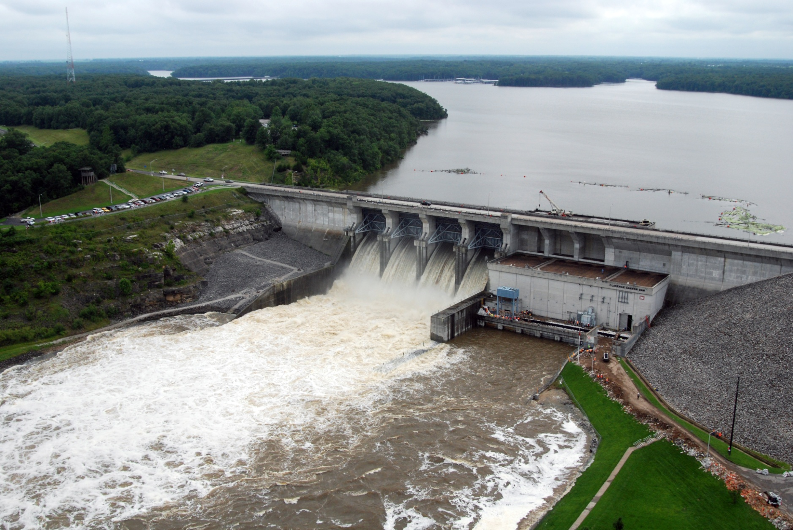
HEC-FIA for CWMS
Simon Evans, P.E., CFM
Hydrologic Engineering Center
CWMS Prospect Course
HEC-FIA Inputs

Slide 2
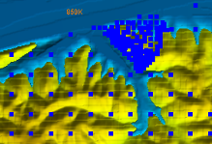
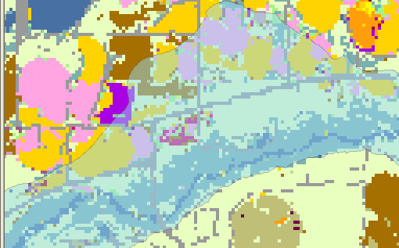
Economic inputs
  Spatially referenced structure inventory (no more aggregated index points)
  Spatial agriculture data
  Data to support calculations
    Damage functions
    Crop types and growing trends
    Population information

Slide 3
National Data sources
  Always ask for better data from the District
    Agriculture Data
      National Agriculture Statistical Survey
      Crop Production functions from state or local sources
    Structure Data
      National Structure Inventory/HAZUS Import
    Terrain Data
      Same as HEC-RAS

Slide 4
Hydraulic Inputs
  HEC-ResSim Output
    HEC-DSS Flow Hydrographs at Common Computation Points
    HEC-DSS Stage Hydrographs at Common Computation Points
  HEC-RAS Output
    HEC-DSS Stage Hydrographs at Cross Sections (Unsteady RAS)
    HEC-DSS Stage at each Cross Section (Steady RAS)
    Gridded Data
      Maximum Depth
      Arrival time of inundation
      Duration
      Max Depth times Velocity

Slide 5
The Hydrograph
Arrival
Time
Stage
Duration
Max Depth
Important Threshold
Time (t)

Slide 6
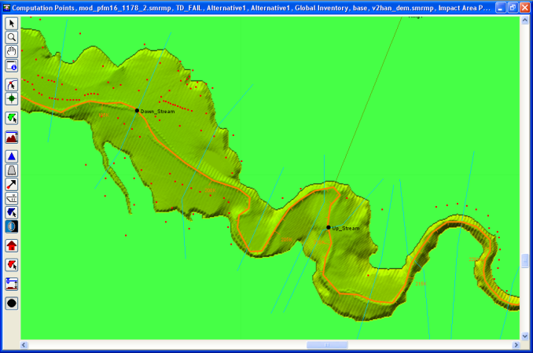
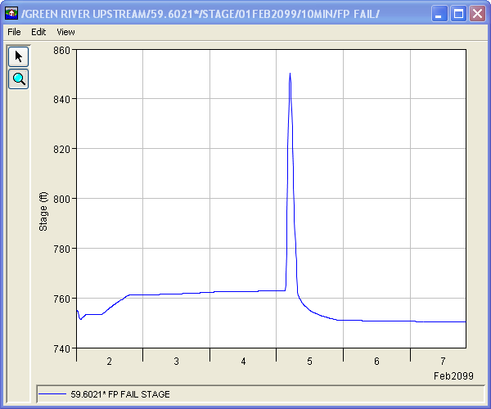
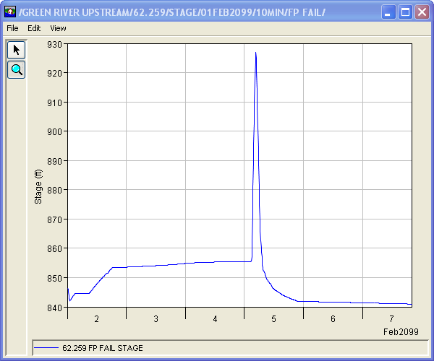
How do stage hydrographs work?
925 ft
847 ft

Slide 7
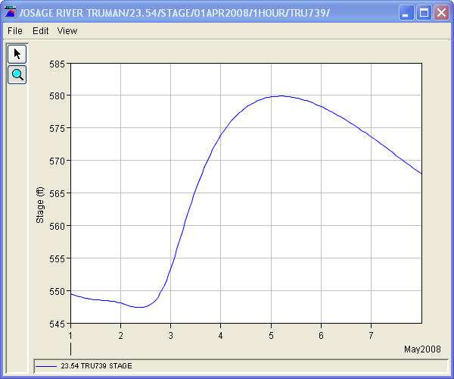
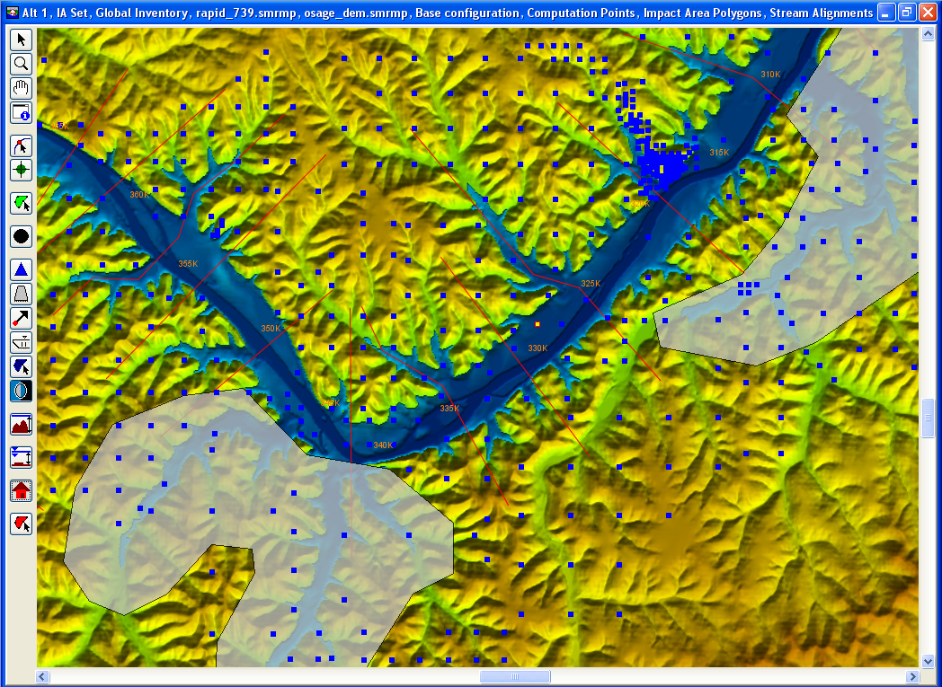
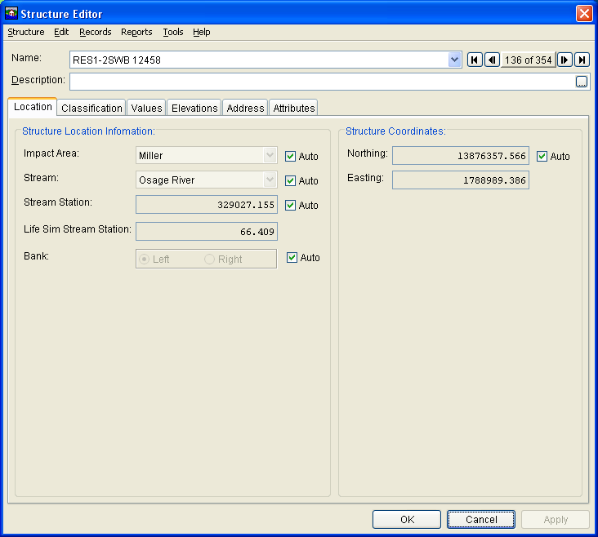
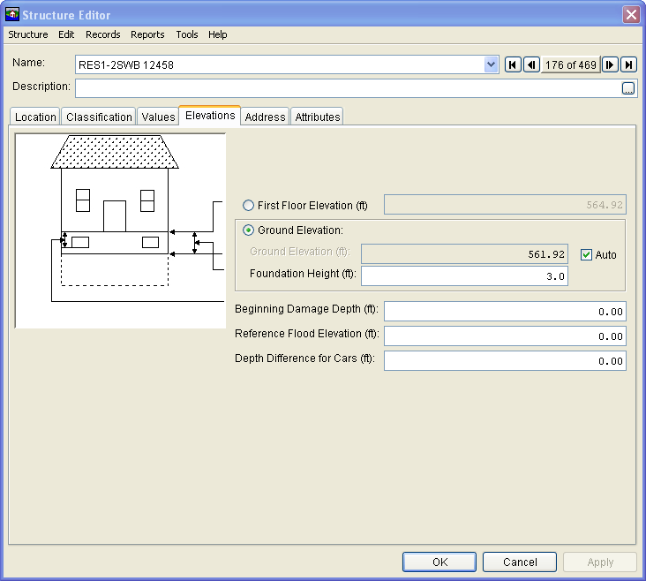
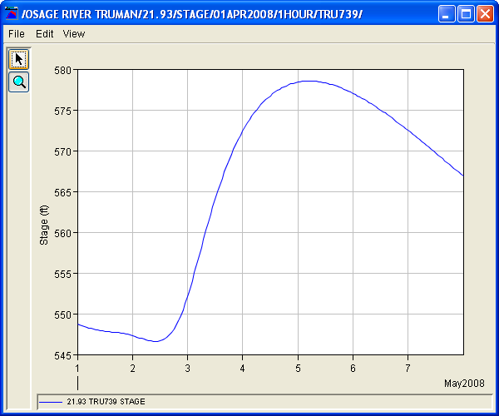
Cross-section Hydrographs

Slide 8
Storage Area Hydrographs

Slide 9
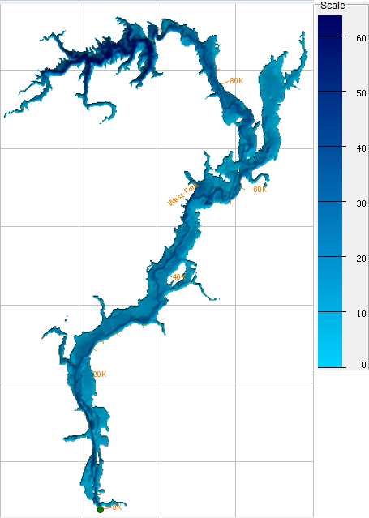
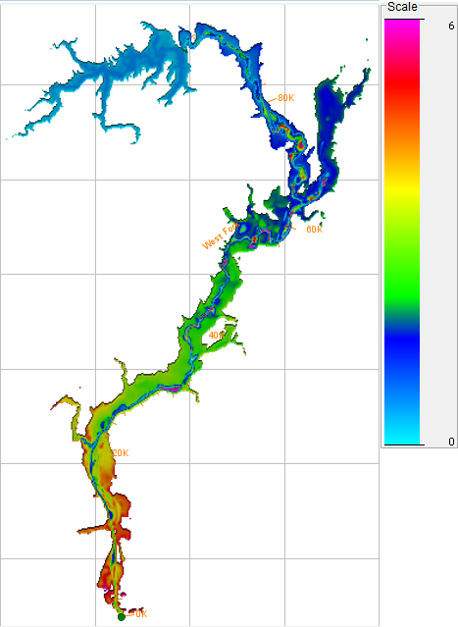
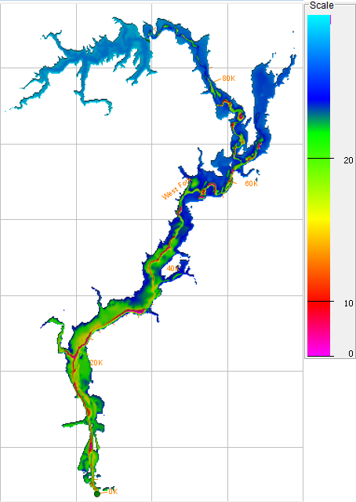
Gridded Data
Maximum Depth
Arrival Time
Duration

Slide 10
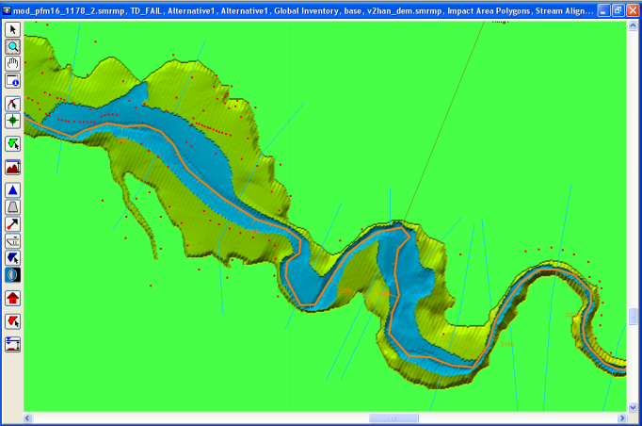
Summary H&H Inputs
  Gridded data: depth, arrival, and duration
  Stage Hydrographs (HEC-ResSim CCPs or HEC-RAS Cross Sections)

Slide 11
Questions
Help additional Training
https://usace.dps.mil/sites/KMP-WM/SitePages/Corps-Water-Management-System-(CWMS).aspx
https://www.hec.usace.army.mil/confluence/cwmsdocs
https://discourse.hecdev.net/c/cwms/5
TDL-CELRH-EC-GW-W-USACE CWMS Modeling | General | Microsoft Teams

