Slide 1
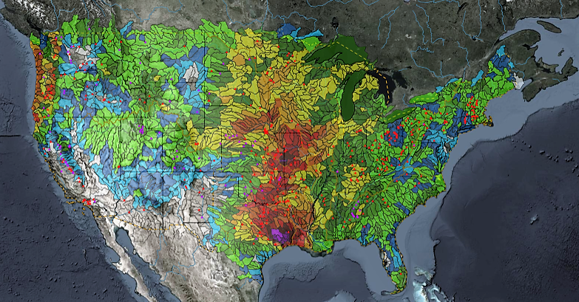
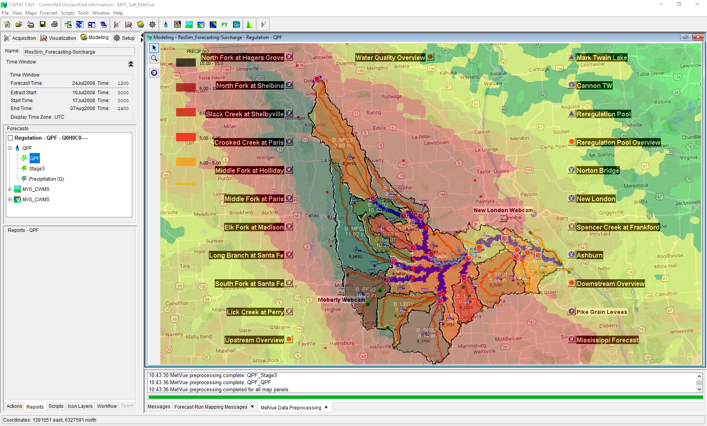

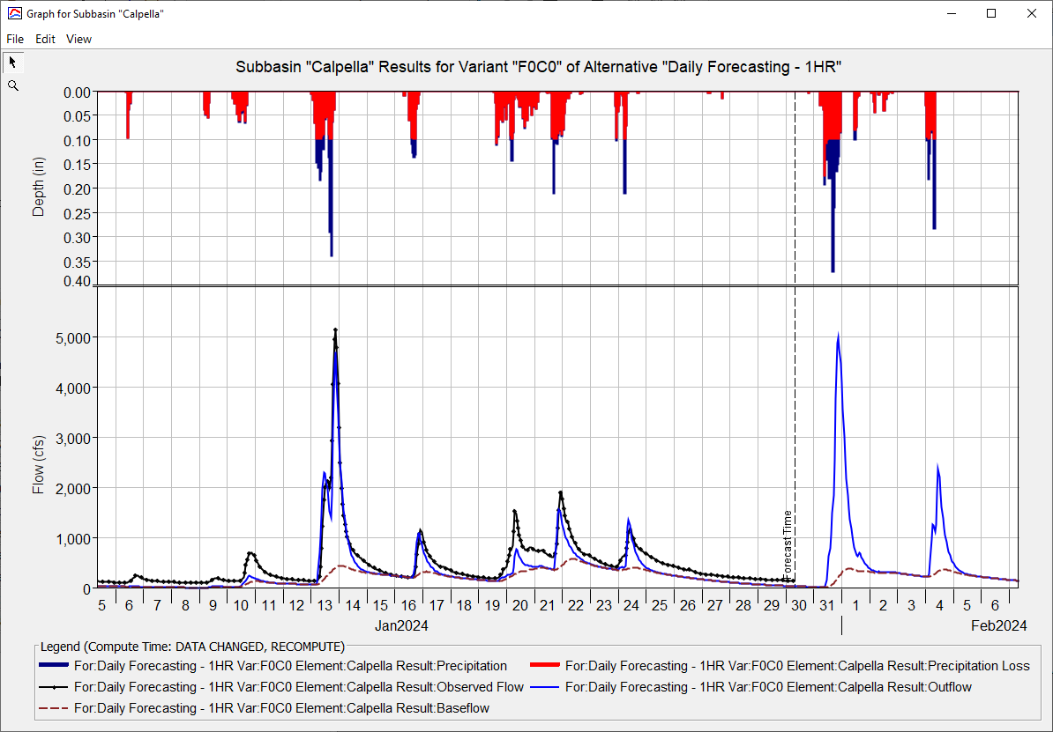
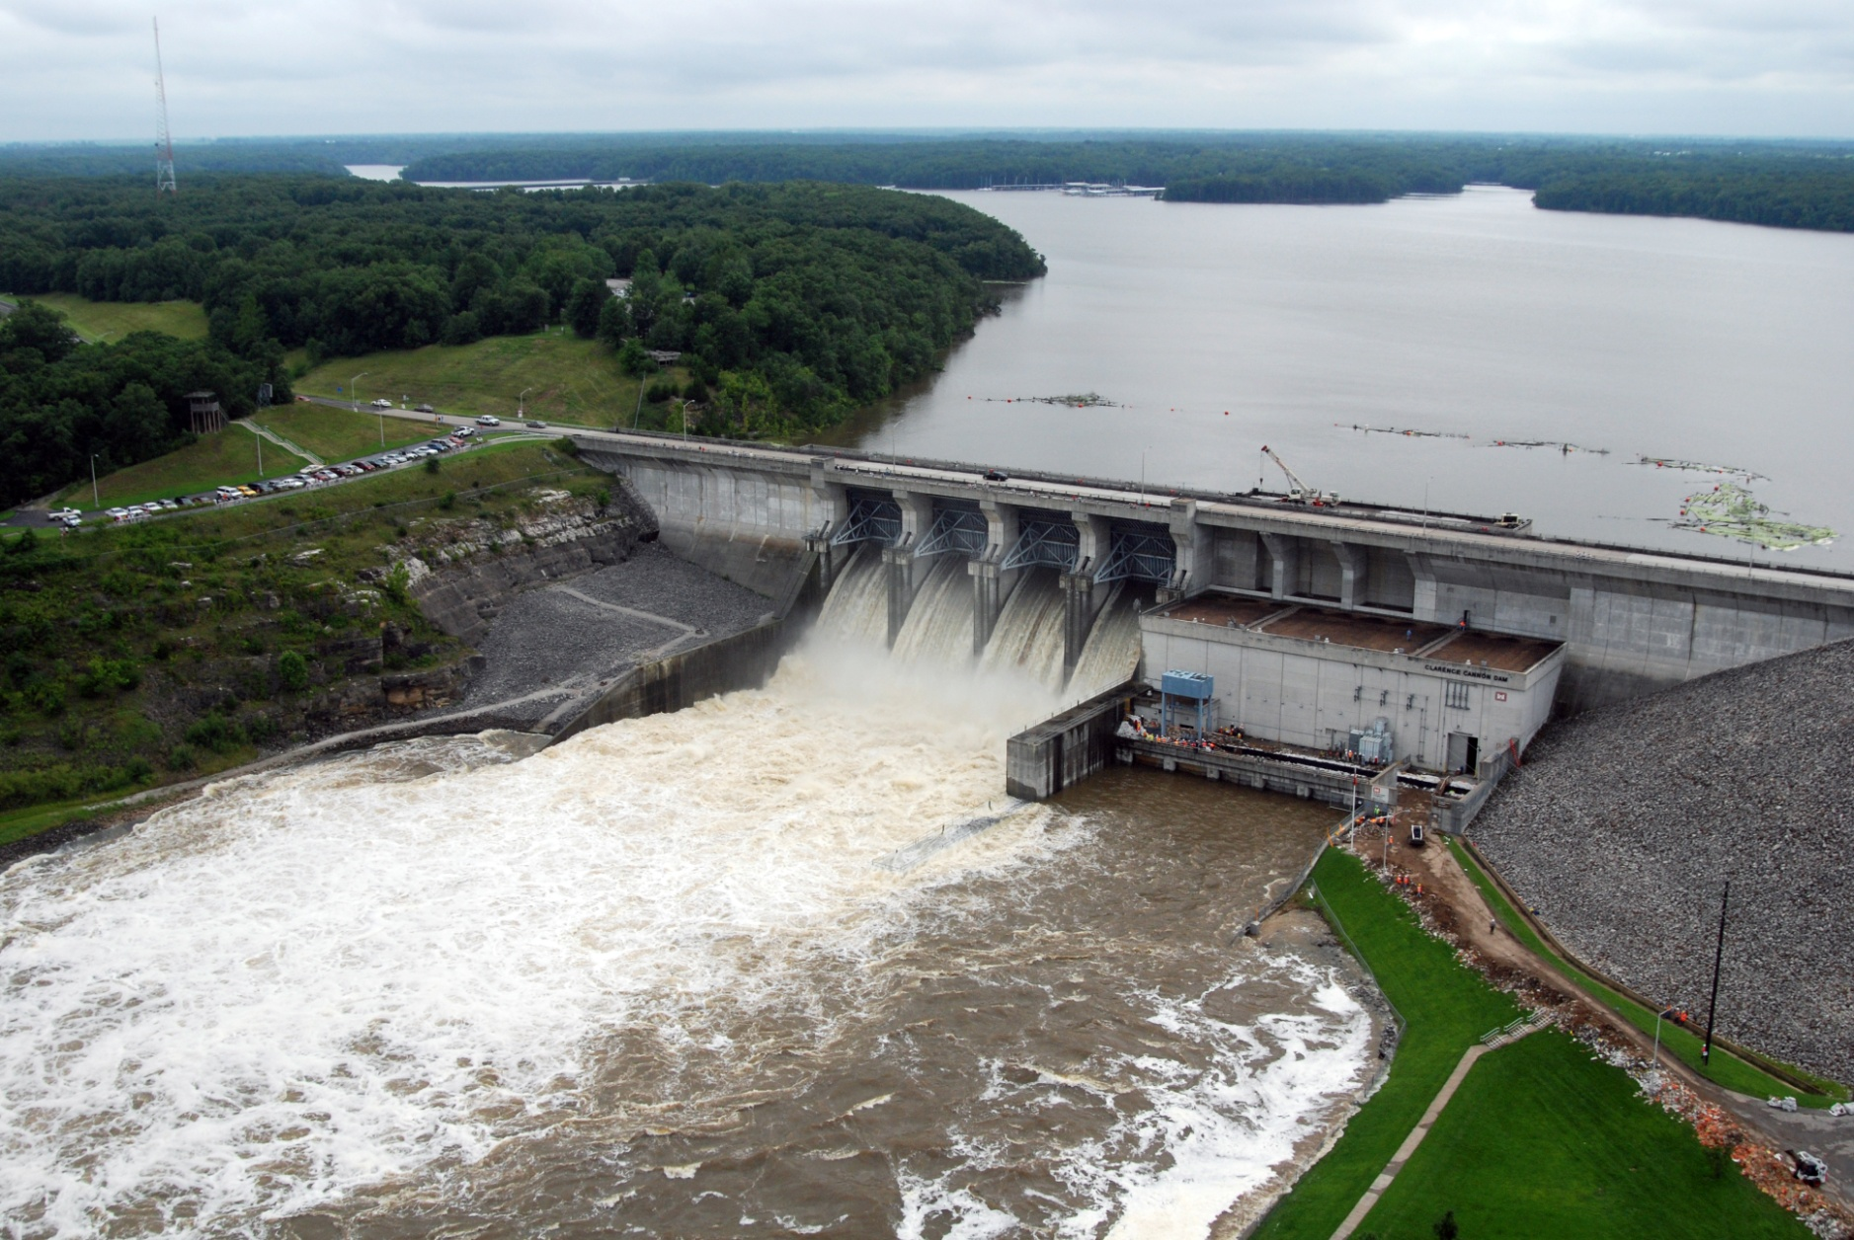
HEC-FIA for CWMS
Simon Evans, P.E., CFM
Hydrologic Engineering Center
CWMS Prospect Course
HEC-FIA Damage Computations and Reporting

Slide 2
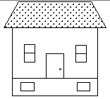
Economic Damage
Stage
Damage
Damage
Maximum Depth
Stage
Time (t)

Slide 3
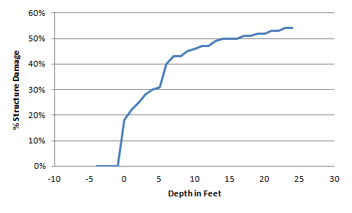

Economic Damage Methodology
42%
x $100,000 = $42,000
7 ft

Slide 4
Crop Damage Methodology
Crop Loss %
Duration
Date
Agriculture
Arrival
Time
Stage
Time (t)

Slide 5
Impact response curves
Impact Response Curve
If stage equals or exceeds this value then alert the authorities that the Town will be flooded.
Stage
Arrival
Time
Important Threshold
Time (t)

Slide 6
Impact Response Curves
Stage
Recession
Time 1
Arrival
Time 1
Arrival
Time 2
Recession
Time 2
Important Threshold
Time (t)

Slide 7
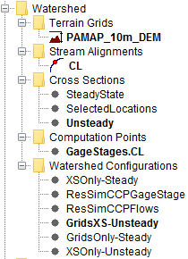
Why are there different Methods?
  To link HEC-FIA to different HEC-ResSim or HEC-RAS outputs
  To compute different types of calculations
  To provide flexibility for applying same consequence
    model for real-time or planning or other analyses
.
.
Inflow, Q_{i}
Inflow, Q_{i}
Inflow, Q_{i}
.
.
Inflow, Q_{i}
Time
Time
Time
.
Time
.
Reservoir 1
.
.
Inflow, Q_{i}
Reservoir 2
Inflow, Q_{i}
Time
Time
.
Inflow, Q_{i}
Inflow, Q_{i}
Time
Ouflow, Q_{o}
Time
Time

Slide 8
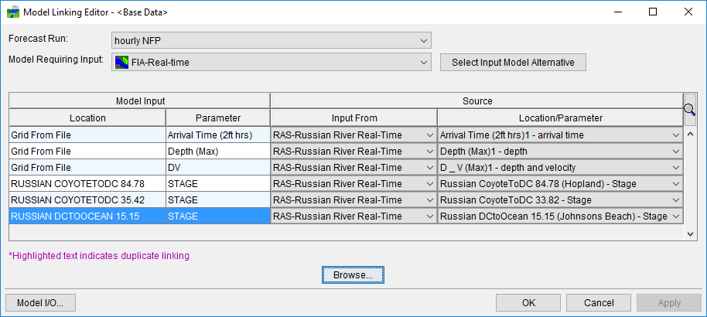
Linking HEC-FIA in CWMS
  Must link output from prior model to serve as input for a given HEC-FIA alternative

Slide 9
What Outputs are available?
  Individual Structure Damage Report
  Aggregated Consequences Summary Report
  Critical Infrastructure Report
  Impact Response Report
    By Rule
    By location
    Summary table
  Interactive Map Elements (i.e., zoom to structure)
  DBF and SHP files for custom products and analyses
  ECAM (indirect economics)

Slide 10
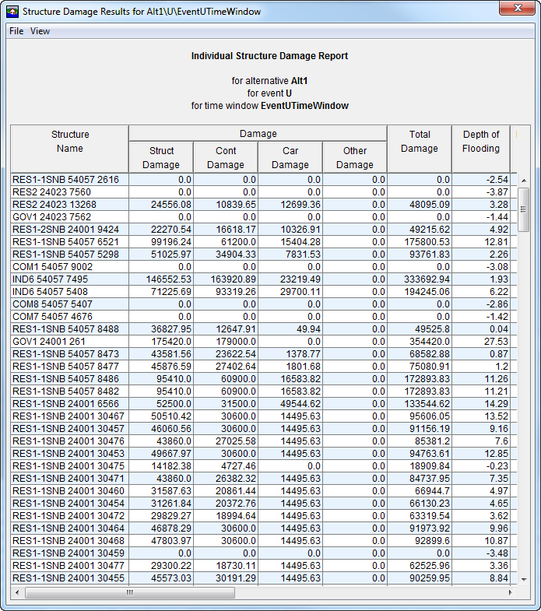
Individual Structure damage Report

Slide 11
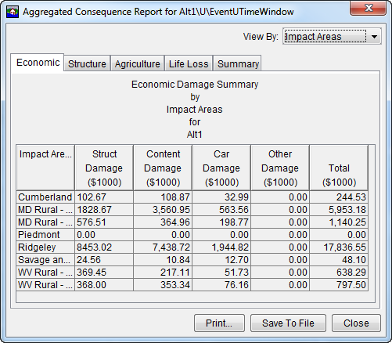
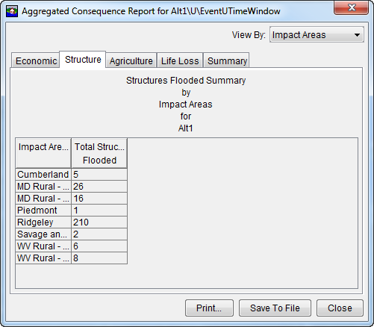
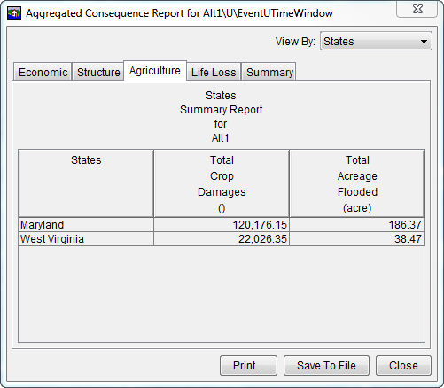
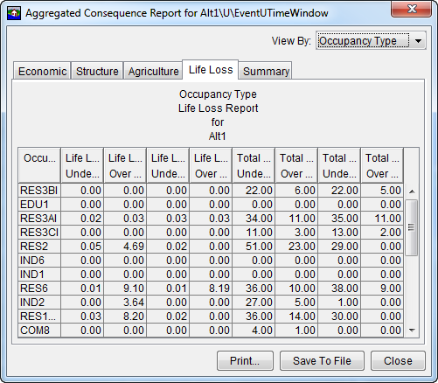
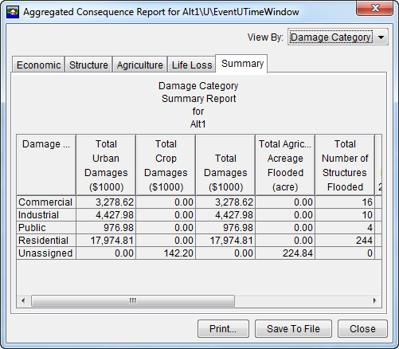
Aggregated Consequence Summary

Slide 12
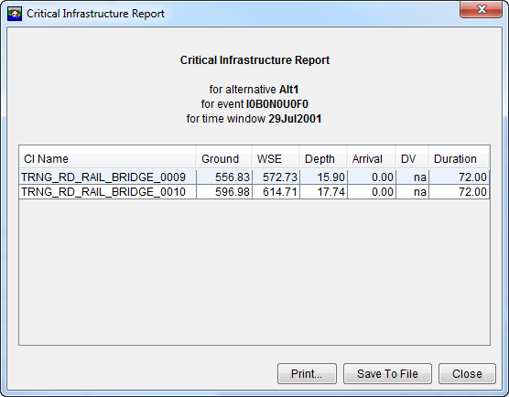
Critical infrastructure report

Slide 13
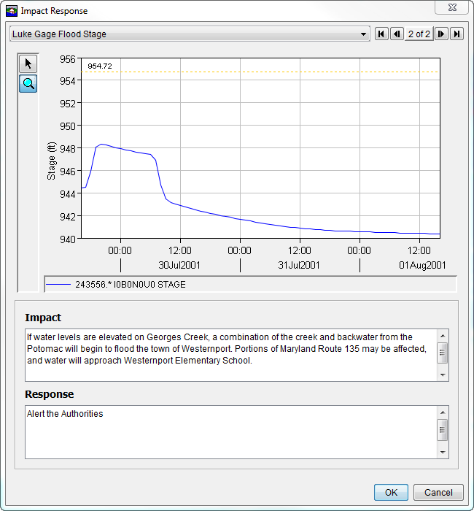
Impact response Report

Slide 14
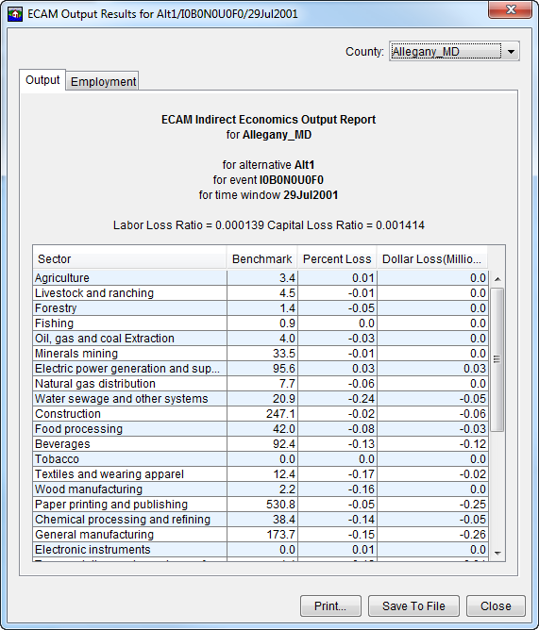
ECAM (indirect Economics)

Slide 15
Summary – Computes and inputs
  HEC-FIA computes single event damages, estimating life and economic losses:
    Structure loss
    Agricultural loss
    Indirect economic loss
    Life Loss
  HEC-FIA inputs include:
    National inventories of agricultural, structures, and terrain data
    Hydraulic data
      Stage hydrographs
      Gridded Data (Maximum Depth, Arrival Time, and Duration)

Slide 16
Summary – Method and Results
  HEC-FIA economic damage estimate methodology is a function of maximum depth
  HEC-FIA Output Reports include:
    Individual Structure Damage Report
    Aggregated Consequences Damage Report
    Critical Infrastructure Report
    Impact Response Report
    ECAM (Indirect Economics) Report

Slide 17
Questions
Help additional Training
https://usace.dps.mil/sites/KMP-WM/SitePages/Corps-Water-Management-System-(CWMS).aspx
https://www.hec.usace.army.mil/confluence/cwmsdocs
https://discourse.hecdev.net/c/cwms/5
TDL-CELRH-EC-GW-W-USACE CWMS Modeling | General | Microsoft Teams

