Slide 1
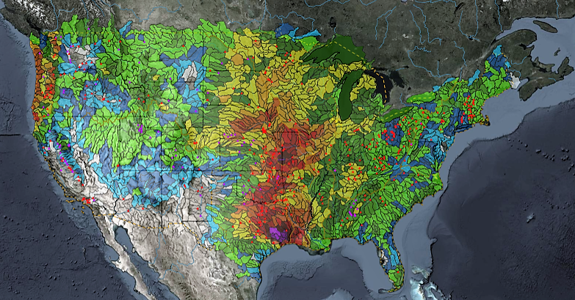
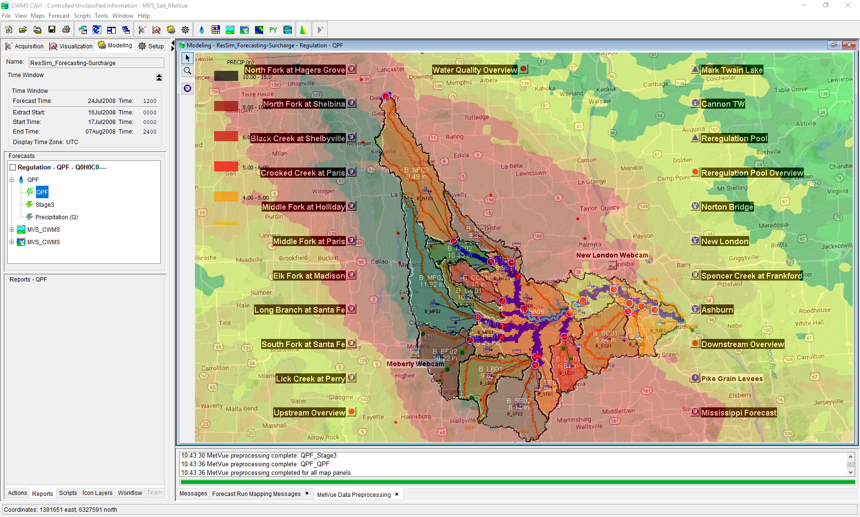

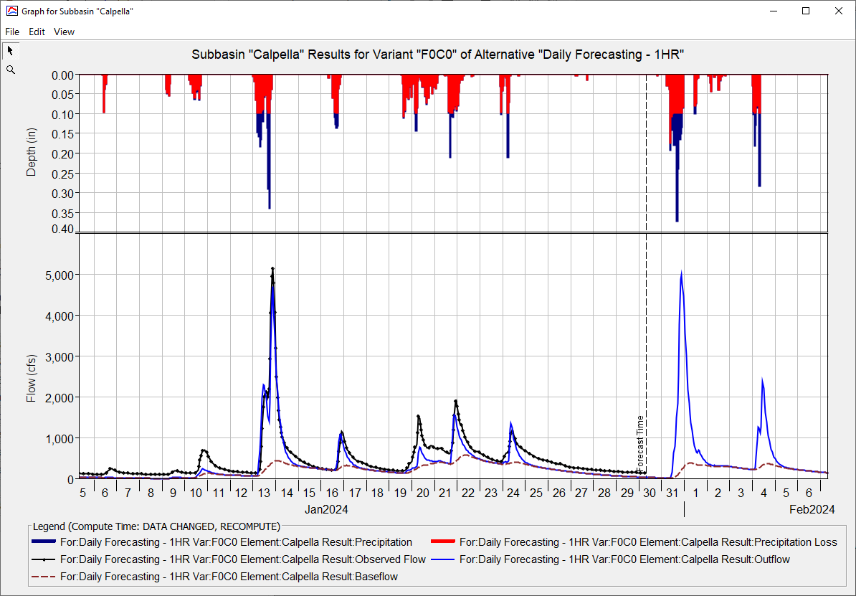
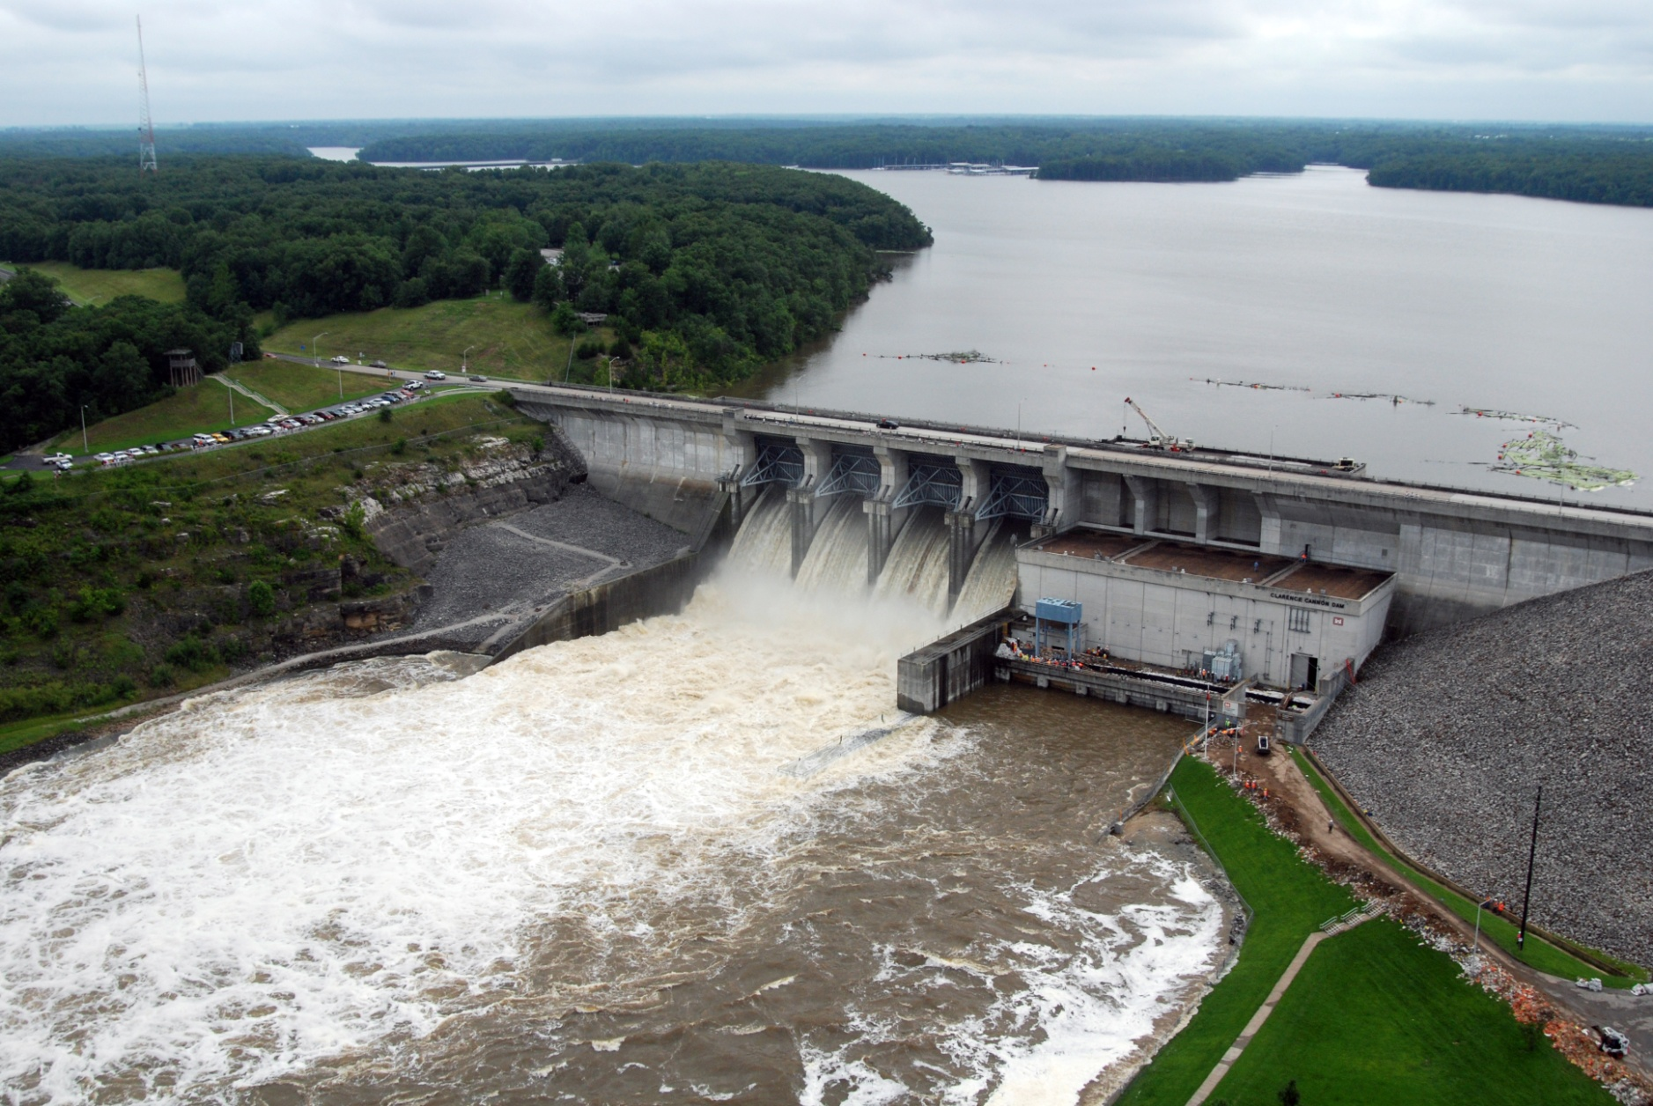
HEC-FIA for CWMS
Simon Evans, P.E., CFM
Hydrologic Engineering Center
CWMS Prospect Course
Flood Damages Reduced Computations in HEC-FIA

Slide 2
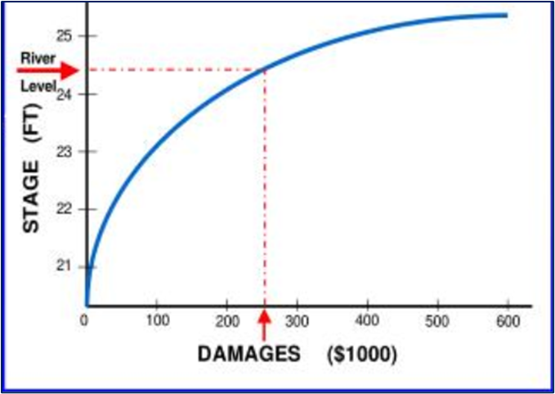
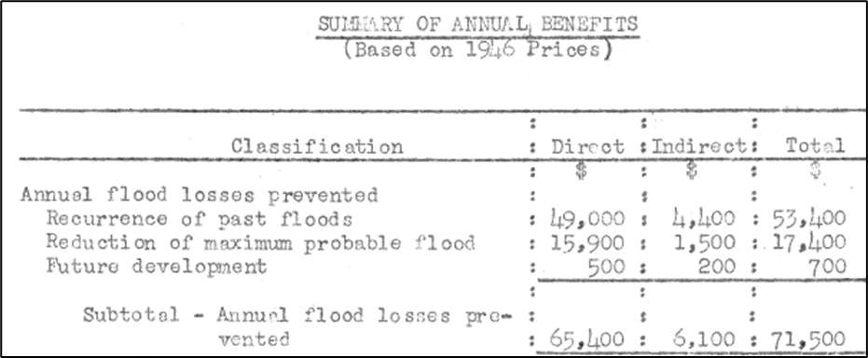
Flood Damages Reduced - Legacy
Legacy Methodology
Index location Damage Curves
Lots of data baked into single location
Long reaches
Mixed Consequence types
Hydraulics
Shortfalls
Outdated
Often undocumented
Black Box approach

Slide 3
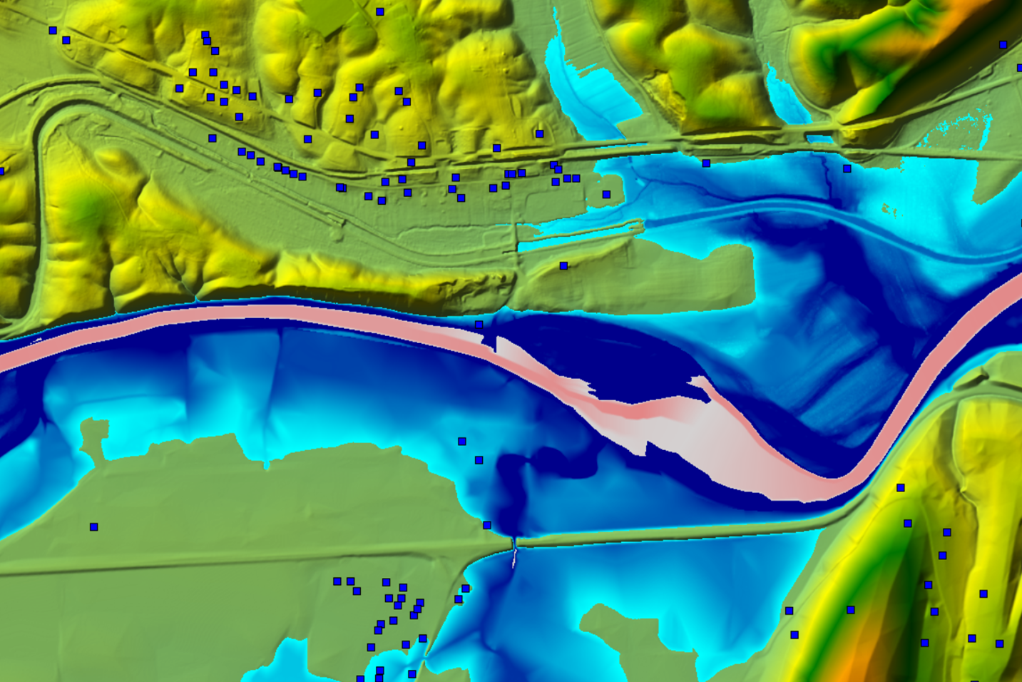
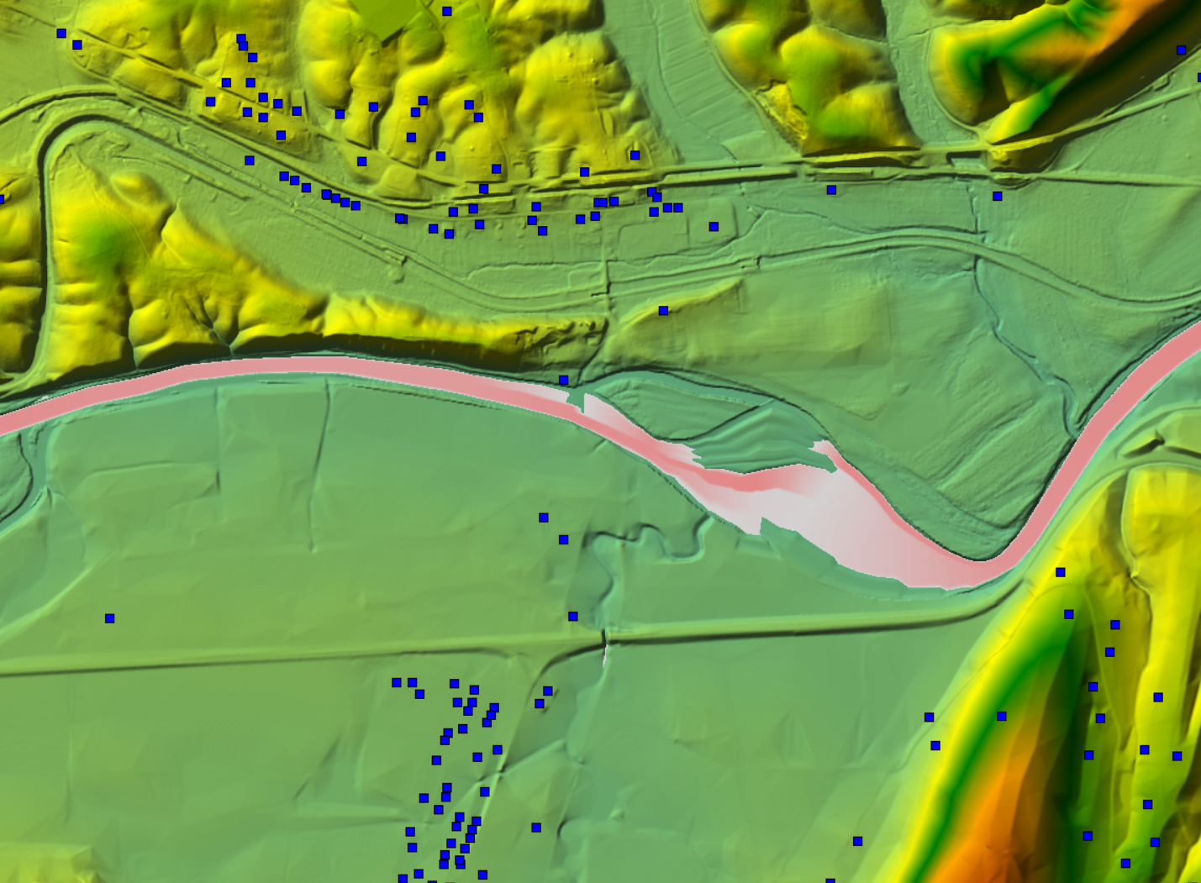

Flood Damages Reduced in CWMS

Slide 4
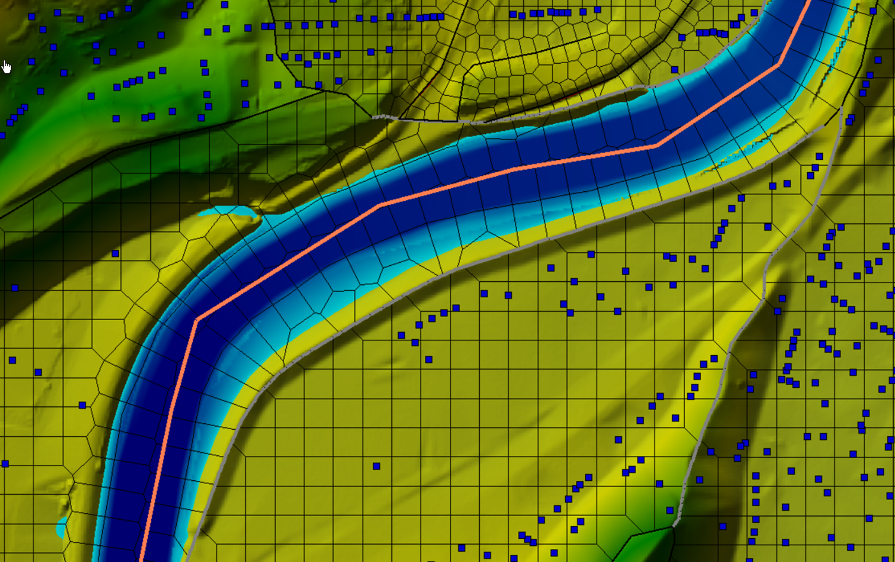
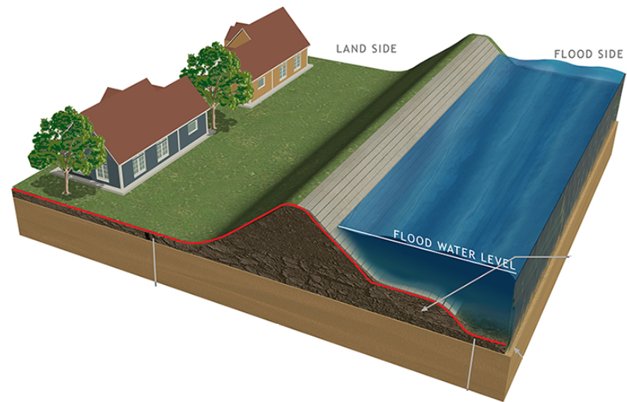

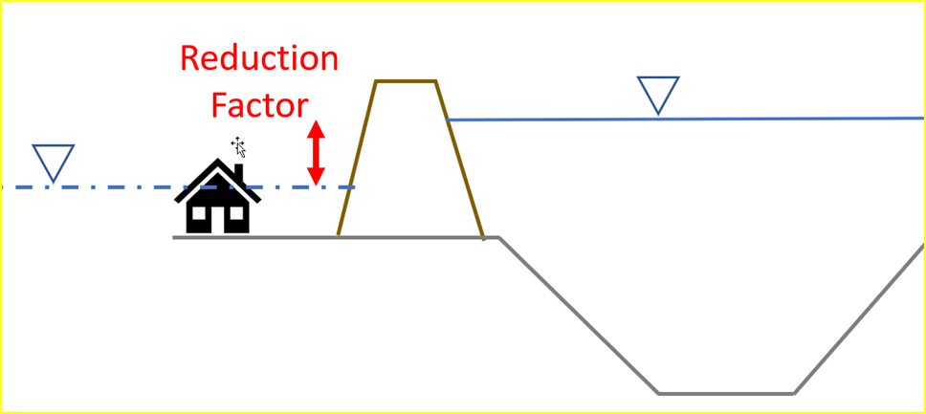

HEC-FIA Without Levee Estimate
Stream Alignment
Regulated
(with levees)
Unregulated
(with levees)
Levee Area

Slide 5

Flood damages reduced in HEC-FIA
New approach available in HEC-FIA 3.3
Accepts 4 inundations
Accepts RAS native HDF results
No bulky “saved to disk” results
Reg
Unreg
Reg
W/O LEVEE
Unreg
W/O LEVEE

Slide 6
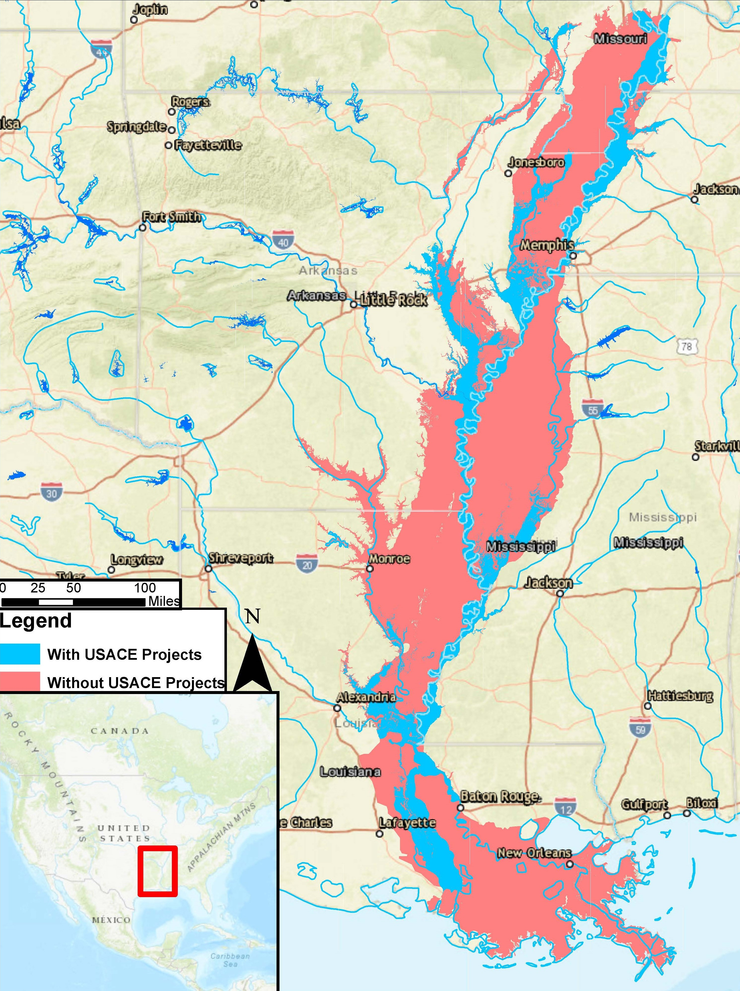
Flood damages reduced in HEC-FIA

Slide 7
Questions Help additional Training
https://usace.dps.mil/sites/KMP-WM/SitePages/Corps-Water-Management-System-(CWMS).aspx
https://www.hec.usace.army.mil/confluence/cwmsdocs
https://discourse.hecdev.net/c/cwms/5
TDL-CELRH-EC-GW-W-USACE CWMS Modeling | General | Microsoft Teams

