Slide 1
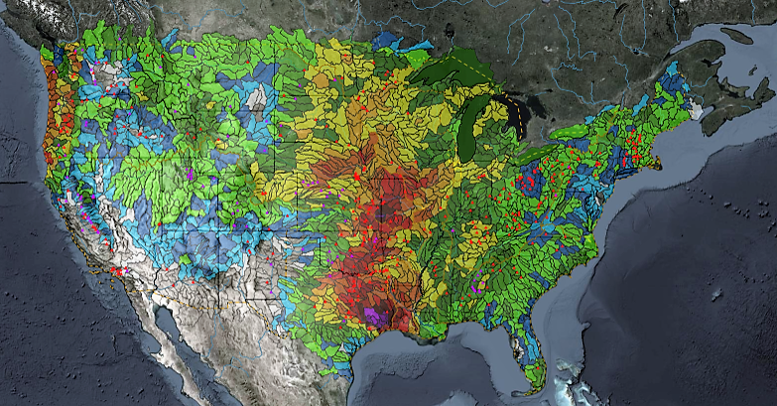
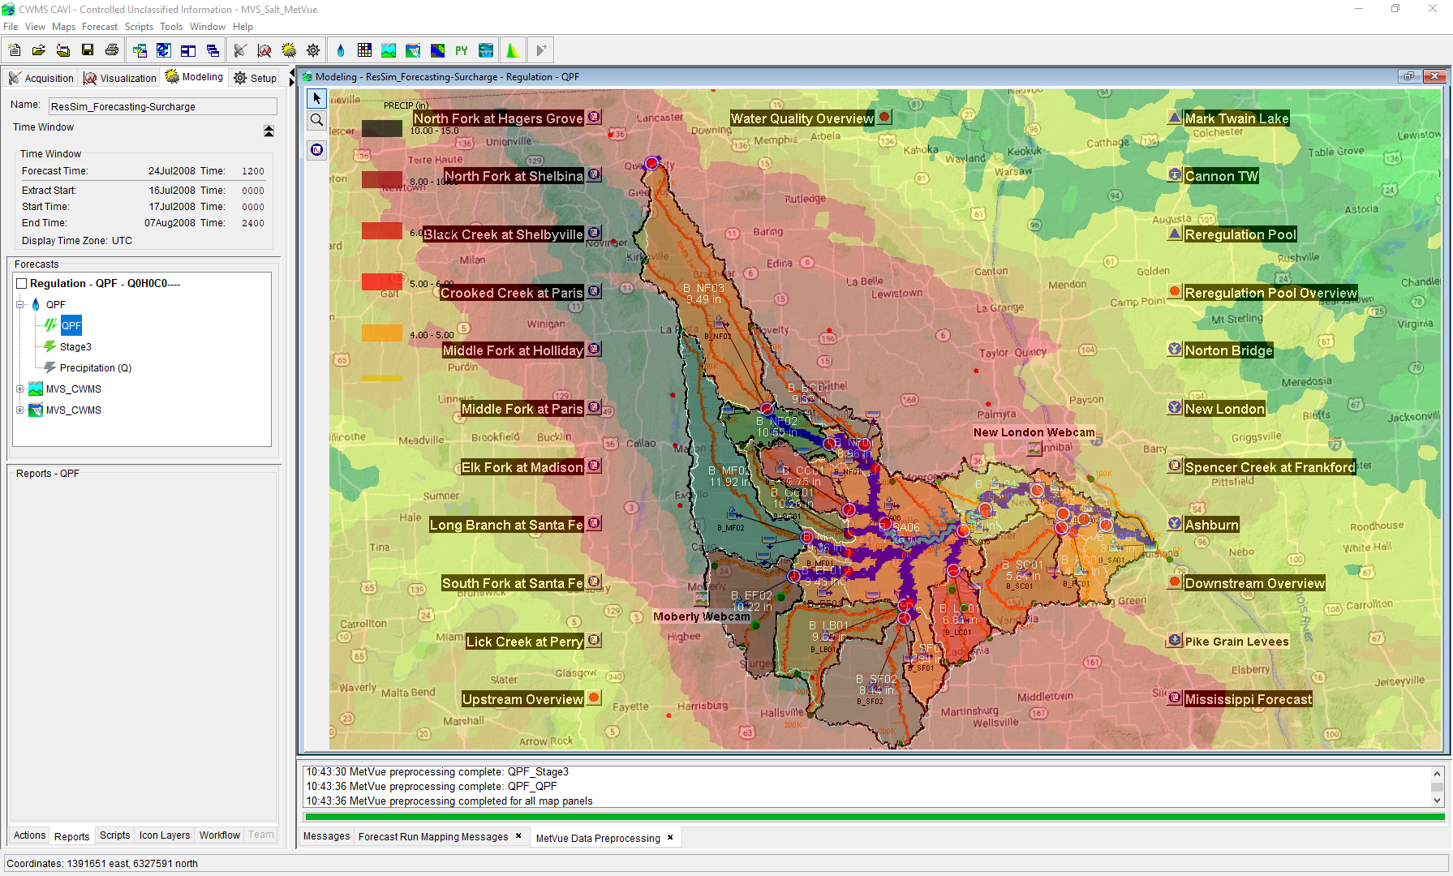

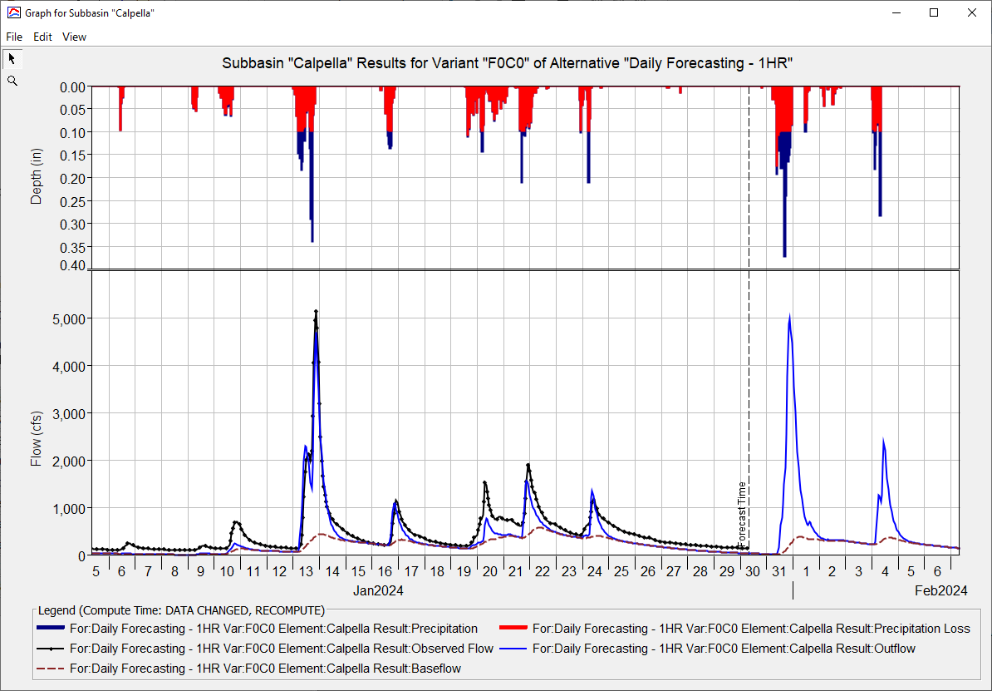
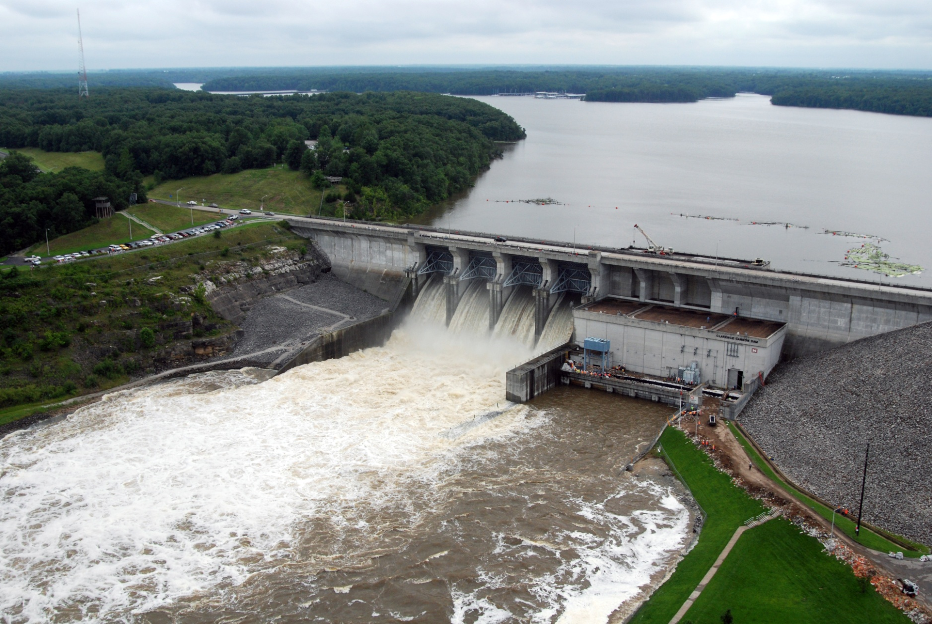
Baltimore District CWMS Real-Time Applications
Simon Evans, P.E., CFM
Hydrologic Engineering Center
CWMS Prospect Course
Overview

Slide 2
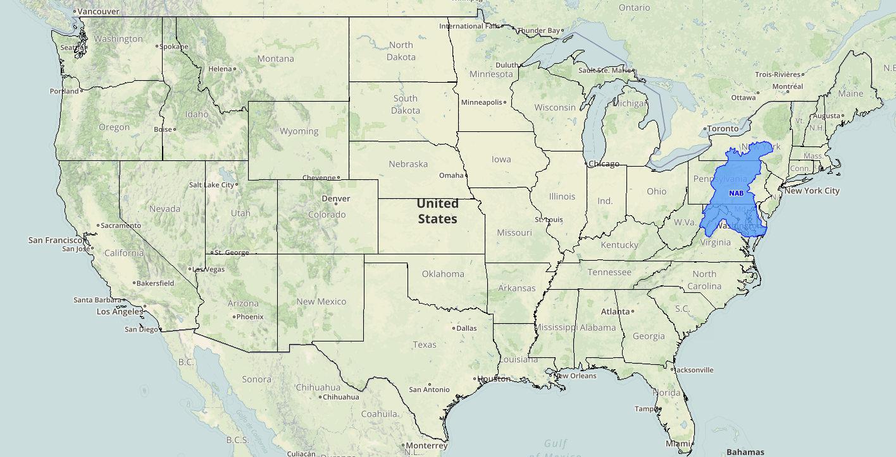
District Background

Slide 3
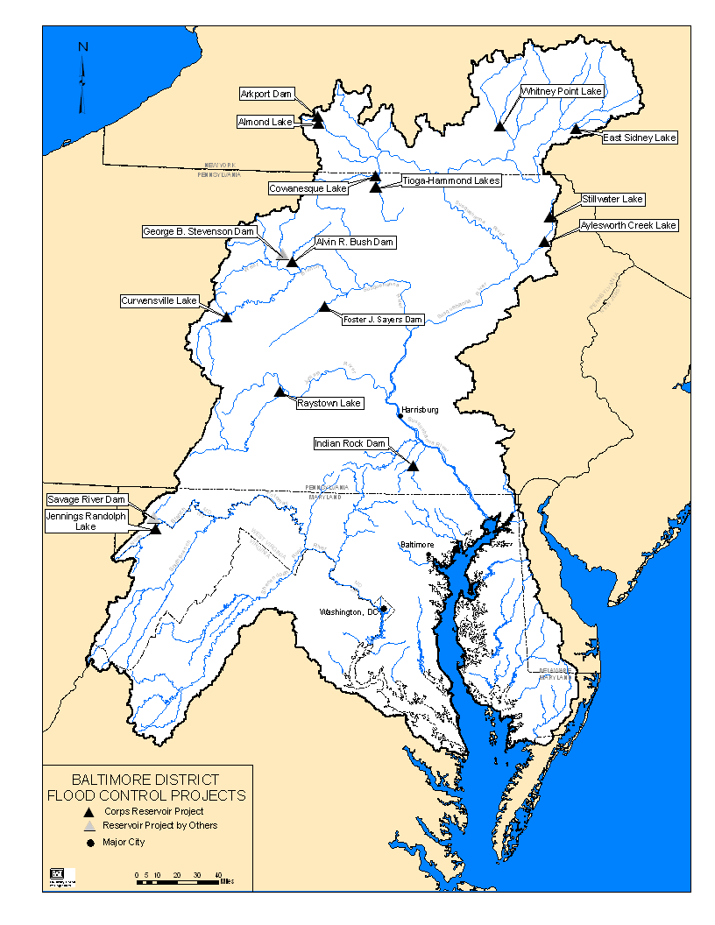
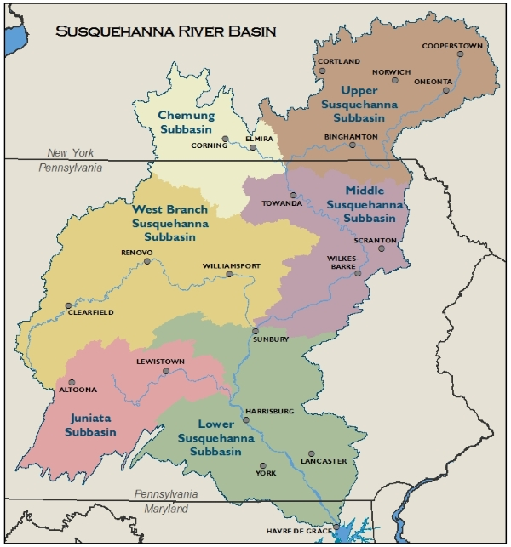
District Background
  Two main river systems across five states
  Susquehanna River Basin (5 separate watershed models)
  Potomac River Basin (1 watershed model)
  17 projects
  2 are State owned and operated
  Project Purposes
  Flood Control
  Water Quality
  Water Supply
  Recreation
  Hydropower (Non-Federal)

Slide 4
NAB CWMS History
Late 1990’s
  NAB one of four sites selected to test the first ever version of CWMS (1997)
  The Bald Eagle Creek watershed was selected by HEC for their internal model testing
  Goal was to replicate WCDS data validation, storage and visualization
  Modeling was not part of the daily reservoir decision making process
  Early 2000’s
    NAB begins initial CWMS model development (Juniata River Basin)
    2010-2020
      2013 thru 2018 - Watershed models for NAB developed through the National CWMS Implementation Plan
      Began working on model implementation in 2018
      Pilot tested the T7 implementation and been on T7 as production server since FY19
      Help HEC test various versions of CWMS;
      involved since 3.2.1
      Last Few Years
        Continued daily CWMS modeling
        Improved snowmelt modeling in HMS
        Improved reporting and frequency of forecasting
        Implemented FDR across all watersheds
        Refreshed older HEC-RAS models
        Currently “GREEN” – but always more to improve

Slide 5
Questions
Help additional Training
https://usace.dps.mil/sites/KMP-WM/SitePages/Corps-Water-Management-System-(CWMS).aspx
https://www.hec.usace.army.mil/confluence/cwmsdocs
https://discourse.hecdev.net/c/cwms/5
TDL-CELRH-EC-GW-W-USACE CWMS Modeling | General | Microsoft Teams

