Slide 1
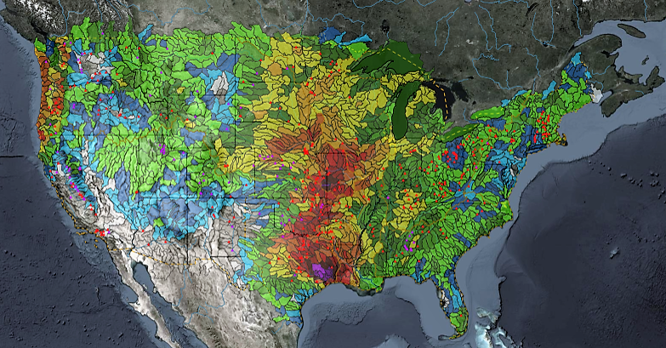
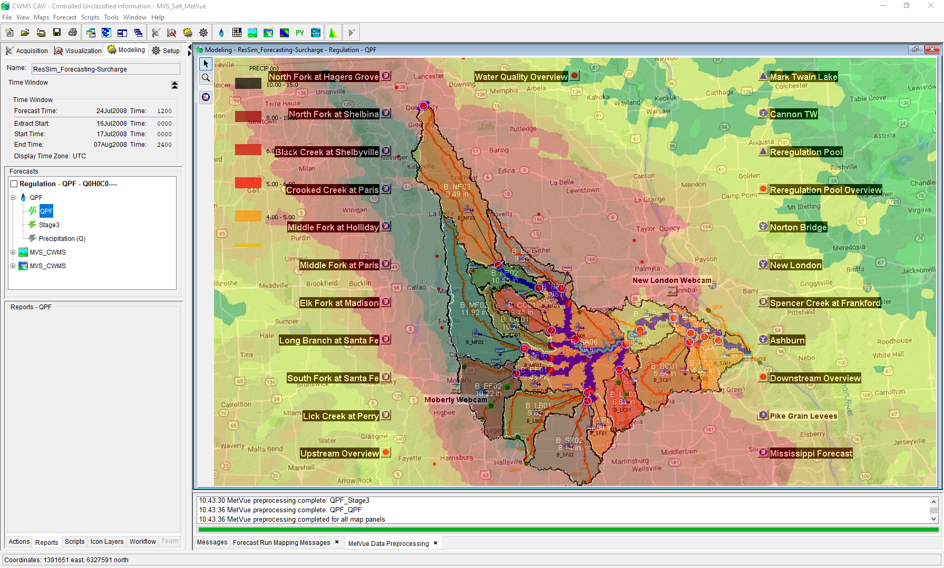

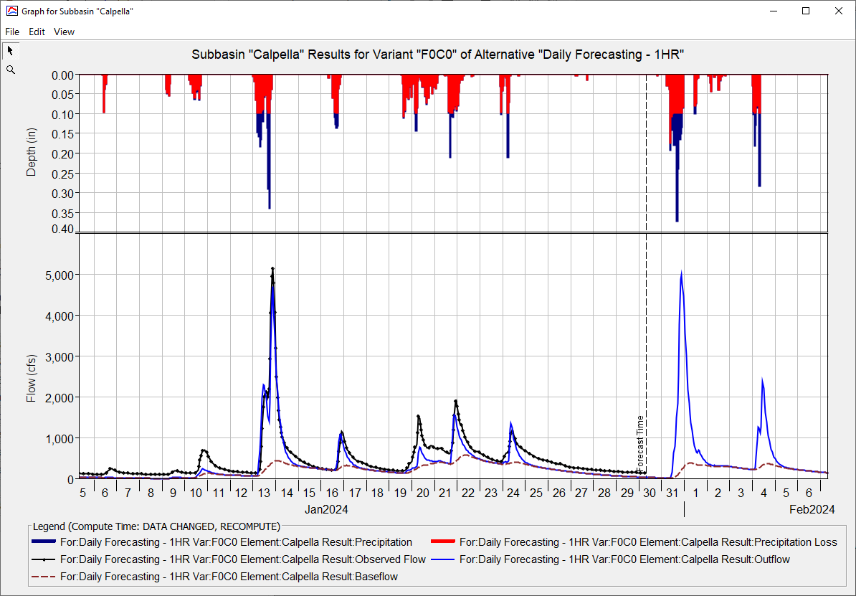
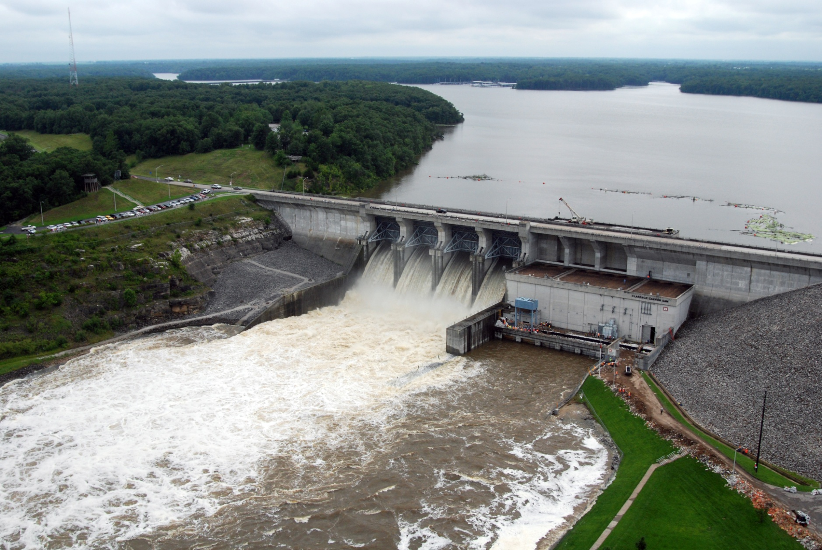
Baltimore District CWMS Real-Time Applications
Simon Evans, P.E., CFM
Hydrologic Engineering Center
CWMS Prospect Course
District Forecasting Routine

Slide 2
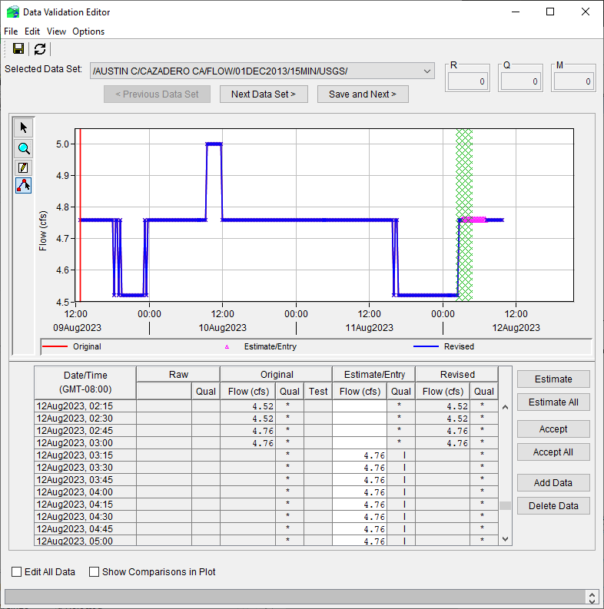
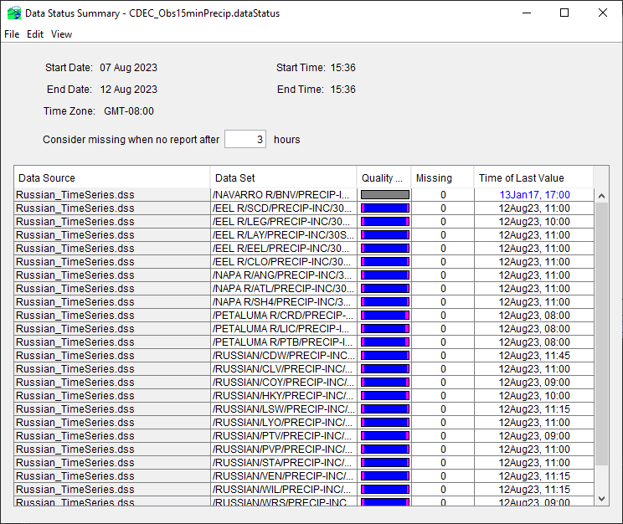
DATA VALIDATION
Group effort
Use Data Status Summary Table and Data Validation Editor from the CAVI
Multiple lists per watershed to focus on critical data to run a forecast

Slide 3
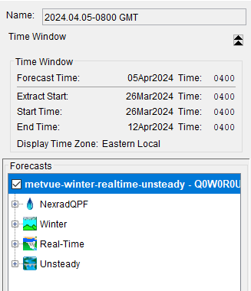
Forecasting Routine
THE GOAL (non-flood) → Run a watershed 3 days a week between 2 modelers → Each model gets run once a week
Start a forecast
calibrate
overrides
Start a forecast
calibrate
overrides
1
2
3
1
2
3
Start new forecast every day
Pick a time window
  Lookback important!
  How long is your forecast?
Extract data
  Is data available for the extent selected?
  Multiple extract lists available
  Separate list for snow parameters

Slide 4
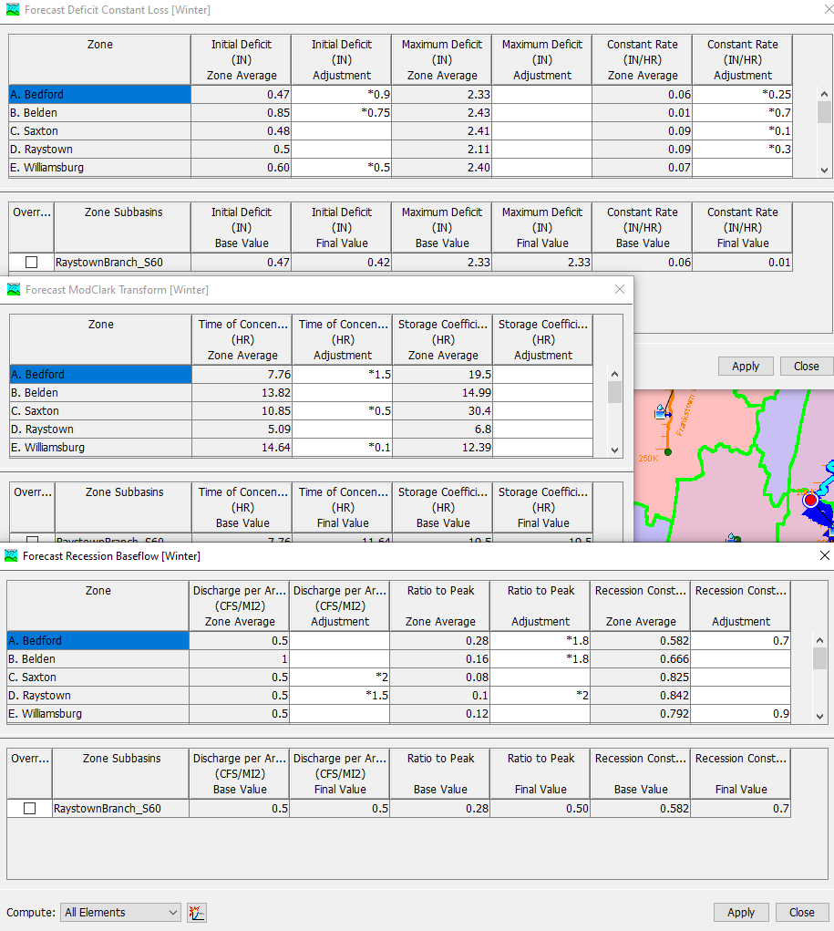
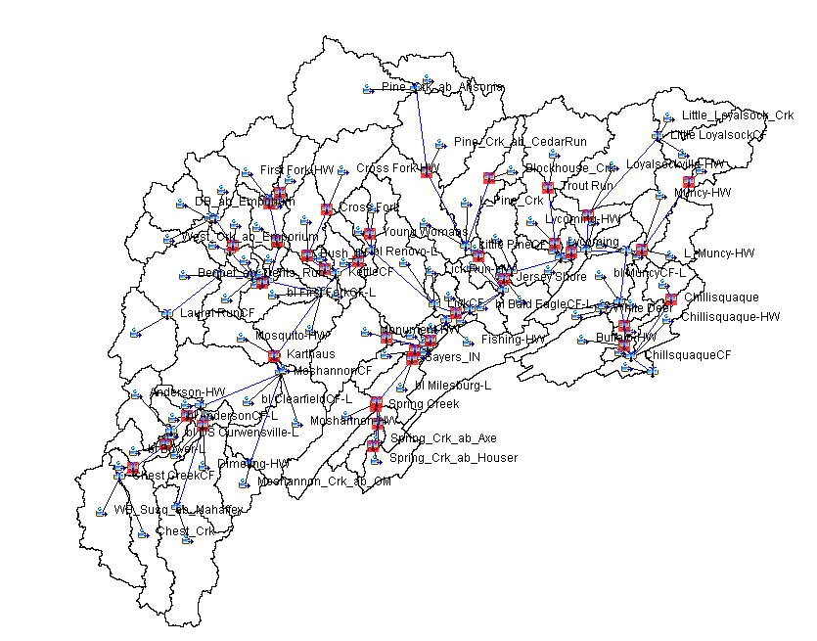
Forecasting Routine
THE GOAL (non-flood) → Run a watershed 3 days a week between 2 modelers → Each model gets run once a week
Start a forecast
CALIBRATE
overrides
2
overrides
1
3
3
Constantly re-calibrating
Watersheds are flashy and events move through over the course of several days
All six models have snow-melt forecasting capabilities
Share the .forecast file in HMS between modelers
  Watershed/hms/forecast/.forecast
Challenges:
  Calibrating after long dry periods
  Gage availability

Slide 5
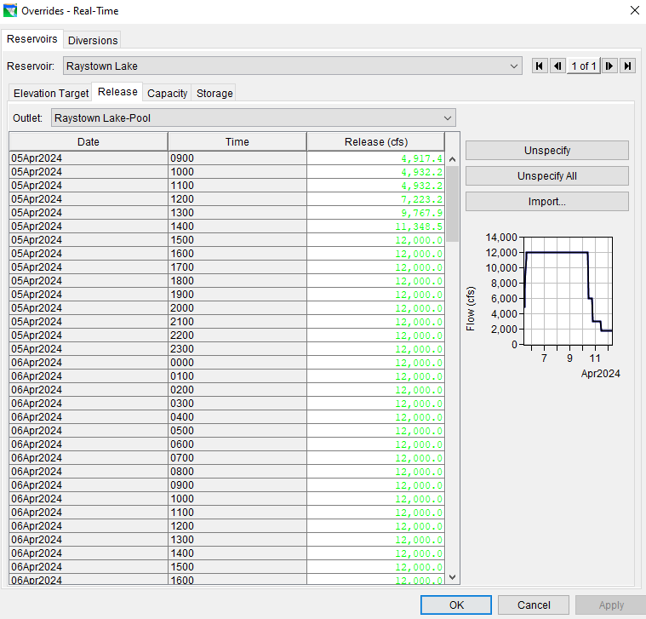
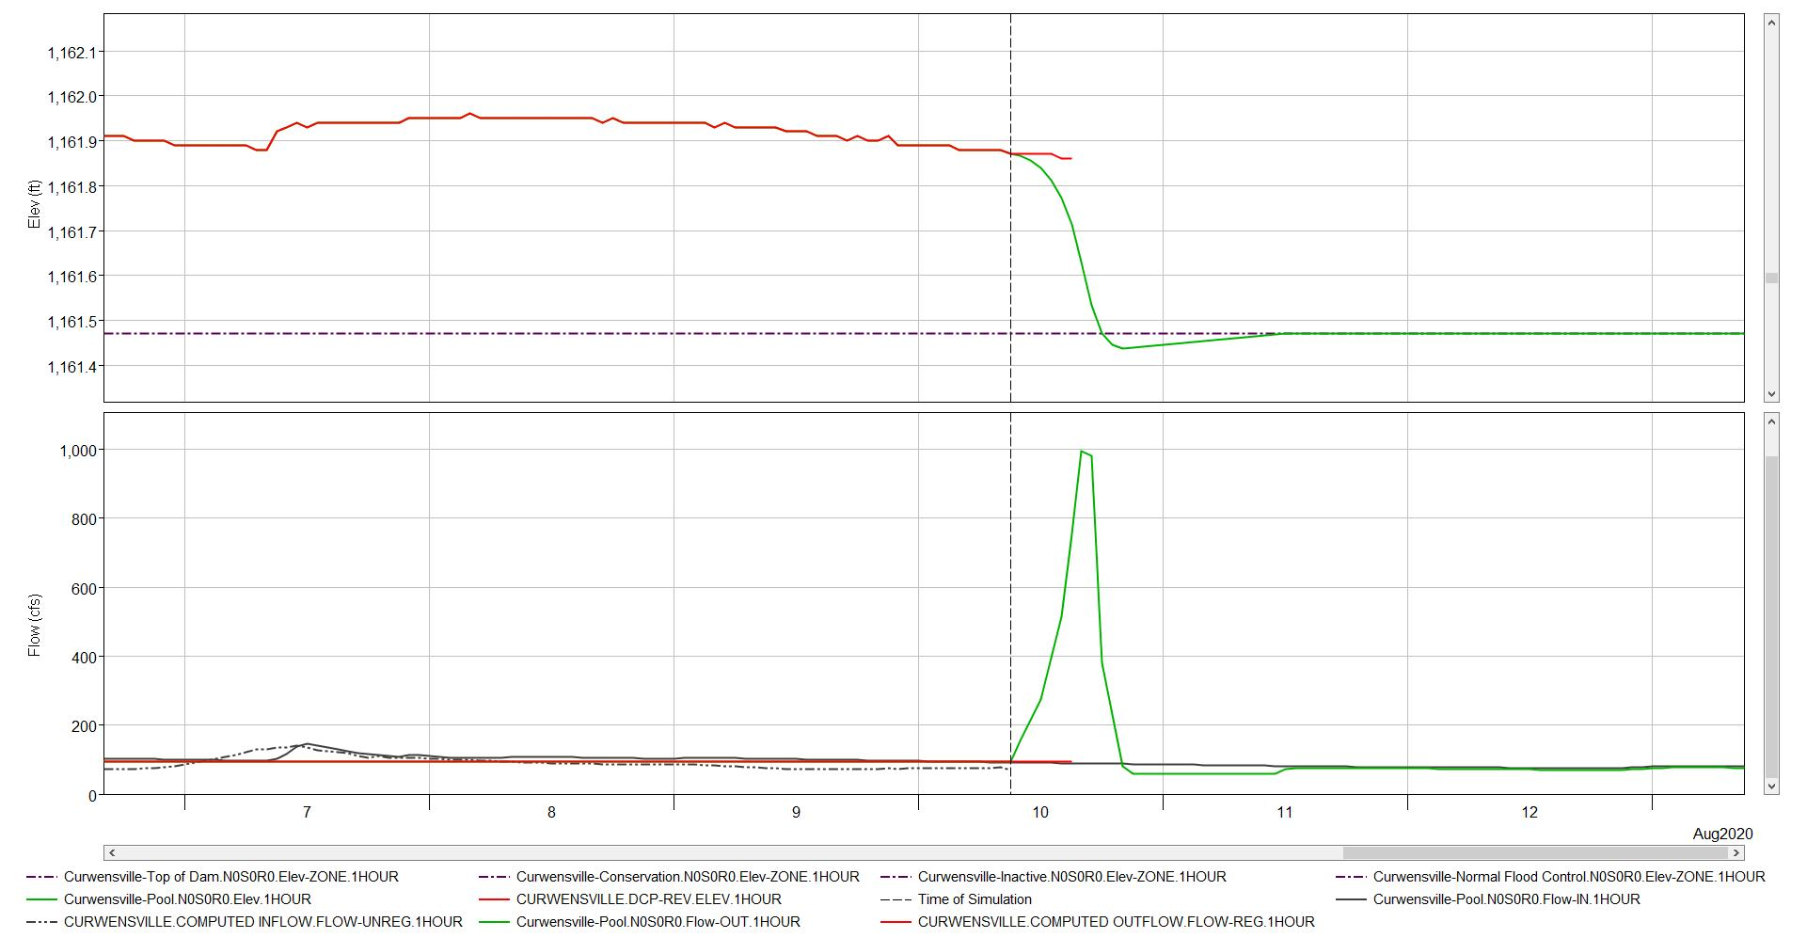
Forecasting Routine
THE GOAL (non-flood) → Run a watershed 3 days a week between 2 modelers → Each model gets run once a week
Start a forecast
calibrate
overrides
1
2
3
Most common reasons for overrides needed:
  Lake levels allowed to be maintained higher than conservation pool
  Recreational releases are not included in ResSim
  Adjusting flow changes to a daily adjustment instead of hourly
Importance of these changes:
  Removing incorrect spikes in reservoir outflow
  Realistic releases are important when lake elevation predictions are needed

Slide 6
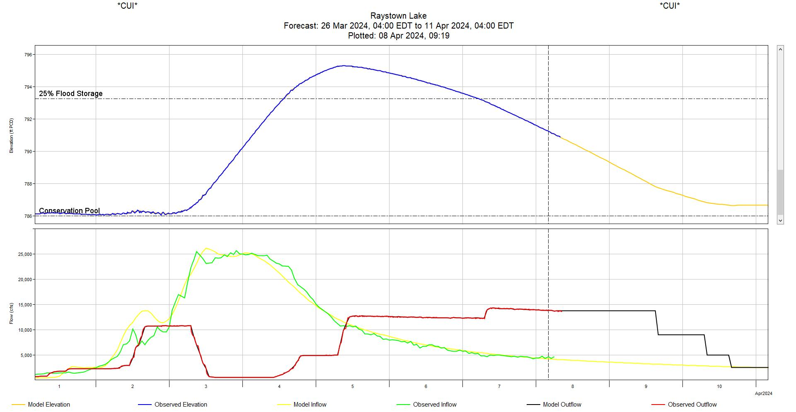
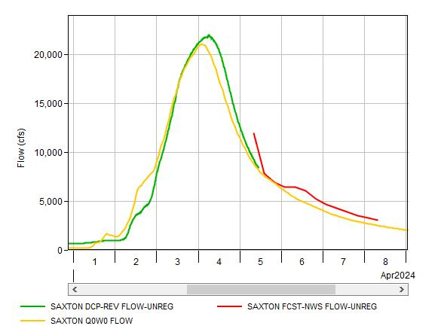
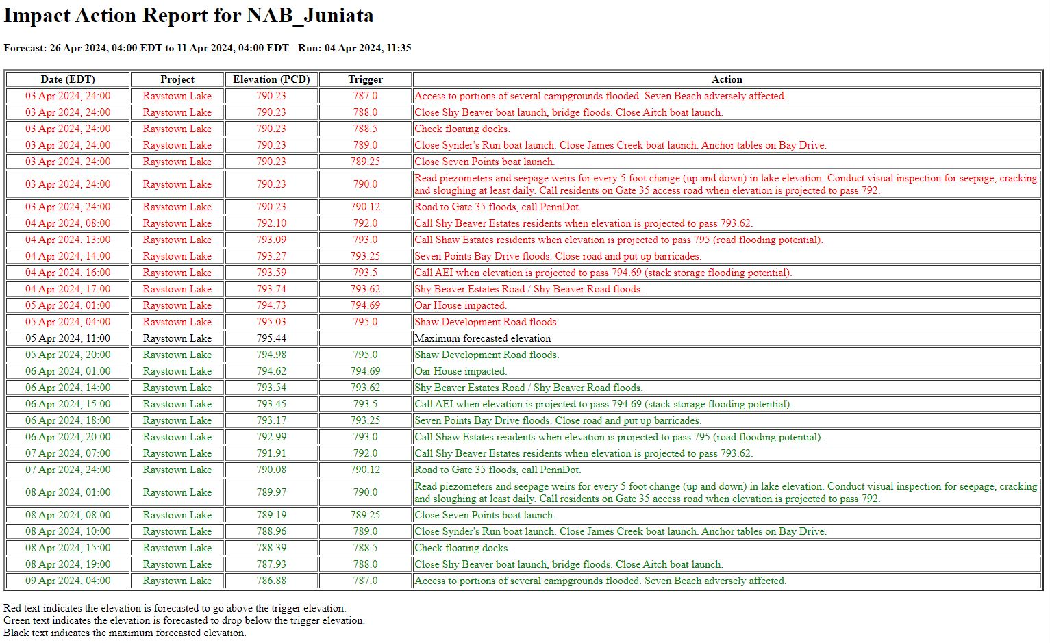
Forecast Products
RESERVOIR PLOTS
AHPS COMPARISON PLOTS
IMPACT ACTION TABLE
Scripted to follow a specific template we prefer and familiar with
Provides lake elevation forecast
Provides forecasted flow regime
Typically, either a 3-day, week or two-week lookout
Extract AHPS forecasts into forecast.dss file
Share comparison with water managers to help convey how reliable the forecast might be
A script run from the CAVI
Lists all actions at the project needed at a specific elevation
Red actions are on the rising side, green actions are on the falling side
Lists the max elevation within the forecast window

Slide 7
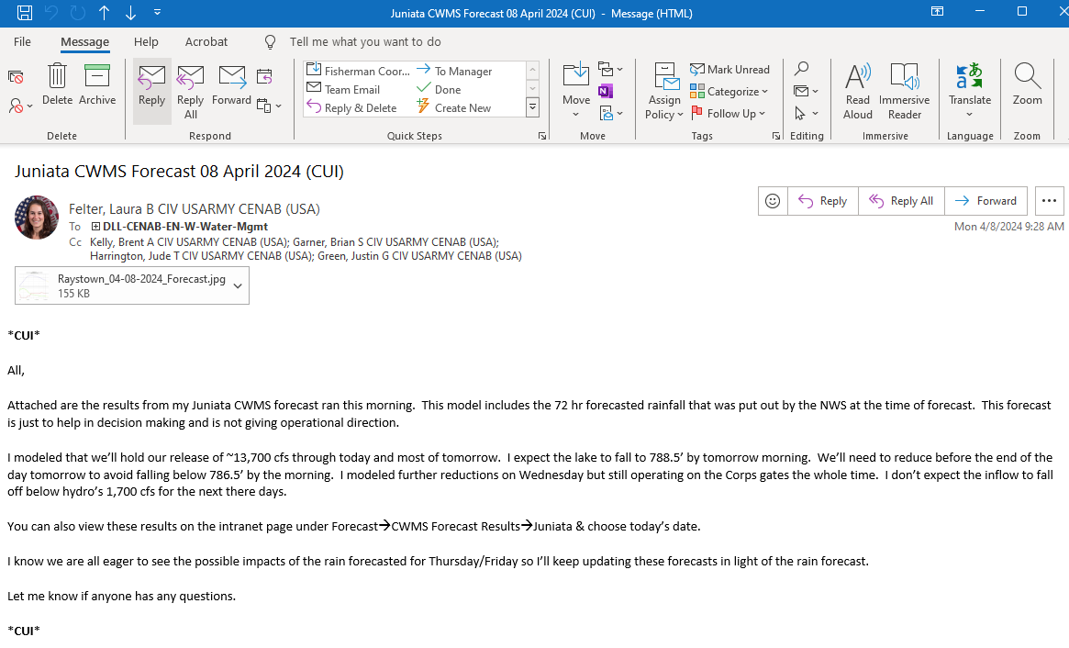
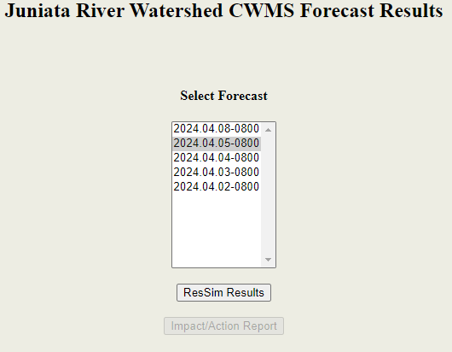

Sharing Forecasts
Email forecast narrative
    Caveats, assumptions, overrides, and plots
    Send to water management staff, dam operators, project managers, and Geotech staff
    Send separately to Emergency Management staff
  Post forecast results to internal water management page
+
=

Slide 8
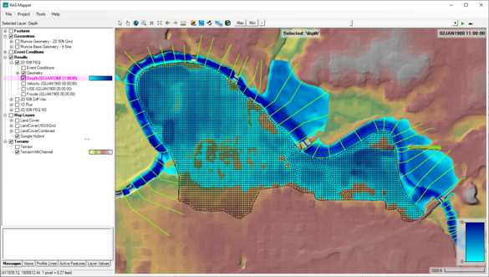
Inundation Mapping + HEC-FIA
HEC-RAS computed when needed during events – less frequently than the other models
Inundation mapping produced and upload to FIM based on District determined thresholds
FIA – not run during a forecast but used after events to calculate Flood Damages Reduced

Slide 9
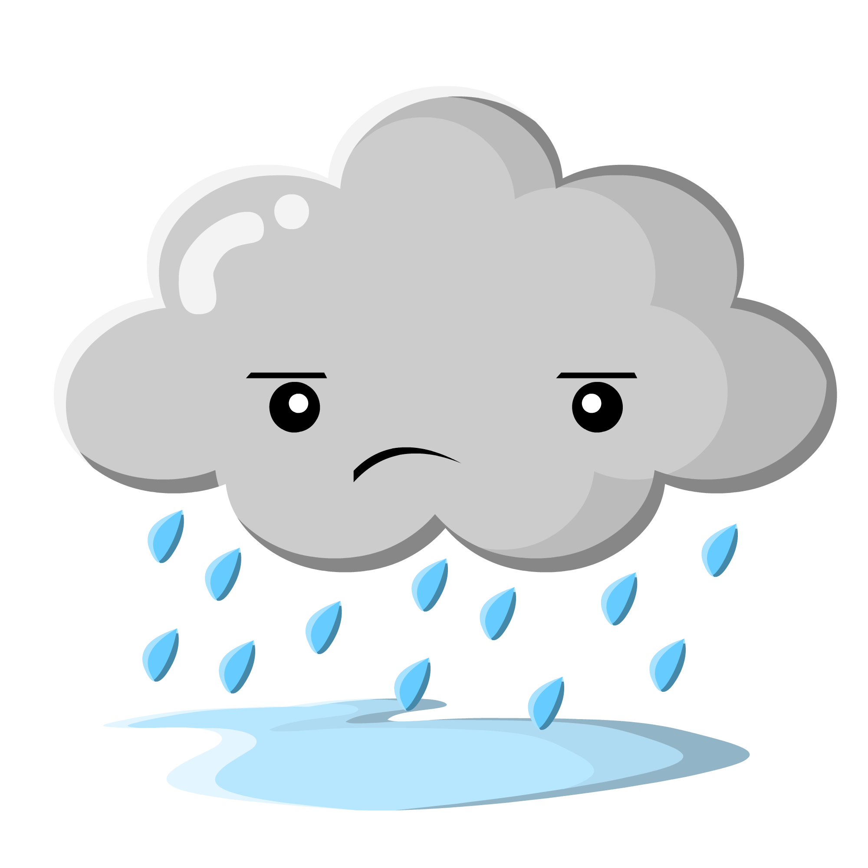
Challenges
  Time & availability to run models frequently
enough when balancing other responsibilities
  Training other Water Managers to run forecasts
  During an event we currently only have two proficient modelers
  Four of our watershed models flow into a fifth model
  Have to pass model results from the 4 into the 5th.
  This also effects our ability get holdouts at all locations in the watershed in order to properly assign benefits to projects that affect multiple sub watersheds.

Slide 10
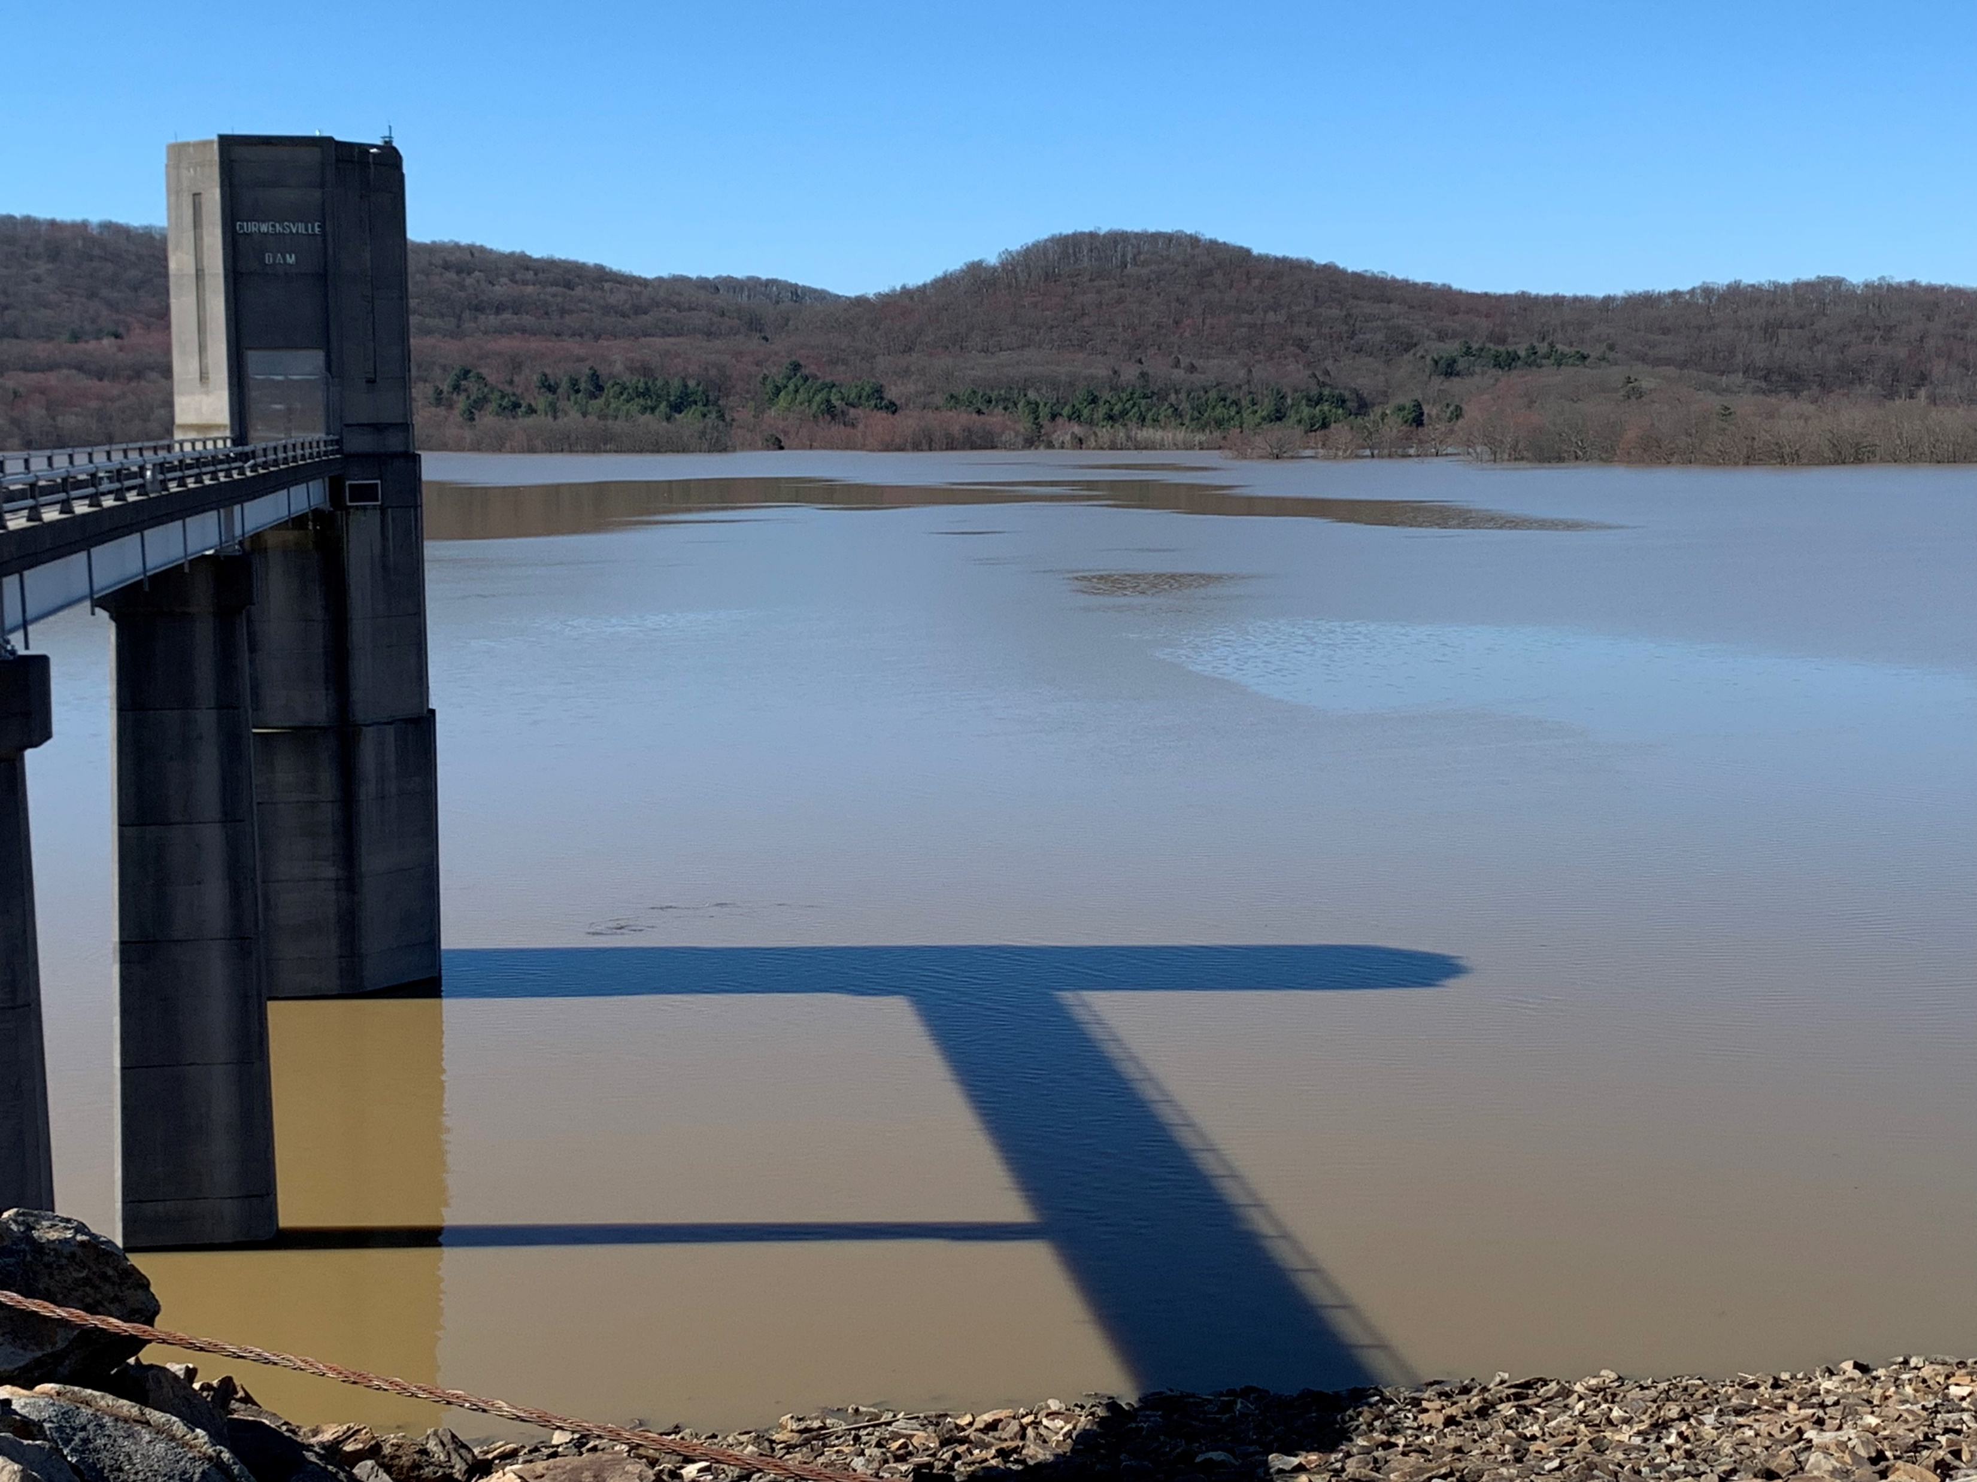
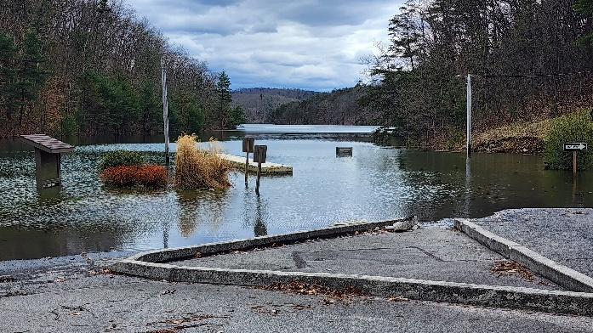
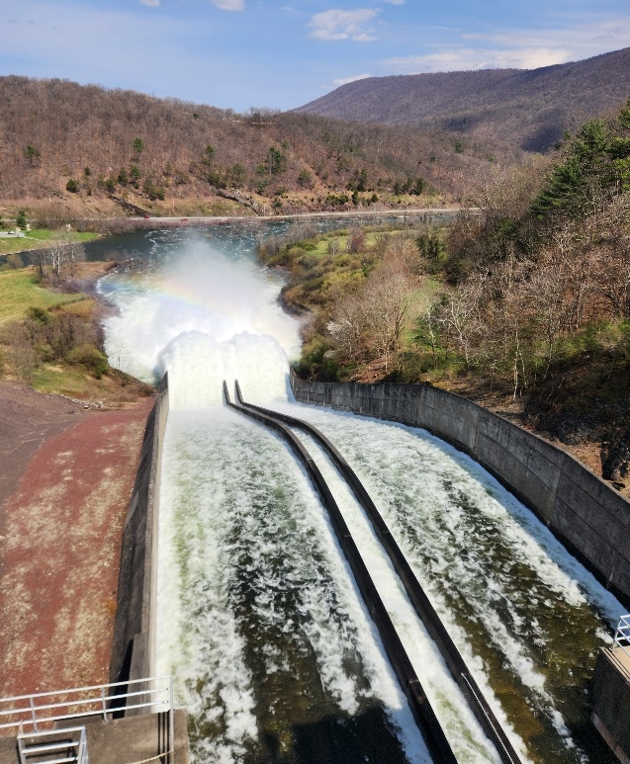
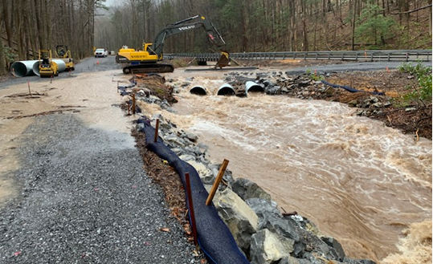
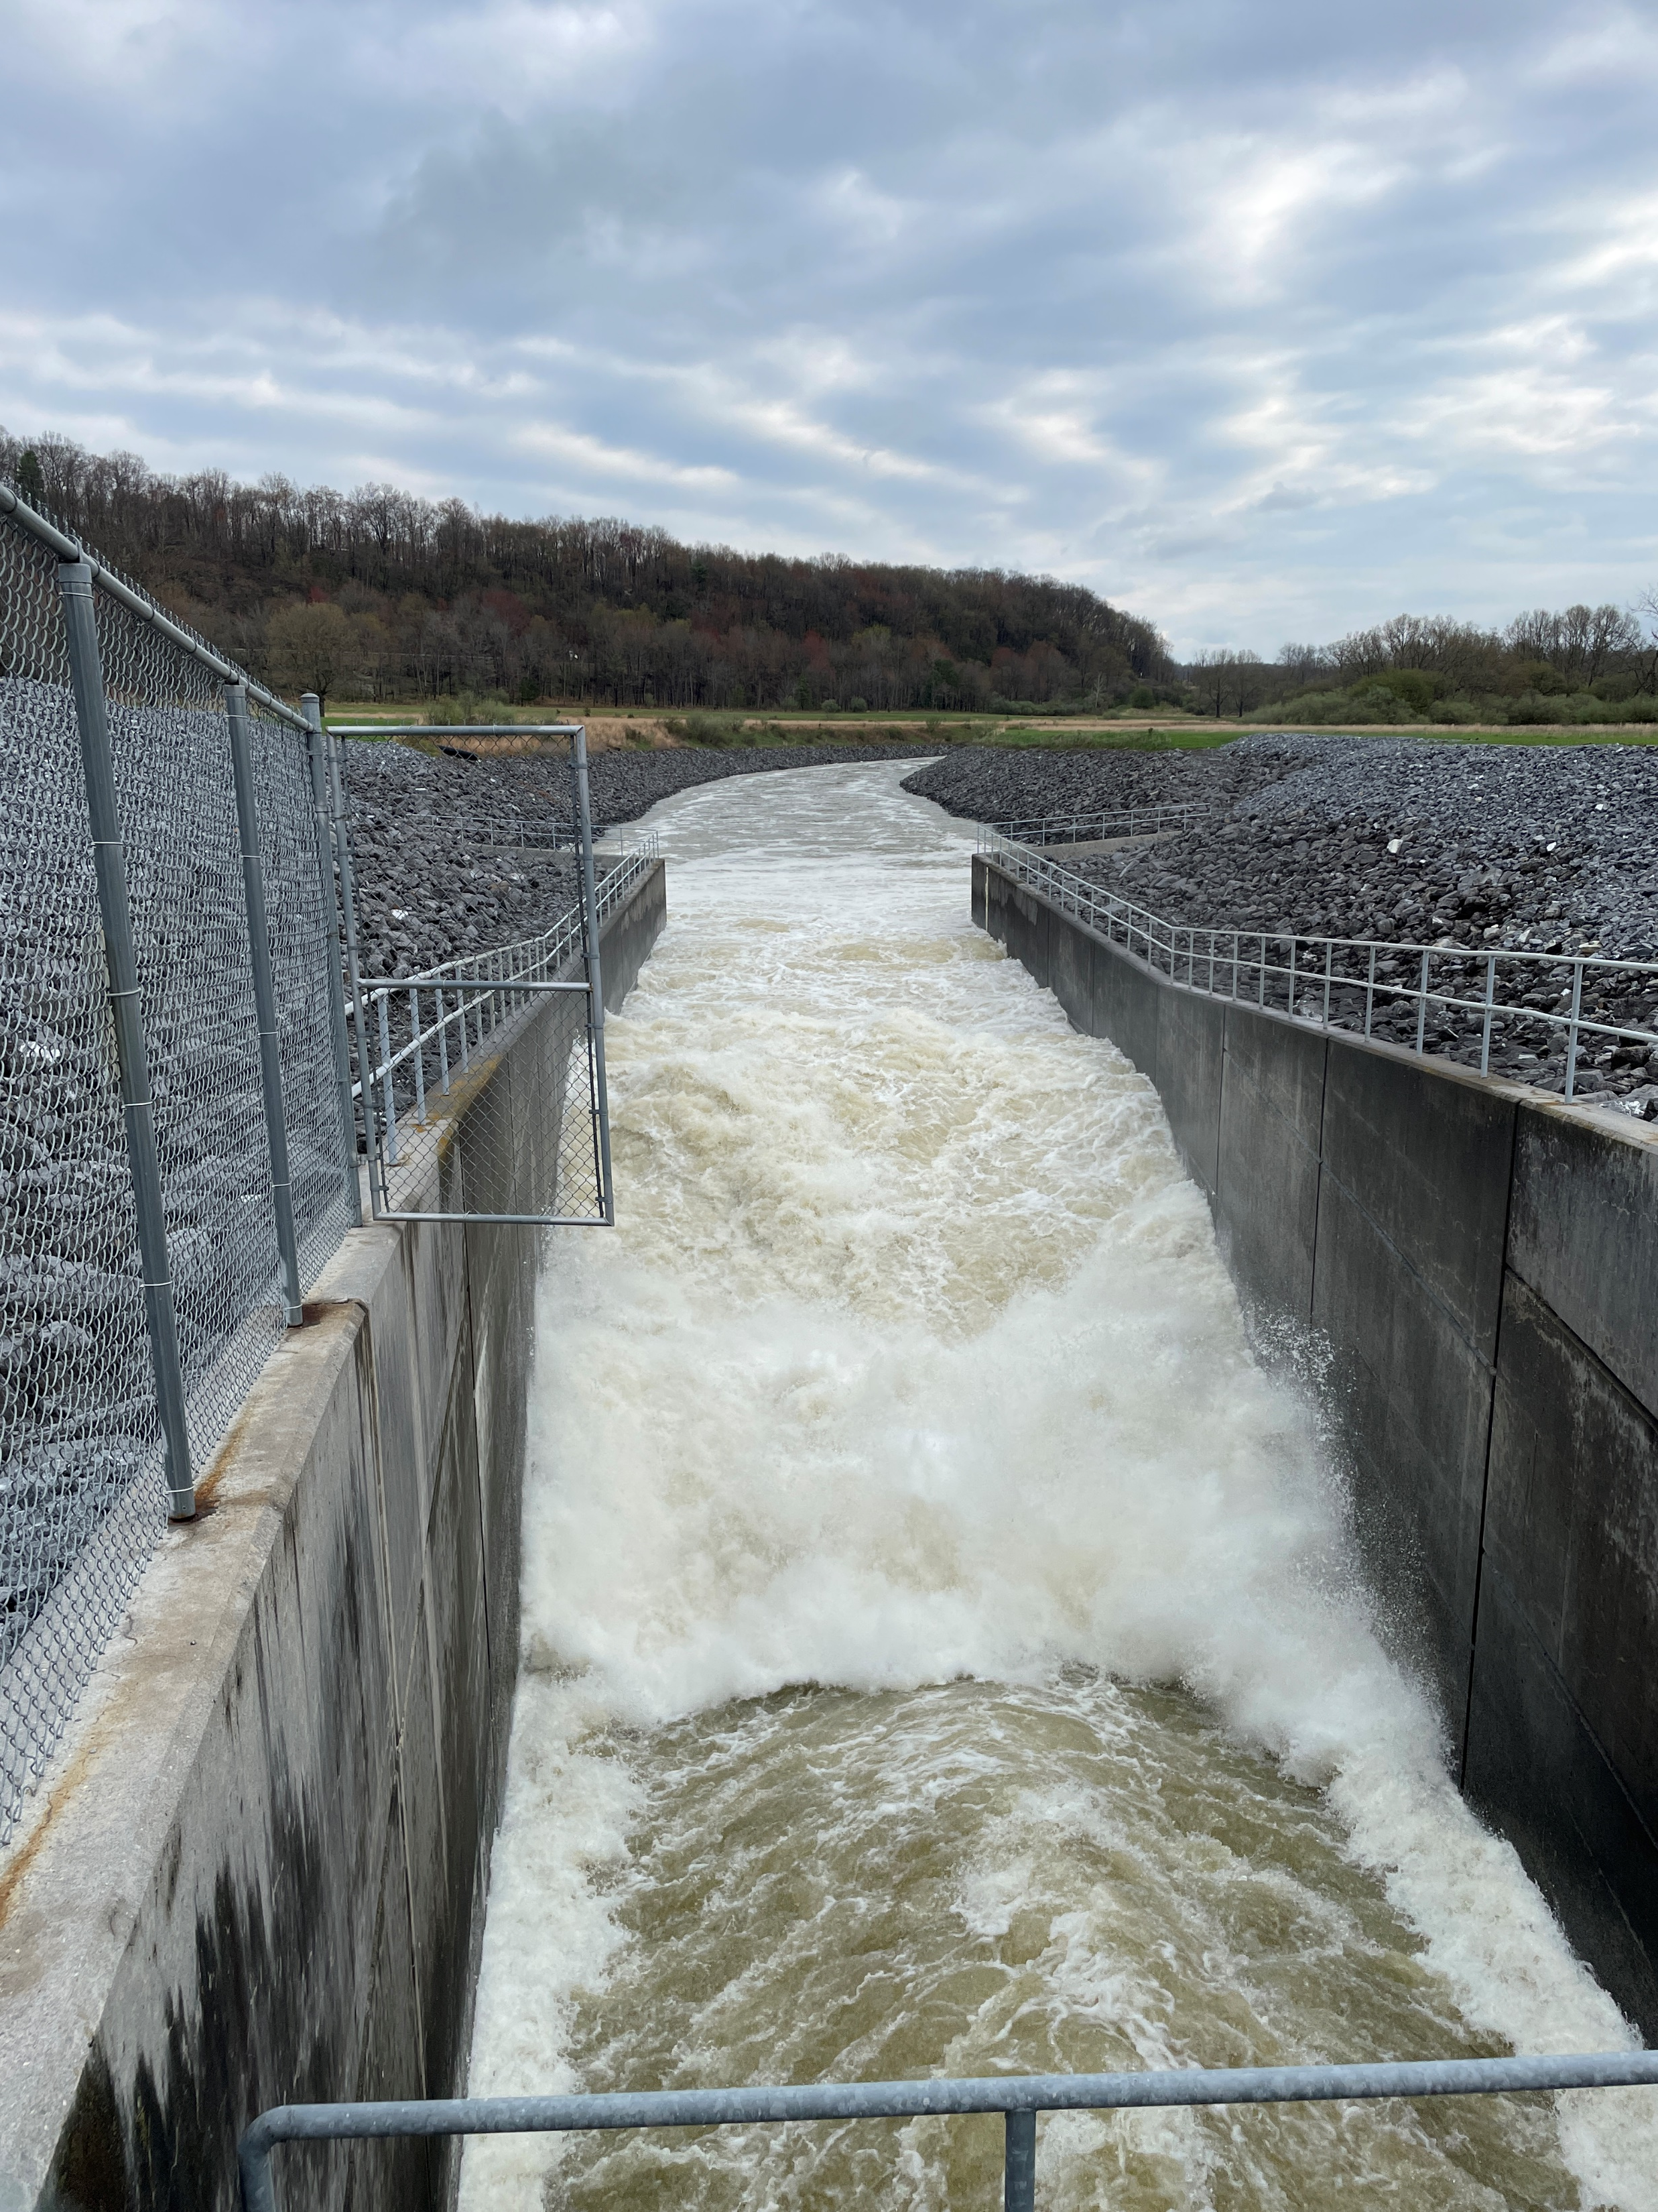
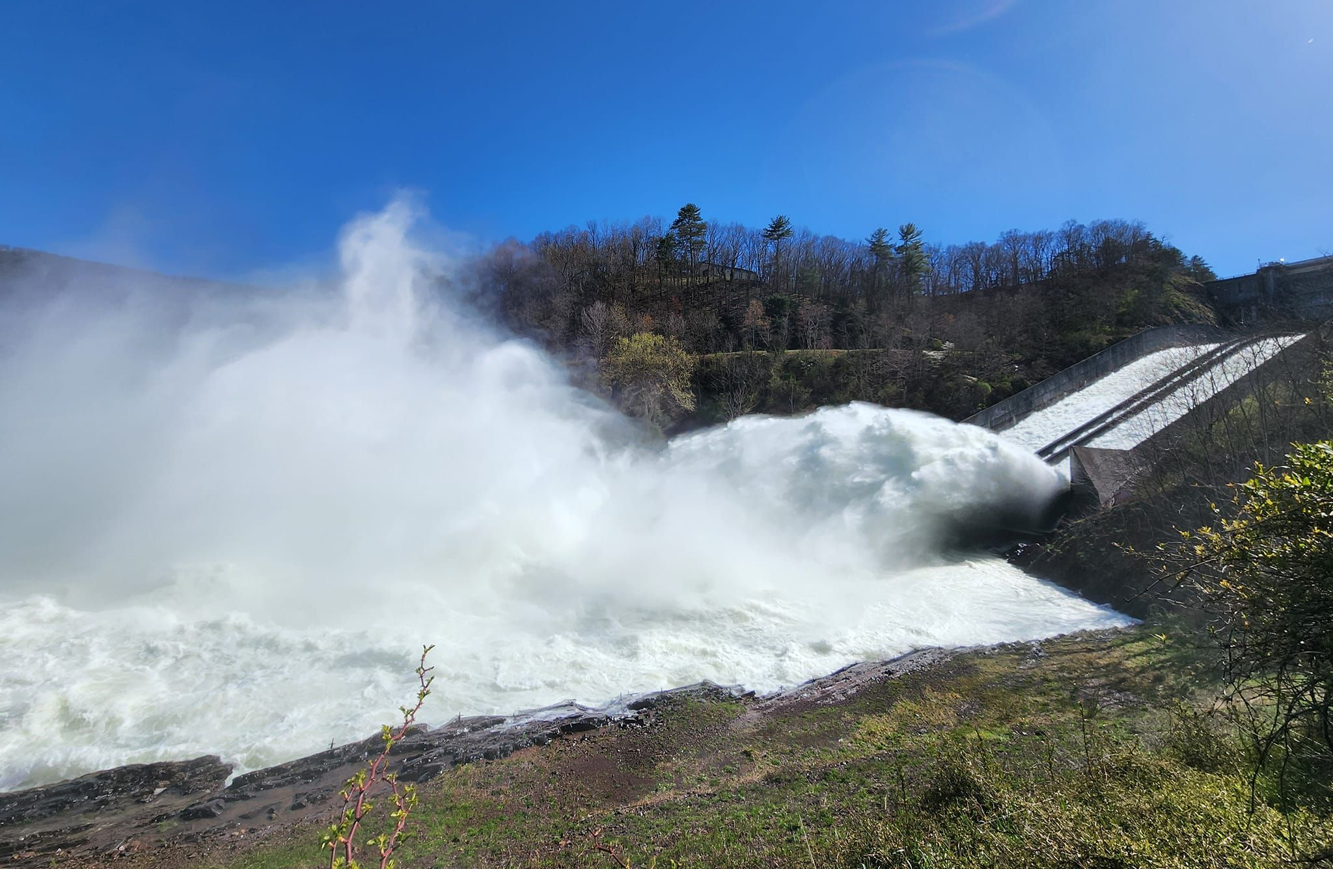
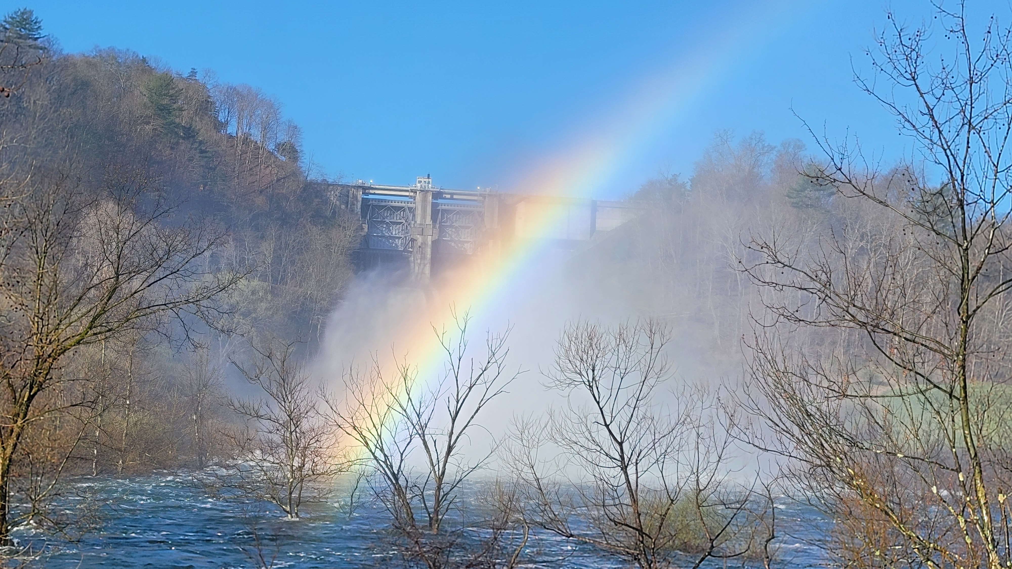
APRIL 2024 FLOOD EVENT
4-5” or rainfall over 4 days
Curwensville Lake
peaked at 51% flood storage used
43’ high (57,500 ac-ft)
3rd highest pool of record
Release = ~4,000 cfs
Release = ~13,000 cfs
Raystown Lake
peaked at 40% flood storage used
20’ high (154,400 ac-ft)
7th highest pool of record

Slide 11
Questions
Help additional Training
https://usace.dps.mil/sites/KMP-WM/SitePages/Corps-Water-Management-System-(CWMS).aspx
https://www.hec.usace.army.mil/confluence/cwmsdocs
https://discourse.hecdev.net/c/cwms/5
TDL-CELRH-EC-GW-W-USACE CWMS Modeling | General | Microsoft Teams

