Slide 1
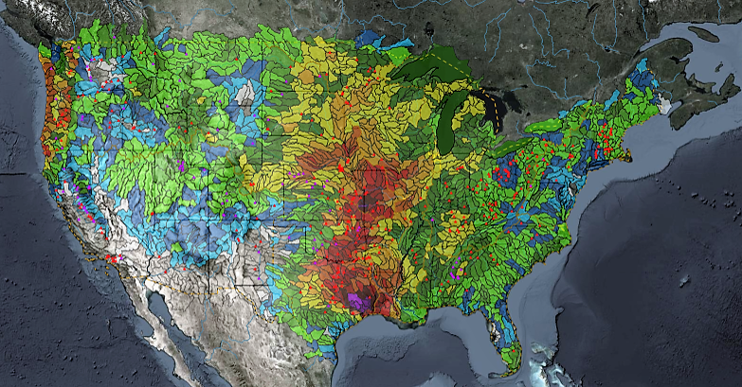
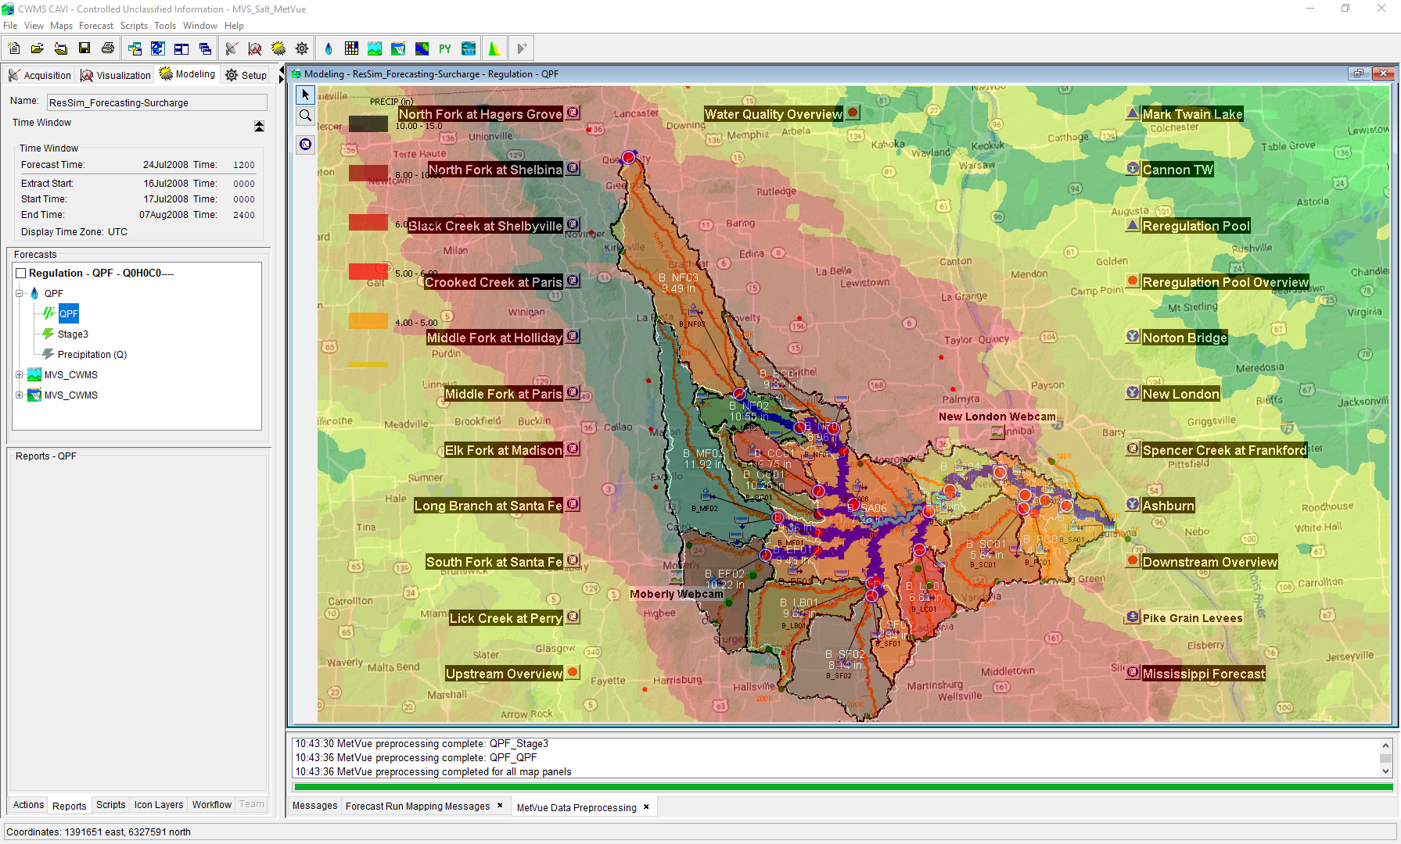

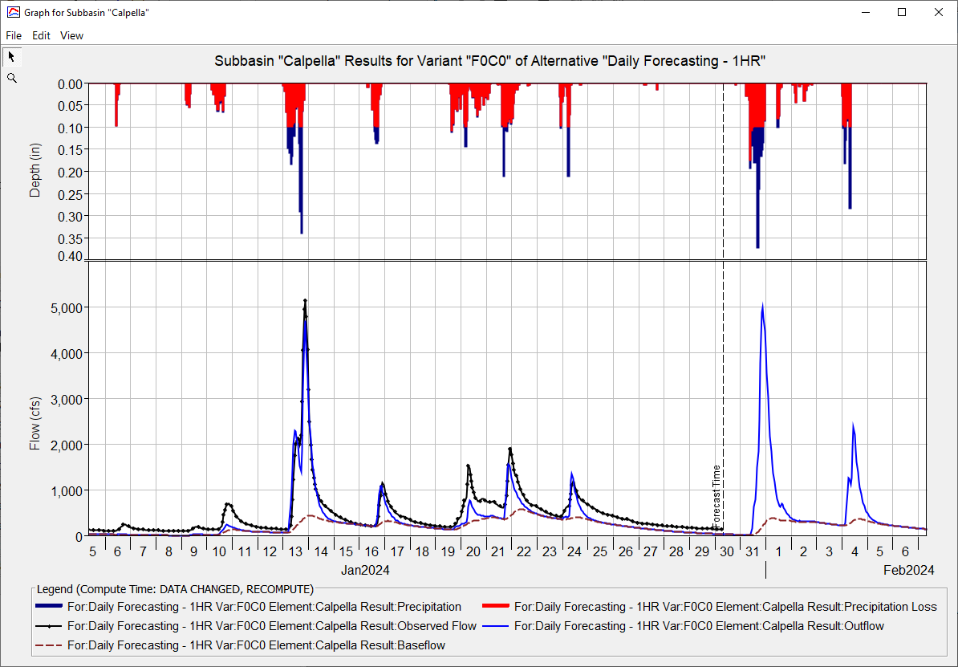
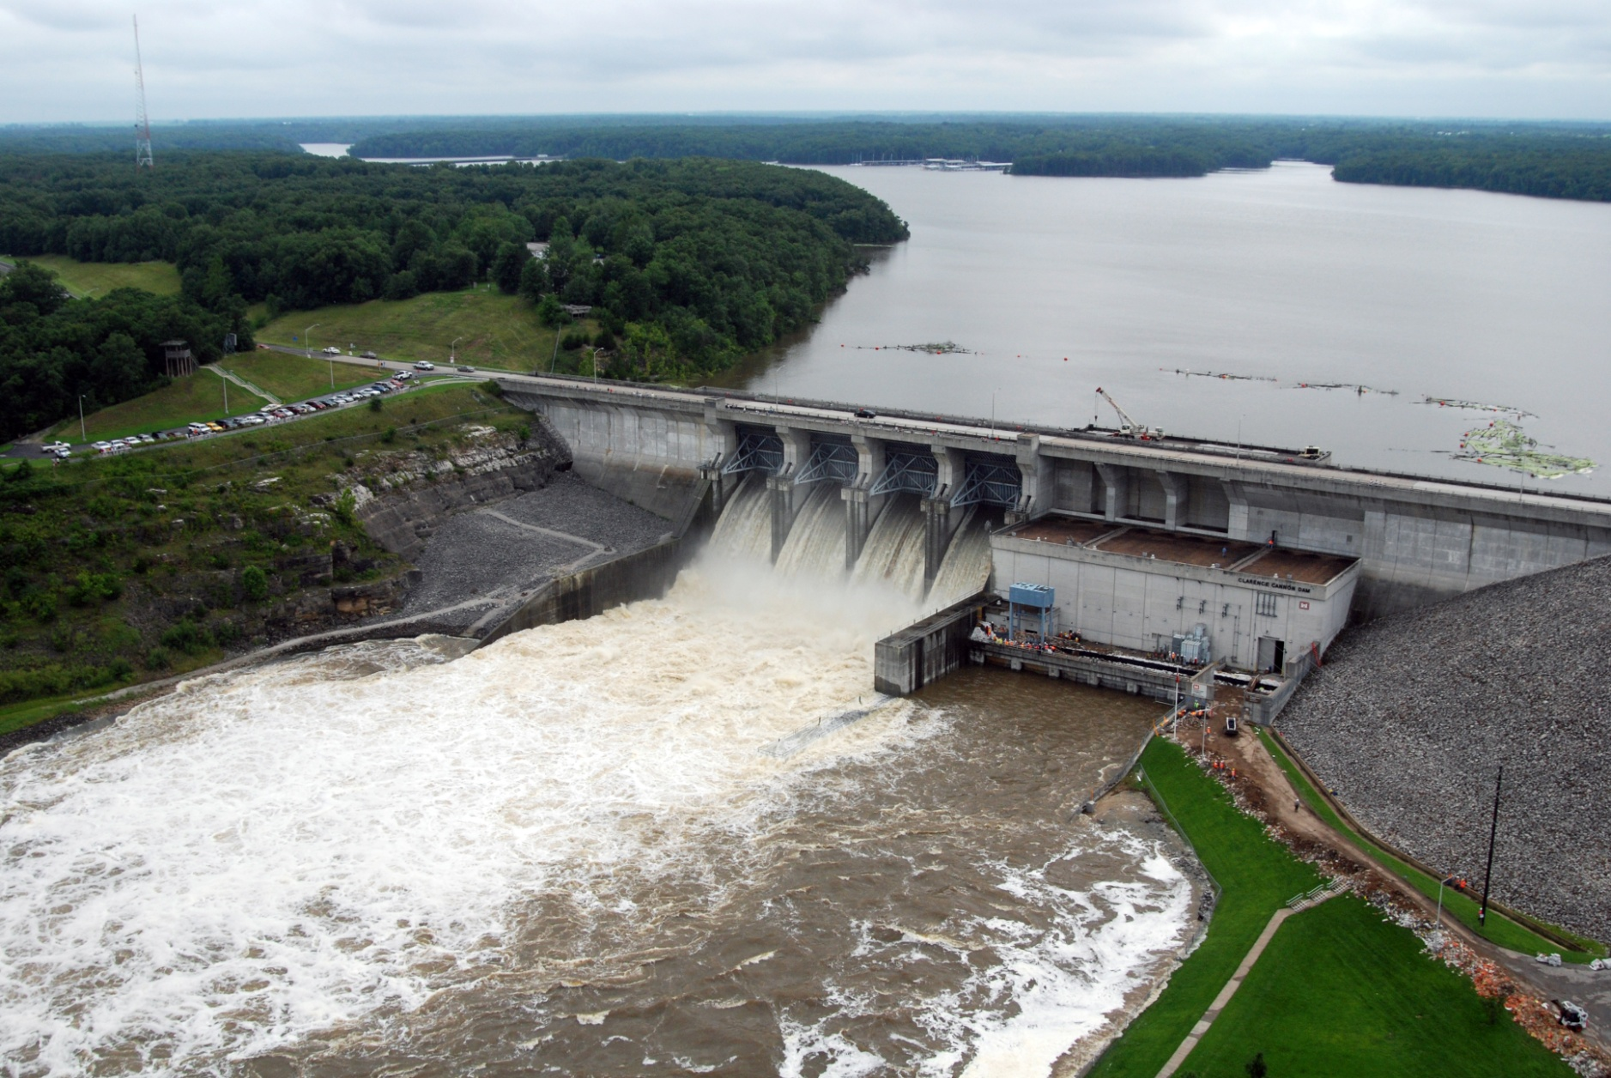
Forecasting with Ensembles in CWMS
Simon Evans, P.E., CFM
Hydrologic Engineering Center
CWMS Prospect Course
Sources of Ensemble Forecasts

Slide 2
Overview
Sources of Ensemble Forecasts
HEC-ResSim Ensemble Compute
CAVI Ensemble Compute
Ensemble Forecast Processor
Ensemble Viewer

Slide 3
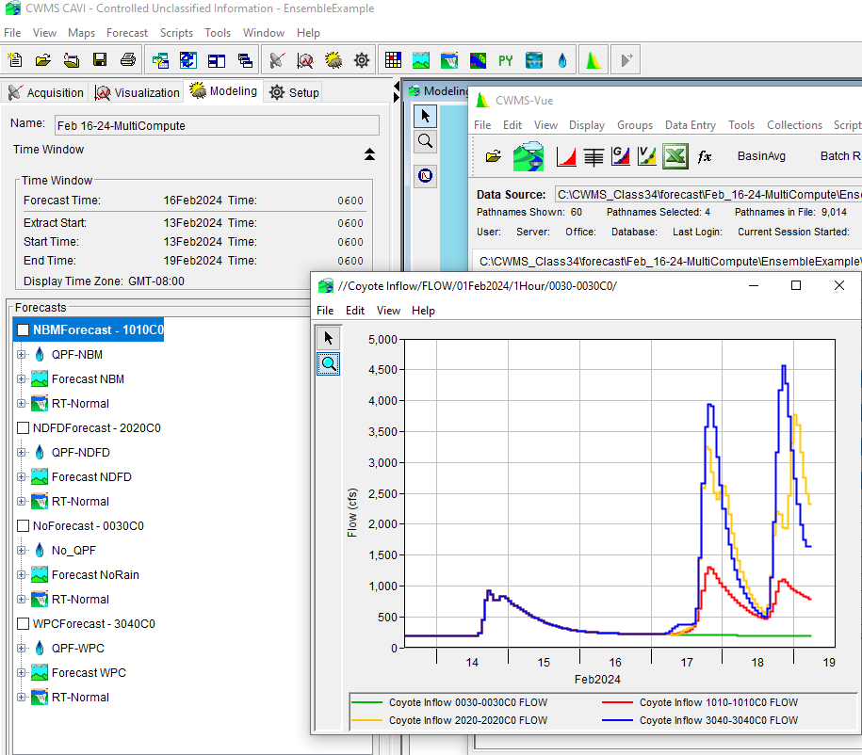
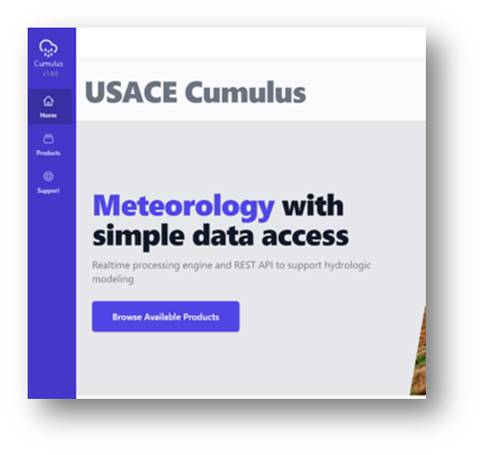
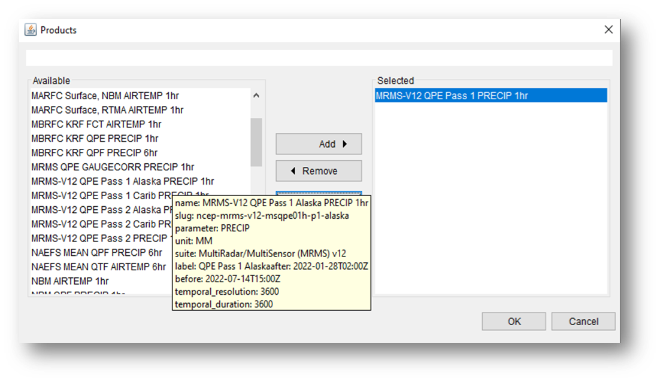
CUMULUS
CWMS supports Cumulus directly:
CorpsNet/VPN access with CAC authentication
https://cumulus.corps.cloud/
HRRR – 1hr
NBM – 1hr
NDFD – 6hr
WPC – 6hr
NAEFS – 6hr

Slide 4
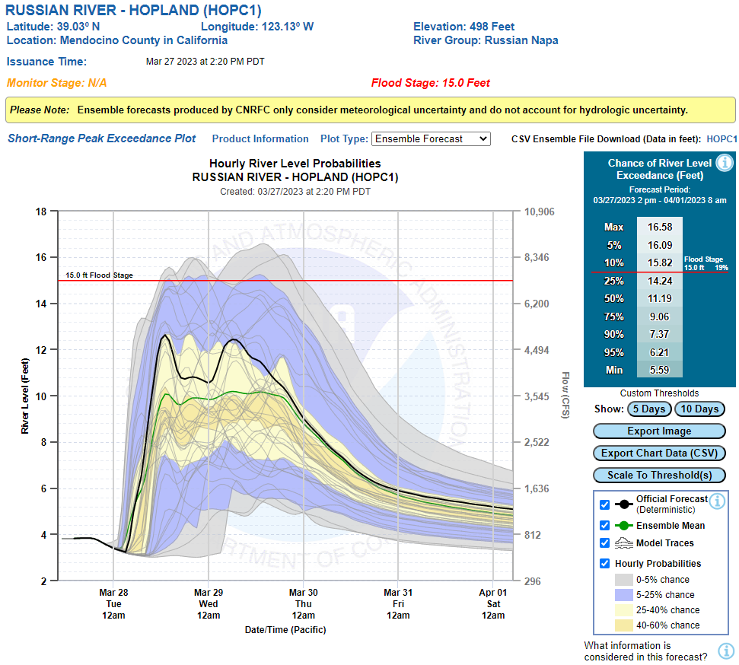
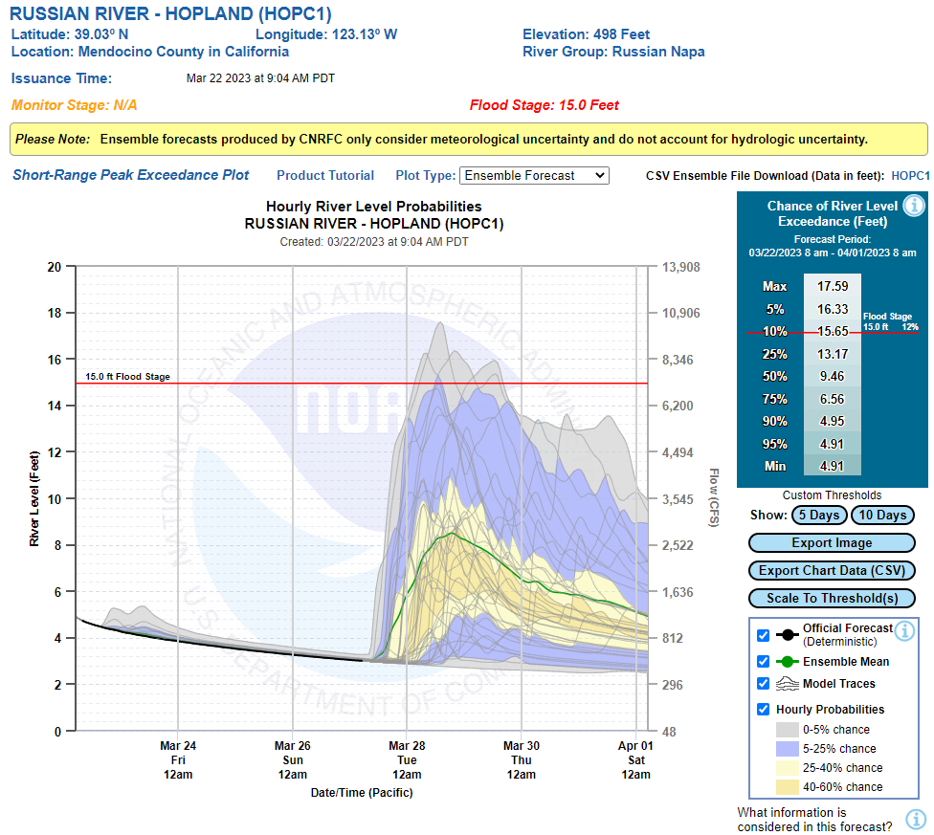
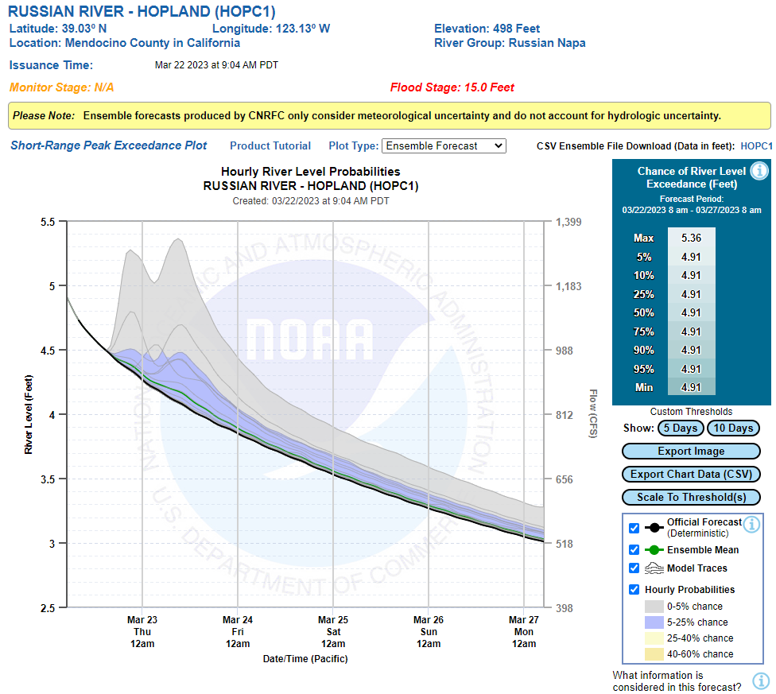
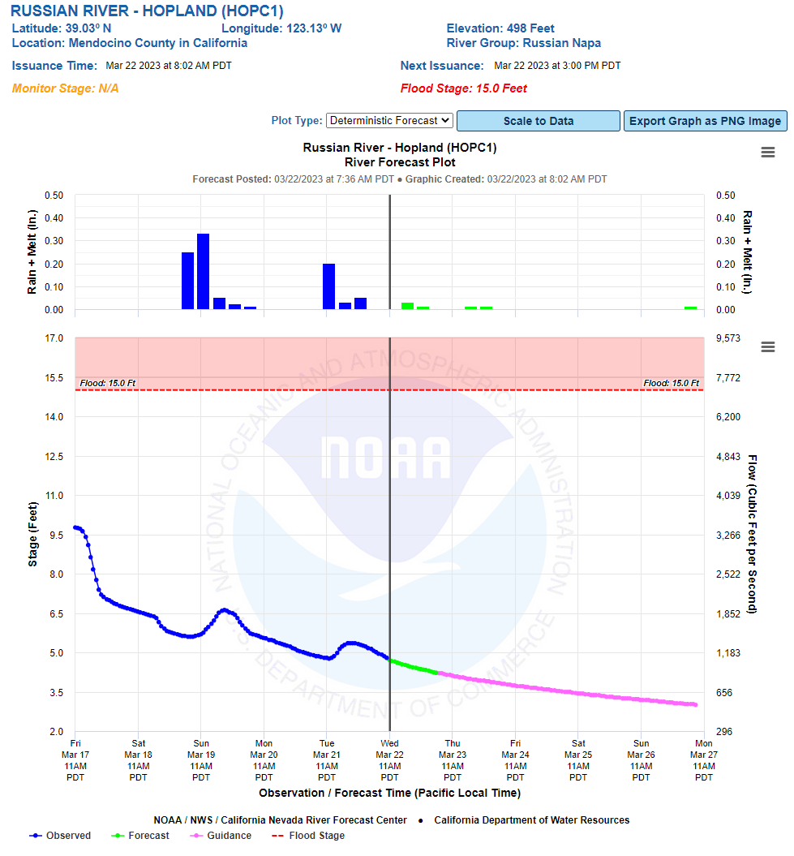
Russian River – Hopland
California Nevada RFC
March Ensemble Forecast
Ensemble Forecast - 5 Day
Ensemble Forecast - 10 Day
Deterministic Forecast

Slide 5
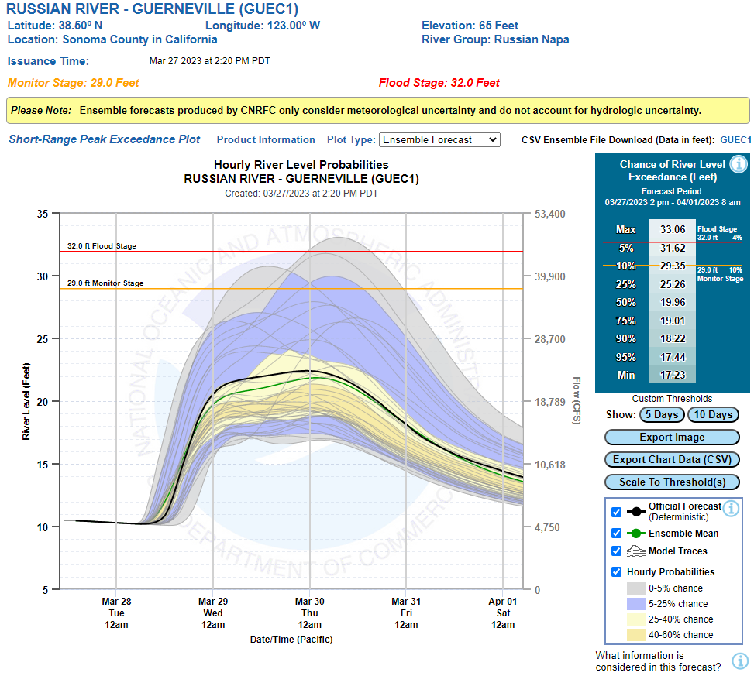
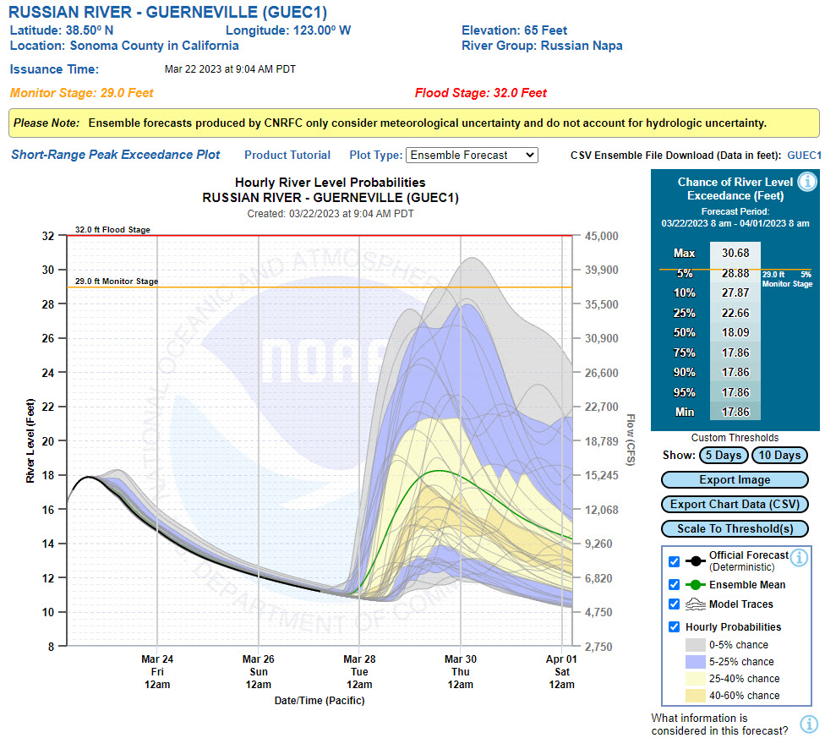
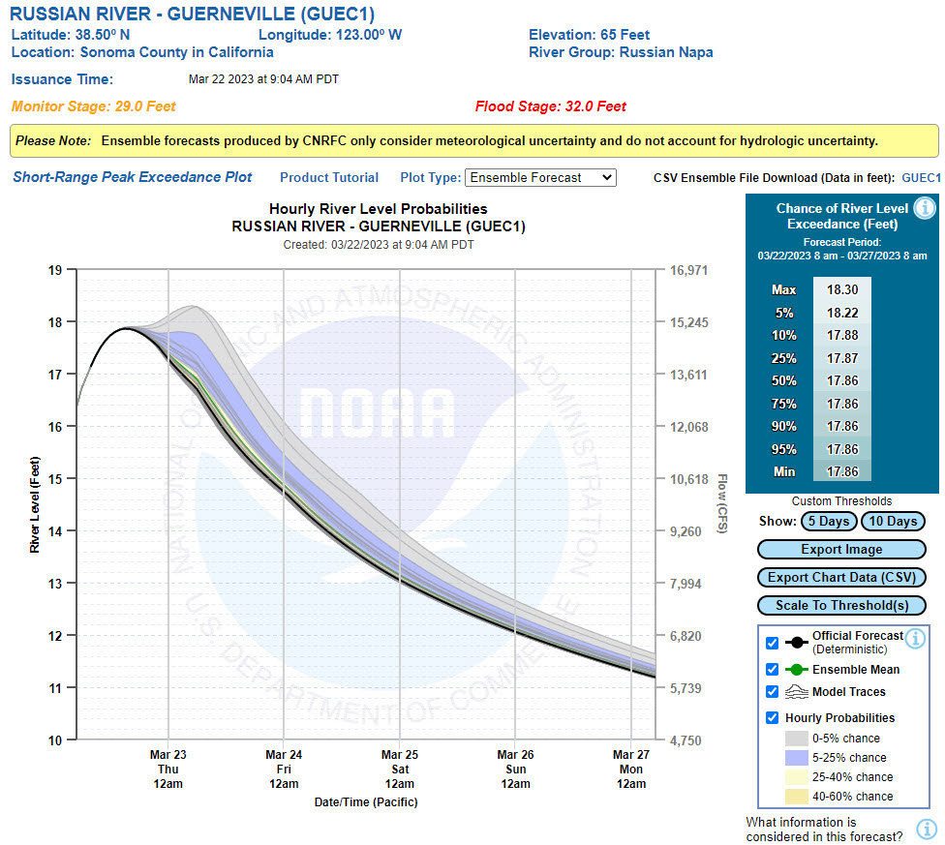
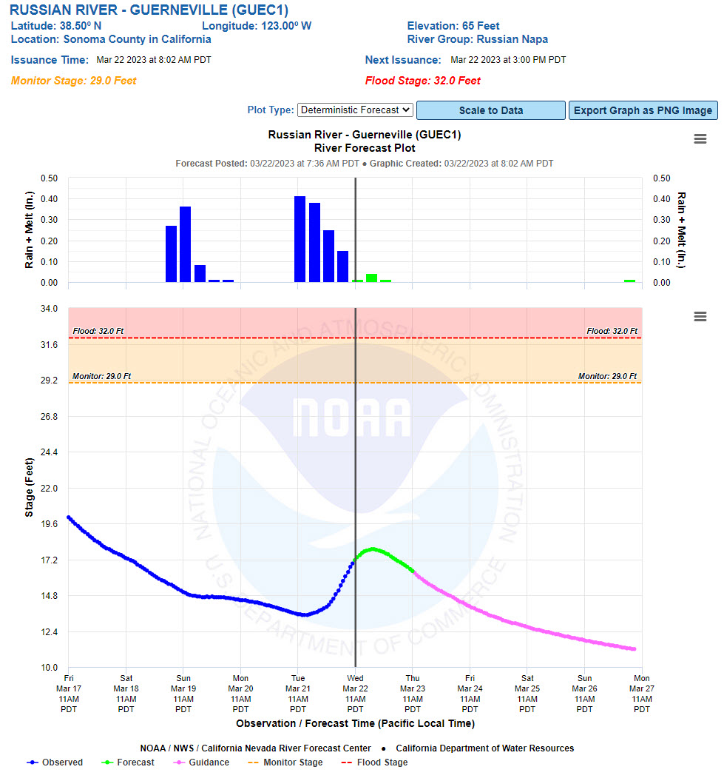
Russian River – Guerneville
California Nevada RFC
March Ensemble Forecast
Ensemble Forecast - 5 Day
Ensemble Forecast - 10 Day
Deterministic Forecast

Slide 6
Questions Help additional Training
https://usace.dps.mil/sites/KMP-WM/SitePages/Corps-Water-Management-System-(CWMS).aspx
https://www.hec.usace.army.mil/confluence/cwmsdocs
https://discourse.hecdev.net/c/cwms/5
TDL-CELRH-EC-GW-W-USACE CWMS Modeling | General | Microsoft Teams

