Slide 1
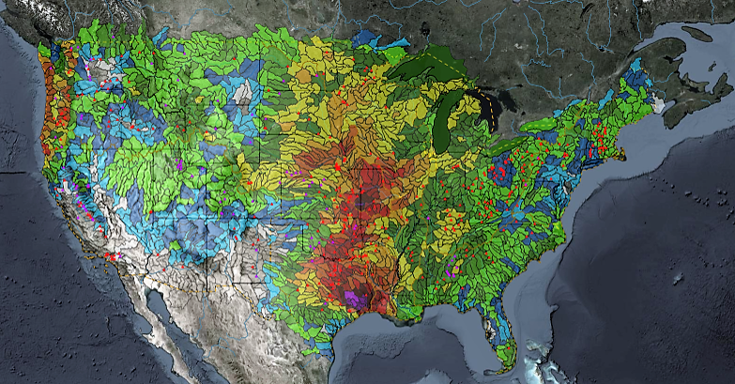
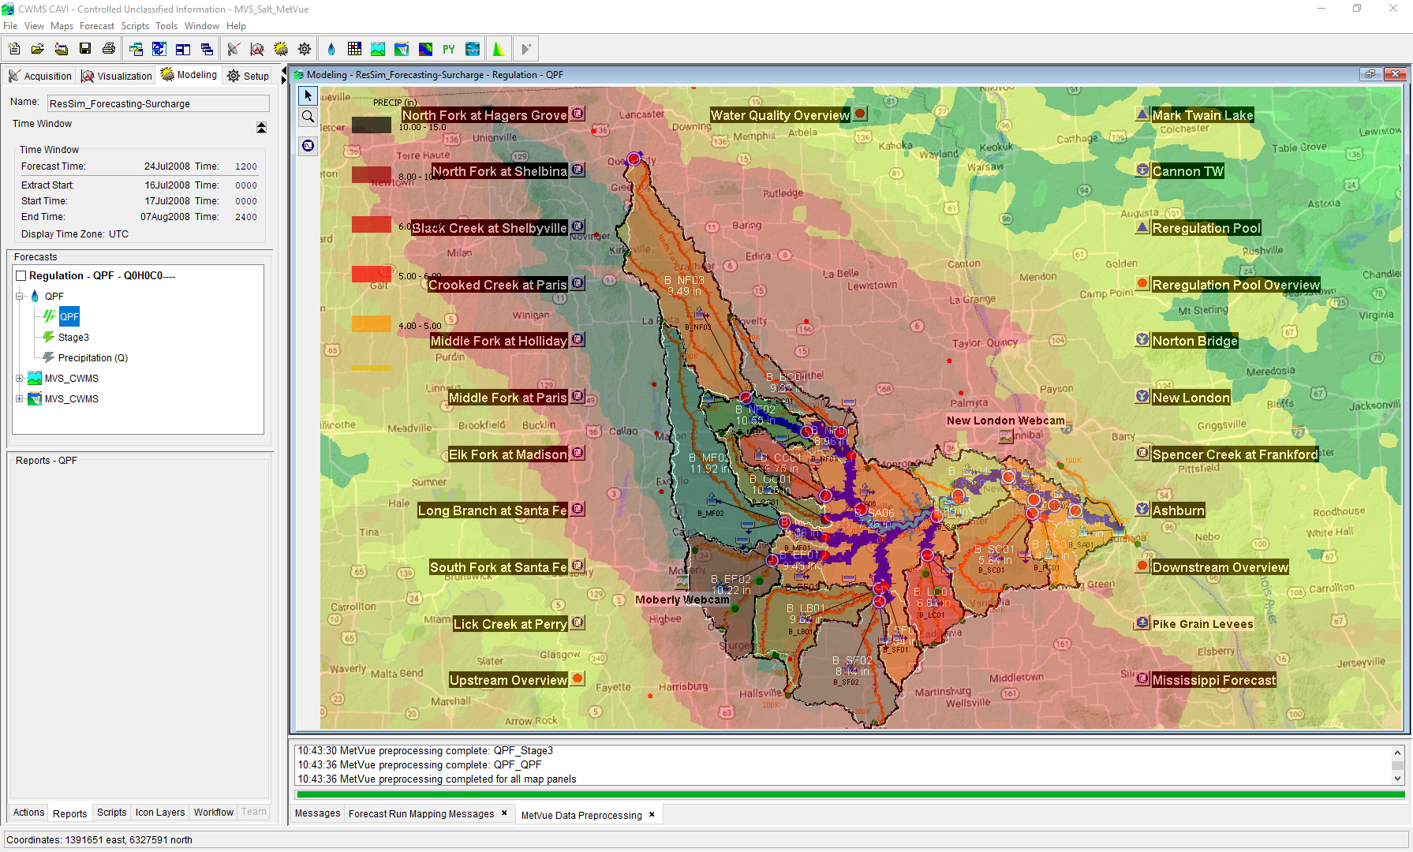

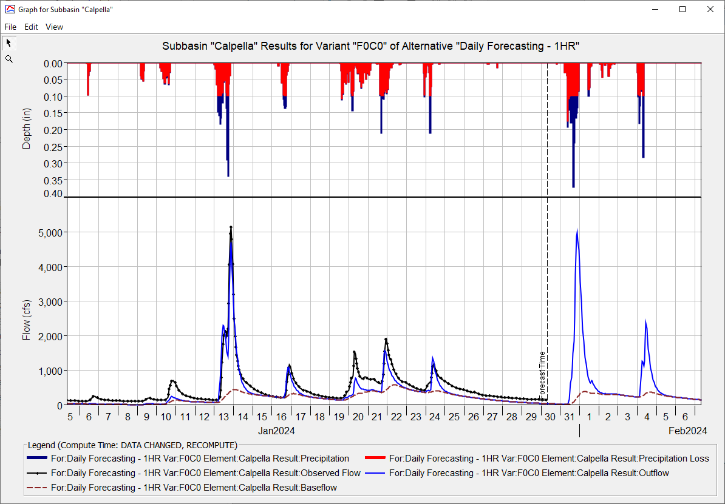
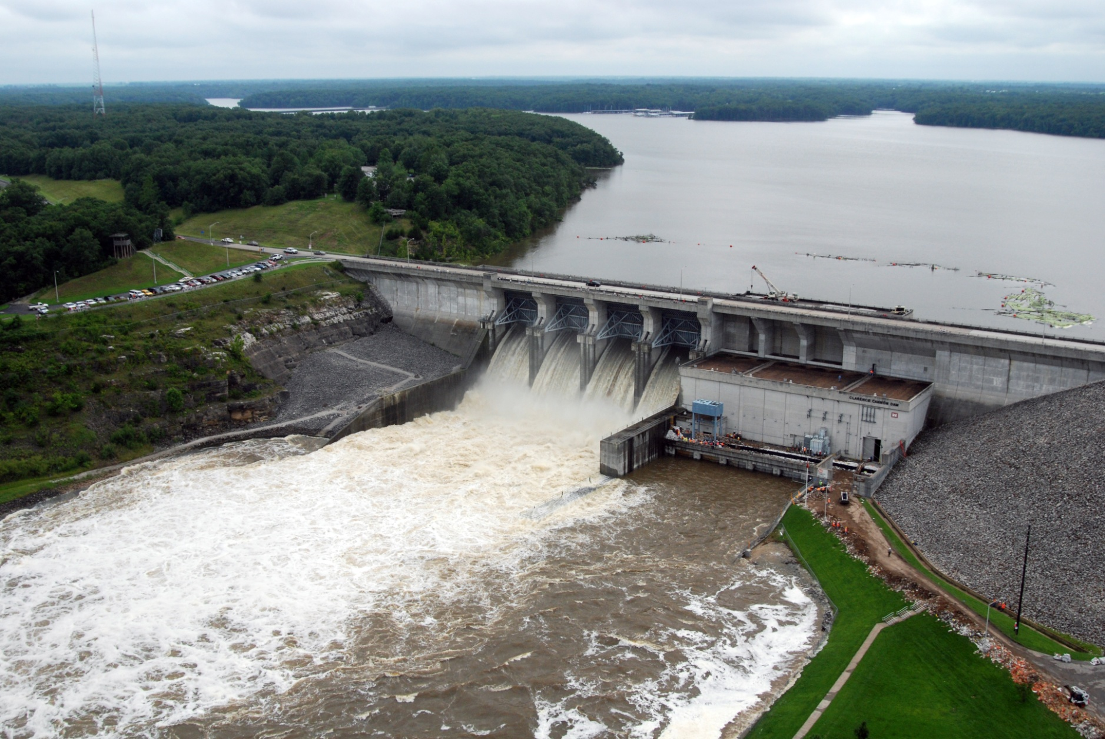
Forecasting with Ensembles in CWMS
Simon Evans, P.E., CFM
Hydrologic Engineering Center
CWMS Prospect Course
CAVI Ensemble Compute

Slide 2
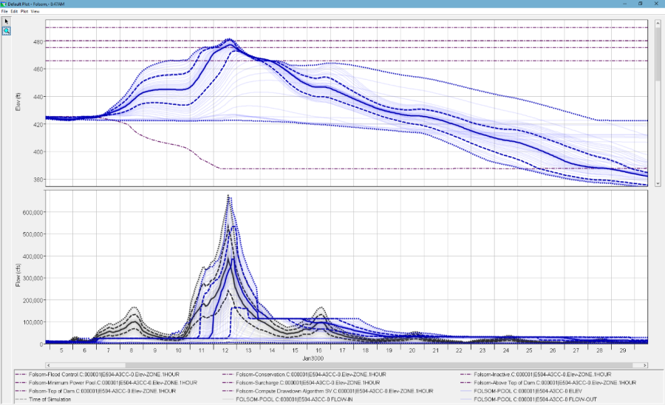

HEC-ResSIm Ensemble Compute
HEC-ResSim
DSS
1
DSS
1
2
2
3
3
n
n
Ensemble
of Input
Reservoir Inflows
Ensemble
of Computed Reservoir Outflows

Slide 3
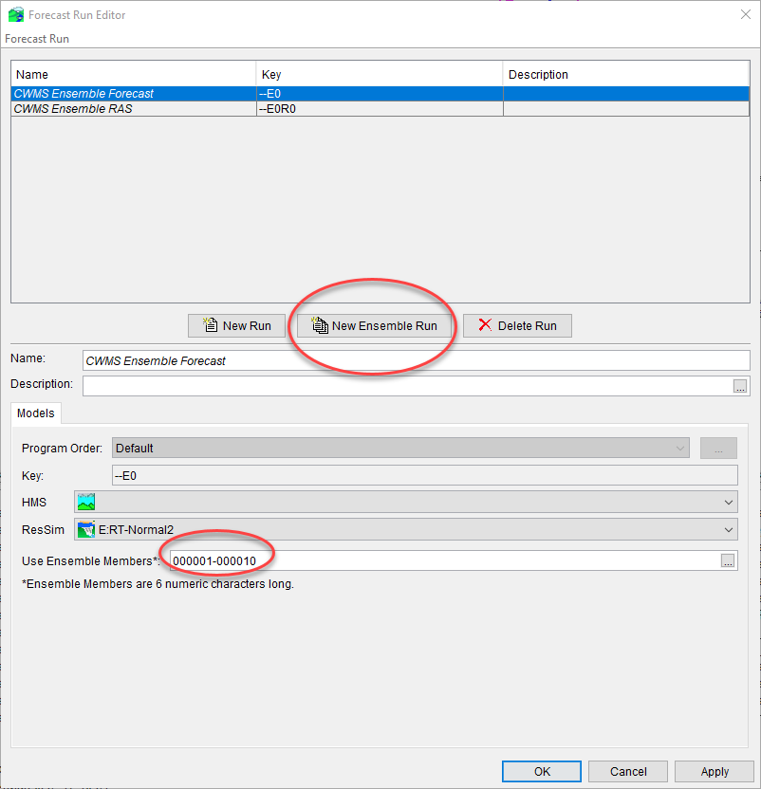
CAVI Ensemble Compute
What does it do?
Each trace used sequentially in an isolated pass through the Program Order
Each trace generates a separate watershed “run” folder in the forecast
Results in separate forecast.dss files, then rolled into a master forecast.dss at end.
Current Limitations
Ensemble input data only from HEC-DSS, not CWMS Database
Gridded ensembles not yet supported
Lacks dedicated tools for reviewing and analyzing results

Slide 4
Questions Help additional Training
https://usace.dps.mil/sites/KMP-WM/SitePages/Corps-Water-Management-System-(CWMS).aspx
https://www.hec.usace.army.mil/confluence/cwmsdocs
https://discourse.hecdev.net/c/cwms/5
TDL-CELRH-EC-GW-W-USACE CWMS Modeling | General | Microsoft Teams

