Slide 1
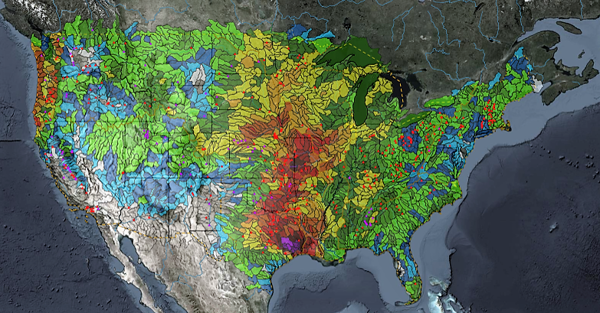
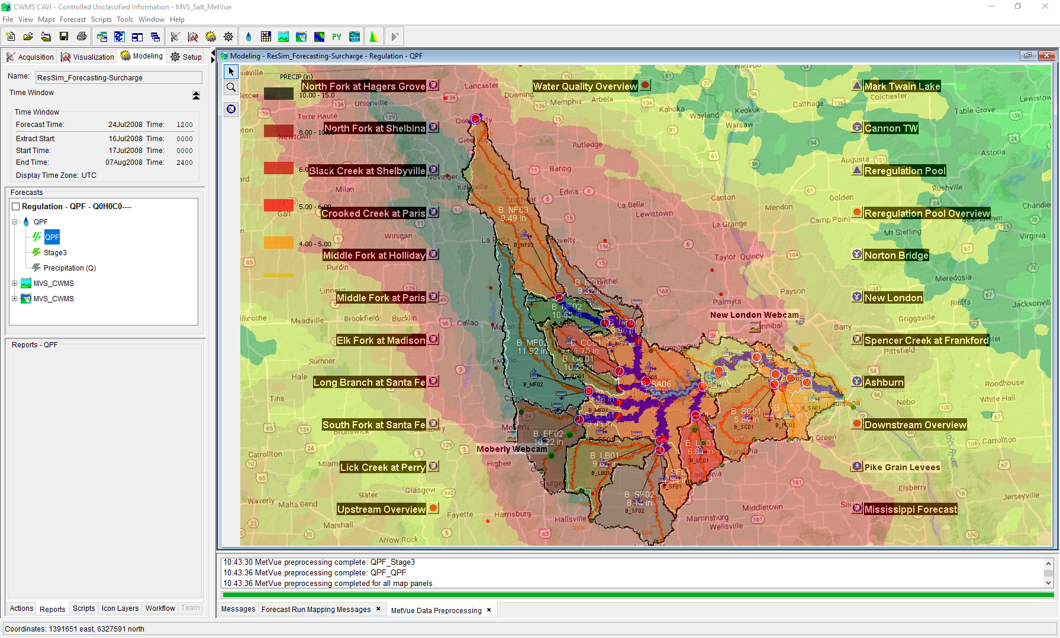

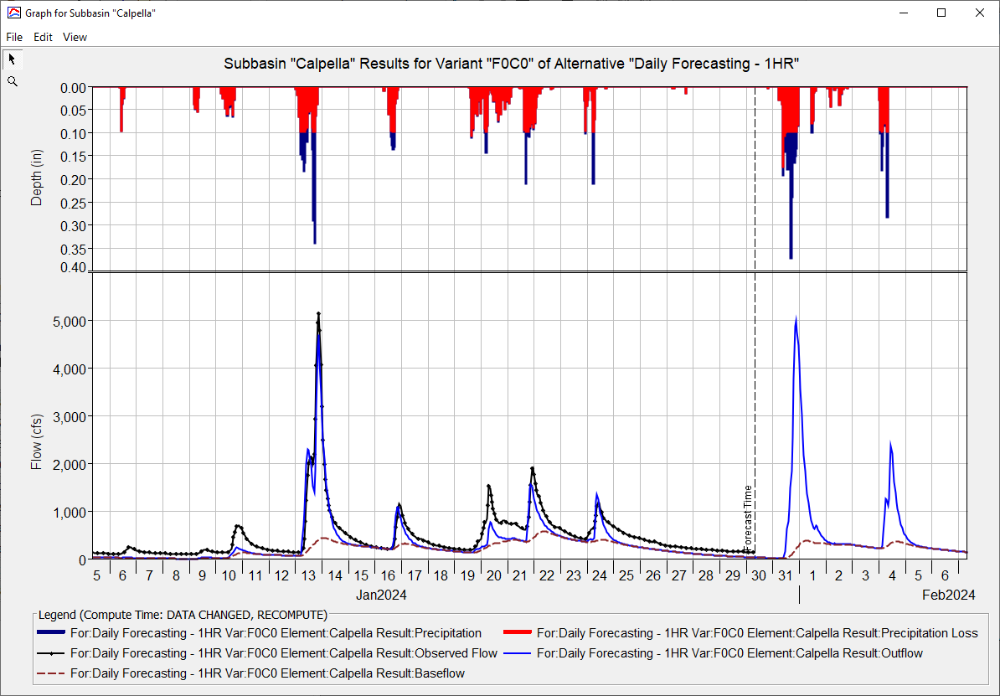
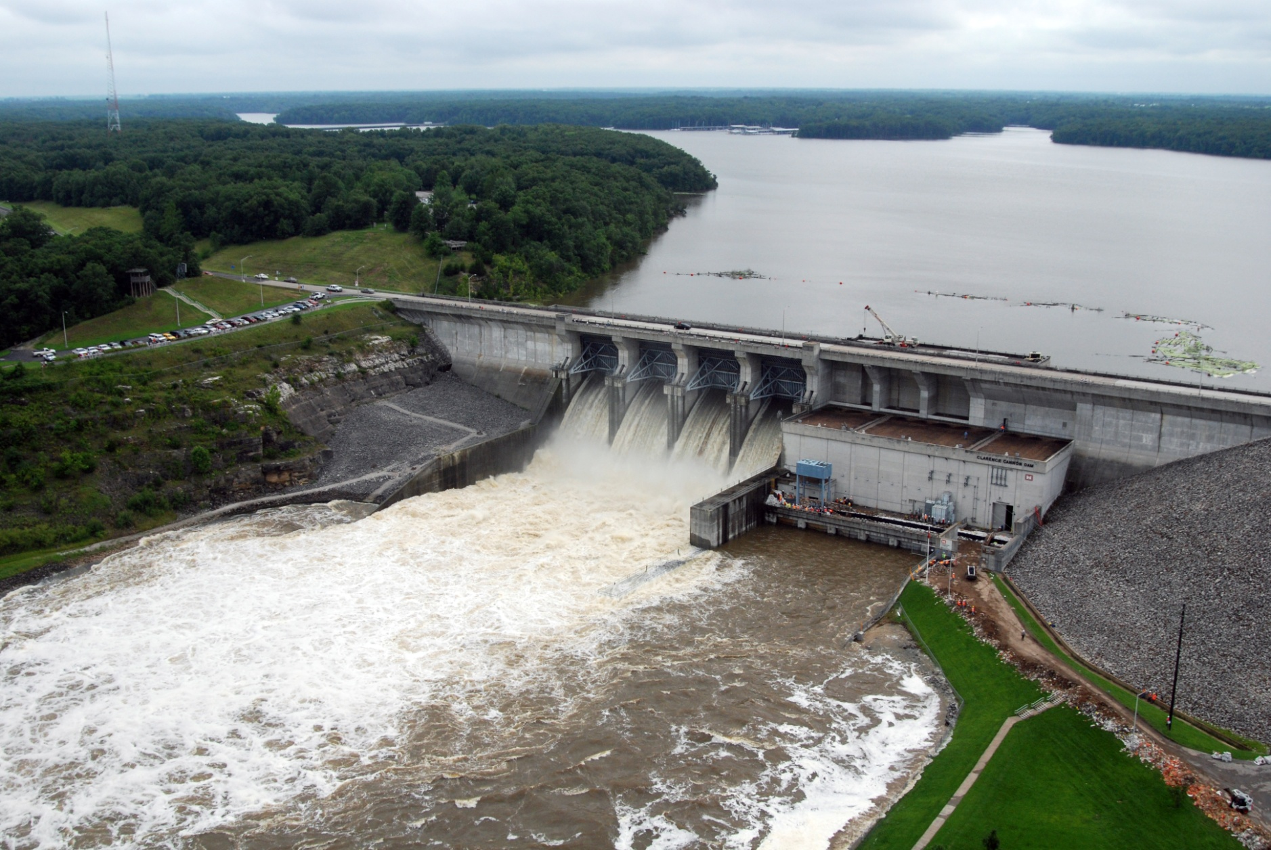
Forecasting with Ensembles in CWMS
Simon Evans, P.E., CFM
Hydrologic Engineering Center
CWMS Prospect Course

Slide 2
Ensemble Forecast Processor (EFP)
What does it do?
  New plugin first available in CWMS 3.4
  Based on HEC-WAT FIRO Forecast Processor
  Part of the Program Order
  Allow user to specify locations within the watershed to calculate statistical metrics from ensemble time series.
  Metrics can be used as input to other applications within the CWMS forecast

Slide 3
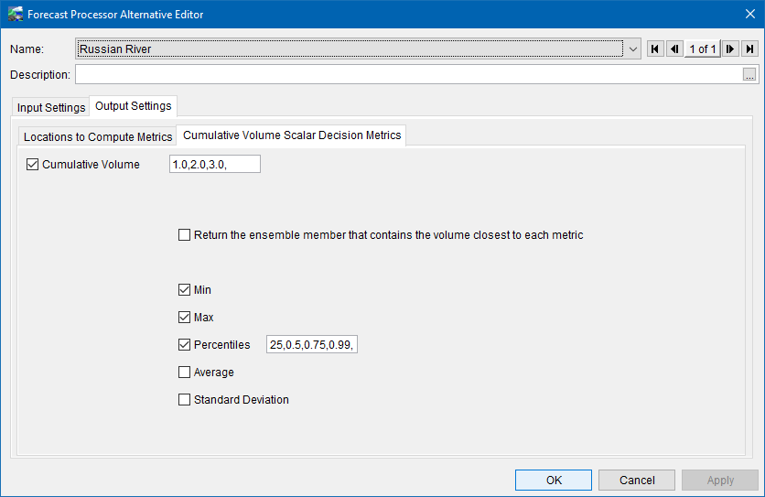
Ensemble Forecast Processor
  Metrics to be computed can either be Scalar or time series
  Scalar metrics:
  Can be used to influence rules in ResSim Alternative (FIRO)
  User defined alternatives
  Based on Prado FIRO Case Study approach

Slide 4
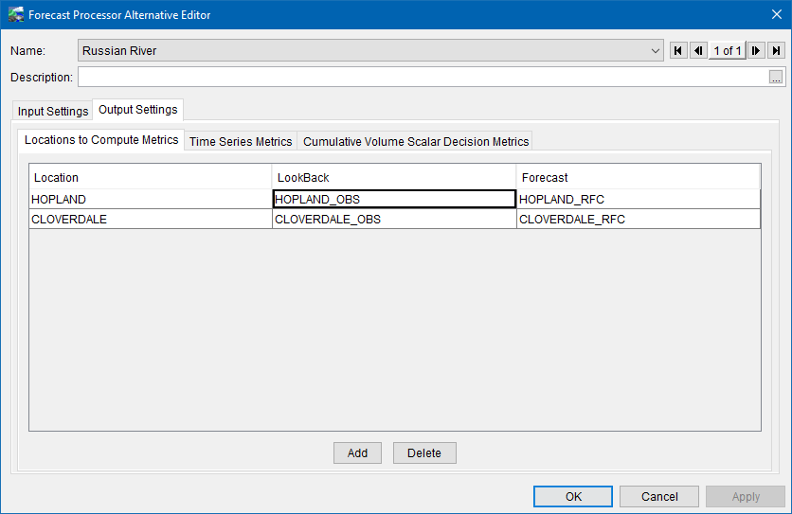
Ensemble Forecast Processor
  Time Series metrics
  Allow for reduced number of ensemble members to be used for input to other models
  For a chosen metric(s) return the specific ensemble member that has the closest volume
  If applicable merge observed time series with the returned ensemble member

Slide 5
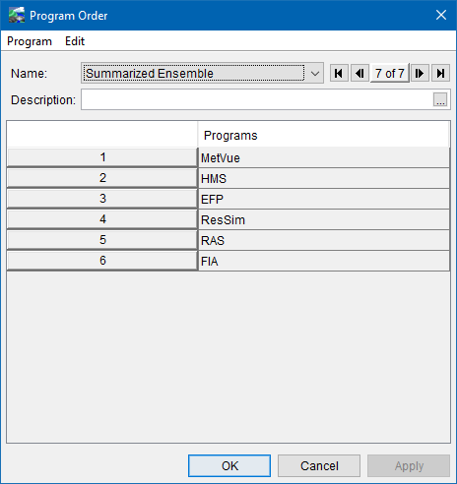
Summarized ensemble forecast
Ensemble CSV
Ensemble DSS
Raw
HEFS Data
Extract
Gridded DSS
HEC-MetVue
+
HEC-HMS
Uncontrolled Flows
Ensemble DSS
DSS
Ensemble Forecast
Processor (EFP)
Metric Data
Metric Data + Uncontrolled Flows
HEC-ResSim
Regulated Flows
Regulated Flows
HEC-RAS + HEC-FIA

Slide 6
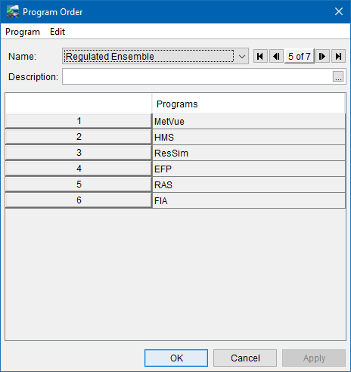
Regulated ensemble forecast
Ensemble CSV
Ensemble DSS
Raw
HEFS Data
Extract
Gridded DSS
HEC-MetVue
+
HEC-HMS
Uncontrolled Flows
Ensemble DSS + Uncontrolled Flows
DSS
Ensemble
HEC-ResSim
Regulated Ensemble DSS
Ensemble Forecast
Processor (EFP)
Regulated Ensemble DSS
Ensemble Summary
Ensemble Summary
HEC-RAS + HEC-FIA

Slide 7
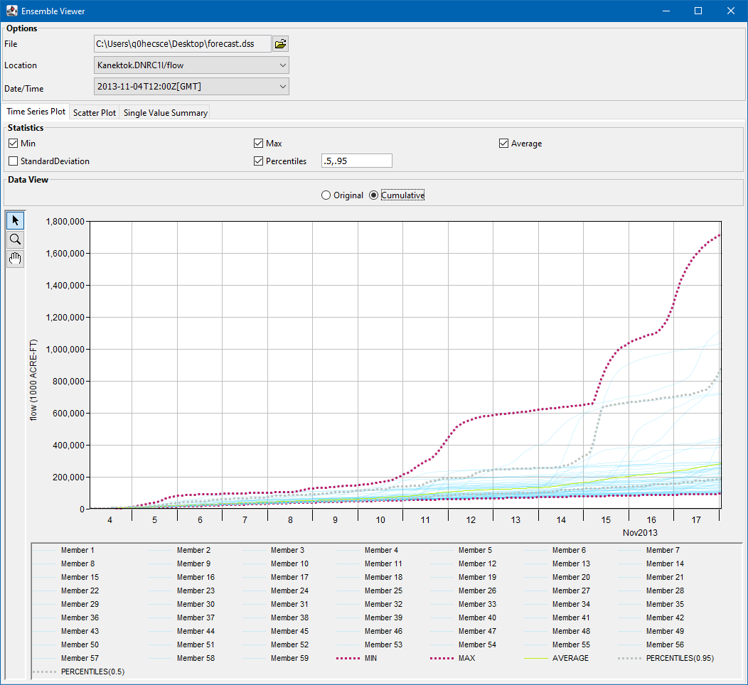
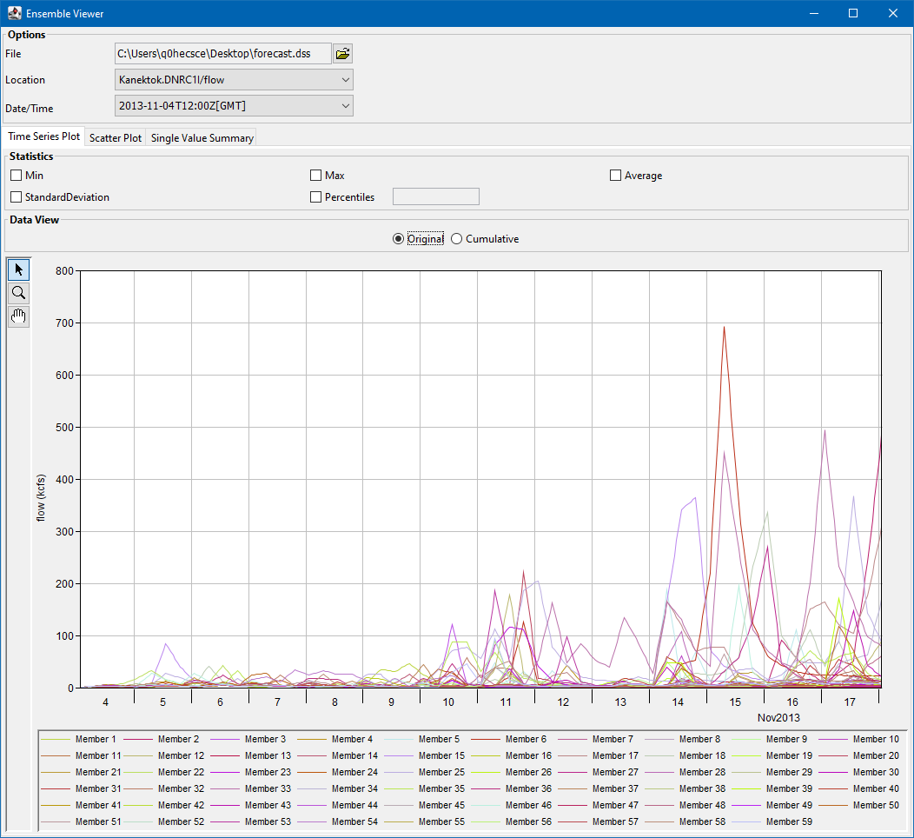
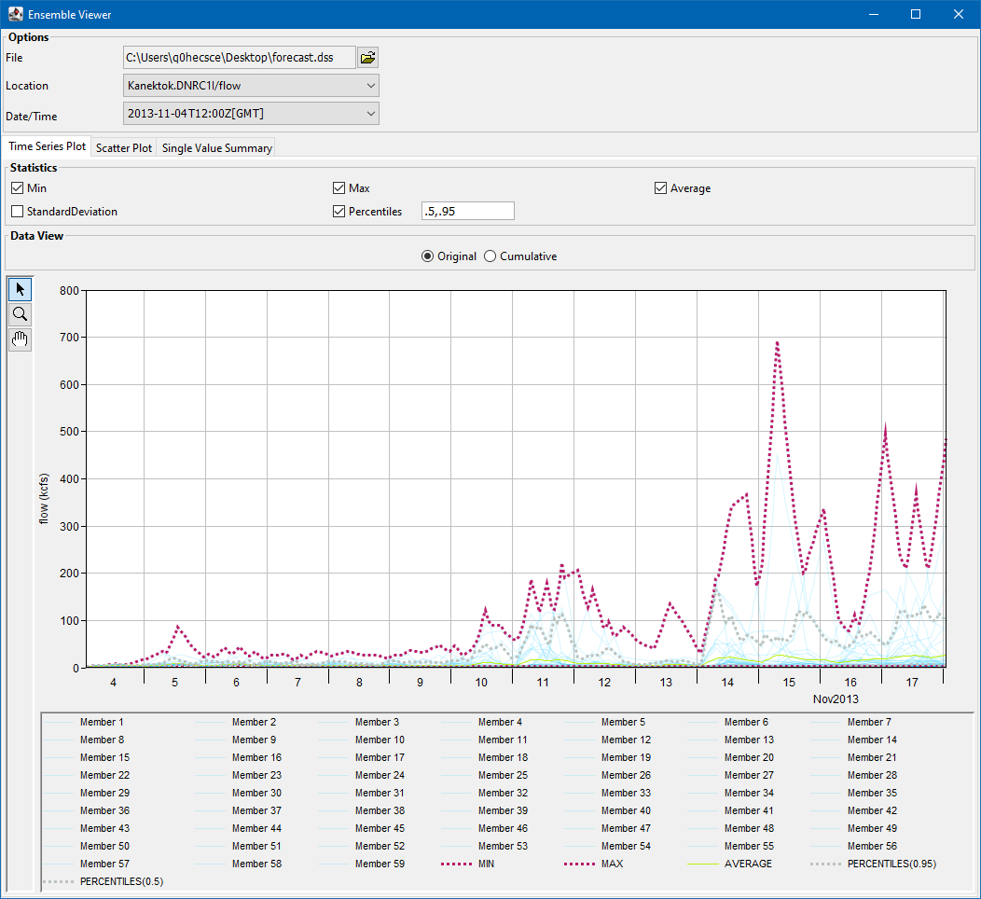
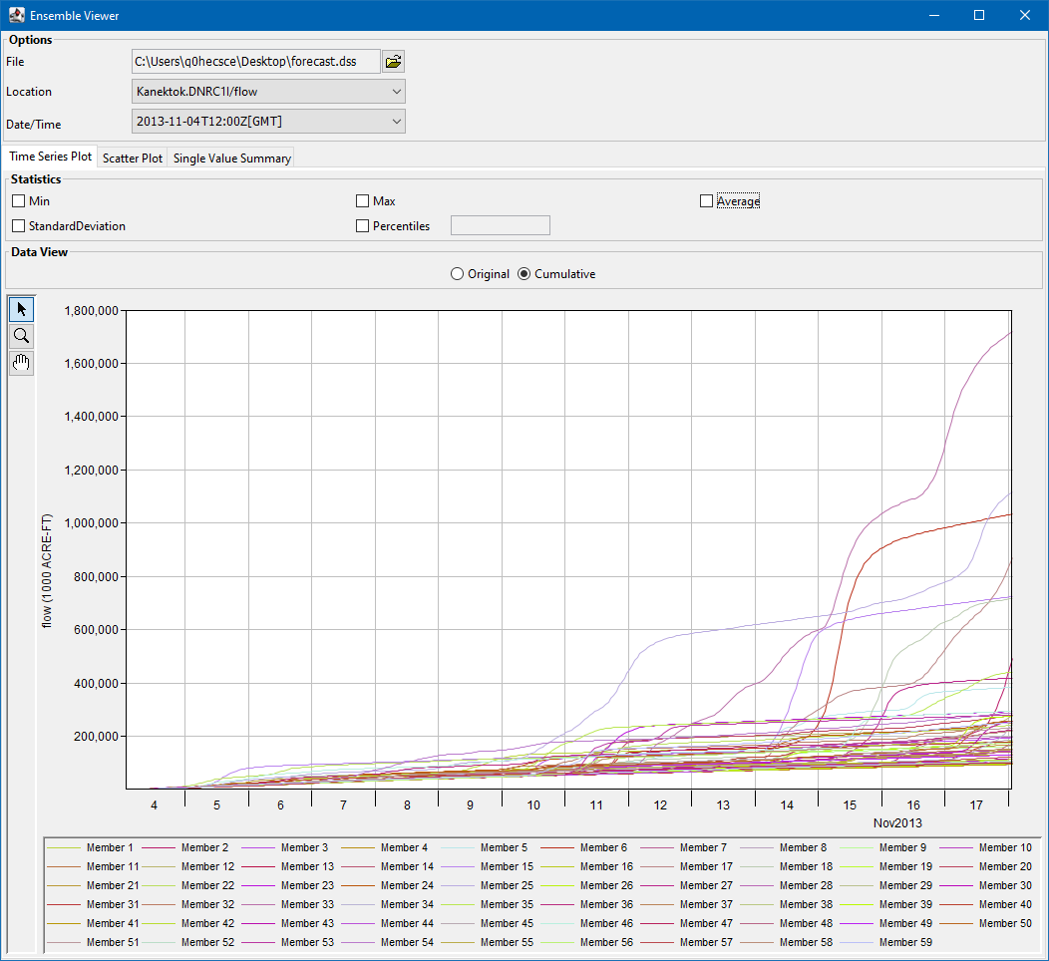
Ensemble Viewer
Allows user to view ensemble time series
Ability to view ensemble metrics that summarize the ensembles as a single summary time series, single value for each ensemble, or as a single summary value
Available from the CAVI under > Tools

Slide 8
Questions
Help additional Training
https://usace.dps.mil/sites/KMP-WM/SitePages/Corps-Water-Management-System-(CWMS).aspx
https://www.hec.usace.army.mil/confluence/cwmsdocs
https://discourse.hecdev.net/c/cwms/5
TDL-CELRH-EC-GW-W-USACE CWMS Modeling | General | Microsoft Teams

