Slide 1
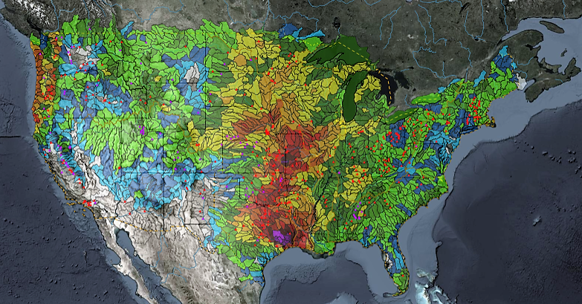
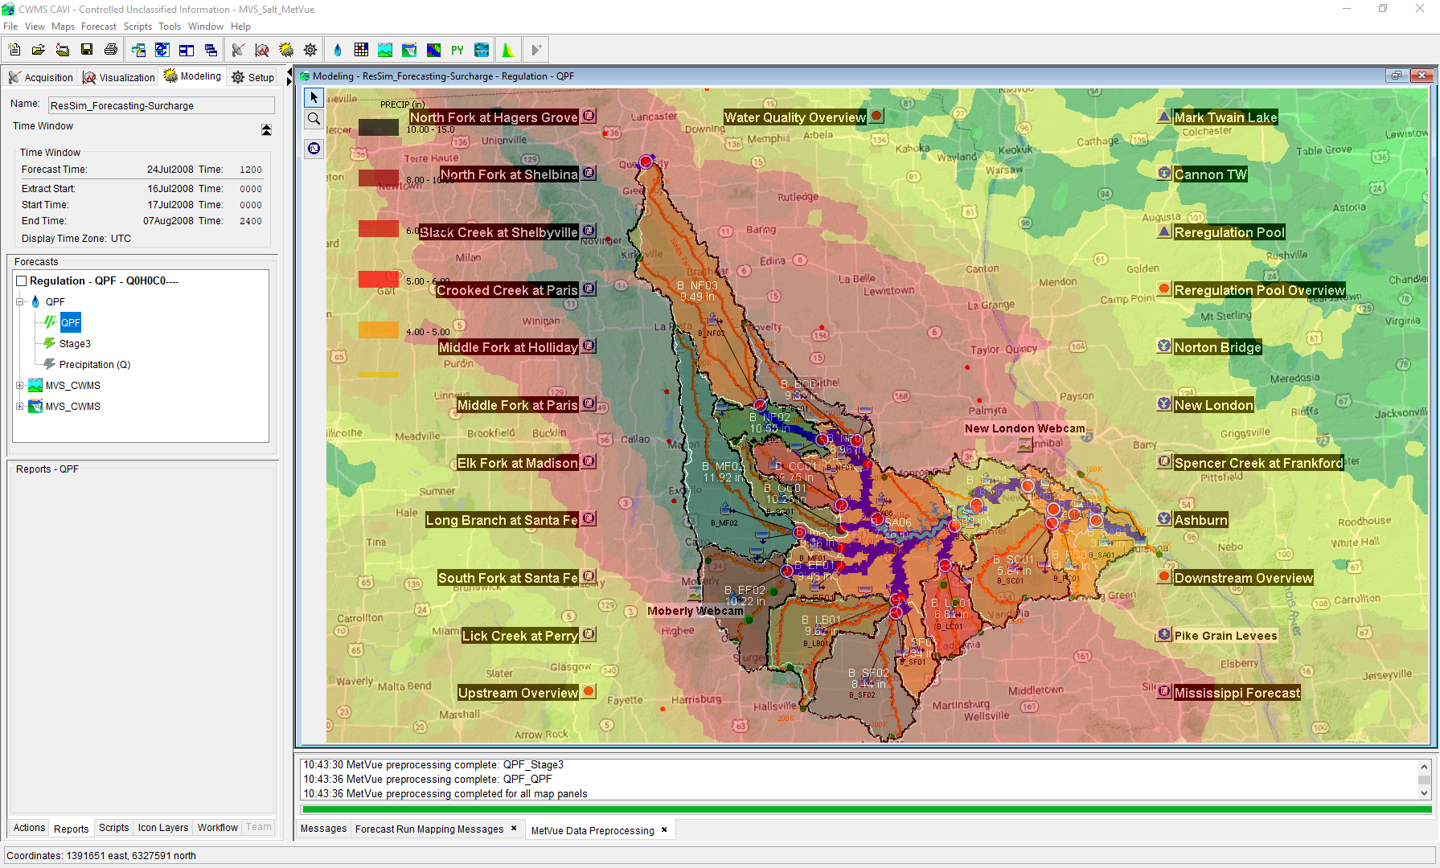

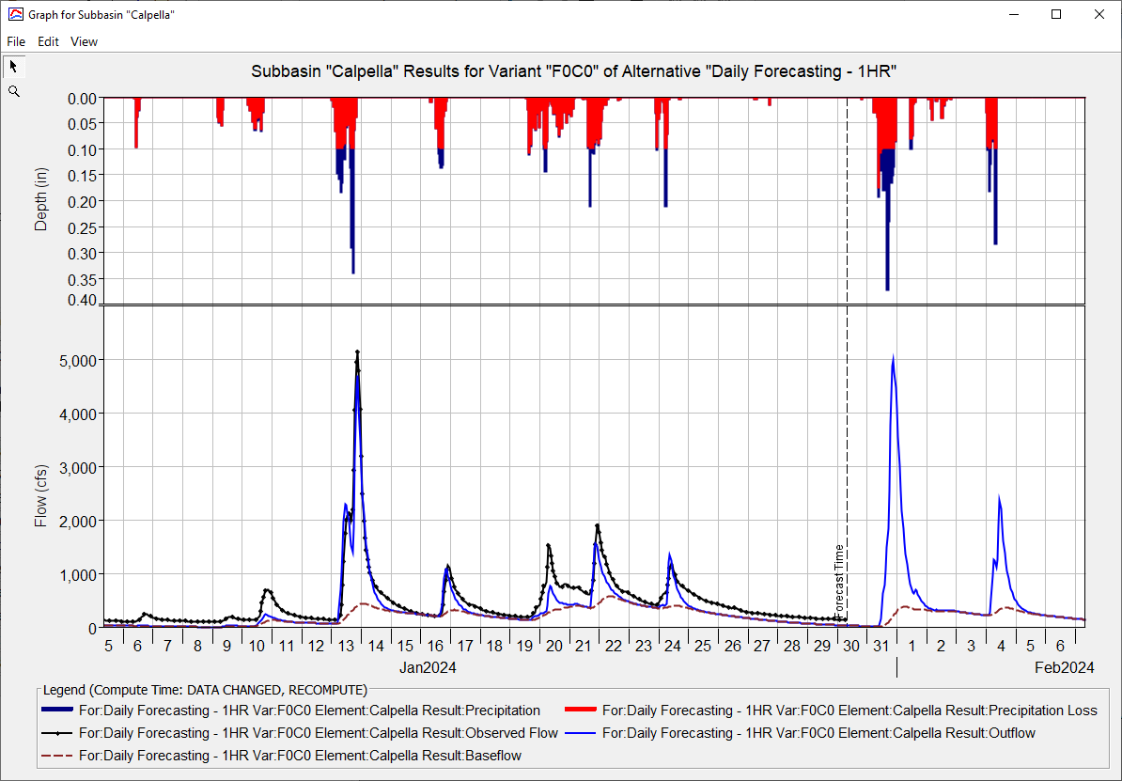
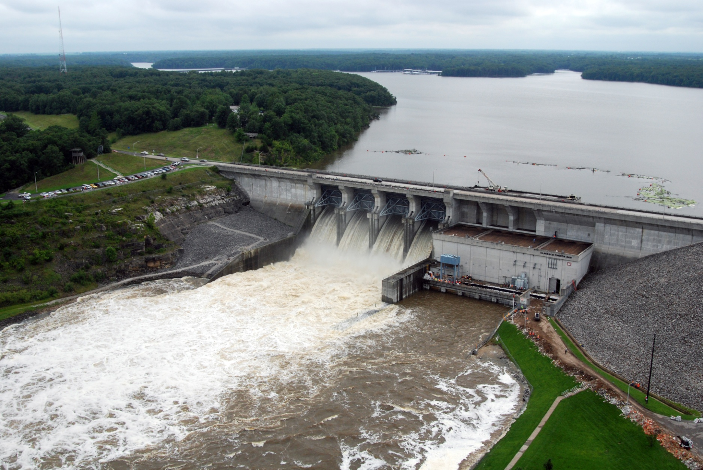
Real Time Data IN CWMS
Kat Feingold
Hydrologic Engineering Center
CWMS Prospect Course

Slide 2
objective
Identify the types of real-time data and their management in CWMS

Slide 3
Overview
  CWMS Real-Time Data Types & Viewing
  CWMS Data Sources
  CWMS Data Processing
  CWMS Data Storage Systems
  CWMS Data Acquisition
Notes:
Overview
There are two categories of real-time data:
Time Series
Grids
CWMS Data Sources include:
USGS and USACE gaging station networks
National Weather Service meteorological data products
USACE Cumulus gridded data web service
Other agencies gaging station networks
CWMS Data Processing is done through manual and automated means for:
Time Series Data
Manual Data Quality Control through the CWMS/CWMSVue Validation Editor
OpenDCS CWMS Computational Processor (CCP)
DSS Scripting
Gridded Data
Manual Edits using HEC-MetVue Interactive Features
Automatic Processing based on HEC-MetVue project and session settings
Missing Data Filing
Dataset Merging
Temporal Aggregation/Disaggregation
Spatial Aggregation/Averaging
MetInterp Point-to-TIN/Grid Spatial Interpolation
Data is stored in two different storage systems:
CWMS Oracle database
Remote and Local DSS files
CWMS Data Acquisition and Access Modes
Data Acquisition is based on:
Realtime telemetry
Federal/State/Local Direct Data Exchange
Federal/State/Local/Public Web Services
CWMS can run in two different “modes” to access data:
Client-Server Mode (requires authentication)
Local (HEC-RTS) mode

Slide 4
CWMS Real-time data types & Viewing

Slide 5
Real-time Data Types in CWMS
Time Series
Grids
  Examples:
    Flow at a gage
    Elevation of a reservoir
  Storage
    HEC-DSS files
    CWMS Oracle Database
  Examples:
    Precipitation estimates from RADAR
    Precipitation Forecasts
    Snow state grids from SNODAS
  Storage:
    HEC-DSS files
    Other Files (GRIB, NetCDF, etc)
Notes:
III. Presentation
Real-Time Data Types
There are two categories of real-time data in CWMS
Time Series Data
Examples: Flow at a Gage, Elevation of a Reservoir
Time series data can be stored in:
HEC-DSS files
CWMS Oracle Database
Grids
Examples: RADAR precipitation estimates, Snow state grids from SNODAS
Grids are stored in DSS files (Not in ORACLE database)
CWMS separates large grid data sets into monthly DSS files with standard naming
For example, Precipitation grids: “precip.yyyy.mm.dss”, “precip.2017.01.dss”
Grids can be stored in other file formats (GRIB, netCDF)

Slide 6
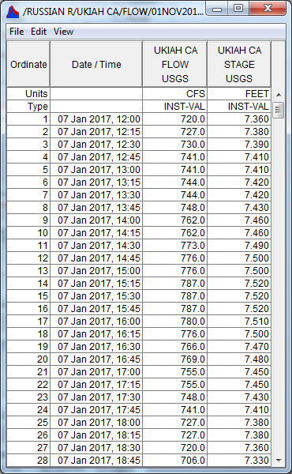
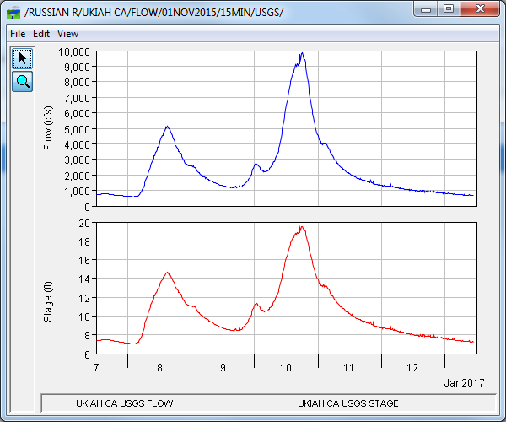
DSS/CWMS Display of Time Series
Notes:
DSS/CWMS Display of Time Series
Time series data can be tabulated or graphed in DSSVue / CWMS-Vue
Many HEC model programs share a common graphics / display library
Graphs and tables can be customized or produced by scripts

Slide 7
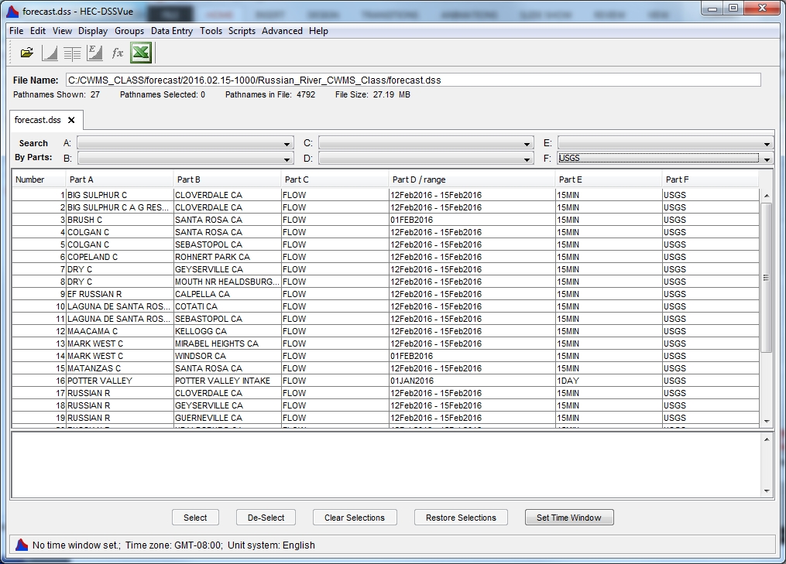
DSS File – Time Series Catalog
Notes:
Real-Time Data Types
DSS File Time Series Catalog
DssVue shows a list or “catalog” of contents of a DSS file
DSS record types (including Time Series) are identified by a 6-part “path name” (A, B, C, D, E, F)

Slide 8
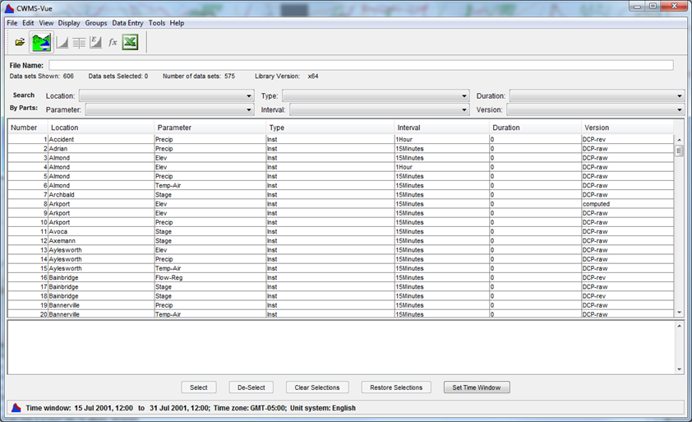
CWMS Database Time Series Catalog
Notes:
CWMS Database Time Series Catalog
CWMS-Vue shows a list of time series stored in CWMS Oracle database
Time Series are identified by 6-part “time-series identifier”
In CWMS 3.3, CWMS-Vue can display location metadata, rating curves, and other information

Slide 9
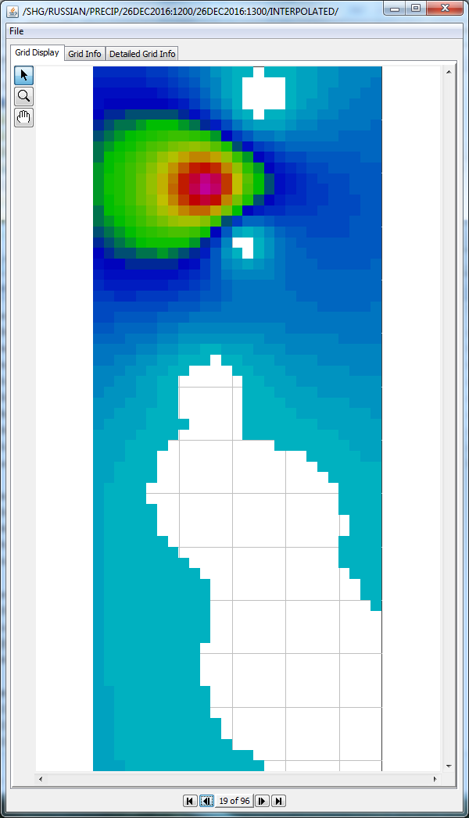
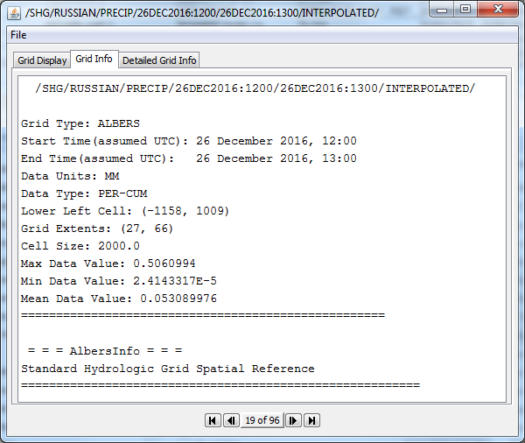
DSS Display of Grids
Notes:
DSS Display of Grids
Grids are stored in DSS files. DSSVue and CWMS-Vue are capable of displaying grids and metadata
Grids can be displayed graphically
Accomplished by clicking the “plot” icon
Background maps are not displayed in DSSVue or CWMS-Vue
Grid metadata (text format) can be viewed
Accomplished by clicking the “tabulate” icon
“Tabulate” shows grid metadata and summary, not array of cell values

Slide 10
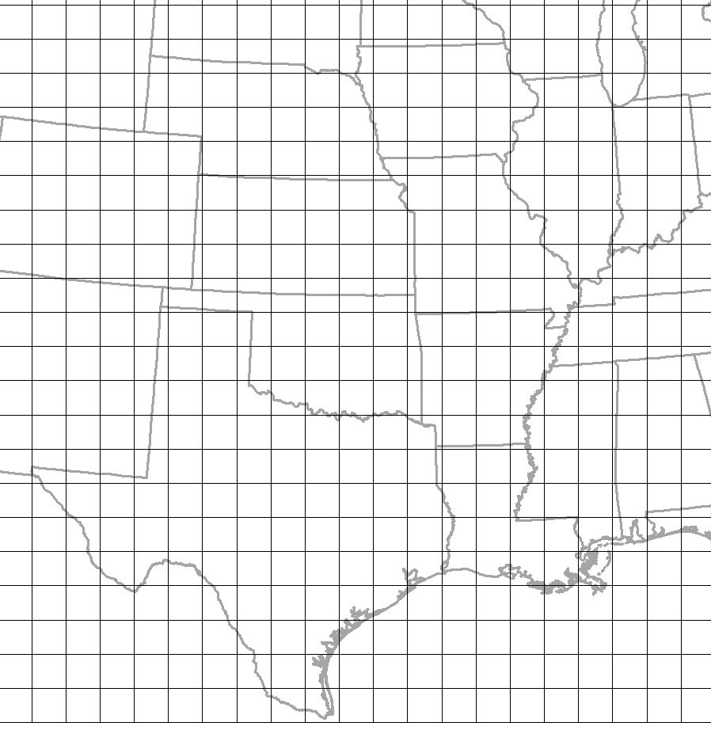
Standard hydrologic grid (SHG)
  Based on Albers Equal-Area map of the US
  Same coordinate system used by USGS for nation-wide mapping
  Locations are identified by cell indices (row and column numbers)
Notes:
Standard Hydrologic Grid (SHG)
Coordinate system is valid in the contiguous United States
Based on Albers Equal-Area map of US
Same coordinate system used by USGS for nationwide mapping
Locations are identified by cell indices (row and column numbers)

Slide 11
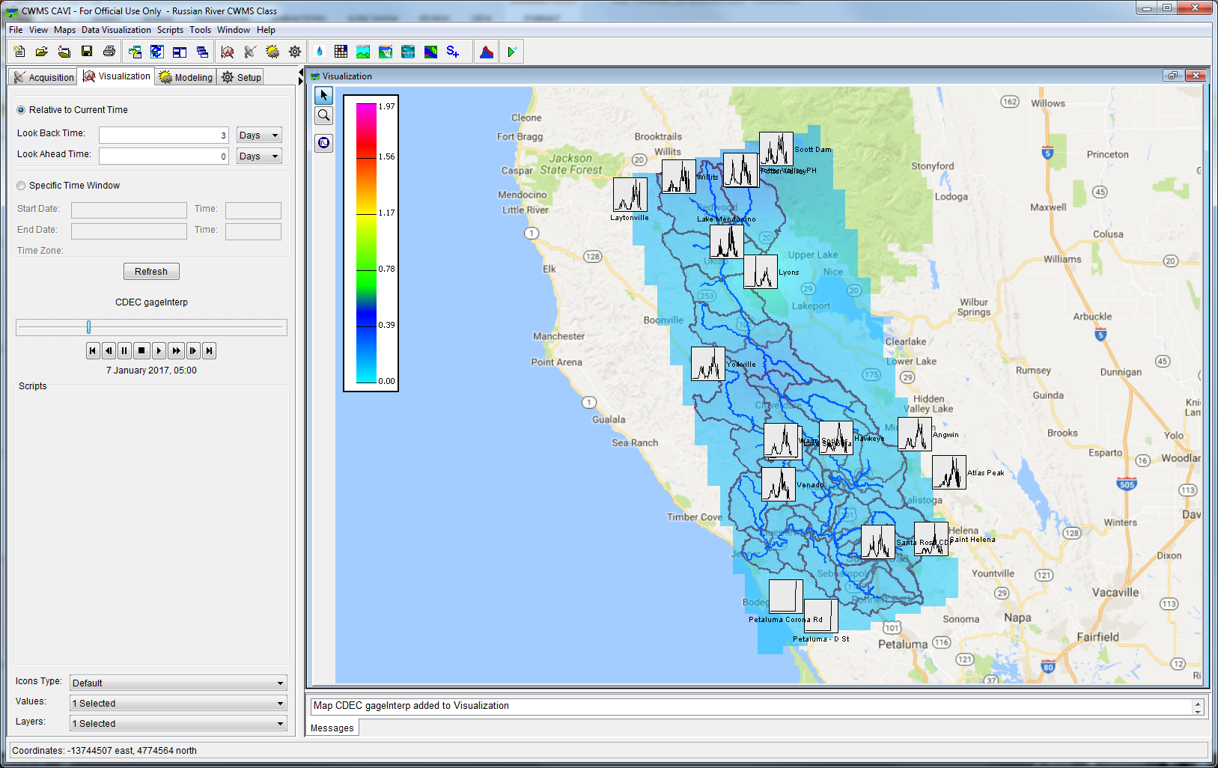
Cavi display of time series and grids
Notes:
Real-Time Data Types
CAVI Display of Time Series and Grids
Grids can be displayed in map context in Data Visualization and Modeling modules of CAVI

Slide 12
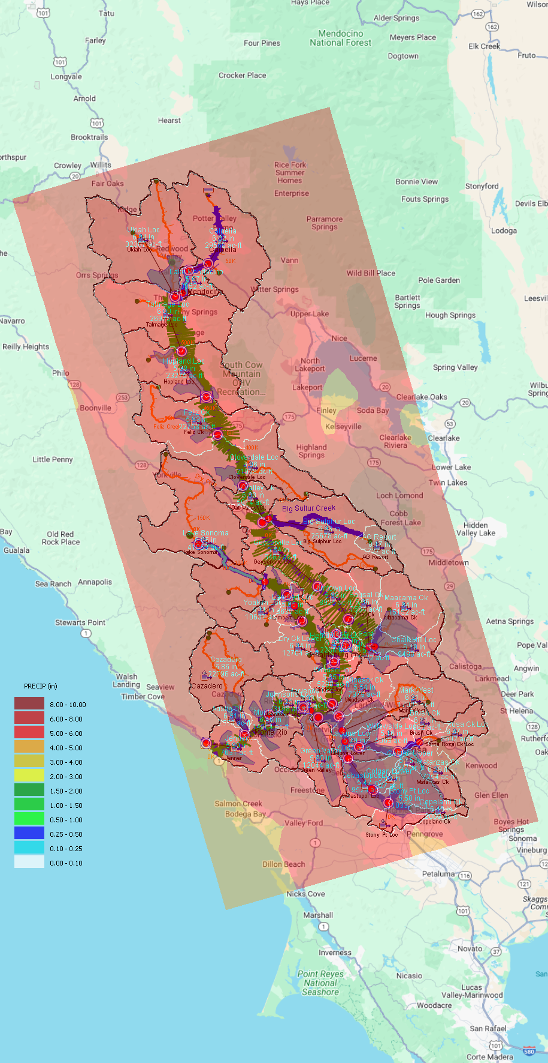
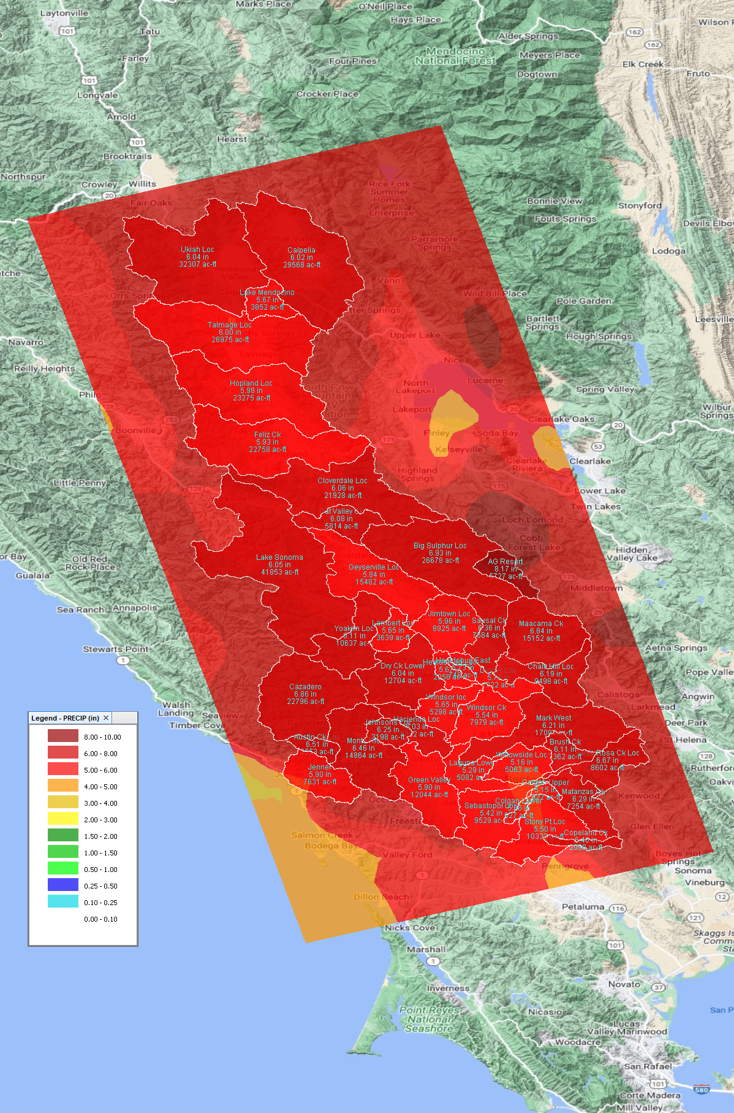
HEC-MetVue Display of Grids
  CAVI Map Window
  MetVue Map Window

Slide 13
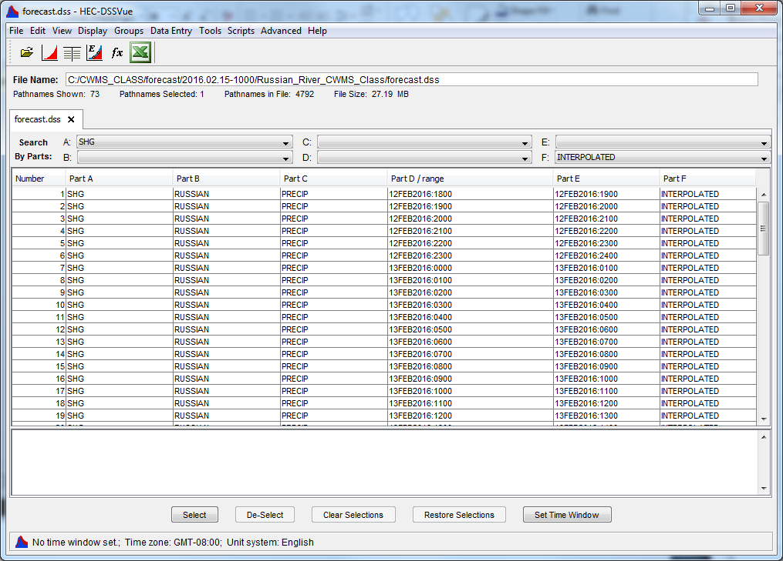
DSS File – grids catalog
Notes:
DSS File Catalog of Grids
Grids are displayed similarly to time-series data in DSSVue and CWMS-Vue
Grids are stored using a 6-part pathname (A, B, C, D, E, F)
A-Part: Coordinate System Reference (Typically SHG for “Standard Hydrologic Grid”)
B-Part: Location
C-Part: Parameter
D-Part/E-Part: Timestamp
F-Part: Version

Slide 14
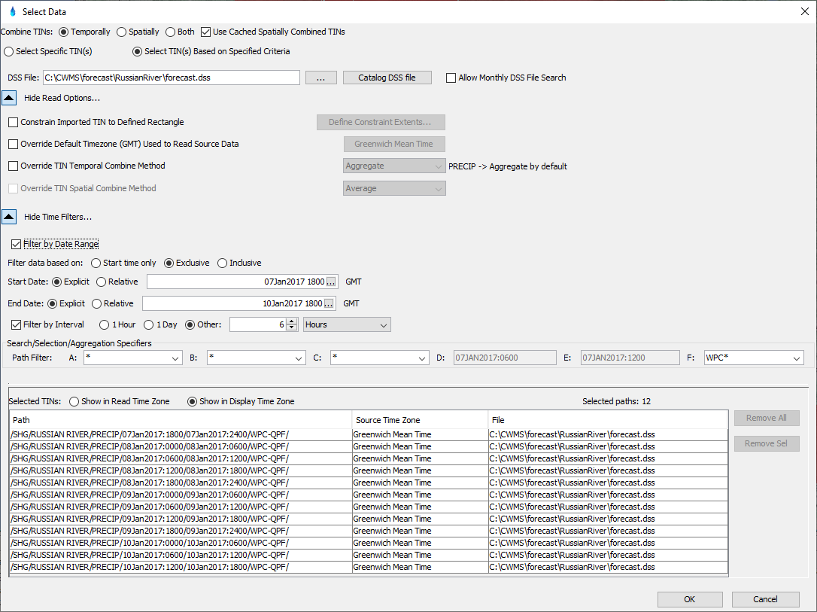
HEC-MetVue – Data Reader

Slide 15
CWMS Data Sources

Slide 16
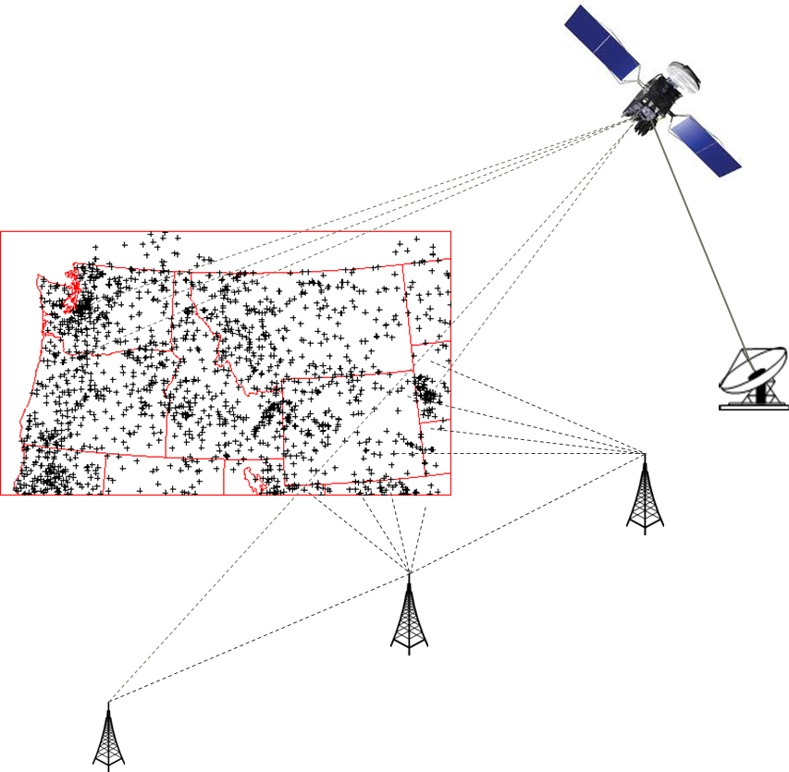
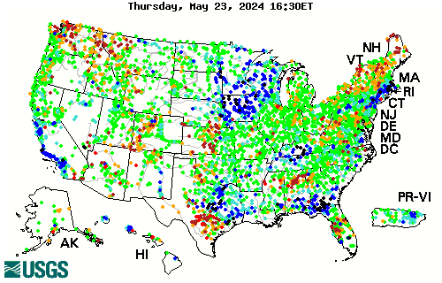
Time Series data Sources
  USACE
  USGS
  https://waterdata.usgs.gov/nwis/rt
  https://dashboard.waterdata.usgs.gov/
  Other (Federal/State/Local)

Slide 17
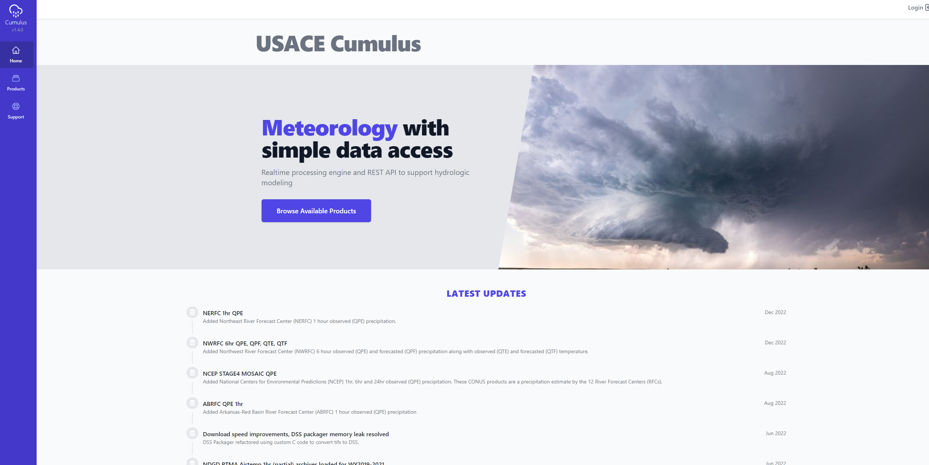
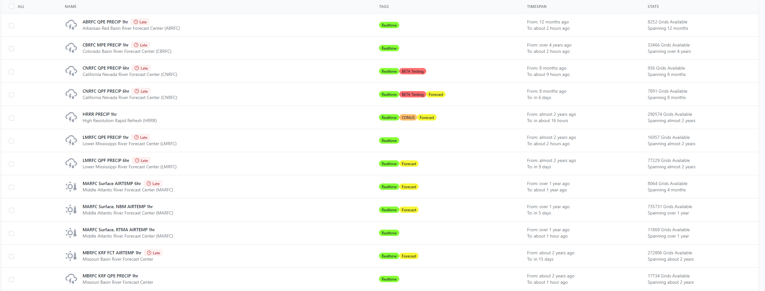
Gridded data sources - Cumulus
  https://cumulus.corps.cloud
  Web service single point of meteorological data access available to USACE WM and HH&C
  Requires CorpsNet Access
    Either Direct or VPN
  Direct Cumulus extract via the CAVI
    Watershed or Area of Interest extents
Notes:
Cumulus is a gridded meteorological data repository that serves the Corps Water Management and Hydrologic and Hydraulic Communities of Practice. Cumulus is a web service that provides on-demand data access through its primary website https://www.cumulus.corps.cloud as well as an (API) that can be used by software programs or other web services to access through custom interface or automated means.
Product – Provides a list of all available historic, real-time, and forecast meteorological parameters
Filtered by
Corps Office – Filter the applicable watersheds for the selected office
Watershed – Determines the clipping extents for the dataset download
Time Window – Defines the start and end dates and times for the dataset download
Cumulus is only available through CorpsNet. And requires, CAC authentication is required to download datasets.

Slide 18
Additional Gridded data sources
  RFC – River Forecast Center
    https://water.weather.gov/ahps/rfc/rfc.php
  NBM – National Blend of Models
    https://vlab.noaa.gov/web/mdl/nbm
  NCEP – National Center for Environmental Predictions
    https://nomads.ncep.noaa.gov
  NDFD – National Digital Forecasting Database
    https://vlab.noaa.gov/web/mdl/ndfd
Notes:
Gridded Precipitation and Temperature Data Sources
Data Sources Overview
River Forecast Centers distribute grids of QPE and QPF (Quantitative Precipitation Estimate/Forecast)
Nationwide grids are available from several sources
National Digital Forecast Database (NDFD)
National Digital Guidance Database (NDGD)
National Center for Environmental Predictions (NCEP)
Weather Prediction Center (WPC)
National Operational Hydrologic Remote Sensing Center (NOHRSC)
Nationwide grids are collected and processed for use in CWMS at the Central Processing Center and can be distributed to your office for use in CWMS modeling

Slide 19
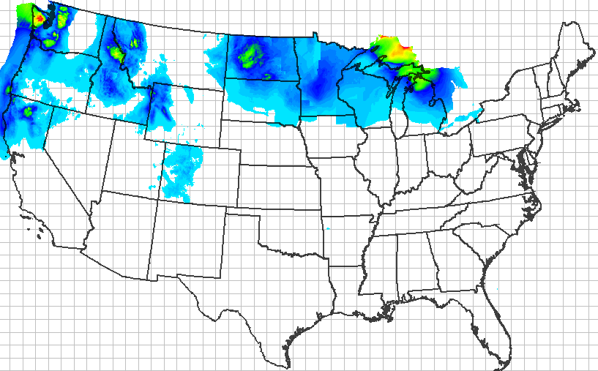
Precipitation forecast (QPF)
Notes:
Data Sources Details
NDFD Precipitation Forecast (QPF)
From National Weather Service National Digital Forecast Database
Resampled to 2km SHG and stored in DSS records at CPC
Can be distributed to division/district offices
Supplement to QPF from River Forecast Center

Slide 20
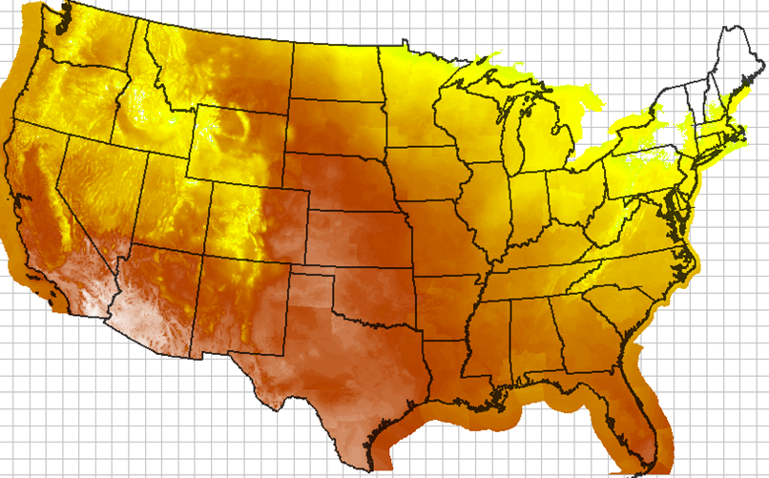
Temperature Forecast (QTf)
Notes:
NDFD Temperature Forecast
From National Weather Service National Digital Forecast Database
Resampled to 2km SHG and stored in DSS records at CPC
Can be distributed to division/district offices
Available for use in snow forecasts or with Gridded Hamon evaporation

Slide 21
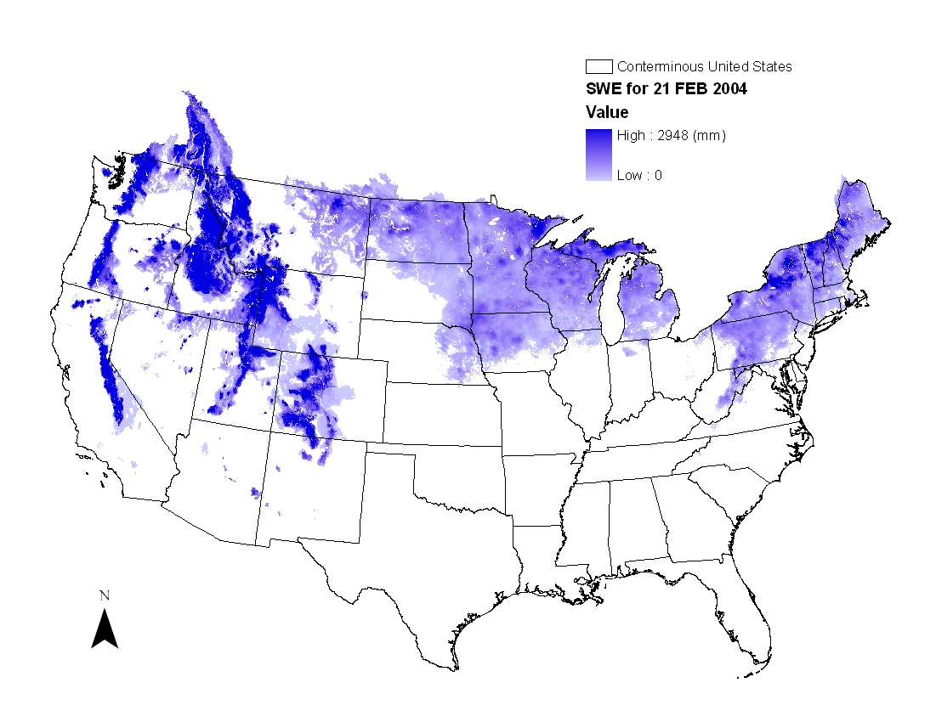
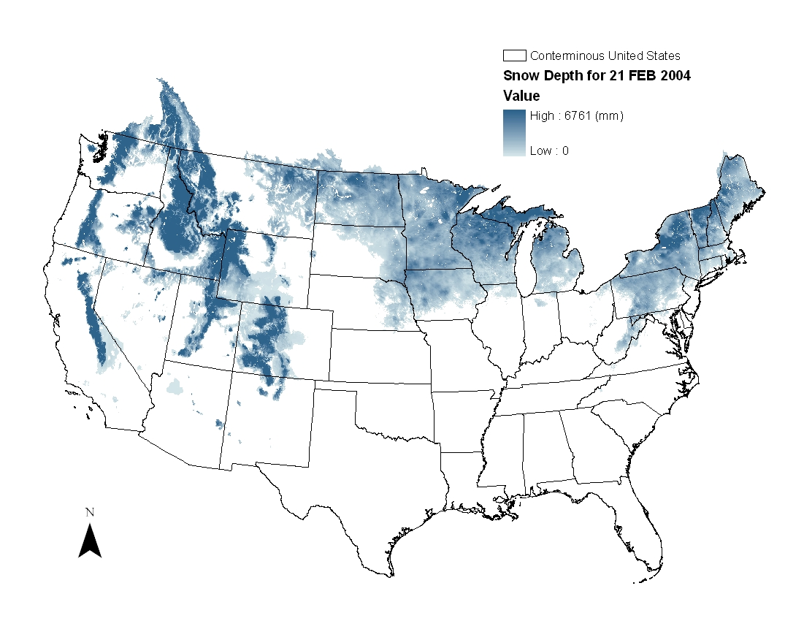
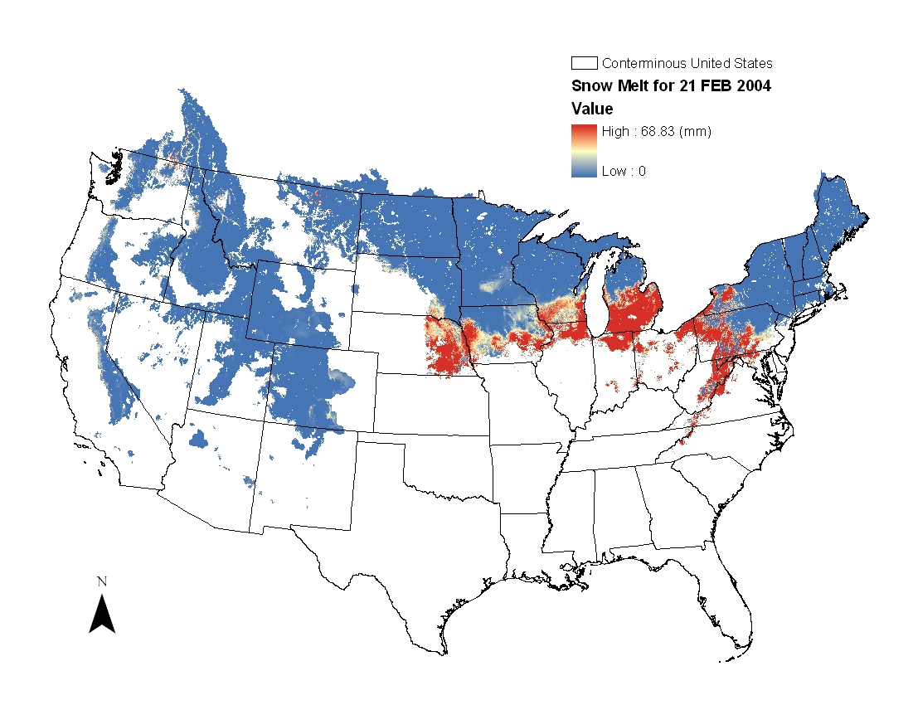
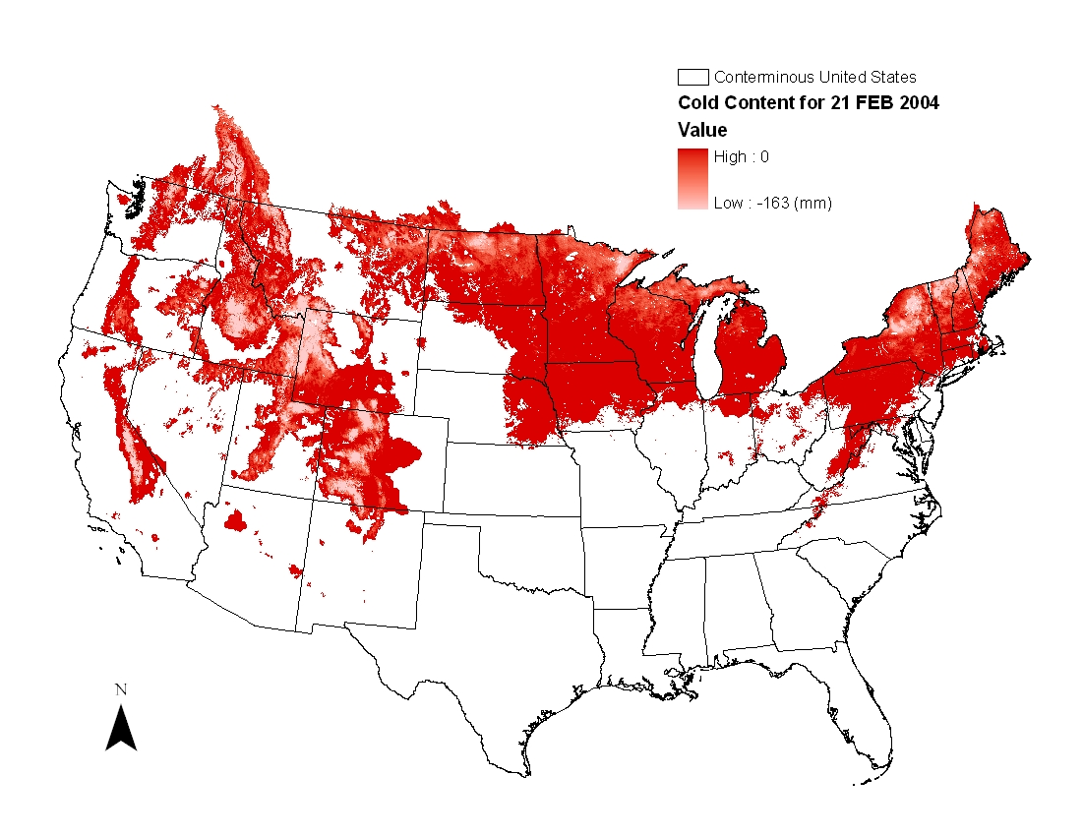
Example Snodas
  Snow Data Assimilation System (SNODAS)
Notes:
SNODAS grids from NOHRSC
SNODAS is the primary source of gridded snow data used in CWMS snowmelt models in the Corps
Hourly/Daily gridded snow products for conterminous U.S.
Based on an energy balance snow model combined with multi-sensor snow observations
Spatial Resolution: 1 sq km resolution
Available period of record: October 2003 – Present
Additional information available at http://www.nohrsc.noaa.gov/

Slide 22
CWMS Data Processing

Slide 23
Time-series Data processing
Data Types
Data Processing
  Observation
    Stage gage
    Rain gage
    Thermometer
  Derived
    Flow from stage & rating
    Storage from elevation & rating
    Model Results
  CWMS/CWMSVue Validation Editor
  CWMS Computational Processor (CCP)
  DSS Math functions and Scripts
Notes:
Real-Time Data Types
Time-Series are obtained and transformed in a variety of ways
Time-series can be obtained from direct observation or derived
Examples of time-series data from direct observations
River stage gage
Precipitation gage
Thermometer
Examples of time-series derived using direct observations and computations
Flow from stage & stage-flow rating
Storage from elevation & elevation-storage curve
There are several tools available for processing and modifiying time series data.
CWMS and CWMSVue Data Validation Editor
CWMS Computational Processor (CCP)
DSS Math functions and Scripts

Slide 24
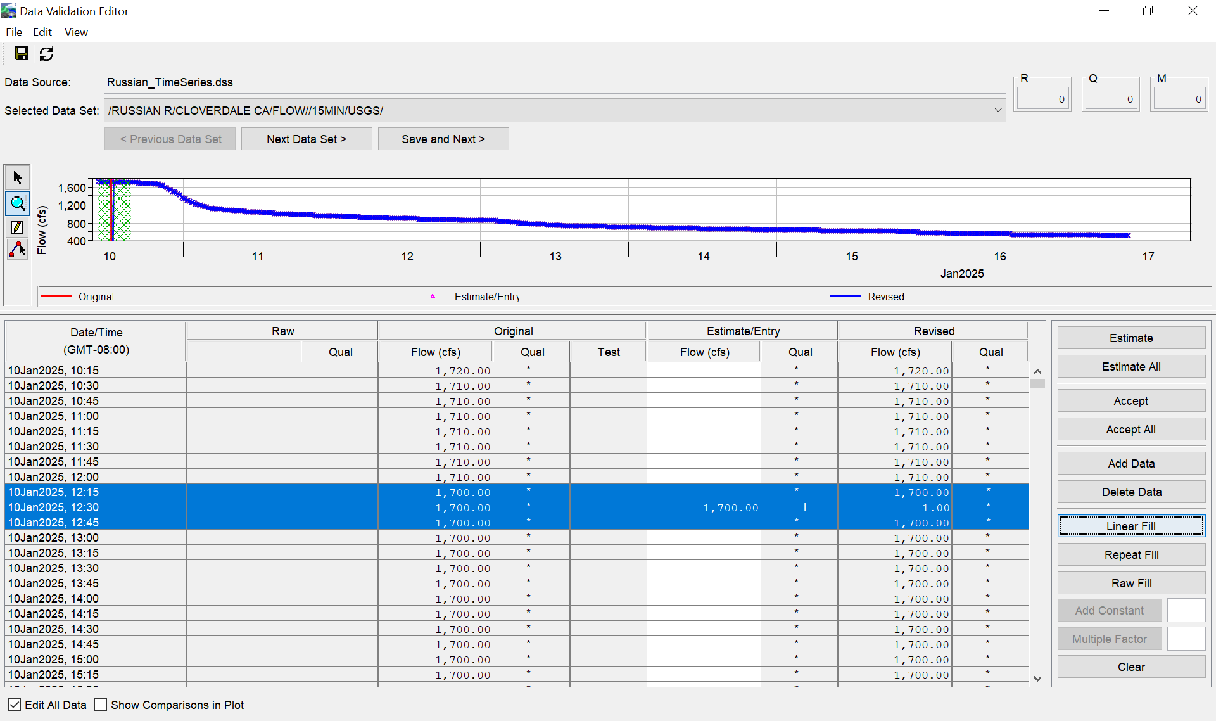
CAVI/CWMSVue Validation Editor
  Interactive Data Review & Editing
    Set value as missing
    Set specified value
    Fill – Linear
    Fill – Repeat
    Fill – Raw
    Add a constant value
    Multiply by a factor

Slide 25
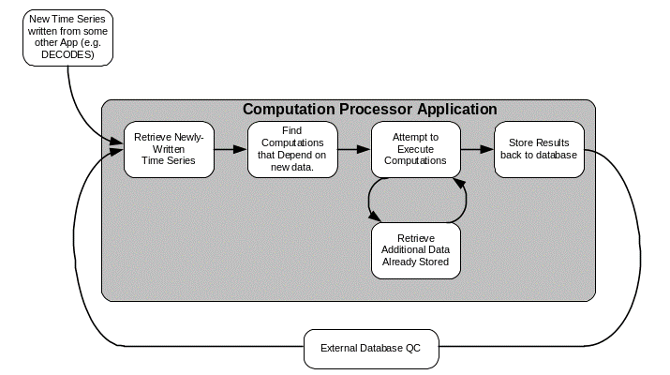
OpenDCS
Cwms Computational Processor (CCP)
  Example Functions
    Average
    Fill Forward
    Disaggregate
    Inflow computation
  References
    Main Documentation
    https://opendcs-env.readthedocs.io/en/latest/
    Standard Algorithms
    https://opendcs-env.readthedocs.io/en/latest/resources-algorithms.html
    Custom Python Algorithms
    https://opendcs-env.readthedocs.io/en/latest/resources-algorithms.html#opendcs-custom-python-algorithms

Slide 26
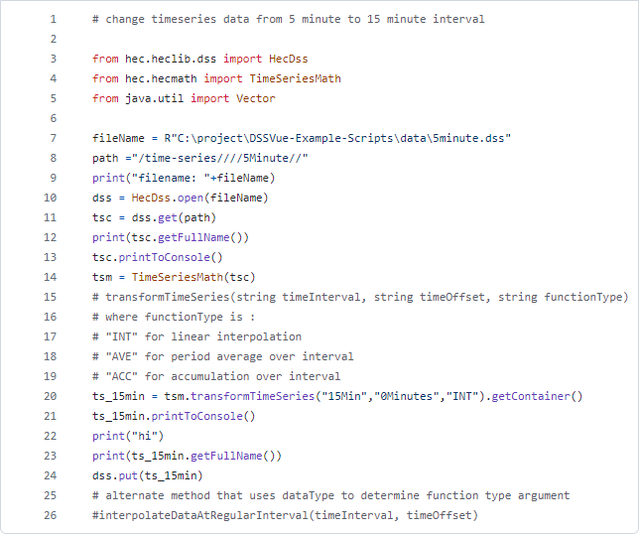
Hec-dss Math functions & Scripts
  Example Functions
    Estimate Missing Values
    Replace Specific Values
    Screen using Minimum and Maximum
    Change Time Interval
    Irregular to Regular
    Rating Table
    Reverse Rating Table
    Moving Average
  References
    HEC-DSSVue Users Manual
    https://www.hec.usace.army.mil/confluence/dssdocs/dssvueum/math-and-statistical-functions
    https://www.hec.usace.army.mil/confluence/dssdocs/dssvueum/scripting/math-functions
    HEC-DSSVue Github Scripts Repo
    https://github.com/HydrologicEngineeringCenter/DSSVue-Example-Scripts/tree/master/src
https://github.com/HydrologicEngineeringCenter/DSSVue-Example-Scripts/blob/master/src/change-interval.py

Slide 27
Grid Data processing
Data Types
Data Processing
  Observation
    RADAR
    Aircraft and Satellite Remote Sensing
  Derived
    Interpolation from point measurements
    Model Results
  HEC-MetVue
    Missing Data Filing
    Dataset Merging
    Temporal Aggregation/Disaggregation
    Spatial Aggregation/Averaging
    TIN-to-Grid and Grid-to-TIN
    MetInterp
      Point-to-TIN/Grid Spatial Interpolation
Notes:
Grids are obtained and transformed in a variety of ways
Grids can be obtained from direct observations
RADAR
Remote Sensing (from Satellite or Aircraft)
Grids can be derived from direct observations (point or gridded).
Interpretation of Remote Sensing products
Interpolation from point measurements to TIN (Triangulated Irregular Network) and Grid.
There are many derived grids available from Weather Service Models/Processes
RTMA (Real-Time-Mezzoscale-Analysis)
MRMS (Multi-Radar-Multi-Sensor)
SNODAS (SNOw Data Assimilation System)
HRRR (High-Resolution-Rapid-Refresh)
Others
HEC-MetVue offers a number of spatial data processing methods:
Missing Data Filing
Dataset Merging
Temporal Aggregation/Disaggregation
Spatial Aggregation/Averaging
TIN-to-Grid and Grid-to-TIN
HEC-MetVue also provides for Point-to-TIN or Point-to-Grid spatil interpolation with a methods, including
Inverse-Distance
Inverse-Distance Squared
Nearest Neighbor
Bilinear

Slide 28
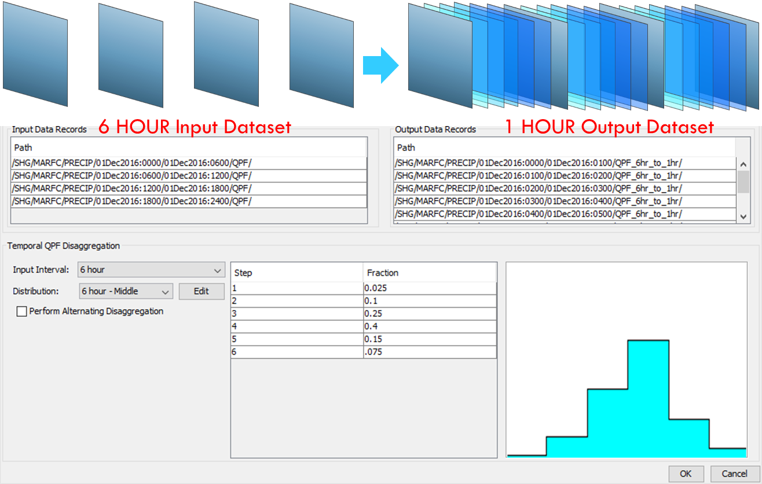
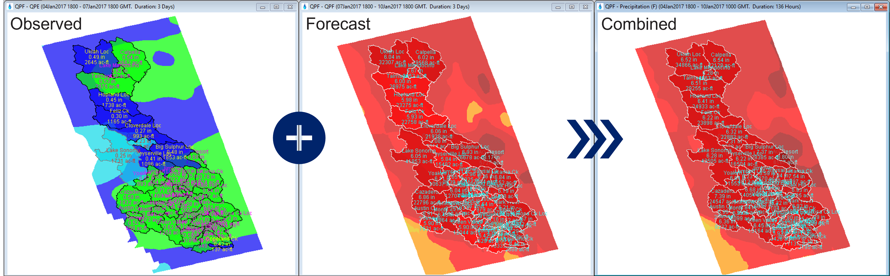
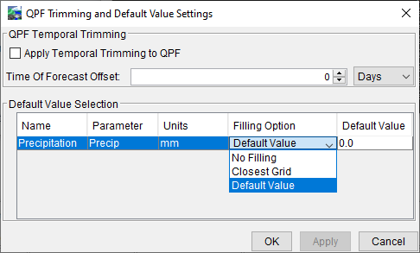
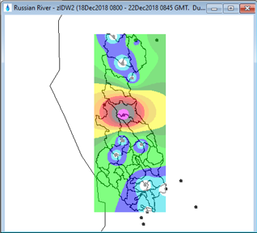
HEC-MetVue Data Processing
Temporal Disaggregation
Dataset Merging
Missing Data Filling
Spatial Interpolation

Slide 29
Data storage Systems

Slide 30


Data storage systems in cwms
CWMS Database
HEC-DSS Files
  Runs on a CWMS T7 Server or Cloud Server
  Oracle-Based Relational Database System
  Supports enterprise-scale data operations
  AIS (Automated Information System)
  Requires authenticated login
  Stored on
    Windows PC
    CWMS server
  Optimized for data sequences like time series
  Local DSS requires no login
Notes:
Data Storage Systems in CWMS
Data in CWMS is stored in two forms, CWMS Oracle Database and DSS Files
CWMS Database:
Runs on CWMS server (locally or in the cloud)
Oracle Relational Database System
Supports enterprise-scale data operations
Army AIS (Automated Information System)
Requires Authenticated Login
DSS Files:
Stored on CWMS server (locally or in the cloud)
Stored on PC or Server file system
Optimized for data sequences like time series
No login required for local DSS file operations

Slide 31
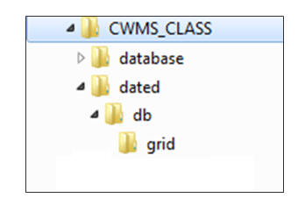


Files and directories for cwms data
Notes:
Data Storage Systems in CWMS
Files and Directories for CWMS Data
Top directCWMS server the top directory is set by $CWMS_HOME environment variable
config directory holds relatively static setup for data acquisition (da) processes
MetInterp configuration files are saved in the config directory
ProcessSheffit criteria files
ory (CWMS_CLASS here) is left to user choice
On dated directory contents change as data collection and transformation processes run
DSS files for grids are stored in dated/db/grid
Temporary files required by data processing programs
Log files
database directory hold DSS files for time series in “Local Mode” (RTS)
In Corps production systems, this is replaced by the CWMS Oracle database
There is no “database” directory on CWMS server

Slide 32
Cwms data Acquisition

Slide 33

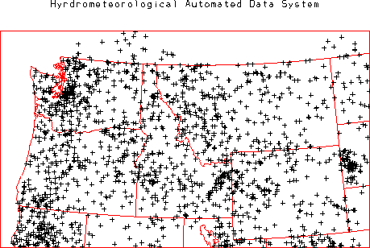






District/division data acquisition
CWMS Client-Server Mode
(Authentication Required)
Hydrometeorological Automated Data System
Federal/state/Local Agency
Federal/State/Local Agency
Dedicated Line
Data Exchange
Satellite
Telemetry
Data
VHF
Line-of-
Sight
Data
Internet
Data Exchange
Server-based
Water
Management
System
Instructions To and
From Dam Operator
Local Water Management Office
Notes:
CWMS Data Modes
Client-Server Mode
Data Acquisition for Corps Office in Production
Data comes from both public and proprietary sources
Data is acquired continuously through automated processes
Data is transmitted over internet, dedicated data exchange lines, line-of-site radio, satellites, and more
Time-series data is stored in CWMS Oracle database on CWMS server(s)
Grids come from National Weather Service and other sources
Grids are stored in server-side DSS files with precip.yyyy.mm.dss naming convention
Many validation/transformation processes may be used

Slide 34
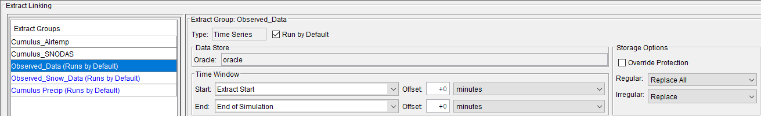
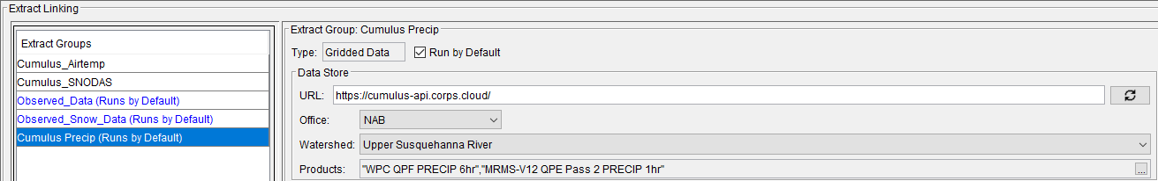
Client-Server CAVI Data Extracts
  CAC authentication required for server access

Slide 35
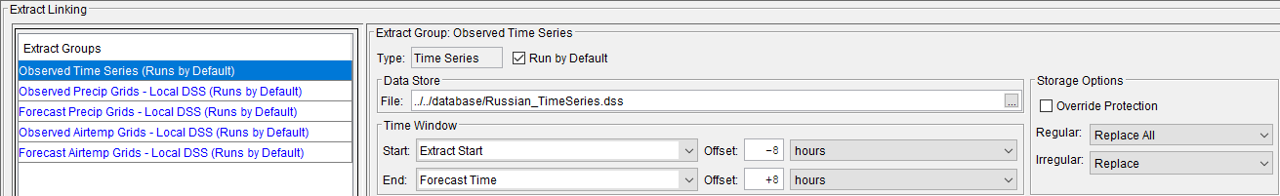
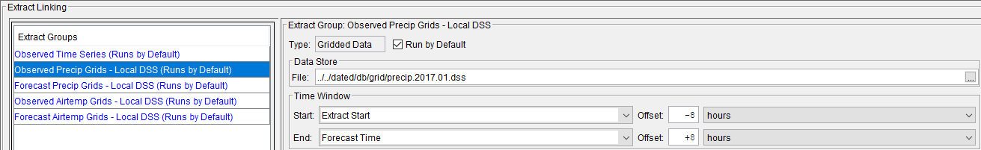
HEC-RTS CAVI Data Extracts
  No authentication required for local DSS file access

Slide 36
Summary
  CWMS data supporting real-time modeling includes both time series and grids from a variety of sources
  Time-series data is stored in CWMS Oracle database and HEC-DSS

Slide 37
Questions
Help additional Training
https://usace.dps.mil/sites/KMP-WM/SitePages/Corps-Water-Management-System-(CWMS).aspx
https://www.hec.usace.army.mil/confluence/cwmsdocs
https://discourse.hecdev.net/c/cwms/5
TDL-CELRH-EC-GW-W-USACE CWMS Modeling | General | Microsoft Teams

