Slide 1
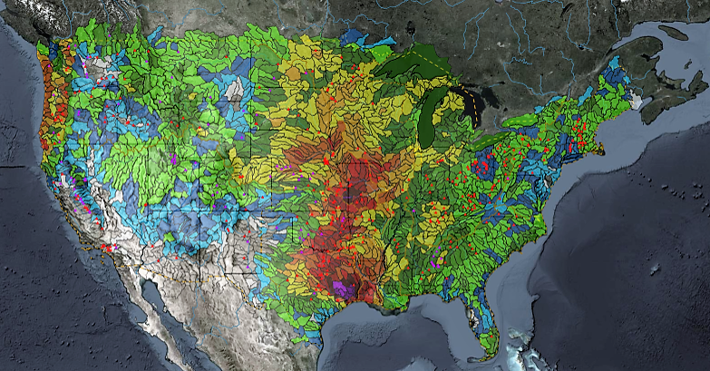
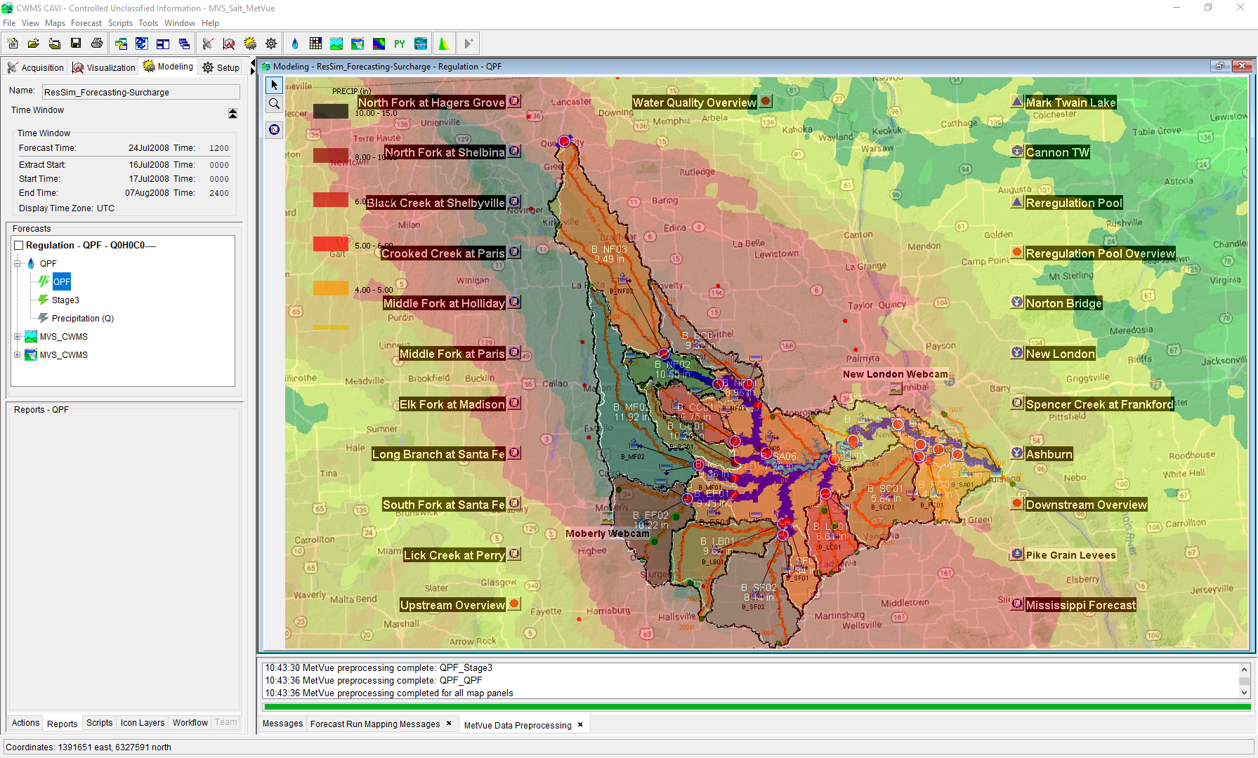

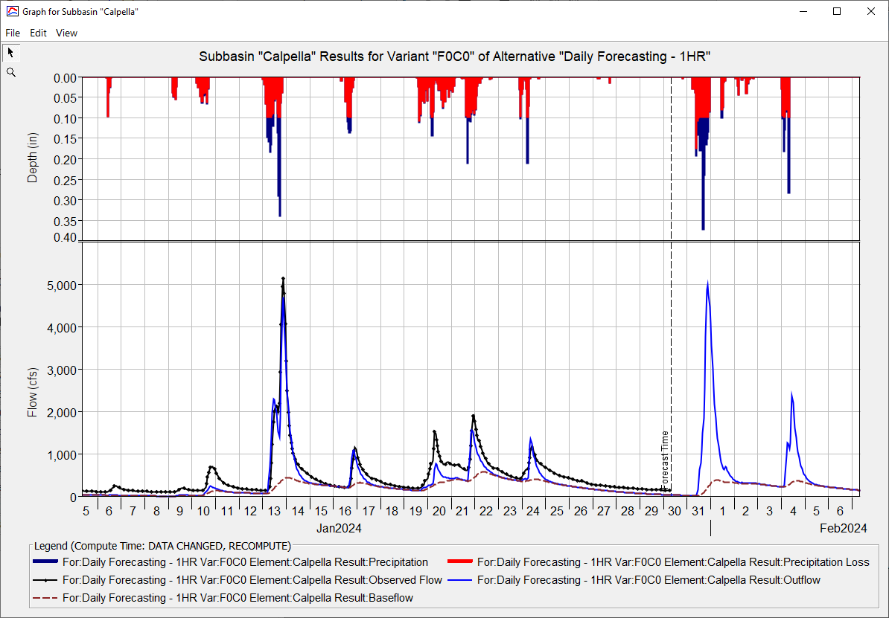
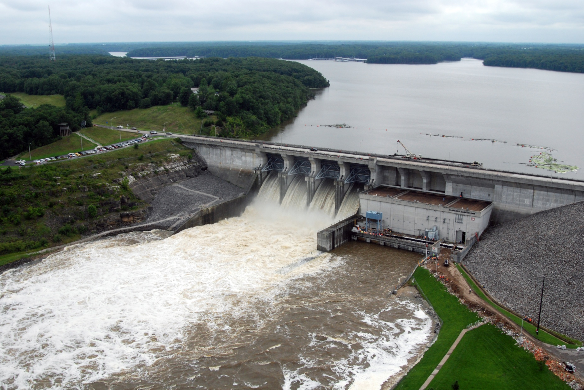
Real Time Data IN CWMS
Kat Feingold
Hydrologic Engineering Center
CWMS Prospect Course

Slide 2
objective
Identify the types of real-time data and their management in CWMS

Slide 3
Overview
CWMS Real-Time Data Types & Viewing
CWMS Data Sources
CWMS Data Processing
CWMS Data Storage Systems
CWMS Data Acquisition
Notes:
Overview
There are two categories of real-time data:
Time Series
Grids
CWMS Data Sources include:
USGS and USACE gaging station networks
National Weather Service meteorological data products
USACE Cumulus gridded data web service
Other agencies gaging station networks
CWMS Data Processing is done through manual and automated means for:
Time Series Data
Manual Data Quality Control through the CWMS/CWMSVue Validation Editor
OpenDCS CWMS Computational Processor (CCP)
DSS Scripting
Gridded Data
Manual Edits using HEC-MetVue Interactive Features
Automatic Processing based on HEC-MetVue project and session settings
Missing Data Filing
Dataset Merging
Temporal Aggregation/Disaggregation
Spatial Aggregation/Averaging
MetInterp Point-to-TIN/Grid Spatial Interpolation
Data is stored in two different storage systems:
CWMS Oracle database
Remote and Local DSS files
CWMS Data Acquisition and Access Modes
Data Acquisition is based on:
Realtime telemetry
Federal/State/Local Direct Data Exchange
Federal/State/Local/Public Web Services
CWMS can run in two different “modes” to access data:
Client-Server Mode (requires authentication)
Local (HEC-RTS) mode

Slide 4
CWMS Real-time data types & Viewing

Slide 5
Real-time Data Types in CWMS
Time Series
Grids
Examples:
Flow at a gage
Elevation of a reservoir
Storage
HEC-DSS files
CWMS Oracle Database
Examples:
Precipitation estimates from RADAR
Precipitation Forecasts
Snow state grids from SNODAS
Storage:
HEC-DSS files
Other Files (GRIB, NetCDF, etc)
Notes:
III. Presentation
Real-Time Data Types
There are two categories of real-time data in CWMS
Time Series Data
Examples: Flow at a Gage, Elevation of a Reservoir
Time series data can be stored in:
HEC-DSS files
CWMS Oracle Database
Grids
Examples: RADAR precipitation estimates, Snow state grids from SNODAS
Grids are stored in DSS files (Not in ORACLE database)
CWMS separates large grid data sets into monthly DSS files with standard naming
For example, Precipitation grids: “precip.yyyy.mm.dss”, “precip.2017.01.dss”
Grids can be stored in other file formats (GRIB, netCDF)

Slide 6
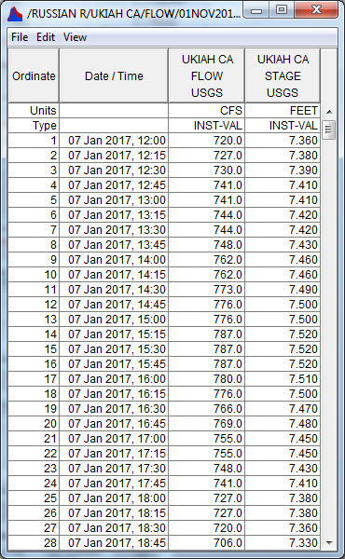
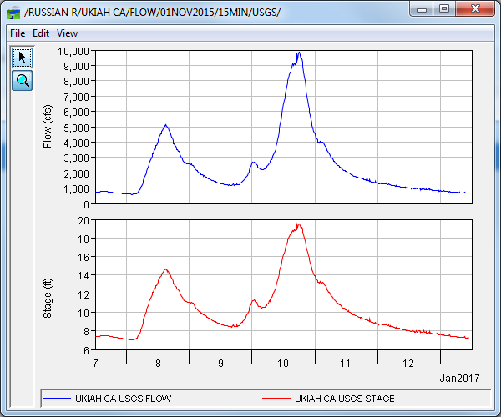
DSS/CWMS Display of Time Series
Notes:
DSS/CWMS Display of Time Series
Time series data can be tabulated or graphed in DSSVue / CWMS-Vue
Many HEC model programs share a common graphics / display library
Graphs and tables can be customized or produced by scripts

Slide 7
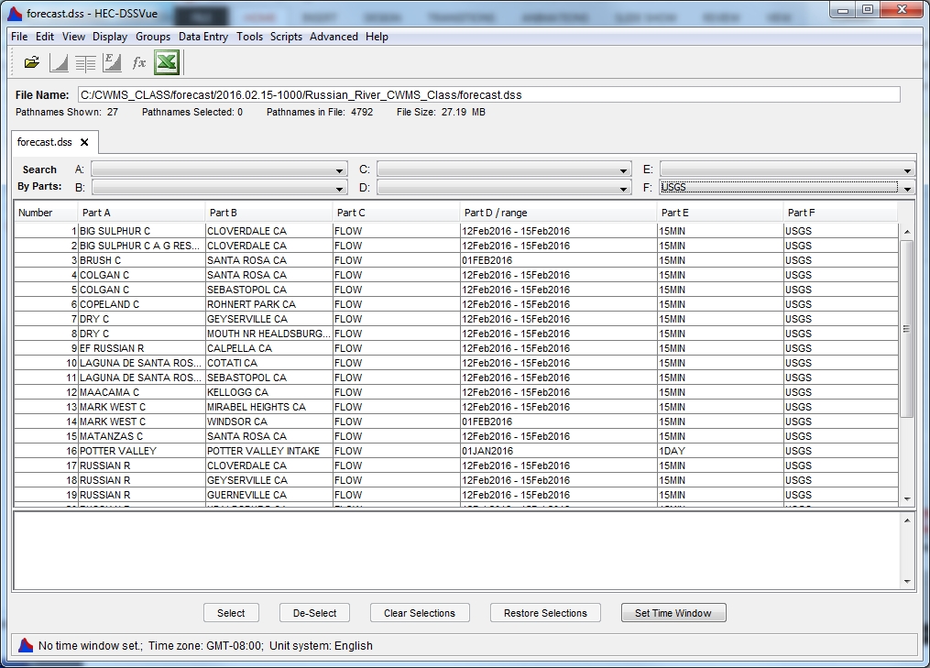
DSS File – Time Series Catalog
Notes:
Real-Time Data Types
DSS File Time Series Catalog
DssVue shows a list or “catalog” of contents of a DSS file
DSS record types (including Time Series) are identified by a 6-part “path name” (A, B, C, D, E, F)

Slide 8
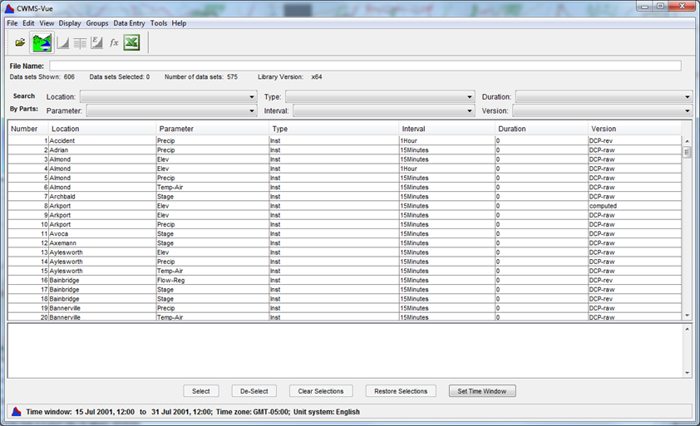
CWMS Database Time Series Catalog
Notes:
CWMS Database Time Series Catalog
CWMS-Vue shows a list of time series stored in CWMS Oracle database
Time Series are identified by 6-part “time-series identifier”
In CWMS 3.3, CWMS-Vue can display location metadata, rating curves, and other information

Slide 9
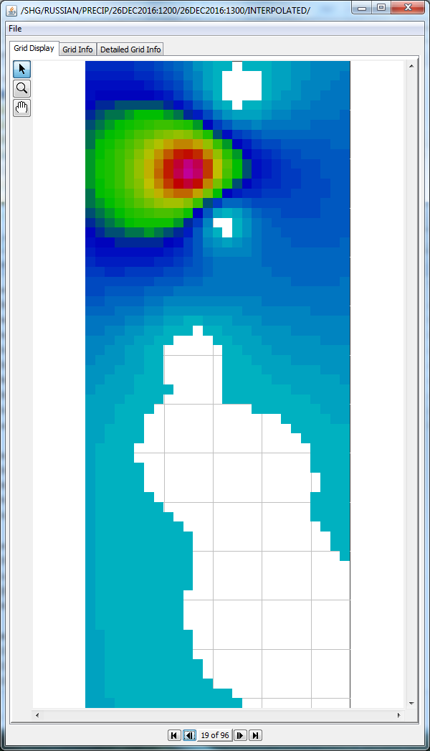
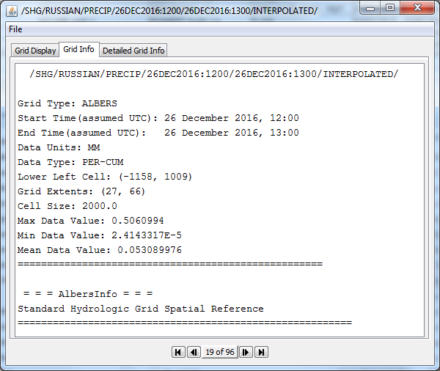
DSS Display of Grids
Notes:
DSS Display of Grids
Grids are stored in DSS files. DSSVue and CWMS-Vue are capable of displaying grids and metadata
Grids can be displayed graphically
Accomplished by clicking the “plot” icon
Background maps are not displayed in DSSVue or CWMS-Vue
Grid metadata (text format) can be viewed
Accomplished by clicking the “tabulate” icon
“Tabulate” shows grid metadata and summary, not array of cell values

Slide 10
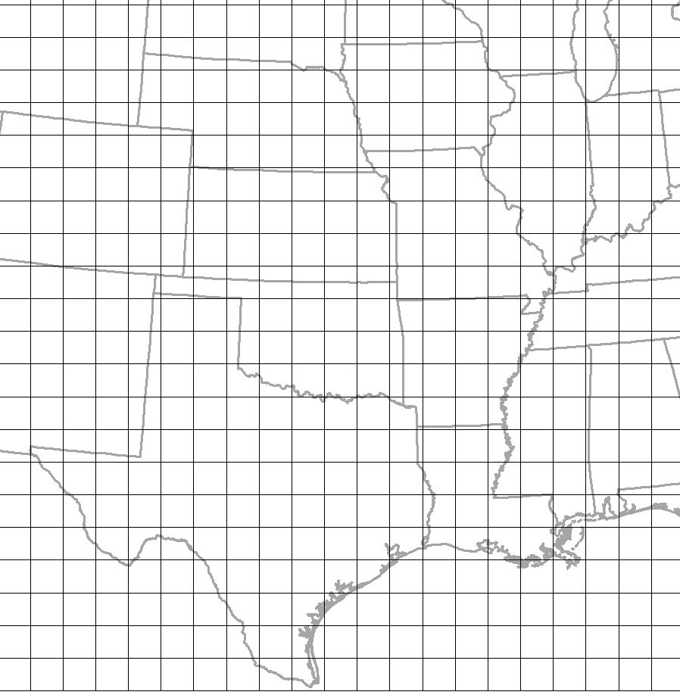
Standard hydrologic grid (SHG)
Based on Albers Equal-Area map of the US
Same coordinate system used by USGS for nation-wide mapping
Locations are identified by cell indices (row and column numbers)
Notes:
Standard Hydrologic Grid (SHG)
Coordinate system is valid in the contiguous United States
Based on Albers Equal-Area map of US
Same coordinate system used by USGS for nationwide mapping
Locations are identified by cell indices (row and column numbers)

Slide 11
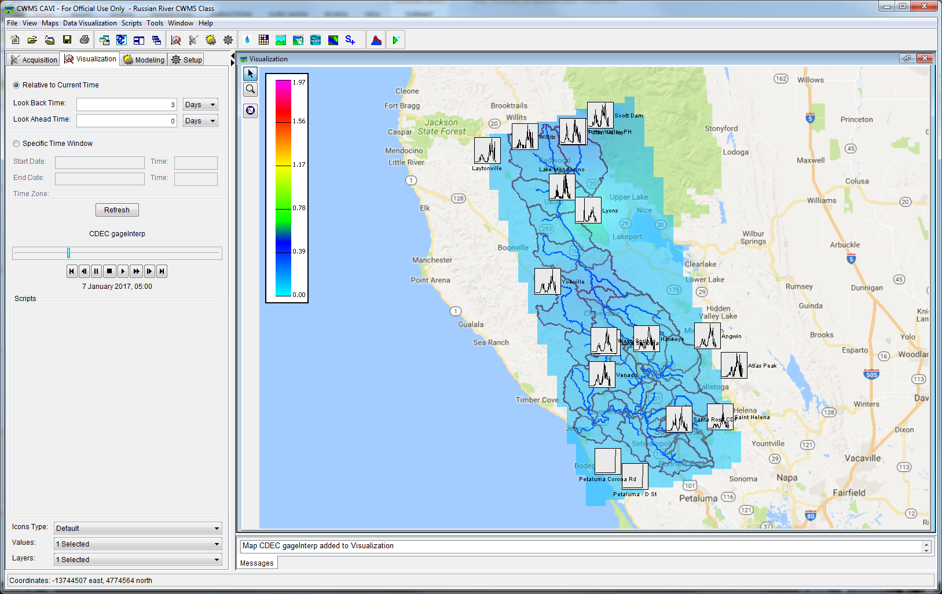
Cavi display of time series and grids
Notes:
Real-Time Data Types
CAVI Display of Time Series and Grids
Grids can be displayed in map context in Data Visualization and Modeling modules of CAVI

Slide 12
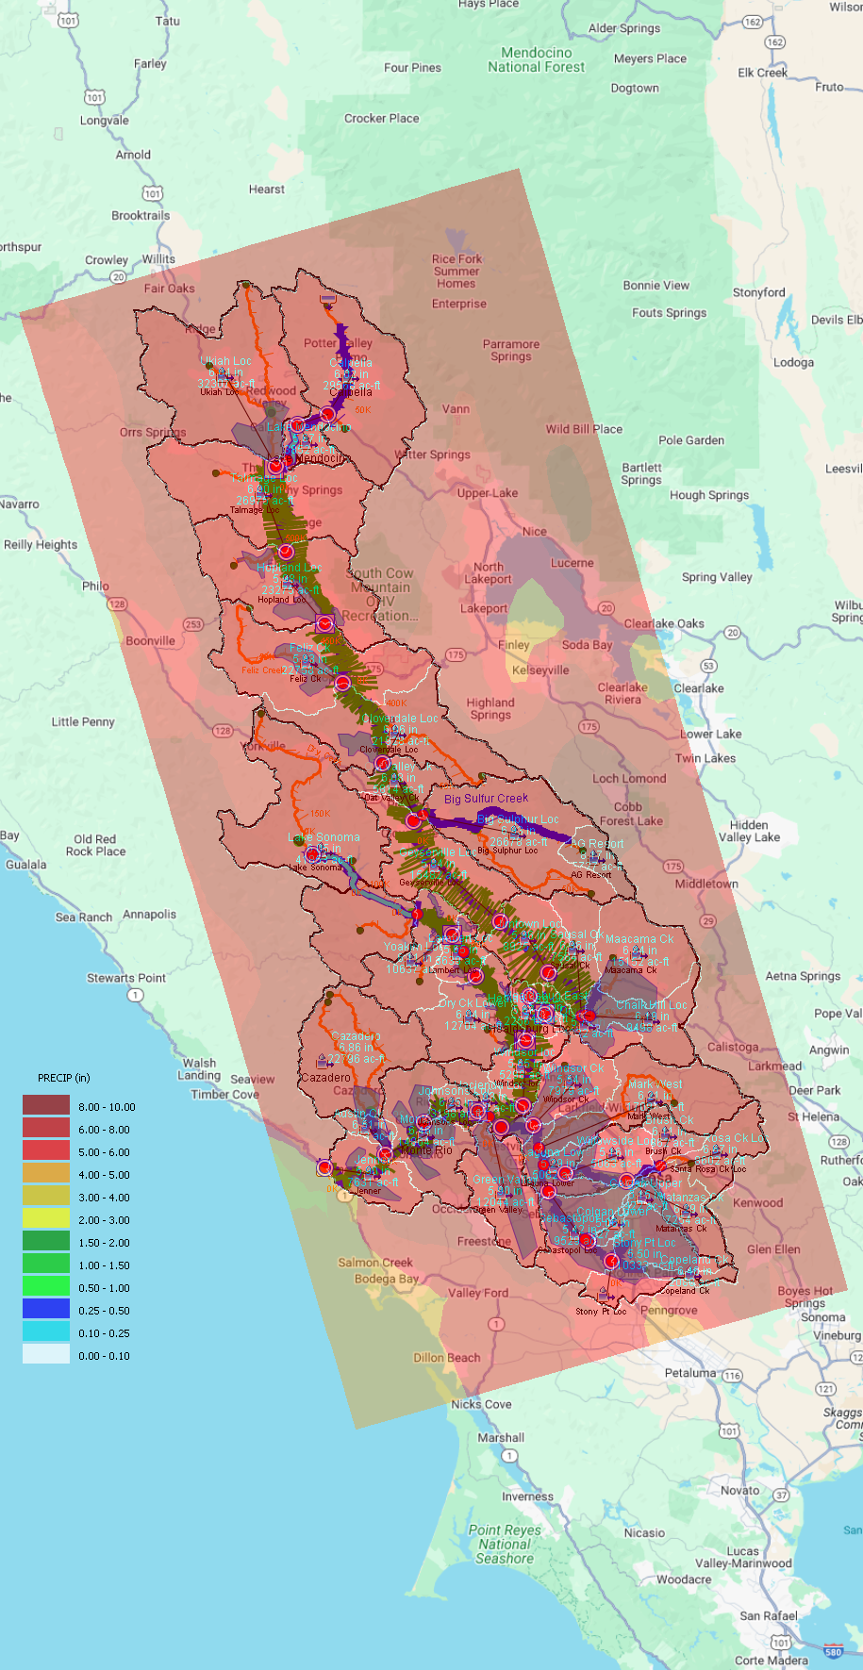
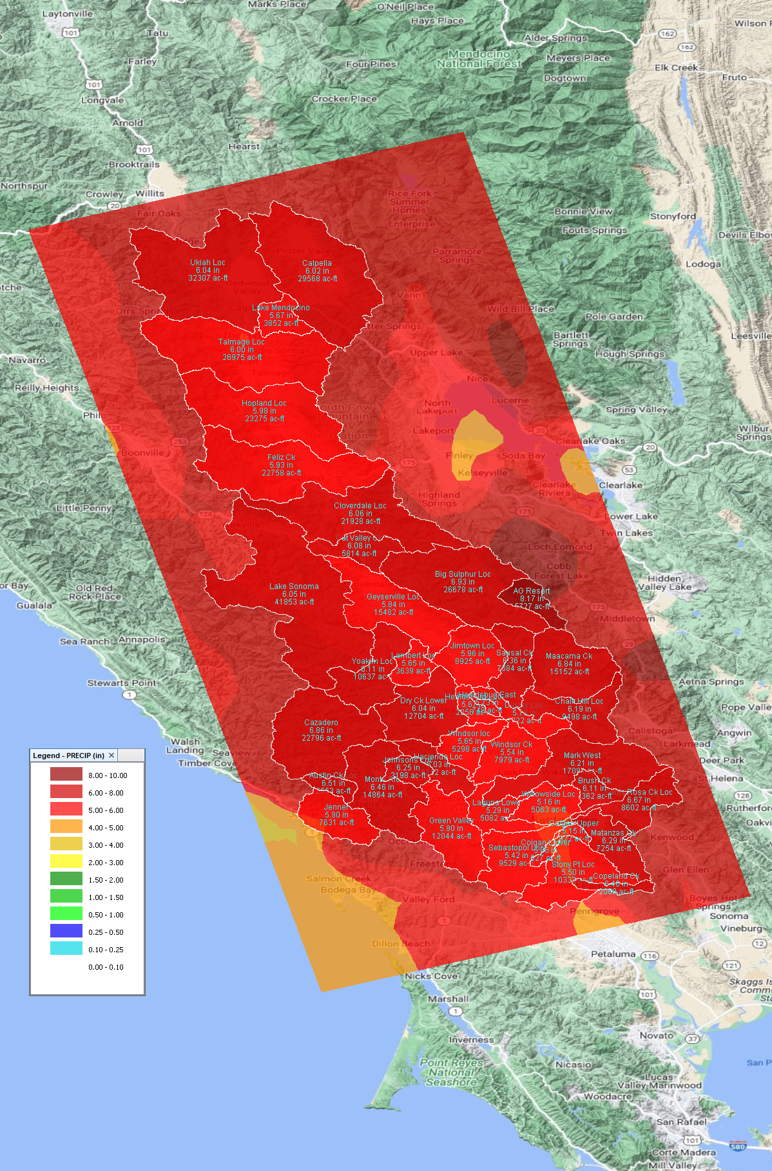
HEC-MetVue Display of Grids
CAVI Map Window
MetVue Map Window

Slide 13
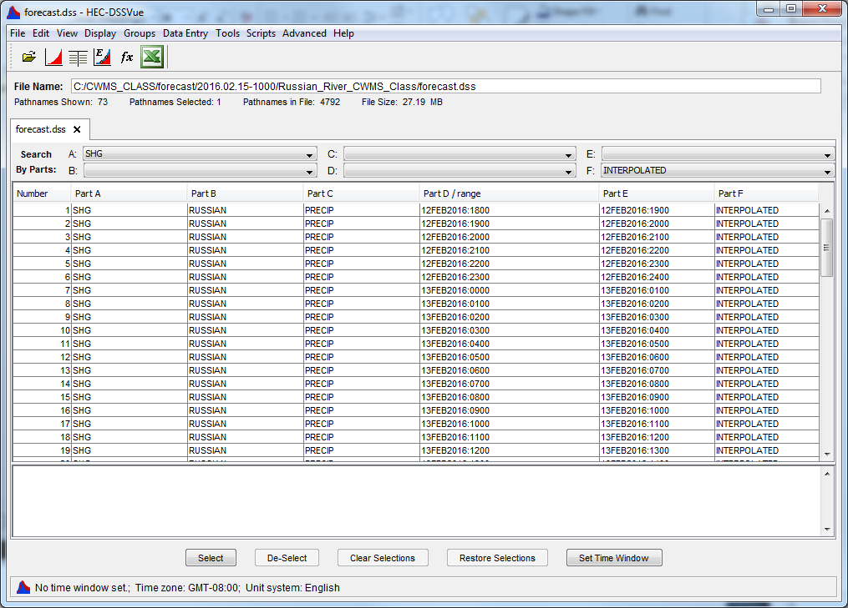
DSS File – grids catalog
Notes:
DSS File Catalog of Grids
Grids are displayed similarly to time-series data in DSSVue and CWMS-Vue
Grids are stored using a 6-part pathname (A, B, C, D, E, F)
A-Part: Coordinate System Reference (Typically SHG for “Standard Hydrologic Grid”)
B-Part: Location
C-Part: Parameter
D-Part/E-Part: Timestamp
F-Part: Version

Slide 14
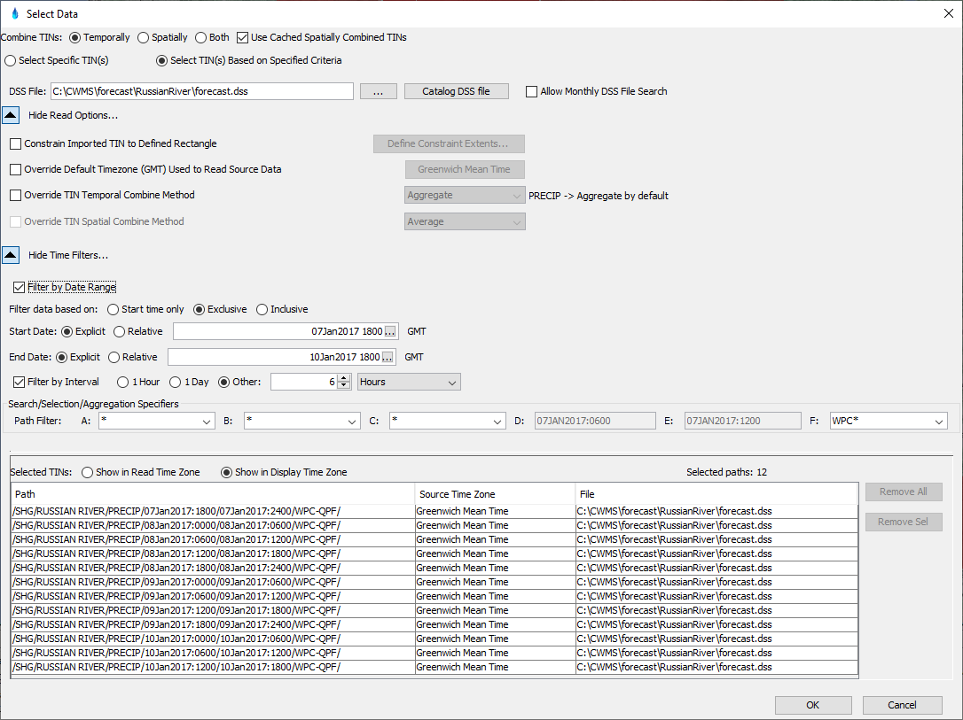
HEC-MetVue – Data Reader

Slide 15
Questions Help additional Training
https://usace.dps.mil/sites/KMP-WM/SitePages/Corps-Water-Management-System-(CWMS).aspx
https://www.hec.usace.army.mil/confluence/cwmsdocs
https://discourse.hecdev.net/c/cwms/5
TDL-CELRH-EC-GW-W-USACE CWMS Modeling | General | Microsoft Teams

