Slide 1
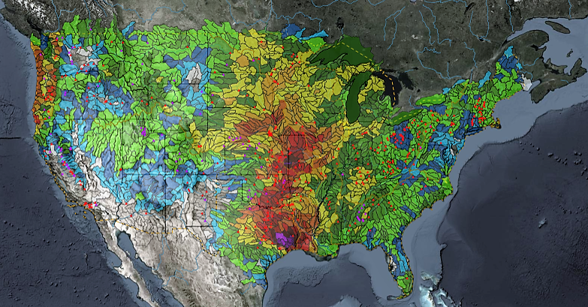
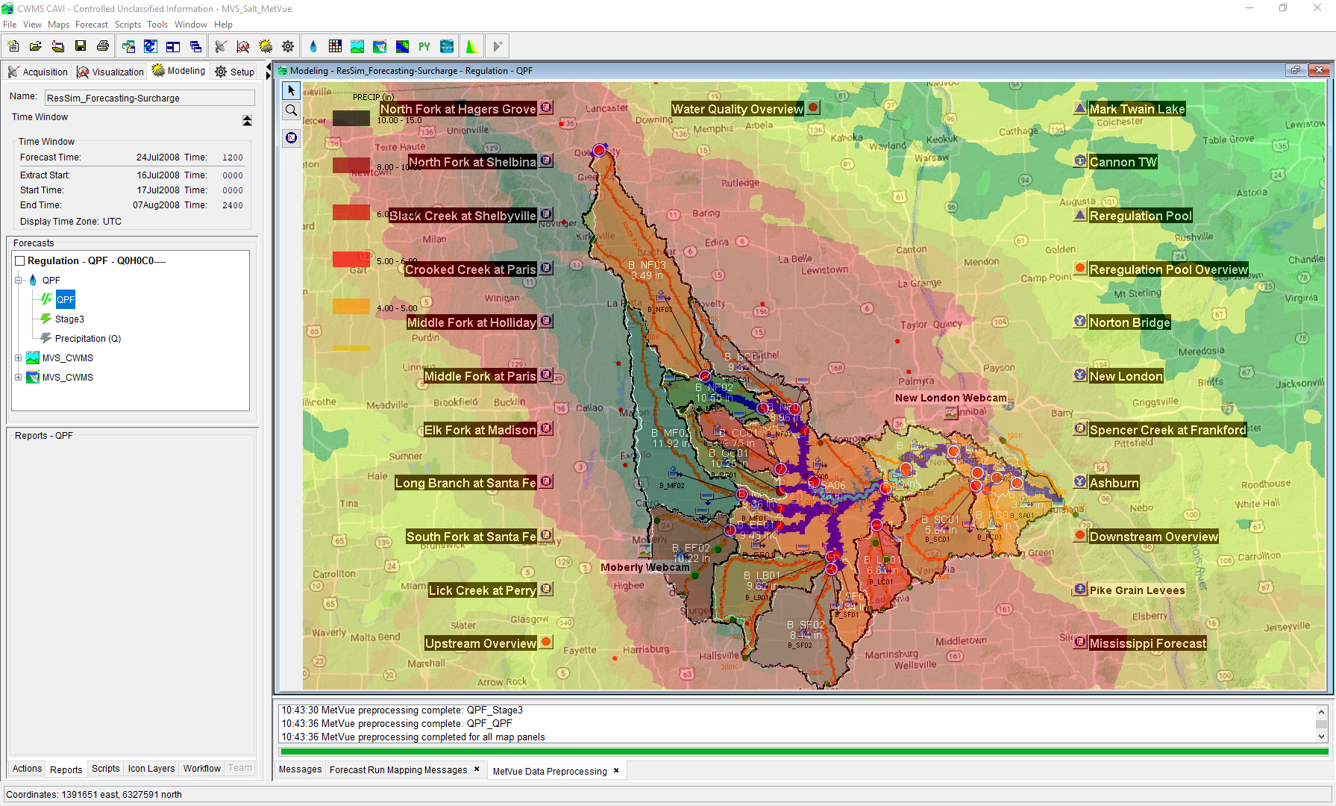

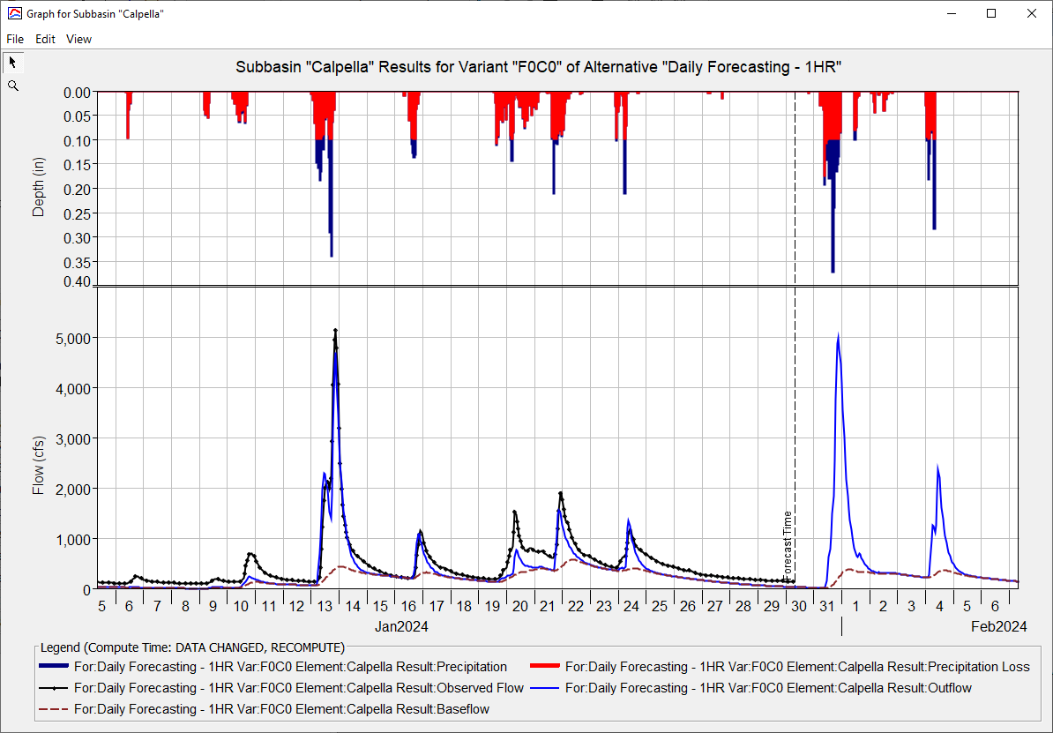
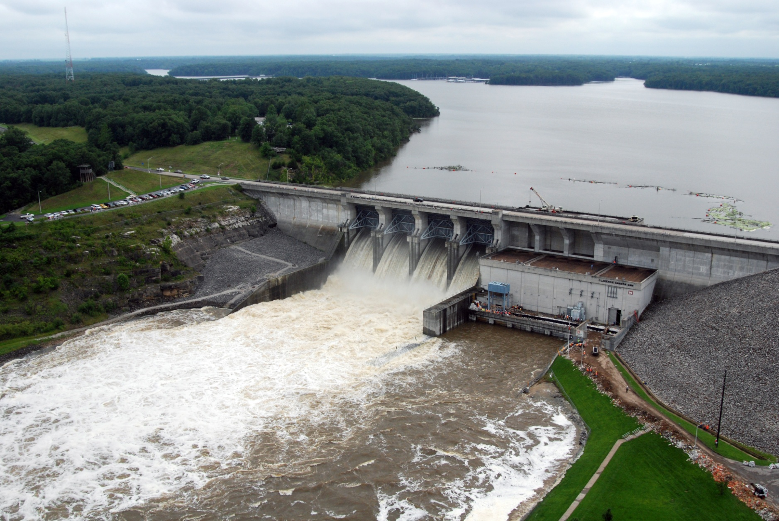
Real Time Data IN CWMS
Kat Feingold
Hydrologic Engineering Center
CWMS Prospect Course

Slide 2
objective
Identify the types of real-time data and their management in CWMS

Slide 3
Overview
CWMS Real-Time Data Types & Viewing
CWMS Data Sources
CWMS Data Processing
CWMS Data Storage Systems
CWMS Data Acquisition
Notes:
Overview
There are two categories of real-time data:
Time Series
Grids
CWMS Data Sources include:
USGS and USACE gaging station networks
National Weather Service meteorological data products
USACE Cumulus gridded data web service
Other agencies gaging station networks
CWMS Data Processing is done through manual and automated means for:
Time Series Data
Manual Data Quality Control through the CWMS/CWMSVue Validation Editor
OpenDCS CWMS Computational Processor (CCP)
DSS Scripting
Gridded Data
Manual Edits using HEC-MetVue Interactive Features
Automatic Processing based on HEC-MetVue project and session settings
Missing Data Filing
Dataset Merging
Temporal Aggregation/Disaggregation
Spatial Aggregation/Averaging
MetInterp Point-to-TIN/Grid Spatial Interpolation
Data is stored in two different storage systems:
CWMS Oracle database
Remote and Local DSS files
CWMS Data Acquisition and Access Modes
Data Acquisition is based on:
Realtime telemetry
Federal/State/Local Direct Data Exchange
Federal/State/Local/Public Web Services
CWMS can run in two different “modes” to access data:
Client-Server Mode (requires authentication)
Local (HEC-RTS) mode

Slide 4
CWMS Data Sources

Slide 5
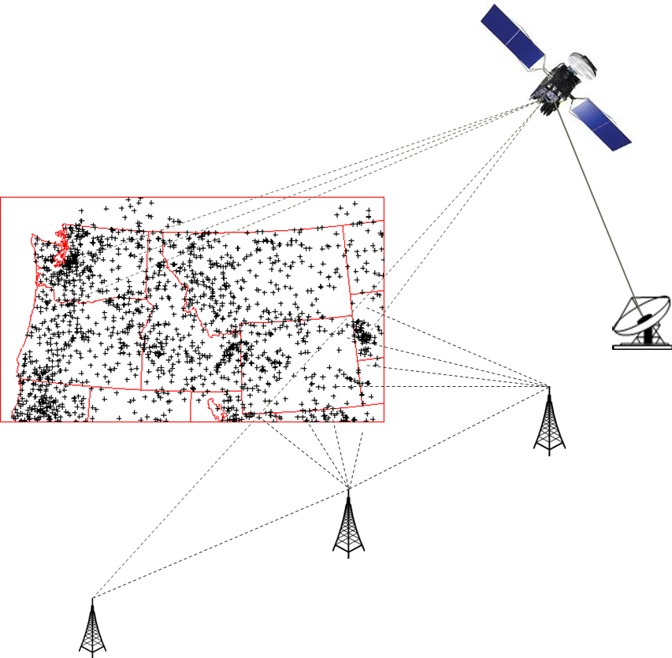
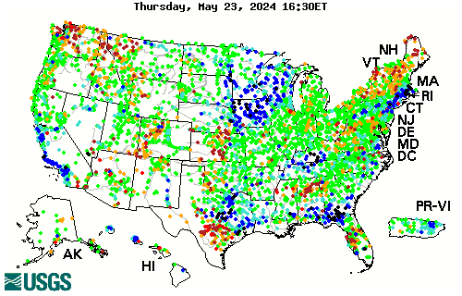
Time Series data Sources
USACE
USGS https://waterdata.usgs.gov/nwis/rt https://dashboard.waterdata.usgs.gov/
Other (Federal/State/Local)

Slide 6
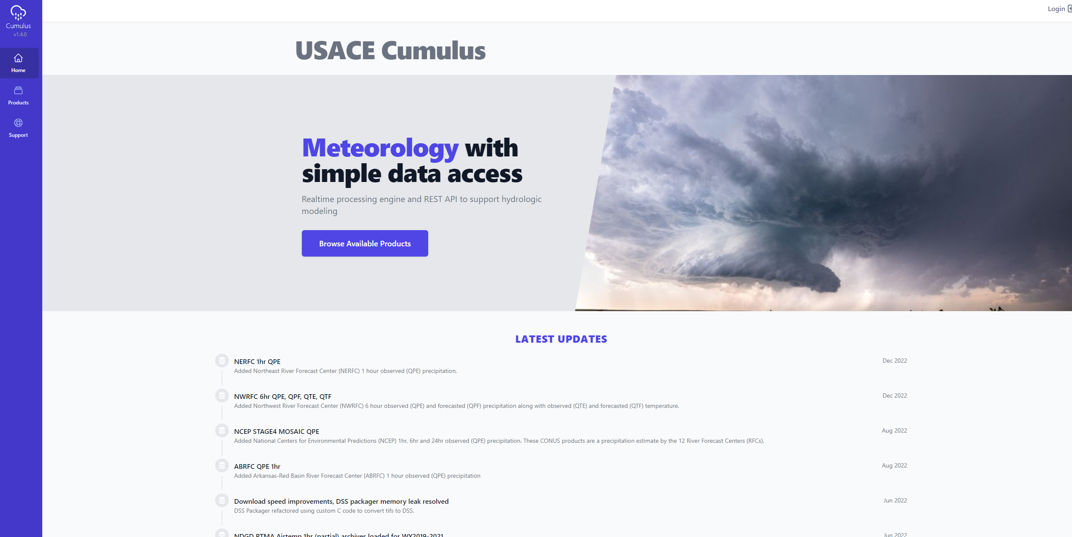
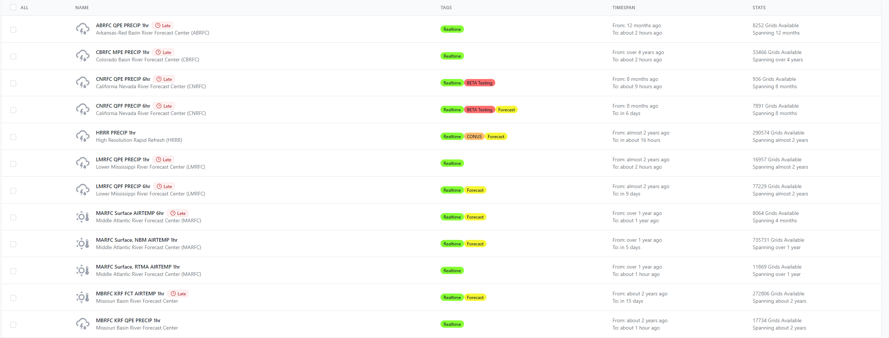
Gridded data sources - Cumulus
https://cumulus.corps.cloud
Web service single point of meteorological data access available to USACE WM and HH&C
Requires CorpsNet Access
Either Direct or VPN
Direct Cumulus extract via the CAVI
Watershed or Area of Interest extents
Notes:
Cumulus is a gridded meteorological data repository that serves the Corps Water Management and Hydrologic and Hydraulic Communities of Practice. Cumulus is a web service that provides on-demand data access through its primary website https://www.cumulus.corps.cloud as well as an (API) that can be used by software programs or other web services to access through custom interface or automated means.
Product – Provides a list of all available historic, real-time, and forecast meteorological parameters
Filtered by
Corps Office – Filter the applicable watersheds for the selected office
Watershed – Determines the clipping extents for the dataset download
Time Window – Defines the start and end dates and times for the dataset download
Cumulus is only available through CorpsNet. And requires, CAC authentication is required to download datasets.

Slide 7
Additional Gridded data sources
RFC – River Forecast Center
https://water.weather.gov/ahps/rfc/rfc.php
NBM – National Blend of Models
https://vlab.noaa.gov/web/mdl/nbm
NCEP – National Center for Environmental Predictions
https://nomads.ncep.noaa.gov
NDFD – National Digital Forecasting Database
https://vlab.noaa.gov/web/mdl/ndfd
Notes:
Gridded Precipitation and Temperature Data Sources
Data Sources Overview
River Forecast Centers distribute grids of QPE and QPF (Quantitative Precipitation Estimate/Forecast)
Nationwide grids are available from several sources
National Digital Forecast Database (NDFD)
National Digital Guidance Database (NDGD)
National Center for Environmental Predictions (NCEP)
Weather Prediction Center (WPC)
National Operational Hydrologic Remote Sensing Center (NOHRSC)
Nationwide grids are collected and processed for use in CWMS at the Central Processing Center and can be distributed to your office for use in CWMS modeling

Slide 8
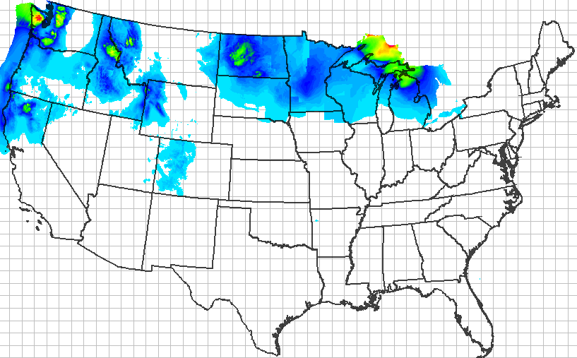
Precipitation forecast (QPF)
Notes:
Data Sources Details
NDFD Precipitation Forecast (QPF)
From National Weather Service National Digital Forecast Database
Resampled to 2km SHG and stored in DSS records at CPC
Can be distributed to division/district offices
Supplement to QPF from River Forecast Center

Slide 9
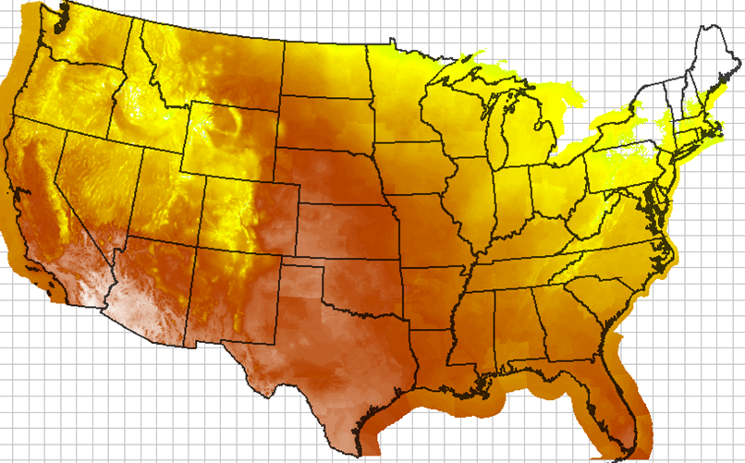
Temperature Forecast (QTf)
Notes:
NDFD Temperature Forecast
From National Weather Service National Digital Forecast Database
Resampled to 2km SHG and stored in DSS records at CPC
Can be distributed to division/district offices
Available for use in snow forecasts or with Gridded Hamon evaporation

Slide 10
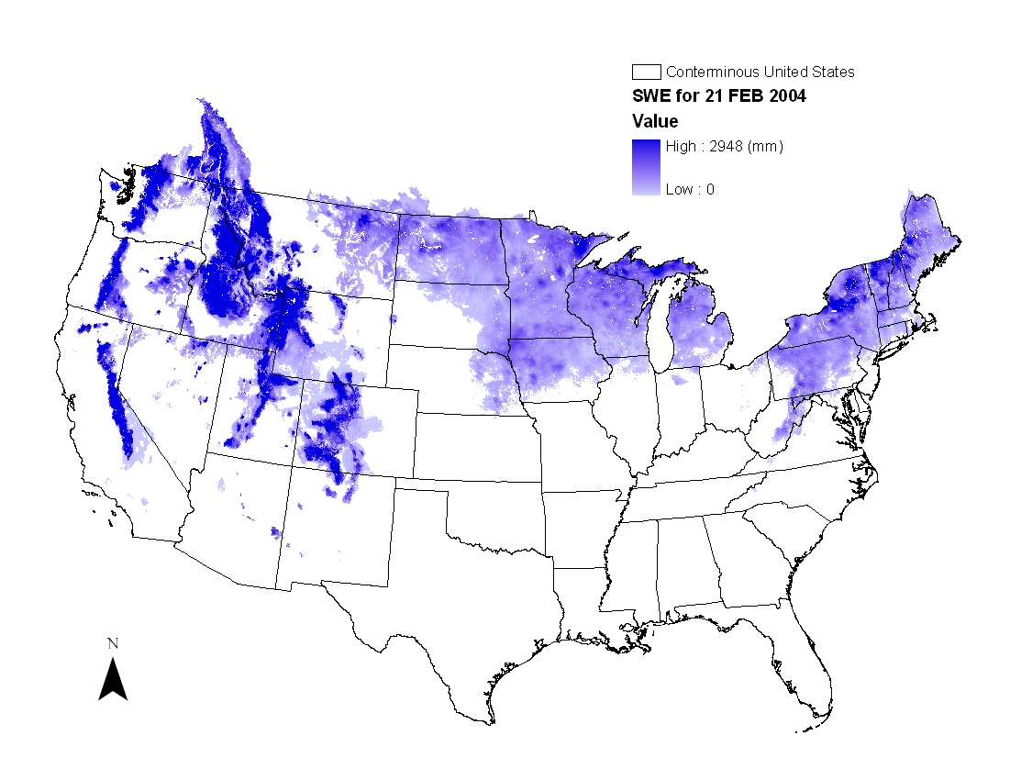
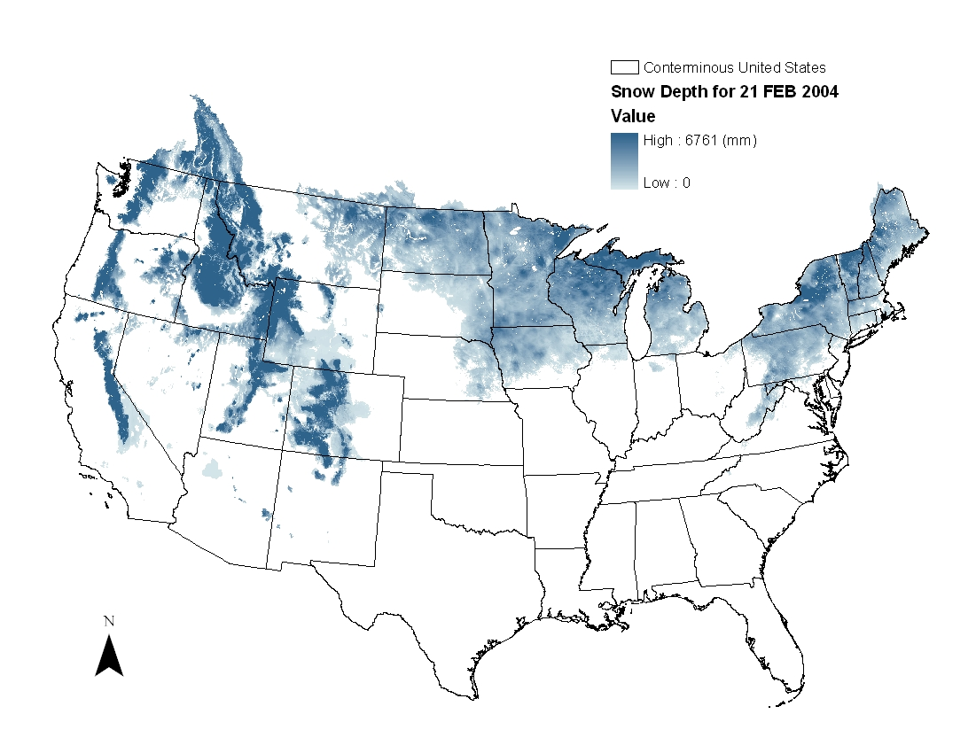
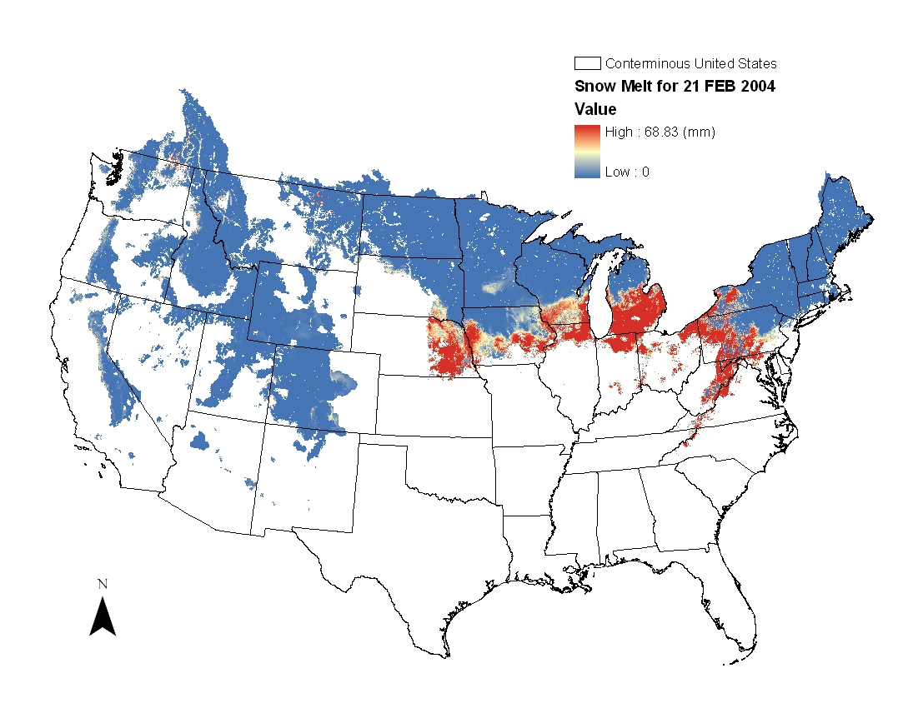
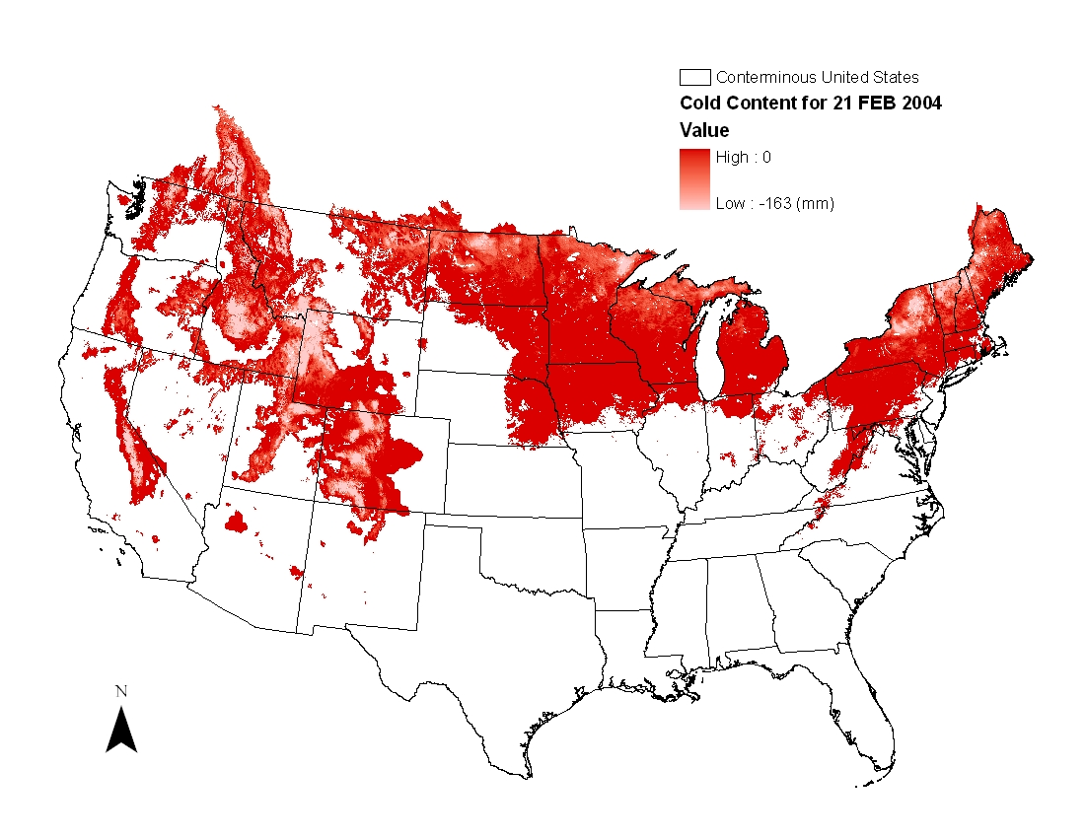
Example Snodas
Snow Data Assimilation System (SNODAS)
Notes:
SNODAS grids from NOHRSC
SNODAS is the primary source of gridded snow data used in CWMS snowmelt models in the Corps
Hourly/Daily gridded snow products for conterminous U.S.
Based on an energy balance snow model combined with multi-sensor snow observations
Spatial Resolution: 1 sq km resolution
Available period of record: October 2003 – Present
Additional information available at http://www.nohrsc.noaa.gov/

Slide 11
Questions Help additional Training
https://usace.dps.mil/sites/KMP-WM/SitePages/Corps-Water-Management-System-(CWMS).aspx
https://www.hec.usace.army.mil/confluence/cwmsdocs
https://discourse.hecdev.net/c/cwms/5
TDL-CELRH-EC-GW-W-USACE CWMS Modeling | General | Microsoft Teams

