Slide 1
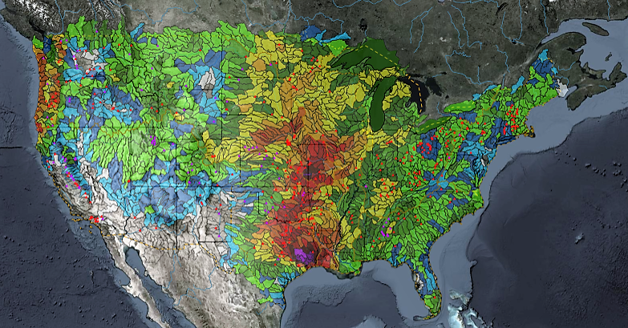
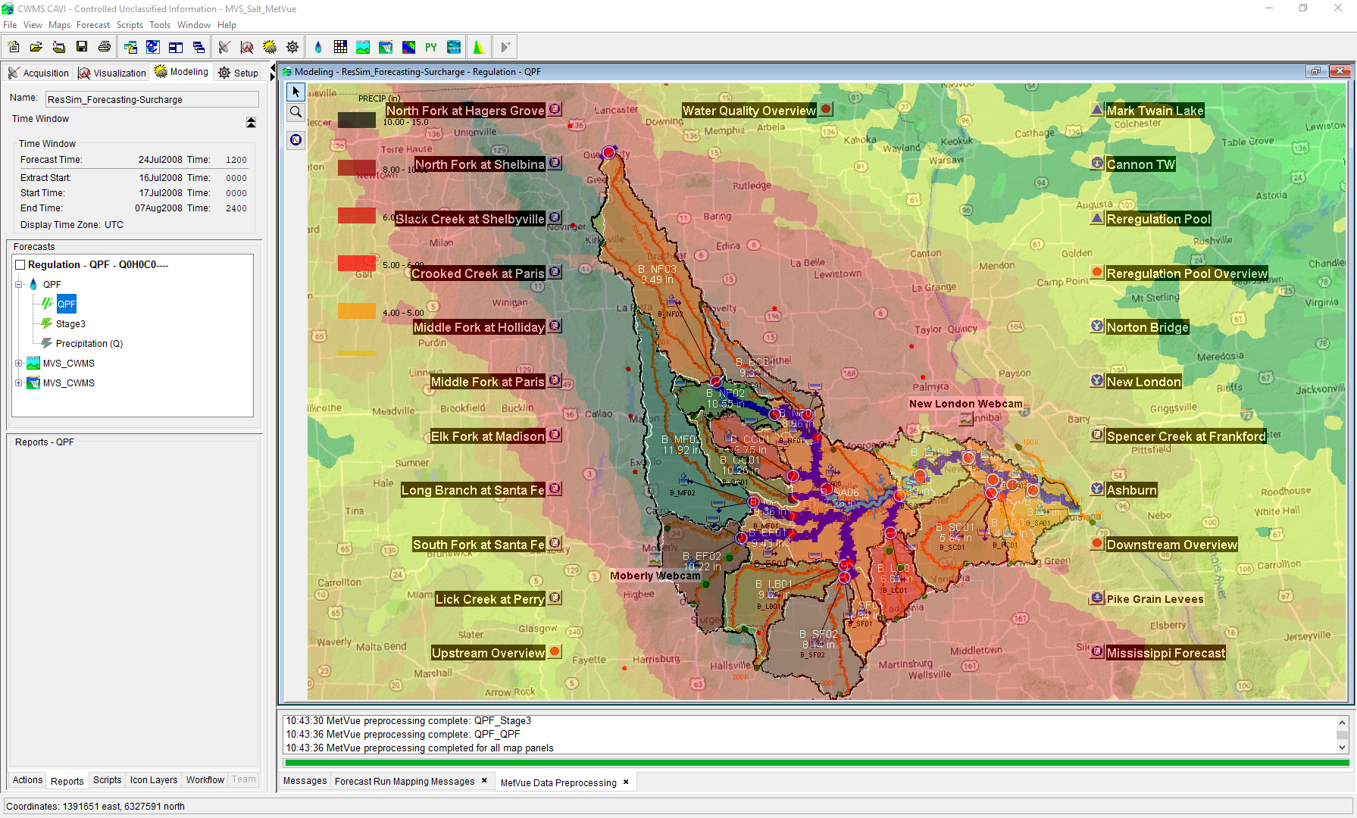

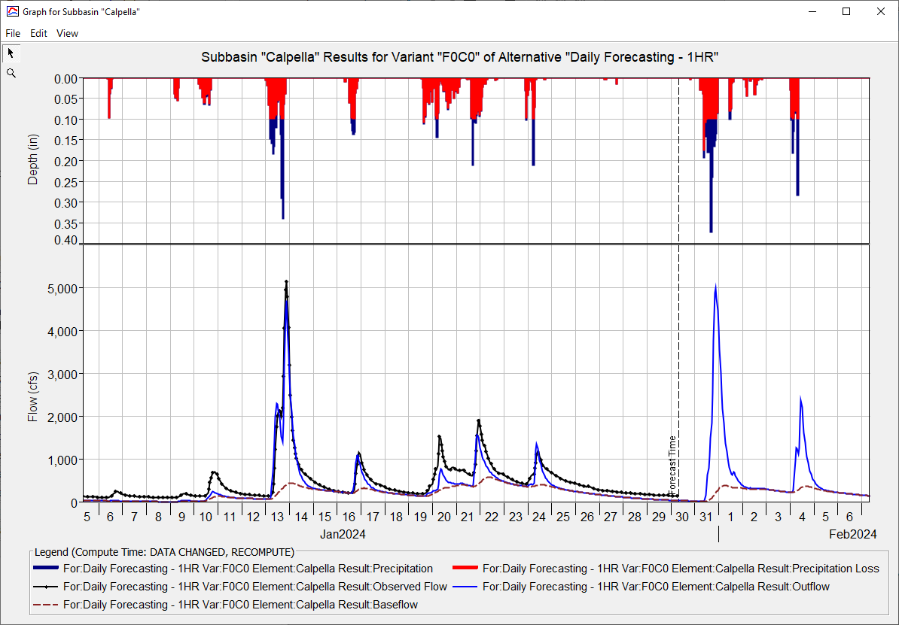
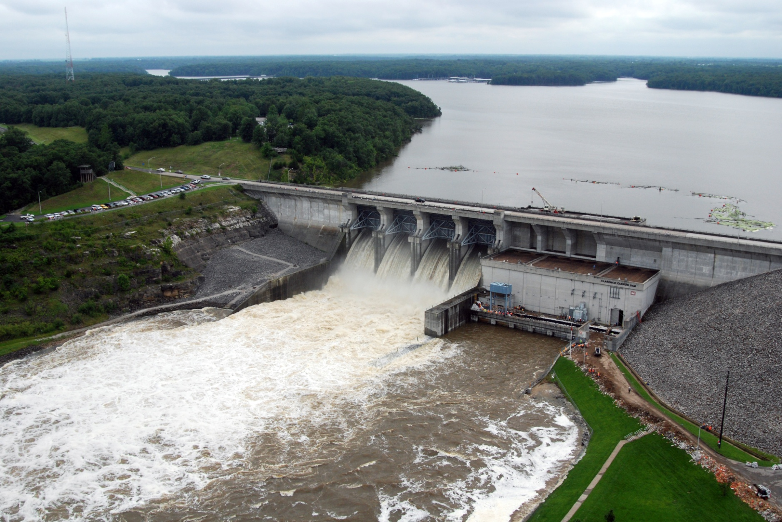
Real Time Data IN CWMS
Kat Feingold
Hydrologic Engineering Center
CWMS Prospect Course

Slide 2
objective
Identify the types of real-time data and their management in CWMS

Slide 3
Overview
CWMS Real-Time Data Types & Viewing
CWMS Data Sources
CWMS Data Processing
CWMS Data Storage Systems
CWMS Data Acquisition
Notes:
Overview
There are two categories of real-time data:
Time Series
Grids
CWMS Data Sources include:
USGS and USACE gaging station networks
National Weather Service meteorological data products
USACE Cumulus gridded data web service
Other agencies gaging station networks
CWMS Data Processing is done through manual and automated means for:
Time Series Data
Manual Data Quality Control through the CWMS/CWMSVue Validation Editor
OpenDCS CWMS Computational Processor (CCP)
DSS Scripting
Gridded Data
Manual Edits using HEC-MetVue Interactive Features
Automatic Processing based on HEC-MetVue project and session settings
Missing Data Filing
Dataset Merging
Temporal Aggregation/Disaggregation
Spatial Aggregation/Averaging
MetInterp Point-to-TIN/Grid Spatial Interpolation
Data is stored in two different storage systems:
CWMS Oracle database
Remote and Local DSS files
CWMS Data Acquisition and Access Modes
Data Acquisition is based on:
Realtime telemetry
Federal/State/Local Direct Data Exchange
Federal/State/Local/Public Web Services
CWMS can run in two different “modes” to access data:
Client-Server Mode (requires authentication)
Local (HEC-RTS) mode

Slide 4
CWMS Data Processing

Slide 5
Time-series Data processing
Data Types
Data Processing
Observation
Stage gage
Rain gage
Thermometer
Derived
Flow from stage & rating
Storage from elevation & rating
Model Results
CWMS/CWMSVue Validation Editor
CWMS Computational Processor (CCP)
DSS Math functions and Scripts
Notes:
Real-Time Data Types
Time-Series are obtained and transformed in a variety of ways
Time-series can be obtained from direct observation or derived
Examples of time-series data from direct observations
River stage gage
Precipitation gage
Thermometer
Examples of time-series derived using direct observations and computations
Flow from stage & stage-flow rating
Storage from elevation & elevation-storage curve
There are several tools available for processing and modifiying time series data.
CWMS and CWMSVue Data Validation Editor
CWMS Computational Processor (CCP)
DSS Math functions and Scripts

Slide 6
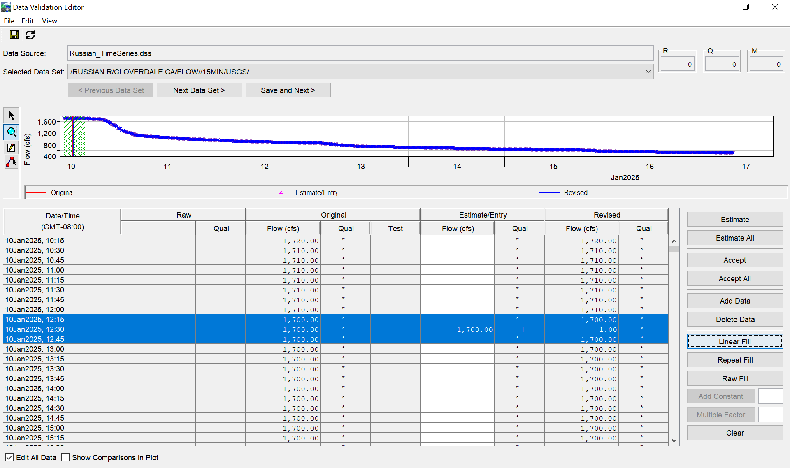
CAVI/CWMSVue Validation Editor
Interactive Data Review & Editing
Set value as missing
Set specified value
Fill – Linear
Fill – Repeat
Fill – Raw
Add a constant value
Multiply by a factor

Slide 7
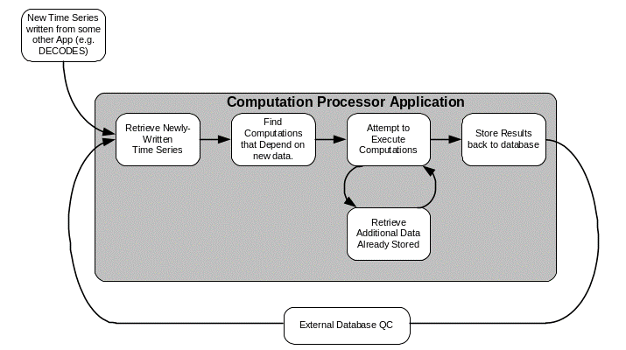
OpenDCS Cwms Computational Processor (CCP)
Example Functions
Average
Fill Forward
Disaggregate
Inflow computation
References
Main Documentation https://opendcs-env.readthedocs.io/en/latest/
Standard Algorithms https://opendcs-env.readthedocs.io/en/latest/resources-algorithms.html
Custom Python Algorithms https://opendcs-env.readthedocs.io/en/latest/resources-algorithms.html#opendcs-custom-python-algorithms

Slide 8
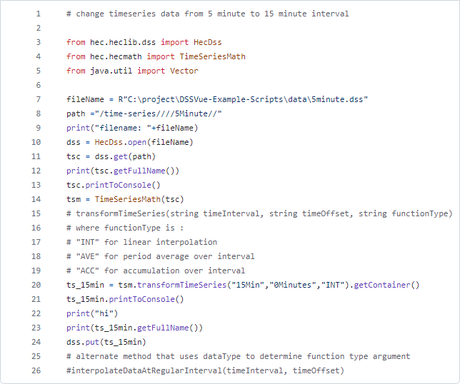
Hec-dss Math functions & Scripts
Example Functions
Estimate Missing Values
Replace Specific Values
Screen using Minimum and Maximum
Change Time Interval
Irregular to Regular
Rating Table
Reverse Rating Table
Moving Average
References
HEC-DSSVue Users Manual https://www.hec.usace.army.mil/confluence/dssdocs/dssvueum/math-and-statistical-functions https://www.hec.usace.army.mil/confluence/dssdocs/dssvueum/scripting/math-functions
HEC-DSSVue Github Scripts Repo https://github.com/HydrologicEngineeringCenter/DSSVue-Example-Scripts/tree/master/src
https://github.com/HydrologicEngineeringCenter/DSSVue-Example-Scripts/blob/master/src/change-interval.py

Slide 9
Grid Data processing
Data Types
Data Processing
Observation
RADAR
Aircraft and Satellite Remote Sensing
Derived
Interpolation from point measurements
Model Results
HEC-MetVue
Missing Data Filing
Dataset Merging
Temporal Aggregation/Disaggregation
Spatial Aggregation/Averaging
TIN-to-Grid and Grid-to-TIN
MetInterp
Point-to-TIN/Grid Spatial Interpolation
Notes:
Grids are obtained and transformed in a variety of ways
Grids can be obtained from direct observations
RADAR
Remote Sensing (from Satellite or Aircraft)
Grids can be derived from direct observations (point or gridded).
Interpretation of Remote Sensing products
Interpolation from point measurements to TIN (Triangulated Irregular Network) and Grid.
There are many derived grids available from Weather Service Models/Processes
RTMA (Real-Time-Mezzoscale-Analysis)
MRMS (Multi-Radar-Multi-Sensor)
SNODAS (SNOw Data Assimilation System)
HRRR (High-Resolution-Rapid-Refresh)
Others
HEC-MetVue offers a number of spatial data processing methods:
Missing Data Filing
Dataset Merging
Temporal Aggregation/Disaggregation
Spatial Aggregation/Averaging
TIN-to-Grid and Grid-to-TIN
HEC-MetVue also provides for Point-to-TIN or Point-to-Grid spatil interpolation with a methods, including
Inverse-Distance
Inverse-Distance Squared
Nearest Neighbor
Bilinear

Slide 10
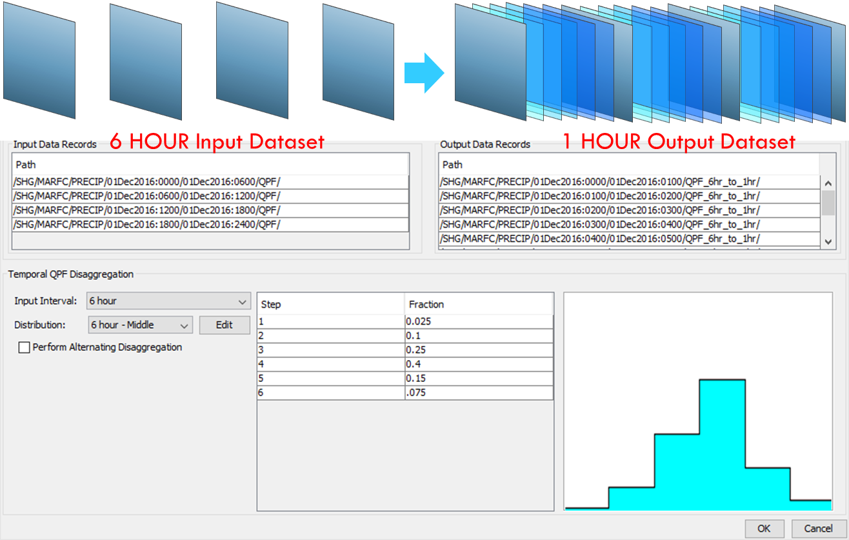
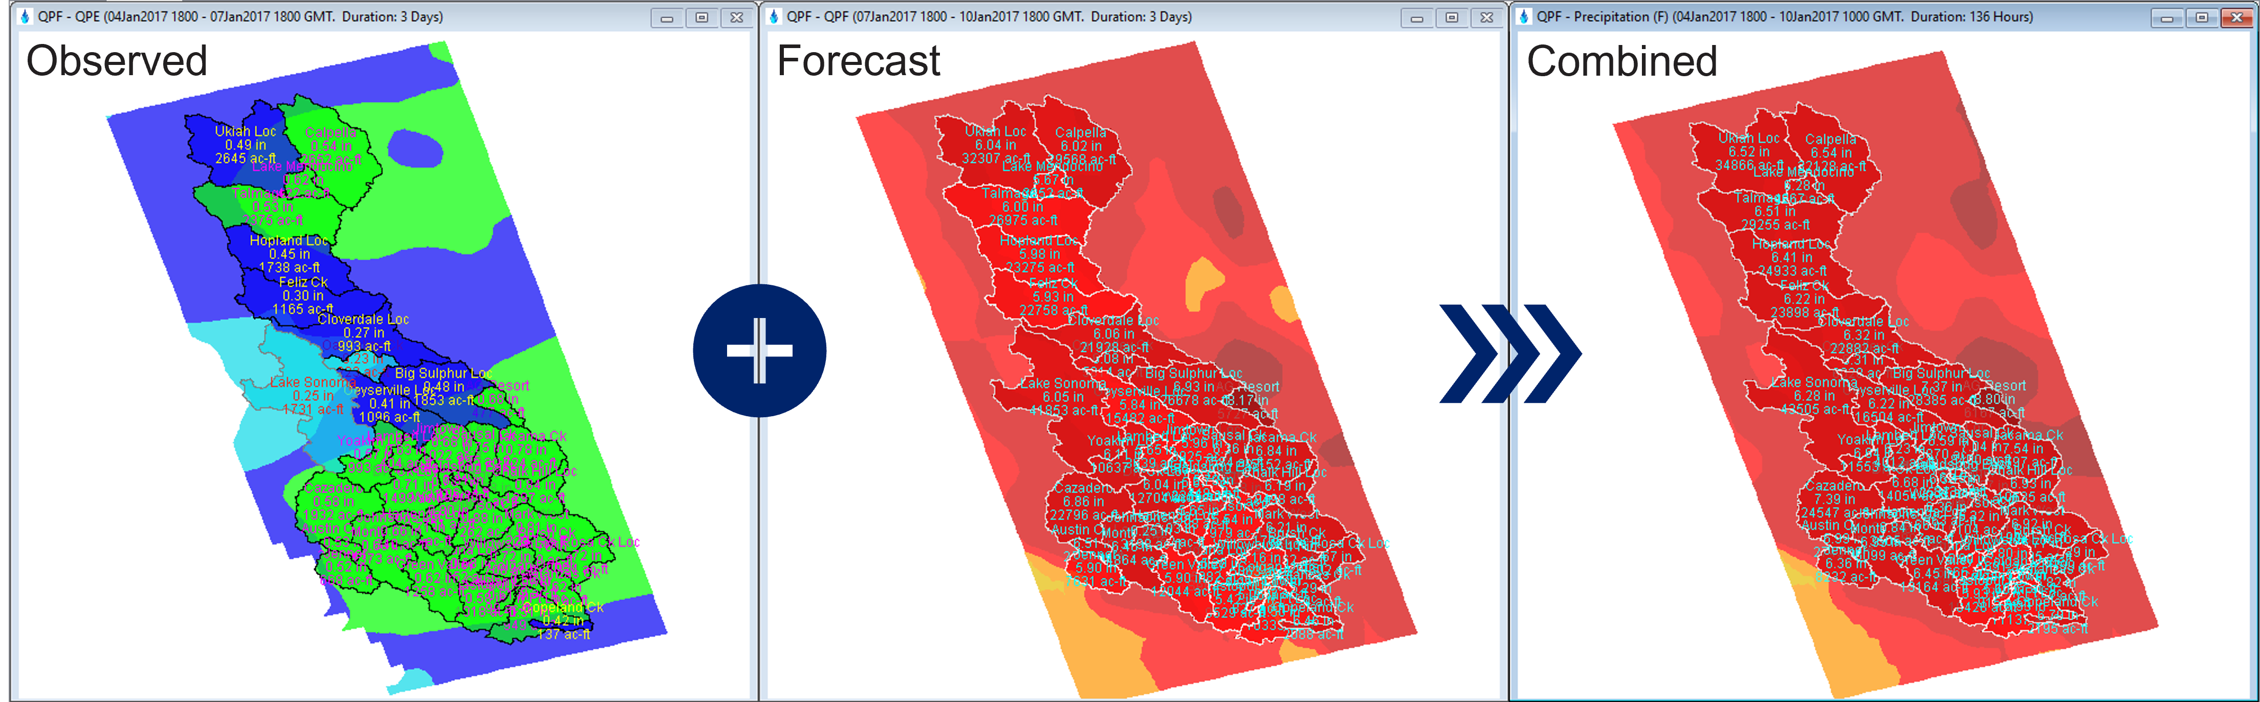
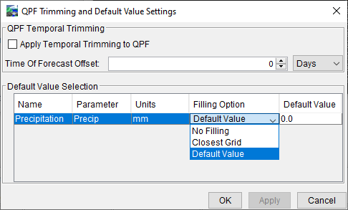
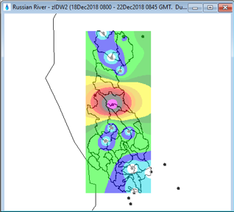
HEC-MetVue Data Processing
Temporal Disaggregation
Dataset Merging
Missing Data Filling
Spatial Interpolation

Slide 11
Questions Help additional Training
https://usace.dps.mil/sites/KMP-WM/SitePages/Corps-Water-Management-System-(CWMS).aspx
https://www.hec.usace.army.mil/confluence/cwmsdocs
https://discourse.hecdev.net/c/cwms/5
TDL-CELRH-EC-GW-W-USACE CWMS Modeling | General | Microsoft Teams

