Slide 1
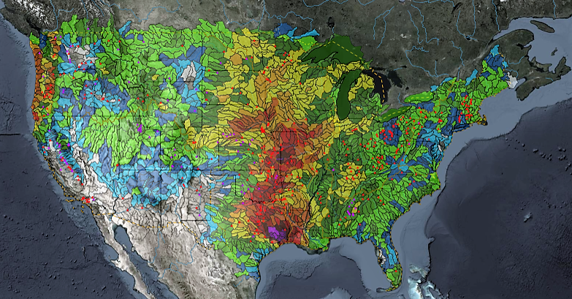
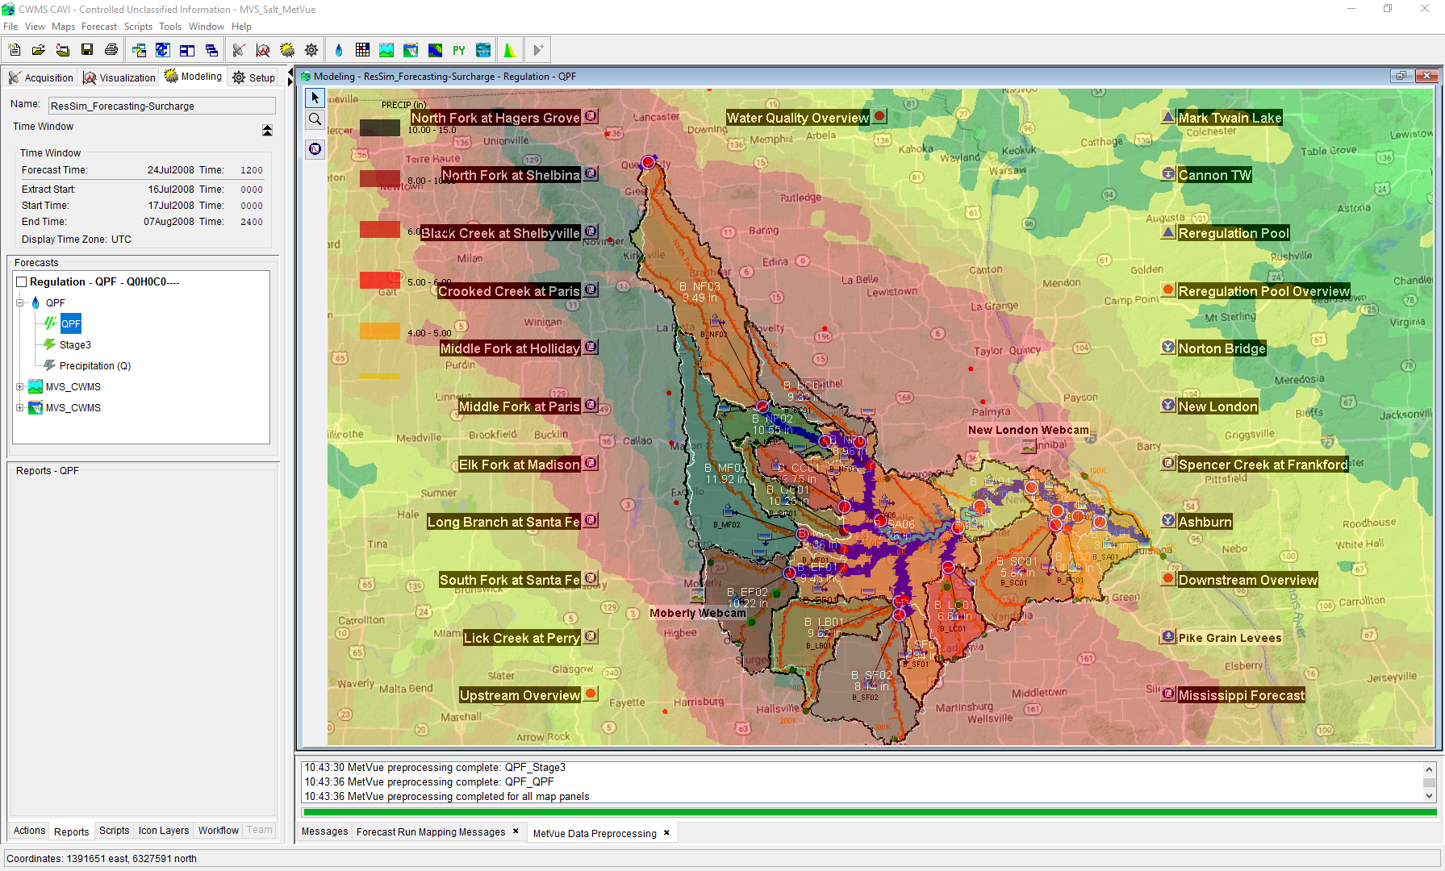

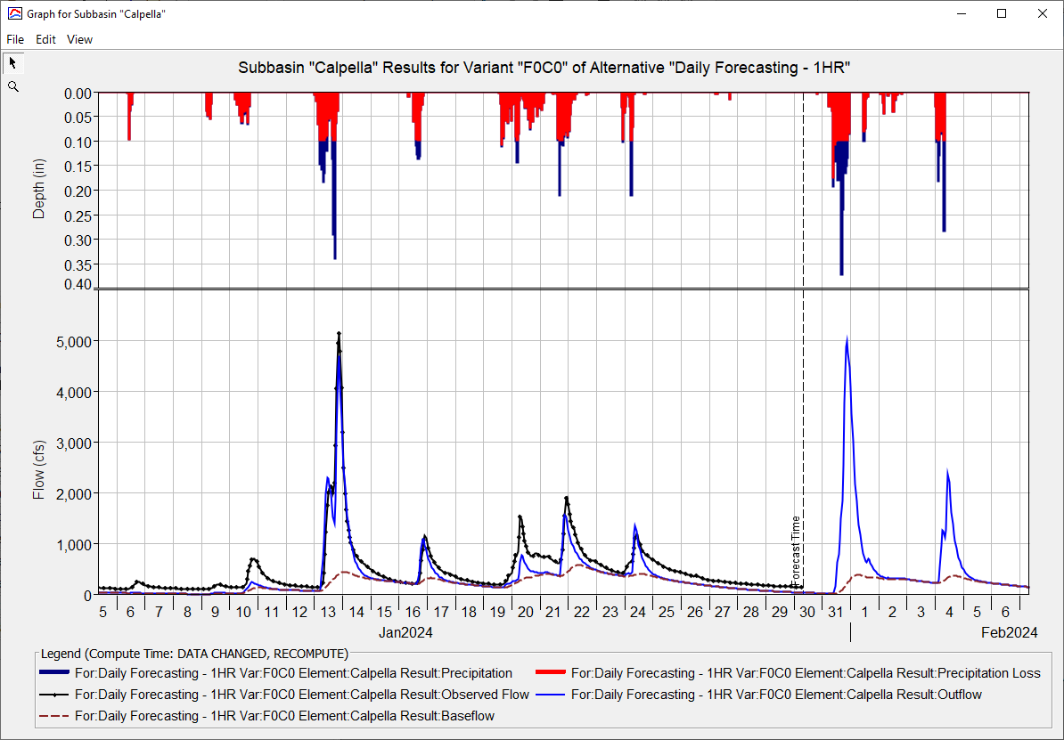
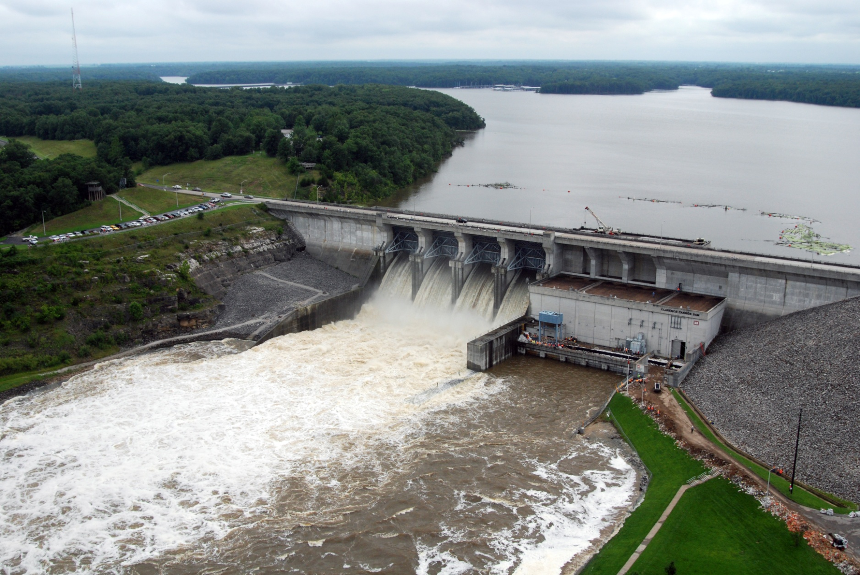
Real Time Data IN CWMS
Kat Feingold
Hydrologic Engineering Center
CWMS Prospect Course

Slide 2
objective
Identify the types of real-time data and their management in CWMS

Slide 3
Overview
  CWMS Real-Time Data Types & Viewing
  CWMS Data Sources
  CWMS Data Processing
  CWMS Data Storage Systems
  CWMS Data Acquisition
Notes:
Overview
There are two categories of real-time data:
Time Series
Grids
CWMS Data Sources include:
USGS and USACE gaging station networks
National Weather Service meteorological data products
USACE Cumulus gridded data web service
Other agencies gaging station networks
CWMS Data Processing is done through manual and automated means for:
Time Series Data
Manual Data Quality Control through the CWMS/CWMSVue Validation Editor
OpenDCS CWMS Computational Processor (CCP)
DSS Scripting
Gridded Data
Manual Edits using HEC-MetVue Interactive Features
Automatic Processing based on HEC-MetVue project and session settings
Missing Data Filing
Dataset Merging
Temporal Aggregation/Disaggregation
Spatial Aggregation/Averaging
MetInterp Point-to-TIN/Grid Spatial Interpolation
Data is stored in two different storage systems:
CWMS Oracle database
Remote and Local DSS files
CWMS Data Acquisition and Access Modes
Data Acquisition is based on:
Realtime telemetry
Federal/State/Local Direct Data Exchange
Federal/State/Local/Public Web Services
CWMS can run in two different “modes” to access data:
Client-Server Mode (requires authentication)
Local (HEC-RTS) mode

Slide 4
Data storage Systems

Slide 5


Data storage systems in cwms
CWMS Database
HEC-DSS Files
  Runs on a CWMS T7 Server or Cloud Server
  Oracle-Based Relational Database System
  Supports enterprise-scale data operations
  AIS (Automated Information System)
  Requires authenticated login
  Stored on
    Windows PC
    CWMS server
  Optimized for data sequences like time series
  Local DSS requires no login
Notes:
Data Storage Systems in CWMS
Data in CWMS is stored in two forms, CWMS Oracle Database and DSS Files
CWMS Database:
Runs on CWMS server (locally or in the cloud)
Oracle Relational Database System
Supports enterprise-scale data operations
Army AIS (Automated Information System)
Requires Authenticated Login
DSS Files:
Stored on CWMS server (locally or in the cloud)
Stored on PC or Server file system
Optimized for data sequences like time series
No login required for local DSS file operations

Slide 6
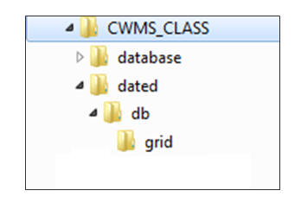


Files and directories for cwms data
Notes:
Data Storage Systems in CWMS
Files and Directories for CWMS Data
Top directCWMS server the top directory is set by $CWMS_HOME environment variable
config directory holds relatively static setup for data acquisition (da) processes
MetInterp configuration files are saved in the config directory
ProcessSheffit criteria files
ory (CWMS_CLASS here) is left to user choice
On dated directory contents change as data collection and transformation processes run
DSS files for grids are stored in dated/db/grid
Temporary files required by data processing programs
Log files
database directory hold DSS files for time series in “Local Mode” (RTS)
In Corps production systems, this is replaced by the CWMS Oracle database
There is no “database” directory on CWMS server

Slide 7
Cwms data Acquisition

Slide 8
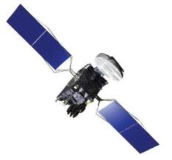
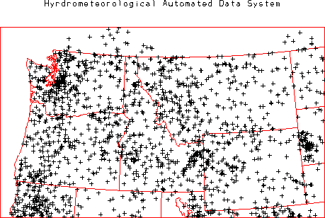






District/division data acquisition
CWMS Client-Server Mode
(Authentication Required)
Hydrometeorological Automated Data System
Federal/state/Local Agency
Federal/State/Local Agency
Dedicated Line
Data Exchange
Satellite
Telemetry
Data
VHF
Line-of-
Sight
Data
Internet
Data Exchange
Server-based
Water
Management
System
Instructions To and
From Dam Operator
Local Water Management Office
Notes:
CWMS Data Modes
Client-Server Mode
Data Acquisition for Corps Office in Production
Data comes from both public and proprietary sources
Data is acquired continuously through automated processes
Data is transmitted over internet, dedicated data exchange lines, line-of-site radio, satellites, and more
Time-series data is stored in CWMS Oracle database on CWMS server(s)
Grids come from National Weather Service and other sources
Grids are stored in server-side DSS files with precip.yyyy.mm.dss naming convention
Many validation/transformation processes may be used

Slide 9
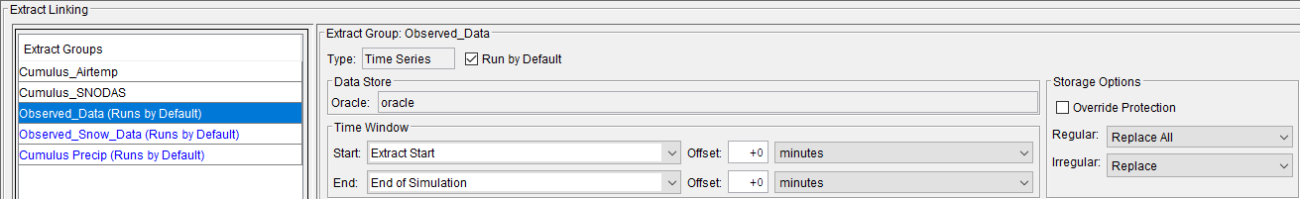
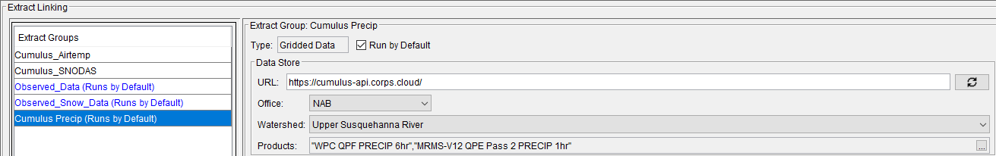
Client-Server CAVI Data Extracts
  CAC authentication required for server access

Slide 10
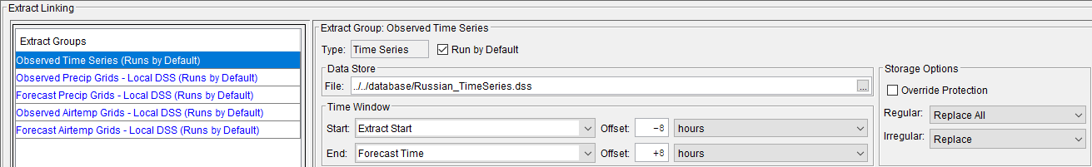
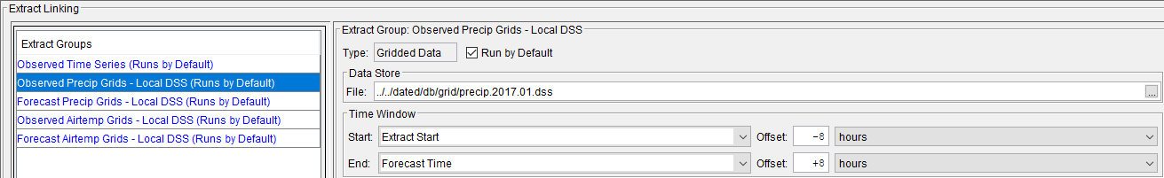
HEC-RTS CAVI Data Extracts
  No authentication required for local DSS file access

Slide 11
Summary
  CWMS data supporting real-time modeling includes both time series and grids from a variety of sources
  Time-series data is stored in CWMS Oracle database and HEC-DSS

Slide 12
Questions
Help additional Training
https://usace.dps.mil/sites/KMP-WM/SitePages/Corps-Water-Management-System-(CWMS).aspx
https://www.hec.usace.army.mil/confluence/cwmsdocs
https://discourse.hecdev.net/c/cwms/5
TDL-CELRH-EC-GW-W-USACE CWMS Modeling | General | Microsoft Teams

