Slide 1
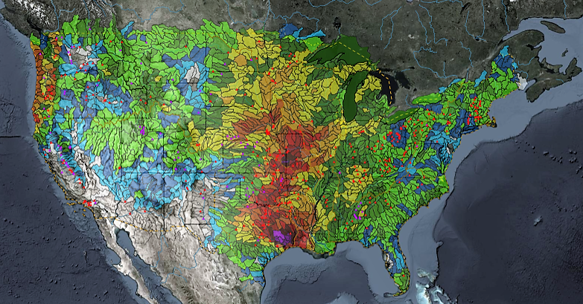
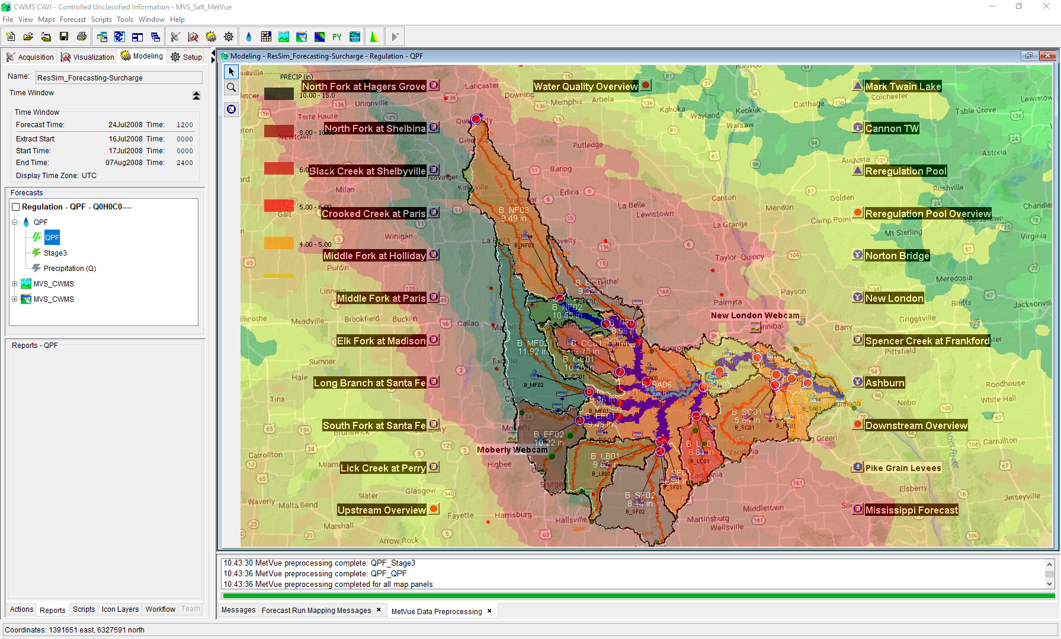

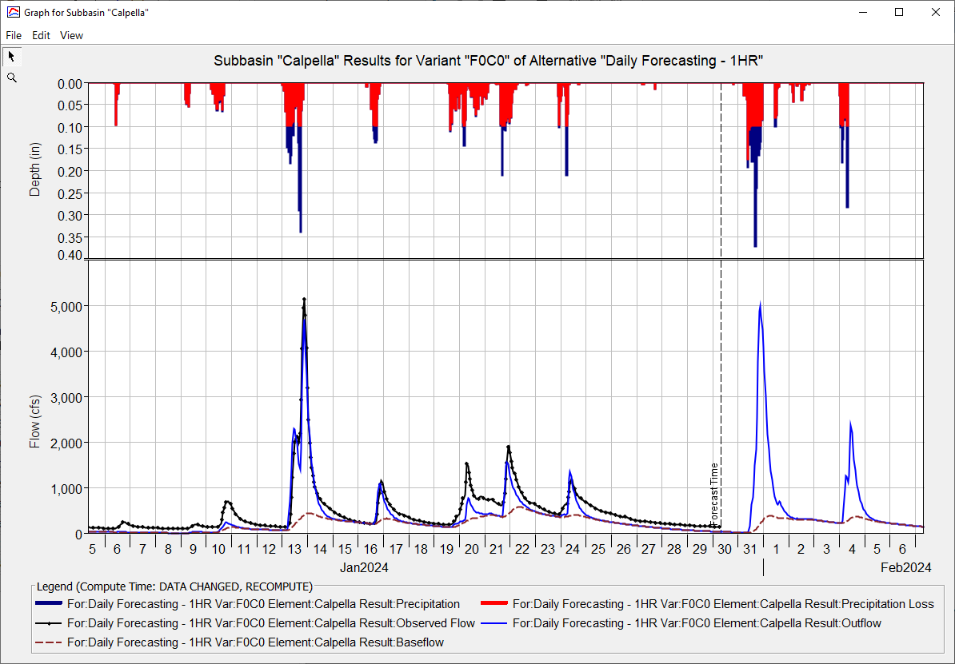

CWMS GRAPHICS AND SCRIPTING
Oskar Hurst,
Hydrologic Engineering Center
CWMS Prospect Course
Overview & Plotting

Slide 2
Objective
Identify graphics (plotting) capabilities in CWMS
Identify scripting capabilities in CWMS
Notes:
Objectives
Identify graphics (plotting) capabilities in CWMS
Identify scripting capabilities in CWMS

Slide 3
Outline
Opening Plots
Plot Components
Customizing Plots
Uses for Scripting
Scripting Components
Scripting Language
Notes:
Outline
Creating Plots
Plot Components
Customizing Plots
Uses for Scripting
Scripting Components
Scripting Language

Slide 4
Opening Plots
Notes:
III. Presentation
Creating Plots

Slide 5
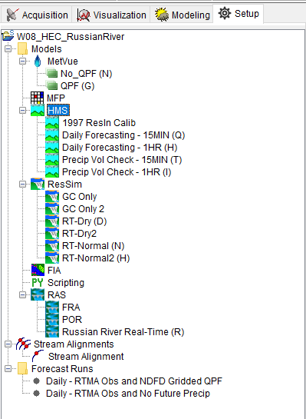
Setup Tab
Select setup table to enter the setup view
Notes:
Plot Components
Viewports are components that include axes, gridlines, and curves.
Plots can have multiple viewports.
Multiple viewports are always stacked vertically (one column, multiple rows)
Viewports are indexed by (row, column) with the top row being 1 and the column always being 1.
Viewports can show major and/or minor grid lines

Slide 6
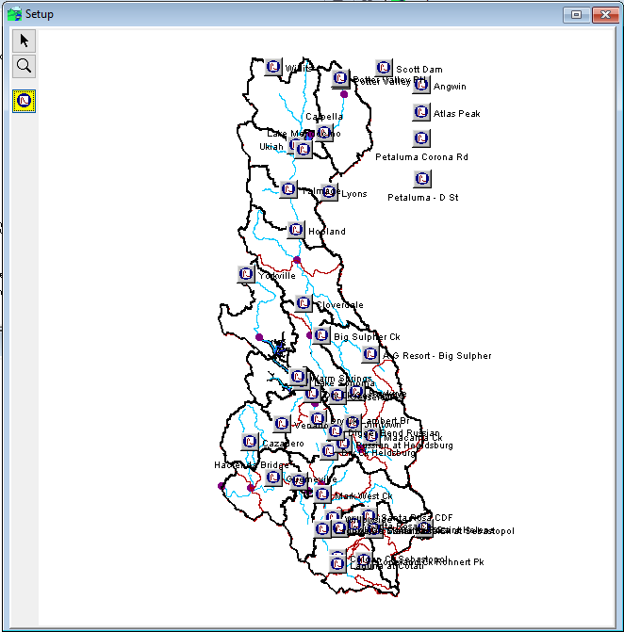

Setup View
Time Series Icon
Organizes Time series data for plotting
To create an Icon Select time series Icon tool then
CTRL + Left Click
Notes:
Plot Components
Viewports are components that include axes, gridlines, and curves.
Plots can have multiple viewports.
Multiple viewports are always stacked vertically (one column, multiple rows)
Viewports are indexed by (row, column) with the top row being 1 and the column always being 1.
Viewports can show major and/or minor grid lines

Slide 7
Setup view
Time Series Icon
Organizes Time series data for plotting
To create an Icon Select time series Icon tool then
CTRL + Left Click
Notes:
Plot Components
Viewports are components that include axes, gridlines, and curves.
Plots can have multiple viewports.
Multiple viewports are always stacked vertically (one column, multiple rows)
Viewports are indexed by (row, column) with the top row being 1 and the column always being 1.
Viewports can show major and/or minor grid lines

Slide 8
Setup view
Time Series Icon
Organizes Time series data for plotting
To create an Icon Select time series Icon tool then
CTRL + Left Click
Notes:
Plot Components
Viewports are components that include axes, gridlines, and curves.
Plots can have multiple viewports.
Multiple viewports are always stacked vertically (one column, multiple rows)
Viewports are indexed by (row, column) with the top row being 1 and the column always being 1.
Viewports can show major and/or minor grid lines

Slide 9
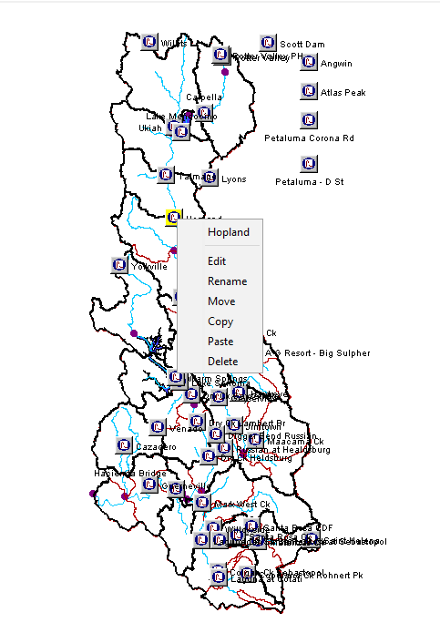
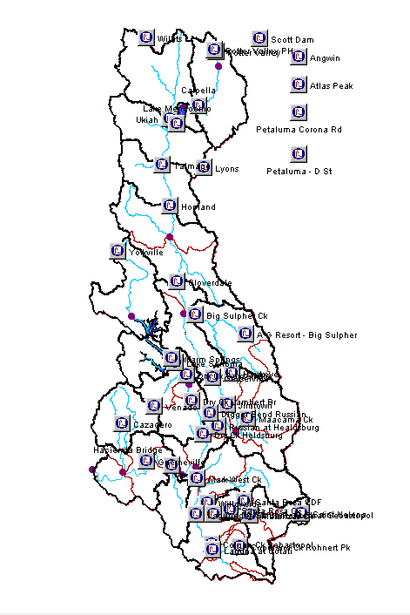
Setup view
Right Click Time series icon to edit data
Notes:
Plot Components
Viewports are components that include axes, gridlines, and curves.
Plots can have multiple viewports.
Multiple viewports are always stacked vertically (one column, multiple rows)
Viewports are indexed by (row, column) with the top row being 1 and the column always being 1.
Viewports can show major and/or minor grid lines

Slide 10
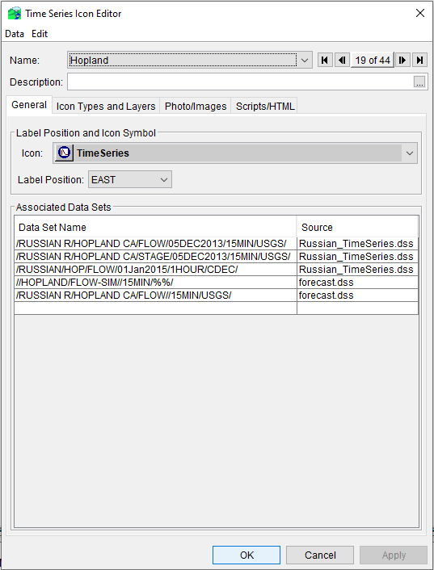
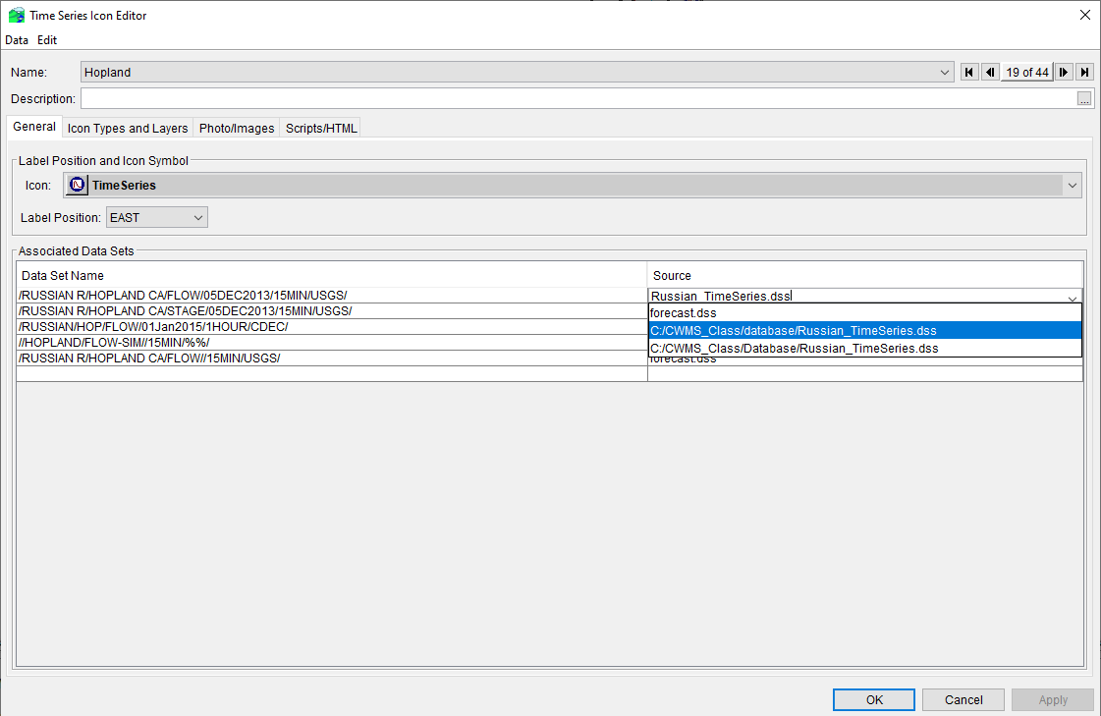
Time Series icon
Notes:
Plot Components
Viewports are components that include axes, gridlines, and curves.
Plots can have multiple viewports.
Multiple viewports are always stacked vertically (one column, multiple rows)
Viewports are indexed by (row, column) with the top row being 1 and the column always being 1.
Viewports can show major and/or minor grid lines

Slide 11
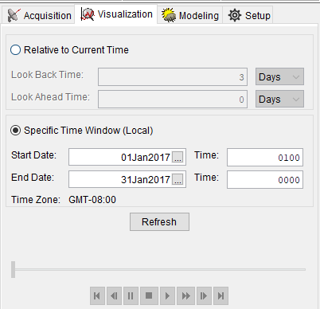
Visualization tabs
Select the Visualization tab to open plots
Notes:
Plot Components
Viewports are components that include axes, gridlines, and curves.
Plots can have multiple viewports.
Multiple viewports are always stacked vertically (one column, multiple rows)
Viewports are indexed by (row, column) with the top row being 1 and the column always being 1.
Viewports can show major and/or minor grid lines

Slide 12
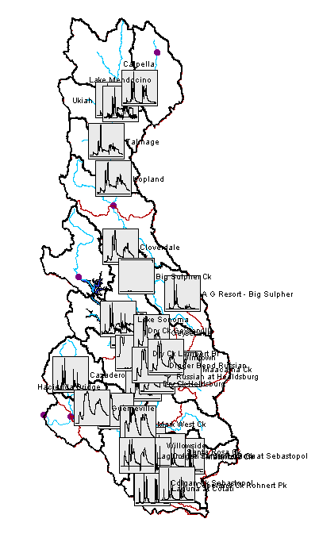
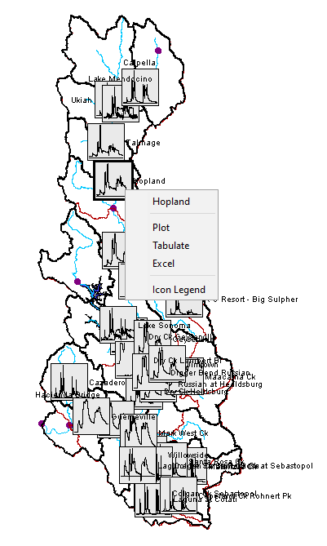
Visualization Tab
Notes:
Plot Components
Viewports are components that include axes, gridlines, and curves.
Plots can have multiple viewports.
Multiple viewports are always stacked vertically (one column, multiple rows)
Viewports are indexed by (row, column) with the top row being 1 and the column always being 1.
Viewports can show major and/or minor grid lines

Slide 13
Visualization Tab
Right Click graph icon and select plot
Notes:
Plot Components
Viewports are components that include axes, gridlines, and curves.
Plots can have multiple viewports.
Multiple viewports are always stacked vertically (one column, multiple rows)
Viewports are indexed by (row, column) with the top row being 1 and the column always being 1.
Viewports can show major and/or minor grid lines

Slide 14
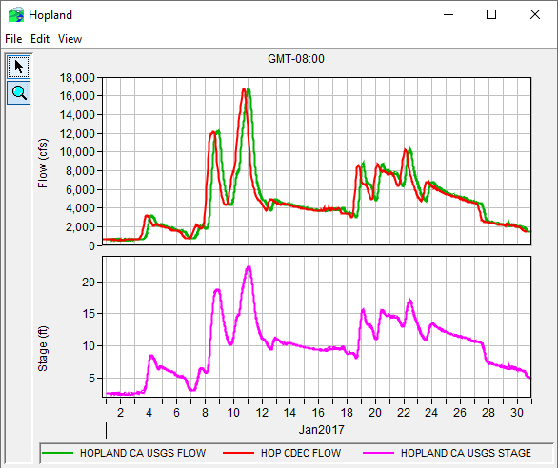
Example Plot
Notes:
Plot Components
Viewports are components that include axes, gridlines, and curves.
Plots can have multiple viewports.
Multiple viewports are always stacked vertically (one column, multiple rows)
Viewports are indexed by (row, column) with the top row being 1 and the column always being 1.
Viewports can show major and/or minor grid lines

Slide 15
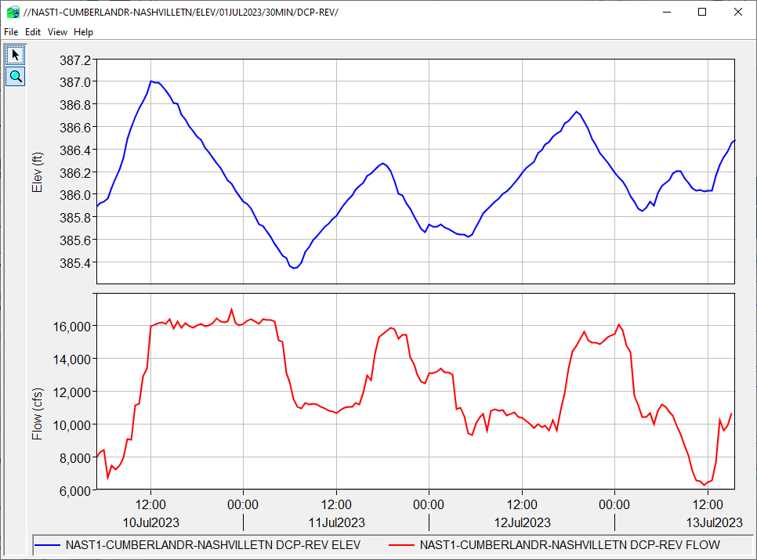
Plot Components
Y2 Axis
Viewport (1,1)
Y1 Axis
Curves
Y1 Axis
Viewport (2,1)
X1 Axis
Legend
Notes:
Plot Components

Slide 16
Viewports
Y2 Axis
Viewport (1,1)
Y1 Axis
Curves
Y1 Axis
Viewport (2,1)
X1 Axis
Legend
Notes:
Plot Components
Viewports are components that include axes, gridlines, and curves.
Plots can have multiple viewports.
Multiple viewports are always stacked vertically (one column, multiple rows)
Viewports are indexed by (row, column) with the top row being 1 and the column always being 1.
Viewports can show major and/or minor grid lines

Slide 17
Axes
Y2 Axis
Viewport (1,1)
Y1 Axis
Curves
Y1 Axis
Viewport (2,1)
X1 Axis
Legend
Notes:
Plot Components
Axes show the scale for values and date/time.
Each viewport has two or three axes: one or two Y axes labeled Y1 (left) and Y2 (right), and an X axis labeled X1
A single X axis is shared by all viewports.
X axes can be numeric (e.g., ratings) or date/time (time series).
Numeric X axes can be linear, logarithmic, or probability
Y axes can only be numeric (linear or logarithmic)
Numeric axes can have labels, which default to parameter and unit.
Date/time axes can have 1, 2, or 3 levels of labeling.
Axes can show major and/or minor tic marks, which correspond with the major and minor viewport gridlines.

Slide 18
Curves
Y2 Axis
Viewport (1,1)
Y1 Axis
Curves
Y1 Axis
Viewport (2,1)
X1 Axis
Legend
Notes:
Plot Components
Curves are the datasets plotted in the viewports.
Each curve is associated with the Y1 or Y2 axis of the viewport.
Each Y axis can be associated with multiple curves of the same parameter and unit.

Slide 19
Legend
Y2 Axis
Viewport (1,1)
Y1 Axis
Curves
Y1 Axis
Viewport (2,1)
X1 Axis
Legend
Notes:
Plot Components
The legend contains identifying items for each curve. Each item contains:
Line. The legend line has the same visual properties as the curve it identifies.
Label. For time series curves, the label is normally a concatenation of the location, version, and parameter of the dataset.
The legend can be placed in various locations in or outside the plot.

Slide 20
Tools
Selector Tool
Zoom Tool
Tool Bar
Notes:
Plot Components
A tool bar is found in each plot. The tool bar contains:
Select tool. This is used to select components of the plot for editing. To edit a component, right-click on it.
Zoom too. This tool is used to zoom-in viewports by dragging the extents to fill the plot. Right-click to zoom-out.

Slide 21
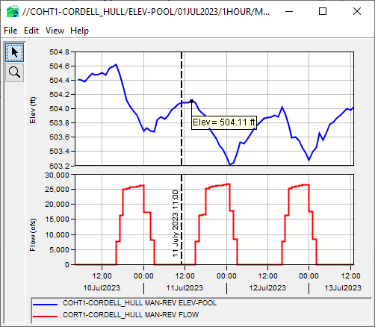
Callout and Marker Lines
Callout
Marker Lines

Slide 22
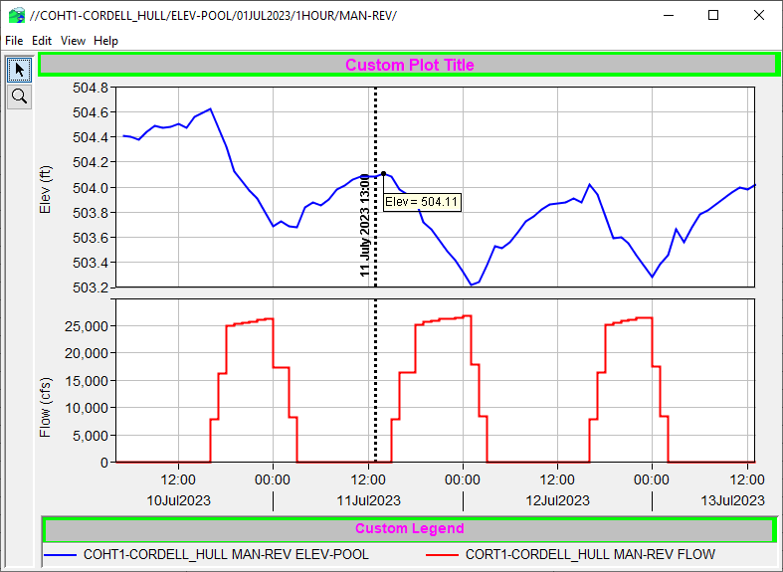
Customizing Plots
Notes:
Customizing Plots

Slide 23
Questions
Help additional Training
https://usace.dps.mil/sites/KMP-WM/SitePages/Corps-Water-Management-System-(CWMS).aspx
https://www.hec.usace.army.mil/confluence/cwmsdocs
https://discourse.hecdev.net/c/cwms/5
TDL-CELRH-EC-GW-W-USACE CWMS Modeling | General | Microsoft Teams
“Just keep CWMS’ing”

Slide 24
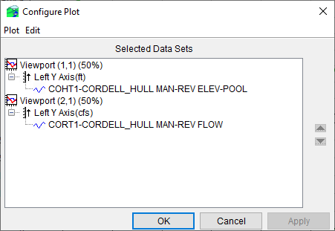
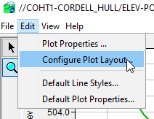
Arranging the Plot
“Edit→Configure Plot Layout…”
  Control number, order, and relative sizes of viewports
  Add, remove, and reverse Y axes
Notes:
Customizing Plots
Arranging the Plot
Select “Edit→Configure Plot Layout…” from plot menu bar.
Opens “Configure Plot” dialog which allows you to:
Control the number, order, and relative sizes of viewports.
Add, remove, and reverse Y axes.

Slide 25
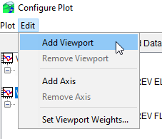
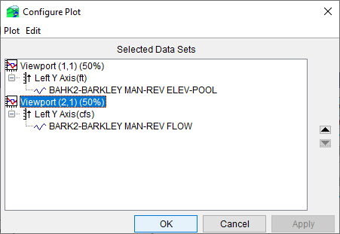
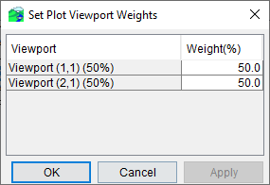
Managing Viewports
Adding & Removing
Sizing (relative weights)
Ordering
Notes:
Customizing Plots
Managing Viewports
Select “Edit→Add Viewport” or “Edit→Remove Viewport” from the Configure Plot menu bar to add or remove viewports
Select “Edit→Set Viewport Weights…” to open the “Set Viewport Weights” dialog, which lets you set the relative sizes (height) of viewports (Must sum to 100%)
Select a viewport and use the up or down button to reorder the viewports.

Slide 26
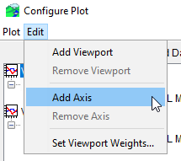
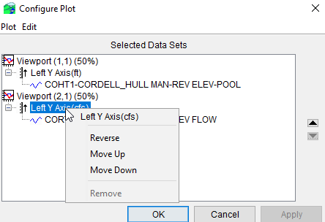
Managing Y Axes
Adding & Removing
Moving
Reversing
Notes:
Customizing Plots
Managing Y Axes
Select a viewport and then select “Edit→Add Axis” from the “Configure Plot” menu bar to add a Y axis.
Select an axis and then select “Edit→Remove Axis” from the “Configure Plot” menu bar to remove a Y axis.
Select an axis and then click on the up or down button to reorder axes.
You can move viewport (2,1) left axis up and it becomes a secondary axis for viewport (1,1) and removed viewport (2,1)
Right-click on an axis and select “Reverse” from the context menu to reverse an axis.

Slide 27
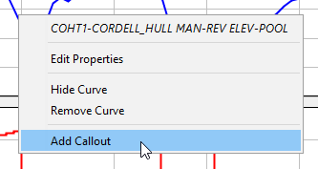
Adding Callouts and Marker Lines
Add a Callout
  Right-click on curve using select tool.
  Select “Add Callout” from the menu.
  Enter info on Callout dialog.
  The callout will be place at the point you clicked. You cannot move the callout once placed (but you can delete it and make another one).
Callout
Notes:
Customizing Plots
Adding Callouts and Marker Lines
Add a callout by right-clicking on a curve and selecting “Add Callout” from context menu.
Cannot be edited
Add a marker line by right-clicking in a viewport and selecting “Add Marker” from the context menu.
Adding a marker line on the X axis of a viewport will not add the marker line to all viewports.
Can edit line style, location and label

Slide 28
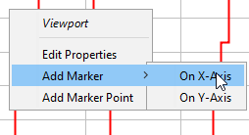
Adding Callouts and Marker Lines
Add a Marker Line
  Right-click in viewport using select tool.
  Select “Add Marker→On ...-Axis” from menu.
  Enter info on marker dialog.
  Marker line will be placed at the location you selected, but you can edit that.
Marker Lines
Notes:
Customizing Plots
Adding Callouts and Marker Lines
Add a callout by right-clicking on a curve and selecting “Add Callout” from context menu.
Cannot be edited
Add a marker line by right-clicking in a viewport and selecting “Add Marker” from the context menu.
Adding a marker line on the X axis of a viewport will not add the marker line to all viewports.
Can edit line style, location and label

Slide 29
Plot With Callout and Marker Lines
Callout
Marker Lines

Slide 30


Plot With Callout and Marker Lines
Right Click Title Area
Right Click Legend Area

Slide 31
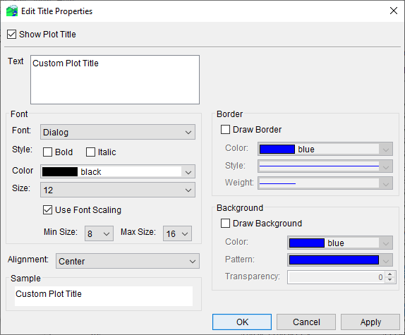
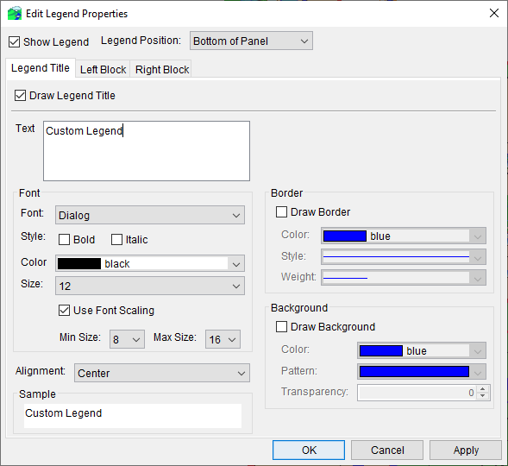
Editing the Title and Legend
Adding a Title
  Right-click above top viewport with the select tool
  Select “Edit Properties” from the menu.
Customizing the Legend
  Right-click in legend with select tool
  Select “Edit Properties” from the menu.
Notes:
Mention that you can also right click within the legend or top viewport to also get to these specific properties
If too close to graph, will edit spacing.

Slide 32
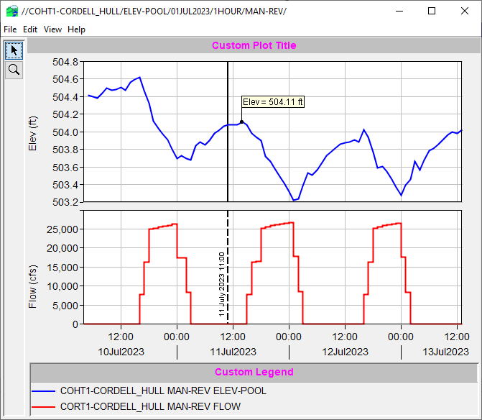
Plot With Title and Legend Edits

Slide 33
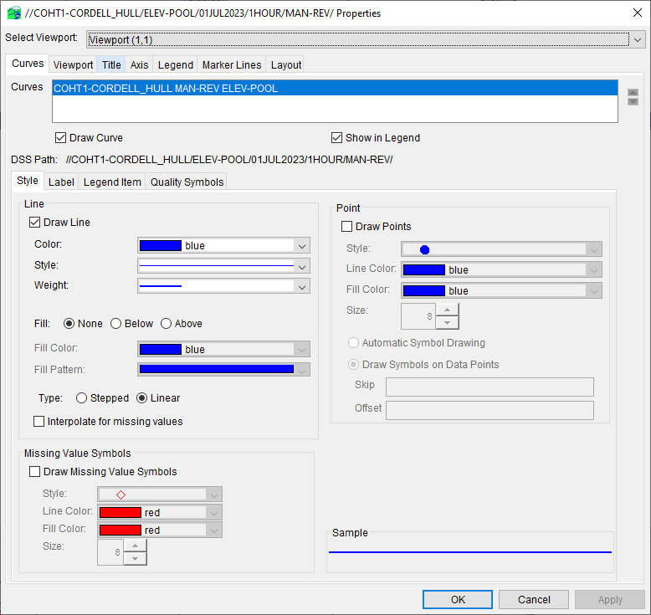
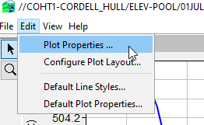
Plot Properties Editor
Select “Edit→Plot Properties…” from plot menu bar.
Editor dialog has same editors as context menus, each in its own tab.
Viewport and curve selected from lists.
Edits apply only to current plot.
Notes:
Customizing Plots
Plot Properties Editor
Select “Edit→Plot Properties” from the plot menu bar to open the Properties dialog.
Every editor available by right-clicking on plot components is also available in this dialog.
Each tab contains a component editor
Specific viewports and curves are selected from lists at the top of the dialog.
Like edits made via right-clicking on components, the edits apply only to the current plot.

Slide 34
Templates
The current layout and properties of any plot can be save to a template by selecting “File→Save Template…” from the plot’s menu bar and saving to a template file.
The same layout and properties can later be applied to another plot by selecting “File→Apply Template…” from the plot’s menu bar and selecting the previously saved template file.
Templates are intended be applied to plots with the same parameters and number of curves as the plot from which the template was created.
Notes:
Customizing Plots
Templates
Templates can save all edits to a plot made using the previous methods so they can be applied to another plot
Select “File→Save Template…” from the plot menu bar to save a template to a file.
To apply the same edits to another plot, select “File→Apply Template…” from the plot menu bar.
Templates are intended to be applied only to plots similar to the one the template was created from (same parameters and number of curves).

Slide 35
Templates in Time Series Icon Layers
A Template can be imposed on a time-series icon layer in order to force icons in that layer to plot their datasets in a fashion different from the default.
  From the tab where you want to see the custom plot, plot the icon, modify it to look the way you want, then save the template.
  Switch to the Setup tab and open the Map Layers dialog (Maps→Map Layers…)
  Expand the Time Series Icons layer, right-click on the desired layer and select Properties from the context menu.
  Use the Template tab on the Time Series Icon Layer Properties dialog to select the template.
Notes:
Customizing Plots
Templates in Time Series Icon Layers
Customize a plot opened from a time series icon, and save the customization as a template.
Open the Map Layers dialog from the Setup tab.
Right-click on the desired time series icon layer and select “Properties” from the context menu.
Use the “Template” tab on the Time Series Icon Layer Properties dialog to select the template.

Slide 36
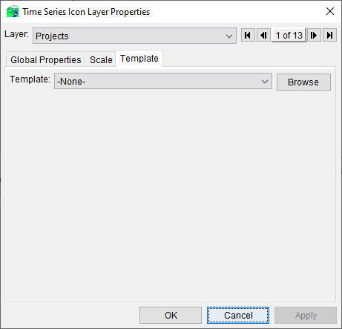
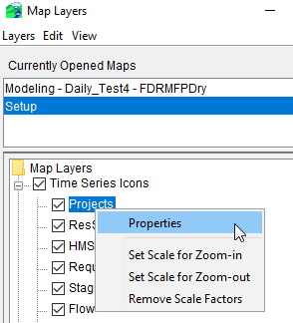
Templates in Time Series Icon Layers

Slide 37
Default Plot Properties
User-editable default plot properties.
Specifies properties that will be applied to every future plot (not applied to any open plots).
Uses editor dialog that resembles the plot properties editor.
  Doesn’t specify default properties for individual curves – these are specified using default line styles.
Individual edits cannot be undone, but deleting the data file for a tab restores that tab to program default properties.
The current default plot properties can be exported to a zip file, and later be re-imported from the zip file.
Notes:
Customizing Plots
Default Plot Properties
Default plot properties are user-editable properties that are applied to future plots only.
Default plot properties are specified using a dialog that resembles the plot properties editor.
Default line styles are not specified in this editor.
Each tab of the editor saves the specified defaults to a file in the C:\Users\<username>\.gfx2d\ directory.
Individual edits cannot be undone, but deleting a tab’s data file restores the program defaults for that tab.
Default plot properties can be exported to, and imported from, zip files.

Slide 38
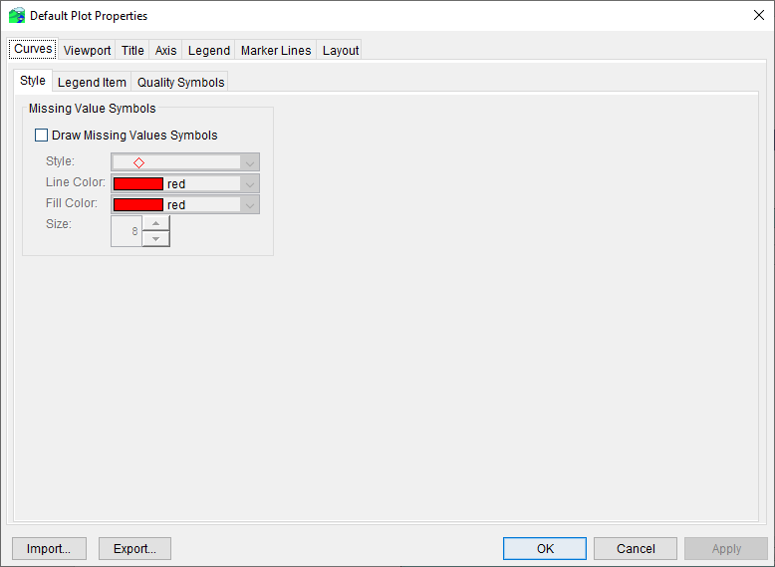
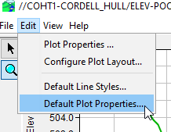
Default Plot Properties Editor
Select “Edit →Default Plot Properties…” from plot menu bar.
Notes:
Customizing Plots
Default Plot Properties Editor
Select “Edit→Default Plot Properties” from the plot menu bar to open the Default Plot Properties dialog.

Slide 39
Default Line Styles
User-editable default styles for curves based on:
  Parameter
  Data Type
  Order (1st curve, 2nd curve, etc…)
Default styles will not be applied to any open plots, but only be applied to future plots.
All default styles saved in one file specified on bottom of editor.
Individual edits cannot be undone, but deleting the file will restore program default styles.
Notes:
Customizing Plots
Default Line Styles
Default line styles are user-editable default properties for curves based on parameter, date type, and order.
Default styles will not be applied to any open plots, but only be applied to future plots.
All default styles saved in one file specified on bottom of editor.
Individual edits cannot be undone, but deleting the file will restore program default styles.

Slide 40
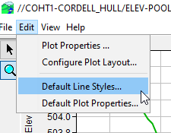
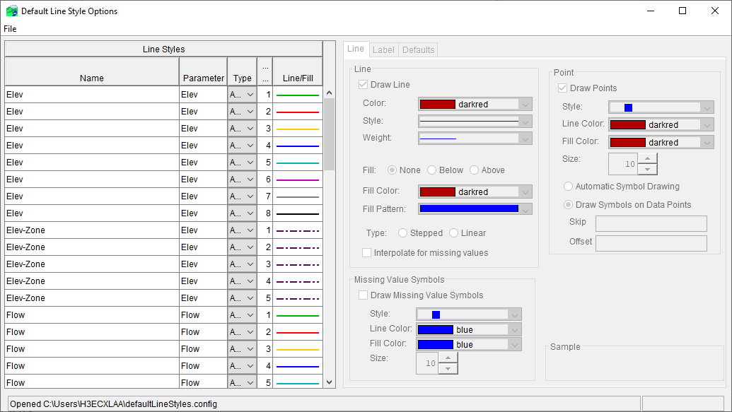
Default Line Style Editor
Select “Edit→Default Line Styles…” from plot menu bar
Notes:
Customizing Plots
Default Line Styles Editor.
Select “Edit→Default Line Styles” from the plot menu bar to open the Default Line Styles dialog.

Slide 41
Uses for Scripting
Notes:
CWMS Scripting Overview

Slide 42
What is Scripting?
Scripting is the process of automating the actions of an interactive program for the purpose of being able to execute a prescribed set of actions with a simple trigger.
May involve small to large amount of initial effort.
Trivially repeatable.
Notes:
CWMS Scripting Overview
What is Scripting
Scripting is the process of automating the actions of an interactive program for the purpose of being able to execute a prescribed set of actions with a simple trigger.
May involve small to large amount of initial effort.
Trivially repeatable.

Slide 43
Why Use Scripting?
To simplify user operation
To ensure repeatability and consistency of results
To reduce time required to generate results
Notes:
CWMS Scripting Overview
Why Use Scripting?
To simplify user operation
To ensure repeatability and consistency of results
To abstract complexity
To reduce time required to generate results

Slide 44
Scripting in CWMS
CWMS includes a scripting facility that can be used to customize and/or automate tasks:
  Create and execute forecasts.
  Analyze and process data stored in Oracle or DSS.
  Create custom plots and tables.
CWMS scripts are written using the combination of a scripting language and the CWMS Application Programming Interface (API)
  There is no way to record interactive operations (i.e., no macro recorder)
  The scripting language is Jython – a version of the Python programming language
Notes:
CWMS Scripting Overview
Scripting in CWMS
CWMS includes a scripting facility that can be used to customize and/or automate tasks:
Create and execute forecasts.
Analyze and process data stored in Oracle or DSS.
Create custom plots and tables.
CWMS scripts are written using the combination of a scripting language and the CWMS Application Programming Interface (API)
There is no way to record interactive operations (i.e., no macro recorder)
The scripting language is Jython – a version of the Python programming language

Slide 45
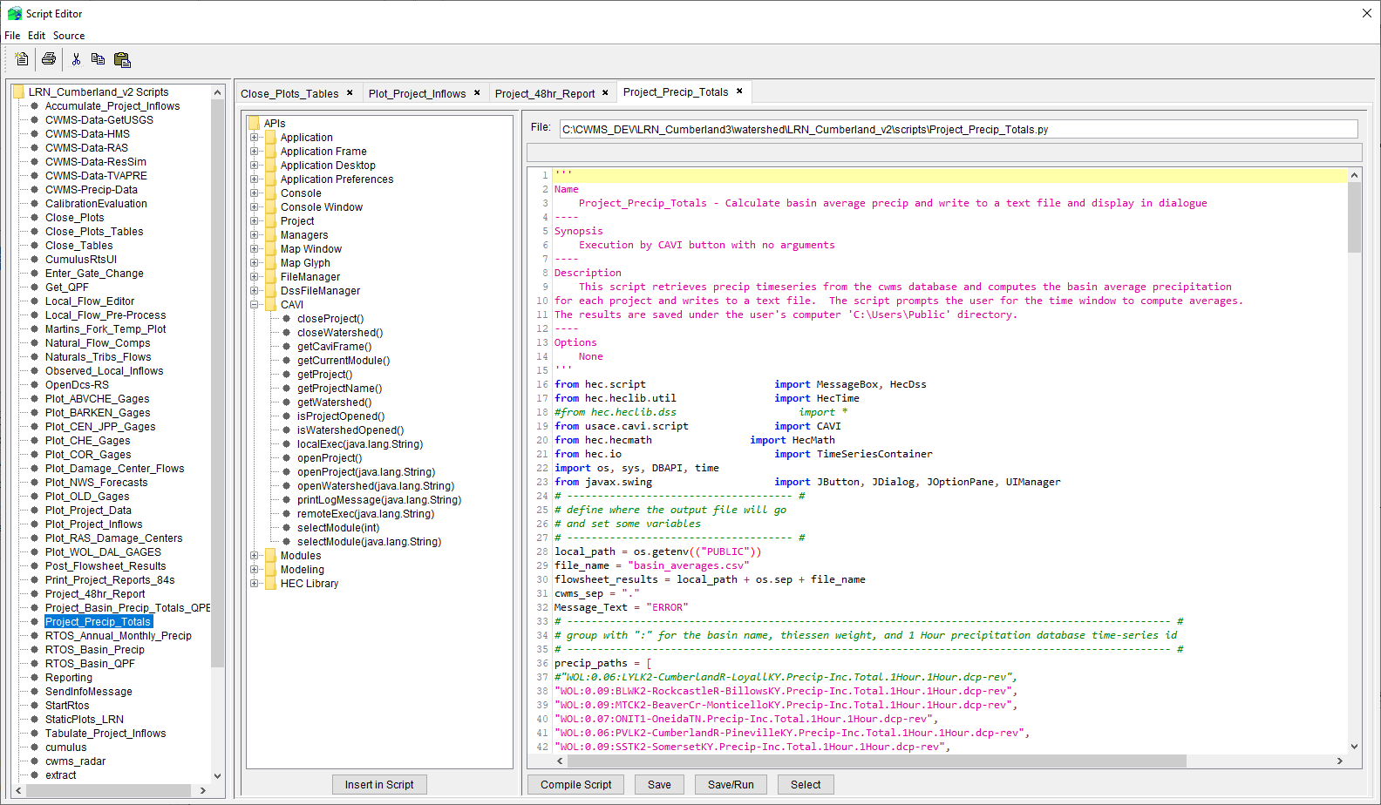
Scripting Components
Notes:
Scripting Components

Slide 46
Script Editor
The main scripting component in CWMS is the Script Editor. It is used for:
  Creating new scripts
  Editing existing scripts
  Testing scripts
Notes:
Scripting Components
Script Editor
The main scripting component in CWMS is the Script Editor. It is used for:
Creating new scripts.
Editing existing scripts.
Testing scripts.

Slide 47
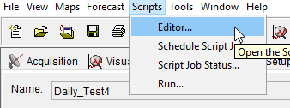
Opening the Script Editor
Select “Scripts→Editor…” from the CAVI menu bar.
Notes:
Scripting Components
Script Editor
Opening the Script Editor
Select “Scripts→Editor…” from the CAVI menu bar.

Slide 48
Script Editor – Tool Bar
New Script
Print Script
Cut
Copy
Paste
Same functions available via menu bar
Select “File→Delete” to delete a script (no tool for this)
Notes:
Scripting Components
Script Editor
Script Editor Toolbar
New Script
Print Script
Cut
Copy
Paste
Same functions available via menu bar
Select “File→Delete” to delete a script (no tool for this)

Slide 49
Script Editor – Tree Pane
Lists scripts for watershed
Double-click on script name to edit it
Notes:
Scripting Components
Script Editor
Script Editor – Tree Pane
Lists scripts for watershed
Double-click on script name to edit it

Slide 50
Script Editor – API Pane
Lists CWMS API methods
To insert code in editor pane:
  Double-click node (inserts at current position)
  Drag node to desired position
  Select node and click “Insert in Script” button (inserts at current position)
Notes:
Scripting Components
Script Editor
Script Editor – API Pane
Lists CWMS API methods
To insert code in editor pane:
Double-click node (inserts at current position)
Drag node to desired position
Select node and click “Insert in Script” button (inserts at current position)

Slide 51
Script Editor – Editor Pane
Displays code for script
Syntax highlighting
Highlights all occurrences of word at current position
Notes:
Scripting Components
Script Editor
Script Editor – Editor Pane
Displays code for script
Syntax highlighting
Highlights all occurrences of word at current position

Slide 52
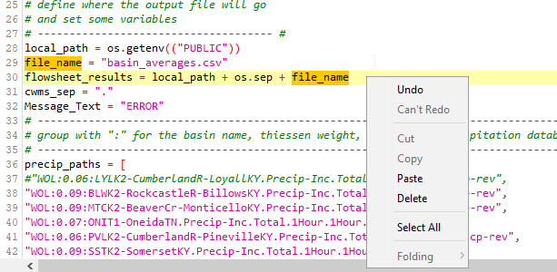
Script Editor – Editor Pane Details
current line (highlighted)
word at current position (highlighted)
context menu
line numbers
Ctrl-F – search
Uses normal select/cut/copy/paste keystroke combinations
Notes:
Scripting Components
Script Editor
Script Editor – Editor Pane Details
Context menu contains editing operations.
Ctrl-F opens search dialog
Standard editing shortcut keys can be used.

Slide 53
Script Editor – Action Buttons
Insert in Script
  Inserts code for selected API method into script at current position
Compile Script
  Compiles the script without saving
Save
  Compiles and saves the script
Save/Run
  Compiles, saves, and executes the script
Select
  Notifies other CWMS components of current script selection
Notes:
Scripting Components
Script Editor
Script Editor – Action Buttons
Insert in Script – inserts code for selected API method into script at current position
Compile Script – compiles the script without saving
Save – compiles and saves the script
Save/Run – compiles, saves, and executes the script
Select – notifies other CWMS components of current script selection

Slide 54
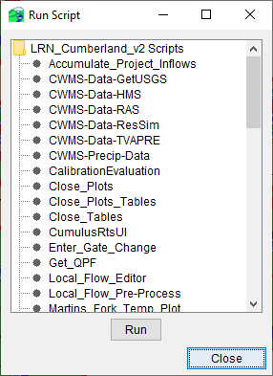
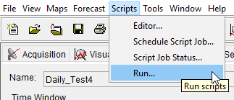
Script Selector
Select “Scripts→Run” from CAVI menu bar.
Displays scripts for watershed.
Double-click on name to run, or select name and click “Run” button.
Notes:
Scripting Components
Script Editor
Script Selector
Select “Scripts→Run” from CAVI menu bar.
Displays scripts for watershed.
Double-click on name to run, or select name and click “Run” button.

Slide 55
Modeling Scripts Panel
Select the Modeling tab.
At the bottom of the tab, select the Scripts tab.
Right-click in the Scripts panel and select “Edit…”
Use the “Select Scripts” dialog to choose which scripts to add to the panel
Notes:
Scripting Components
Modeling Scripts Panel
Select the Modeling tab.
At the bottom of the tab, select the Scripts tab.
Right-click in the Scripts panel and select “Edit…”
Use the “Select Scripts” dialog to choose which scripts to add to the panel

Slide 56
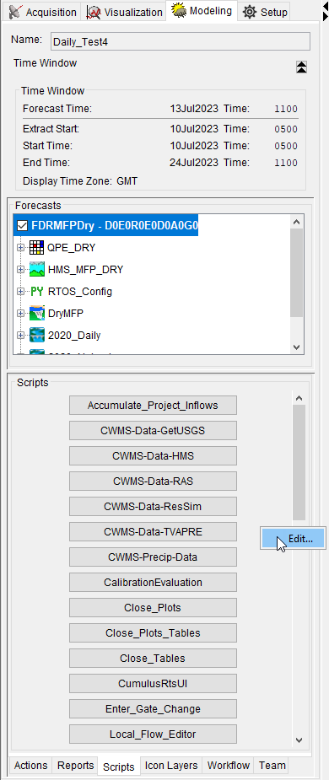
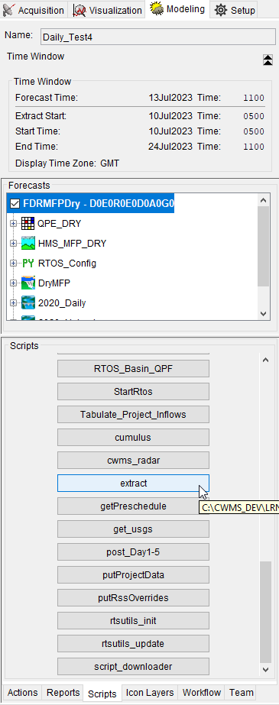
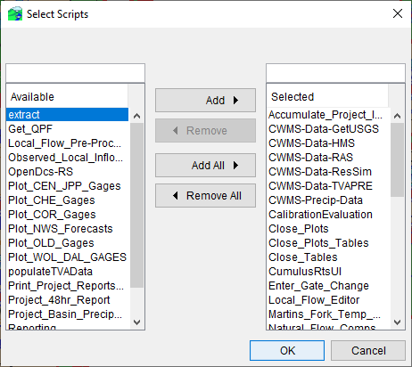
Modeling Scripts Panel

Slide 57
Assigning Scripts To Time Series Icons
Switch to Watershed Setup Module.
Right-click the icon and select “Edit” from the context menu.
Select the “Scripts/HTML” tab on the properties dialog.
Populate the scripts dialog with the appropriate information.
  Put a variable assignment statement in the “Arguments” column. That variable with its assigned value will be available in the script.
    This allows a common script to be used on many icons, as each icon will have its unique assignment to the same variable
Dismiss dialogs and save configuration.
Notes:
Scripting Components
Time Series Icons Scripts
Assigning Scripts to Time Series Icons.
Switch to Watershed Setup Module.
Right-click the icon and select “Edit” from the context menu.
Select the “Scripts/HTML” tab on the properties dialog.
Populate the scripts dialog with the appropriate information.
Put a variable assignment statement in the “Arguments” column. That variable with its assigned value will be available in the script.This allows a common script to be used on many icons, as each icon will have its unique assignment to the same variable
Dismiss dialogs and save configuration.

Slide 58
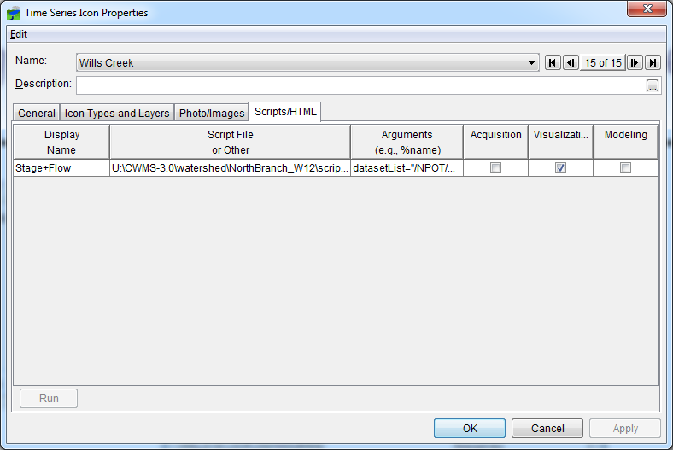
Assigning Scripts To Time Series Icons

Slide 59
Section 5 Review
What component is used to create and edit scripts?
What are three ways to execute a script?
What is the API pane used for?
How can multiple time series icons use a common script and produce individual results?
Notes:
Scripting Components
Section 5 Review
What component is used to create and edit scripts?
Script Editor
What are three ways to execute a script?
From the Script Editor (Save/Run)
From the Script Selector
From the Modeling Scripts Panel
From a Time Series Icon
What is the API pane used for?
To insert code for a CWMS API method into the script
How can multiple time series icons use a common script and produce individual results?
By assigning different values to the same variable in the “Arguments” column of the “Scripts/HTML” tab

Slide 60
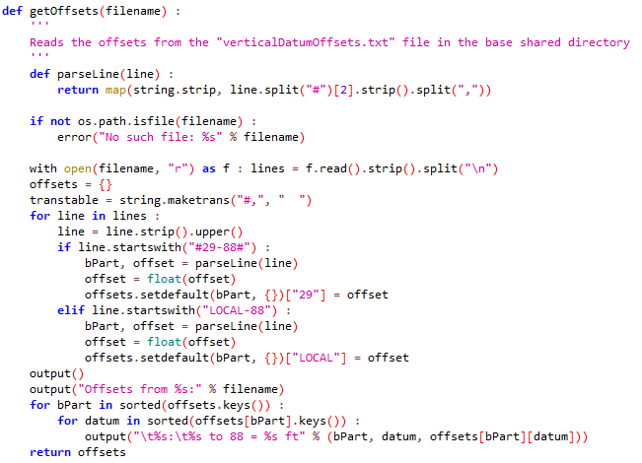
Scripting Language
Notes:
Scripting Language

Slide 61
What is Jython?
Jython is a Java-based implementation of the Python programming language. This means:
  You learn the Python language to learn Jython. Python tutorials and book references can be found at http://www.python.org.
  Jython code can interface seamlessly with Java code. The CWMS API is written in Java, but Jython can use it as if it were written in Python.
Notes:
Scripting Language
What is Jython?
Jython is a Java-based implementation of the Python programming language. This means:
You learn the Python language to learn Jython.
Python tutorials and book references can be found at http://www.python.org.
Jython code can interface seamlessly with Java code.
The CWMS API is written in Java, but Jython can use it as if it were written in Python.

Slide 62
Jython Scripting Resources
HEC-DSSVue User’s Guide
  Scripting (army.mil)
  Available from within HEC-DSSVue by selecting “Help→Help” from the menu bar.
  HEC-DSSVue shares the same API as CWMS for many items, including plots, tables, and HEC-DSS file access.
Examples
  Some examples are installed with HEC-DSSVue in the “samples” directory
  https://github.com/HydrologicEngineeringCenter/DSSVue-Example-Scripts
  The CWMS wiki (https://cwms.usace.army.mil/dokuwiki/) contains many scripting examples, including accessing the CWMS database.
  HEC Monolith documentation https://www.hec.usace.army.mil/software/javadocs/hec-monolith/
Notes:
Scripting Language
Jython Scripting Resources
Chapter 8 of the HEC-DSSVue User’s Guide
HEC-DSSVue shares the same API as CWMS for many items, including plots, tables, and HEC-DSS file access.
Interactive documentation is available from within HEC-DSSVue by selecting “Help→Help” from the menu bar.
Examples
Many examples are installed with HEC-DSSVue in the “samples” directory
The CWMS wiki (https://cwms.usace.army.mil/dokuwiki/) contains many scripting examples, including accessing the CWMS database.
For general Java and Python, Army Civilians in the Scientist, Engineer and Analyst (CP16) Career Field have access to Udemy for Business.
Create an account with your usace.army.mil at Udemy for Business (armyciv.udemy.com)
Should be emailed instructions on how to setup
100 days of code course has been highly recommended.
https://armyciv.udemy.com/course/100-days-of-code/

