Slide 1
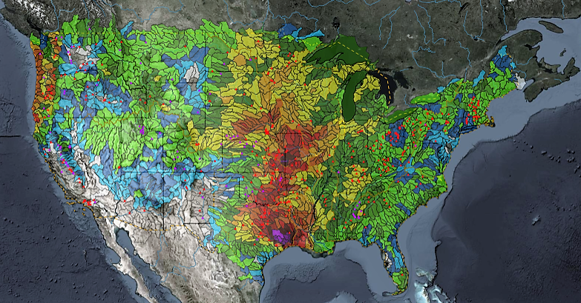
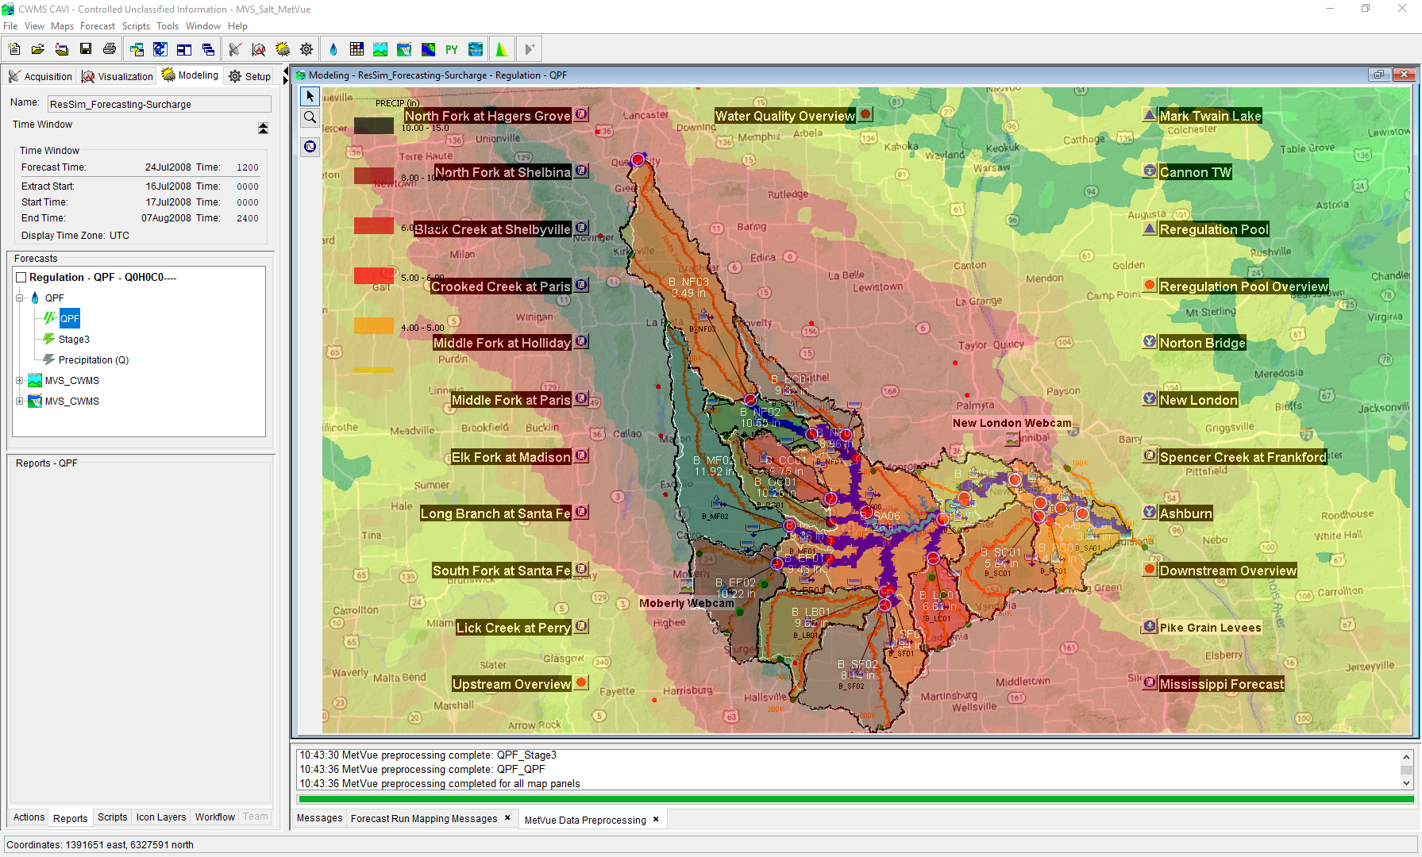

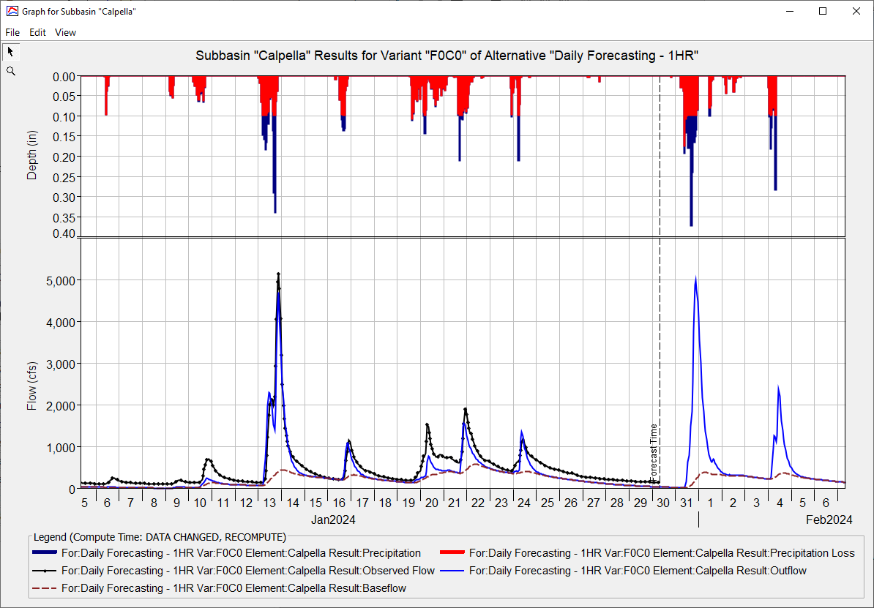

CWMS GRAPHICS AND SCRIPTING
Oskar Hurst,
Hydrologic Engineering Center
CWMS Prospect Course
Customizing Plots

Slide 2
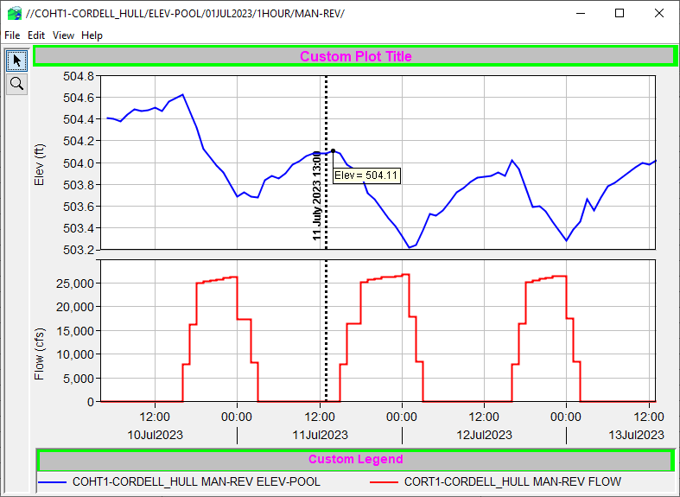
Customizing Plots
Notes:
Customizing Plots

Slide 3
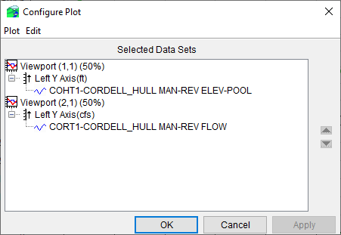
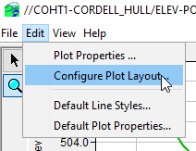
Arranging the Plot
“Edit→Configure Plot Layout…”
Control number, order, and relative sizes of viewports
Add, remove, and reverse Y axes
Notes:
Customizing Plots
Arranging the Plot
Select “Edit→Configure Plot Layout…” from plot menu bar.
Opens “Configure Plot” dialog which allows you to:
Control the number, order, and relative sizes of viewports.
Add, remove, and reverse Y axes.

Slide 4
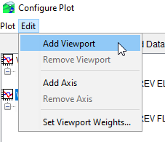
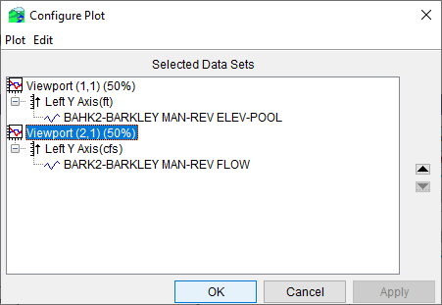
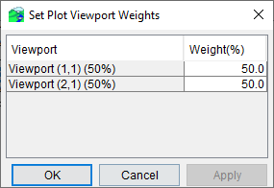
Managing Viewports
Adding & Removing
Sizing (relative weights)
Ordering
Notes:
Customizing Plots
Managing Viewports
Select “Edit→Add Viewport” or “Edit→Remove Viewport” from the Configure Plot menu bar to add or remove viewports
Select “Edit→Set Viewport Weights…” to open the “Set Viewport Weights” dialog, which lets you set the relative sizes (height) of viewports (Must sum to 100%)
Select a viewport and use the up or down button to reorder the viewports.

Slide 5
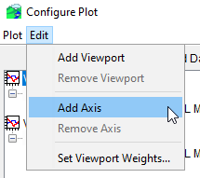
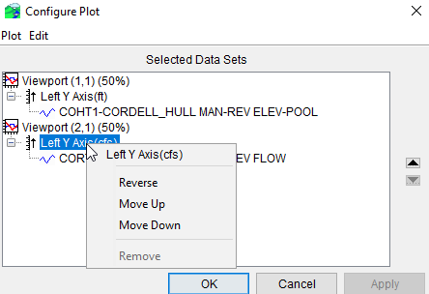
Managing Y Axes
Adding & Removing
Moving
Reversing
Notes:
Customizing Plots
Managing Y Axes
Select a viewport and then select “Edit→Add Axis” from the “Configure Plot” menu bar to add a Y axis.
Select an axis and then select “Edit→Remove Axis” from the “Configure Plot” menu bar to remove a Y axis.
Select an axis and then click on the up or down button to reorder axes.
You can move viewport (2,1) left axis up and it becomes a secondary axis for viewport (1,1) and removed viewport (2,1)
Right-click on an axis and select “Reverse” from the context menu to reverse an axis.

Slide 6
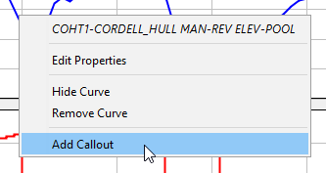
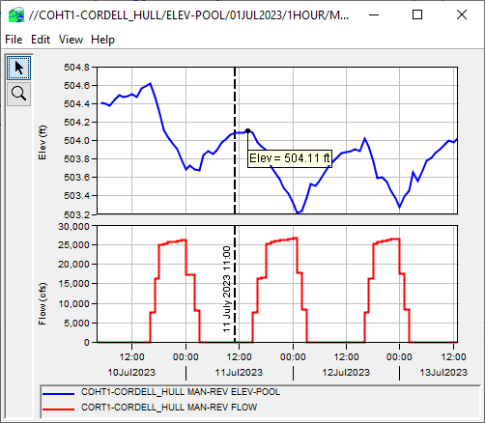
Adding Callouts and Marker Lines
Add a Callout
Right-click on curve using select tool.
Select “Add Callout” from the menu.
Enter info on Callout dialog.
The callout will be place at the point you clicked. You cannot move the callout once placed (but you can delete it and make another one).
Callout
Notes:
Customizing Plots
Adding Callouts and Marker Lines
Add a callout by right-clicking on a curve and selecting “Add Callout” from context menu.
Cannot be edited
Add a marker line by right-clicking in a viewport and selecting “Add Marker” from the context menu.
Adding a marker line on the X axis of a viewport will not add the marker line to all viewports.
Can edit line style, location and label

Slide 7
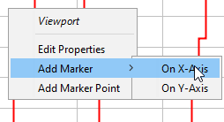
Adding Callouts and Marker Lines
Add a Marker Line
Right-click in viewport using select tool.
Select “Add Marker→On ...-Axis” from menu.
Enter info on marker dialog.
Marker line will be placed at the location you selected, but you can edit that.
Marker Lines
Notes:
Customizing Plots
Adding Callouts and Marker Lines
Add a callout by right-clicking on a curve and selecting “Add Callout” from context menu.
Cannot be edited
Add a marker line by right-clicking in a viewport and selecting “Add Marker” from the context menu.
Adding a marker line on the X axis of a viewport will not add the marker line to all viewports.
Can edit line style, location and label

Slide 8
Plot With Callout and Marker Lines
Callout
Marker Lines

Slide 9


Plot With Callout and Marker Lines
Right Click Title Area
Right Click Legend Area

Slide 10
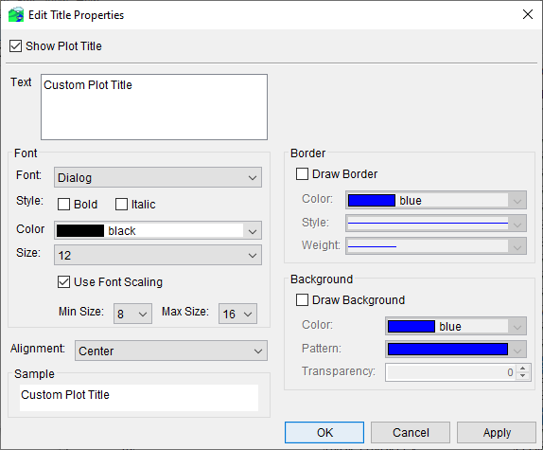
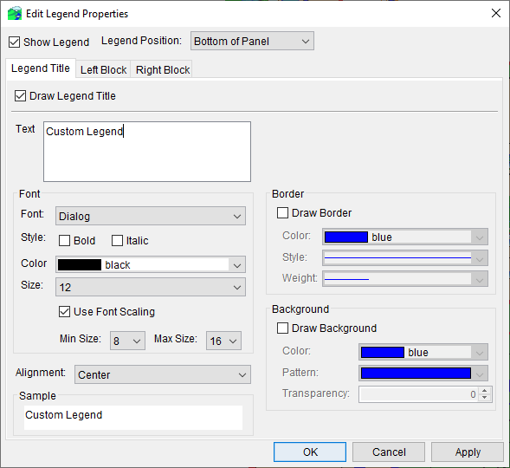
Editing the Title and Legend
Adding a Title
Right-click above top viewport with the select tool
Select “Edit Properties” from the menu.
Customizing the Legend
Right-click in legend with select tool
Select “Edit Properties” from the menu.
Notes:
Mention that you can also right click within the legend or top viewport to also get to these specific properties
If too close to graph, will edit spacing.

Slide 11
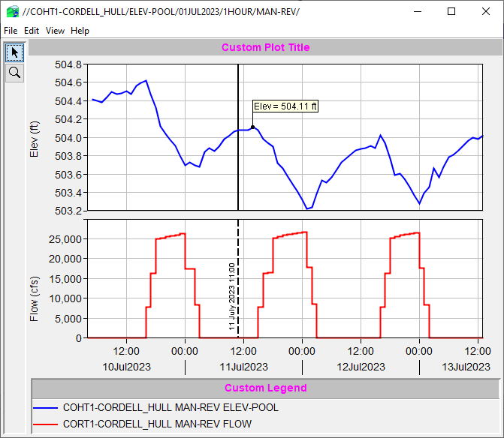
Plot With Title and Legend Edits

Slide 12
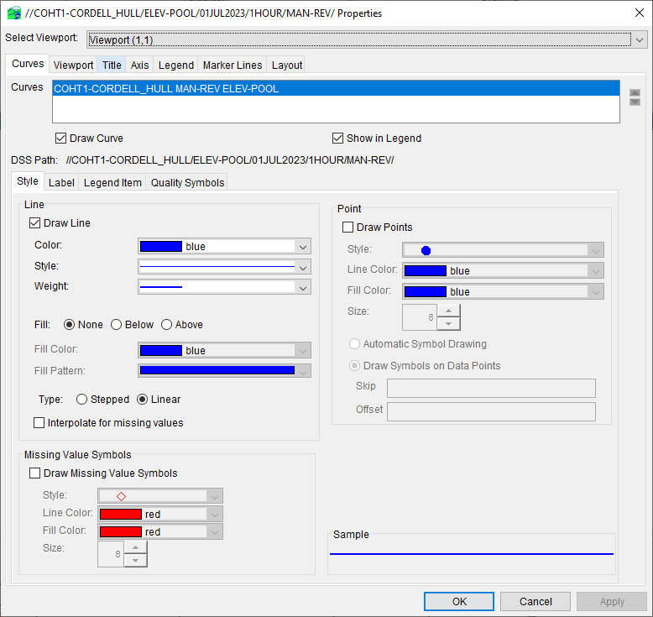
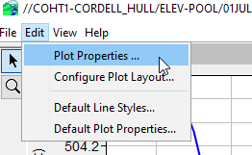
Plot Properties Editor
Select “Edit→Plot Properties…” from plot menu bar.
Editor dialog has same editors as context menus, each in its own tab.
Viewport and curve selected from lists.
Edits apply only to current plot.
Notes:
Customizing Plots
Plot Properties Editor
Select “Edit→Plot Properties” from the plot menu bar to open the Properties dialog.
Every editor available by right-clicking on plot components is also available in this dialog.
Each tab contains a component editor
Specific viewports and curves are selected from lists at the top of the dialog.
Like edits made via right-clicking on components, the edits apply only to the current plot.

Slide 13
Templates
The current layout and properties of any plot can be save to a template by selecting “File→Save Template…” from the plot’s menu bar and saving to a template file.
The same layout and properties can later be applied to another plot by selecting “File→Apply Template…” from the plot’s menu bar and selecting the previously saved template file.
Templates are intended be applied to plots with the same parameters and number of curves as the plot from which the template was created.
Notes:
Customizing Plots
Templates
Templates can save all edits to a plot made using the previous methods so they can be applied to another plot
Select “File→Save Template…” from the plot menu bar to save a template to a file.
To apply the same edits to another plot, select “File→Apply Template…” from the plot menu bar.
Templates are intended to be applied only to plots similar to the one the template was created from (same parameters and number of curves).

Slide 14
Templates in Time Series Icon Layers
A Template can be imposed on a time-series icon layer in order to force icons in that layer to plot their datasets in a fashion different from the default.
From the tab where you want to see the custom plot, plot the icon, modify it to look the way you want, then save the template.
Switch to the Setup tab and open the Map Layers dialog (Maps→Map Layers…)
Expand the Time Series Icons layer, right-click on the desired layer and select Properties from the context menu.
Use the Template tab on the Time Series Icon Layer Properties dialog to select the template.
Notes:
Customizing Plots
Templates in Time Series Icon Layers
Customize a plot opened from a time series icon, and save the customization as a template.
Open the Map Layers dialog from the Setup tab.
Right-click on the desired time series icon layer and select “Properties” from the context menu.
Use the “Template” tab on the Time Series Icon Layer Properties dialog to select the template.

Slide 15
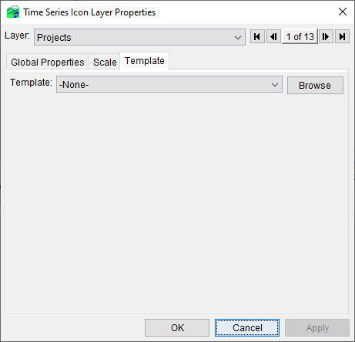
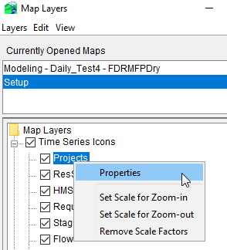
Templates in Time Series Icon Layers

Slide 16
Default Plot Properties
User-editable default plot properties.
Specifies properties that will be applied to every future plot (not applied to any open plots).
Uses editor dialog that resembles the plot properties editor.
Doesn’t specify default properties for individual curves – these are specified using default line styles.
Individual edits cannot be undone, but deleting the data file for a tab restores that tab to program default properties.
The current default plot properties can be exported to a zip file, and later be re-imported from the zip file.
Notes:
Customizing Plots
Default Plot Properties
Default plot properties are user-editable properties that are applied to future plots only.
Default plot properties are specified using a dialog that resembles the plot properties editor.
Default line styles are not specified in this editor.
Each tab of the editor saves the specified defaults to a file in the C:\Users\<username>\.gfx2d\ directory.
Individual edits cannot be undone, but deleting a tab’s data file restores the program defaults for that tab.
Default plot properties can be exported to, and imported from, zip files.

Slide 17
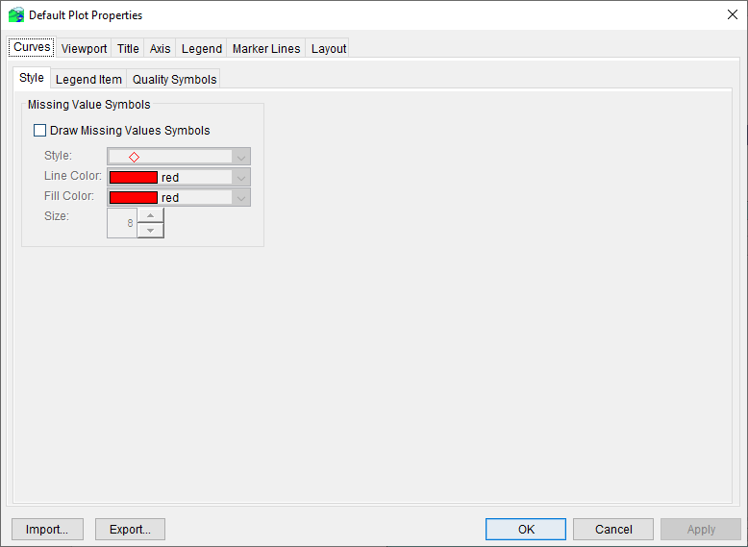
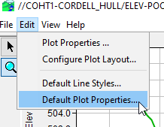
Default Plot Properties Editor
Select “Edit →Default Plot Properties…” from plot menu bar.
Notes:
Customizing Plots
Default Plot Properties Editor
Select “Edit→Default Plot Properties” from the plot menu bar to open the Default Plot Properties dialog.

Slide 18
Default Line Styles
User-editable default styles for curves based on:
Parameter
Data Type
Order (1st curve, 2nd curve, etc…)
Default styles will not be applied to any open plots, but only be applied to future plots.
All default styles saved in one file specified on bottom of editor.
Individual edits cannot be undone, but deleting the file will restore program default styles.
Notes:
Customizing Plots
Default Line Styles
Default line styles are user-editable default properties for curves based on parameter, date type, and order.
Default styles will not be applied to any open plots, but only be applied to future plots.
All default styles saved in one file specified on bottom of editor.
Individual edits cannot be undone, but deleting the file will restore program default styles.

Slide 19
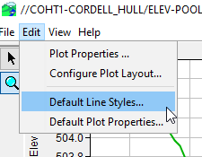
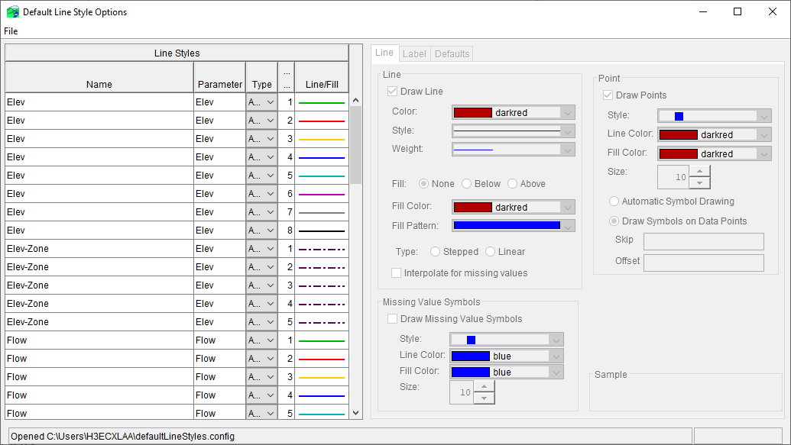
Default Line Style Editor
Select “Edit→Default Line Styles…” from plot menu bar
Notes:
Customizing Plots
Default Line Styles Editor.
Select “Edit→Default Line Styles” from the plot menu bar to open the Default Line Styles dialog.

Slide 20
Uses for Scripting
Notes:
CWMS Scripting Overview

Slide 21
Questions Help additional Training
https://usace.dps.mil/sites/KMP-WM/SitePages/Corps-Water-Management-System-(CWMS).aspx
https://www.hec.usace.army.mil/confluence/cwmsdocs
https://discourse.hecdev.net/c/cwms/5
TDL-CELRH-EC-GW-W-USACE CWMS Modeling | General | Microsoft Teams
“Just keep CWMS’ing”

