Slide 1
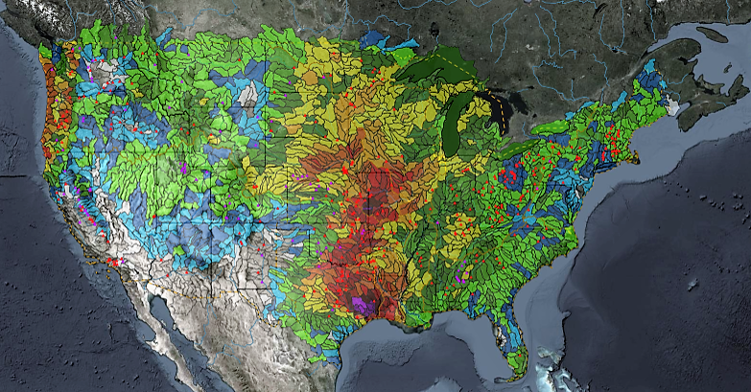
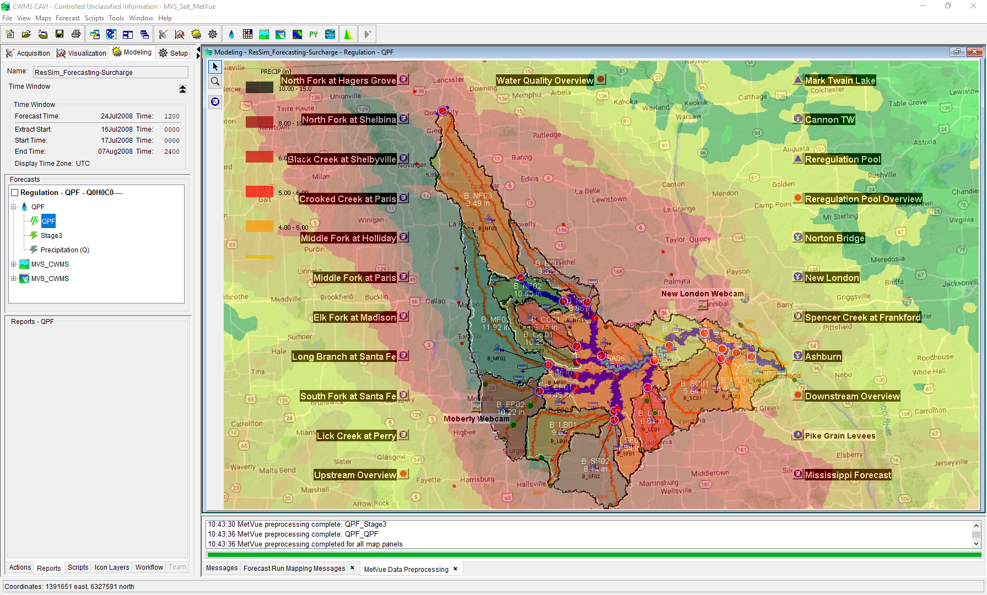

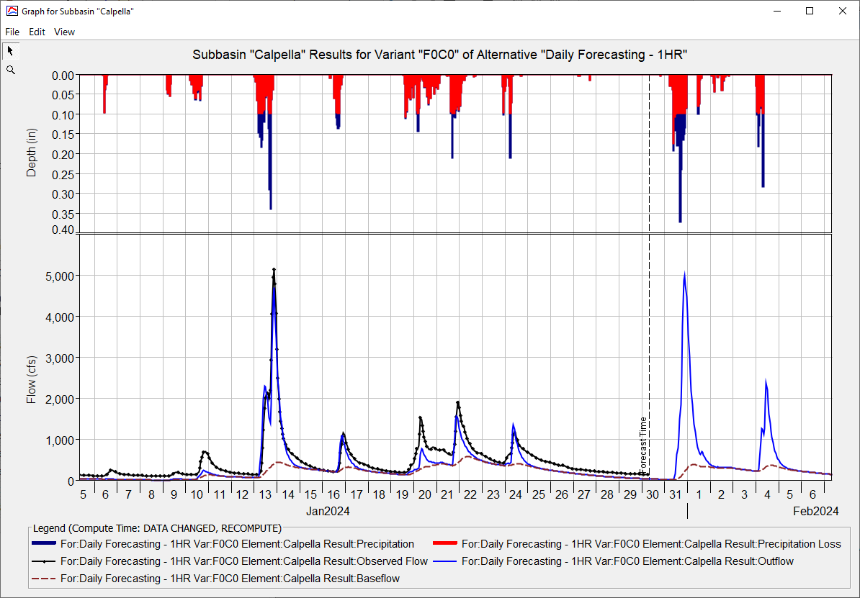
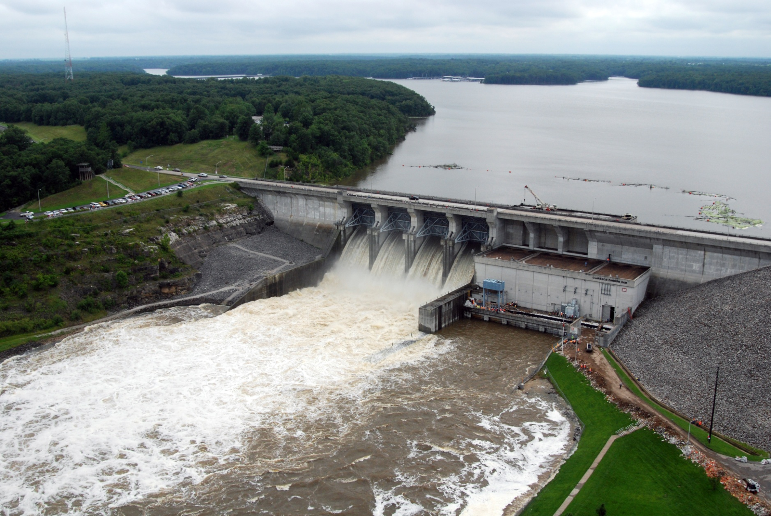
CWMS GRAPHICS AND SCRIPTING
Oskar Hurst,
Hydrologic Engineering Center
CWMS Prospect Course
Scripting

Slide 2
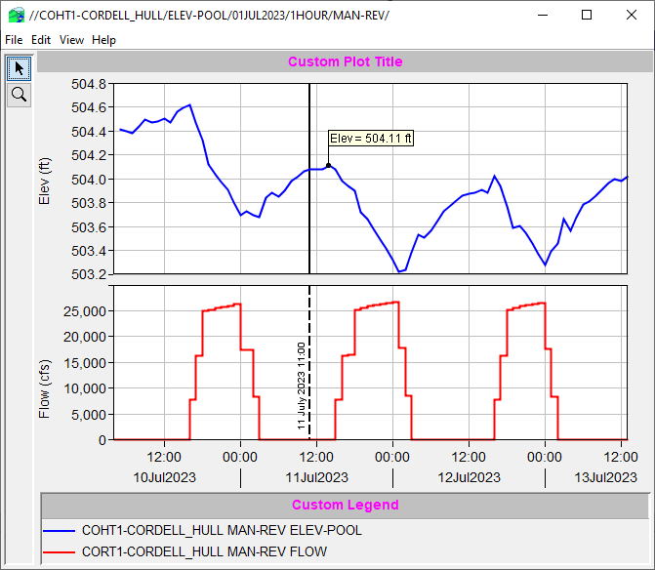
Uses for Scripting
Notes:
CWMS Scripting Overview

Slide 3
What is Scripting?
Scripting is the process of automating the actions of an interactive program for the purpose of being able to execute a prescribed set of actions with a simple trigger.
May involve small to large amount of initial effort.
Trivially repeatable.
Notes:
CWMS Scripting Overview
What is Scripting
Scripting is the process of automating the actions of an interactive program for the purpose of being able to execute a prescribed set of actions with a simple trigger.
May involve small to large amount of initial effort.
Trivially repeatable.

Slide 4
Why Use Scripting?
To simplify user operation
To ensure repeatability and consistency of results
To reduce time required to generate results
Notes:
CWMS Scripting Overview
Why Use Scripting?
To simplify user operation
To ensure repeatability and consistency of results
To abstract complexity
To reduce time required to generate results

Slide 5
Scripting in CWMS
CWMS includes a scripting facility that can be used to customize and/or automate tasks:
  Create and execute forecasts.
  Analyze and process data stored in Oracle or DSS.
  Create custom plots and tables.
CWMS scripts are written using the combination of a scripting language and the CWMS Application Programming Interface (API)
  There is no way to record interactive operations (i.e., no macro recorder)
  The scripting language is Jython – a version of the Python programming language
Notes:
CWMS Scripting Overview
Scripting in CWMS
CWMS includes a scripting facility that can be used to customize and/or automate tasks:
Create and execute forecasts.
Analyze and process data stored in Oracle or DSS.
Create custom plots and tables.
CWMS scripts are written using the combination of a scripting language and the CWMS Application Programming Interface (API)
There is no way to record interactive operations (i.e., no macro recorder)
The scripting language is Jython – a version of the Python programming language

Slide 6
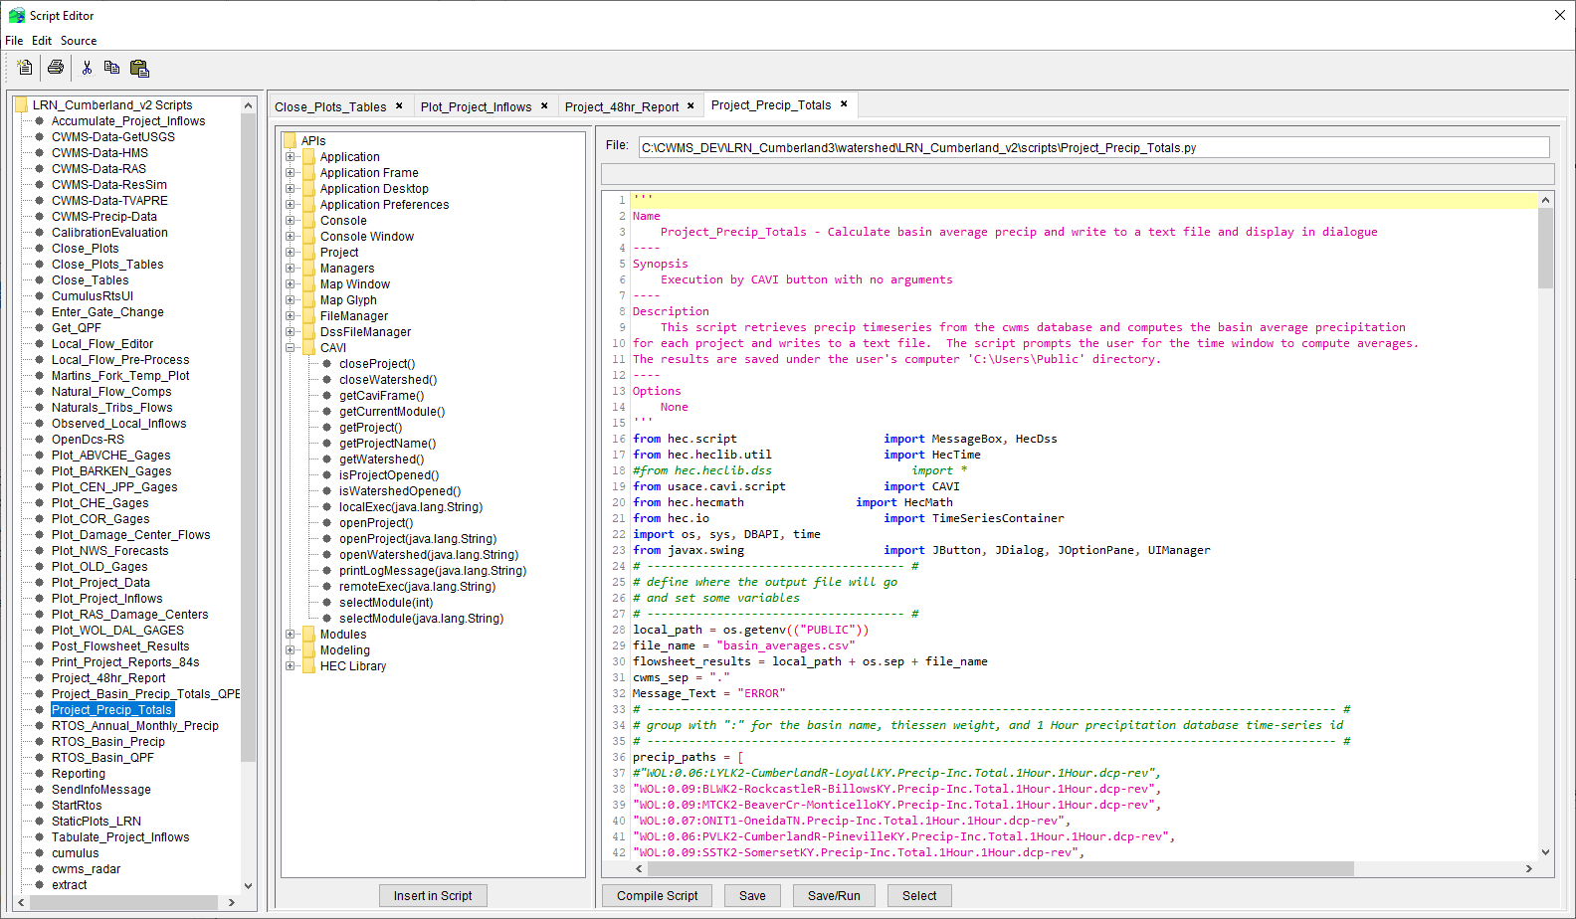
Scripting Components
Notes:
Scripting Components

Slide 7
Script Editor
The main scripting component in CWMS is the Script Editor. It is used for:
  Creating new scripts
  Editing existing scripts
  Testing scripts
Notes:
Scripting Components
Script Editor
The main scripting component in CWMS is the Script Editor. It is used for:
Creating new scripts.
Editing existing scripts.
Testing scripts.

Slide 8
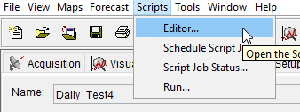
Opening the Script Editor
Select “Scripts→Editor…” from the CAVI menu bar.
Notes:
Scripting Components
Script Editor
Opening the Script Editor
Select “Scripts→Editor…” from the CAVI menu bar.

Slide 9
Script Editor – Tool Bar
New Script
Print Script
Cut
Copy
Paste
Same functions available via menu bar
Select “File→Delete” to delete a script (no tool for this)
Notes:
Scripting Components
Script Editor
Script Editor Toolbar
New Script
Print Script
Cut
Copy
Paste
Same functions available via menu bar
Select “File→Delete” to delete a script (no tool for this)

Slide 10
Script Editor – Tree Pane
Lists scripts for watershed
Double-click on script name to edit it
Notes:
Scripting Components
Script Editor
Script Editor – Tree Pane
Lists scripts for watershed
Double-click on script name to edit it

Slide 11
Script Editor – API Pane
Lists CWMS API methods
To insert code in editor pane:
  Double-click node (inserts at current position)
  Drag node to desired position
  Select node and click “Insert in Script” button (inserts at current position)
Notes:
Scripting Components
Script Editor
Script Editor – API Pane
Lists CWMS API methods
To insert code in editor pane:
Double-click node (inserts at current position)
Drag node to desired position
Select node and click “Insert in Script” button (inserts at current position)

Slide 12
Script Editor – Editor Pane
Displays code for script
Syntax highlighting
Highlights all occurrences of word at current position
Notes:
Scripting Components
Script Editor
Script Editor – Editor Pane
Displays code for script
Syntax highlighting
Highlights all occurrences of word at current position

Slide 13
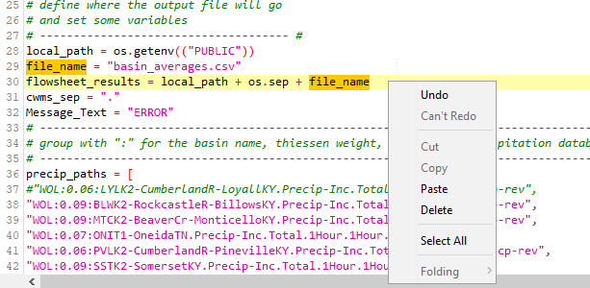
Script Editor – Editor Pane Details
current line (highlighted)
word at current position (highlighted)
context menu
line numbers
Ctrl-F – search
Uses normal select/cut/copy/paste keystroke combinations
Notes:
Scripting Components
Script Editor
Script Editor – Editor Pane Details
Context menu contains editing operations.
Ctrl-F opens search dialog
Standard editing shortcut keys can be used.

Slide 14
Script Editor – Action Buttons
Insert in Script
  Inserts code for selected API method into script at current position
Compile Script
  Compiles the script without saving
Save
  Compiles and saves the script
Save/Run
  Compiles, saves, and executes the script
Select
  Notifies other CWMS components of current script selection
Notes:
Scripting Components
Script Editor
Script Editor – Action Buttons
Insert in Script – inserts code for selected API method into script at current position
Compile Script – compiles the script without saving
Save – compiles and saves the script
Save/Run – compiles, saves, and executes the script
Select – notifies other CWMS components of current script selection

Slide 15
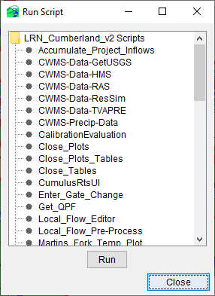
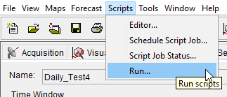
Script Selector
Select “Scripts→Run” from CAVI menu bar.
Displays scripts for watershed.
Double-click on name to run, or select name and click “Run” button.
Notes:
Scripting Components
Script Editor
Script Selector
Select “Scripts→Run” from CAVI menu bar.
Displays scripts for watershed.
Double-click on name to run, or select name and click “Run” button.

Slide 16
Modeling Scripts Panel
Select the Modeling tab.
At the bottom of the tab, select the Scripts tab.
Right-click in the Scripts panel and select “Edit…”
Use the “Select Scripts” dialog to choose which scripts to add to the panel
Notes:
Scripting Components
Modeling Scripts Panel
Select the Modeling tab.
At the bottom of the tab, select the Scripts tab.
Right-click in the Scripts panel and select “Edit…”
Use the “Select Scripts” dialog to choose which scripts to add to the panel

Slide 17
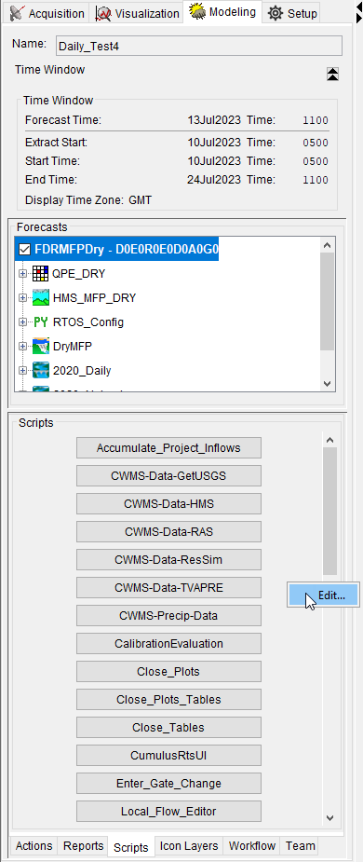
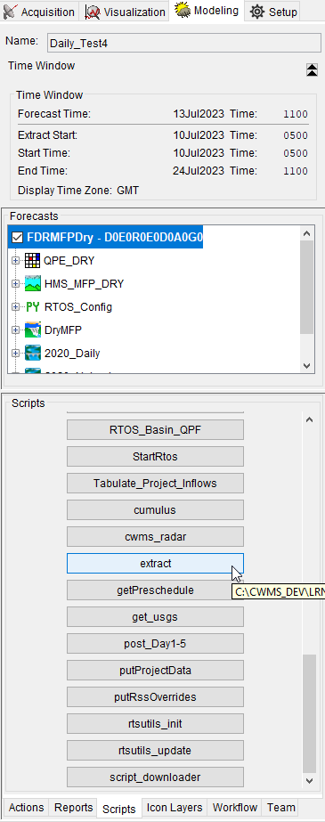
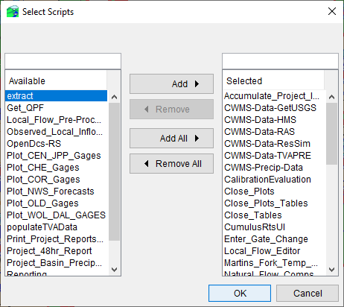
Modeling Scripts Panel

Slide 18
Assigning Scripts To Time Series Icons
Switch to Watershed Setup Module.
Right-click the icon and select “Edit” from the context menu.
Select the “Scripts/HTML” tab on the properties dialog.
Populate the scripts dialog with the appropriate information.
  Put a variable assignment statement in the “Arguments” column. That variable with its assigned value will be available in the script.
    This allows a common script to be used on many icons, as each icon will have its unique assignment to the same variable
Dismiss dialogs and save configuration.
Notes:
Scripting Components
Time Series Icons Scripts
Assigning Scripts to Time Series Icons.
Switch to Watershed Setup Module.
Right-click the icon and select “Edit” from the context menu.
Select the “Scripts/HTML” tab on the properties dialog.
Populate the scripts dialog with the appropriate information.
Put a variable assignment statement in the “Arguments” column. That variable with its assigned value will be available in the script.This allows a common script to be used on many icons, as each icon will have its unique assignment to the same variable
Dismiss dialogs and save configuration.

Slide 19
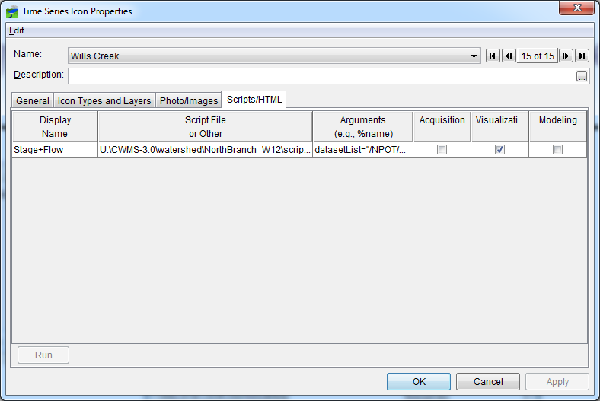
Assigning Scripts To Time Series Icons

Slide 20
Section 5 Review
What component is used to create and edit scripts?
What are three ways to execute a script?
What is the API pane used for?
How can multiple time series icons use a common script and produce individual results?
Notes:
Scripting Components
Section 5 Review
What component is used to create and edit scripts?
Script Editor
What are three ways to execute a script?
From the Script Editor (Save/Run)
From the Script Selector
From the Modeling Scripts Panel
From a Time Series Icon
What is the API pane used for?
To insert code for a CWMS API method into the script
How can multiple time series icons use a common script and produce individual results?
By assigning different values to the same variable in the “Arguments” column of the “Scripts/HTML” tab

Slide 21
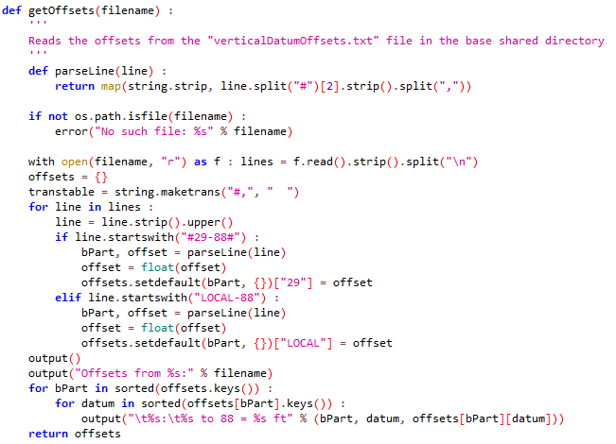
Scripting Language
Notes:
Scripting Language

Slide 22
What is Jython?
Jython is a Java-based implementation of the Python programming language. This means:
  You learn the Python language to learn Jython. Python tutorials and book references can be found at http://www.python.org.
  Jython code can interface seamlessly with Java code. The CWMS API is written in Java, but Jython can use it as if it were written in Python.
Notes:
Scripting Language
What is Jython?
Jython is a Java-based implementation of the Python programming language. This means:
You learn the Python language to learn Jython.
Python tutorials and book references can be found at http://www.python.org.
Jython code can interface seamlessly with Java code.
The CWMS API is written in Java, but Jython can use it as if it were written in Python.

Slide 23
Jython Scripting Resources
HEC-DSSVue User’s Guide
  Scripting (army.mil)
  Available from within HEC-DSSVue by selecting “Help→Help” from the menu bar.
  HEC-DSSVue shares the same API as CWMS for many items, including plots, tables, and HEC-DSS file access.
Examples
  Some examples are installed with HEC-DSSVue in the “samples” directory
  https://github.com/HydrologicEngineeringCenter/DSSVue-Example-Scripts
  The CWMS wiki (https://cwms.usace.army.mil/dokuwiki/) contains many scripting examples, including accessing the CWMS database.
  HEC Monolith documentation https://www.hec.usace.army.mil/software/javadocs/hec-monolith/
Notes:
Scripting Language
Jython Scripting Resources
Chapter 8 of the HEC-DSSVue User’s Guide
HEC-DSSVue shares the same API as CWMS for many items, including plots, tables, and HEC-DSS file access.
Interactive documentation is available from within HEC-DSSVue by selecting “Help→Help” from the menu bar.
Examples
Many examples are installed with HEC-DSSVue in the “samples” directory
The CWMS wiki (https://cwms.usace.army.mil/dokuwiki/) contains many scripting examples, including accessing the CWMS database.
For general Java and Python, Army Civilians in the Scientist, Engineer and Analyst (CP16) Career Field have access to Udemy for Business.
Create an account with your usace.army.mil at Udemy for Business (armyciv.udemy.com)
Should be emailed instructions on how to setup
100 days of code course has been highly recommended.
https://armyciv.udemy.com/course/100-days-of-code/

Slide 24
Questions
Help additional Training
https://usace.dps.mil/sites/KMP-WM/SitePages/Corps-Water-Management-System-(CWMS).aspx
https://www.hec.usace.army.mil/confluence/cwmsdocs
https://discourse.hecdev.net/c/cwms/5
TDL-CELRH-EC-GW-W-USACE CWMS Modeling | General | Microsoft Teams
“Just keep CWMS’ing”

