Slide 1
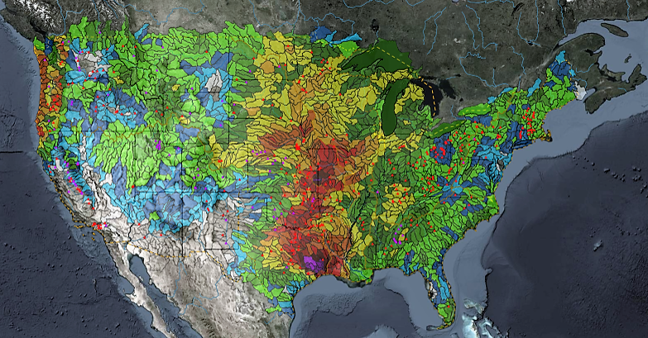
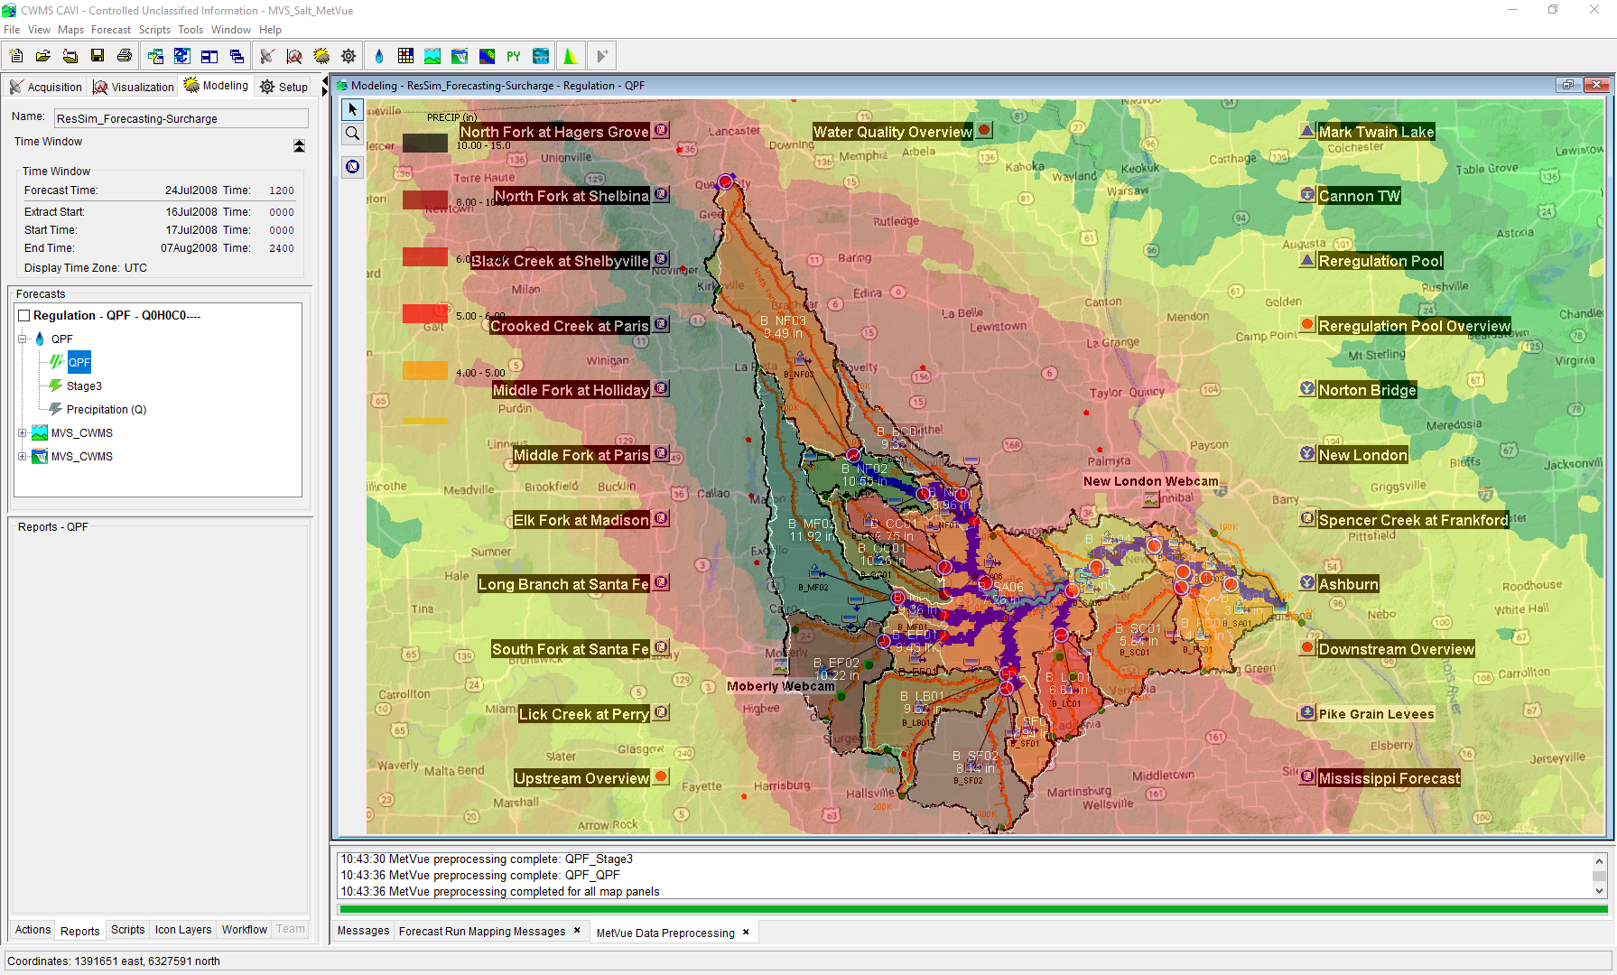

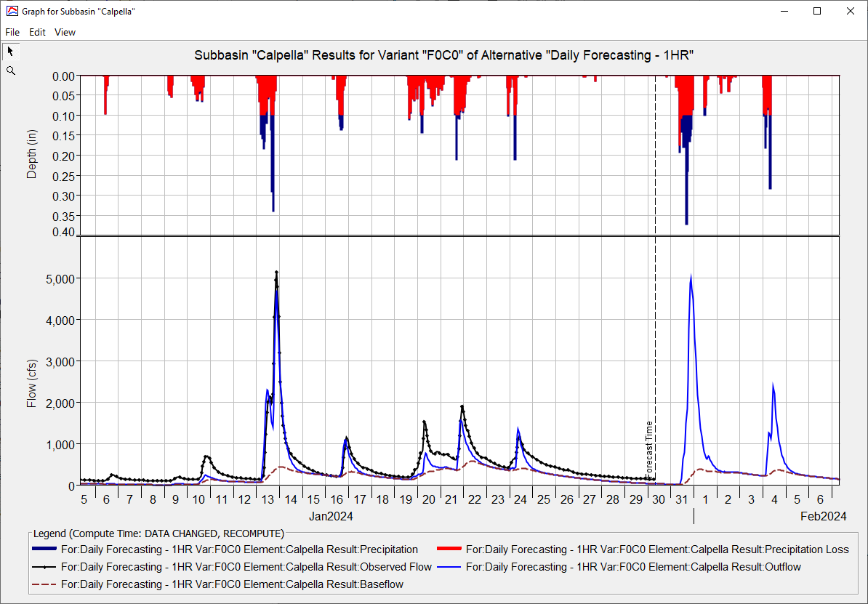
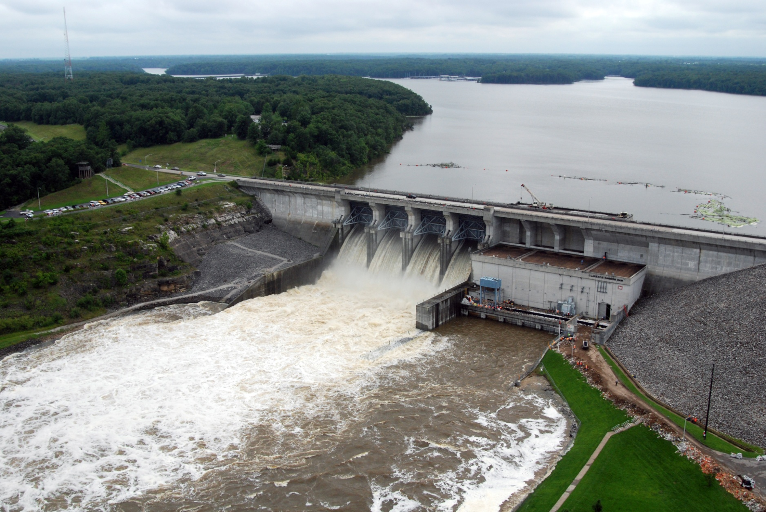
CWMS New & upcoming Features
Fauwaz Hanbali
Hydrologic Engineering Center
CWMS Prospect Course

Slide 2


Outline
New in CWMS 3.4
CAVI
CWMSVue
HEC-MetVue
HEC-HMS
HEC-ResSim
HEC-FIA
Upcoming Features

Slide 3
New in CWMS 3.4
CAVI and CWMSVue

Slide 4






CWMS 3.4 Software Package
3.4
3.4
3.3
4.12
3.5.1
6.5
3.4

Slide 5
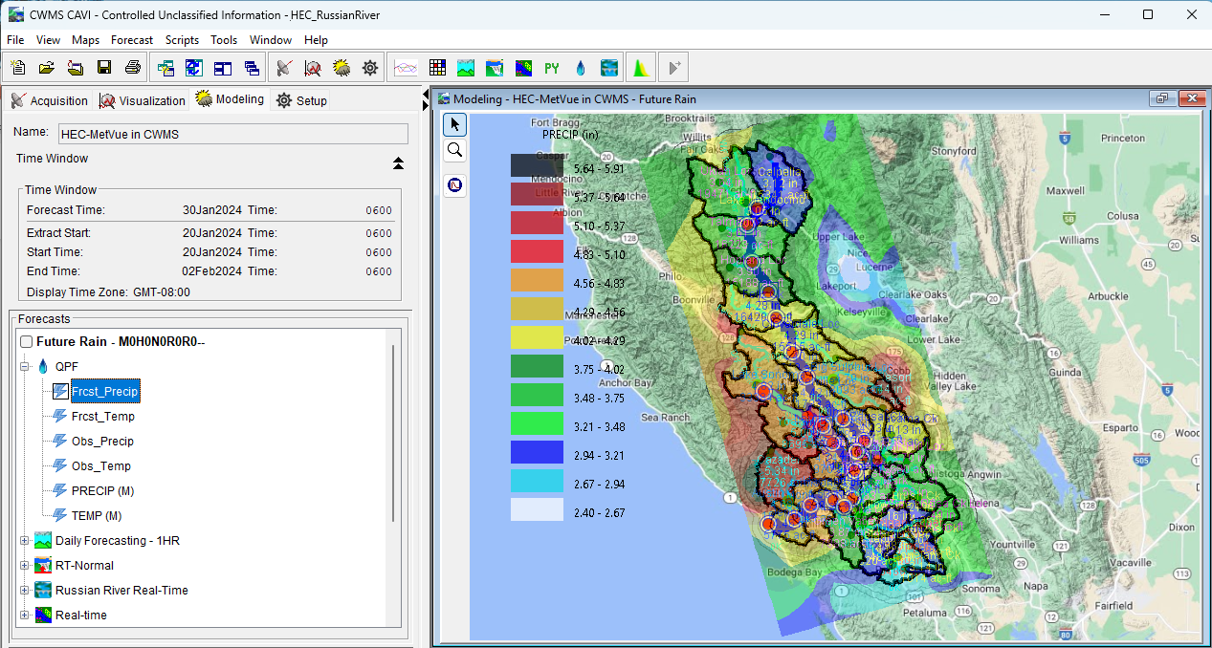
CAVI Updates
Java 11 and DSS 7 Upgrades
CWMS Data API (CDA) Writes Support
Ensemble Forecast Process Plugin
Ensemble Viewer Plugin

Slide 6


CAVI – Java 11 & DSS 7 Upgrades
Upgraded from DSS6 to DSS7
Conversion from Fortan to C
Expanded File size limit from 2GB to unlimited
Upgraded from Java 8 to Java 11
Enhanced Security
Extended Oracle Support

Slide 7
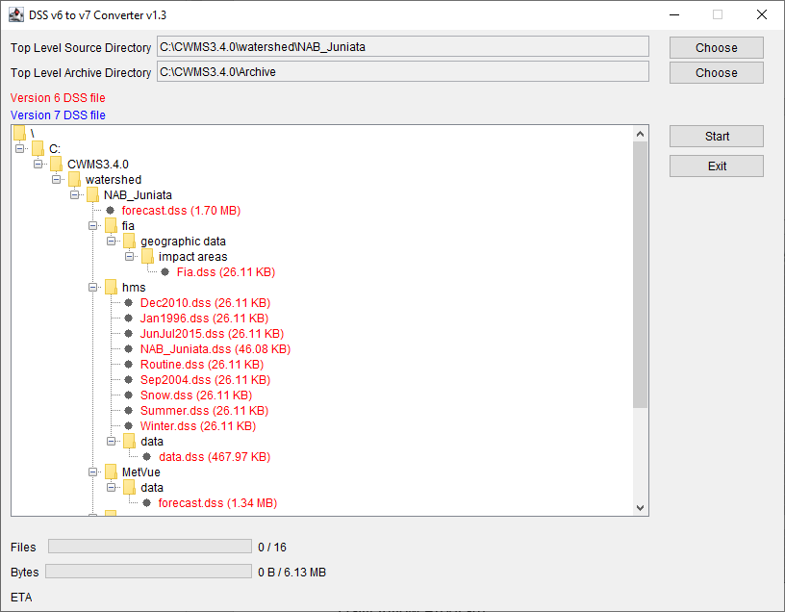
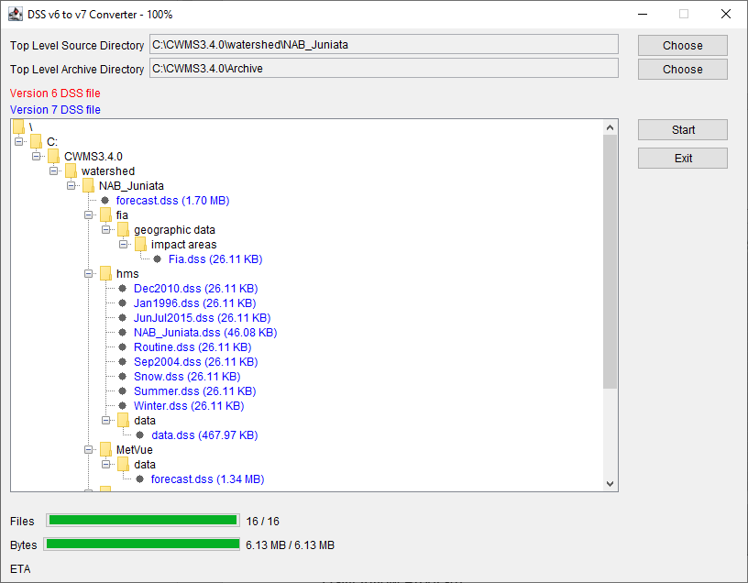
CAVI – Upgrading to DSS7
First Step that must be conducted when migrating CWMS watersheds to CWMS3.4
DSSConverter Jython Script https://github.com/HydrologicEngineeringCenter/DSSVue-Example-Scripts/blob/master/src/DssConverter.py
Inventories DSS6 files under a user selected top level source directory
Converts DSS6 files to DSS7 files upon user execution
Moves DSS6 files to a user selected top level archive directory

Slide 8
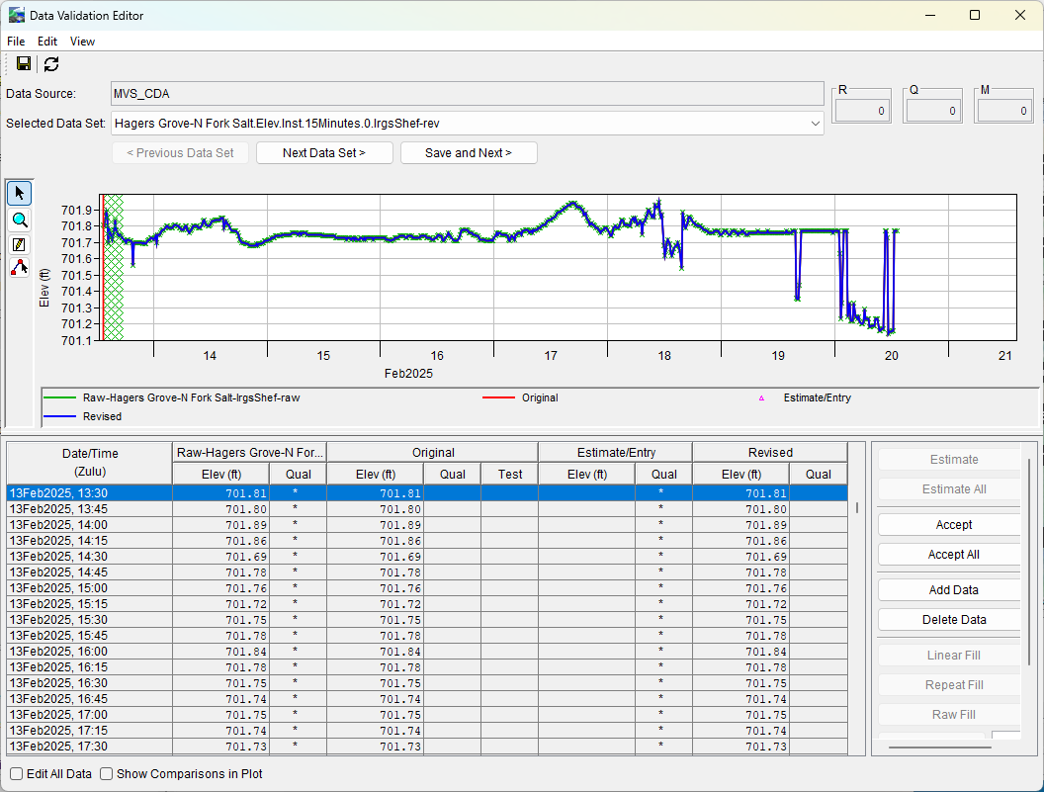
CAVI – CDA Write support
Time Series Icons
Data Validation Editor
Data Status Summary
CAVI Post
CWMSjy replacing-dbapi-py-with-cwmsjy-for-scripting

Slide 9

Ensemble Forecast Processor (EFP)
Extract
CAVI Plugin in the Program Order
Allows user to specify locations within the watershed to calculate statistical metrics from ensemble time series
Metrics can be used as input to other applications within the CWMS forecast
EFP
ResSim
RAS
FIA

Slide 10
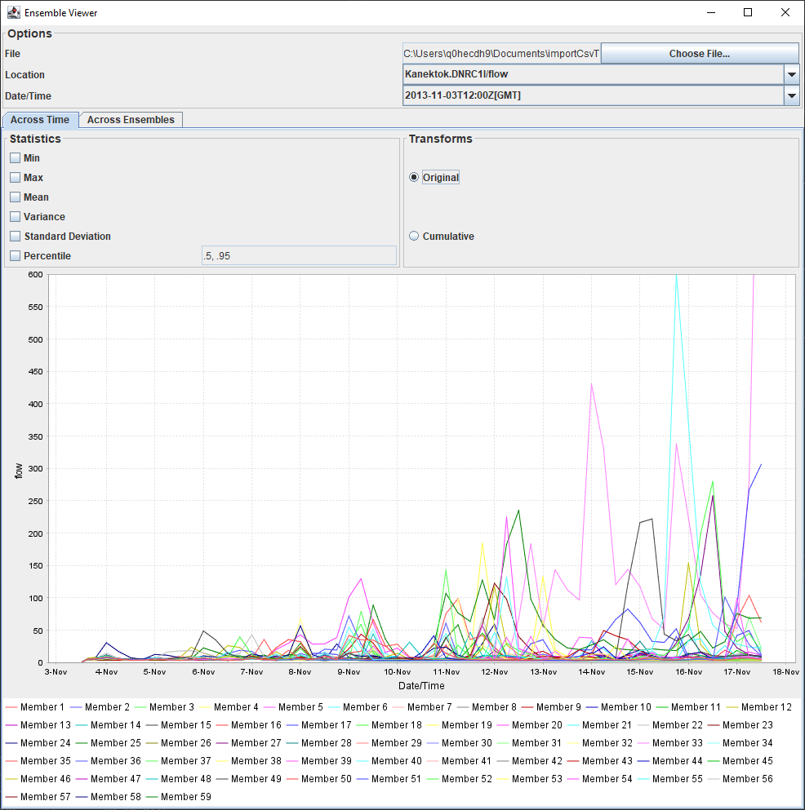
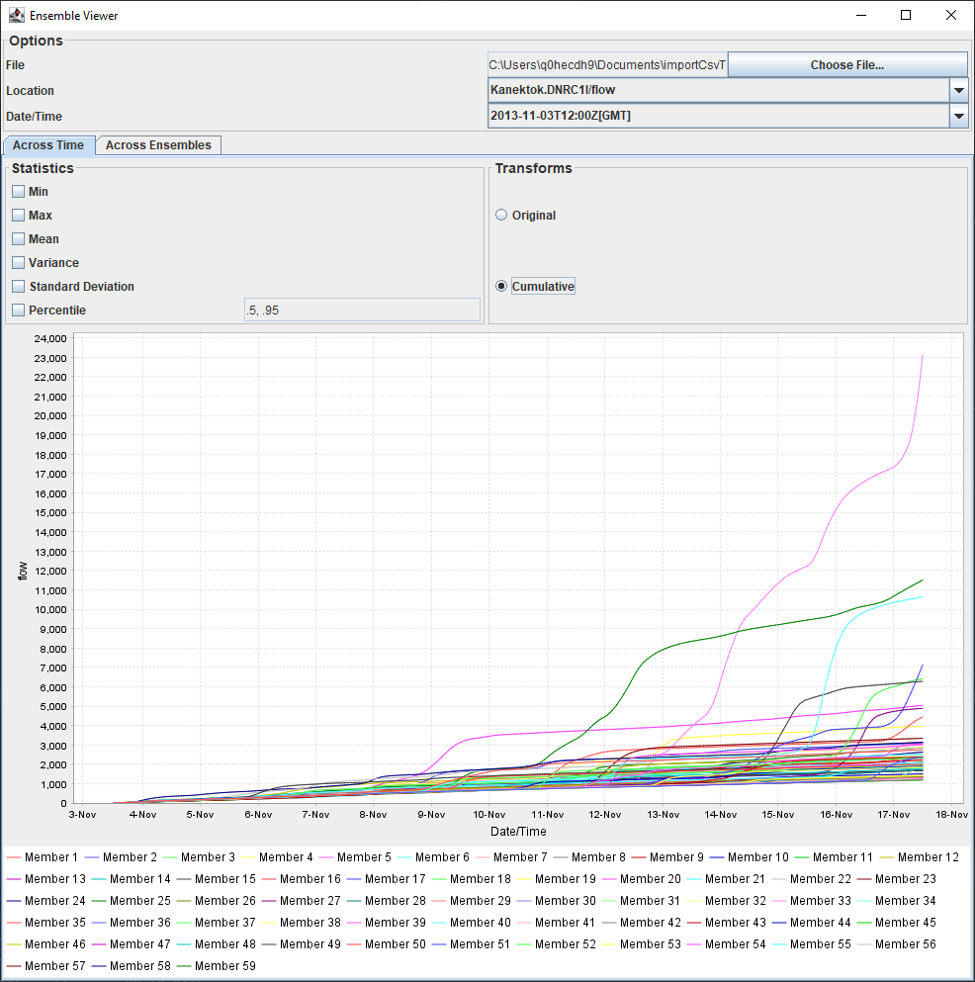
Ensemble Viewer
Original Time Series
Cumulative Time Series

Slide 11
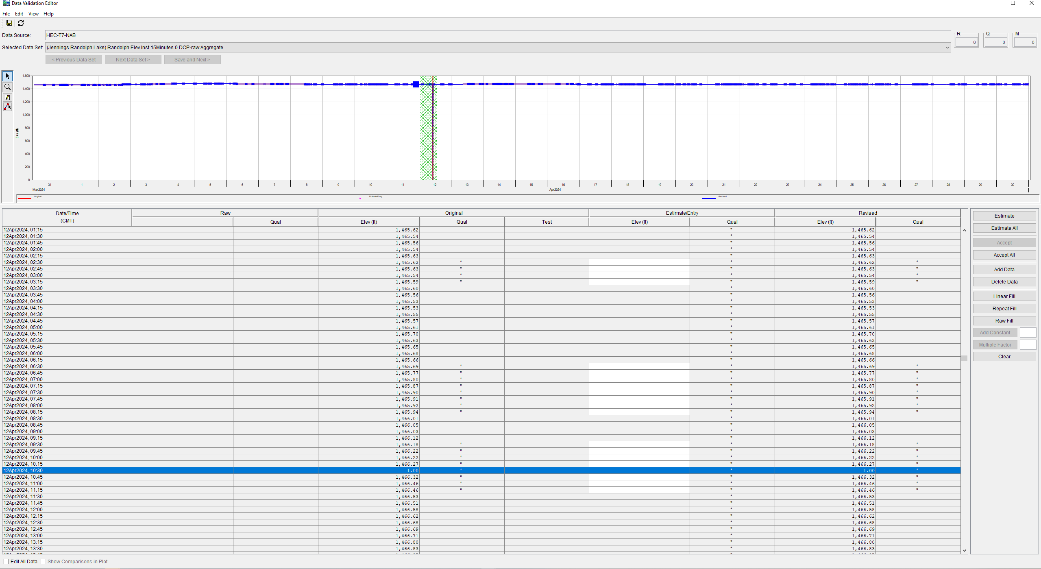
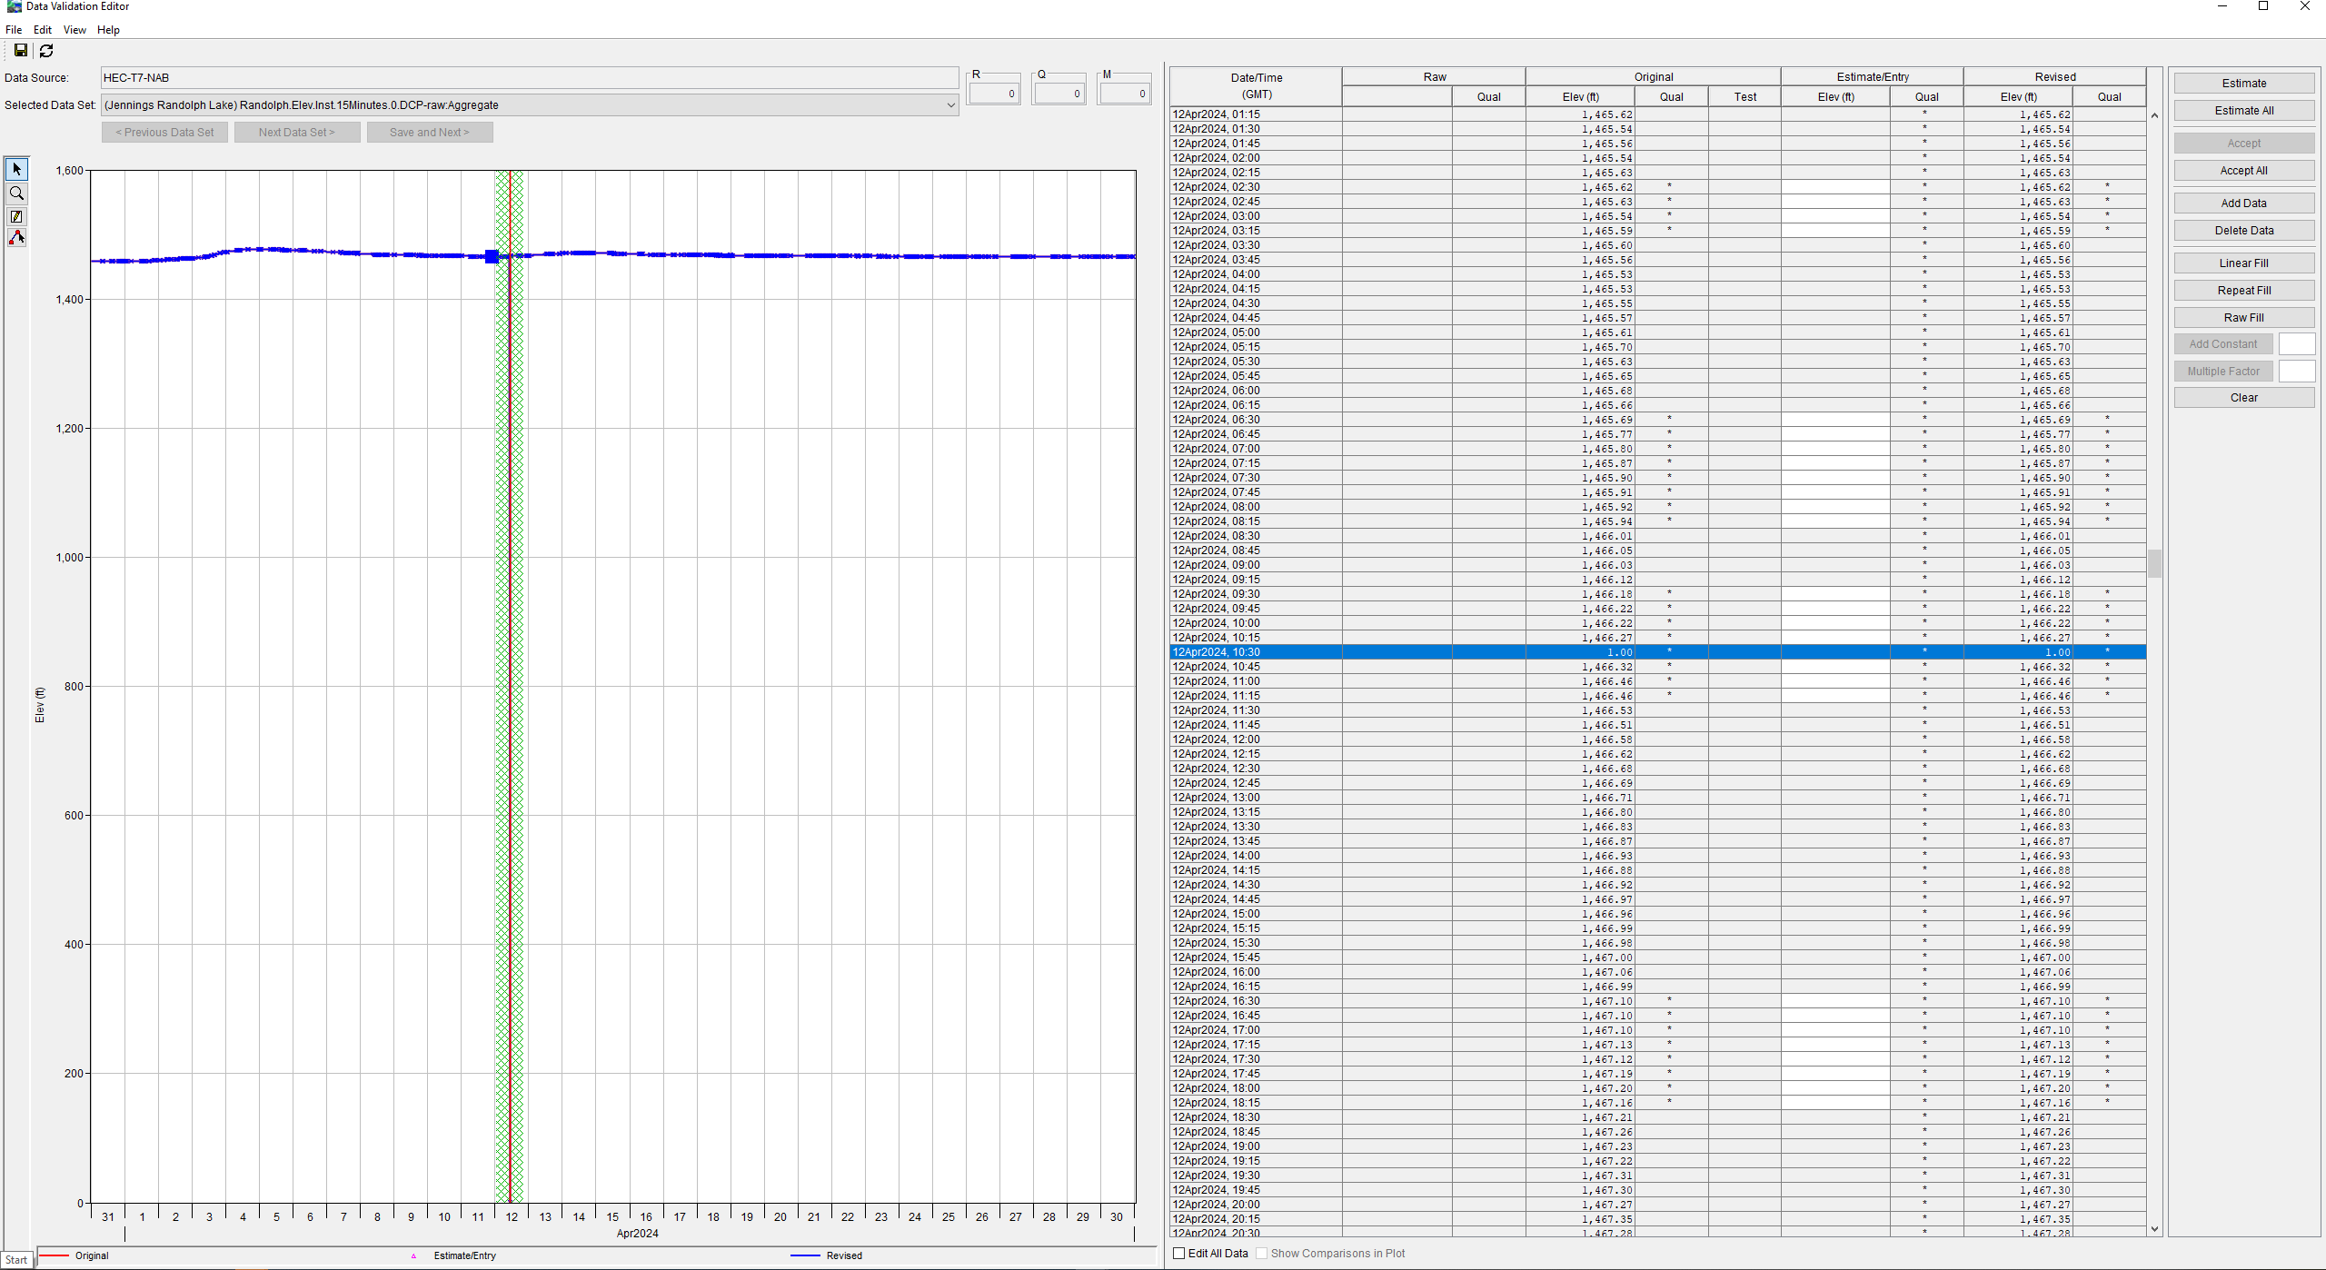
CWMSVue Enhancements
Time Zone labeling in tables, plots, data validation and graphical editors
CWMS Data API (CDA) writes support
Performance enhancements to Data Validation Editor (DVE) writes to the database
Data Validation Editor (DVE) layout shortcut actions improvements
Data Validation Editor
Default Layout
Data Validation Editor
New Vertical Layout Option

Slide 12
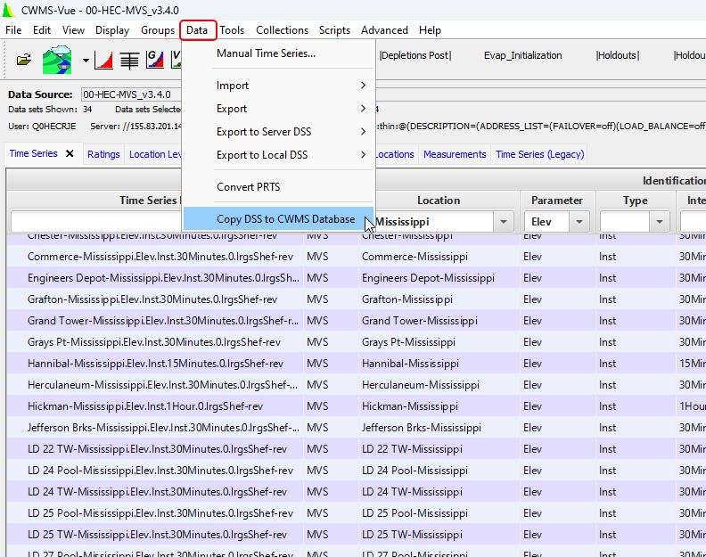
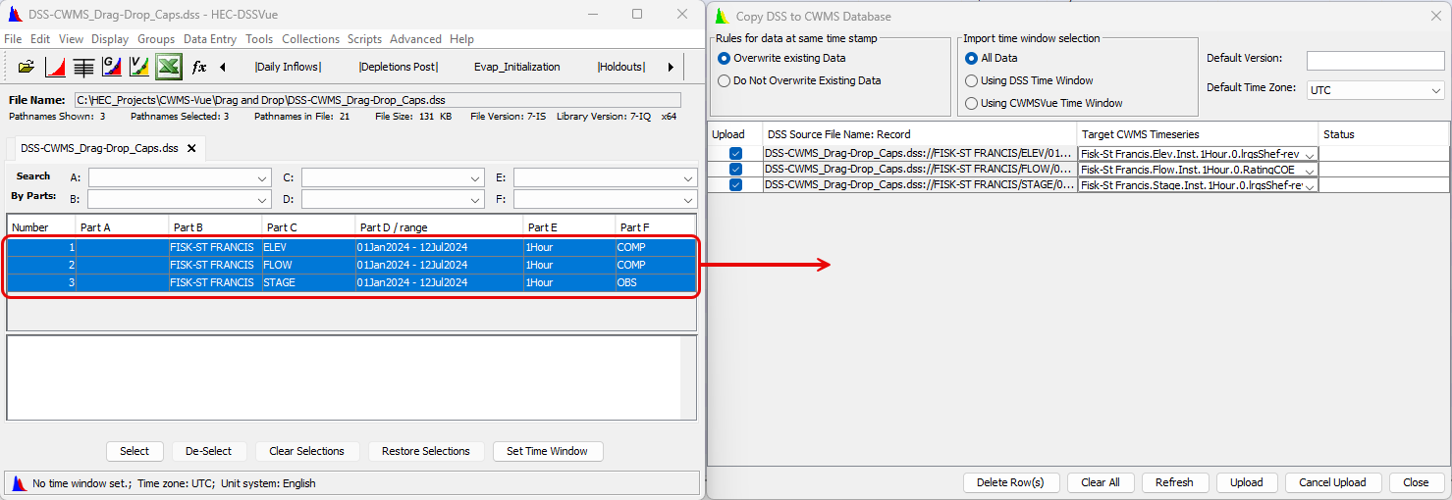
Drag and drop DSS CWMS-Vue
DSS Pathnames must be in all Caps for
DSS records must have proper time zones

Slide 13
New in CWMS 3.4
HEC-MetVue, HEC-HMS, and HEC-FIA

Slide 14
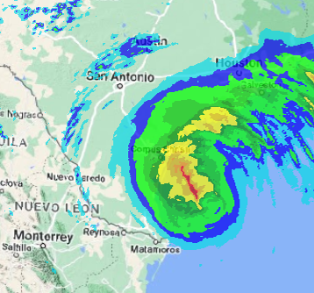
HEC-MetVue Enhancements
Cumulus Plugin
Zone Creation Editor
Zonal Adjustments Editor
Temporal Editing of Grids through the Dynamic Time Window Scanning Tool
Edits Tracking Tool

Slide 15
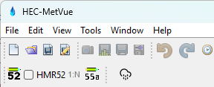
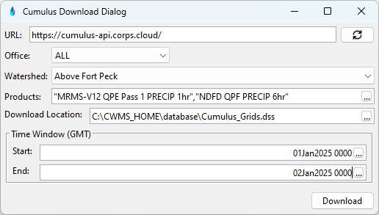
HEC-MetVue Cumulus Plugin
Available only for USACE as part in the CWMS package
Ad hoc daily downloads to local database

Slide 16
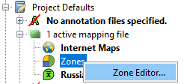
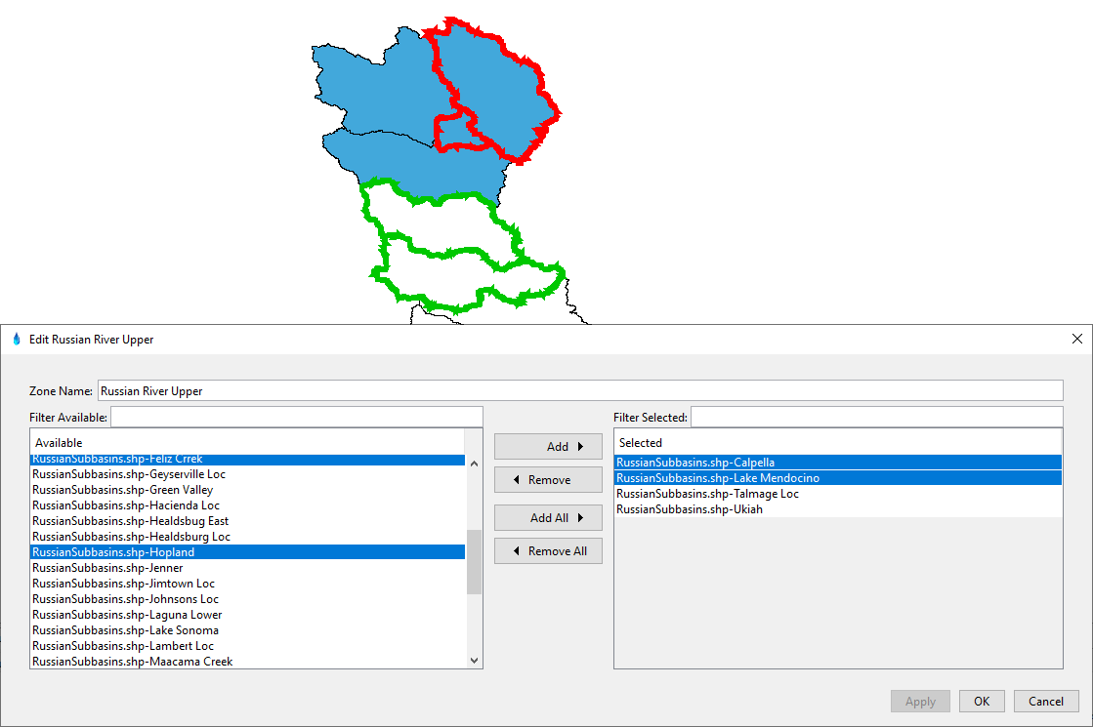
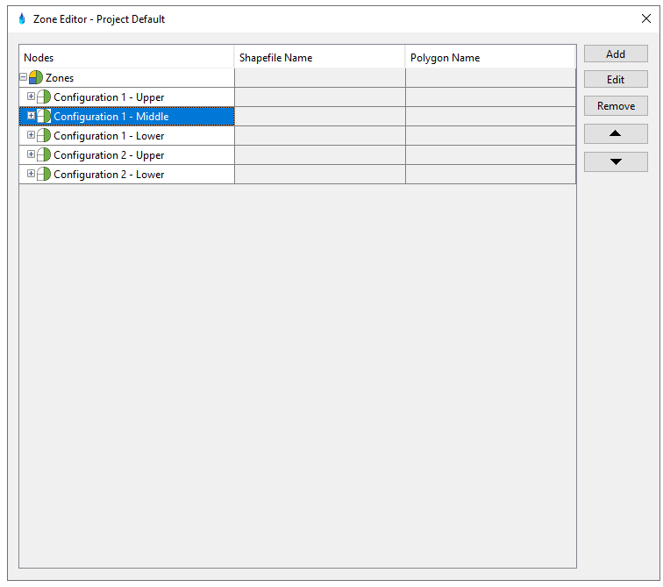
HEC-MetVue Zone Creation Editor
Grouping basins through the editor or direct selections in the map

Slide 17
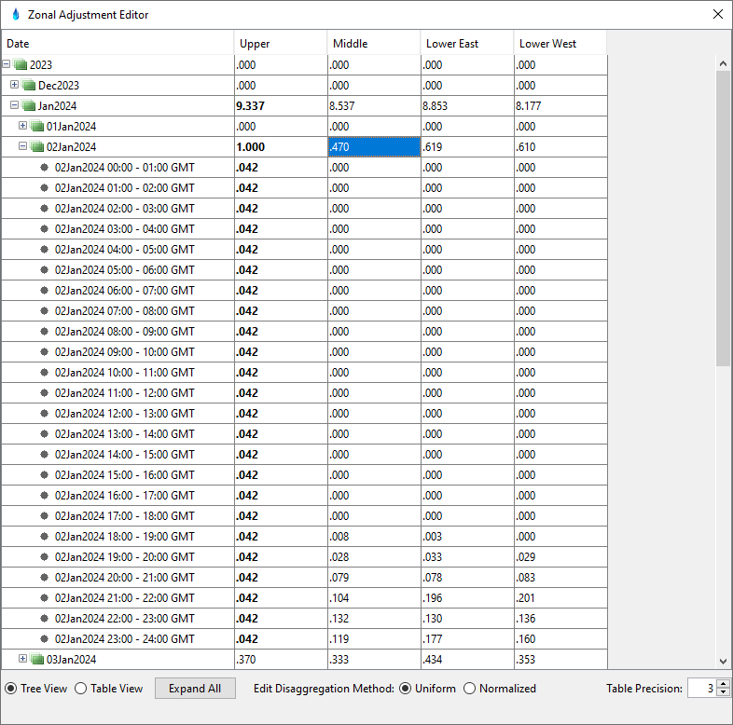
HEC-MetVue Zonal Adjustments Editor
Uniform Adjustments
Normalized Adjustments
Maintains temporal precipitation pattern

Slide 18
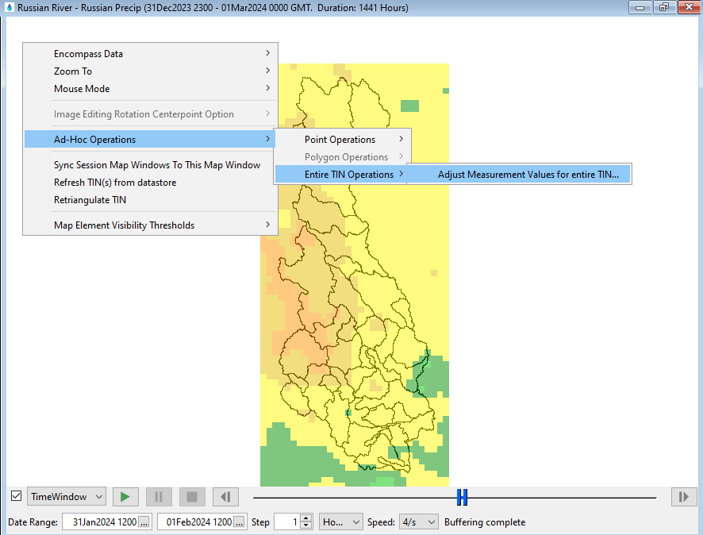
HEC-MetVue Temporal Editing of Grids Dynamic Time Window Scanning Tool
Single time interval
Editing an individual grid
Range of time intervals
Editing multiple grids
Uniform Disaggregation based on data type

Slide 19
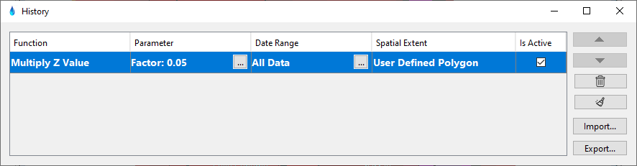
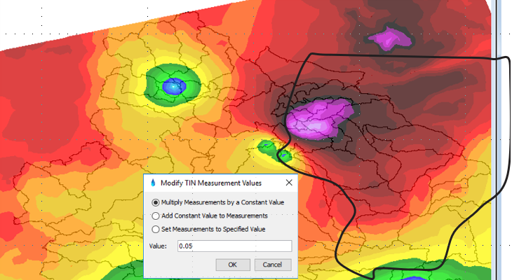
HEC-MetVue Edits Tracker Tool
Track edits
Adjust, undo, redo, or clear edits
Export text report for documenting edits
Export JSON script for importing and recreating edits later

Slide 20
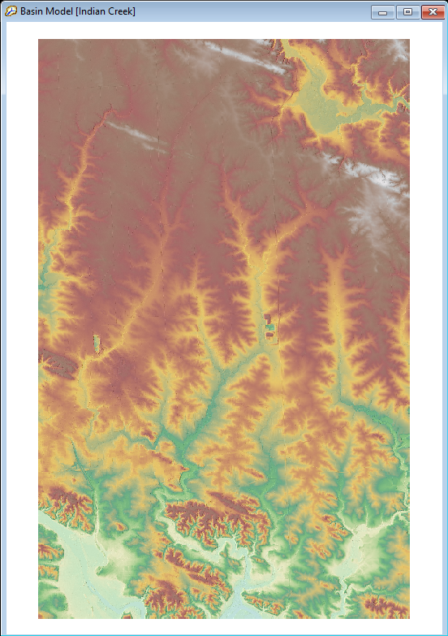
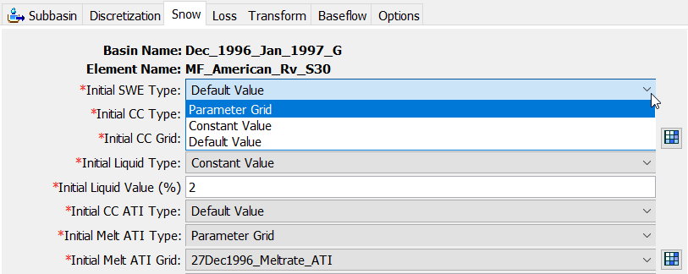
HEC-HMS Enhancements
Improved terrain data management
Single terrain file association with all basin models
New infiltration method
Linear Deficit and Constant Loss
Variable ModClark options
“Default Values” and “Constant Value” are available for initializing gridded temperature index snow method

Slide 21
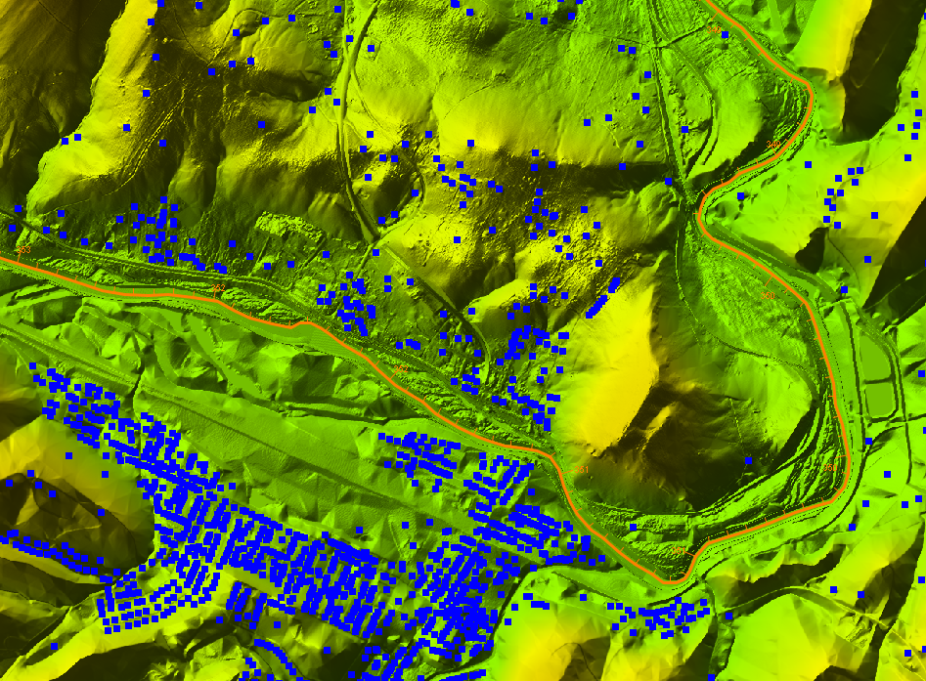
HEC-FIA Enhancements
RAS-FIA (HDF5) Inundation Configuration and improved Model Linking in the CAVI
Regulated
Unregulated
Regulated without levee
Unregulated without levee
Agricultural Flood Damages Reduced Analysis
RAS Mapper Access from within HEC-FIA

Slide 22
Upcoming Features

Slide 23
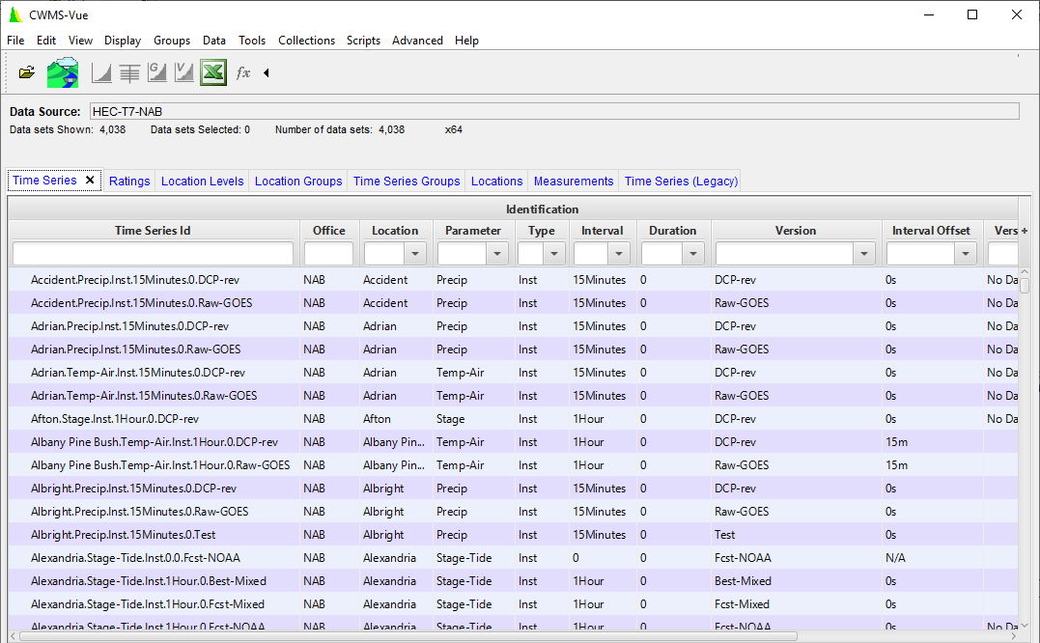
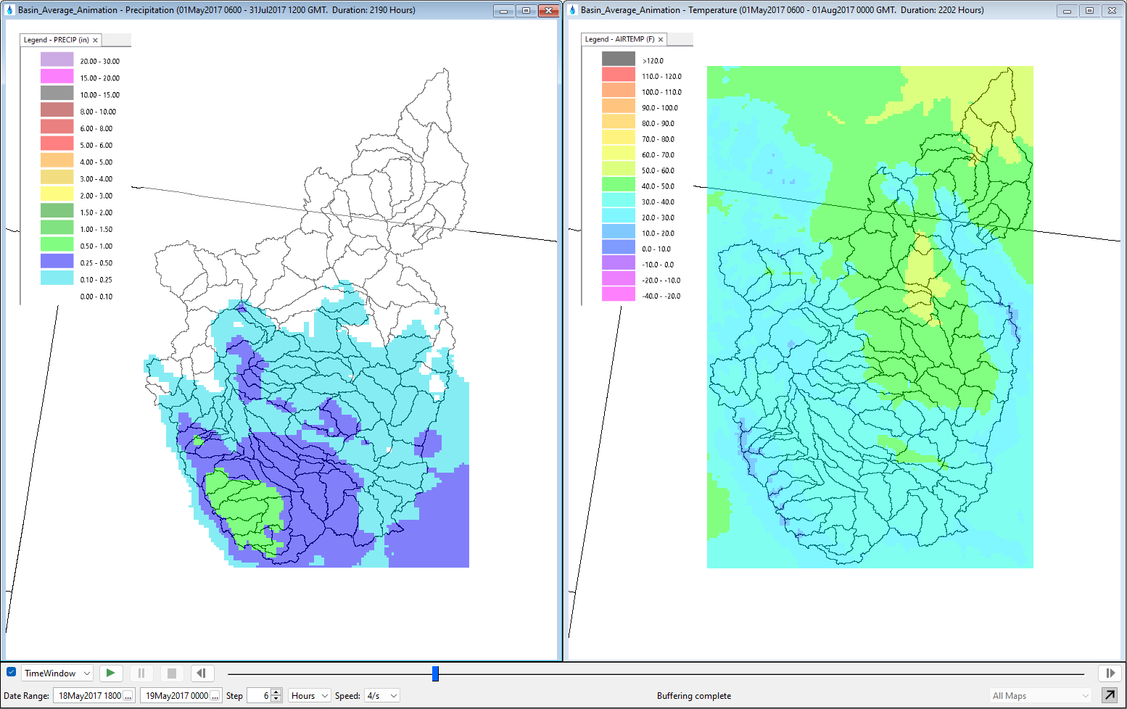
CWMS 3.5
CWMSVue 4.0
Faster Loading of tabs/catalogues
Standalone release
CAVI 3.5
MFP and Data Exchange Retirements
HEC-MetVue 3.4
Basin Average Layer support in Animation
Synced Map Windows Animation

Slide 24
CWMS 3.6 OR Beyond
CAVI
Login updates to support single sign on to CWMS (CDA & Cumulus) web services
Extract Editor support for paired data and versioned time series
HEC-MetVue
MetInterp and Ensemble Alternatives
Basin Average layer Scaling
Animation Video Recorder
HEC-HMS
Ensemble and Optimization Alternatives
Check box for Blending
Observed Inflow/Outflow/Storage for Reservoirs
HEC-ResSim
OSI on-the-fly editor for irregular and daily overrides
Gates overrides
CAVI Cloud Compute
Cloud Compute Instructions and Execution Actions from the CAVI
Initially support HEC-MetVue, HEC-HMS, and HEC-ResSim
Alternatives to Jython scripting

Slide 25


Cloud Migration
Legacy
Migration
Cloud Optimized
FY22-FY25
FY26-FY28
CPC
CWBI CLOUD
T7
Office A
T7
Office B
Built-in COOP
Cloud Databases
More
Web Apps
Postgres
Time Series
Oracle
COOP
Postgres
Data &
Modeling
Dashboards
Cumulus
Grids
Data processing
TBD
Data Dissemination
A2W
Model Library
Cloud Compute
User A
User B
User A
User B
User
User
CAVI
CAVI
CAVI
CAVI
CAVI
CAVI &/or Browser

Slide 26
Questions Help additional Training
https://usace.dps.mil/sites/KMP-WM/SitePages/Corps-Water-Management-System-(CWMS).aspx
https://www.hec.usace.army.mil/confluence/cwmsdocs
https://discourse.hecdev.net/c/cwms/5
TDL-CELRH-EC-GW-W-USACE CWMS Modeling | General | Microsoft Teams

