Slide 1
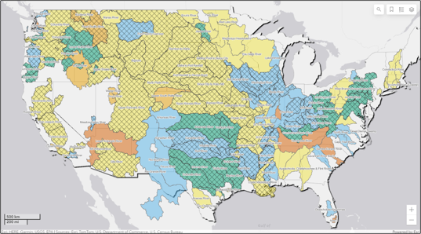

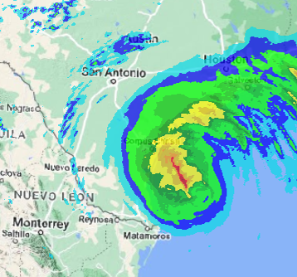
CWMS New & upcoming Features
Part A – New in CWMS 3.4 (CAVI/CWMSVUe)
Fauwaz Hanbali
Hydrologic Engineering Center
CWMS Prospect Course

Slide 2


Outline
New in CWMS 3.4
CAVI
CWMSVue
HEC-MetVue
HEC-HMS
HEC-ResSim
HEC-FIA
Upcoming Features

Slide 3






CWMS 3.4 Software Package
3.4
3.4
3.3
4.12
3.5.1
6.5
3.4

Slide 4
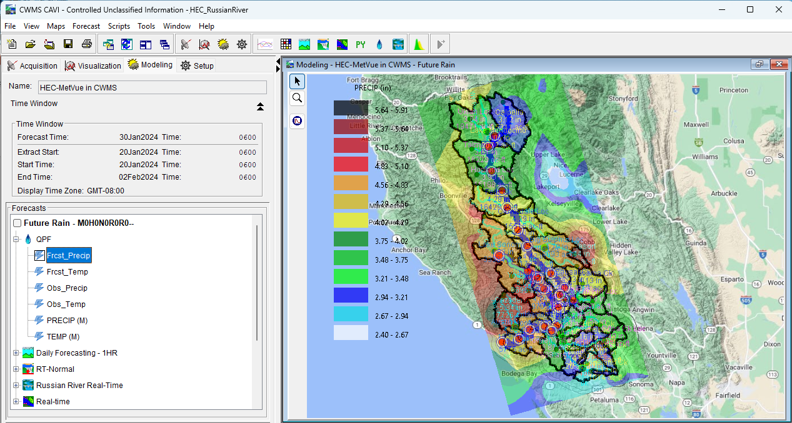
CAVI Updates
Java 11 and DSS 7 Upgrades
CWMS Data API (CDA) Writes Support
Ensemble Forecast Process Plugin
Ensemble Viewer Plugin

Slide 5


CAVI – Java 11 & DSS 7 Upgrades
Upgraded from DSS6 to DSS7
Conversion from Fortan to C
Expanded File size limit from 2GB to unlimited
Upgraded from Java 8 to Java 11
Enhanced Security
Extended Oracle Support

Slide 6
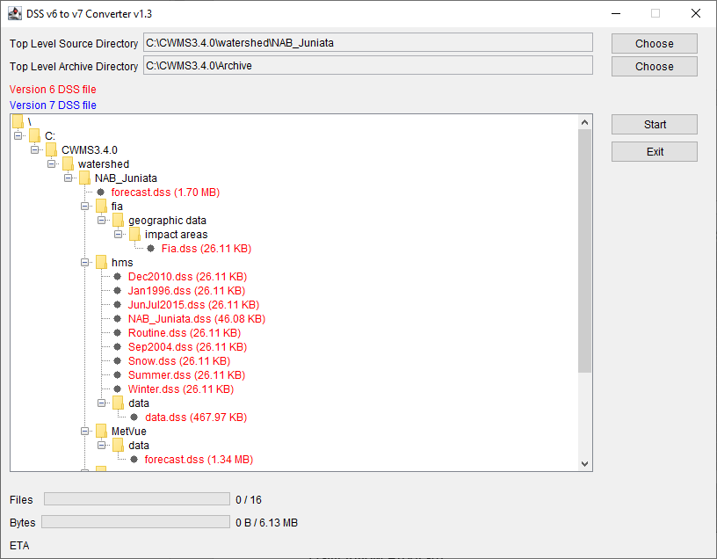
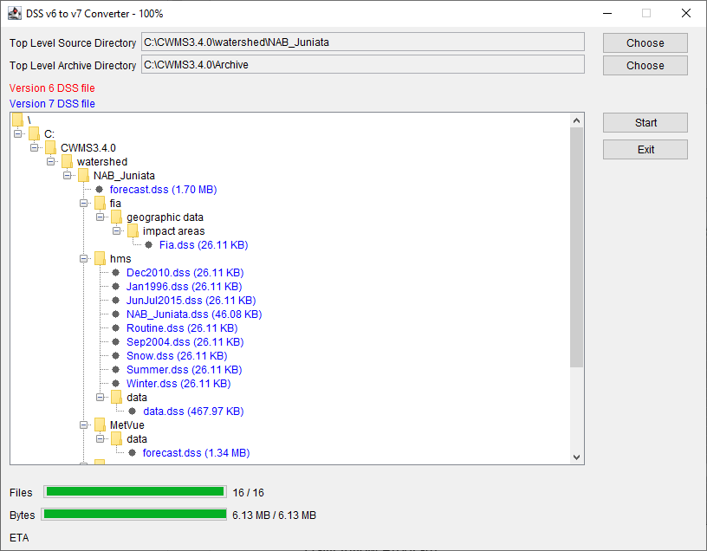
CAVI – Upgrading to DSS7
First Step that must be conducted when migrating CWMS watersheds to CWMS3.4
DSSConverter Jython Script https://github.com/HydrologicEngineeringCenter/DSSVue-Example-Scripts/blob/master/src/DssConverter.py
Inventories DSS6 files under a user selected top level source directory
Converts DSS6 files to DSS7 files upon user execution
Moves DSS6 files to a user selected top level archive directory

Slide 7
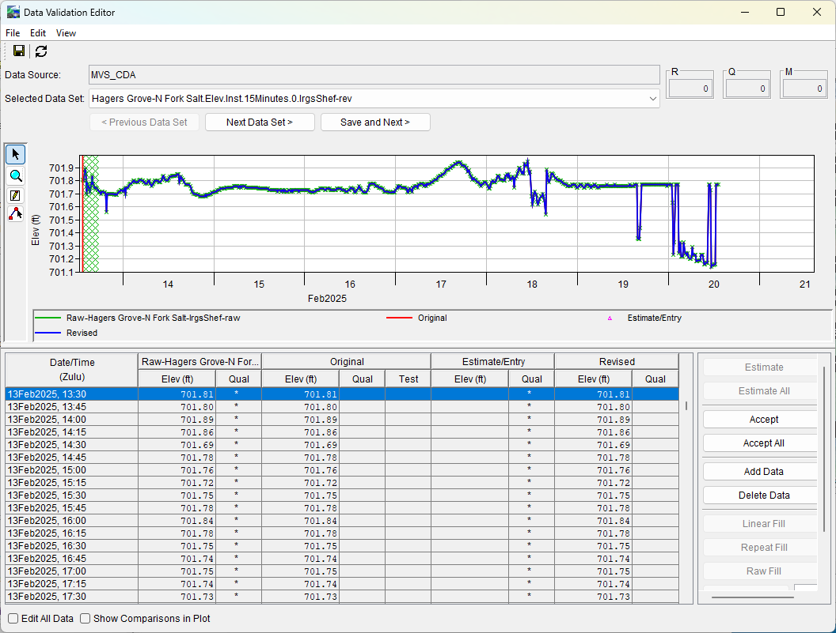
CAVI – CDA Write support
Time Series Icons
Data Validation Editor
Data Status Summary
CAVI Post
CWMSjy replacing-dbapi-py-with-cwmsjy-for-scripting

Slide 8

Ensemble Forecast Processor (EFP)
Extract
CAVI Plugin in the Program Order
Allows user to specify locations within the watershed to calculate statistical metrics from ensemble time series
Metrics can be used as input to other applications within the CWMS forecast
EFP
ResSim
RAS
FIA

Slide 9
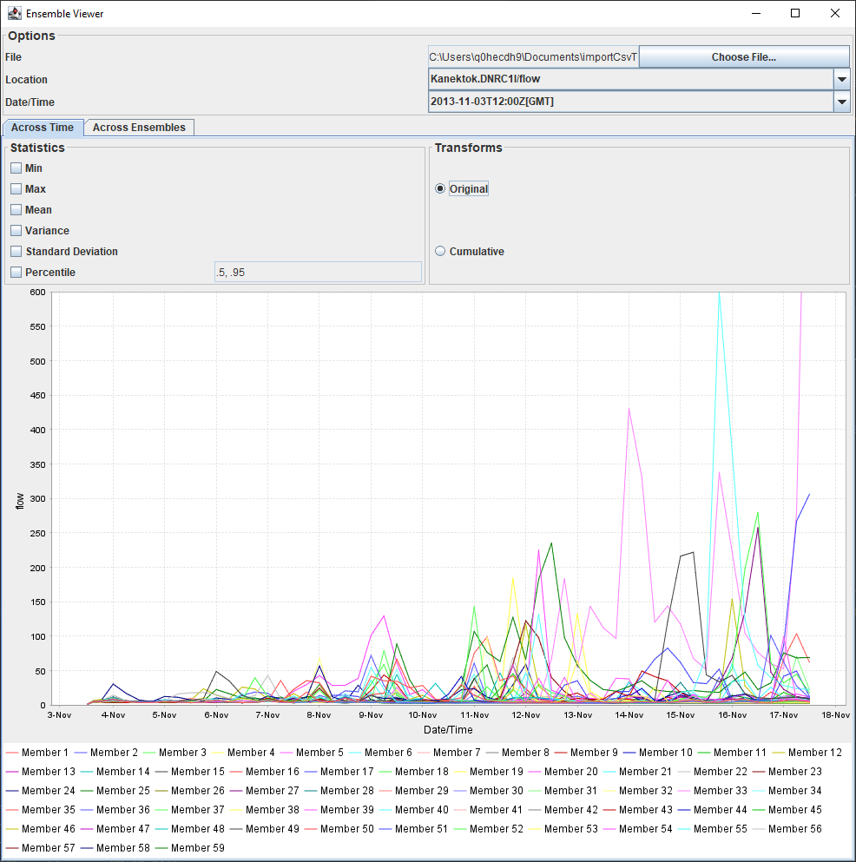
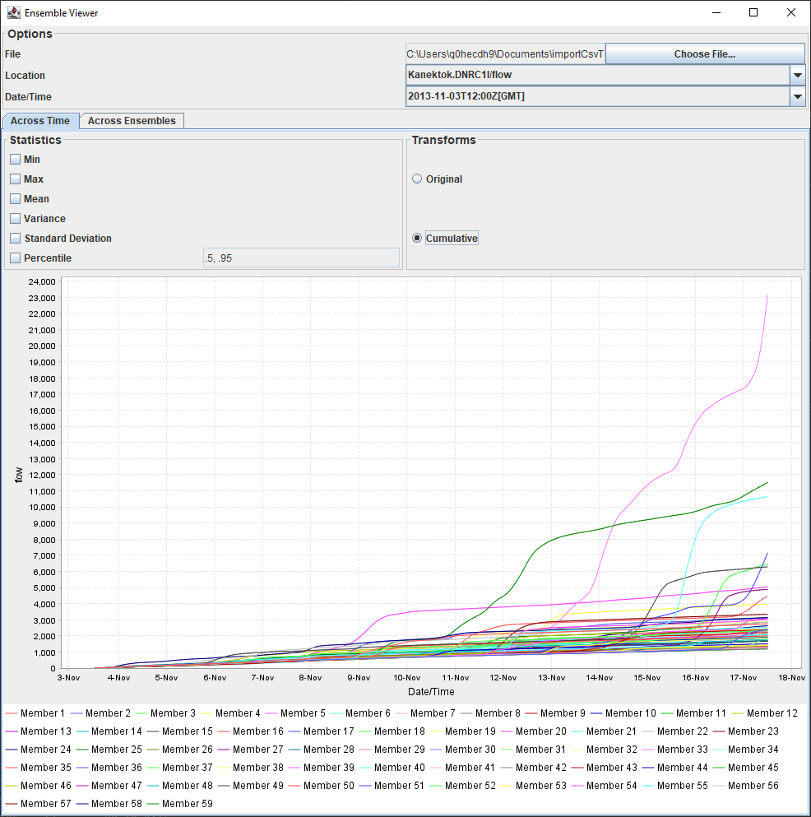
Ensemble Viewer
Original Time Series
Cumulative Time Series

Slide 10
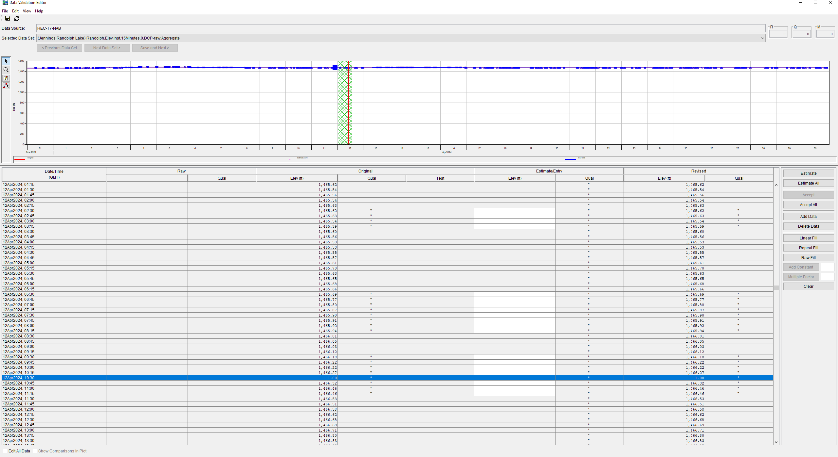
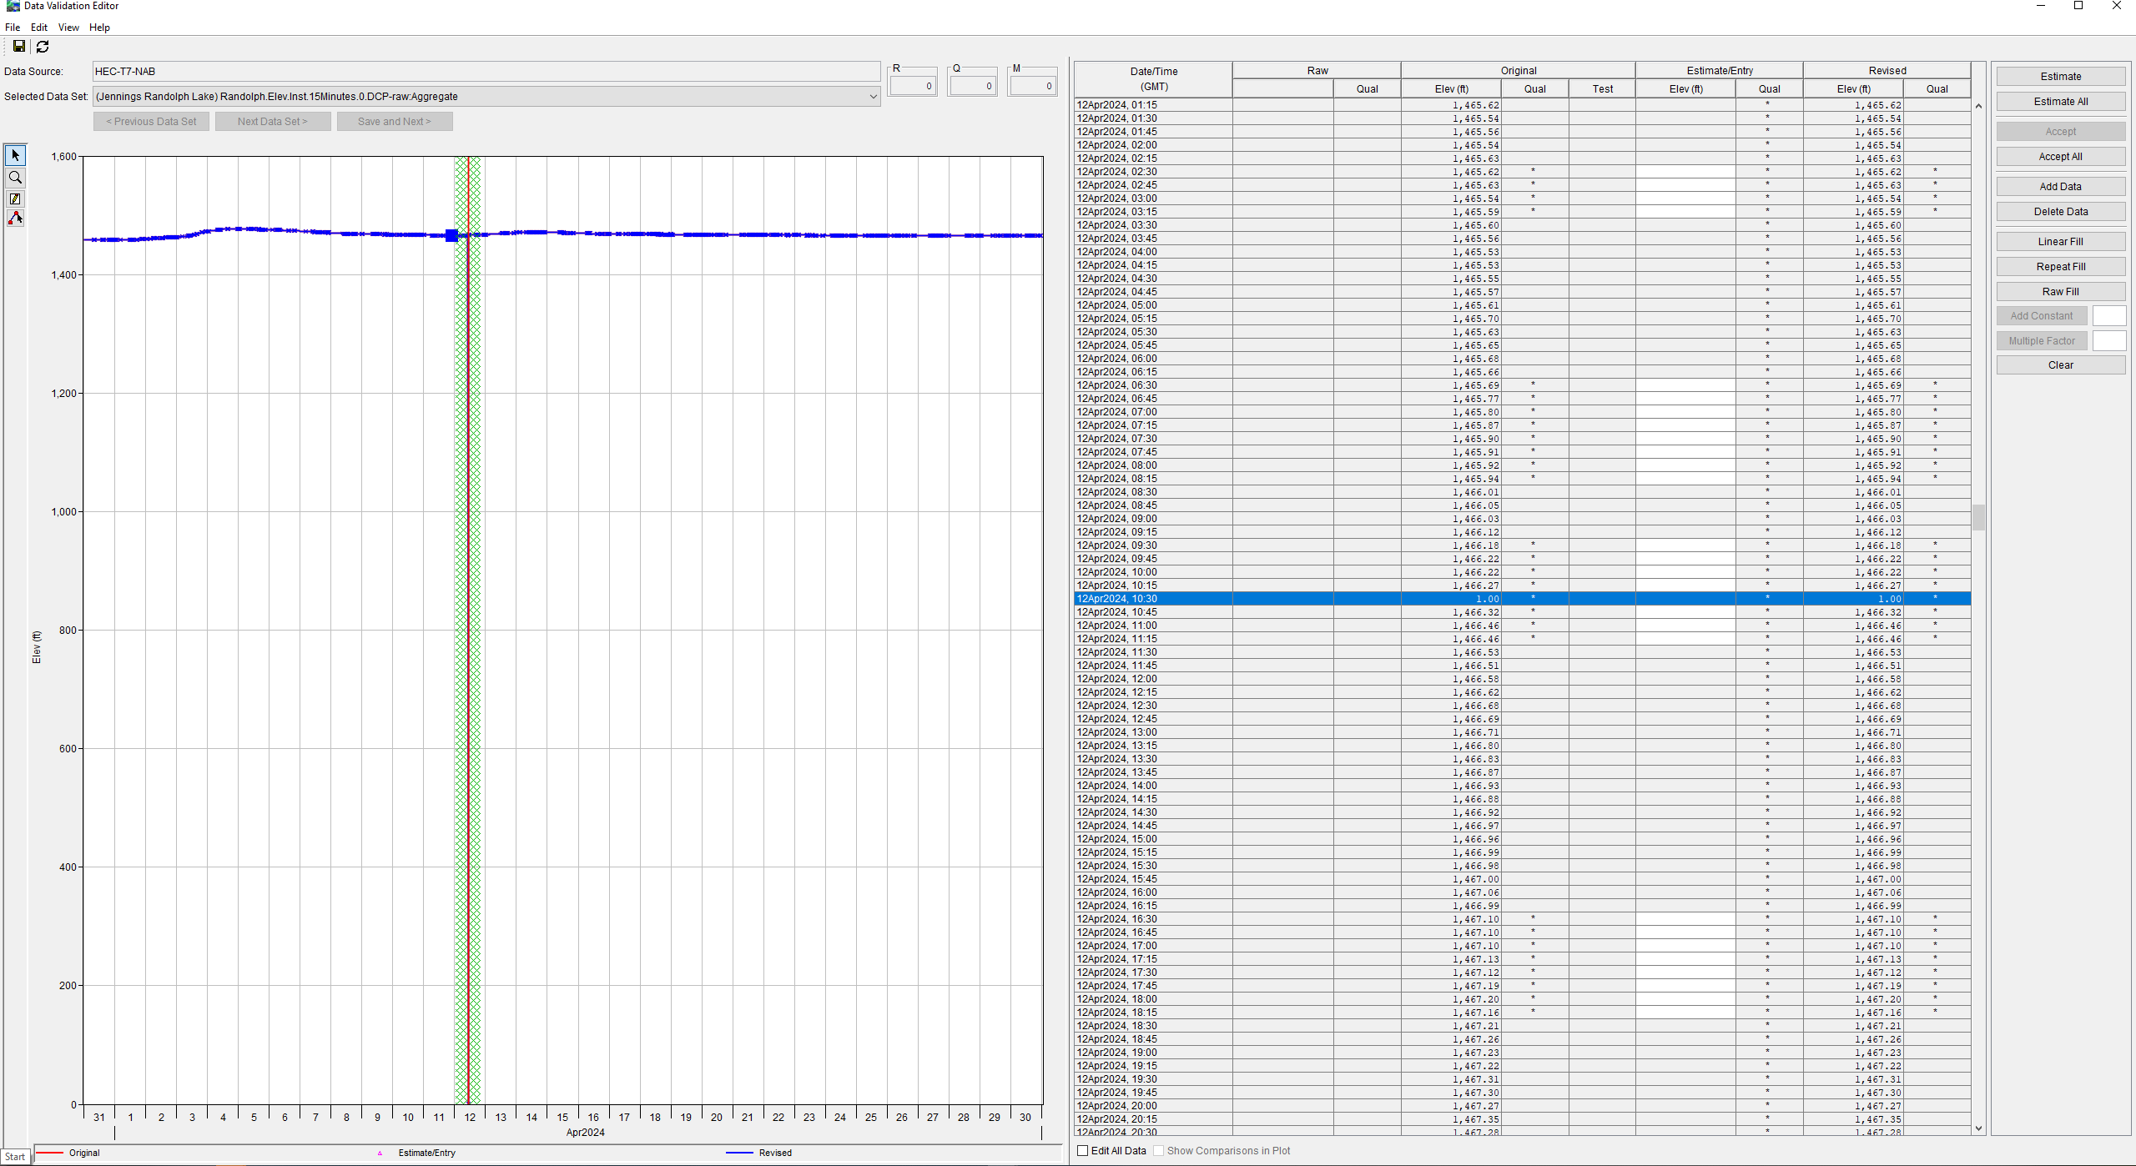
CWMSVue Enhancements
Time Zone labeling in tables, plots, data validation and graphical editors
CWMS Data API (CDA) writes support
Performance enhancements to Data Validation Editor (DVE) writes to the database
Data Validation Editor (DVE) layout shortcut actions improvements
Data Validation Editor
Default Layout
Data Validation Editor
New Vertical Layout Option

Slide 11
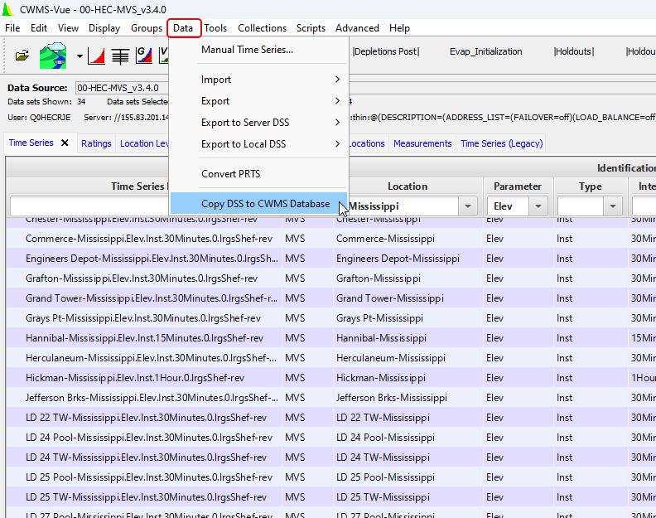
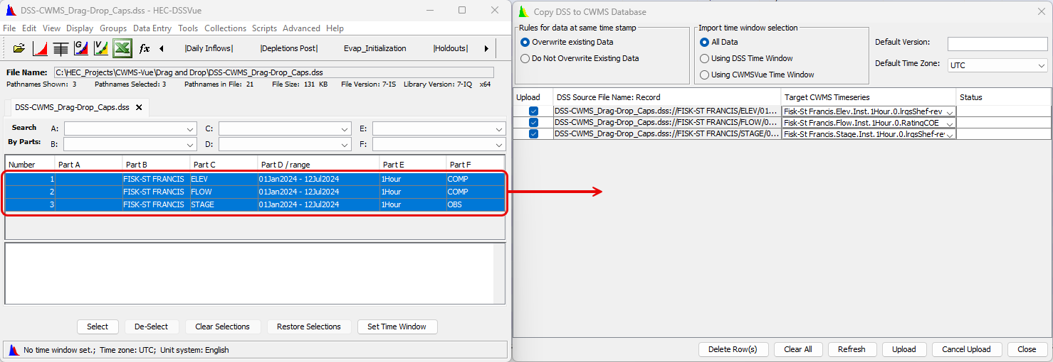
Drag and drop DSS CWMS-Vue
DSS Pathnames must be in all Caps for
DSS records must have proper time zones

Slide 12
Questions Help additional Training
https://usace.dps.mil/sites/KMP-WM/SitePages/Corps-Water-Management-System-(CWMS).aspx
https://www.hec.usace.army.mil/confluence/cwmsdocs
https://discourse.hecdev.net/c/cwms/5
TDL-CELRH-EC-GW-W-USACE CWMS Modeling | General | Microsoft Teams

