Slide 1
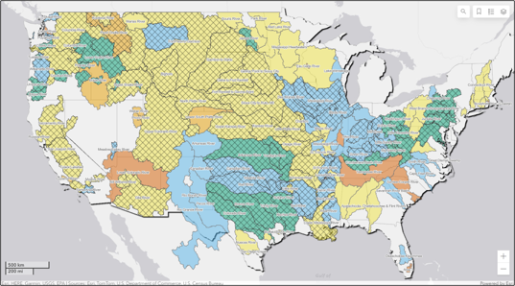

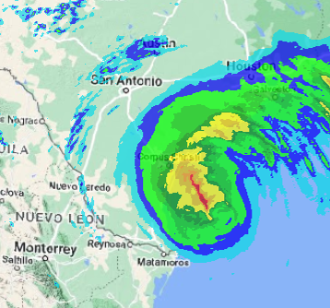
CWMS
New & upcoming Features
Part B – New in CWMS 3.4 (MetVue/HMS/ResSim/FIA)
Fauwaz Hanbali
Hydrologic Engineering Center
CWMS Prospect Course

Slide 2


Outline
  New in CWMS 3.4
    CAVI
    CWMSVue
    HEC-MetVue
    HEC-HMS
    HEC-ResSim
    HEC-FIA
  Upcoming Features

Slide 3

HEC-MetVue Enhancements
  Cumulus Plugin
  Zone Creation Editor
  Zonal Adjustments Editor
  Temporal Editing of Grids through the Dynamic Time Window Scanning Tool
  Edits Tracking Tool

Slide 4
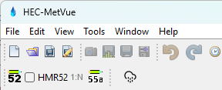
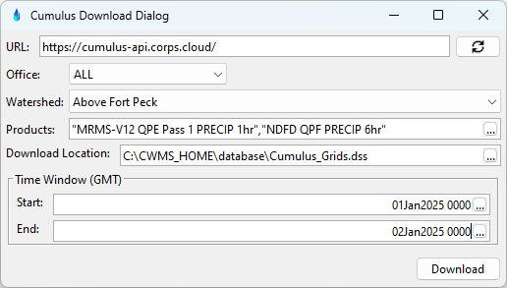
HEC-MetVue Cumulus Plugin
  Available only for USACE as part in the CWMS package
  Ad hoc daily downloads to local database

Slide 5
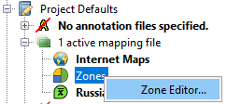
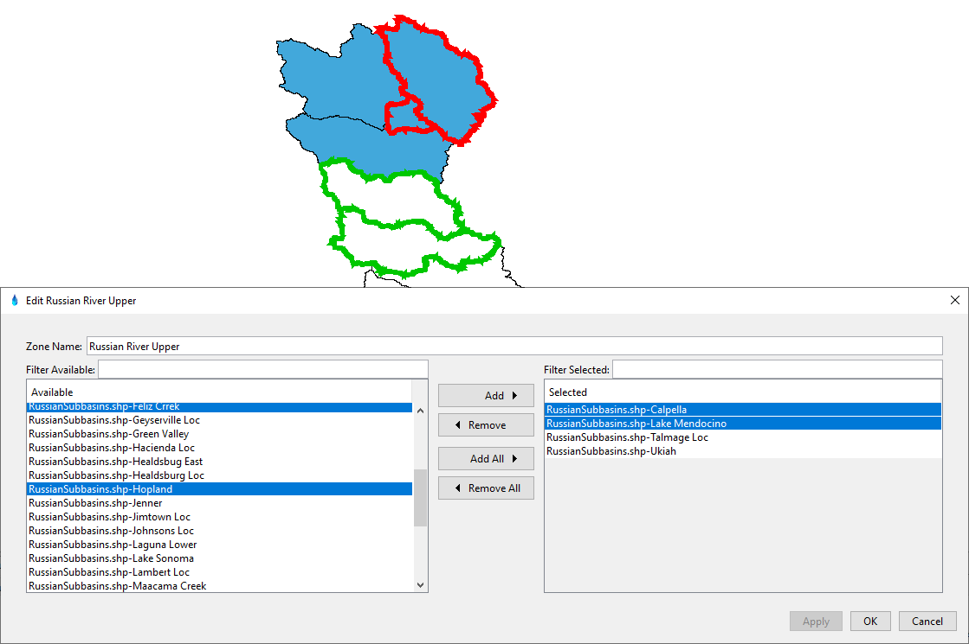
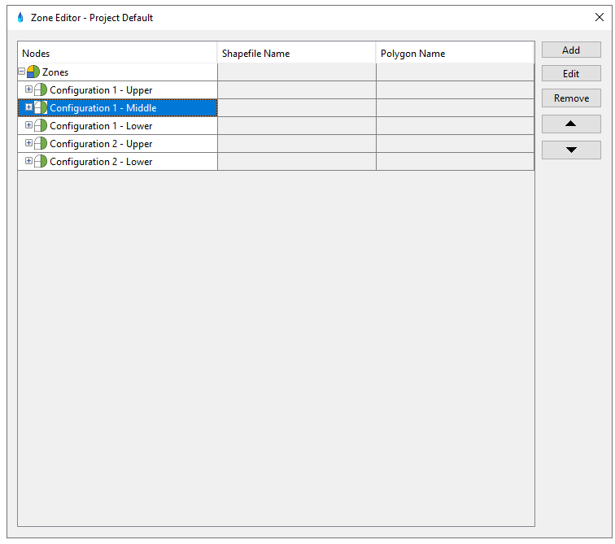
HEC-MetVue Zone Creation Editor
  Grouping basins through the editor or direct selections in the map

Slide 6
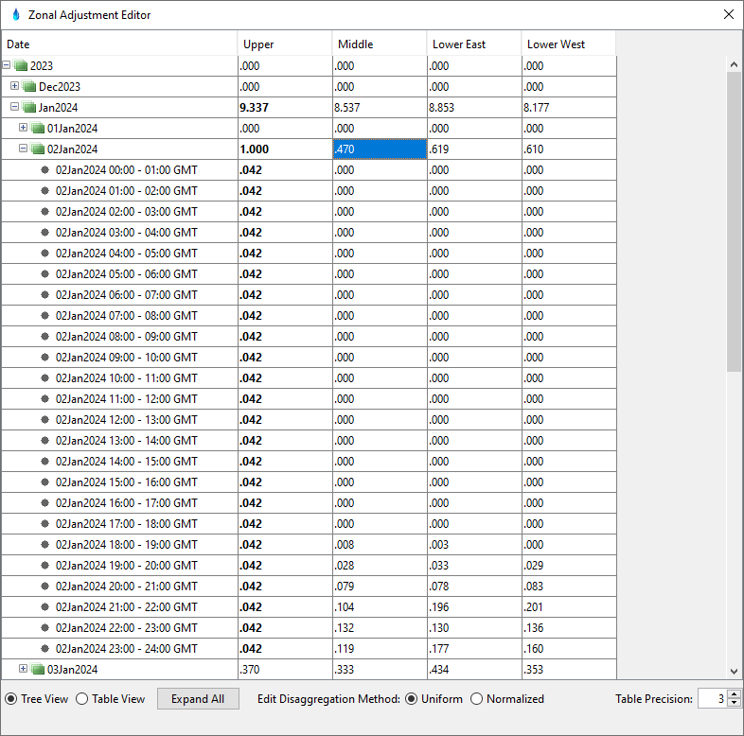
HEC-MetVue Zonal Adjustments Editor
  Uniform Adjustments
  Normalized Adjustments
    Maintains temporal precipitation pattern

Slide 7
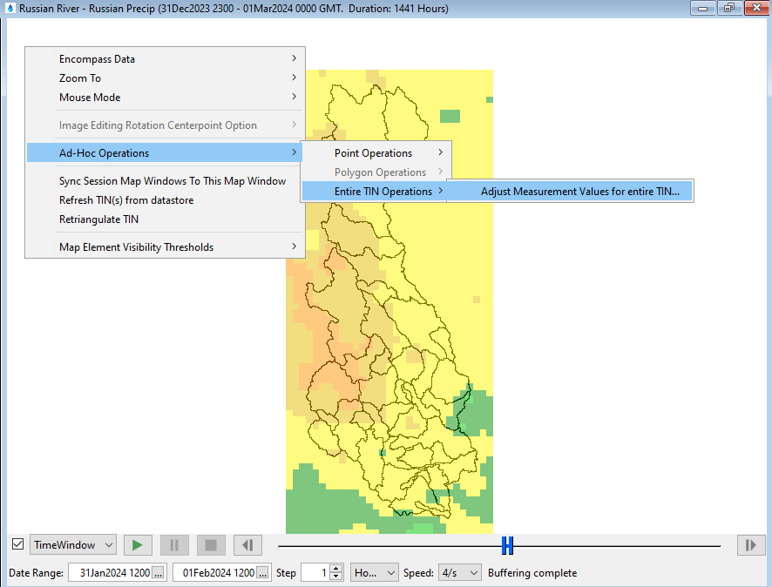
HEC-MetVue Temporal Editing of Grids
Dynamic Time Window Scanning Tool
  Single time interval
    Editing an individual grid
  Range of time intervals
    Editing multiple grids
    Uniform Disaggregation based on data type

Slide 8
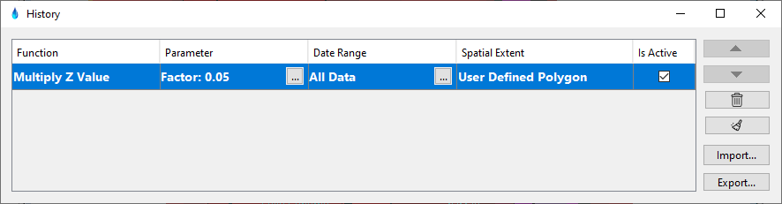
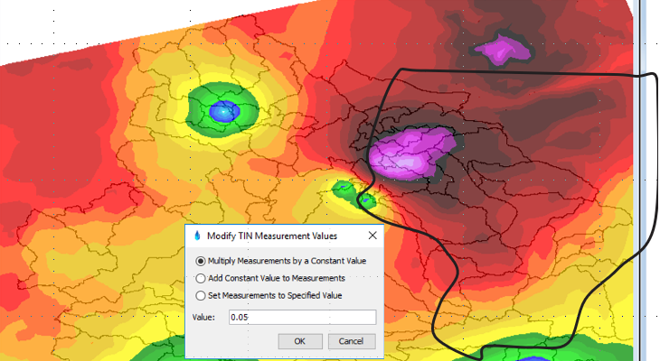
HEC-MetVue Edits Tracker Tool
  Track edits
    Adjust, undo, redo, or clear edits
  Export text report for documenting edits
  Export JSON script for importing and recreating edits later

Slide 9

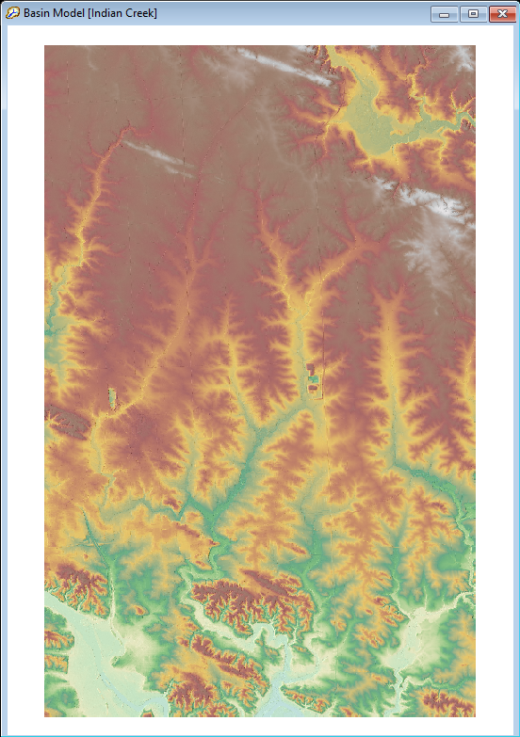
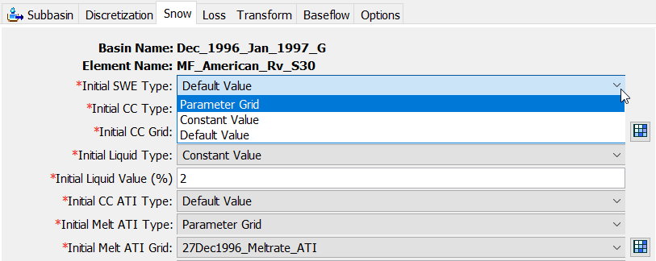
HEC-HMS Enhancements
Improved terrain data management
  Single terrain file association with all basin models
New infiltration method
  Linear Deficit and Constant Loss
Variable ModClark options
“Default Values” and “Constant Value” are available for initializing gridded temperature index snow method

Slide 10

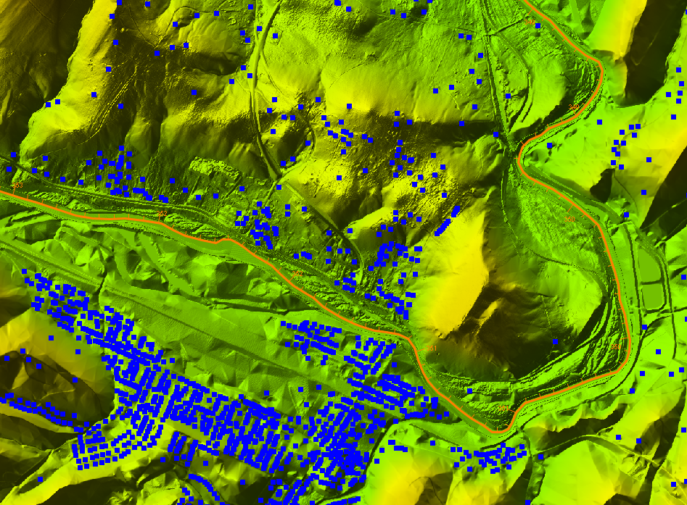
HEC-FIA Enhancements
  RAS-FIA (HDF5) Inundation Configuration and improved Model Linking in the CAVI
    Regulated
    Unregulated
    Regulated without levee
    Unregulated without levee
  Agricultural Flood Damages Reduced Analysis
  RAS Mapper Access from within HEC-FIA

Slide 11


Cloud Migration
Legacy
Migration
Cloud Optimized
FY22-FY25
FY26-FY28
CPC
CWBI CLOUD
T7
Office A
T7
Office B
Built-in COOP
Cloud Databases
More
Web Apps
Postgres
Time Series
Oracle
COOP
Postgres
Data &
Modeling
Dashboards
Cumulus
Grids
Data processing
TBD
Data Dissemination
A2W
Model Library
Cloud Compute
User A
User B
User A
User B
User
User
CAVI
CAVI
CAVI
CAVI
CAVI
CAVI &/or Browser

Slide 12
Questions
Help additional Training
https://usace.dps.mil/sites/KMP-WM/SitePages/Corps-Water-Management-System-(CWMS).aspx
https://www.hec.usace.army.mil/confluence/cwmsdocs
https://discourse.hecdev.net/c/cwms/5
TDL-CELRH-EC-GW-W-USACE CWMS Modeling | General | Microsoft Teams

