Slide 1
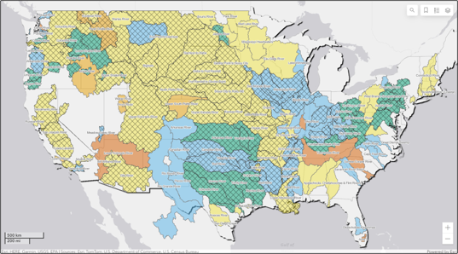

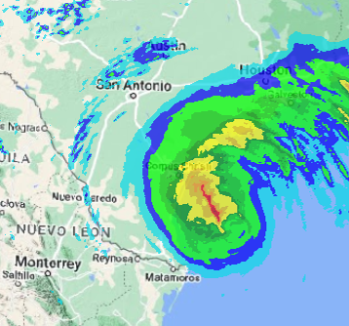
CWMS New & upcoming Features
Part C – Upcoming features
Fauwaz Hanbali
Hydrologic Engineering Center
CWMS Prospect Course

Slide 2


Outline
New in CWMS 3.4
CAVI
CWMSVue
HEC-MetVue
HEC-HMS
HEC-ResSim
HEC-FIA
Upcoming Features

Slide 3
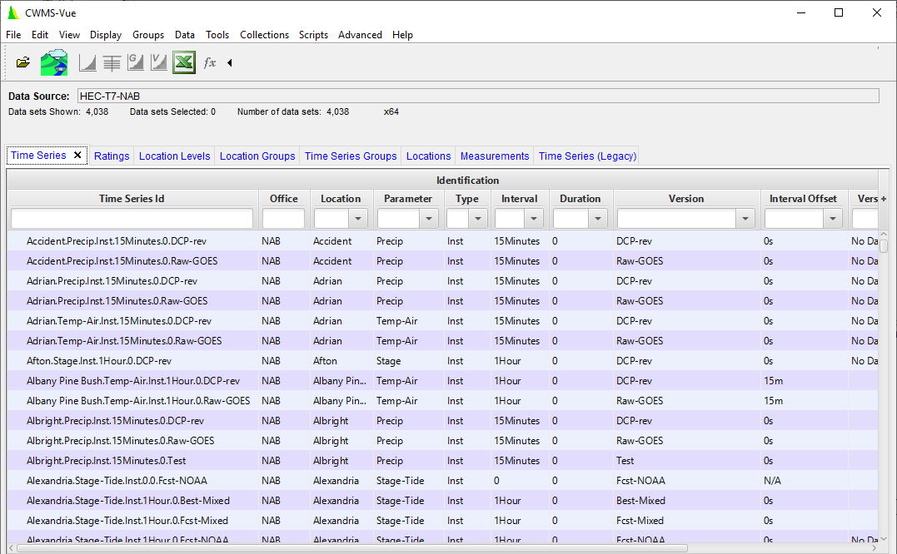
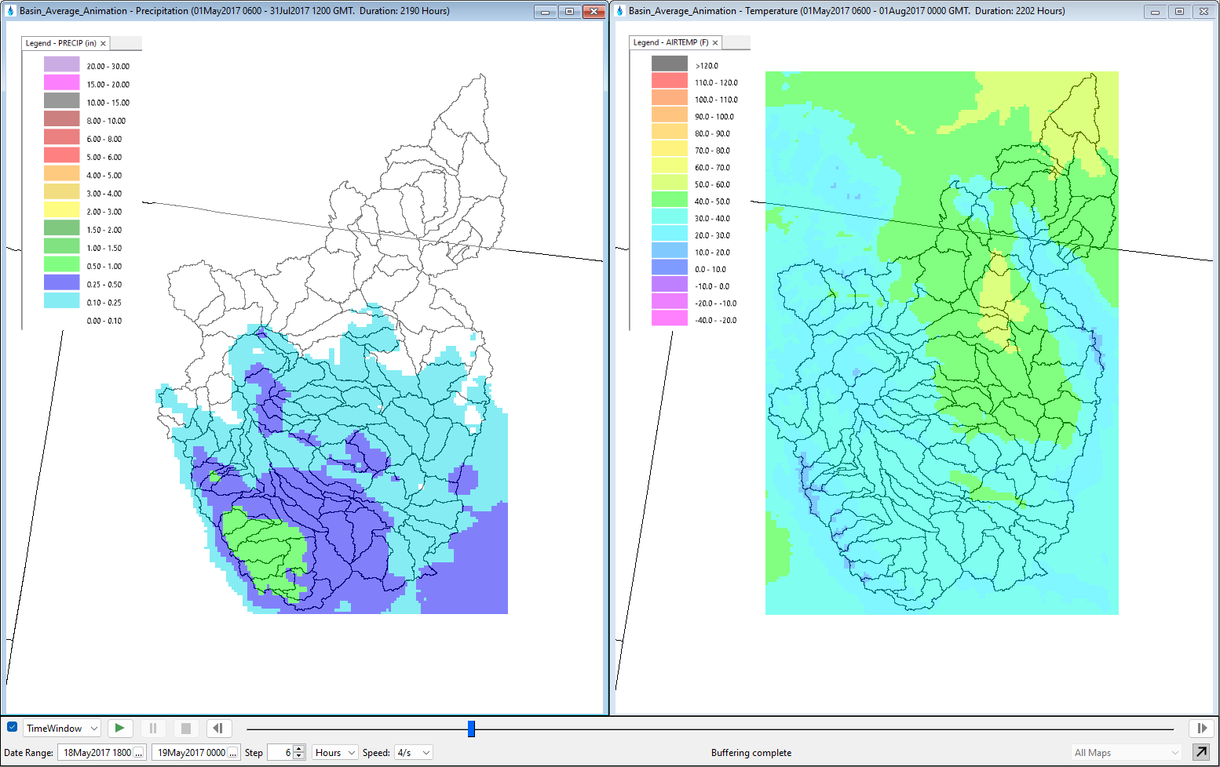
CWMS 3.5
CWMSVue 4.0
Faster Loading of tabs/catalogues
Standalone release
CAVI 3.5
MFP and Data Exchange Retirements
HEC-MetVue 3.4
Basin Average Layer support in Animation
Synced Map Windows Animation

Slide 4
CWMS 3.6 OR Beyond
CAVI
Login updates to support single sign on to CWMS (CDA & Cumulus) web services
Extract Editor support for paired data and versioned time series
HEC-MetVue
MetInterp and Ensemble Alternatives
Basin Average layer Scaling
Animation Video Recorder
HEC-HMS
Ensemble and Optimization Alternatives
Check box for Blending
Observed Inflow/Outflow/Storage for Reservoirs
HEC-ResSim
OSI on-the-fly editor for irregular and daily overrides
Gates overrides
CAVI Cloud Compute
Cloud Compute Instructions and Execution Actions from the CAVI
Initially support HEC-MetVue, HEC-HMS, and HEC-ResSim
Alternatives to Jython scripting

Slide 5


Cloud Migration
Legacy
Migration
Cloud Optimized
FY22-FY25
FY26-FY28
CPC
CWBI CLOUD
T7
Office A
T7
Office B
Built-in COOP
Cloud Databases
More
Web Apps
Postgres
Time Series
Oracle
COOP
Postgres
Data &
Modeling
Dashboards
Cumulus
Grids
Data processing
TBD
Data Dissemination
A2W
Model Library
Cloud Compute
User A
User B
User A
User B
User
User
CAVI
CAVI
CAVI
CAVI
CAVI
CAVI &/or Browser

Slide 6
Questions Help additional Training
https://usace.dps.mil/sites/KMP-WM/SitePages/Corps-Water-Management-System-(CWMS).aspx
https://www.hec.usace.army.mil/confluence/cwmsdocs
https://discourse.hecdev.net/c/cwms/5
TDL-CELRH-EC-GW-W-USACE CWMS Modeling | General | Microsoft Teams

