Slide 1
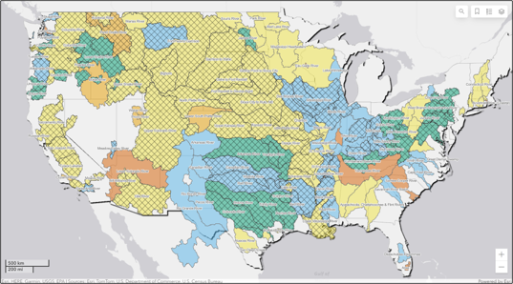

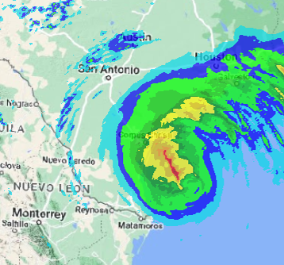
HEC-MetVue overview
Fauwaz Hanbali
Hydrologic Engineering Center
CWMS Prospect Course

Slide 2
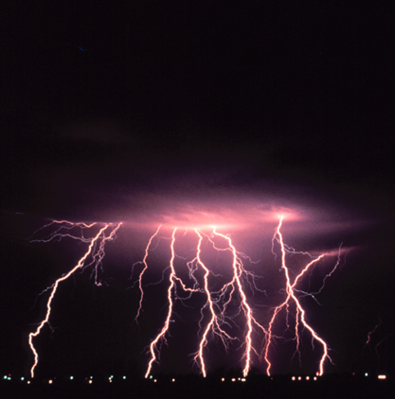
Overview
HEC-MetVue Program Interface
HEC-MetVue Key Features Orientation
HEC-MetVue Interactive and Automated Data Processing and Analysis
HEC-MetVue in CWMS
HEC-MetVue

Slide 3
HEC-MetVue Program Interface

Slide 4
HEC-METVUE Meteorological Visualization Utility Engine

Slide 5
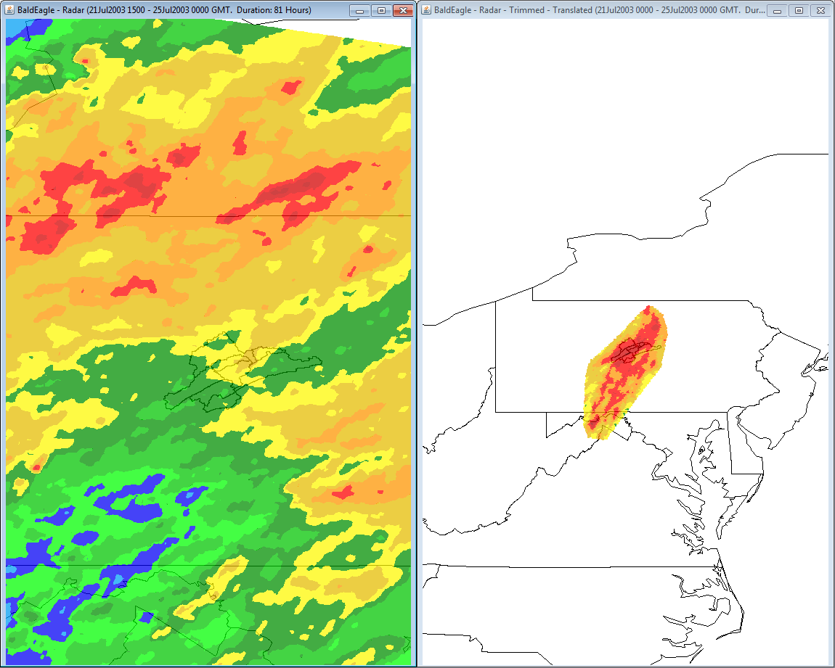
Map Panel Features
Visualization Layers
Contour, Basin Avg., TIN Mesh, Point Measurement, & Gage Interpolation Layers
Interactive zoom:
Encompass Data or background map extents
Previous zoom levels
Map Panel tiling and zoom level syncing
Mouse tracking (point coordinate & value)

Slide 6
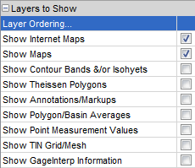
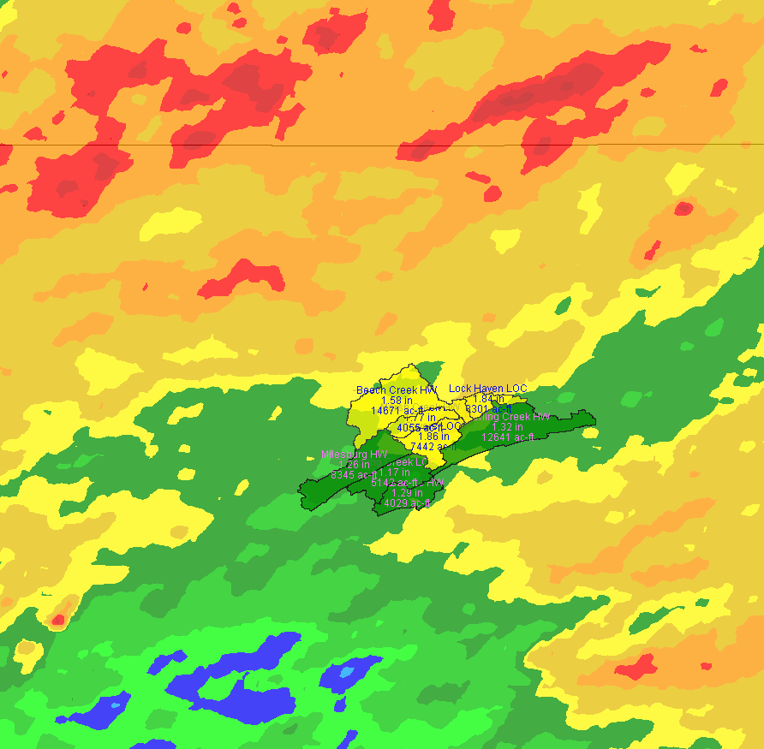
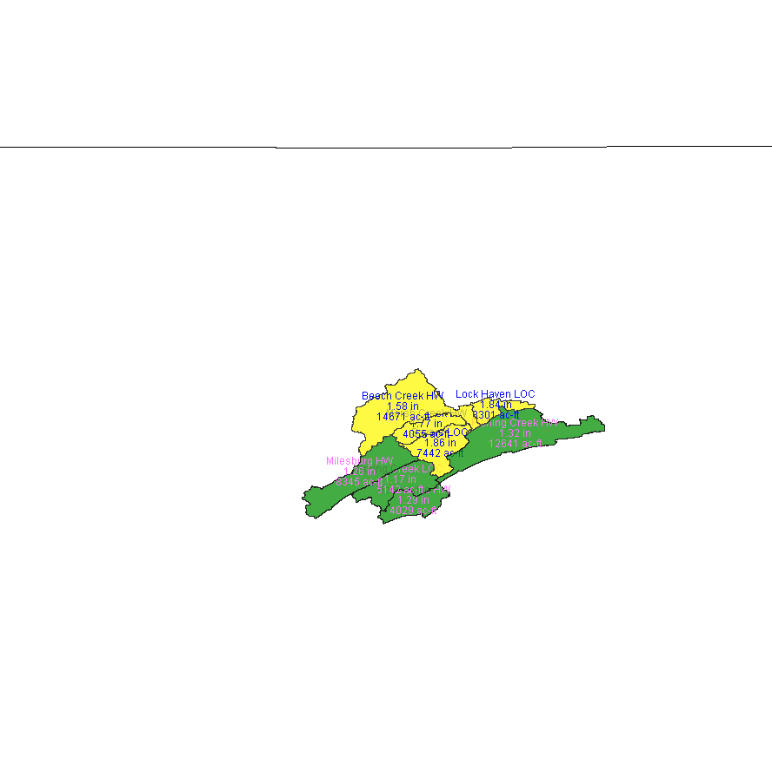

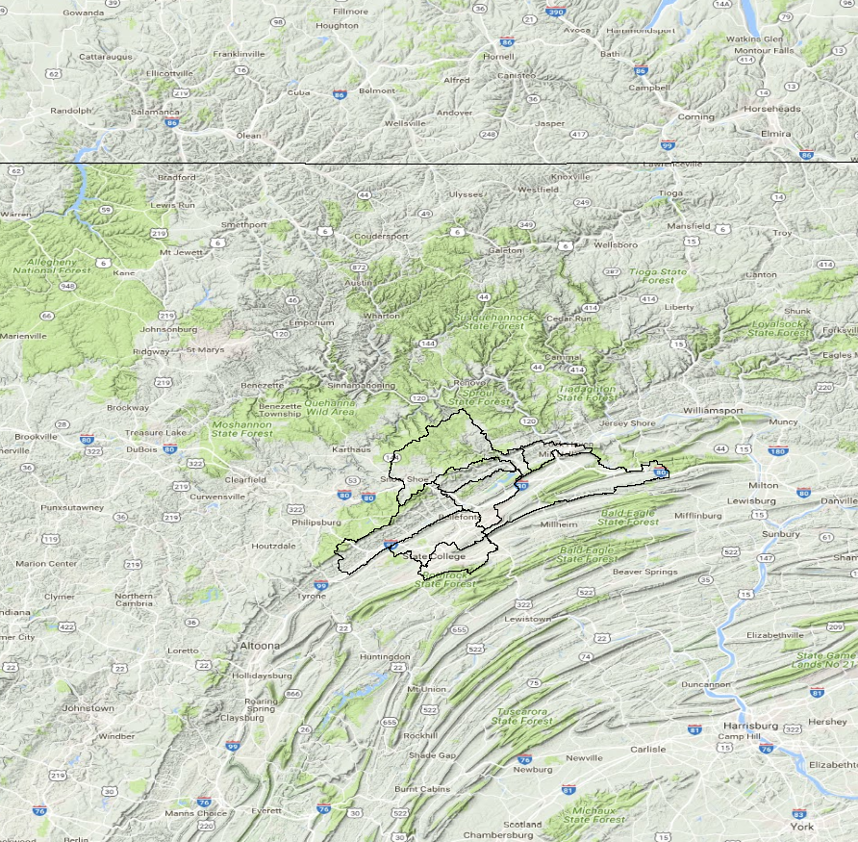
Layer Visualization Options
Contour Layer
Basin Average Layer
TIN Layer
Web Map Layer

Slide 7
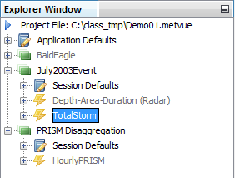
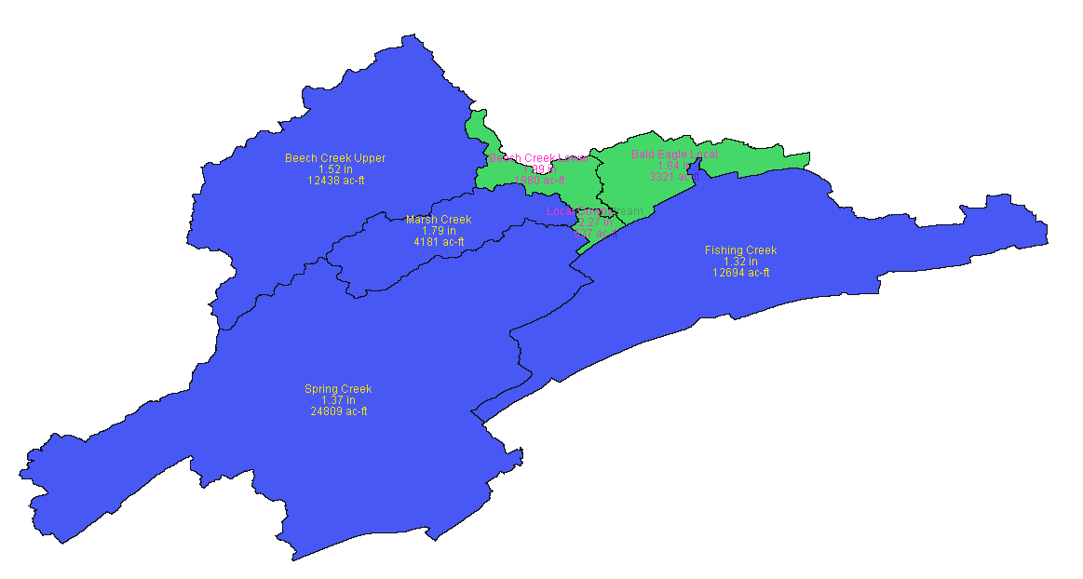
HEC-MetVue File & Data Management
A Project File (*.metvue) is in XML format and contains project configuration and settings information
A Session is the work area for the user to organize work units (Map Windows)
A Map Window is the work unit that contains the information the user views and edits
Session
Session
Map Window

Slide 8
HEC-MetVue Key Features Orientation

Slide 9
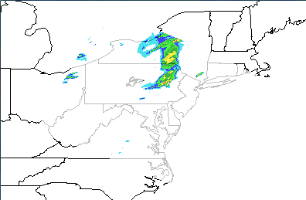
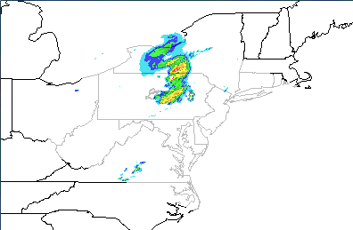
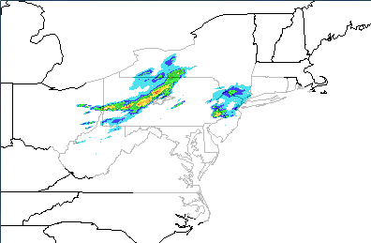
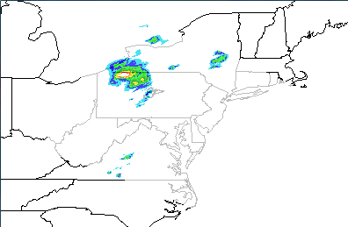
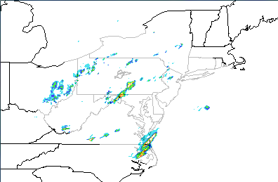
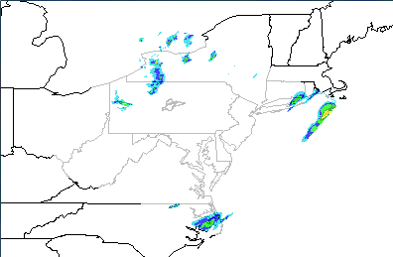
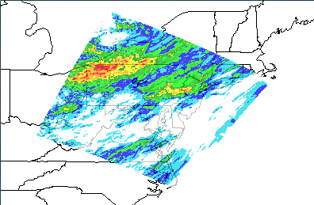
HEC-MetVue Temporal Aggregation
Hourly Radar TINs for N-Hours of Duration
Aggregate TIN for the N-Hours Duration

Slide 10
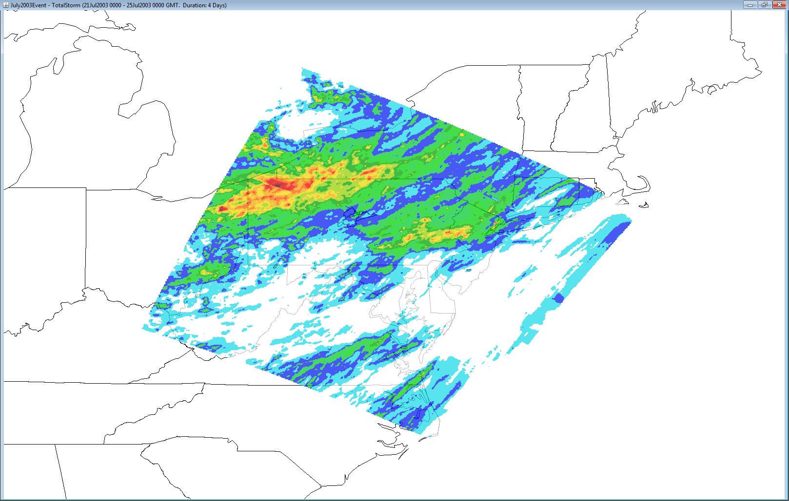
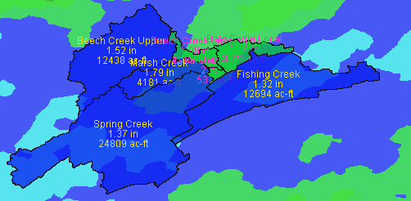
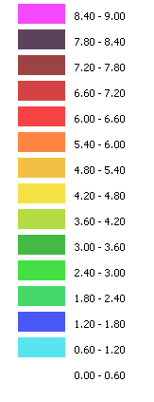
HEC-MetVue Basin Average Computation

Slide 11

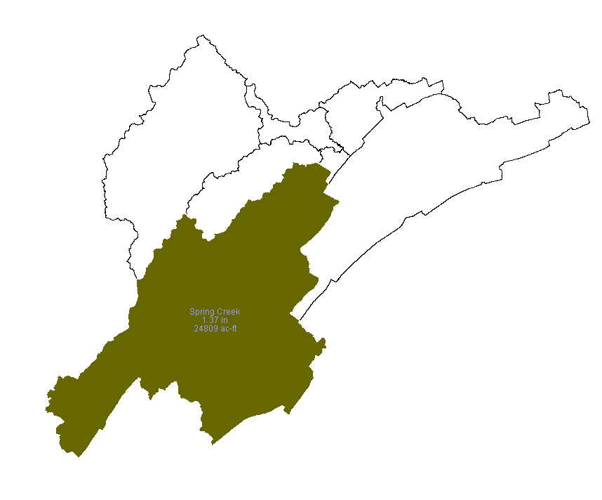
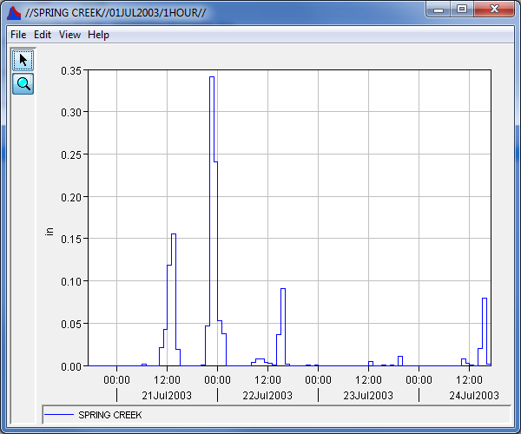
Save Time Series
96 aggregated (Hourly) TINs
21July2003 – 25July2003
Spring Creek
1.37 in
24809 ac-ft

Slide 12

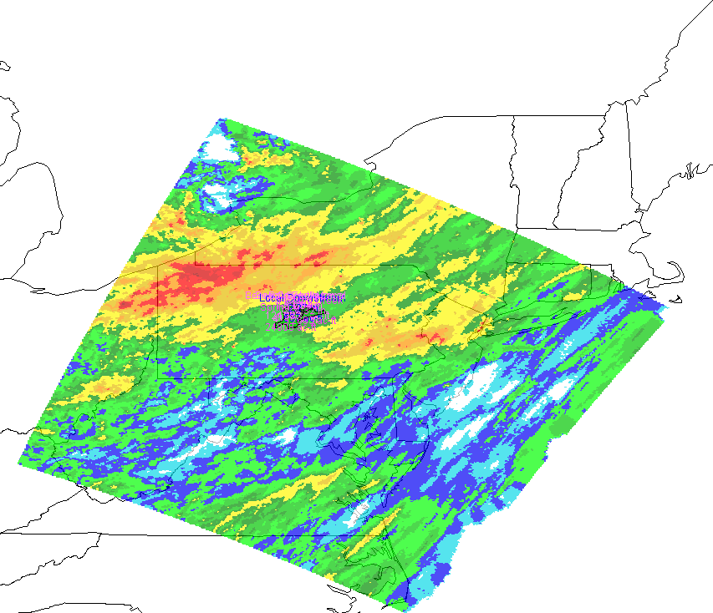
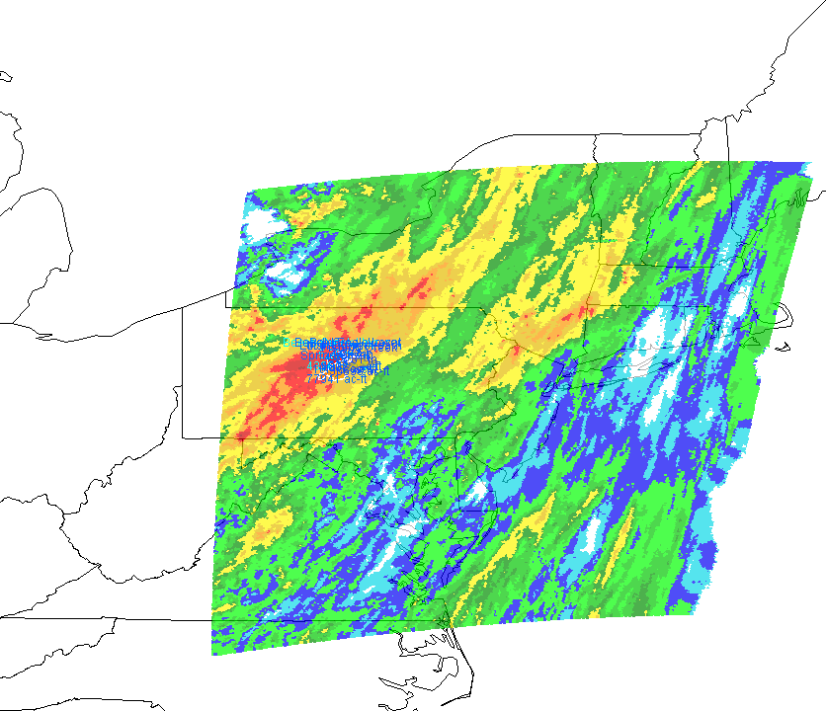
Save Modified Image as a Projection on a Grid
Translating and/or rotating an image will require reprojection of the image for saving the output.
Original Image
Translated and Rotated Image

Slide 13
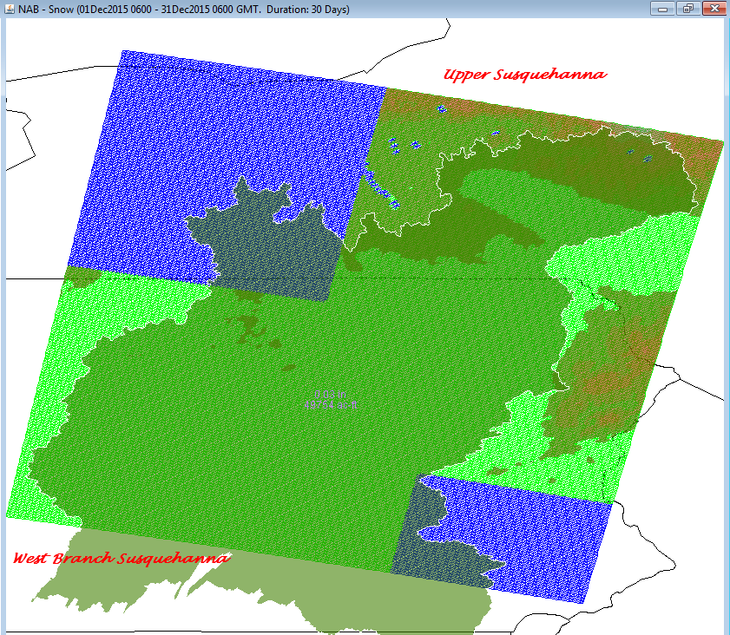
HEC-MetVue Spatial Aggregation

Slide 14


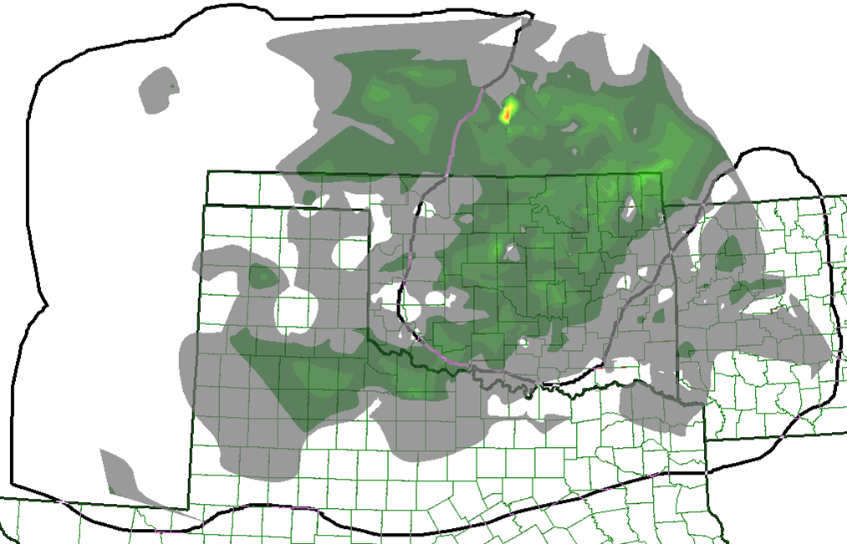
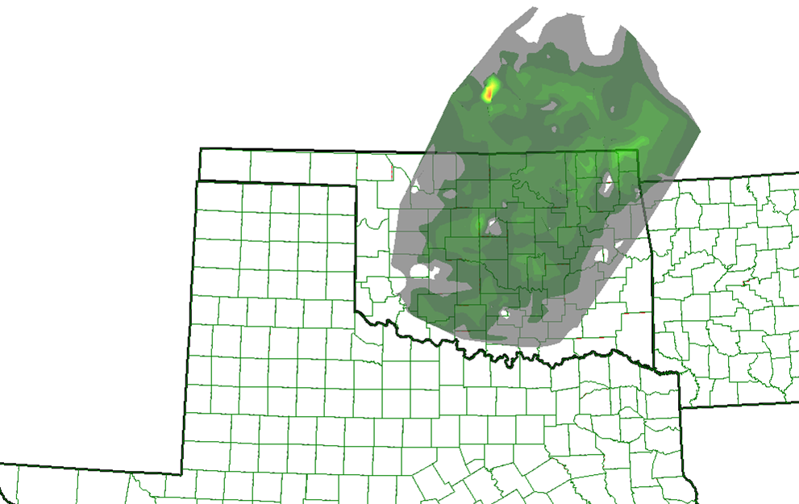
HEC-METVUE Analysis & Manipulation
Refine Storms
Trim & Correct
Translate Storms
Spatially
Temporally
Rotate Storms
Temporally
Scale Storms
Factor & Resize
Animate Storms
Original Image
Trimmed Image

Slide 15
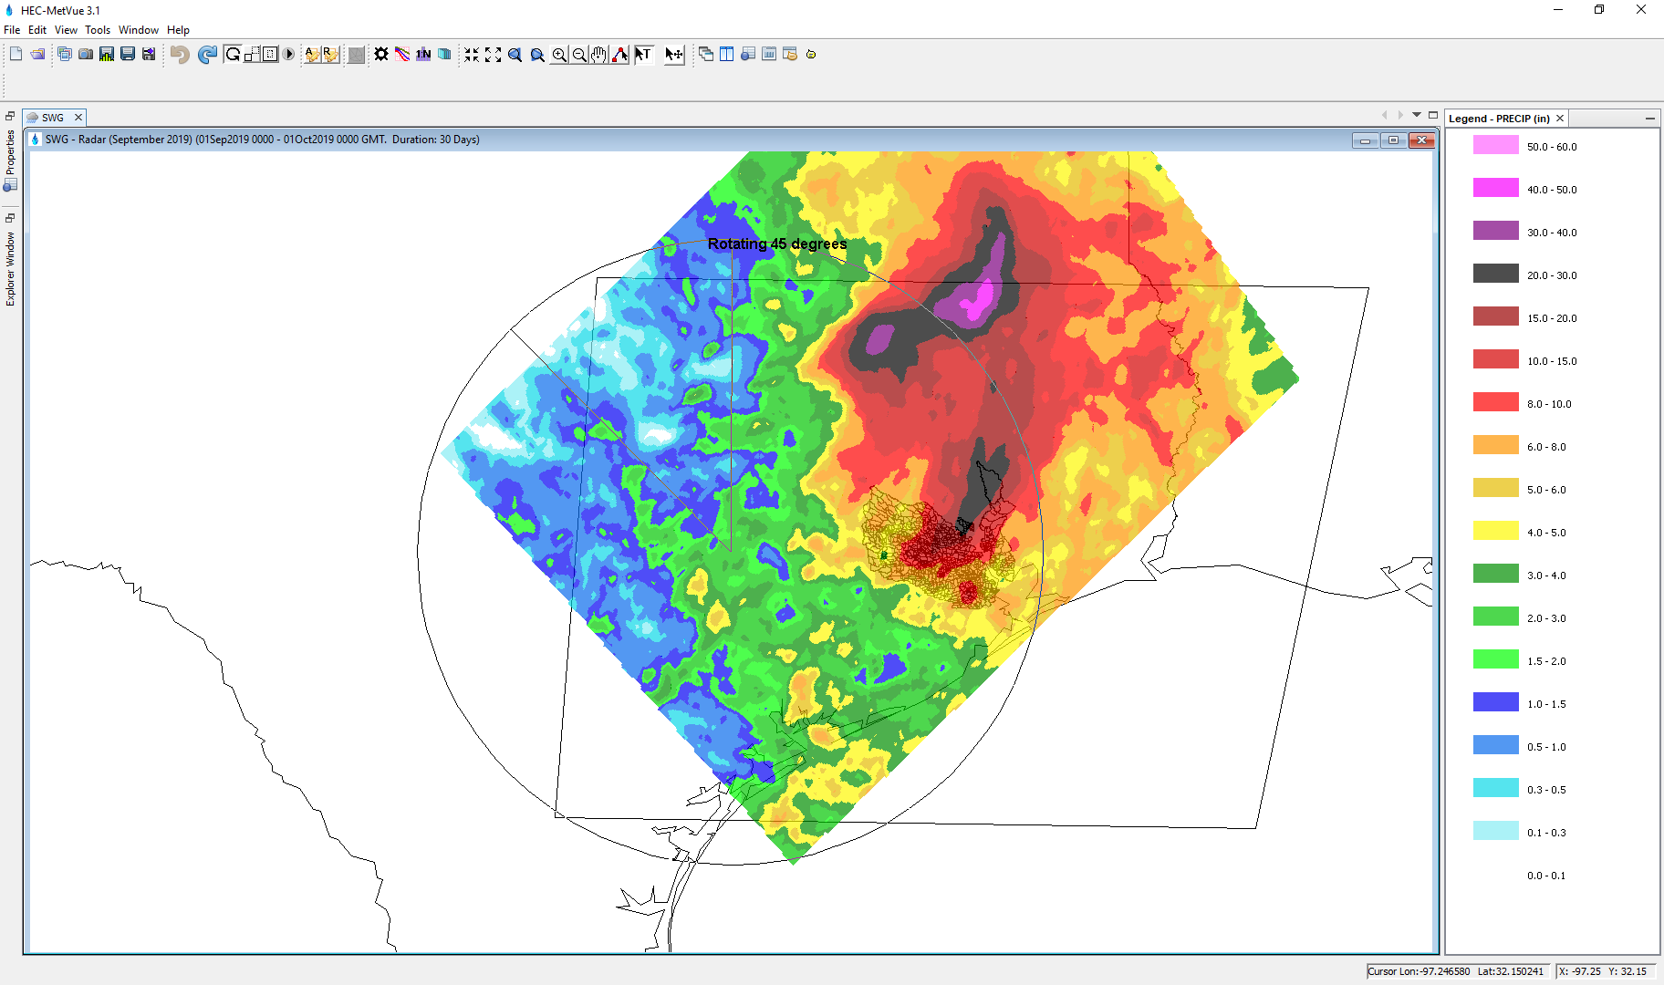
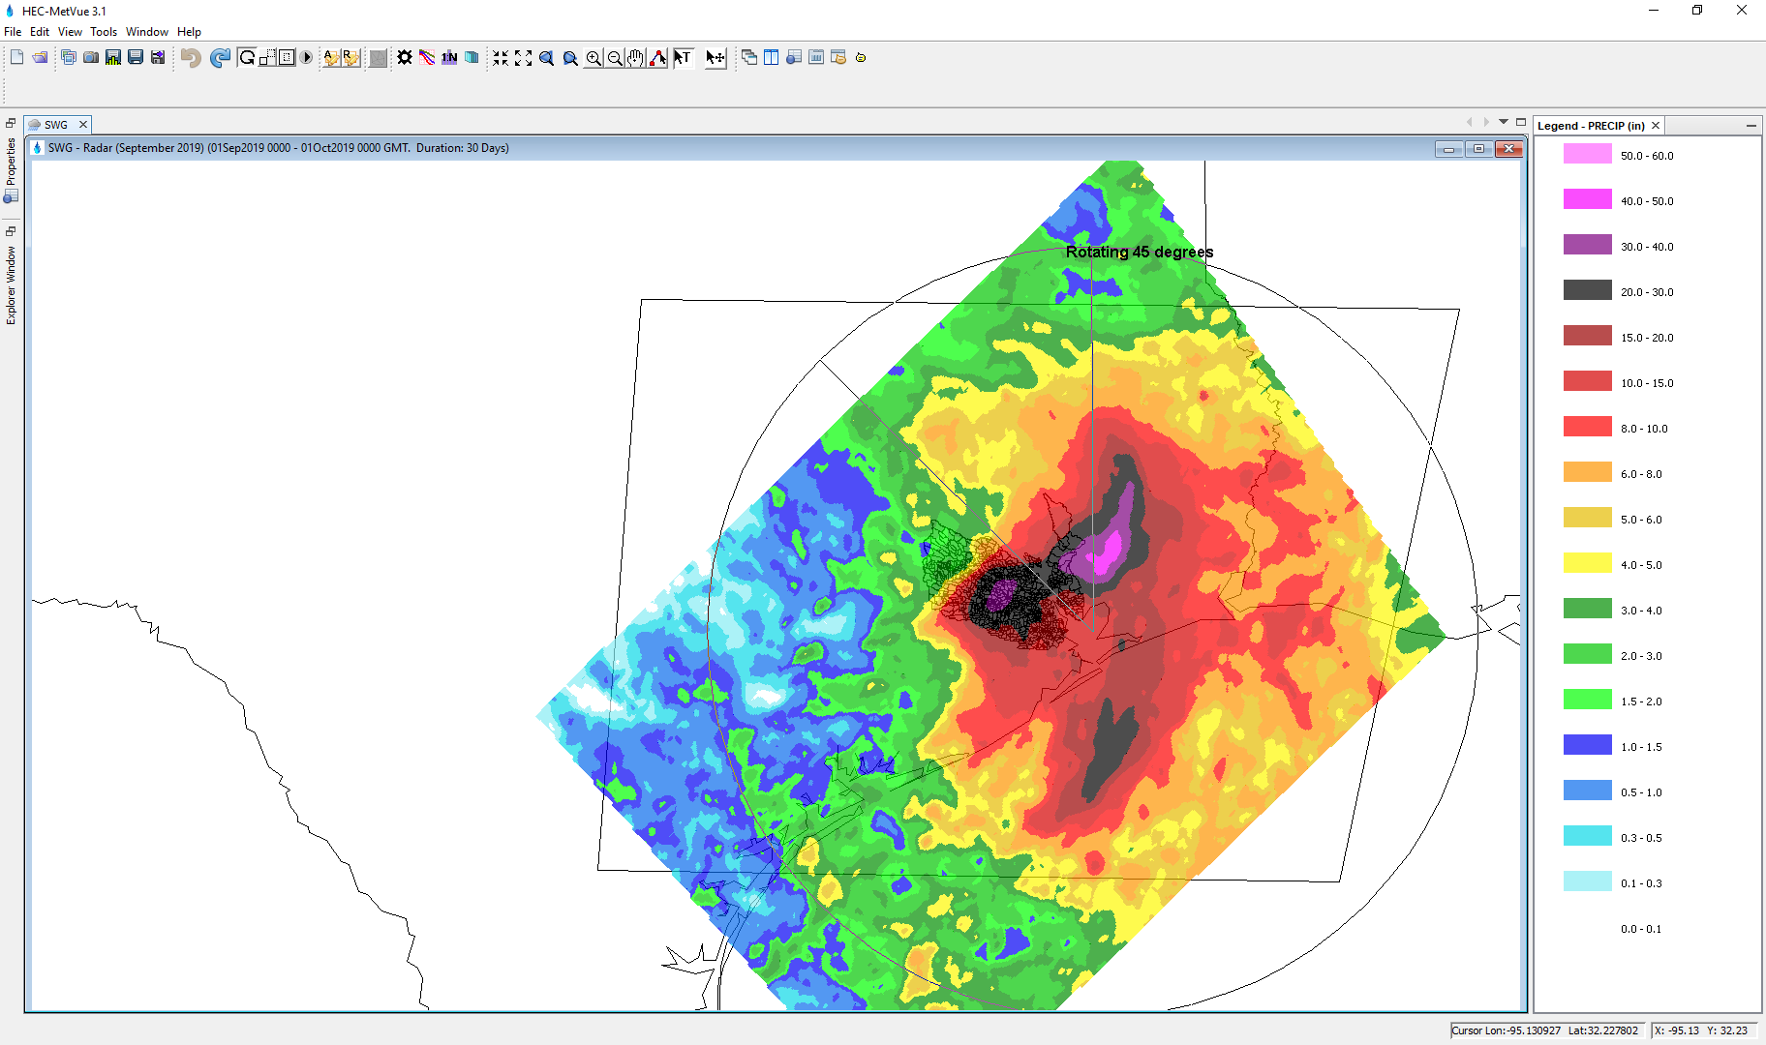
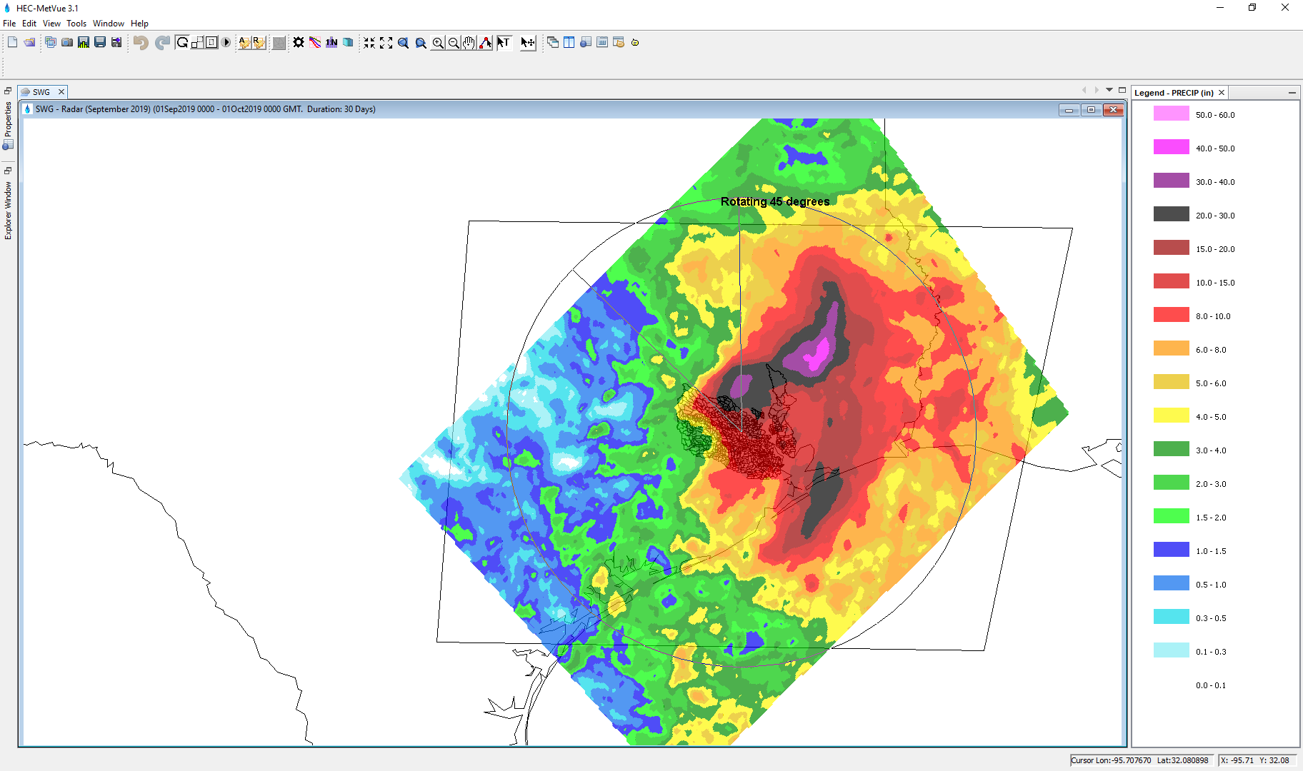
Image Rotation
Map Center
Rotating 45 degrees
TIN Weighted Center
Rotating 45 degrees
TIN Geometric Center
Rotating 45 degrees

Slide 16
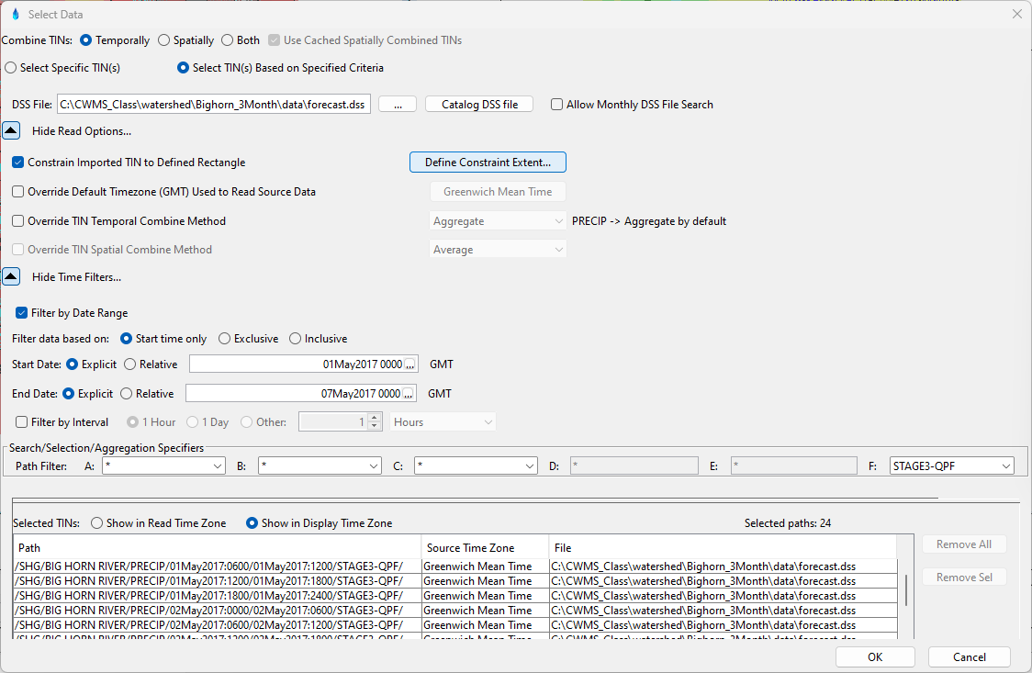
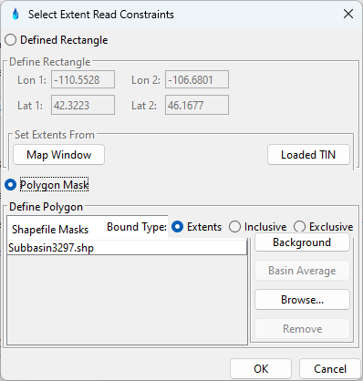
DSS Grid Selection

Slide 17
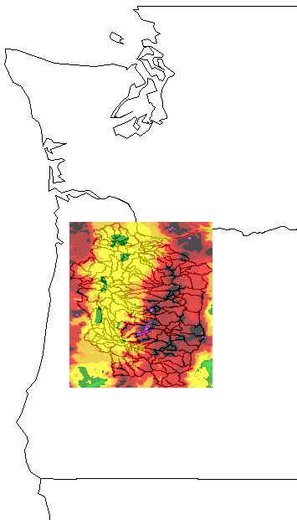
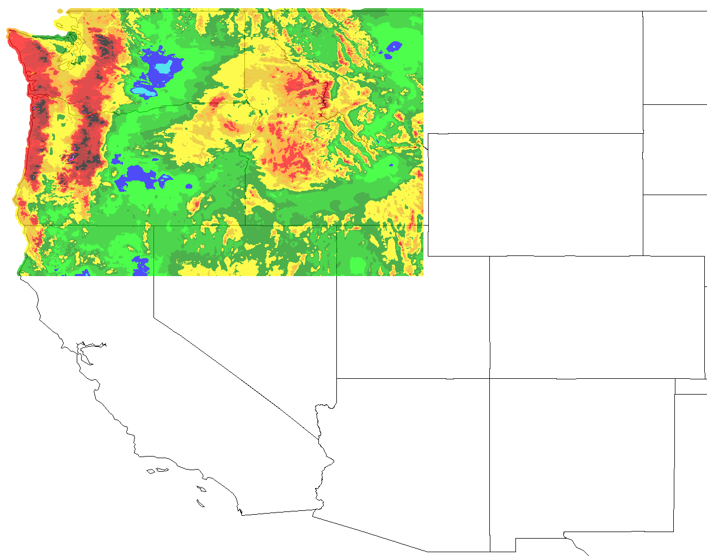
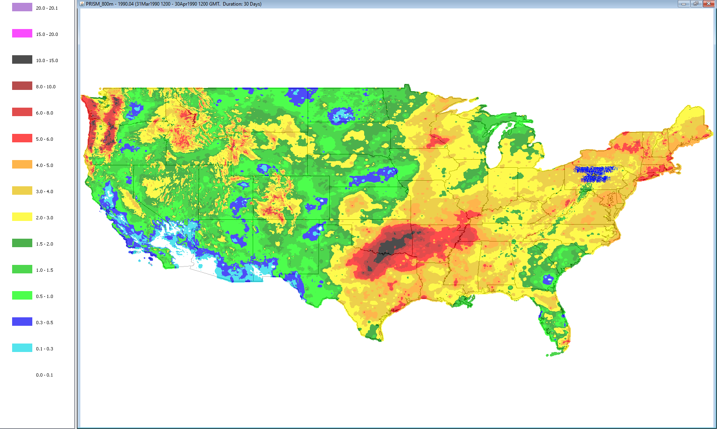
Sample PRISM Data
Polygon
Mask
Defined Rectangle
Mask

Slide 18
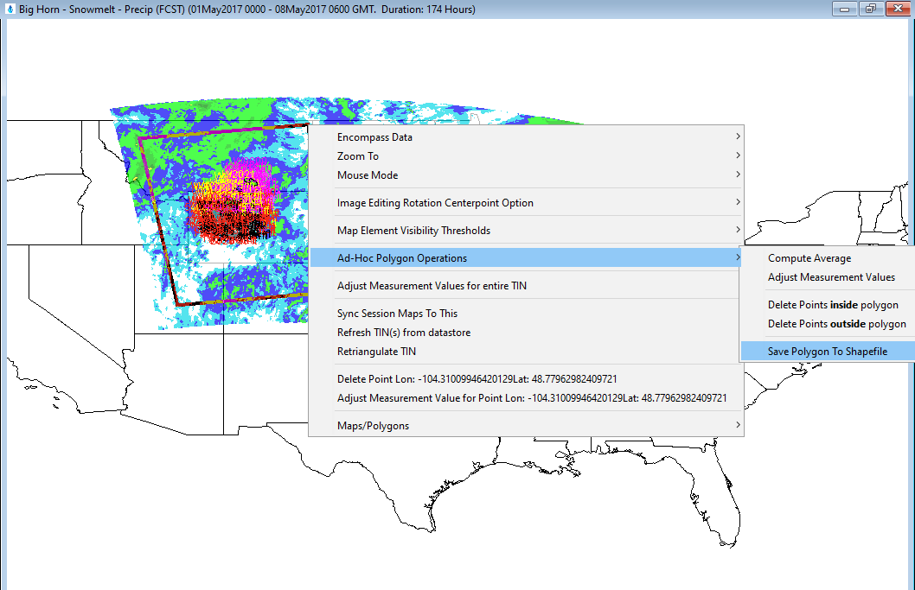
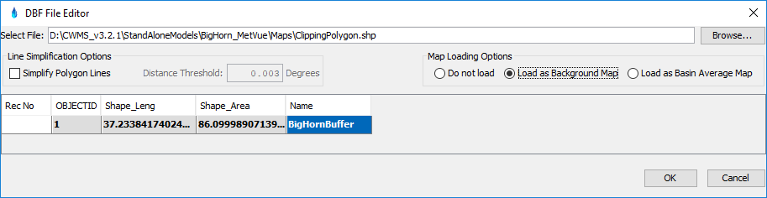
Ad-hoc Polygon Clipping

Slide 19
Time Zone Handling
Input Zone
DSS and other data types typically have Time Zone Information in their metadata.
If input data lacks meta data, PC Time Zone assumed by default, but user can override the time zone setting.
Display Time Zone is a user setting to convert the input dataset’s time zone.
MetVue allows for writing output datasets in any desired time zone.
Input
Display
Output

Slide 20
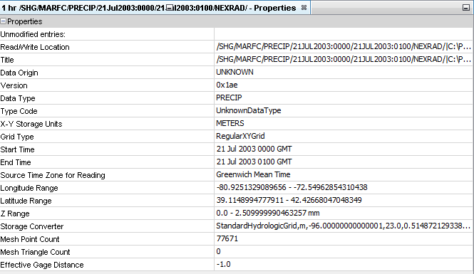
Dataset Meta Data

Slide 21
Supported Meteorological Variables
Precipitation
Temperature
Snow Water Equivalent
Snow Melt
Snow Depth
Liquid Water
Cold Content
Cold Content ATI
Metlrate ATI
Air Pressure
Humidity
Dew Point
Sky Cover
Wind Speed
Wind Direction
Solar Radiation
Sunshine
Energy
Albedo
Evapotranspiration
Moisture Deficit
Percolation Rate
Impervious Area
Crop Coefficient
Storage Capacity
Water Content
Water Potential

Slide 22
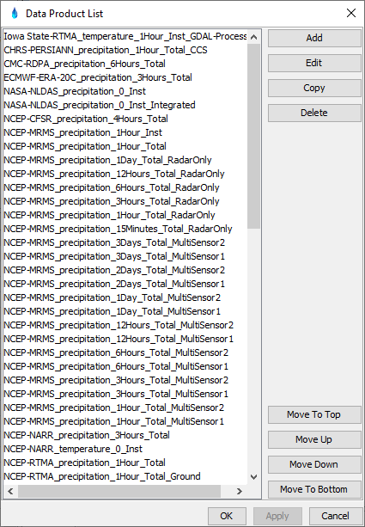
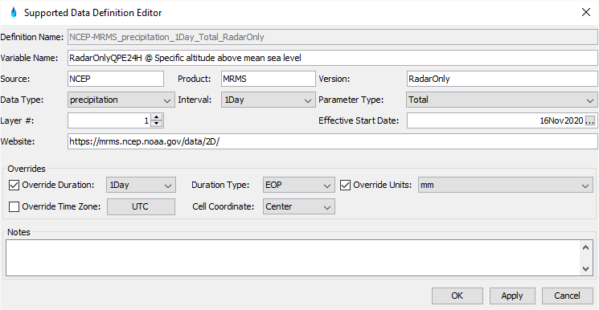
Supported Data Products

Slide 23
Hec-MetVue Interactive and Automated Data Processing

Slide 24
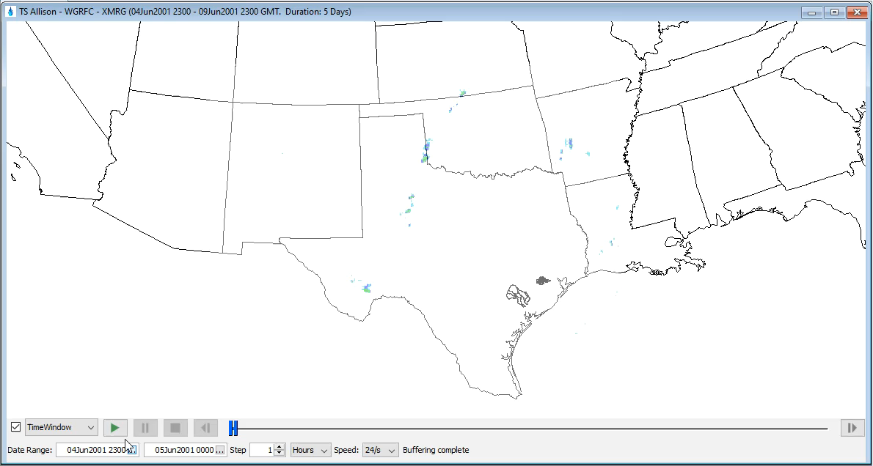
Combined Dynamic Time Window/Animation

Slide 25
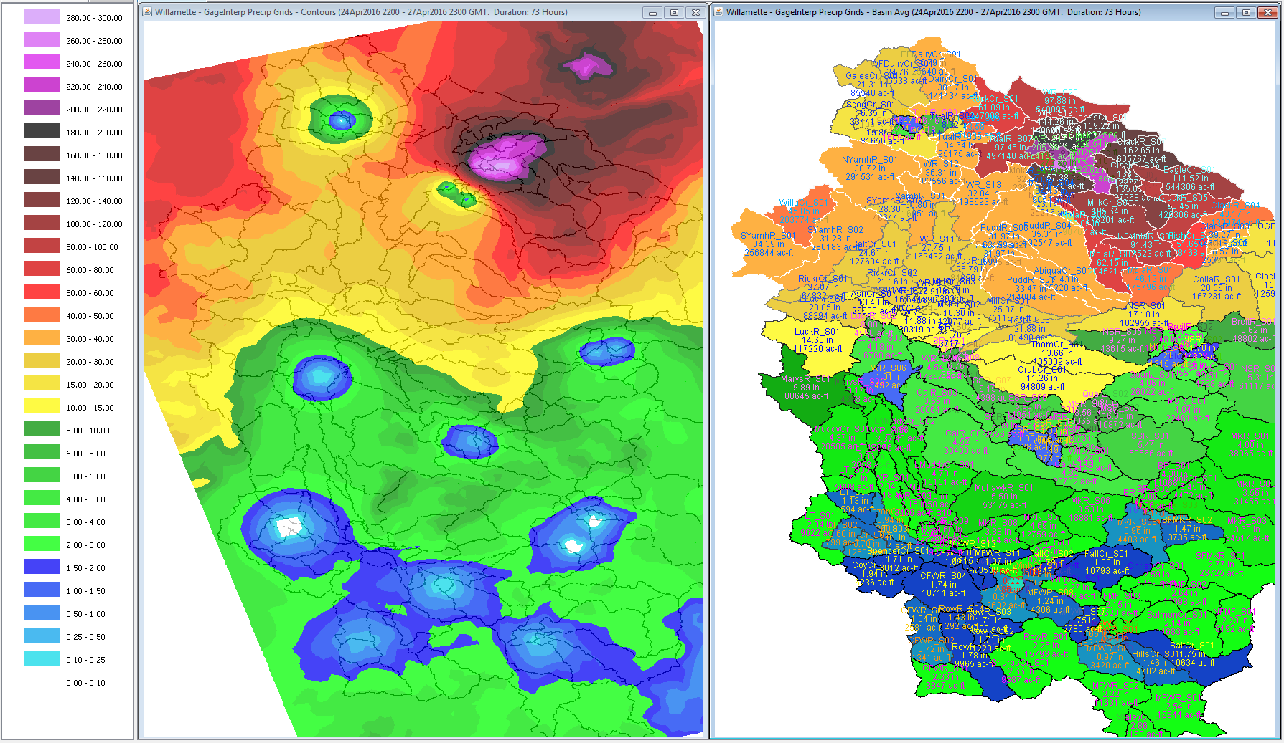
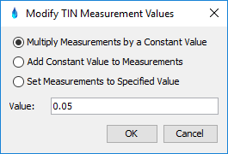
Quality Control of Interpolated Precipitation Grids

Slide 26
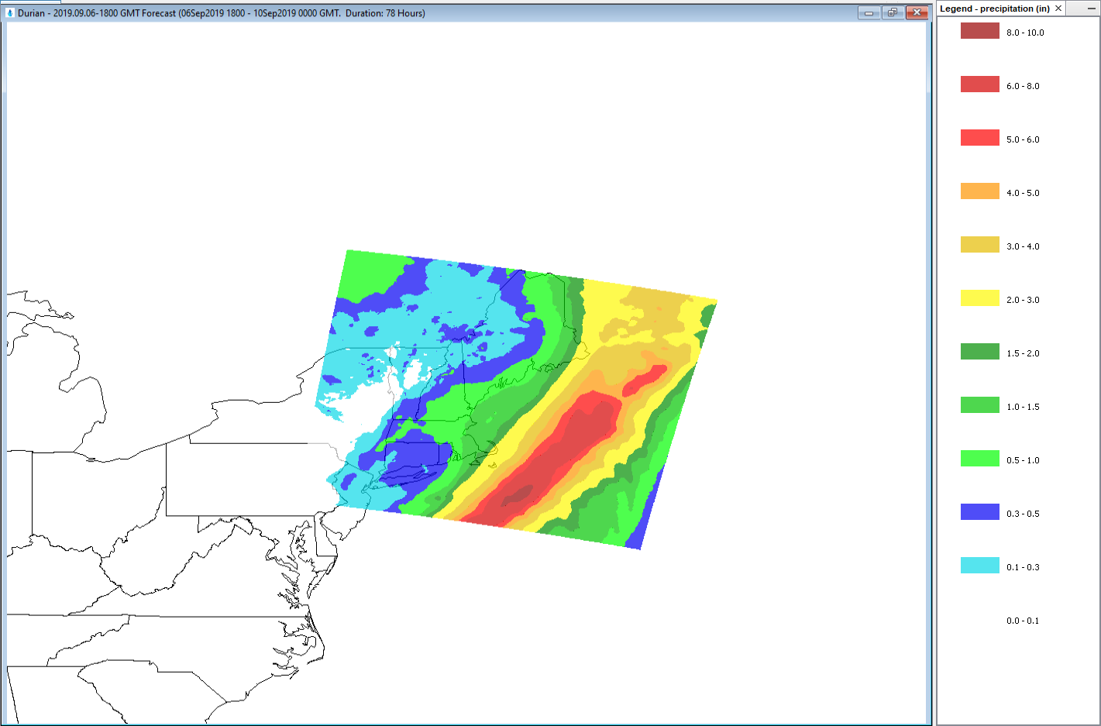
Image Translation
3-Day QPF issued on 2019.09.06-1800 GMT

Slide 27
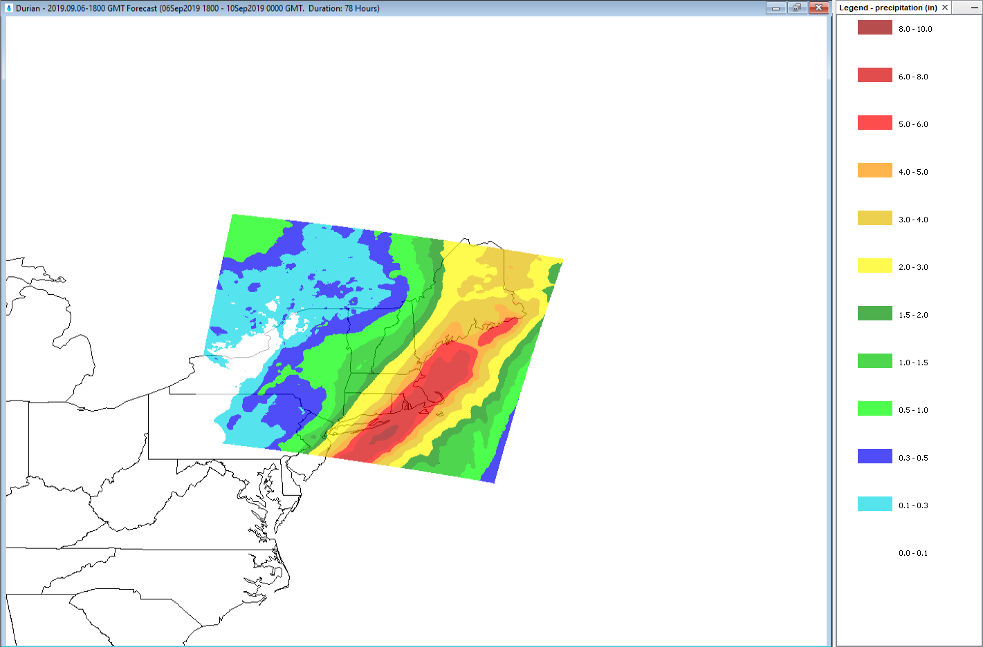
Image Translation
What if?
3-Day QPF issued on 2019.09.06-1800 GMT
(Translated over area of interest to prepare for potential consequences)

Slide 28
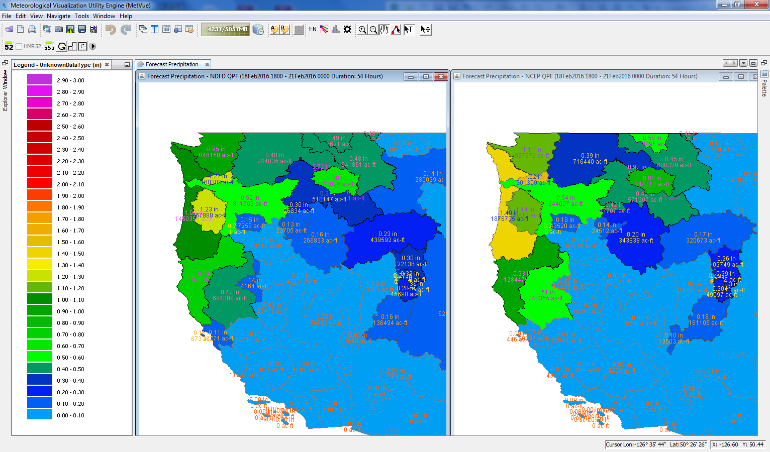
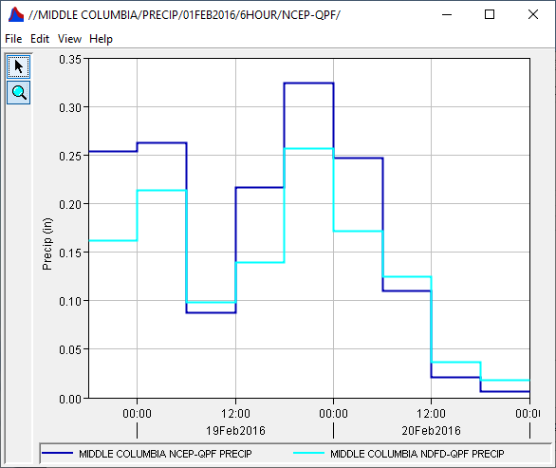
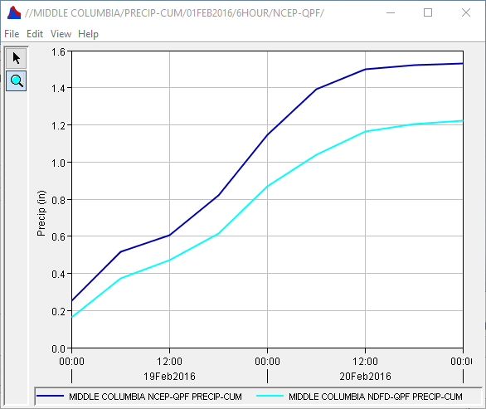
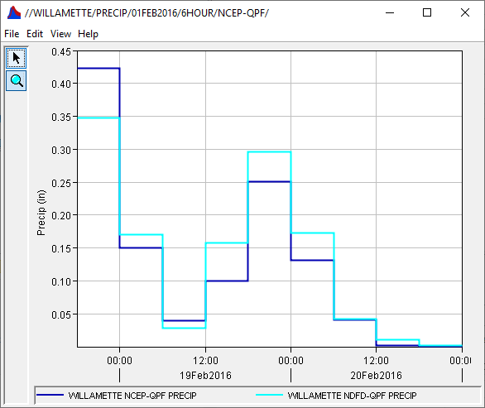
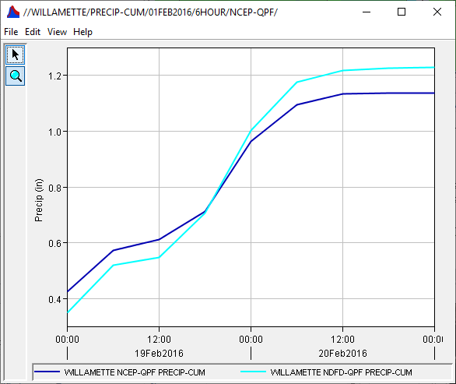
Basin Average Comparison Quantitative Forecast Precipitation (QPF)
NDFD QPF
NCEP QPF
http://www.nws.noaa.gov/ndfd/anonymous_ftp.htm
ftp://ftp.hpc.ncep.noaa.gov/5km_qpf/

Slide 29


Ad Hoc Time Series Plotting
Hurricane Florence (September 2018)

Slide 30

MetInterp
Inverse Distance Squared (IDW2)
Inverse Distance (IDW)
Nearest Neighbor (NN)
Bilinear (BL)
IDW2
NN
IDW
BL

Slide 31
HEC-MetVue Command Line Operations
Command Line Utilities for automating HEC-MetVue operations
Batch File | Description
GridReader.cmd | Read/Write supported Gridded Data Formats (e.g. ESRI ASCII Grid & HEC-DSS)
NCGribExtractor.cmd | Extract individual variables from multi-variable NetCDF or GRIB files
AddTin.cmd | Aggregate multiple TINs or Grids
BasinComps.cmd | Compute basin averages
ProjectTinToGrid.cmd | Generate projected Grids from TINs or modified Grids
MetInterp.cmd | Use time series measurements at point locations to generate interpolated grids.
TriangulateTin.cmd | Use aggregate measurements at point locations to generate an interpolated TIN
CalRad.cmd | Adjust Radar grids based on interpolated Gage TINs

Slide 32



District Daily Precipitation Reports Automated Processing of Real-Time Precipitation Basin Averages

Slide 33

uCOP MetVue Dashboard
Automated Processing of Real-Time NWS Products
USACE Projects HW Basin Averages

Slide 34



Slide 35
HEC-MetVue in CWMS

Slide 36

HEC-MetVue in CWMS
Automated Processing
Visualization & Interactive Analysis
Modeling & Forecast Scenarios
Data Acquisition & Processing
Data Transformation
Missing Data Filling
Historic Data Time Shifting of analog years
Report Generation
Storm Totals
Product Comparisons
Quality Control
Animation & Dynamic Time Window Scanning
What-if Scenarios
HRRR
&/or QPF
MetInterp or NEXRAD
Forecast
Precipitation
&Temperature
Observed
Precipitation
& Temperature
MetVue
Observed & Forecast
Gridded and/or Non-Gridded Precipitation and Temperature
HMS
Flow
ResSim
Flow
Flow
Observed & Forecast
Gridded and/or
Non-Gridded
Precipitation, Wind Velocity/Direction and Temperature
FIA
Stage
RAS

Slide 37


RTS-MetVue Model Alternative
HEC-MetVue Session = RTS-MetVue Model Alternative
HEC-MetVue Sessions
RTS-MetVue Alternatives

Slide 38

QPF Temporal Disaggregation
6 HOUR Input Dataset
1 HOUR Output Dataset

Slide 39

MetVue Model Alternative Input settings

Slide 40

MetVue Model Alternative Output settings

Slide 41


CWMS RTS-MetVue Simulation

Slide 42
Simulation Alternatives
Observed
Forecast
Interpolated Grids
RTMA
MRMS
RFC QPE
Zero Forecast
HRRR
3Day NDFD QPF
7Day WPC QPF

Slide 43
Summary
HEC-MetVue allows for the display, verification, and editing of spatial data through interactive and visual means.
HEC-MetVue is designed to process and edit precipitation and other meteorological data sets including operations such as: spatial extents trimming, spatial and temporal translation, scaling and resizing, and animations.
HEC-MetVue provides a variety of data transformation and analysis tools, as well as batch processing utilities that can be used in CWMS real-time decision support, in particular:
Weather/Watershed Monitoring and Assessment and Report Generation
Scenario Development for Forecast Modeling

Slide 44
Questions Help additional Training
https://usace.dps.mil/sites/KMP-WM/SitePages/Corps-Water-Management-System-(CWMS).aspx
https://www.hec.usace.army.mil/confluence/cwmsdocs
https://discourse.hecdev.net/c/cwms/5
TDL-CELRH-EC-GW-W-USACE CWMS Modeling | General | Microsoft Teams

