Slide 1

Objectives
  To become familiar with the automation capabilities of HEC-DSSVue
    Two Types of Automation
    Creating/Editing Scripts
    The Script Editor
    Executing Scripts
    Testing/Debugging Scripts
    Scripting Time Series Math Operations
    Scripting Plots

Slide 2
Two types of automation
The ways to programmatically automate HEC-DSSVue are:
  Plugins
    Written in Java
    Executed from code compiled to .jar files
      Source code is not available to user
      Can be assumed to not be modified after distribution
  Scripts
    Written in Jython
      Python 2.7 (interpreter and library) implemented in Java
        ☹ Not compatible with Python 3
        ☹ Cannot load Python modules that rely on compiled code (e.g., numpy, pandas)
        ☺ Can utilize Java classes and methods
    Executed from .py files
      Source code is fully available to user
      Can easily be modified by user as needed
We will focus only on scripting in Jython in this class

Slide 3
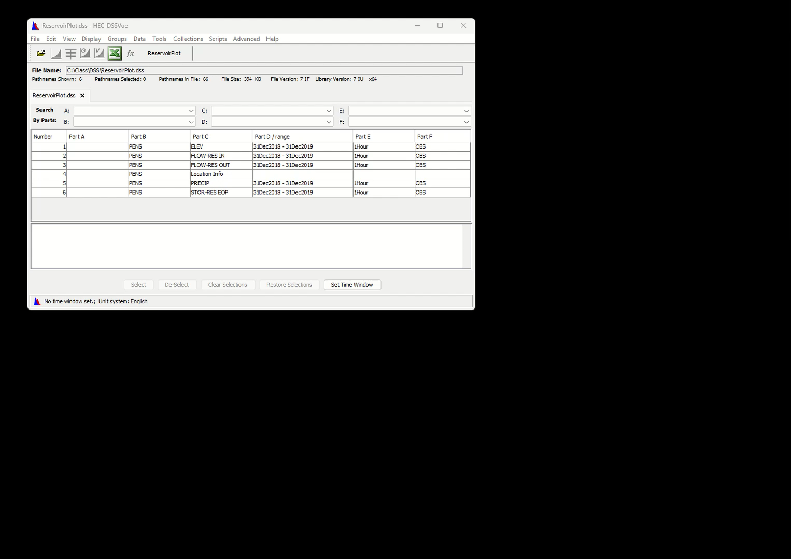
Creating/Editing scripts
  The Script Editor is used to create new and edit existing scripts
    Select Tools→Script Editor from the HEC-DSSVue menu bar to launch the Script Editor
    Select the script to edit from the Tree Pane
    To create a new script:
      Highlight the HecDssVue folder
      Select File→New from the Script Editor menu bar
      Enter a name in the Label field
      Click the Save button
Notes:
To Launch the Script Editor: Select Tools→Script Editor from the menu bar
To Edit a script: Select the script to edit from the Tree Pane
To Create a New Script:
• Highlight the HecDssVue folder
• Select File→New From the menu bar
• Enter a name in the Label field
• Click the Save button
~~~ End of Session ~~~
Next Session: The Script Editor In Detail

Slide 4
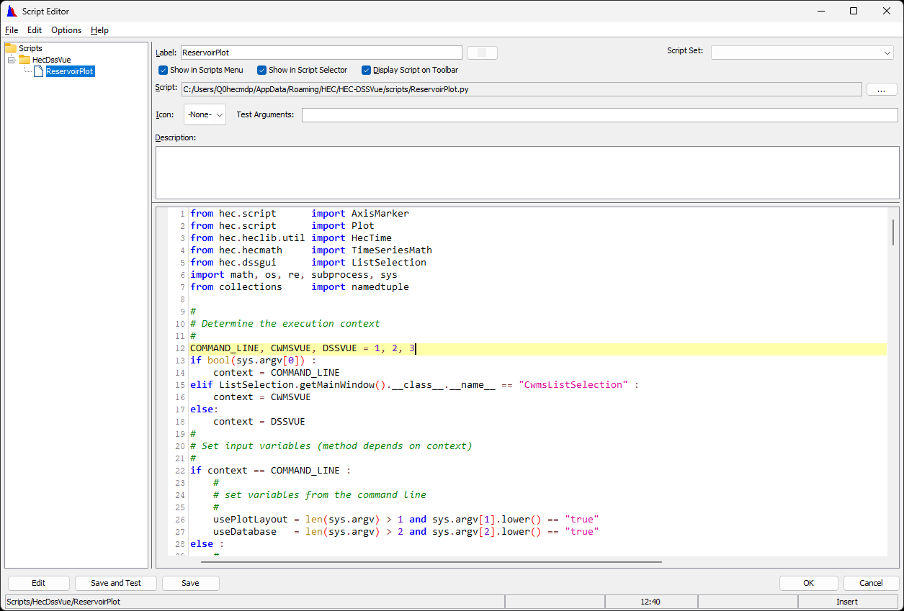
The Script Editor
Tree Pane

Slide 5
The Script Editor
Editor Pane

Slide 6
The Script Editor
Label
Menu bar background
Script File Path

Slide 7
The Script Editor
Display Controls
Scripts Menu
Script Selector
Toolbar

Slide 8
The Script Editor
Text Arguments
Allows setting of the values of one or more script variables at run time

Slide 9
The Script Editor
Description Pane
Optional description of script purpose or operation

Slide 10
The Script Editor
Action Buttons
Edit
  Changes to edit mode
Save and Test
  Saves and runs script
Save
  Saves script only
OK
  Saves script and exits script editor
Cancel
  Exits script editor without saving script

Slide 11
The Script Editor
Unused Controls
Used in script editors in other applications

Slide 12
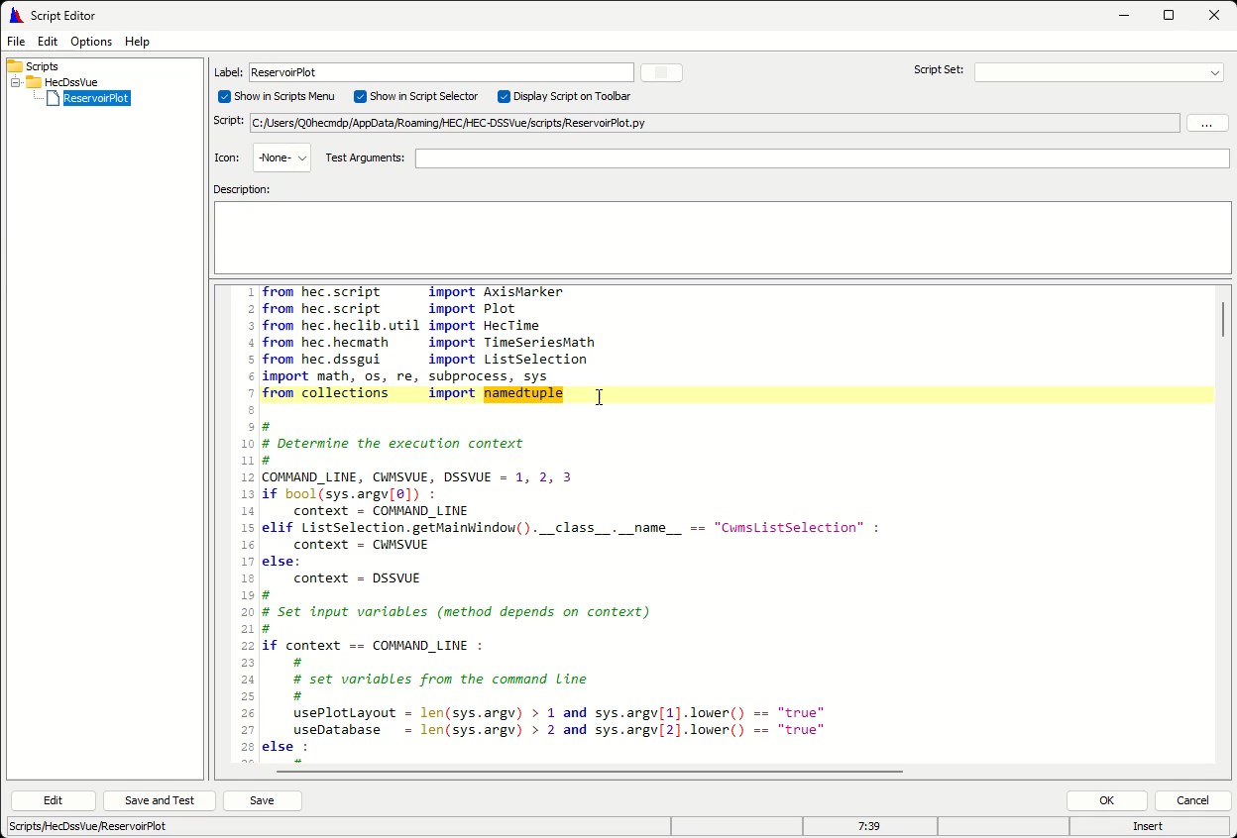
Using external editor
Don’t use external editor (e.g., VSCode) directly on script file.
HEC-DSSVue won’t know then the file is modified.
Instead, use select-all/copy/paste between editors and use the Script Editor to save the modified script.
Notes:
~~~ End of Section ~~~
Next Session is Executing Scripts

Slide 13
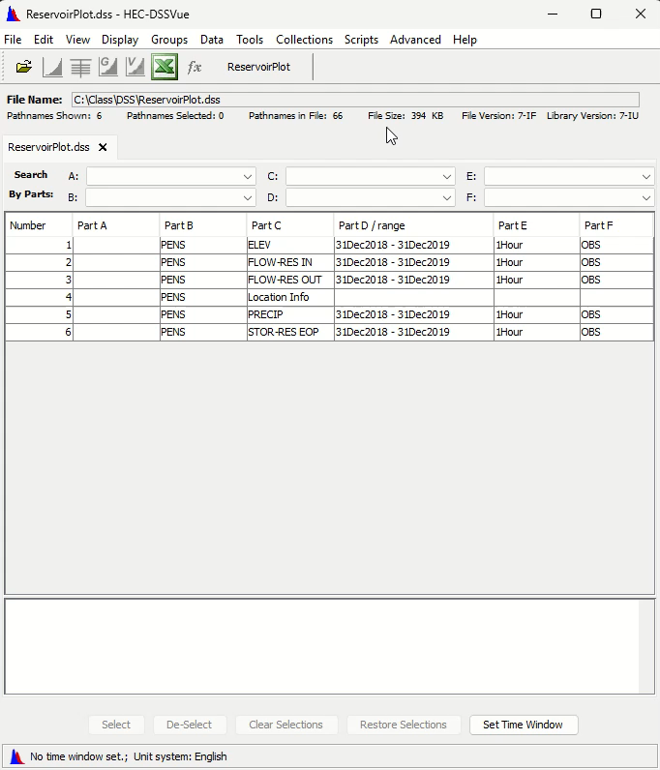
Executing scripts
From Scripts Menu

Slide 14
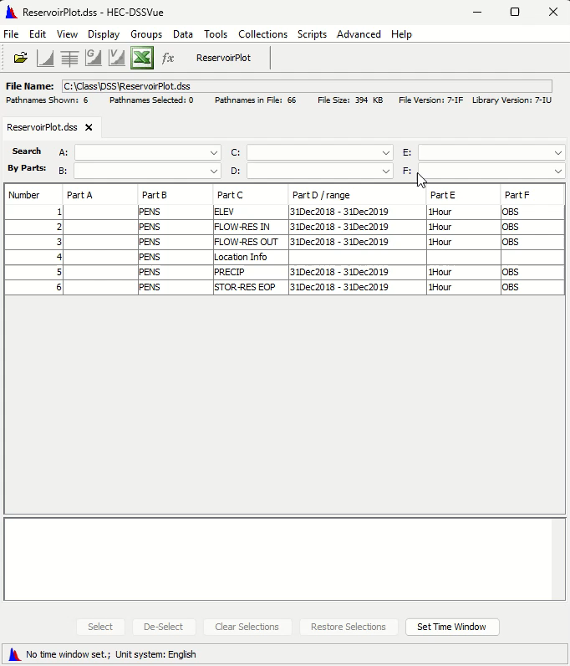
Executing scripts
From Script Selector

Slide 15

Executing scripts
From Toolbar

Slide 16
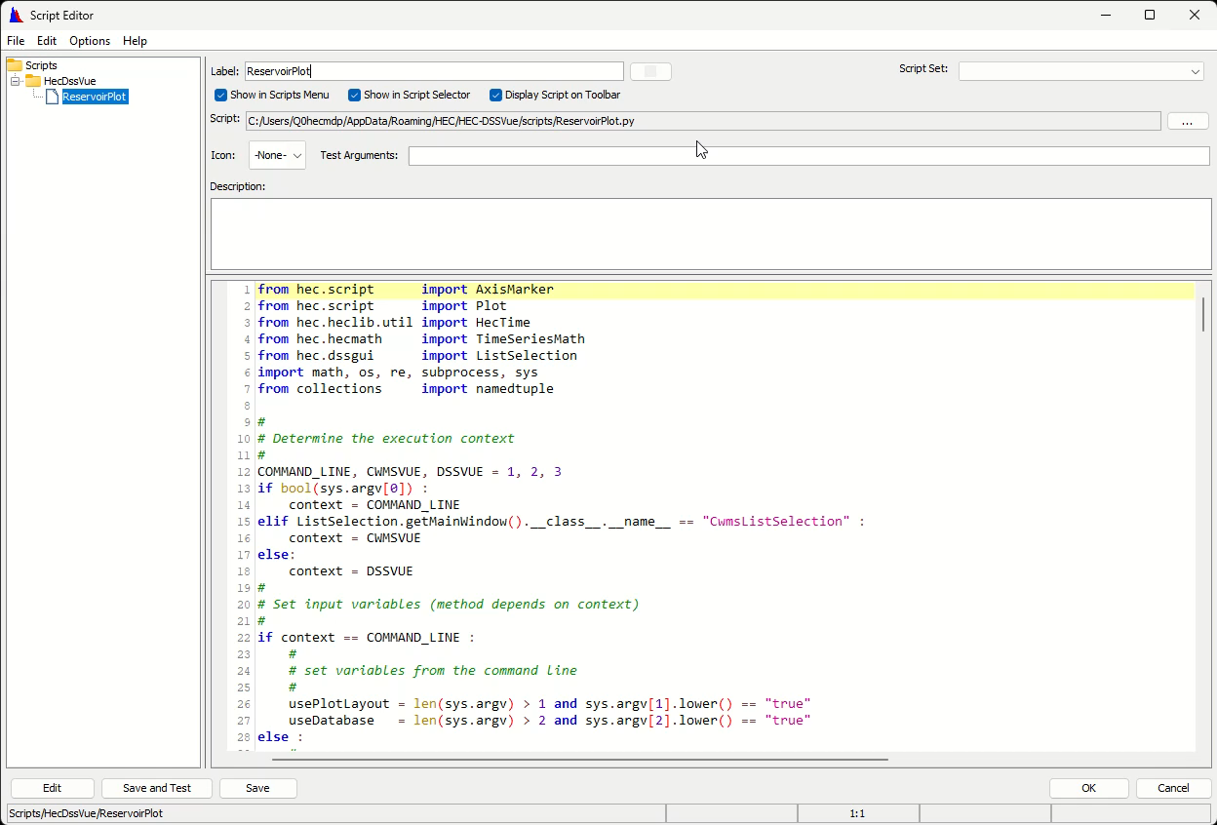
Executing scripts
From Script Editor
This is the only way to execute a script that has none of the display controls checked.

Slide 17
Command line execution
There are two ways to execute scripts from the command line.
    jython.exe script_directory\script_name.py [arguments]
    jython.bat script_directory\script_name.py [arguments]
  Using jython.exe
    Starts a new window to execute the script and returns immediately
      Any output goes to the new window
      New window closes as soon as script exits
      In batch files, can execute multiple scripts simultaneously (in multiple windows)
  Using jython.bat
    Executes the script in the current window
      Any output goes to the current window
      Current window remains open after script
      In batch files, can execute multiple scripts sequentially

Slide 18
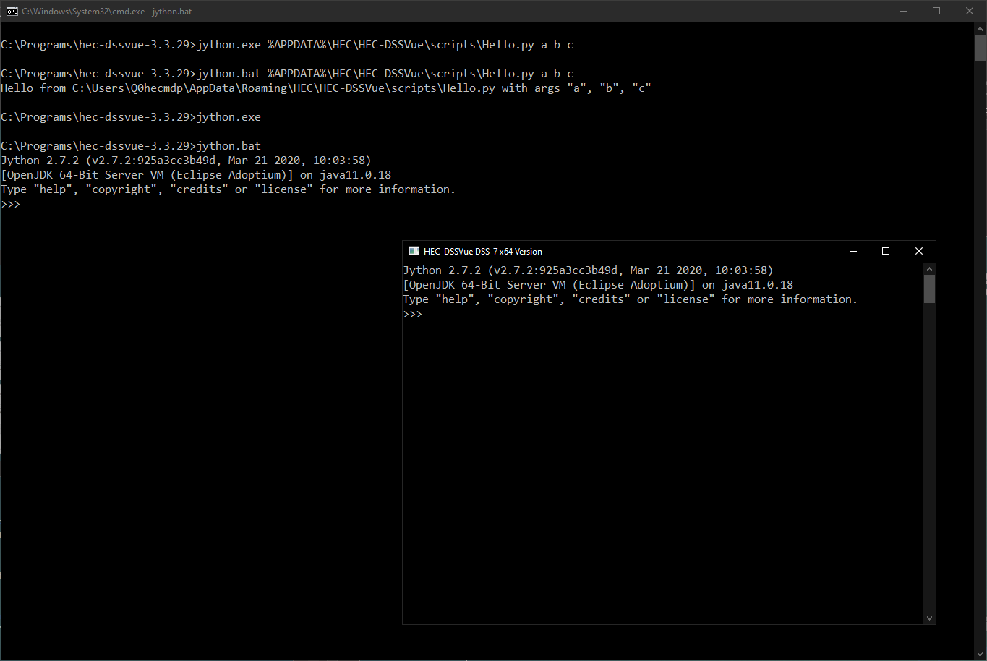
Command line execution
Ran script in another window
Ran script in this window
Started interactive session another window
Started interactive session this window
To exit an interactive session, enter "exit()" or press Ctrl-Z at the ">>>" prompt.

Slide 19
Testing and debugging scripts
  Does it complete without an error message?
  Execute script
  Yes
  Is the output as expected?
  No
  No
  Yes
  ☹ Debug Time!
  ☺ Congratulations!

Slide 20
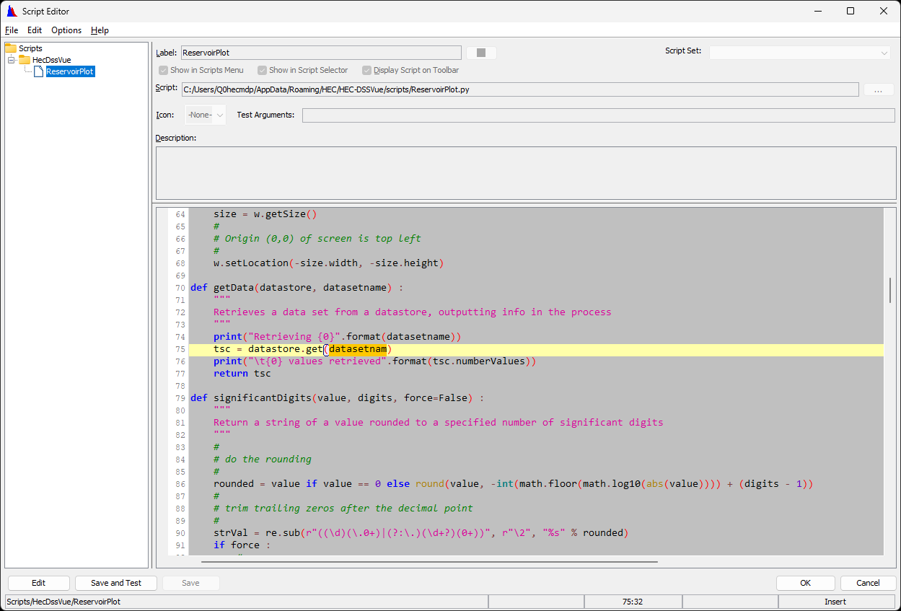
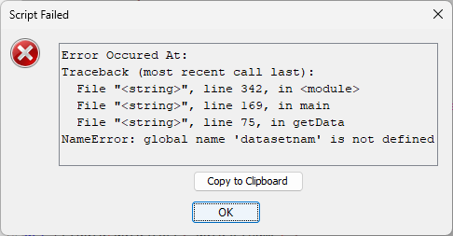
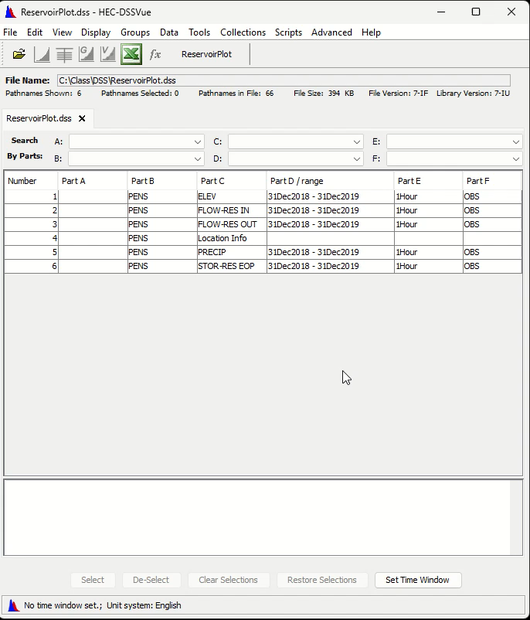
Error Messages
  Popup when saving or running script
  Are output to console log
  Specify line number of error

Slide 21
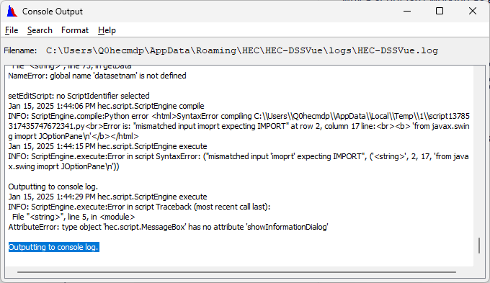
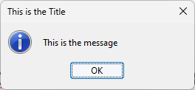
Types of debugging
  Post-Mortem
    Use print statement/function
      Outputs information to console log
      Reviewable after execution
    Use file output
      Outputs information to file of your choosing
      Reviewable after execution
  Run-Time
    Outputs to dialogs during execution
      Pauses execution at each dialog
  Source-Level
    Requires IDE (e.g., Intellij IDEA)
    Set breakpoints
    Inspect values of variables
    Step through code line-by-line

Slide 22
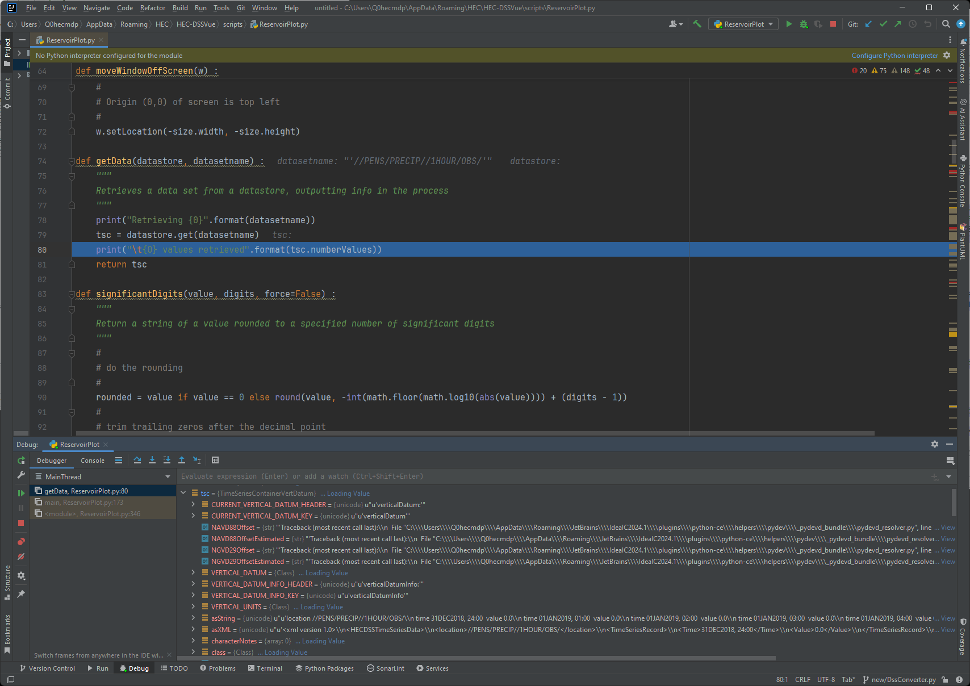
Debugging in intellij Idea

Slide 23
Scripting HEC-DSS files link
from hec.heclib.dss import HecDss
dss = HecDss.open(dssFileName)
…
dss.close()
Where:
  dss is the variable to refer to the open HEC-DSS file
  dssFileName is either
    A literal string
      dss = HecDss.open("C:/Class/ReservoirPlot.dss")
    A previously defined variable referring to the file name
    dssfilename = "C:/Class/ReservoirPlot.dss"
    dss = HecDss.open(dssfilename)

Slide 24
Retrieving/storing time series
  Time series object come in two flavors
    TimeSeriesContainer objects (link)
      Data only (times, values, quality codes, metadata)
      Data can be directly manipulated
      Retrieved with tsc = dss.get(pathname)
      Stored with dss.put(tsc)
    TimeSeriesMath objects (link)
      Data and operations
      Data cannot be directly manipulated
      Retrieved with tsm = dss.read(pathname)
      Stored with dss.write(tsm)
    Where:
      dss is a variable referring to the open HEC-DSS file
      tsc and tsm are variables referring to TimeSeiresContainer and TimeSeriesMath objects, respectively
      pathname is a string literal or variable referring to the pathname

Slide 25
Converting between timeseries objects
from hec.hecmath import TimeSeriesMath
tsc = tsm.getData()
tsm.setData(tsc) # modifies existing TimeSeriesMath object
tsm = TimeSeriesMath(tsc) # creates new TimeSeriesMath object
  Where:
    tsc and tsm are variables referring to TimeSeiresContainer and TimeSeriesMath objects

Slide 26
Scripting time series math operations link
  Most TimeSeriesMath operations create and return a new TimeSeriesMath object
    These operations do not modify the original TimeSeriesMath object
    The returned object must be assigned to a variable to utilize the result of the operation
      The returned object may be assigned to the same variable as the original object or another variable
      ✔ tsm2 = tsm.multiply(10.0) # both the old and new objects are available
      ✔ tsm = tsm.multiply(10.0) # the old object has been replaced with the new object
      ✗ tsm.multiply(10.0) # useless – the result of the operation has been lost

Slide 27
Basic plot creation link
from hec.script import Plot
…
# read and/or generate time one or more time series
…
plot = Plot.newPlot() # can also be plot = Plot.newPlot("Plot Title")
plot.addData(tsc1) # can also be like plot.addData(tsm1.getData())
plot.addData(tsc2) # add as many time series as necessary
plot.showPlot()

Slide 28
Basic plot creation link
from hec.script import Plot
…
# read and/or generate time one or more time series
…
plot = Plot.newPlot() # can also be plot = Plot.newPlot("Plot Title")
plot.addData(tsc1) # can also be like plot.addData(tsm1.getData())
plot.addData(tsc2) # add as many time series as necessary
plot.showPlot()

Slide 29
Basic plot creation link
from hec.script import Plot
…
# read and/or generate time one or more time series
…
plot = Plot.newPlot() # can also be plot = Plot.newPlot("Plot Title")
plot.addData(tsc1) # can also be like plot.addData(tsm1.getData())
plot.addData(tsc2) # add as many time series as necessary
plot.showPlot()

Slide 30
custom plot creation link
plot = Plot.newPlot()
# can also be plot = Plot.newPlot("Plot Title")
layout = Plot.newPlotLayout()
viewport = layout.addViewport([relative_height])
# multiple viewports are added in top-to-bottom order
# relative_height is an optional value that is used to proportion the heights
# of multiple viewports with respect to each other. If set interactively,
# the values must sum to 100%, but there is no such restriction when
# scripting. You may have to adjust this value to get the desired look.
viewport.addCurve(axis_name, data)
# axis_name is "Y1", "Y2" or a variable containing one of those values
# data is a TimeSeriesContainer object
plot.configurePlotLayout(layout)
plot.showPlot()

Slide 31
Plot modification link
plot.showPlot()
# plot modification is always placed after showPlot()
viewport = plot.getViewport(index_or_name)
# index = integer (0 is topmost)
# name is data set name (pathname with or without D-part)
axis = viewport.getAxis(axis_name)
# axis_name is "Y1", "Y2" or a variable containing one of those values
# "Y1" is the left-side axis, "Y2" is the right-side axis
axis.setReversed(state)
# state is a bool literal (True/False) or variable (True = y increases up!)
curve = plot.getCurve(data_or_name)
# data is a TimeSeriesMath or TimeSeriesContainer object
# name is data set name (pathname with or without D-part)
curve.setLineColor(color)
# color is a string literal (e.g., "red") or variable
# valid color names are listed here
Notes:
You can also retrieve a vieport’s X axis by .getAxis(“X1”).
This axis is shared by all viewports

Slide 32
AXIS markers link
from hec.script import AxisMarker
# must be imported before it can be used
…
plot.showPlot()
# plot modification is always placed after showPlot()
marker = AxisMarker()
marker.axis = "Y1"
# can also use X for X1 and Y for Y1, no alias for Y2
marker.value = "7.0"
# value is always a string, if on X1 axis like "24Jun2009, 02:00"
marker.labelText = "Stage = 7.0"
viewport = plot.getViewport(data_set)
# can use actual data set (tsc or tsm) in addition to integer or name
viewport.addAxisMarker(marker)

Slide 33
review
  To become familiar with the automation capabilities of HEC-DSSVue
    Two Types of Automation (plugins and scripts)
    Creating/Editing Scripts (launching script editor, choosing or creating a script)
    The Script Editor (script editor, external editor)
    Executing Scripts (scripts menu, script selector, toolbar, script editor, command line)
    Testing/Debugging Scripts (post-mortem, run-time, source-level)
    Scripting Time Series Math Operations (TimeSeriesContainer, TimeSeriesMath)
    Scripting Plots (basic and custom plot creation, plot modification)

