Slide 1
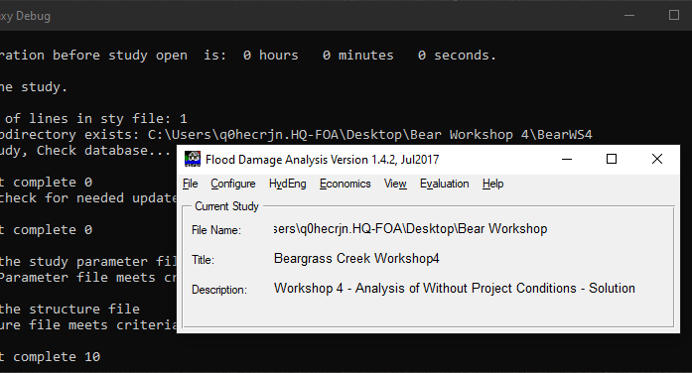
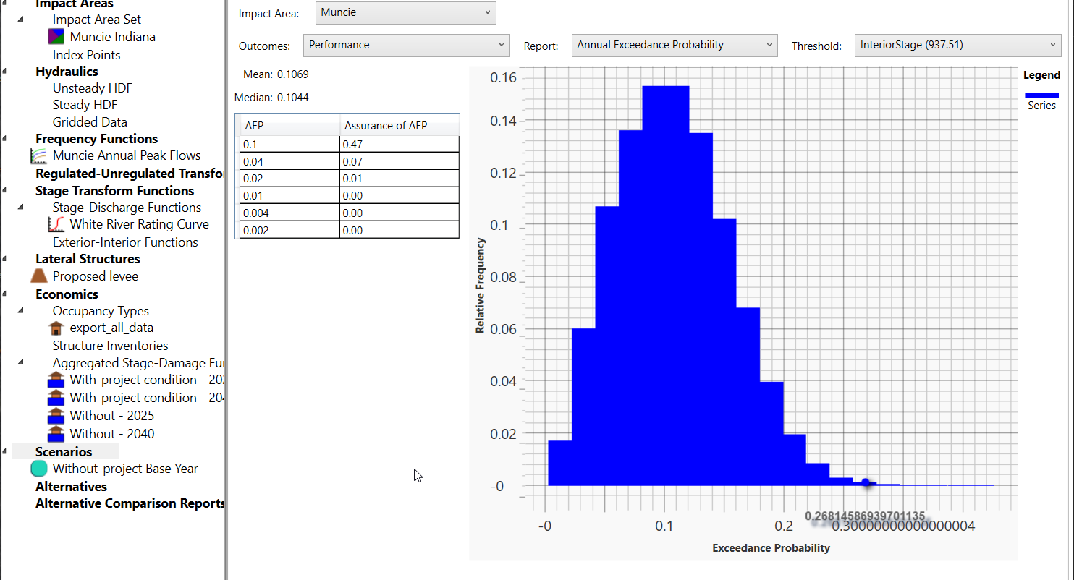
Hec-fda quarterly webinar
Frequency Functions
HEC-FDA Team
Lea Adams
Brennan Beam
Will Lehman
Jordan Lucas
Richard Nugent
Julia Slaughter
Notes:
Why are we spending time on this?
Sensitivity in EAD is largely driven by uncertainty in the flow-frequency function

Slide 2
Refresher on the fda EAD Compute method
For more information, see:
Flood Risk Assessment YouTube Playlist
PROSPECT #209 Online Course Content
EM 1110-2-1619

Slide 3
FDA METHOD
Flow
Flow
stage
1
Exceedance probability
0
Damage
Damage
Integrate!
stage
1
0
Exceedance probability
Notes:
Briefly walk through the FDA method

Slide 4
Curve composition
y = f(x)
x = g(z)
y = f(g(z)) = h(z)

Slide 5
Curve composition
Flow-frequency function | Stage-flow function
z := frequency | x := flow
x := flow | y := stage
flow = g(frequency) | stage = f(flow)
stage = f(g(frequency)) = h(frequency)

Slide 6
FDA METHOD: Curve Combination
Flow
Flow
stage
1
Exceedance probability
0
Damage
Damage
Integrate!
stage
1
0
Exceedance probability
Notes:
Describe what is happening here in terms of curve composition

Slide 7
FDA EAD Compute with sampling
Running Average
Average of the Realization EADs
.
EAD estimates
^
EAD
Damages
Number of realizations
1st Realization
Integration of the curve
= Realization EAD1
1
0
Annual exceedance probability (from the hydrology)
Notes:
At the beginning of the presentation, we noted that simply integrating an instance (click) of the damage exceedance relationship does not actually incorporate uncertainty (click) . This produces one instance of expected annual damage, (click) which kicks off the tracking of the average of the instances of expected annual damage and the distribution of the instances of expected annual damage. The diagram on the bottom left-hand corner has damage as the y-axis and annual exceedance probability for the x-axis. To incorporate uncertainty, (click) the steps that we walked through on the last slide are repeated many times, to generate up to tens of thousands of realizations of the damage-frequency function. So what is happening is that the software is representing many possibilities of the hydrologic, hydraulic, and economic conditions to produce a distribution of flood risk, as measured by expected annual damage – a measure of the amount of damage that can actually happen – the mean of the realized cumulative distribution function of damage. This distribution can be seen in orange in the plot on the lower right-hand side. The y-axis is relative frequency in percent, the x-axis is EAD. This process continues until the change in the running average of expected annual damage changes very little, at which point the process has converged (we can be confident that the expected value will not change any further with further simulations, as seen in red in the plot at the top in the center. In other words, the average fully represents the range of modeled conditions. One caveat: convergence inherently depends on what factors we have considered and their possible distributions. Convergence is ignorant of any factor that we have left out due to inability to measure or plain ignorance of the factor.

Slide 8
Frequency functions:
Flow vs stage
Notes:
Two types of H&H frequency functions: flow and stage

Slide 9
Objective: estimate ead
EAD is the integral of the damage-frequency function
To develop the damage-frequency function, we compose stage-damage with stage-frequency
Two options for developing stage-frequency:
    Compose a stage-flow function with a flow-frequency
    Skip (1), just enter stage-frequency
    Option 1
Frequency | Flow (cfs) | Flow (cfs) | Stage (ft) | Stage (ft) | Damage ($)
.999 | 200 | 200 | 10 | 10 | 0
.95 | 400 | 400 | 12 | 12 | 0
.5 | 800 | 800 | 14 | 14 | 50
.2 | 1200 | 1200 | 19 | 19 | 5,000
.1 | 1900 | 1900 | 21 | 21 | 10,000
.05 | 2200 | 2200 | 24 | 24 | 23,000
.001 | 2800 | 2800 | 25 | 25 | 40,000
Frequency | Damage ($)
.999 | 0
.95 | 0
.5 | 50
.2 | 5,000
.1 | 10,000
.05 | 23,000
.001 | 40,000
Notes:
Take a look at how we compose the functions in table form

Slide 10
Objective: estimate ead
EAD is the integral of the damage-frequency function
To develop the damage-frequency function, we compose stage-damage with stage-frequency
Two options for developing stage-frequency:
    Compose a stage-flow function with a flow-frequency
    Skip (1), just enter stage-frequency
    Option 2
Frequency | Stage (ft) | Stage (ft) | Damage ($)
.999 | 10 | 10 | 0
.95 | 12 | 12 | 0
.5 | 14 | 14 | 50
.2 | 19 | 19 | 5,000
.1 | 21 | 21 | 10,000
.05 | 24 | 24 | 23,000
.001 | 25 | 25 | 40,000
Frequency | Damage ($)
.999 | 0
.95 | 0
.5 | 50
.2 | 5,000
.1 | 10,000
.05 | 23,000
.001 | 40,000
Frequency | Stage (ft) | Stage (ft) | Damage ($)
.999 | 10 | 10 | 0
.95 | 12 | 12 | 0
.5 | 14 | 14 | 50
.2 | 19 | 19 | 5,000
.1 | 21 | 21 | 10,000
.05 | 24 | 24 | 23,000
.001 | 25 | 25 | 40,000
Notes:
Take a look at how we compose the functions in table form

Slide 11
FDA METHOD: Curve Combination
Flow
Flow
stage
1
Exceedance probability
0
Damage
Damage
Integrate!
stage
1
0
Exceedance probability
Notes:
Describe what is happening here in terms of curve composition and why do we like option 1 better than option 2 – because option 2 disregards uncertainty in flow for a given exceedance probability. The other reason we like option 1 better is because hydrologic uncertainties and stage uncertainties are two different animals. Uncertainty in frequency is focused on period of record or hydrologic modeling methods. Hydraulic uncertainty is focused on uncertainties in channel dimensions, manning’s roughness, debris blockages, etc.

Slide 12
FDA EAD Compute with sampling
Running Average
Average of the Realization EADs
.
^
EAD
Damages
Number of realizations
EAD estimates
1st Realization
Integration of the curve
= Realization EAD1
1
0
Annual exceedance probability (for the hydrology)
Notes:
Does the uncertainty about the damage frequency function – as demonstrated by the variation in the different damage-frequency functions – reflect uncertainty in flow?

Slide 13
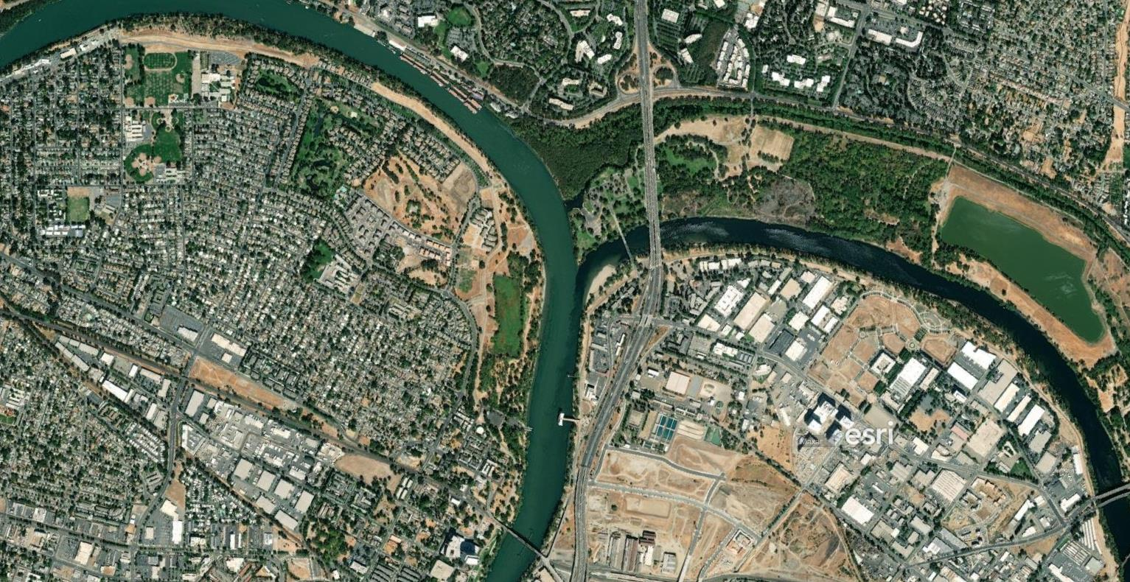
When is stage-frequency justified?
Use stage-frequency when:
When stage to flow is not one-to-one.
When stage is the only available gauge data.
When is stage to flow not one-to-one? Examples include:
Backwater
Tidal conditions
Ice jam floods
Notes:
A stage-frequency function may be used when stage gage data is all that is available for a study and/or when there is no unique correspondence between flow and stage such as in locations highly controlled by backwater or tidal conditions or in the case of ice jam floods. We need the stage-discharge function to pass the pencil test, which requires you to be able to horizontally move the pencil up and down the function and the pencil should cross the function only once. Passing the test means that a given discharge value D corresponds with one and only one stage value S, and vice versa. That stage S only occurs with discharge D.
We can add a dash of nuance here, with backwater, there is still a defined relationship, it just includes an additional variable, needing both upstream flow and downstream stage. Nothing wrong with 2 variable lookups, in general, but that involves another probability distribution for the additional variable. This is sometimes when we would do coincident frequency analysis to get a stage frequency curve, which still means going into FDA starting with stage-frequency.
In other situations, there is no defined relationship for lower stages impacted by tidal backwater but a defined relationship for higher stages when the tidal backwater is washed out. In this case, there is always the option of finding a flow at some location that dominates the stage at another location, thus allowing you to develop a low-frequency and flow-stage relationships to separate the hydrologic and hydraulic uncertainty for the most part.
The image on the right-hand side is satellite imagery of the confluence of the American River with the Sacramento River. The American River is a darker color on the right side of the image while the Sacramento river is the lighter color on the left side of the image. You can see that the Sacramento dominates the flow at the confluence. As flood magnitude increases, the flows on the American at the confluence tend to slow down or even go in reverse as stage continues to increase – so we’ve lost the 1:1 relationship.
Care should be taken in using this approach because in current analysis practice all uncertainties are collapsed into a single uncertainty as defined by the period of record. This function should be avoided when stage has a direct relationship with flow.

Slide 14
Flow-Frequency functions: analytical vs graphical
Notes:
Assume now that we’ve made the decision to go with option 1 so that we can reflect uncertainty in flow

Slide 15
Flow-frequency function options
Relationship between a flow magnitude Q and the probability p of that flow magnitude being exceeded in a given year.
Necessary to get to damage-frequency function: relationship between level of damage D and the probability p of that level of damage being exceeded in a given year.
2 possibilities:
Analytical
(parametric)
Graphical
(non-parametric/empirical)

Slide 16
FDA METHOD
Flow
Flow
This process results in 1 realization of EAD, it is not the final estimate of EAD
stage
1
Exceedance probability
0
Damage
Damage
Integrate!
stage
1
0
Exceedance probability
Notes:
Reminder that we’re talking about whether the function in the top-right-hand corner can be described as an analytical or graphical

Slide 17
Flow-frequency function options
Analytical: Log Pearson Type III Distribution – a distribution identified by the mean, standard deviation, and skew of the time series of annual maximum flows.
Graphical: Flow or stage magnitude is ordered smallest to largest; plotted against exceedance probabilities, and line is drawn between the flows to develop the empirical distribution (not a mathematical equation).
Notes:
Analytical: relationship between flow and the probability of exceedance modeled using a Log Pearson Type III Distribution – a distribution identified by the mean, standard deviation, and skew of the time series of annual maximum flows. Uncertainty defined by sampling of mean and standard deviation.
Graphical: Flow or stage magnitude is ordered smallest to largest; line is drawn between the flows. Uncertainty defined by the order statistics less simple method.
A good way to think about it is you can always use a graphical relationship but an analytical relationship must be defined by statistical frequency analysis following bulletin 17c.

Slide 18
conditions => recommended function type
Analytical
Unregulated streamflow data at the point of interest is available
LP3 moments can be derived using regional regression analysis or existing regional equations
A streamflow record can be modeled using precipitation records
Graphical
Unregulated streamflow data available nearby the point of interest
Flow quantiles are derived from regional regression analysis or existing regional equations
Discharge is predicted using rainfall-routing-runoff modeling
Streamflow is regulated
Notes:
Any ONE of the conditions suggest the function type to use

Slide 19
Unregulated-regulated transform functions
Notes:
Inclusion of something like a reservoir or detention basin affects the rate of streamflow. The idea is that the reservoir reduces streamflow. So we might see 20,000 cfs of unregulated flows into a reservoir, and the reservoir would let out 12,000 cfs of regulated flows. This adds an interesting dimension to the choice of frequency function.

Slide 20
Unregulated-regulated Function Basics
Unregulated flow is typically defined using analytical method – Log Pearson III
Transforms inflow-frequency into outflow-frequency function
Produces regulated outflows from reservoirs, diversion etc.
Unregulated discharge
Regulated discharge
Regulated discharge
Annual Chance Exceedance
Unregulated discharge
Annual Chance Exceedance
Notes:
A transform flow relationship may be used to define a relationship between unregulated and regulated flow, inflow and outflow, or another relationship to transform the flow defined by the discharge-probability function. This transform flow relationship could be the result of reservoir or channel routing, channel diversion, etc. Although a graphical curve could represent a regulated probability function, it is better to first derive an unregulated curve and use the transform flow function to convert the unregulated curve into a regulated curve. Starting with an unregulated frequency function and bringing in an inflow-outflow function allows for the isolation of the uncertainty related to the transformation mechanism, while maintaining the uncertainty of the discharge-probability function. Using this method also allows us to use the Log Pearson Type III distribution to define the unregulated flow probability function. It is possible that the inflows are regulated if we’re looking at a reservoir on a stream which is downstream from another reservoir. In that case, the “unregulated” inflows could be represented using a graphical frequency function, which would then be paired with an inflow-outflow function.
In the charts at the bottom of the slide, an unregulated flow-exceedance probability function is plotted on the left, and is scaled against a regulated discharge function in the middle. Observe that the reduction in peak flows translates to a flattening of the flow-exceedance probability function as seen on the right.

Slide 21
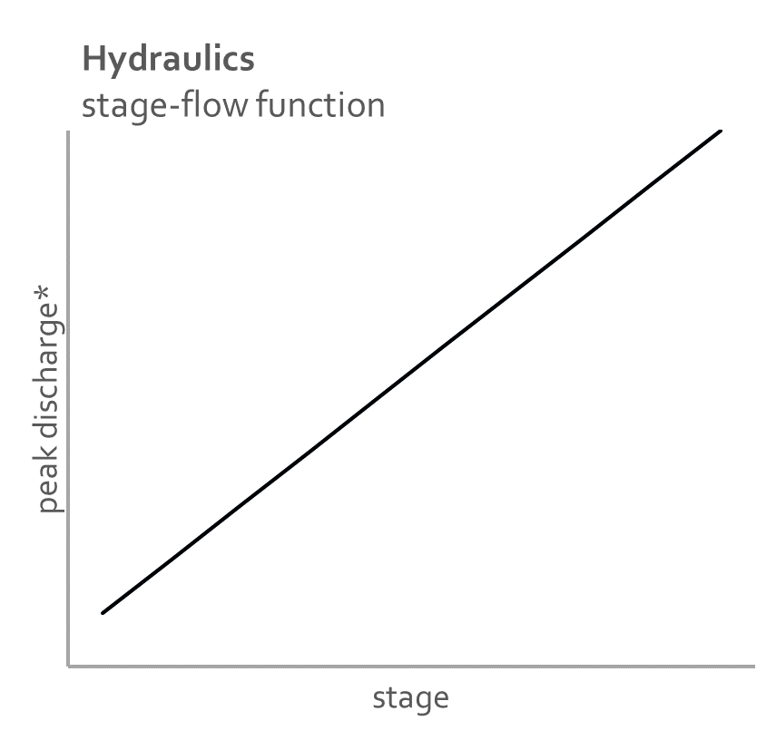
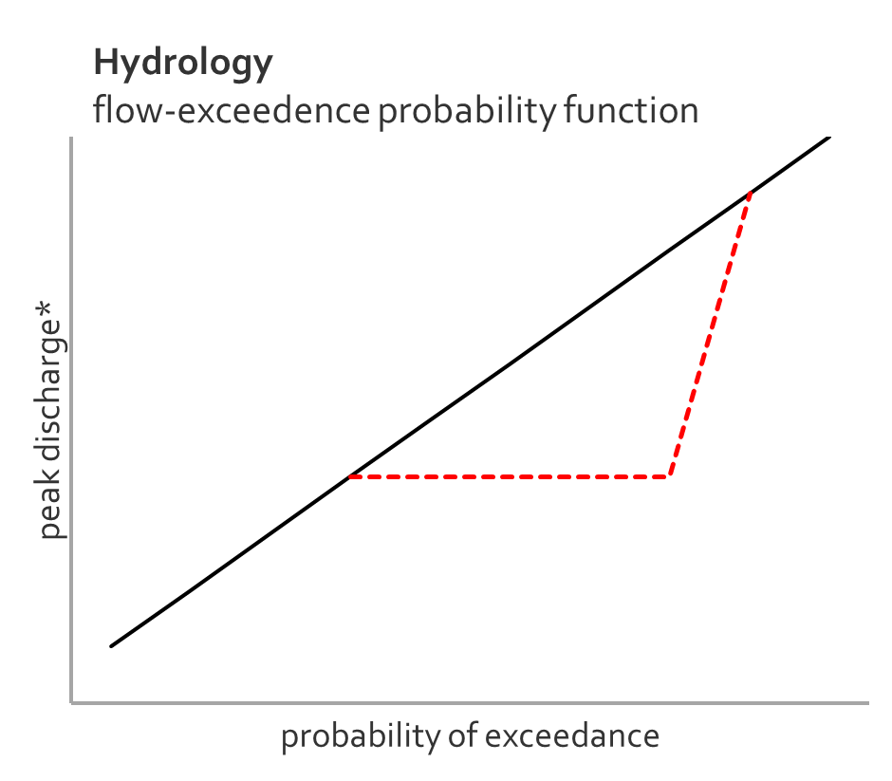
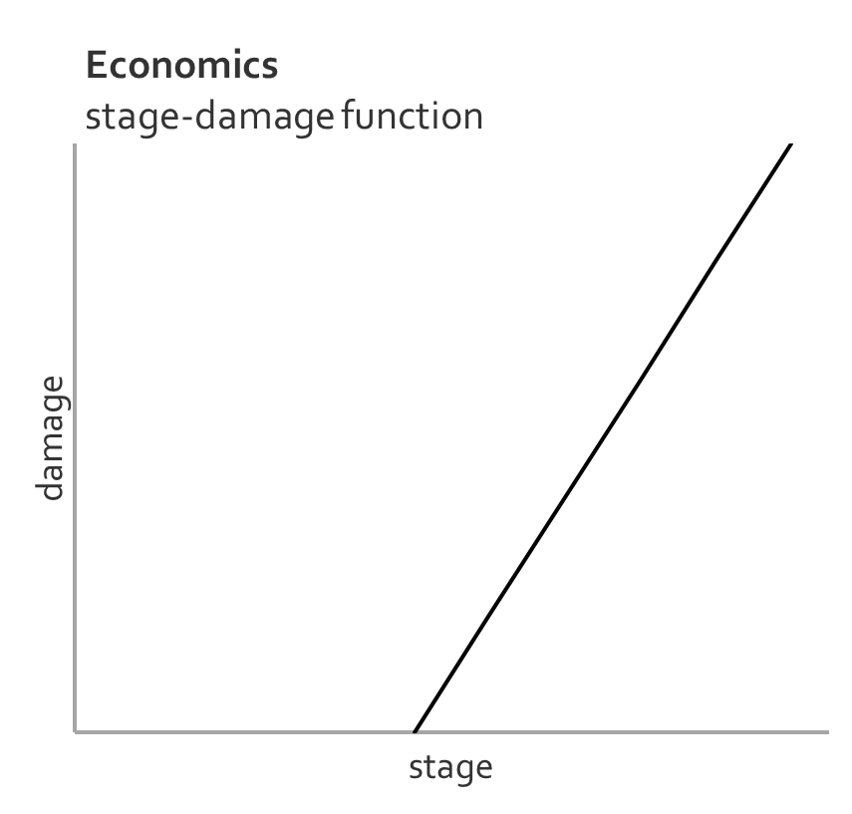
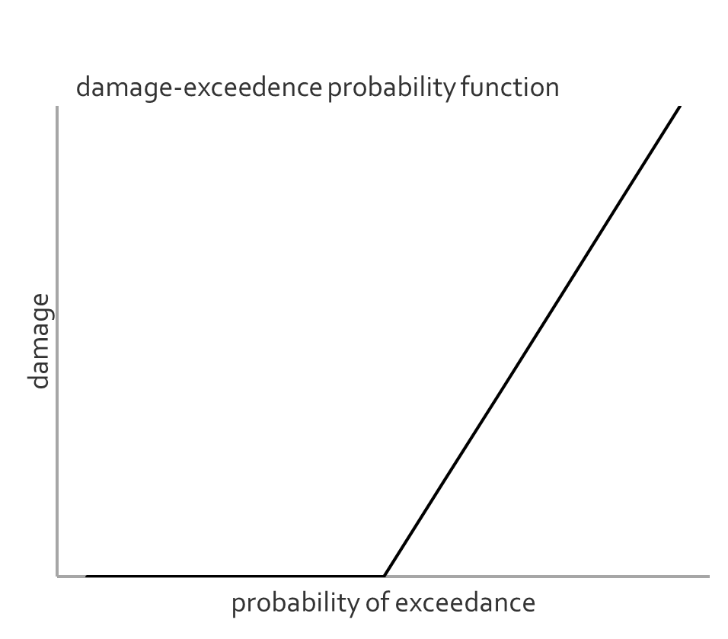
Unregulated-regulated in action
high
low
high
low
Notes:
In the case of an unregulated flow for a given event or probability of exceedance, (click) we can identify a peak discharge from the flow-exceedance probability function. (click) The identified peak discharge corresponds to a particular stage from the stage-flow or rating function. (click) The identified stage corresponds to a level of damage on the stage-damage function, (click) and relating this level of damage to the probability of exceedance from the flow-exceedance probability function identifies a probability that the level of damage is exceeded.
In the case of a regulated flow such as a dam, (click) the dam holds back flows for large events (low frequency events) so that peak flows are reduced. This continues until the reservoir behind dam would become dangerously full, at which point releases would increase. (click) For a given flow, the stage would stay the same, as nothing has been changed about the channel that would alter the rating function. (click) For a given stage, damages are the same, assuming that the dam does not encourage or discourage development. (click) Now because the dam has decreased the frequency of certain peak stages, the damage-exceedance probability function is truncated.
So what we see is that the inflow function may be represented by the black flow-exceedance probability function in the top right, and the outflow function is equal to the inflow function, except where the red dashed line breaks away from the black line, in which case the outflow function is represented by the red dashed line.

Slide 22
transform function uncertainty
Inflow-frequency uncertainty
The parametrized frequency function represents natural variability
The parameterization of the frequency function represents knowledge uncertainty
Regulated-unregulated uncertainty
  Volume of event with a given flow involves natural variability
  Information on the elevation to storage relationship involves knowledge uncertainty
Notes:
Definition of an inflow-outflow function is necessary to isolate the uncertainty related to the transformation mechanism, while maintaining the uncertainty of the inflow discharge-probability function.
The transform function assumes that peak outflow is a function of peak inflow. But it isn’t exactly because of the effect of the storage volume on the outflow. One way to reduce the uncertainty is to use an inflow frequency curve based on duration that is closer to the critical duration. The critical duration is the inflow duration that outflows are most sensitive to. As an example, many of the reservoirs in the Sacramento River basin have a critical duration of around 3-days. This is why we typically develop a family of flow frequency curves that represent a range of durations from peak, 1-day, 3-day, 5-day….30-day for reservoir systems. This is a pretty complex topic and could probably be a webinar on its own, hosted by an engineer – not an economist. There is a more detailed description in EM 1110-2-1420.

Slide 23
Inflow-Outflow Alternatives
Regulated, graphical flow-frequency function
Limits ability to properly define uncertainties in flow
Notes:
An alternative to the method described in this video is using a regulated graphical flow-frequency function as opposed to an unregulated analytical flow frequency function with a transform flow function. (click) Doing so however limits the ability to properly define uncertainties in the flow

Slide 24
Flow-frequency uncertainty
Notes:
Now let’s talk about what uncertainty about an analytical flow-frequency function looks like

Slide 25
Analytical flow-frequency uncertainty
HEC-FDA Version 1.4.3 implements a method for sampling the flow-frequency function that is consistent with USGS Bulletin 17B.
    With each iteration, the mean and standard deviation are re-sampled.
    For reference, see Appendix G, Section 3.2 of the HEC-FDA User’s Manual
HEC-FDA Version 2.0 implements a method consistent with USGS Bulletin 17C.
    With each iteration, a bootstrapped sample of flows are drawn from the input function
    A new distribution is fit to the sample based on the sample’s mean, standard deviation, and skew
    This approach allows for uncertainty in mean, standard deviation, and skew
Notes:
Remind folks of the difference between 17B and 17C.

Slide 26
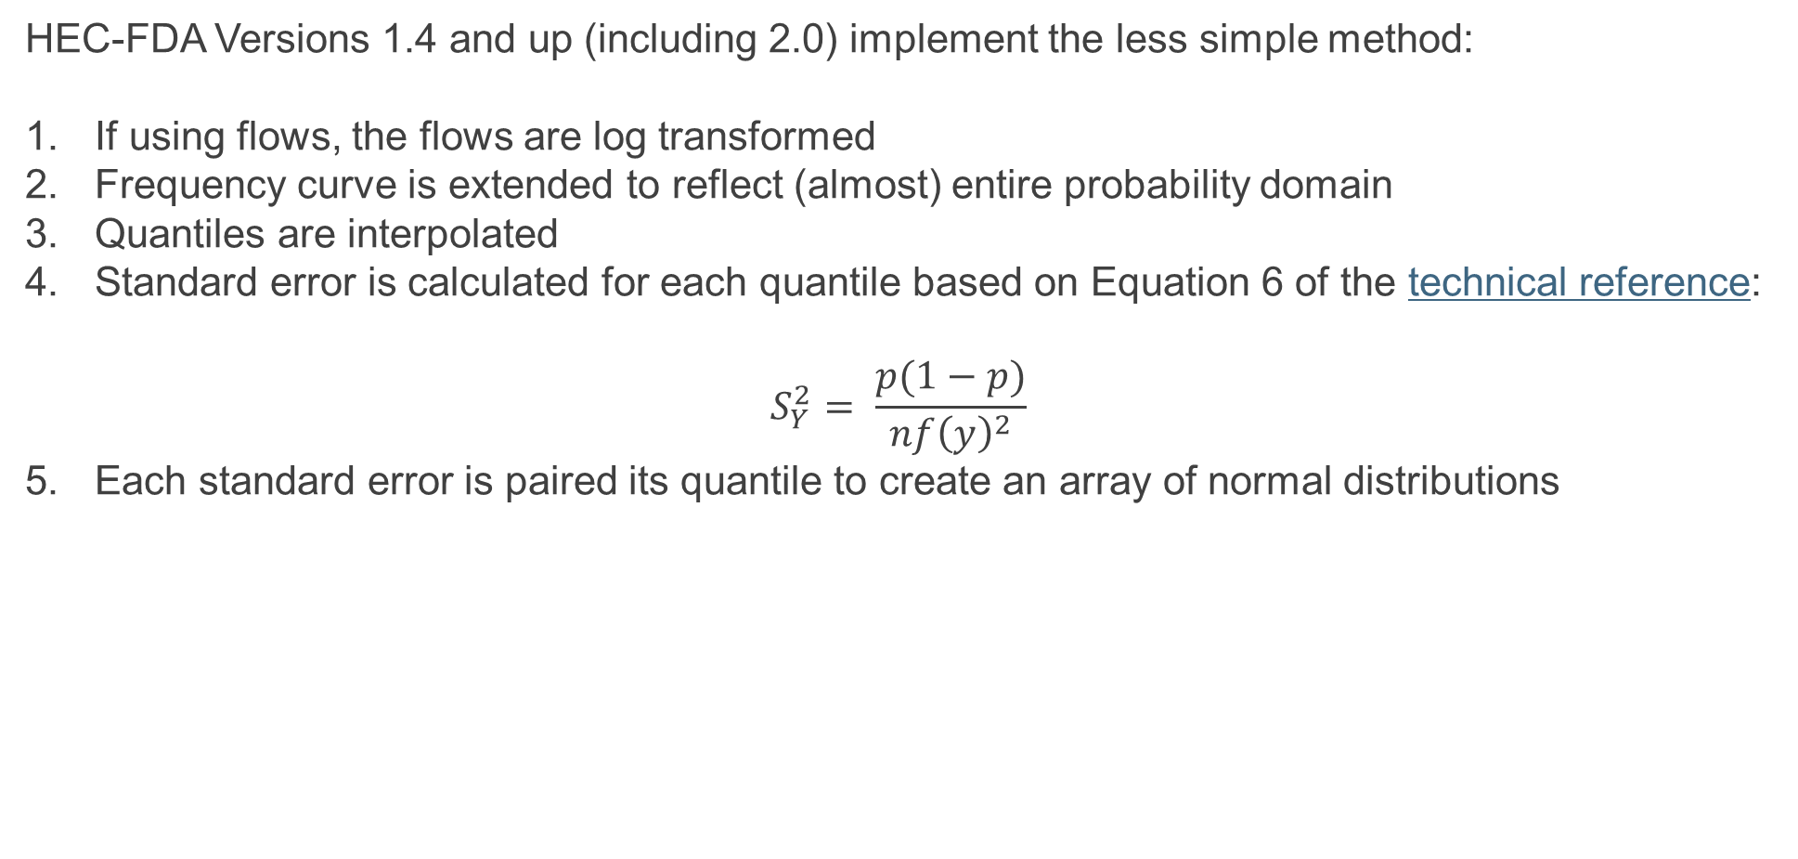
Graphical frequency uncertainty
HEC-FDA Versions 1.4 and up (including 2.0) implement the less simple method:
If using flows, the flows are log transformed
Frequency curve is extended to reflect (almost) entire probability domain
Quantiles are interpolated
Standard error is calculated for each quantile based on Equation 6 of the technical reference:
$$S_{Y}^{2}= \frac{p(1−p)}{nf{\left(y\right)}^{2}}$$
Each standard error is paired its quantile to create an array of normal distributions
Notes:
Where did the less simple name come from?

Slide 27
Questions?
To learn more, check out these resources:
Appendix G, HEC-FDA User’s Manual
HEC-FDA Technical Reference Manual
PROSPECT 209 Online Course Content
EM 1110-2-1619, Chapters 4 & 5
HEC Discourse
HEC Discourse is the formal tool through which to ask FDA questions. We enjoy hearing from you directly, too. Richard’s contact info:
Richard.J.Nugent@usace.army.mil
(530) 227-0639
MS Teams
Interested in following the development of HEC-FDA Version 2.0?
Computational engine repository
User interface repository

